Slide 1
University of Rome Tor Vergata Dep. of Business, Government and Philosophy Studies Managing a consulting Team (and Project)… "Theory 2 Practice" Marco Giustacchini Director – PwC Advisory marco.giustacchini@it.pwc.com
www.pwc.com
27 November 2015
Notes:
MG

Slide 2
Agenda
1 Objective and scope
2 Team "concept"
3 Team management
4 Project management
5 Q&A
Notes:
GM

Slide 3
1
Objective and scope
Team "concept"
Team management
Project management
Q&A
Notes:
GM

Slide 4
What's in…
Objective and scope
Main goals…
1
To share how to "manage" a team
2
To learn how a team "fits" into a project
3
To share key challenges related to team and project management

Slide 5
2
Objective and scope
Team "concept"
Team management
Project management
Q&A
Notes:
GM

Slide 6
What is a consulting team?
Team "concept"
A consulting team is primarily a… TEAM
As any other team
F1 Racing Team
Medical
Squad
Rock
Band
Cabin
Crew
Football
Club

Slide 7
What do they have in common?
Team "concept"
?
F1 Racing Team
Medical
Squad
Rock
Band
Cabin
Crew
Football
Club

Slide 8
What do they have in common?
Team "concept"
F1 Racing Team
Two (or more) people
People with different skills
A common goal
Medical
Squad
Rock
Band
Cabin
Crew
Football
Club

Slide 9
Getting back to the question…
Team "concept"
A team is
a group of people with a full set of complementary skills
required to achieve a shared target
Consulting Team
Partner
Senior Manager
Senior Associate
Senior Associate
Associate
Associate

Slide 10
3
Objective and scope
Team "concept"
Team management
Project management
Q&A
Notes:
GM

Slide 11
Know your team…
Team management
a group of people with
INTERACTION
a full set of complementary skills
ROLES &
RESPONSABILITIES
required to achieve a shared target
MOTIVATION

Slide 12
… as well as what your team needs…
Team management
a group of people with
INTERACTION
Governance &
Guidance
a full set of complementary skills
ROLES &
RESPONSABILITIES
Structure,
Objectives & Duties
required to achieve a shared target
MOTIVATION
Inspiration &
Self-Actualisation

Slide 13
… and how to feed-back your team
Team management
a group of people with
INTERACTION
Governance &
Guidance
E
EXAMPLE
a full set of complementary skills
ROLES &
RESPONSABILITIES
Structure,
Objectives & Duties
E
EFFECT
required to achieve a shared target
MOTIVATION
Inspiration &
Self-Actualisation
C
COACH

Slide 14
… and how to feed-back your team
Team management
E
EXAMPLE
Feedback has to be put in context
E
EFFECT
Feedback has to refer to "why" is given
C
COACH
Feedback has to be about "Continue" or "Change"

Slide 15
Getting back to the question…
Team management
A team is
a group of people with a full set of complementary skills, required to achieve a shared target
and
team members operates with high degree of interdependence
to achieve a common goals
by
feeding back each other mutually and taking responsibilities for their own tasks
while
fulfilling personal ambitions

Slide 16
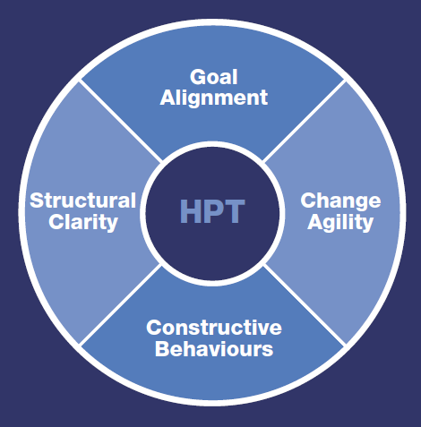
… and an high performing team
Team management
Goal Alignment
Open commitment to set clear goals and objectives
Structural Clarity
Clear structural environment including; processes, roles, accountabilities and success measures
Constructive Behaviours
Collective commitment including; straight talk, mutual support, fluid coaching and acknowledgement
Change Agility
Remain agile in dynamic, demanding environments

Slide 17
4
Objective and scope
Team "concept"
Team management
Project management
Q&A
Notes:
GM

Slide 18
How a team fits into a project…
Project Management
CONSULTING VALUE CHAIN
Support activities
(Cost generators)
Firm & Brand Management
1
Finance & Controlling
Set up your team at early stage of the project cycle
Provide your team with clear goals and guidance
2
Governance & Risk Management
3
Information & Communication Technology Management
4
Human Capital & Talent Management
5
Knowledge Sharing & Management
6
Core activities
(Revenue & Cost generators)
CRM & Networking
Value Proposition & Offering
Project Management & Advisoring
Sell-on Management
7
8
9
10
SUB-PROCESSES BREAKDOWN
Vision
& Scoping
As-Is
Analysis
To-Be
Design
Piloting & Simulation
Implementation
& Roll-out
Benefits Management
9.1
9.2
9.3
9.4
9.5
9.6

Slide 19
… through project set up
Project Management
Governance &
Guidance
Objective
Scope
Approach
Deliverables
Structure,
Objectives & Duties
Project Structure
Governance
Project Plan
Inspiration &
Self-Actualisation
Assumptions
Consulting Fees

Slide 20
… through project set up…
Project Management
Objective
What are the project goals / benefits?
Scope
What are the project boundaries?
Approach
How do we deliver project goals?
Deliverables
What do we deliver to Client?
Project Structure
How is team organised? Who's in?
Governance
How do we interact?
Project Plan
When do we deliver and what?
Assumptions
What do we needs from the Client?
Consulting Fees
What is the investment?

Slide 21
… how does this impacts on the team?
Project Management
Objective
?
Scope
Approach
Deliverables
Project Structure
Governance
Project Plan
Assumptions
Consulting Fees

Slide 22
5
Objective and scope
Team "concept"
Team management
Project management
Q&A
Notes:
GM

Slide 23
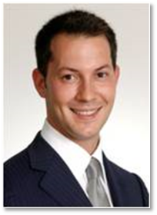
 | Marco Giustacchini Director PricewaterhouseCoopers Advisory
Marco is a Direct0r with 11 years of experience in management consulting, with focus on business performance management, planning and reporting. His main areas of expertise cover Strategy and the so called Finance for C.E.O, including business modelling, design and implementation of target operating models, revenue integrity and maximisation, arbitration support, and post-merger integration He has a strong international background, developed by providing consulting services to large global companies in more than 10 countries. His profile is backed by a cross-industry experience, mainly gained by supporting Energy & Utility, Telecom, and Aerospace & Defence companies on the design and implementation of complex corporate forecasting and reporting models Marco’s other areas of experience include, risk management, process control optimisation, and programme and project management

Slide 24
Thank you
This publication has been prepared for general guidance on matters of interest only, and does not constitute professional advice. You should not act upon the information contained in this publication without obtaining specific professional advice. No representation or warranty (express or implied) is given as to the accuracy or completeness of the information contained in this publication, and, to the extent permitted by law, PricewaterhouseCoopers Advisory SpA, its members, employees and agents do not accept or assume any liability, responsibility or duty of care for any consequences of you or anyone else acting, or refraining to act, in reliance on the information contained in this publication or for any decision based on it.
© 2015 PwC. All rights managed. In this document, “PwC” refers to PricewaterhouseCoopers Advisory SpA which is a member firm of PricewaterhouseCoopers International Limited, each member firm of which is a separate legal entity.

