Slide 1
Chapter 12 Technical Analysis
Presenter
Venue
Date
Notes:
Technical analysis has been used by traders and analysts for centuries, but it has only recently achieved broad acceptance among regulators and the academic community. This chapter gives a brief overview of the field, compares technical analysis with other schools of analysis, and describes some of the main tools in technical analysis. Some applications of technical analysis are subjective. That is, although certain aspects, such as the calculation of indicators, have specific rules, the interpretation of findings is often subjective and based on the long-term context of the security being analyzed. This aspect is similar to fundamental analysis, which has specific rules for calculating ratios, for example, but introduces subjectivity in the evaluation phase.
DISCLAIMER: Candidates should understand that this presentation is NOT a substitute for a thorough understanding of the CFA Program curriculum. This presentation is also NOT necessarily a reflection of all the knowledge and skills needed for candidates to successfully complete questions regarding this topic area on the CFA exam.

Slide 2
The Logic of Technical Analysis
Supply and demand determine prices
Changes in supply and demand cause changes in prices
Prices can be projected with charts and other technical tools
Notes:
LOS: Explain the principles of technical analysis, its applications, and its underlying assumptions.
Page 516
Technical analysis is a form of security analysis that uses price and volume data, which is often graphically displayed, in decision making. Technical analysis can be used for securities in any freely traded market around the globe. A freely traded market is one in which willing buyers trade with willing sellers without external intervention or impediment. Prices are the result of the interaction of supply and demand in real time. Technical analysis is used on a wide range of financial instruments, including equities, bonds, commodity futures, and currency futures.

Slide 3
Assumptions of Technical Analysis
Market trends and patterns reflect irrational human behavior.
Trends and patterns repeat themselves and are thus predictable.
Human behavior is often erratic and driven by emotion.
Notes:
LOS: Explain the principles of technical analysis, its applications, and its underlying assumptions.
Pages 516-517
Technical analysis can be thought of as the study of collective investor psychology or sentiment. Prices in any freely traded market are set by human beings or their automated proxies (such as computerized trading programs), and price is set at the equilibrium between supply and demand at any instant in time. Various fundamental theorists have proposed that markets are efficient and rational, but technicians believe that humans are often irrational and emotional and that they tend to behave similarly in similar circumstances.
Although fundamental data are key inputs in the determination of value, these data are analyzed by humans, who may be driven, at least partially, by factors other than rational factors. Human behavior is often erratic and driven by emotion in many aspects of one’s life, so technicians conclude that it is unreasonable to believe that investing is the one exception where humans always behave rationally. Technicians believe that market trends and patterns reflect this irrational human behavior. Thus, technical analysis is the study of market trends or patterns. And technicians believe the trends and patterns tend to repeat themselves and are, therefore, somewhat predictable. So, technicians rely on the recognition of patterns that have occurred in the past in an attempt to project future patterns of security prices.
Market participants use many inputs and analytical tools before trading. Technical analysts believe that emotions play a role. Investors with a favorable fundamental view may nonetheless sell a financial instrument for other reasons, including pessimistic investor sentiment, margin calls, and requirements for their capital—for example, to pay for a child’s college tuition. Technicians do not care why market participants are buying or selling, just that they are doing so.

Slide 4
Charts
Line Chart
Bar Chart
Candlestick Chart
Point and Figure Chart
Notes:
LOS: Discuss the construction and interpretation of different types of technical analysis charts.
Page 520
Charts are the graphical display of price and volume data, and the display may be done in a number of ways. Charts are an essential component of the technical analyst’s toolkit. Charts provide information about past price behavior and provide a basis for inferring likely future price behavior. A variety of charts can be useful in studying the markets. The selection of the chart to use in technical analysis is determined by the intended purpose of the analysis.

Slide 5
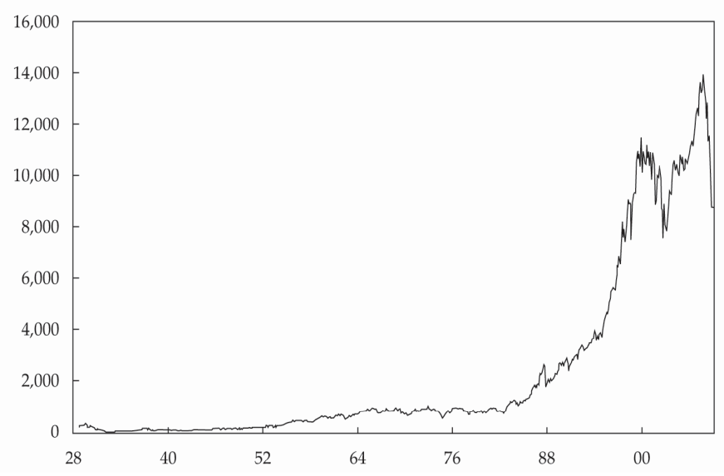
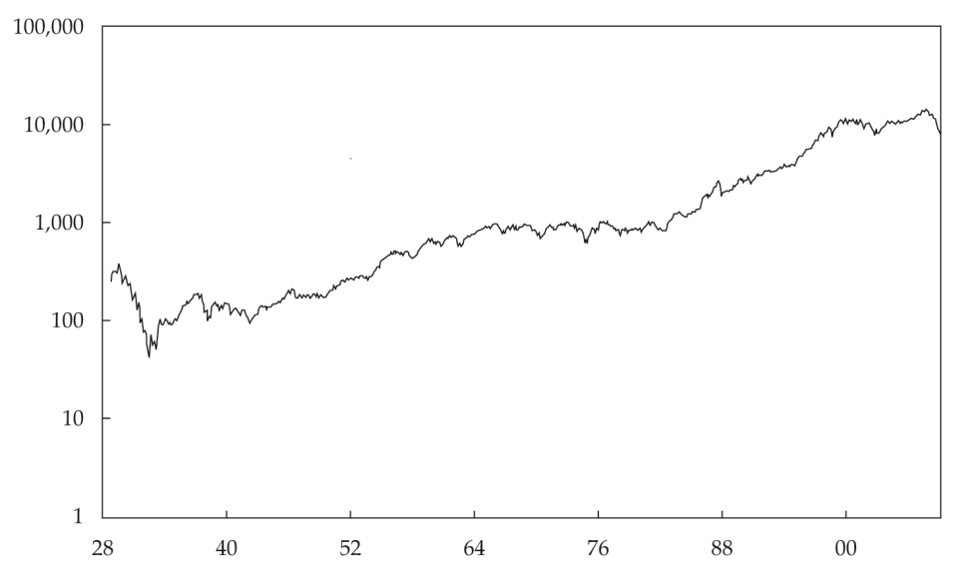
Line Charts and Scale
EXHIBIT 12-7 Dow Jones Industrial Average on a Linear Scale, 1928–2010 (in U.S. dollars)
EXHIBIT 12-8 Dow Jones Industrial Average on a Logarithmic Scale, 1928–2010 (in U.S. dollars)
Notes:
LOS: Discuss the construction and interpretation of different types of technical analysis charts.
Pages 520, 526-527
Line charts are familiar to all types of analysts and are a simple graphic display of price trends over time. Usually, the chart is a plot of data points, such as share price, with a line connecting these points. Line charts are typically drawn with closing prices as the data points. The vertical axis (y-axis) reflects price level, and the horizontal axis (x-axis) is time. Even though the line chart is the simplest chart, an analyst can quickly glean information from this chart.
For any chart—line, bar, or candlestick—the vertical axis can be constructed with either a linear scale (also known as an arithmetic scale) or a logarithmic scale, depending on how you want to view the data. With a logarithmic scale, equal vertical distances on the chart correspond to equal percentage changes. A logarithmic scale is appropriate when the data move through a range of values representing several orders of magnitude (e.g., from 10 to 10,000); a linear scale is better suited for narrower ranges (e.g., prices from $35 to $50). The share price history of a particular company, for instance, is usually best suited to a linear scale because the data range is usually narrow.
Consider Exhibits 12-7 and 12-8, which both show the yearly history of the Dow Jones Industrial Average (DJIA) from 1928 to 2010. Plotting the index on a linear scale, as in Exhibit 12-7, makes it difficult to gather much information from the first 50 years of the data series. Analysts can see a slight uptrend but not much else. The eye is drawn to the bull market of the 1980s, the subsequent dot-com bubble, and the recent era of the subprime crisis. When plotted on a logarithmic scale, as in Exhibit 12-8, however, many people would find that the data tell a more comprehensive story. The Great Depression of the 1930s stands out, but over the following 75 years, the data follow a relatively stable upward trend.

Slide 6
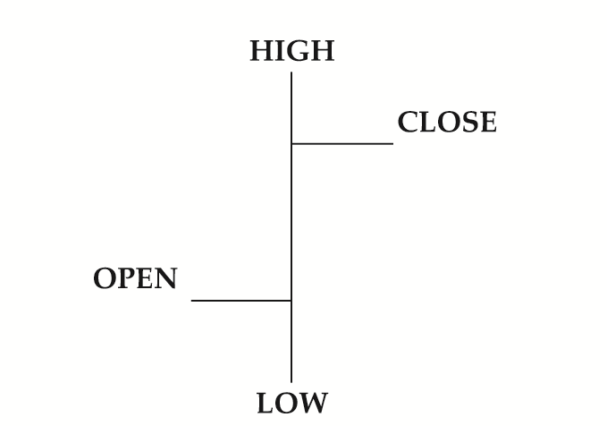
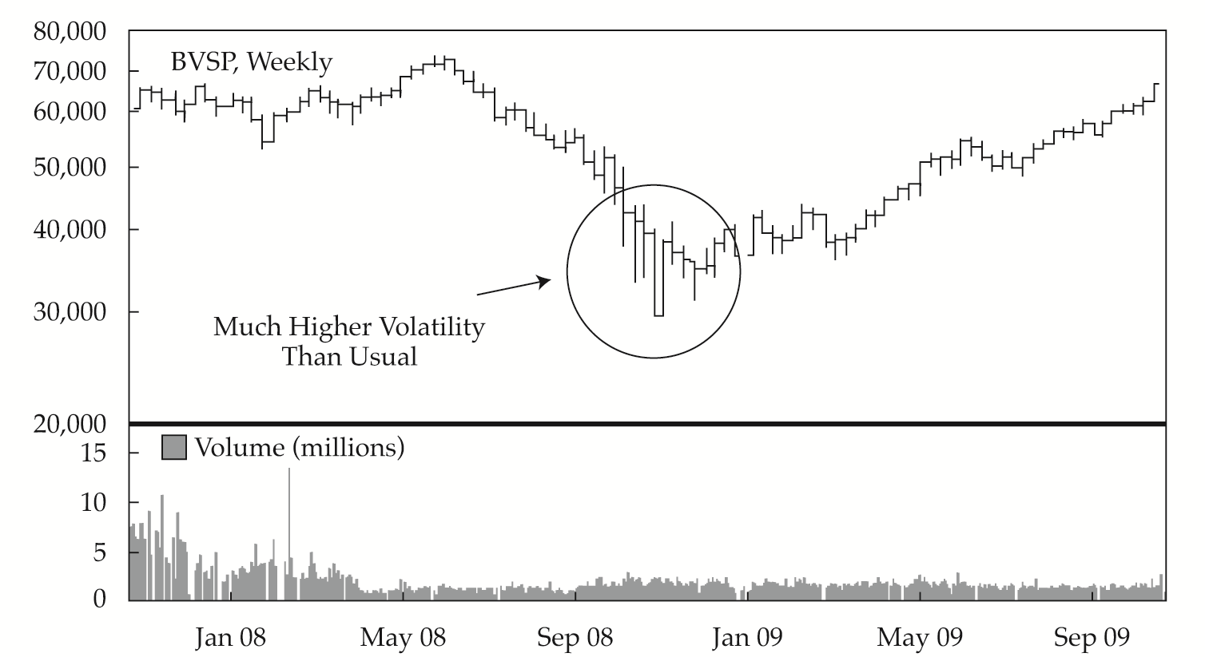
Bar Charts
EXHIBIT 12-2 Bar Chart Notation
EXHIBIT 12-3 Bar Chart: Bovespa Index, November 2007–November 2009 (price in Brazilian reals)
Notes:
LOS: Discuss the construction and interpretation of different types of technical analysis charts.
Pages 521-522
A line chart has one data point per time interval. A bar chart, in contrast, has four bits of data in each entry—the high and low price encountered during the time interval plus the opening and closing prices. Such charts can be constructed for any time period, but they are customarily constructed from daily data.
As Exhibit 12-2 shows, a vertical line connects the high and low price of the day; a cross-hatch to the right indicates the closing price, and a cross-hatch to the left indicates the opening price. The appeal of this chart is that the analyst immediately gets a sense of the nature of that day’s trading. A short bar indicates little price movement during the day; that is, the high, low, and close were near the opening price. A long bar indicates a wide divergence between the high and the low for the day.
Exhibit 12-3 shows daily performance of the Brazilian Bovespa Index (BVSP) from late 2007 through late 2009. The top part provides the price open, close, high, and low; the bottom part shows volume, which will be discussed in Section 3.1.6. The downturn in the second half of 2008 is obvious, but also notable are the extreme price movements in the fourth quarter of 2008. There were 40 trading days from 29 September to 24 November. On 20 of those days, the closing value of the index changed from the previous close by at least 4%, a huge move by historical standards. During the same period, the average daily price range (high to low) was 7%, compared with 3.7% in the previous two months. This potentially important information would not be captured in a line chart.

Slide 7
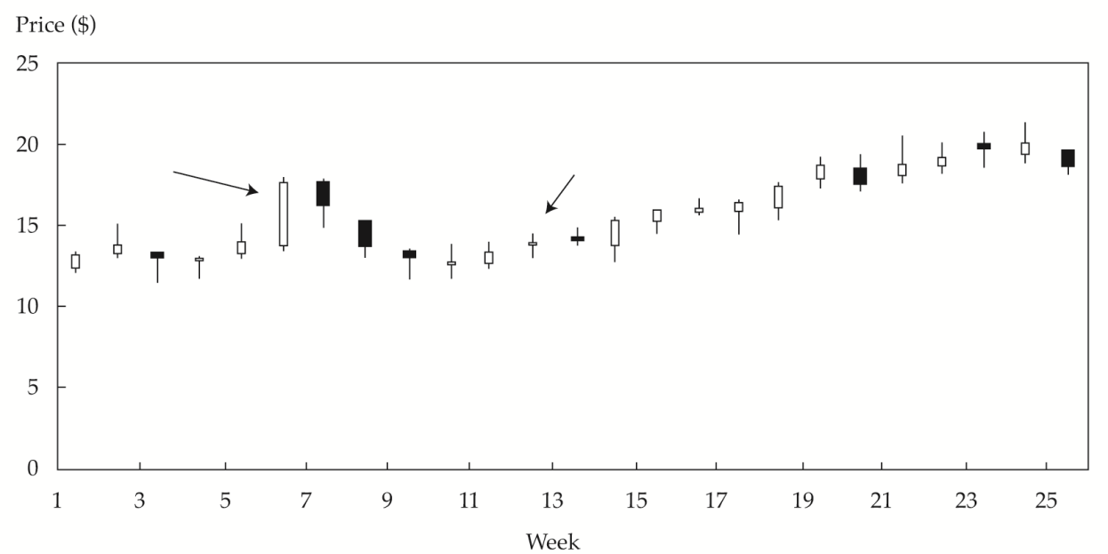
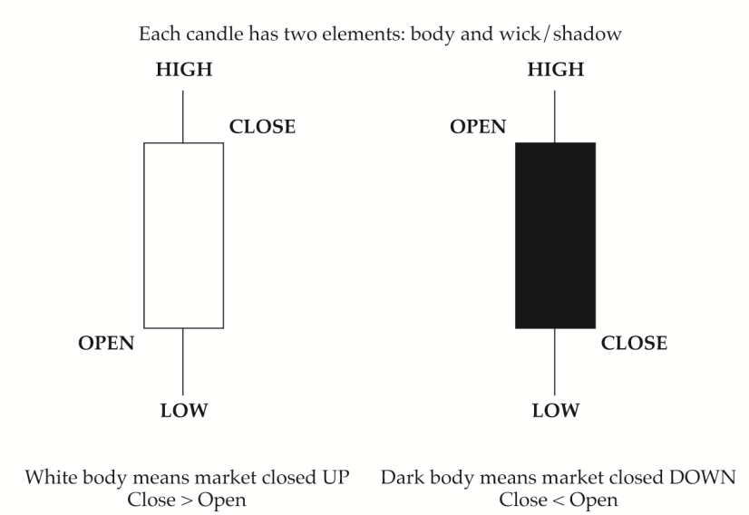
Candlestick Charts
EXHIBIT 12-4 Construction of a Candlestick Chart
EXHIBIT 12-5 Candlestick Chart: Companhia Vale do Rio Doce, 1 January– 15 June 2009 (prices in U.S. dollars)
Notes:
LOS: Discuss the construction and interpretation of different types of technical analysis charts.
Pages 523-524
Candlestick charts trace their roots to Japan, where technical analysis has been in use for centuries. Like a bar chart, a candlestick chart provides four prices per data point entry: the opening and closing prices and the high and low prices during the period. As shown in Exhibit 12-4, a vertical line represents the range through which the security price traveled during the time period. The line is known as the wick or shadow. The body of the candle is shaded if the opening price was higher than the closing price, and the body is clear if the opening price was lower than the closing price.
Exhibit 12-5 shows a weekly candlestick chart for Companhia Vale do Rio Doce for the period of 1 January through 15 June 2009.
The advantage of the candlestick chart over the bar chart is that price moves are much more visible in the candlestick chart, which allows faster analysis. The bar chart indicates market volatility only by the height of each bar, but in candlestick charts, the difference between opening and closing prices and their relationship to the highs and lows of the day are clearly apparent. Compare the sixth candle with the twelfth in Exhibit 12-5. In the sixth candle, the analyst can see significant volatility because the high of the day and low of the day are so far apart. The stock opened near the low of the day and closed near the high, suggesting a steady rally during the day. In contrast, the twelfth candle shows no difference between the high and low, and the shares opened and closed at the same price, creating a cross-pattern. In Japanese terminology used in candlestick charting, this pattern is called a doji. The doji signifies that after a full day of trading, the positive price influence of buyers and the negative price influence of sellers exactly counteracted each other, which tells the analyst that this market is in balance. If a doji occurs at the end of a long uptrend or downtrend, it signals that the trend will probably reverse.

Slide 8
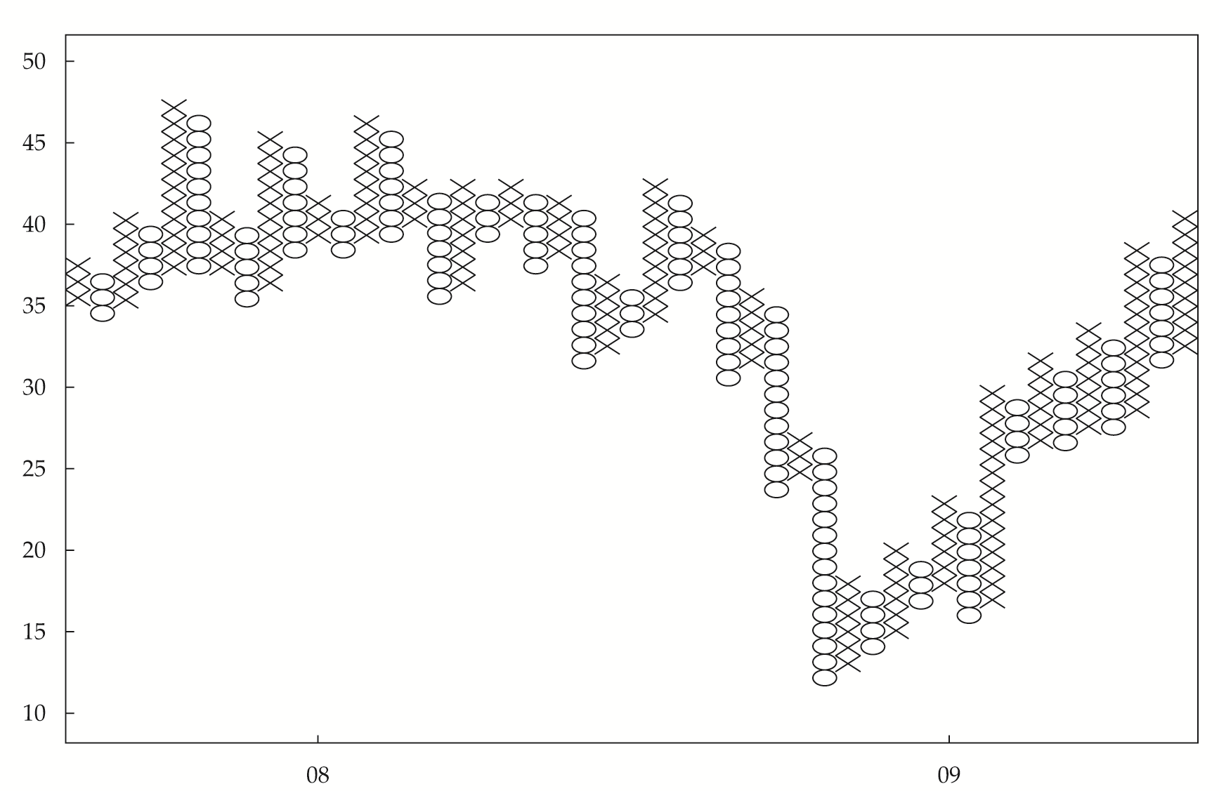
Point and Figure Charts
EXHIBIT 12-6 Point and Figure Chart: Wharf Holdings Daily Price Chart, 2007–2009 (Hong Kong dollars)
Note: The box size is HK$1, and the reversal size is three.
Notes:
LOS: Discuss the construction and interpretation of different types of technical analysis charts.
Pages 524-526
As illustrated in Exhibit 12-6, a point and figure chart is drawn on a grid and consists of columns of X’s alternating with columns of O’s. Neither time nor volume are represented on this type of chart, and the horizontal axis represents the number of changes in price, not time. Movement along the horizontal axis does reflect the passage of time, but not in any uniform fashion. The analyst makes entries on a point and figure chart only when the price changes by the “box size,” which is explained next. This lack of a normal time dimension is perhaps the most unusual characteristic of a point and figure chart.
To construct a point and figure chart, the analyst must determine both the box size and the reversal size. Box size refers to the change in price represented by the height of each box (boxes are generally square, but the width has no meaning). In Exhibit 12-6, the box size is HK$1. The reversal size is used to determine when to create a new column. In Exhibit 12-6, the reversal size is three, meaning a reversal in price of three or more boxes.
In a point and figure chart, X represents an increase in price and O represents a decline in price. In constructing a chart, the technician draws an X in a column of boxes every time the security price closes up by the amount of the box size. If the price increases by twice the box size, the technician draws two X’s to fill in two boxes, one on top of the other. The technician fills in more boxes for larger price moves. The resulting column starts at the opening price level and extends to the closing price level. As long as the security keeps closing at higher prices, the technician keeps filling in boxes with X’s, which makes the column higher and higher. If the price does not increase by at least the box size, no indication is made on the chart. Thus, in some cases, the chart is not updated for long periods, but no indication of this passage of time is made on the chart.
The reversal size determines when to create a new column. A reversal results in the technician shifting to the next column over and beginning a column of O’s. The first box to be filled in is to the right and below the highest X in the prior column. The technician then fills in an O to bring the column down to the price level at the close. As long as the downtrend continues, without a reversal in price, the technician continues adding O’s to the column below the prior O’s. A reversal in the downtrend by at least the amount of the reversal size prompts the technician to move to the next column and begin drawing a series of X’s again.
Point and figure charts are particularly useful for making trading decisions because they clearly illustrate price levels that may signal the end of a decline or advance. They also clearly show price levels at which a security may frequently trade. In using the point size and reversal size to make trading decisions, for uptrends, or columns of X’s, the practitioner would maintain long positions. The reversal size could be considered the amount of loss that would prompt the closing of a long position and the establishment of a new short position. The larger the reversal size, the fewer columns in the chart and the longer uptrends and downtrends will run.
Analysis of a point and figure chart is relatively straightforward as long as the technician understands its construction and limitations. The chart is relatively simple, and repeated high and low prices are evident. Congestion areas, where a security trades up and down in a narrow range, are evidenced by a series of short columns of X’s and O’s spanning roughly the same price range. Major, sustained price moves are represented by long columns of X’s (when prices are moving up) or O’s (when prices are moving down).

Slide 9
Price and Volume
Price Is Trending Higher or Lower
Volume Is Increasing
Confirmation: Trend Will Continue
Volume Is Decreasing
Divergence: Trend Will End
Notes:
LOS: Discuss the construction and interpretation of different types of technical analysis charts.
Page 528
Volume is an important characteristic that is included at the bottom of many charts. Volume is used to assess the strength or conviction of buyers and sellers in determining a security’s price. For example, on a daily price chart, below the price section would be a column chart showing the volume traded for that day.
Some technicians consider volume information to be crucial. If volume increases during a time frame in which price is also increasing, that combination is considered positive and the two indicators are said to “confirm” each other. The signal would be interpreted to mean that over time, more and more investors are buying the financial instrument and they are doing so at higher and higher prices. This pattern is considered a positive technical development.
Conversely, if volume and price diverge—for example, if a stock’s price rises while its volume declines—the implication is that fewer and fewer market participants are willing to buy that stock at the new price. If this trend in volume continues, the price rally will soon end because demand for the security at higher prices will cease.

Slide 10
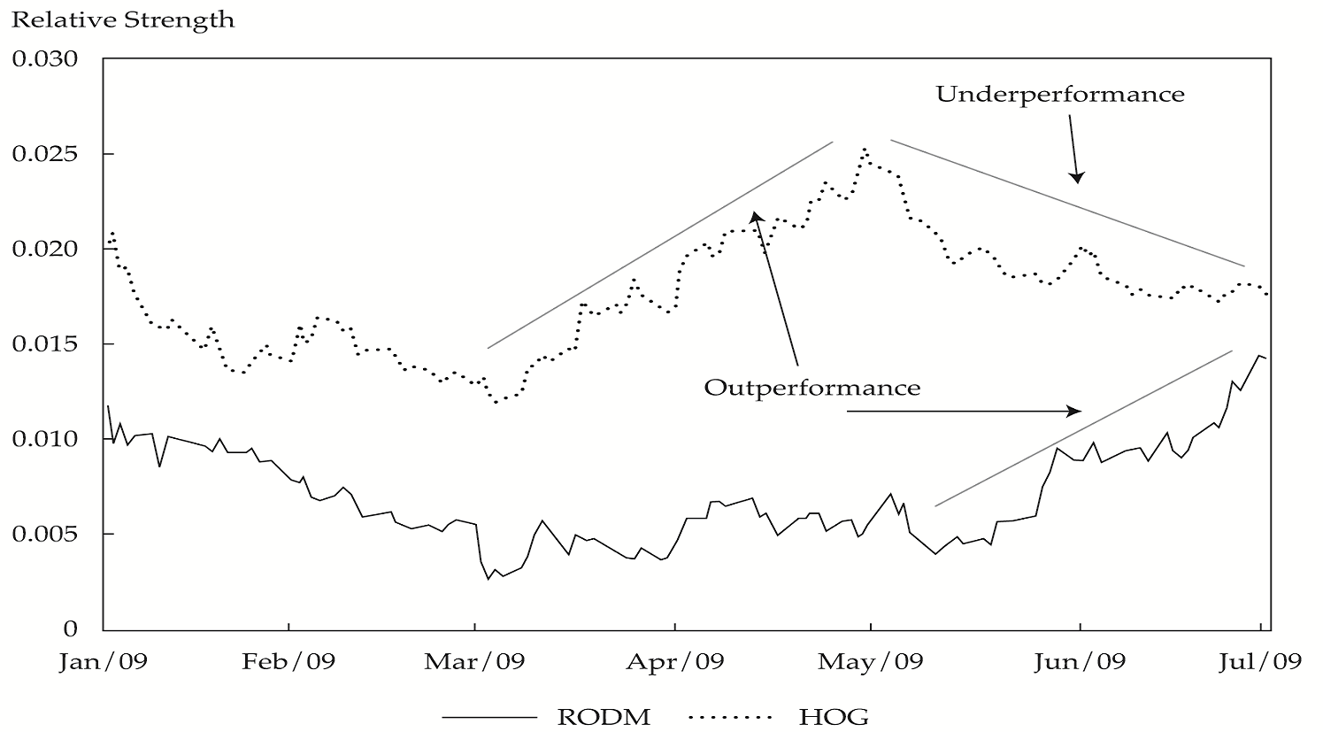
Relative Strength Analysis
EXHIBIT 12-10 Relative Strength Analysis: HOG vs. the S&P 500 and RODM vs. the S&P 500, January–June 2009
Notes:
LOS: Discuss the construction and interpretation of different types of technical analysis charts.
Pages 529-530
Relative strength analysis is widely used to compare the performance of a particular asset, such as a common stock, with that of some benchmark—such as, in the case of common stocks, the FTSE 100, the Nikkei 225, or the S&P 500 Index—or the performance of another security. The intent is to show out- or underperformance of the individual issue relative to some other index or asset. Typically, the analyst prepares a line chart of the ratio of two prices, with the asset under analysis as the numerator and with the benchmark or other security as the denominator. A rising line shows the asset is performing better than the index or other stock; a declining line shows the opposite. A flat line shows neutral performance.
Suppose a private investor is researching two investment ideas she read about. Harley-Davidson Motor Company (HOG) is a well-known motorcycle company; Rodman and Renshaw (RODM) is a small investment bank. The investor wants to determine which of these two has been the stronger performer (relative to the S&P 500) over the past few months. Exhibit 12-10 shows the relative strength lines for the two stocks for the first six months of 2009. Each point on the relative strength plot is simply the ratio of a share price to the S&P 500. For example, on 9 March 2009, HOG closed at US$8.42 and the S&P 500 closed at $676.53. The relative strength data point is, therefore, 8.42/676.53, or 0.0124. On 27 April, HOG closed at US$19.45, with the S&P 500 at $857.51. The relative strength value is 19.45/857.51, or 0.0227, nearly double the 9 March value.
The units on the vertical axis are not significant; the ratio is a function of the relative prices of the assets under consideration. The important information is how the ratio has changed. This type of chart allows an analyst to make a visual determination of that change. As Exhibit 12-10 illustrates, Harley-Davidson was a strong performer in March and April but lagged the index beginning in May. In contrast, the stock of Rodman and Renshaw began a significant rise in mid-May that outperformed the market average.

Slide 11
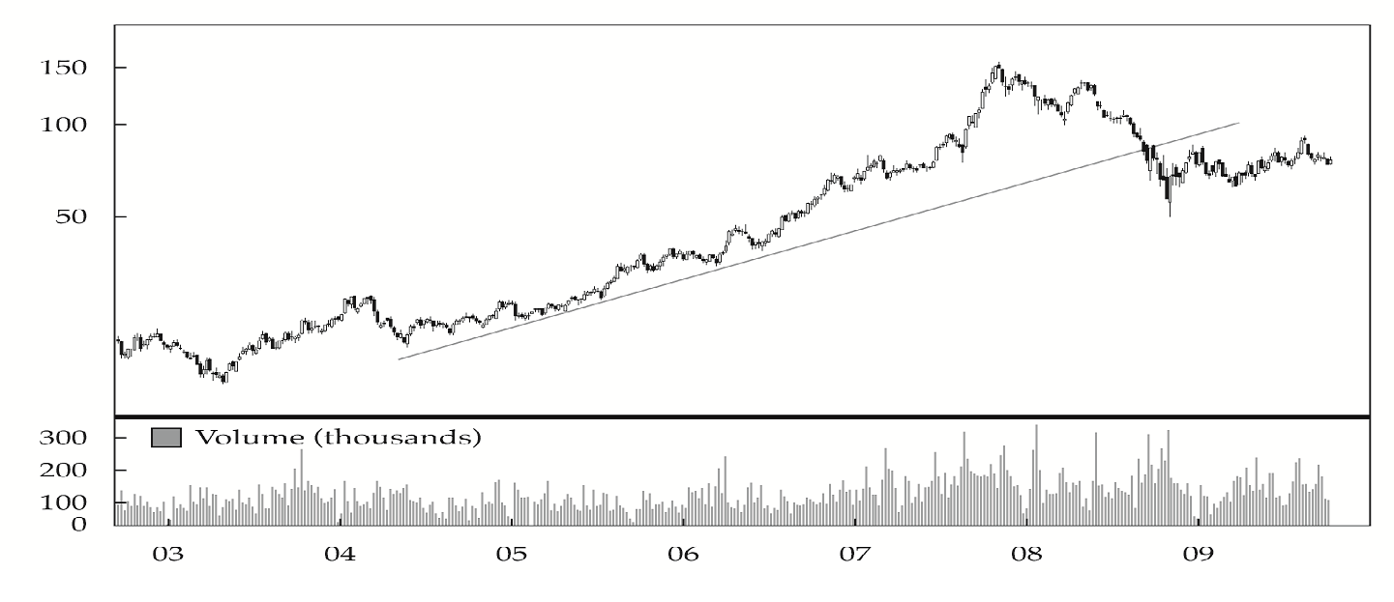
Trend Analysis
EXHIBIT 12-11 Trend Analysis: China Mobile Weekly Price Chart, 2002–2010 (prices in Hong Kong dollars)
Uptrend
Higher Highs, Higher Lows
Demand Exceeds Supply
Downtrend
Lower Highs, Lower Lows
Supply Exceeds Demand
Notes:
LOS: Demonstrate the uses of trend, support and resistance lines, and change in polarity.
Pages 530-531
The concept of a trend is perhaps the most important aspect of technical analysis. Trend analysis is based on the observation that market participants tend to act in herds and that trends tend to stay in place for some time.
An uptrend for a security is when the price goes to higher highs and higher lows. As the security moves up in price, each subsequent new high is higher than the prior high and each time there is a retracement, which is a reversal in the movement of the security’s price, it must stop at a higher low than the prior lows in the trend period. To draw an uptrend line, a technician draws a line connecting the lows of the price chart. Major breakdowns in price, however, when the price drops through and below the trendline by a significant amount (many technicians use 5%–10% below the trendline) indicate that the uptrend is over and may signal a further decline in the price. Minor breakthroughs below previous lows simply call for the line to be moderately adjusted over time. Time is also a consideration in trends: The longer the security price stays below the trendline, the more meaningful the breakdown is considered to be.
In an uptrend, the forces of demand are greater than the forces of supply. So, traders are willing to pay higher and higher prices for the same asset over time. Presumably, the strong demand indicates that investors believe the intrinsic value of the security is increasing.
A downtrend is when a security makes lower lows and lower highs. As the security moves down in price, each subsequent new high must be lower than the prior high and each time there is a retracement, it must stop at a lower low than the prior lows in the trend period. To draw a downtrend line, a technician draws a line connecting the highs of the price chart. Major breakouts above the downtrend line (e.g., 5%–10%) indicate that the downtrend is over and a rise in the security’s price may occur. And as with an uptrend, the longer the security price stays above the trendline, the more meaningful the breakout is considered to be.
In a downtrend, supply is overwhelming demand. Over time, sellers are willing to accept lower and lower prices to exit long positions or enter new short positions.

Slide 12
Support and Resistance
Price
Resistance/Support
Resistance Becomes Support
Support
Support
A low price range in which buying activity is sufficient to stop a decline in price
Resistance
A high price range in which selling activity is sufficient to stop a rise in price
Change in Polarity
Once a resistance (support) level is breached, it becomes a support (resistance) level
Notes:
LOS: Demonstrate the uses of trend, support and resistance lines, and change in polarity.
Pages 531-532
Two concepts related to trend are support and resistance. Support is defined as a low price range in which buying activity is sufficient to stop the decline in price. It is the opposite of resistance, which is a price range in which selling is sufficient to stop the rise in price. The psychology behind the concepts of support and resistance is that investors have come to a collective consensus about the price of a security. Support and resistance levels can be sloped lines, as in trendlines, or horizontal lines.
A key tenet of support and resistance as a part of technical analysis is the change in polarity principle, which states that once a support level is breached, it becomes a resistance level. The same holds true for resistance levels; Once breached, they become support levels. For example, if the price of a security never rises above SFr10 over a long period of time and begins to decline each time it reaches this level but then finally breaks through this level by a significant amount, the point to which the price rises becomes a support level.
Support and resistance levels are commonly round numbers. Support indicates that at some price level, investors consider a security to be an attractive investment and are willing to buy, even in the wake of a sharp decline (and for resistance, at some level, investors are not willing to buy, even in an uptrend). The fact that these price points tend to be round numbers strongly suggests that human sentiment is at work.

Slide 13
Chart Patterns
Chart Patterns
Reversal Patterns
Head and Shoulders or Inverse Head and Shoulders
Double Tops or Bottoms
Continuation Patterns
Triangles
Triple Tops or Bottoms
Rectangles
Flags and Pennants
Notes:
LOS: Identify and interpret common chart patterns.
Pages 532-533
Chart patterns are formations that appear in price charts that create some type of recognizable shape. Common patterns appear repeatedly and often lead to similar subsequent price movements. Thus, the identification and analysis of chart patterns is a common aspect of technical analysis used to predict security prices. An important connection to understand is that patterns form as a result of the behavior of market participants and that these patterns represent graphical depictions of the collective psychology of the market at a given time.
The recurring patterns that appear in charts can be used as a basis for market forecasting. The reason chart patterns have predictive value is that they are graphic representations of human trading activity and human behavior is frequently repeated, especially trading activity that is driven by fear (in market sell-offs) or hope and greed (as evidenced in bubbles—that is, rallies that extend well beyond valuation levels that would be derived by fundamental values).
Chart patterns can be divided into two categories: reversal patterns and continuation patterns. These terms refer to the trend for the security in question prior to the formation of the pattern. The most important concept to understand in using chart patterns is that without a clear trend in place prior to the pattern, the pattern has no predictive value. This aspect is frequently forgotten by investors who are so eager to identify and use patterns that they forget the proper application of charts.

Slide 14
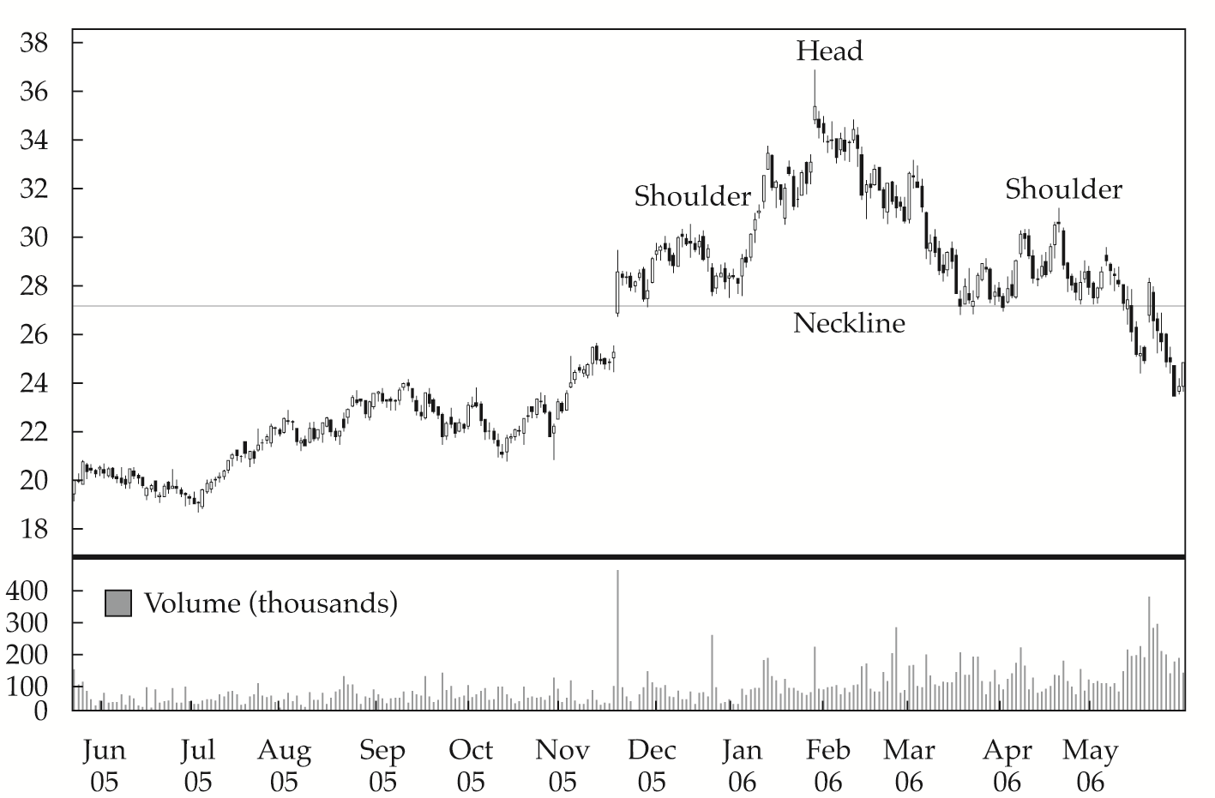
Head and Shoulders
EXHIBIT 12-13 Head and Shoulders Pattern: Marvell Technology Daily Price Chart, June 2005–June 2006 (price in U.S. dollars ÷ 100)
(Head and Shoulders) Price target = Neckline – (Head − Neckline)
(Inverse Head and Shoulders) Price target = Neckline + (Head – Neckline)
Notes:
LOS: Identify and interpret common chart patterns.
Pages 533-537
Perhaps the most widely recognized reversal pattern is the head and shoulders pattern. The pattern consists of three segments. Volume is an important characteristic in interpreting this pattern. Because head and shoulders indicate a trend reversal, a clear trend must exist prior to the formation of the pattern in order for the pattern to have predictive validity. For a head and shoulders pattern, the prior trend must be an uptrend. Later, the authors discuss the inverse head and shoulders pattern (preceded by a downtrend).
Exhibit 12-13 depicts a head and shoulders pattern for Marvell Technology Group during 2006. The three parts of the pattern are as follows:
• Left shoulder: This part appears to show a strong rally, with the slope of the rally being greater than the prior uptrend, on strong volume. The rally then reverses back to the price level where it started, forming an inverted V pattern, but on lower volume.
• Head: The head is a more pronounced version of the left shoulder. A rally following the first shoulder takes the security to a higher high than the left shoulder by a significant enough margin to be clearly evident on the price chart. Volume is typically lower in this rally, however, than in the one that formed the first, upward side of the left shoulder. This second rally also fails, with price falling back to the same level at which the left shoulder began and ended. This price level is called the neckline. This price level also will be below the uptrend line formed by connecting the low prices in the uptrend preceding the beginning of the head and shoulders pattern. This head pattern is the first signal that the rally may be coming to an end and that a reversal may be starting.
• Right shoulder: The right shoulder is a mirror image (or close to a mirror image) of the left shoulder but on lower volume, signifying less buying enthusiasm. The price rallies up to roughly the same level as the first shoulder, but the rally reverses at a lower high price than the rally that formed the head.
When attempting to profit from the a head and shoulders pattern, a technician will often use the price differences between the head and the neckline to set a price target, which is the price at which the technician anticipates closing the investment position. The price target for the head and shoulders pattern is calculated as follows: Price target = Neckline – (Head – Neckline).
Calculating price targets for inverse head and shoulders patterns is similar to the process for head and shoulders patterns, but in this case, because the pattern predicts the end of a downtrend, the technician calculates how high the price is expected to rise once it breaches the neckline. For an inverse head and shoulders pattern, the formula is similar to a head and shoulders pattern: Price target = Neckline + (Neckline – Head).

Slide 15
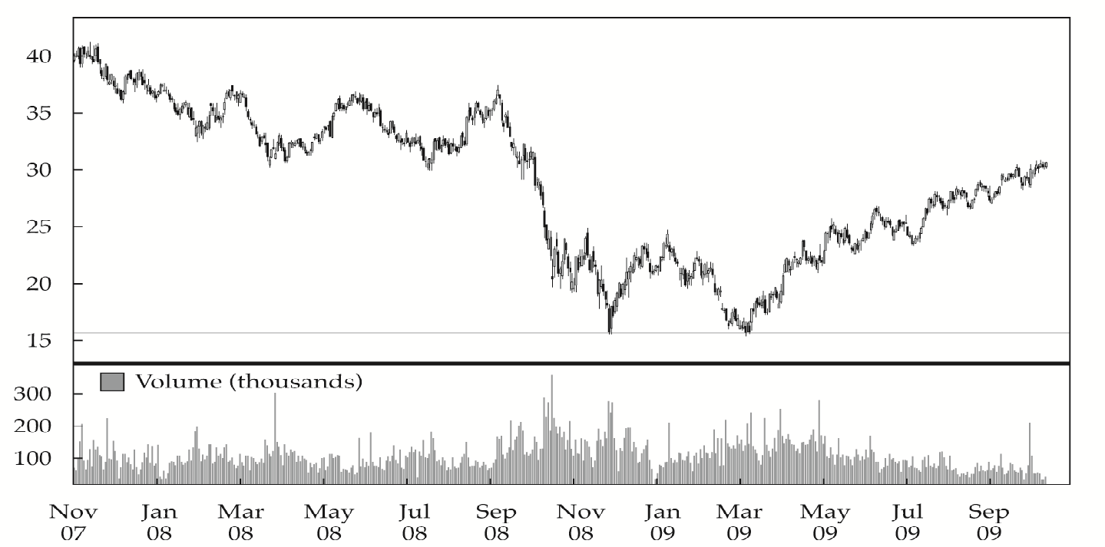
Double Tops and Bottoms
EXHIBIT 12-16 Double-Bottom Pattern: Time Warner Daily Price Chart, November 2007–October 2009 (price in U.S. dollars)
Notes:
LOS: Identify and interpret common chart patterns.
Pages 537-539
A double top is when an uptrend reverses twice at roughly the same high price level. Typically, volume is lower on the second high than on the first high, signaling a diminishing of demand. The longer the time is between the two tops and the deeper the sell-off is after the first top, the more significant the pattern is considered to be. Price targets can be calculated from this pattern in a manner similar to the calculation for the head and shoulders pattern. For a double top, price is expected to decline below the low of the valley between the two tops by at least the distance from the valley low to the high of the double tops.
Double bottoms are formed when the price reaches a low, rebounds, and then sells off back to the first low level. Exhibit 12-16 depicts a double-bottom pattern for Time Warner. Technicians use the double bottom to predict a change from a downtrend to an uptrend in security prices. For double bottoms, the price is expected to appreciate above the peak between the two bottoms by at least the distance from the valley lows to the peak.
The reason these patterns are significant is that they show that at some price point, investors step in to reverse trends that are underway. For an uptrend, a double top implies that at some price point, enough traders are willing to either sell positions (or enter new short positions) that their activities overwhelm and reverse the uptrend created by demand for the shares. A reasonable conclusion is that this price level has been fundamentally derived and that it represents the intrinsic value of the security that is the consensus of investors. With double bottoms, if a security ceases to decline at the same price point on two separate occasions, the analyst can conclude that the market consensus is that at that price point, the security is now cheap enough that it is an attractive investment.

Slide 16
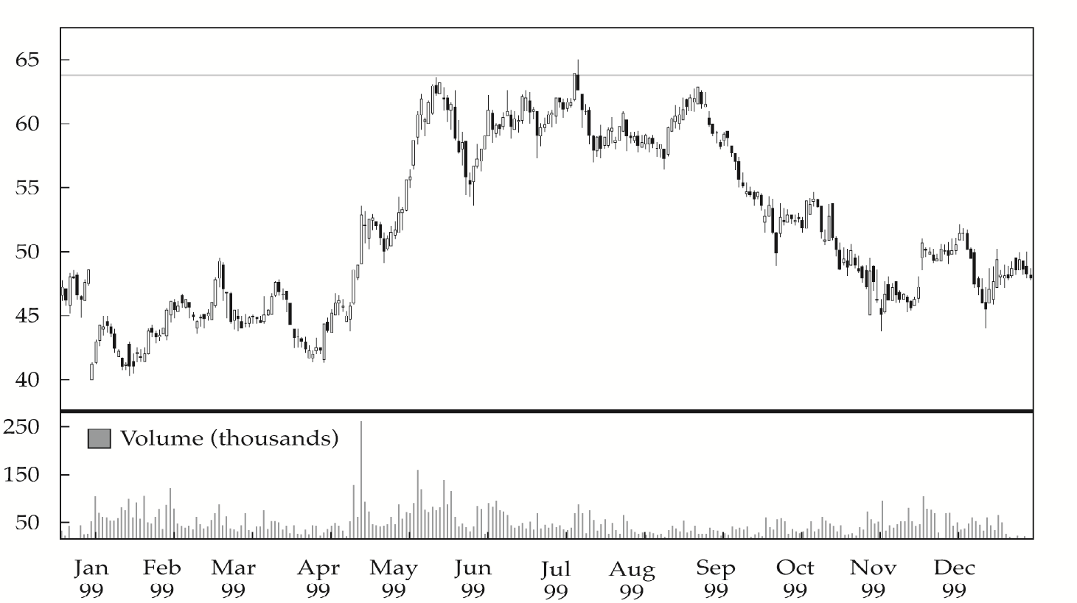
Triple Tops and Bottoms
EXHIBIT 12-17 Triple-Top Pattern: Rockwell Automation Daily Price Chart, 1999 (price in U.S. dollars)
Notes:
LOS: Identify and interpret common chart patterns.
Pages 539-540
Triple tops consist of three peaks at roughly the same price level, and triple bottoms consist of three troughs at roughly the same price level. A triple top for Rockwell Automation during 1999 is shown in Exhibit 12-17.
One of the challenges in double-top and triple-top patterns, and one of the valid criticisms of technical analysis in general, is that an analyst cannot know which pattern will result until after the fact. For example, after the broad equity market sell-off in the first quarter of 2009, a number of investment professionals were quoted as calling for a “retest of the lows”—in technical terms, a double bottom.
There is no evidence that market corrections (or rallies) must end with a double bottom (or double top in the case of an uptrend), and there is no generally accepted technical theory that predicts whether a low will be repeated once or even twice before a reversal occurs. A double bottom is considered to be a more significant pattern than a single bottom because traders have stepped in on two occasions to halt declines. However, traders have no way to determine whether a double top or bottom will be followed by a third top or bottom. Triple tops and triple bottoms are rare, but when they occur, they are more significant reversal patterns than double tops or double bottoms. On three separate occasions, traders stepped in to sell or buy shares with enough volume to end a rally or decline under way at the time. Nevertheless, the greater the number of times the price reverses at the same level, and the greater the time interval over which this pattern occurs, the greater the significance of the pattern.

Slide 17
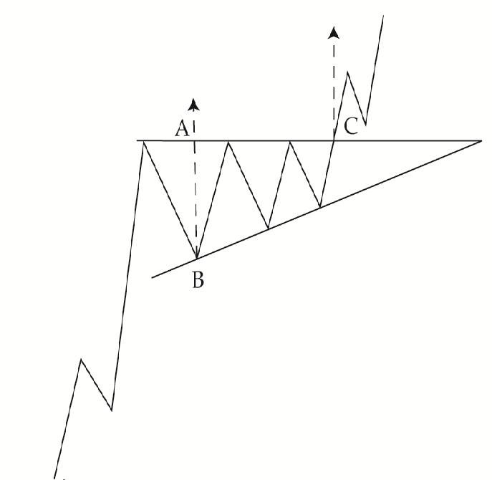
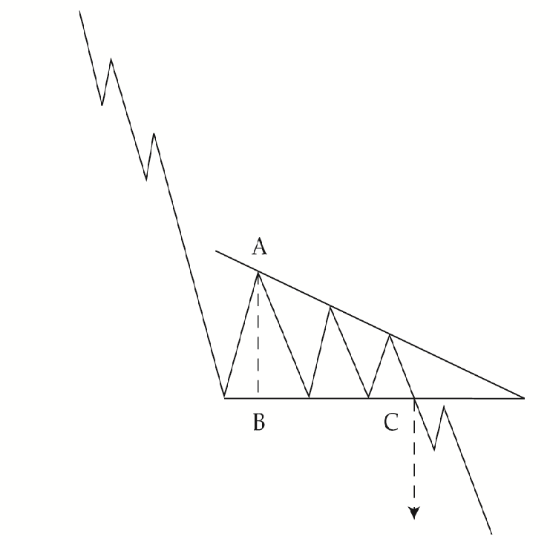
Triangles
EXHIBIT 12-18 Ascending Triangle Pattern
EXHIBIT 12-19 Descending Triangle Pattern
Notes:
LOS: Identify and interpret common chart patterns.
Pages 540-542
Triangle patterns are a type of continuation pattern. They come in three forms: symmetrical triangles, ascending triangles, and descending triangles. A triangle pattern forms as the range between high and low prices narrows, visually forming a triangle. In old terminology, triangles were referred to as “coils” (which was also synonymous with “springs”) because a triangle was considered analogous to a spring being wound up tighter and tighter and storing energy that would at some point be released. In a triangle, a trendline connects the highs and a trendline connects the lows. As the distance between the highs and lows narrows, the trendlines meet, forming a triangle. In a daily price chart, a triangle pattern usually forms over a period of several weeks.
In an ascending triangle, as shown in Exhibit 12-18, the trendline connecting the high prices is horizontal and the trendline connecting the low prices forms an uptrend. What this pattern means is that market participants are selling the stock at the same price level over a period of time, putting a halt to rallies at the same price point, but that buyers are getting more and more bullish and stepping in at increasingly higher prices to halt sell-offs instead of waiting for further price declines. An ascending triangle typically forms in an uptrend. The horizontal line represents sellers taking profits at around the same price point, presumably because they believe that this price represents the fundamental, intrinsic value of the security. The fact that the rally continues beyond the triangle may be a bullish signal; it means that another set of investors is presumably willing to buy at an even higher price because their analysis suggests the intrinsic value of the security is higher. Alternatively, the fundamental facts themselves may have changed; that is, the security’s fundamental value may be increasing over time. The technician does not care which explanation is true; the technician is relying solely on the information conveyed by the security price itself, not the underlying reason.
In the descending triangle, shown in Exhibit 12-19, the low prices form a horizontal trendline and the high prices form a series of lower and lower highs. Typically, a descending triangle will form in a downtrend. At some point in the sell-offs, buyers appear with enough demand to halt sell-offs each time they occur, at around the same price. Again, this phenomenon may be the result of fundamental analysts believing that the security has reached a price where it represents a significant discount to its intrinsic value and these analysts step in and buy. As the triangle forms, each rally ceases at a lower and lower high price point, suggesting the selling demand is exerting greater price influence than buying demand.

Slide 18
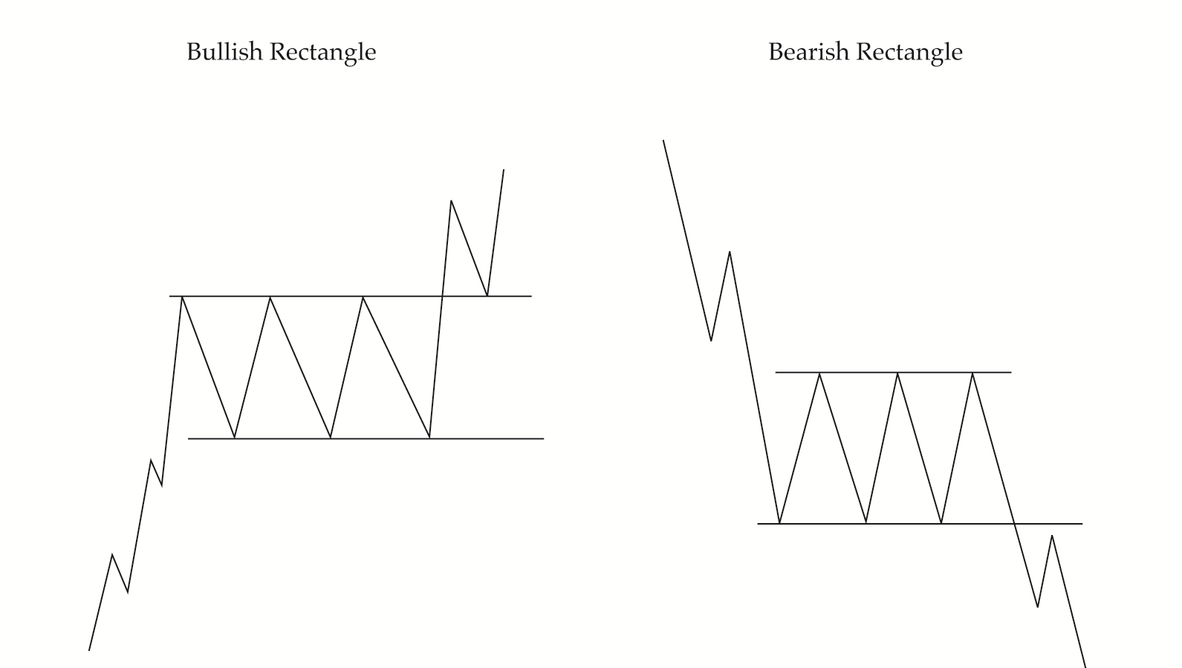
Rectangles
EXHIBIT 12-21 Rectangle Patterns
Notes:
LOS: Identify and interpret common chart patterns.
Pages 542-543
A rectangle pattern is a continuation pattern formed by two parallel trendlines, one formed by connecting the high prices during the pattern and the other formed by the lows. Exhibit 12-21 shows two rectangle patterns. As is the case with other patterns, the rectangle pattern is a graphical representation of what has been occurring in terms of collective market sentiment. The horizontal resistance line that forms the top of the rectangle shows that investors are repeatedly selling shares at a specific price level, bringing rallies to an end. The horizontal support line forming the bottom of the rectangle indicates that traders are repeatedly making large enough purchases at the same price level to reverse declines. The support level in a bullish rectangle is natural because the long-term trend in the market is bullish. The resistance line may simply represent investors taking profits. Conversely, in a bearish rectangle, the support level may represent investors buying the security. Again, the technician is not concerned with why a pattern has formed, only with the likely next price movement once the price breaks out of the pattern.

Slide 19
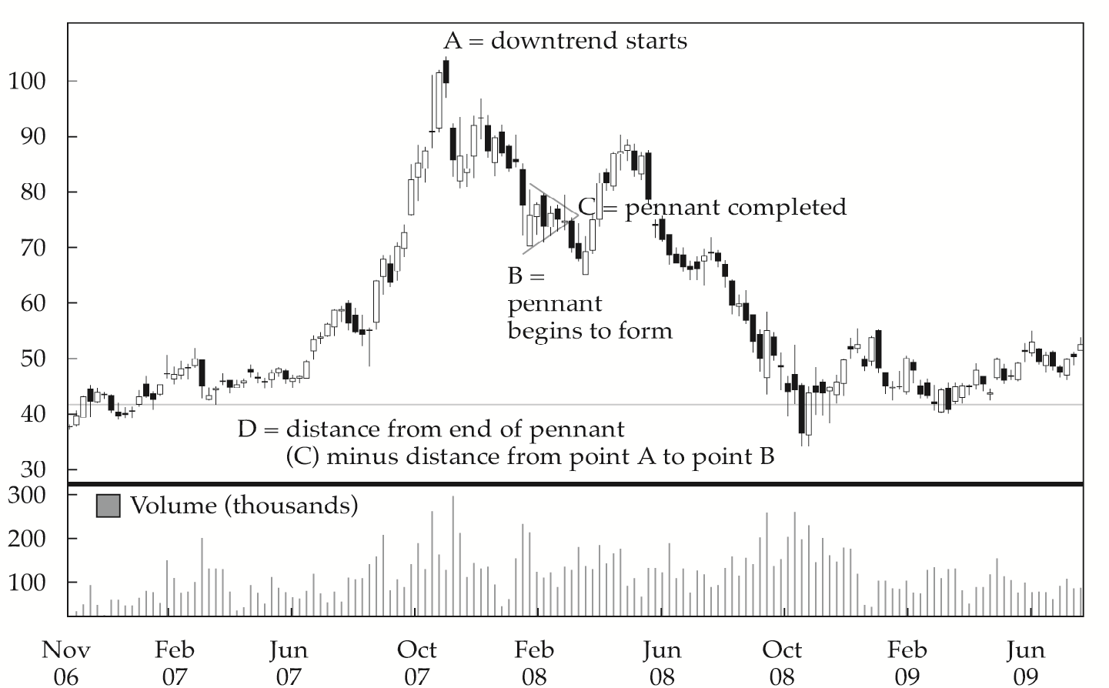
Flags and Pennants
EXHIBIT 12-22 Pennant Formation: China Mobile ADR, November 2006–July 2009 (price in U.S. dollars)
Notes:
LOS: Identify and interpret common chart patterns.
Pages 543-544
Flags and pennants are considered minor continuation patterns because they form over short periods of time—on a daily price chart, typically over a week. They are similar to each other and have the same uses. A flag is formed by parallel trendlines, in the same way that most countries’ flags are rectangular and create a parallelogram. Typically, the trendlines slope in a direction opposite to the trend up to that time; for example, in an uptrend, they slope down. A pennant formation is similar except that the trendlines converge to form a triangle, similar to the pennants of many sports teams or pennants flown on ships. The key difference between a triangle and pennant is that a pennant is a short-term formation whereas a triangle is a long-term formation.
The expectation for both flags and pennants is that the trend will continue after the pattern in the same direction it was going prior to the pattern. The price is expected to change by at least the same amount as the price change from the start of the trend to the formation of the flag or pennant. In Exhibit 12-22, a downtrend begins at point A, which is $104. At point B, which is $70, a pennant begins to form. The distance from point A to point B is $34. The pennant ends at point C, which is $76. The price target is $76 minus $34, which is $42, minus the line labeled D.

Slide 20
Technical Indicators
Price-Based Indicators
Momentum Oscillators
Sentiment Indicators
Flow-of-Funds Indicators
Notes:
LOS: Discuss common technical analysis indicators: price-based indicators, momentum oscillators, sentiment, and flow of funds.
Pages 544, 547, 555, 558
The technical analyst uses a variety of technical indicators to supplement the information gleaned from charts. A technical indicator is any measure based on price, market sentiment, or fund flows that can be used to predict changes in price. These indicators often have a supply-and-demand underpinning; that is, they measure how potential changes in supply and demand might affect a security’s price.
Price-based indicators somehow incorporate information contained in the current and past history of market prices. Indicators of this type range from simple (e.g., a moving average) to complex (e.g., a stochastic oscillator).
One of the key challenges in using indicators overlaid on a price chart is the difficulty of discerning changes in market sentiment that are out of the ordinary. Momentum oscillators are intended to alleviate this problem. They are constructed from price data, but they are calculated so that they either oscillate between a high and low (typically 0 and 100) or oscillate around a number (such as 0 or 100). Because of this construction, extreme highs or lows are easily discernible. These extremes can be viewed as graphic representations of market sentiment when selling or buying activity is more aggressive than historically typical. Because they are price based, momentum oscillators also can be analyzed by using the same tools technicians use to analyze price, such as the concepts of trend, support, and resistance.
Sentiment indicators attempt to gauge investor activity for signs of increasing bullishness or bearishness. Sentiment indicators come in two forms—investor polls and calculated statistical indices.
Technicians look at fund flows as a way to gauge the potential supply and demand for equities. Demand can come in the form of margin borrowing against current holdings or cash holdings by mutual funds and other groups that are normally large holders of equities, such as insurance companies and pension funds. The more cash these groups hold, the more bullish is the indication for equities. One caveat in looking at potential sources of demand is that, although these data indicate the potential buying power of various large investor groups, the data say nothing about the likelihood that the groups will buy. On the supply side, technicians look at a new or secondary issuance of stock because these activities put more securities into the market and increase supply.

Slide 21
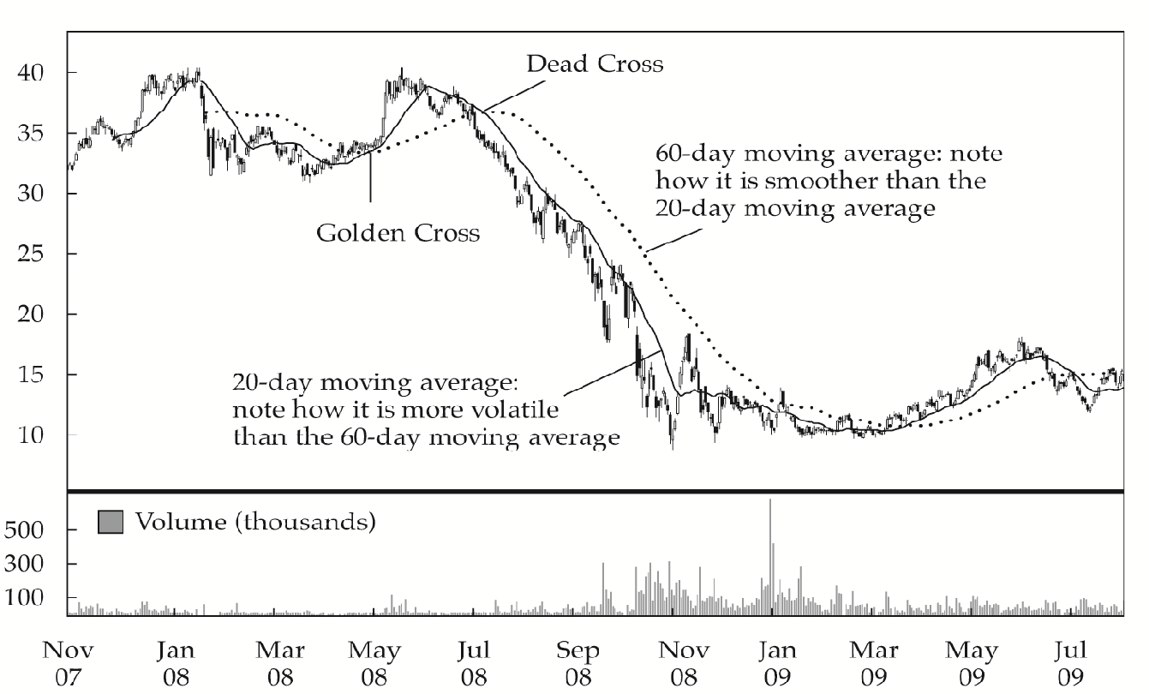
Price-Based Indicator: Moving Average
EXHIBIT12-23 Daily Price Chart with 20-Day and 60-Day Moving Averages: Gazprom EDR, November 2007–August 2009 (price in euros)
Notes:
LOS: Discuss common technical analysis indicators: price-based indicators, momentum oscillators, sentiment, and flow of funds.
Pages 544-545
A moving average is the average of the closing price of a security over a specified number of periods. Moving averages smooth out short-term price fluctuations, giving the technician a clearer image of market trend. Technicians commonly use a simple moving average, which weights each price equally in the calculation of the average price. Some technicians prefer to use an exponential moving average (also called an exponentially smoothed moving average), which gives the greatest weight to recent prices while giving exponentially less weight to older prices.
The number of data points included in the moving average depends on the intended use of the moving average. A 20-day moving average is commonly used because a month contains roughly 20 trading days. Also, 60 days is commonly used because it represents a quarter year (three months) of trading activity.
Two or more moving averages can be used in conjunction. Exhibit 12-23 shows the price chart of Gazprom SP European Depositary Receipts (EDRs) on the Frankfurt Stock Exchange overlaid with 20-day and 60-day EDR moving averages for late 2007 to mid-2009. Note that the longer the time frame used in the creation of a moving average, the smoother and less volatile the line. Investors often use moving-average crossovers as a buy or sell signal. When a short-term moving average crosses from underneath a longer-term average, this movement is considered bullish and is termed a golden cross. Conversely, when a short-term moving average crosses from above a longer-term moving average, this movement is considered bearish and is called a dead cross. In the case shown in Exhibit 12-23, a trading strategy of buying on golden crosses and selling on dead crosses would have been profitable.

Slide 22
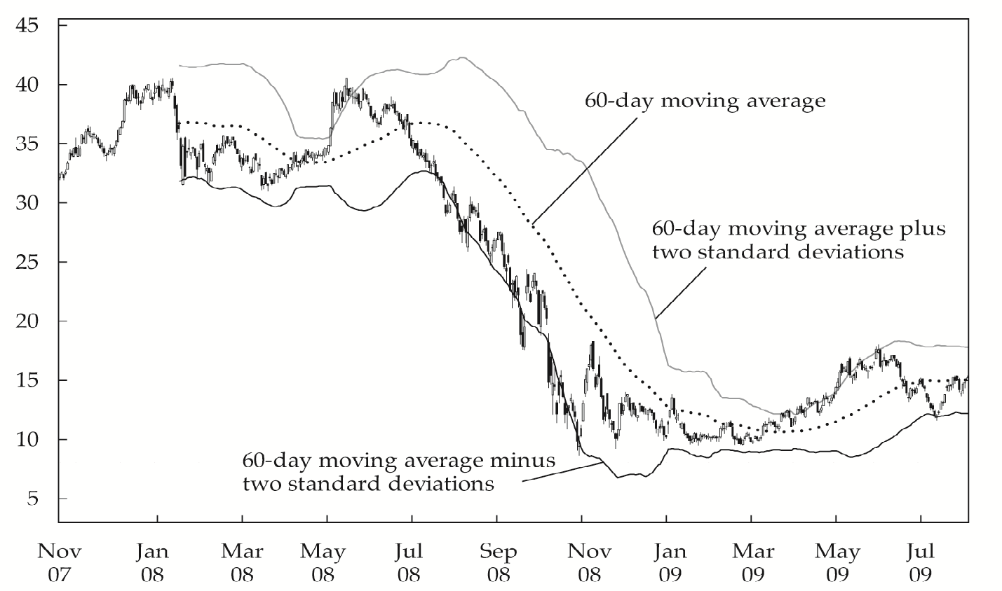
Price-Based Indicator: Bollinger Band
EXHIBIT12-24 Bollinger Band Using 60-Day Moving Average and 2 Standard Deviations: Gazprom EDR Daily Price Chart, November 2007–August 2009 (price in euros)
Notes:
LOS: Discuss common technical analysis indicators: price-based indicators, momentum oscillators, sentiment, and flow of funds.
Pages 546-547
Market veteran John Bollinger combined his knowledge of technical analysis with his knowledge of statistics to create an indicator called Bollinger Bands. Bollinger Bands consist of a moving average plus a higher line representing the moving average plus a set number of standard deviations from average price (for the same number of periods as used to calculate the moving average) and a lower line that is a moving average minus the same number of standard deviations. Exhibit 12-24 depicts Bollinger Bands for the Gazprom EDR.
The more volatile the security being analyzed becomes, the wider the range becomes between the two outer lines or bands. Similar to moving averages, Bollinger Bands can be used to create trading strategies that can be easily computerized and tested. A common use is as a contrarian strategy, in which the investor sells when a security price reaches the upper band and buys when it reaches the lower band. This strategy assumes that the security price will stay within the bands.
This type of strategy is likely to lead to a large number of trades, but it also limits risk because the trader can quickly exit unprofitable trades. In the event of a sharp price move and a change in trend, however, a contrarian strategy based on Bollinger Bands would be unprofitable. So, long-term investors might actually buy on a significant breakout above the upper boundary band because a major breakout would imply a change in trend likely to persist for some time. The long-term investor would sell on a significant breakout below the lower band. In this strategy, significance would be defined as breaking above or below the band by a certain percentage (say, 5% or 10%) and/or for a certain period of time (say, a week for a daily price chart). Again, such rules can easily be computerized and tested.

Slide 23
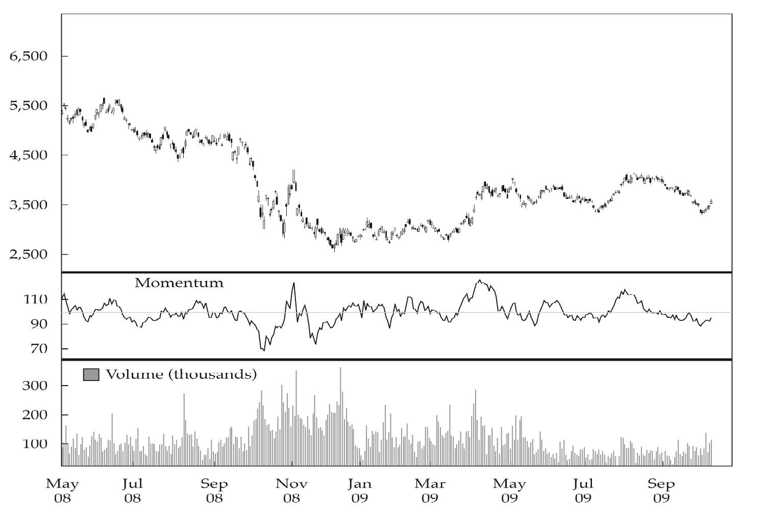
Momentum Oscillator: Rate of Change Oscillator (M = V ÷ Vx × 100)
EXHIBIT 12-25 Momentum Oscillator with 100 as Midpoint: Toyota Motor, May 2008–October 2009 (price in Japanese yen)
Notes:
LOS: Discuss common technical analysis indicators: price-based indicators, momentum oscillators, sentiment, and flow of funds.
Pages 547-549
The terms momentum oscillator and rate of change oscillator are synonymous. “Rate of change” is often abbreviated ROC. The ROC oscillator is calculated by taking the most recent closing price, subtracting the closing price from a prior date that is a set number of days in the past, and multiplying the result by 100:
M = (V – Vx) × 100
where
M = momentum oscillator value
V = last closing price
Vx = closing price x days ago, typically 10 days
When the ROC oscillator crosses zero in the same direction as the direction of the trend, this movement is considered a buy or sell signal. For example, if the ROC oscillator crosses into positive territory during an uptrend, it is a buy signal. If it enters into negative territory during a downtrend, it is considered a sell signal. The technician will ignore crossovers in opposition to the trend because the technician must always first take into account the general trend when using oscillators.
An alternative method of constructing this oscillator it to set it so that it oscillates above and below 100, instead of 0, as follows:
M = V/Vx × 100
This approach is shown in Exhibit 12-25 for Toyota Motor Corporation. The calculation method for the ROC oscillator for Toyota stock, traded on the Tokyo Stock Exchange, is for the oscillator to move around 100 and x is 12 days. Note that for this stock, the ROC oscillator tends to maintain a range between ¥85 and ¥115. So, episodes when the oscillator moves outside this range are of particular interest to the technician.

Slide 24
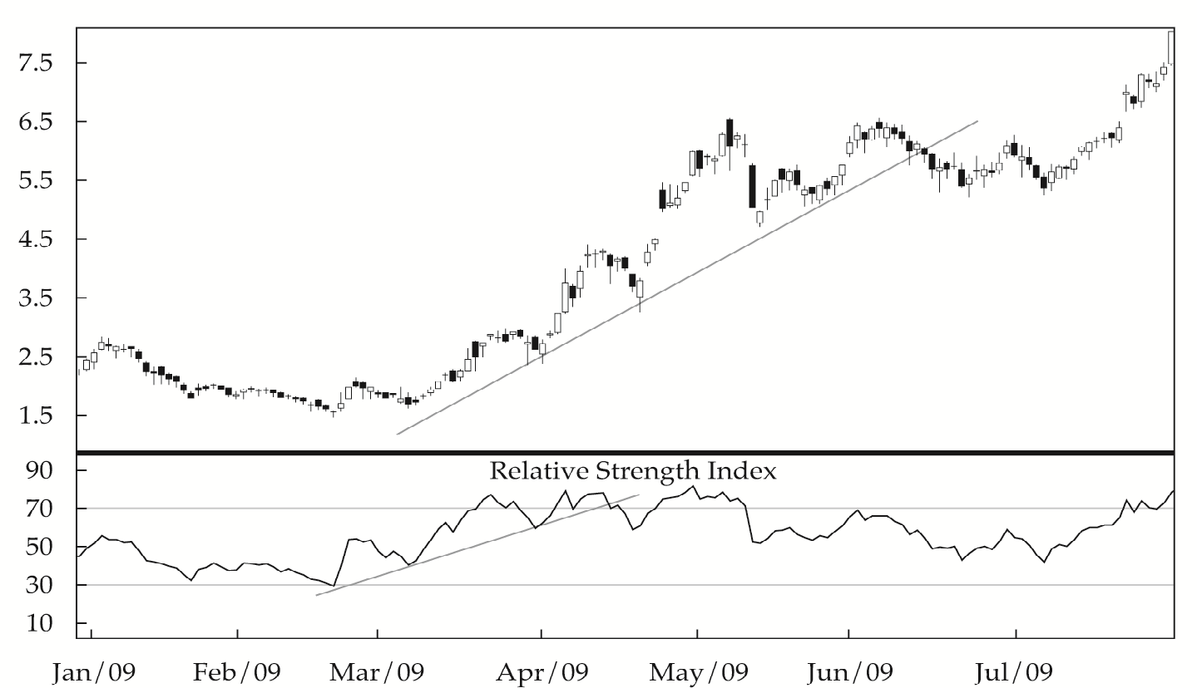
Momentum Oscillator: Relative Strength Index
EXHIBIT 12- 27 Candlestick Chart with RSI: Ford, January–August 2009 (price in U.S. dollars)
Notes:
LOS: Discuss common technical analysis indicators: price-based indicators, momentum oscillators, sentiment, and flow of funds.
Pages 549-551
A relative strength index (RSI) is computed over a rolling time period. It graphically compares a security’s gains with its losses over the set period. The creator of the RSI, Welles Wilder, suggested a 14-day time period, and this period is generally the period used in most technical analysis software. The technician should understand that this variable can be changed and that the optimal time range should be determined by how the technician intends to use the RSI information. Factors that influence selection of the time period are similar to those that influence the selection of a time period for moving averages. Short time periods (such as 14 days) provide information about short-term price behavior. If 200 days is used, this short-term information will be smoothed out and, perhaps, will not be apparent at all.
The index construction forces the RSI to lie within 0 and 100. A value above 70 represents an overbought situation. Values below 30 suggest the asset is oversold. Again, as is the case with most technical tools, an analyst cannot simply learn the default settings and use them in every case. The 30–70 range is a good rule of thumb, but because the oscillator is a measure of volatility, less volatile stocks (such as utilities) may normally trade in a much narrower range. More volatile stocks (such as small-capitalization technology stocks) may trade in a wider range. The range also does not have to be symmetrical around 50. For example, in an uptrend, one might see a range of 40–80 but in downtrends, a range of 20–60.
The RSI measure often appears at the bottom or top of a price chart. Exhibit 12-27 shows a candlestick chart of Ford stock in 2009 with the corresponding RSI. The candlestick chart of Ford stock prices illustrates several aspects of the use of an RSI. For example, because the RSI oscillator was higher than 70 on 23 March, the stock was overbought at that time, so a simple reading of the chart might have led to the conclusion that the trader should sell the stock. Doing so, however, would have caused the trader to miss a significant advance in the shares. A more careful technical analysis that took into account the trend would have indicated that the stock was in an uptrend, so RSI readings above 70 could be expected.
Because RSI is a price-based oscillator, the trader can also apply trend lines to analyze it. Note in Exhibit 12-27 that both the share price and the RSI oscillator were in uptrends from February until April but that the RSI uptrend was broken on 15 April, a potential warning that the uptrend in price might also break downward. In June, the share price broke its uptrend support line.

Slide 25
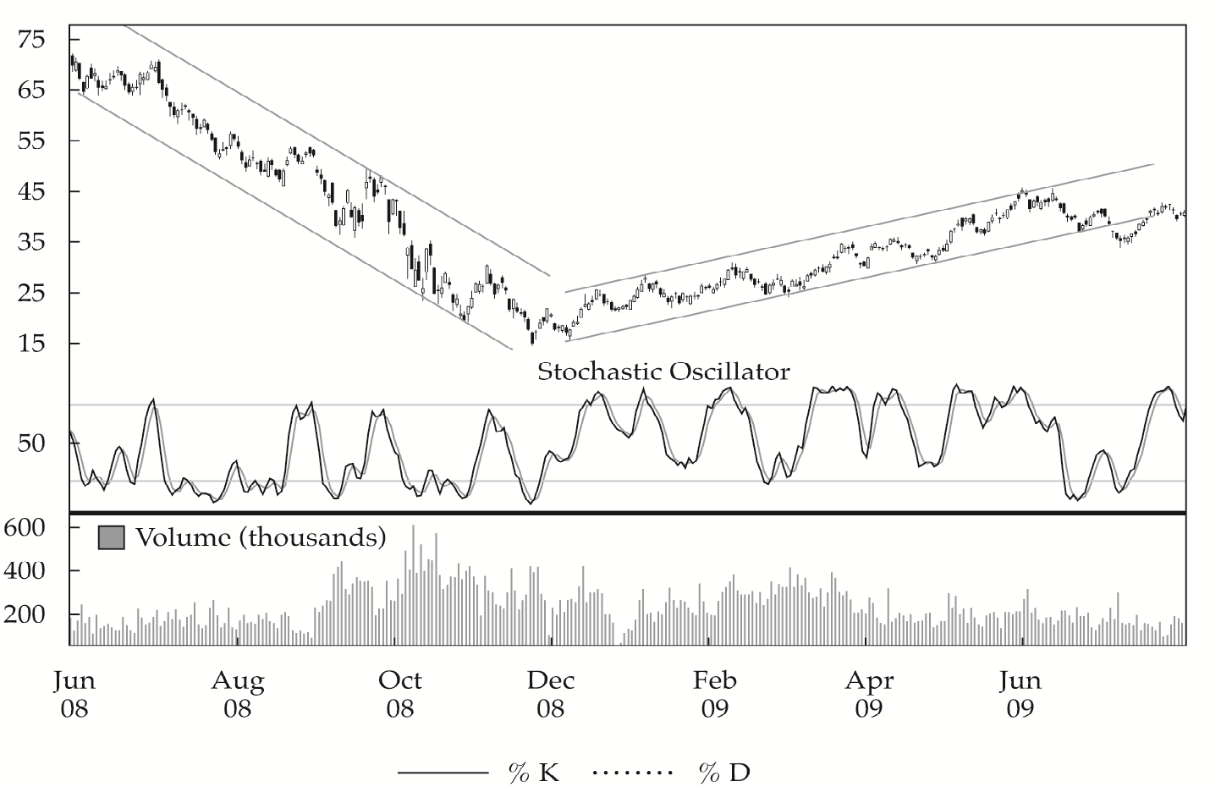
Momentum Oscillator: Stochastic Oscillator
EXHIBIT 12-28 Weekly Price Chart and Stochastic Oscillator: Petroleo Brasileiro ADR, June 2008–July 2009 (price in U.S. dollars)
Notes:
LOS: Discuss common technical analysis indicators: price-based indicators, momentum oscillators, sentiment, and flow of funds.
Pages 551-553
The stochastic oscillator is based on the observation that in uptrends, prices tend to close at or near the high end of their recent range and in downtrends, they tend to close near the low end. The logic behind these patterns is that if the shares of a stock are constantly being bid up during the day but then lose value by the close, continuation of the rally is doubtful. If sellers have enough supply to overwhelm buyers, the rally is suspect. If a stock rallies during the day and is able to hold on to some or most of those gains by the close, that sign is bullish.
The stochastic oscillator oscillates between 0 and 100 and has a default setting of a 14-day period, which, again, might be adjusted for the situation as the authors discussed for the RSI. The oscillator is composed of two lines, called %K and %D, that are calculated as follows:
%K = 100 ((C − L14) / (H14 − L14))
where
C = latest closing price
L14 = lowest price in past 14 days
H14= highest price in past 14 days
and
%D = average of the last three %K values calculated daily
Analysts should think about the %D in the same way they would a long-term moving-average line in conjunction with a short-term line. That is, %D, because it is the average of three %K values, is the slower moving, smoother line and is called the signal line. And %K is the faster moving line. The %K value means that the latest closing price (C) was in the %K percentile of the high–low range (L14 to H14).
The default oversold–overbought range for the stochastic oscillator is based on reading the signal line relative to readings of 20 and 80, but warnings about always using the default range for the RSI oscillator also apply in the case of the stochastic oscillator. The stochastic oscillator should be used with other technical tools, such as trend analysis or pattern analysis. If both methods suggest the same conclusion, the trader has convergence (or confirmation), but if they give conflicting signals, the trader has divergence, which is a warning signal suggesting that further analysis is necessary.
Exhibit 12-28 provides a good example of how the stochastic oscillator can be used together with trend analysis. The exhibit provides the weekly price chart and stochastic oscillator for Petroleo Brasileiro ADRs, which are traded on the New York Stock Exchange, for June 2008 through June 2009. Note that during the downtrend on the left side of the chart the stochastic oscillator often moved below 20. Each time it reached 80, however, it provided a valid sell signal. When the downtrend ended in November 2008 and an uptrend began, the stochastic oscillator was regularly moving above 80 but each time the %K line moved above %D, a valid buy signal was given.

Slide 26
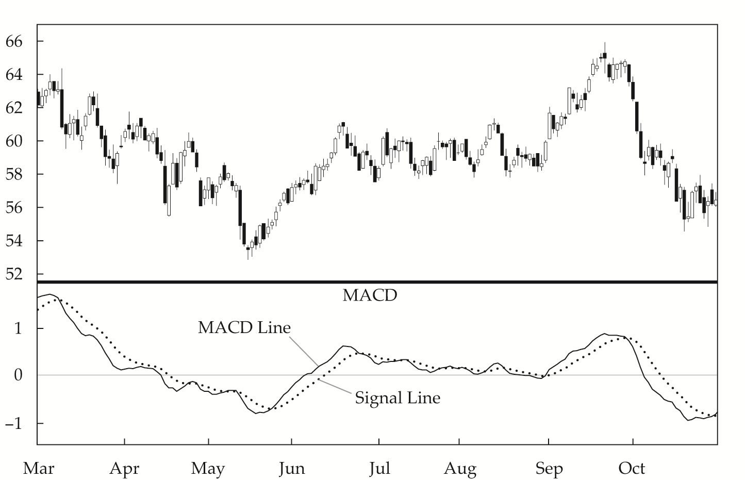
Momentum Oscillator: MACD Oscillator
EXHIBIT12-29 MACD and Daily Price Chart: Exxon Mobil, March–November 2005 (price in U.S. dollars)
Notes:
LOS: Discuss common technical analysis indicators: price-based indicators, momentum oscillators, sentiment, and flow of funds.
Pages 553-554
The moving-average convergence/divergence oscillator is commonly referred to as MACD, which is pronounced Mack Dee. The MACD is the difference between a short-term and a long-term moving average of the security’s price. The MACD is constructed by calculating two lines, the MACD line and the signal line:
• MACD line: difference between two exponentially smoothed moving averages, generally 12 and 26 days
• Signal line: exponentially smoothed average of MACD line, generally 9 days
The indicator oscillates around zero and has no upper or lower limit. Rather than using a set overbought–oversold range for MACD, the analyst compares the current level with the historical performance of the oscillator for a particular security to determine when a security is out of its normal sentiment range.
MACD is used in technical analysis in three ways. The first is to note crossovers of the MACD line and the signal line, as discussed for moving averages and the stochastic oscillator. Crossovers of the two lines may indicate a change in trend. The second is to look for times when the MACD is outside its normal range for a given security. The third is to use trend lines on the MACD itself. When the MACD is trending in the same direction as price, this pattern is convergence, and when the two are trending in opposite directions, the pattern is divergence.
Exhibit 12-29 shows a daily price chart of Exxon Mobil (at the top) with the MACD oscillator for March through October of 2005. Note the convergence in the bottoming of both the oscillator and price in May, which provided confirmation of a change in trend. This change was further confirmed by the MACD line crossing above the signal line. A bearish signal was given in September with the change in trend of both price and the oscillator and the crossover of the signal line by the MACD line. The fact that the MACD oscillator was moving up to a level that was unusually high for this stock would have been an early warning signal in September.

Slide 27
Sentiment Indicator: Opinion Polls
Investors Intelligence Advisors’ Sentiment Report
Market Vane Bullish Consensus
Consensus Bullish Sentiment Index
Daily Sentiment Index
AAII Investor Sentiment Survey
Notes:
LOS: Discuss common technical analysis indicators: price-based indicators, momentum oscillators, sentiment, and flow of funds.
Page 555
A wide range of services conduct periodic polls of either individual investors or investment professionals to gauge their sentiment about the equity market. The most common of the polls are the Investors Intelligence Advisors’ Sentiment reports, Market Vane Bullish Consensus, Consensus Bullish Sentiment Index, and Daily Sentiment Index, all of which poll investment professionals, and reports of the American Association of Individual Investors (AAII), which polls individual investors. All but the AAII survey are subscription-based services. Barron’s magazine publishes data from four of these surveys on a weekly basis.
By regularly polling, compiling these data over time, and presenting it graphically, these services provide technicians with an analyzable snapshot of investor sentiment over time. Technicians look at prior market activity and compare it with highs or lows in sentiment, as well as inflection points in sentiment, as a gauge when they are forecasting the future direction of the market.

Slide 28
Sentiment Indicator: Calculated Statistical Indices
Put/Call Ratio
Normally below 1.0
Considered a contrary indicator
CBOE Volatility Index
Based on options on stocks in the S&P 500
Used with trend, pattern, or oscillator tools
Margin Debt
Rising margin debt believed to be a signal of aggressive buying
Considered a contrary indicator
Short Interest Ratio
Short interest ÷ Average daily trading volume
Considered a contrary indicator
Notes:
LOS: Discuss common technical analysis indicators: price-based indicators, momentum oscillators, sentiment, and flow of funds.
Pages 555-558
The other category of sentiment indicators are indicators that are calculated from market data, such as security prices. The two most commonly used are derived from the options market; they are the put/call ratio and the volatility index. Additionally, many analysts look at margin debt and short interest.
The put/call ratio is the volume of put options traded divided by the volume of call options traded for a particular financial instrument. Investors who buy put options on a security are presumably bearish, and investors who buy call options are presumably bullish. The volume in call options is greater than the volume traded in put options over time, so the put/call ratio is normally below 1.0. The ratio is considered to be a contrarian indicator, meaning that higher values are considered bearish and lower values are considered bullish.
The CBOE Volatility Index (VIX) is a measure of near-term market volatility calculated by the Chicago Board Options Exchange. Since 2003, it has been calculated from option prices on the stocks in the S&P 500. The VIX rises when market participants become fearful of an impending market decline. These participants then bid up the price of puts, and the result is an increase in the VIX level. Technicians use the VIX in conjunction with trend, pattern, or oscillator tools, and it is interpreted from a contrarian perspective. When other indicators suggest that the market is oversold and the VIX is at an extreme high, this combination is considered bullish.
Investor psychology plays an important role in the intuition behind margin debt as an indicator. When stock margin debt is increasing, investors are aggressively buying and stock prices will move higher because of increased demand. Eventually, the margin traders use all of their available credit, so their buying power (and, therefore, demand) decreases, which fuels a price decline. Falling prices may trigger margin calls and forced selling, thereby driving prices even lower.
The short interest ratio represents the number of day trading activity represented by short interest. To facilitate comparisons of large and small companies, common practice is to “normalize” this value by dividing short interest by average daily trading volume to get the short interest ratio: Short interest ratio = Short interest/Average daily trading volume. It is considered to show market sentiment and to be a contrarian indicator. Some people believe that if a large number of shares are sold short and the short interest ratio is high, the market should expect a falling price for the shares because of so much negative sentiment about them.

Slide 29
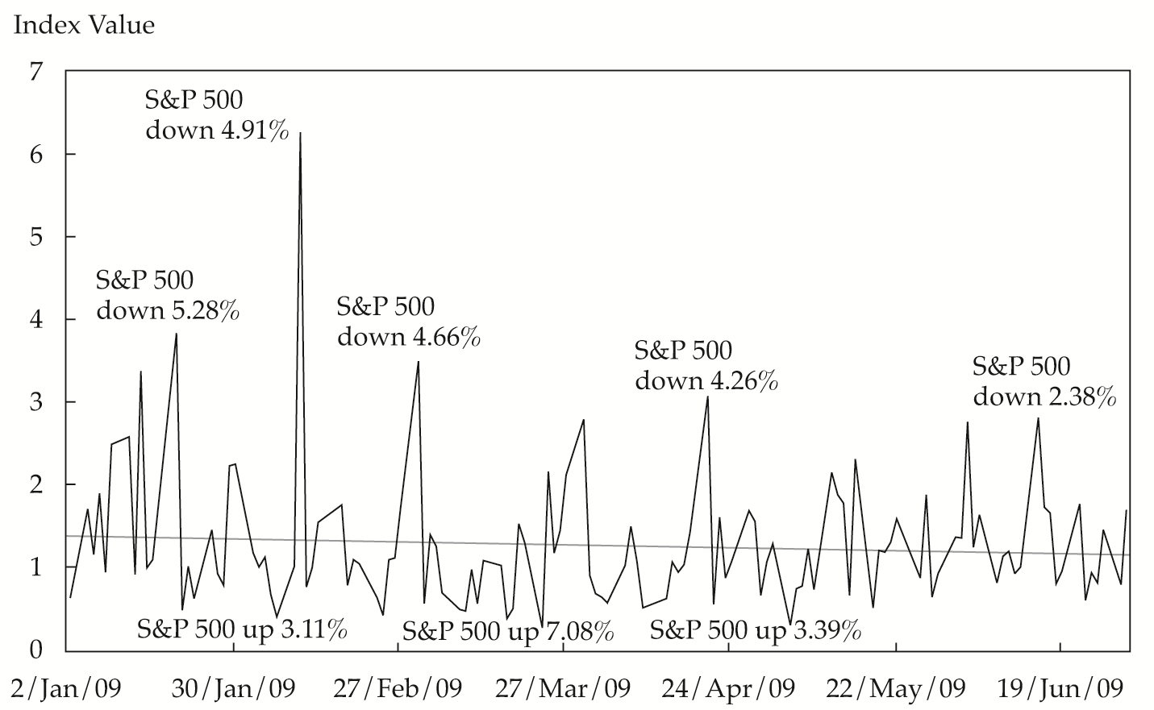
Flow-of-Funds Indicator: Arms Index (TRIN)
EXHIBIT12-32 Arms Index for the S&P 500, January–July 2009
Notes:
LOS: Discuss common technical analysis indicators: price-based indicators, momentum oscillators, sentiment, and flow of funds.
Pages 558-560
A common flow of funds indicator is the Arms Index, also called the TRIN (for “short-term trading index”). This indicator is applied to a broad market (such as the S&P 500) to measure the relative extent to which money is moving into or out of rising and declining stocks. The index is a ratio of two ratios:
Arms Index = (Number of advancing issues/Number of declining issues)/(Volume of advancing issues/Volume of declining issues)
When this index is near 1.0, the market is in balance; that is, as much money is moving into rising stocks as into declining stocks. A value above 1.0 means that there is more volume in declining stocks; a value below 1.0 means that most trading activity is in rising stocks. Exhibit 12-32 shows the Arms Index for the S&P 500 on a daily basis for the first six months of 2009. The majority of the points lie above the 1.0 level, suggesting that the market continued to be in a selling mood. Note that the up spikes are associated with large price decreases in the index level and the down spikes reflect the opposite. The trendline shows a slightly negative slope, providing some slight encouragement for the bulls.

Slide 30
Other Flow-of-Funds Indicators
Margin Loans
Ability to buy stock on margin may increase demand
Declining margin balances may result in forced selling
Mutual Fund Cash Positions
Considered a contrary indicator: High cash balances represent buying power
New Equity Issuance and Secondary Offerings
Considered a contrary indicator: High issuance and offerings are considered signs of a market top
Some analysts take into account the level of interest rates
Notes:
LOS: Discuss common technical analysis indicators: price-based indicators, momentum oscillators, sentiment, and flow of funds.
Pages 560-562
Margin debt was previously discussed as an indicator of market sentiment. Margin debt is also widely used as a flow-of-funds indicator because margin loans may increase the purchases of stocks and declining margin balances may force the selling of stocks.
An analyst’s initial intuition might be that when mutual fund cash positions are relatively low, fund managers are bullish and anticipate rising prices but when fund managers are bearish, they conserve cash to wait for lower prices. Advocates of this technical indicator argue exactly the opposite: When the mutual fund cash position is low, fund managers have already bought, and the effects of their purchases are already reflected in security prices. When the cash position is high, however, that money represents buying power that will move prices higher when the money is used to add positions to the portfolio. The mutual fund cash position is another example of a contrarian indicator. Some analysts modify the value of the cash percentage to account for differences in the level of interest rates. Cash is not sitting in a desk drawer; it is on deposit somewhere earning interest. When interest rates are low, holding cash can be a substantial drag on the fund’s performance if the broad market advances. When interest rates are high, holding cash is less costly.
When a company’s owners decide to take a company public and offer shares for sale, the owners want to put those shares on the market at a time when investors are eager to buy. That is, the owners want to offer the shares when they can sell them at a premium price. Premium prices occur near market tops. The new equity issuance indicator suggests that as the number of initial public offerings (IPOs) increases, the upward price trend may be about to turn down.
Technicians also monitor secondary offerings to gauge potential changes in the supply of equities. Although secondary offerings do not increase the supply of shares, because existing shares are sold by insiders to the general public, they do increase the supply available for trading or the float. So, from a market perspective, secondary offerings of shares have the potential to change the supply-and-demand equation as much as IPOs do.

Slide 31
Cycles
Kondratieff Wave (K-wave)
Western economies have a 54-year cycle
Originally tied to economic cycles and commodity prices
18-Year Cycle
3 × 18 years = 54 years
Most often mentioned in connection with real estate prices
Decennial Pattern
Pattern of market returns broken down based on the last digit of a year
Years ending in 5 have the best returns
Presidential Cycle
Returns broken down by year of U.S. President’s term in office
Third year (year prior to next election) has best historical performance
Notes:
LOS: Discuss common technical analysis indicators: price-based indicators, momentum oscillators, sentiment, and flow of funds.
Pages 562-563
Over the centuries, technicians have noted recurring cycles of various frequencies in the capital markets. The study of cycles in the markets is part of broader cycle studies that exist in numerous fields of study.
The longest of the widely recognized cycles was identified by Nikolai Kondratieff in the 1920s. Kondratieff was an economist in the Soviet Union who suggested that Western economies had a 54-year cycle. He traced cycles from the 1780s to the time he published this theory in the 1920s, and the economic depression of the 1930s was consistent with the cycle he identified. His theory was mainly tied to economic cycles and commodity prices, but cycles can also be seen in the prices of equities during the time of his work.
The 18-year cycle is interesting because three 18-year cycles make up the longer 54-year Kondratieff Wave. The 18-year cycle is most often mentioned in connection with real estate prices, but it can also be found in equities and other markets.
The decennial pattern is the pattern of average stock market returns (based on the DJIA) broken down on the basis of the last digit in the year. Years ending with a 0 have had the worst performance, and years ending with a 5 have been by far the best. The DJIA was up every year ending in a 5 from 1885 until 1995, but it declined 0.6% in 2005.
This cycle in the United States connects the performance of the DJIA with presidential elections. In this theory, years are grouped into categories on the basis of whether they were election years or the first, second, or third year following an election. The third year is the year prior to the next election. The third year shows the best performance; in fact, the DJIA experienced a positive return in every pre-election year from 1943 through 2007. One explanation for this outcome is that with so many politicians up for re-election, they inject stimulus into the economy in an attempt to improve their chances to be re-elected. Election years are also usually positive years for the stock market, but with less consistency. Post-election years and the so-called midterm year have the worst performance.

Slide 32
Elliott Wave Theory
Grand Supercycle
Supercycle
Cycle
Primary
Intermediate
Minor
Minute
Minuette
Subminuette
Follow patterns that are ratios of
Fibonacci Sequence: 0, 1, 1, 2, 3, 5, 8, 13, 21…
Notes:
LOS: Discuss the key tenets of Elliott Wave Theory and the importance of Fibonacci numbers.
Pages 563-564
In a theory proposed by R.N. Elliott in 1938, the market moves in regular, repeated waves or cycles. He identified and categorized these waves and wrote in detail about aspects of market cycles. The longest of the waves is called the “grand supercycle” and takes place over centuries. Elliott traced grand supercycles back to the founding of the United States, and his successors have continued his work. Each grand supercycle can be broken down into subcycles until ending with the “subminuette,” which unfolds over several minutes. The major cycles are:
• Grand supercycle
• Supercycle
• Cycle
• Primary
• Intermediate
• Minor
• Minute
• Minuette
• Subminuette
An important aspect of Elliott’s work is that he discovered that market waves follow patterns that are ratios of the numbers in the Fibonacci sequence. Leonardo Fibonacci was an 11th century Italian mathematician who explained this sequence in his book Liber Abaci, but the sequence was known to mathematicians as far back as 200 B.C.E in India. The Fibonacci sequence starts with the numbers 0, 1, 1, and then each subsequent number in the sequence is the sum of the two preceding numbers:
0, 1, 1, 2, 3, 5, 8, 13, 21, 34...
Elliott was more interested in the ratios of the numbers in the sequence because he found that the ratio of the size of subsequent waves was generally a Fibonacci ratio. The ratios of one Fibonacci number to the next that Elliott considered most important are the following:
1/2 = 0.50, 2/3 = 0.6667, 3/5 = 0.6, 5/8 = 0.625, 8/13 = 0.6154
He also noticed that the ratio of a Fibonacci sequence number to its preceding number is important:
2/1 = 2, 3/2 = 1.5, 5/3 = 1.6667, 8/5 = 1.600, 13/8 = 1.6250
These ratios converge around 1.618. In mathematics, 1.618 is called the “golden ratio,” and it can be found throughout nature—in astronomy, biology, botany, and many other fields. It is also widely used in art and architecture. The ancient Egyptians built the pyramids on the basis of this ratio, and the ancient Greeks used it widely.

Slide 33
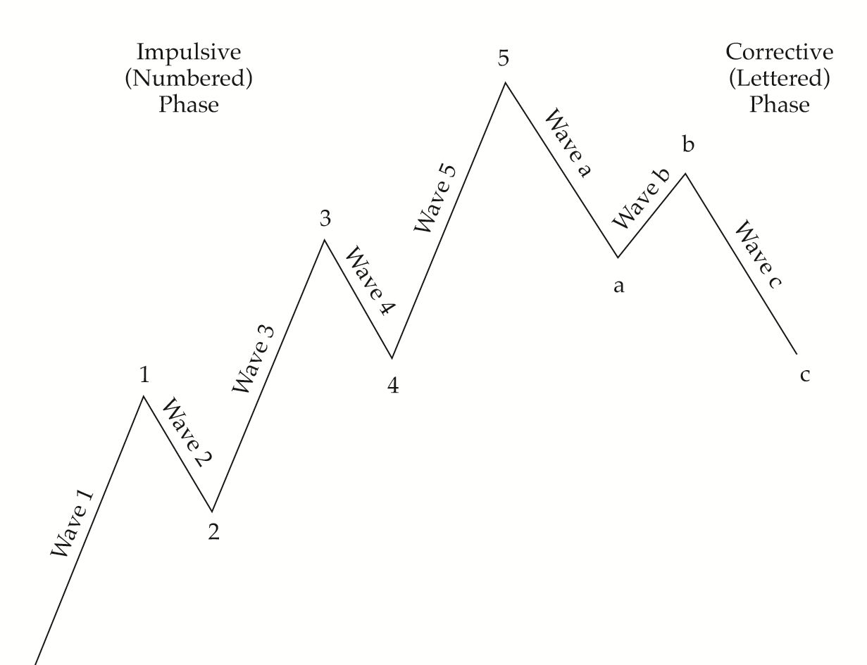
EXHIBIT 12-34 Impulse Waves and Corrective Waves
Notes:
LOS: Discuss the key tenets of Elliott Wave Theory and the importance of Fibonacci numbers.
Pages 565-566
Elliott numbered impulse waves 1–5 and corrective waves a, b, and c. Exhibit 12-34 depicts the impulse and corrective waves in a bull market. Note the following shown in Exhibit 12-34:
• Wave 1 starts as a basing pattern and displays an increase in price, volume, and breadth. Wave 1 consists of five smaller waves.
• Wave 2 moves down, retracing much of the gain in Wave 1 but not all of it. Common percentage retracements are Fibonacci ratios, such as 50% or 62%. Wave 2 never erases all of the gains from Wave 1. Wave 2 consists of three smaller waves.
• Wave 3 moves above the high of the first wave and has strong breadth, volume, and price movement. Most of the price movement in an uptrend typically occurs in Wave 3. Wave 3 consists of five smaller waves. Wave 3 often moves prices 1.68 times higher than the length of Wave 1, which is a Fibonacci ratio.
• Wave 4 is, again, a correction, and the ratio of the change in price during this wave to the price change during the third wave is also generally a Fibonacci ratio. Wave 4 commonly reverses 38% of the gain in Wave 3. Wave 5 is also an up wave. Generally, the price movement in Wave 5 is not as great as that in Wave 3. The exception to the rule is that Wave 5 may become extended, as when euphoria overtakes the market. Wave 5 consists of five smaller waves.
After Wave 5 is completed, the market traces out a series of three corrective waves, labeled a, b, and c in Exhibit 12-34.
• Wave a is a down wave in a bull market; Wave a itself breaks down into three waves.
• Wave b is an upward movement and breaks down into five waves. Wave b is a false rally and is often called a “bull trap.”
• Wave c is the final corrective wave. In a bull market, it does not move below the start of the prior Wave 1 pattern. Wave c breaks down into three subwaves.
This description of the waves applies to bull markets; in bear markets, the impulse waves are labeled A through E and the corrective waves are labeled 1, 2, and 3. Waves in the direction of the trend consist of five subwaves, and counterwaves consist of three subwaves.

Slide 34
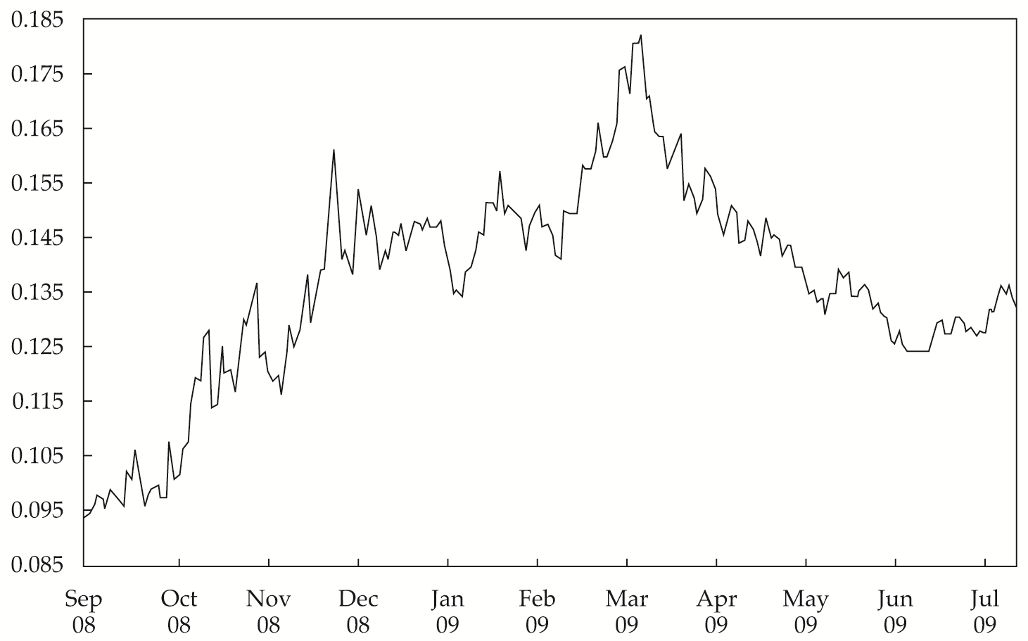
Intermarket Analysis
Inflection points in one market
May be a warning sign of a change in trend in another market
EXHIBIT 12-35 Relative Strength of 10-Year T-Bonds vs. S&P 500, September 2008–July 2009
Notes:
LOS: Describe intermarket analysis as it relates to technical analysis and asset allocation.
Pages 566-567
Intermarket analysis is a field within technical analysis that combines analysis of major categories of securities—namely, equities, bonds, currencies, and commodities—to identify market trends and possible inflections in a trend. Intermarket analysis also looks at industry subsectors, such as the nine sectors the S&P 500 is divided into, and the relationships among the major stock markets of countries with the largest economies, such as the New York, London, and Tokyo stock exchanges.
In intermarket analysis, technicians often look for inflection points in one market as a warning sign to start looking for a change in trend in a related market. To identify these intermarket relationships, a commonly used tool is relative strength analysis, which charts the price of one security divided by the price of another.
Exhibit 12-35 shows the relative price of 10-year U.S. Treasury bonds compared with the S&P 500. The rise in T-bond price relative to the S&P 500 can be clearly seen. The inflection point in this chart occurs in March 2009. This point would signal that the time had come to move investments from bonds to stocks.

Slide 35
Summary
Principles, applications, and assumptions of technical analysis
Construction and interpretation of charts
Trend, support, and resistance lines, and change in polarity
Common technical analysis patterns, indicators, and cycles
Elliott Wave Theory
Intermarket analysis

