Slide 1
Exchange programme 2019-20

Slide 2
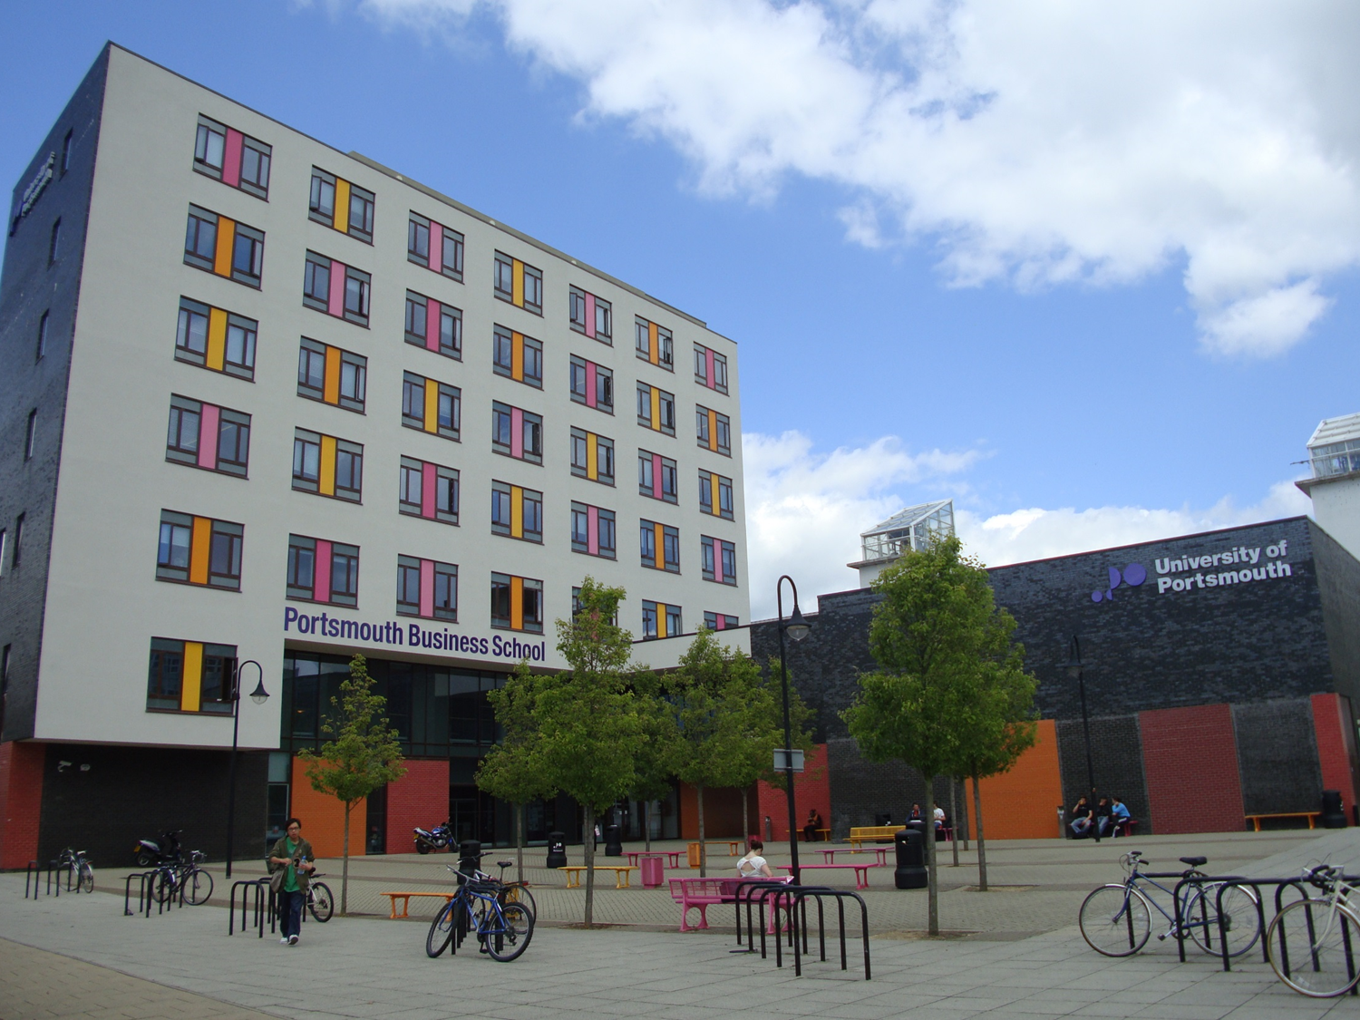
Proud to be Portsmouth
2
TOP 150
NO.1
in the UK
Boosting Graduate
Salaries
The Economist 2017
YOUNG UNIVERSITIES Times Higher Education Young University Rankings 2018
97.5%
Of graduates working
or in further study
Destinations of Leavers from
Higher Education Survey 2018
FIVE STAR
RATING
For Teaching, Employability,
Internationalisation, Facilities
and Innovation
QS Top Universities 2018
TOP 20
Uni in the UK
Student Satisfaction
National Student Survey 2018
TOP 25
Uni in the UK
The Guardian 2019

Slide 3
1. The University
5. Support
2. The City
6. Experiences
3. Faculty of Business and Law
7. Accommodation
4. Learning at BAL
8. Contact us

Slide 4
Portsmouth
4
70 miles from London
Seafront location on the south coast of England
City Centre campus
Good transport links to UK and Europe

Slide 5
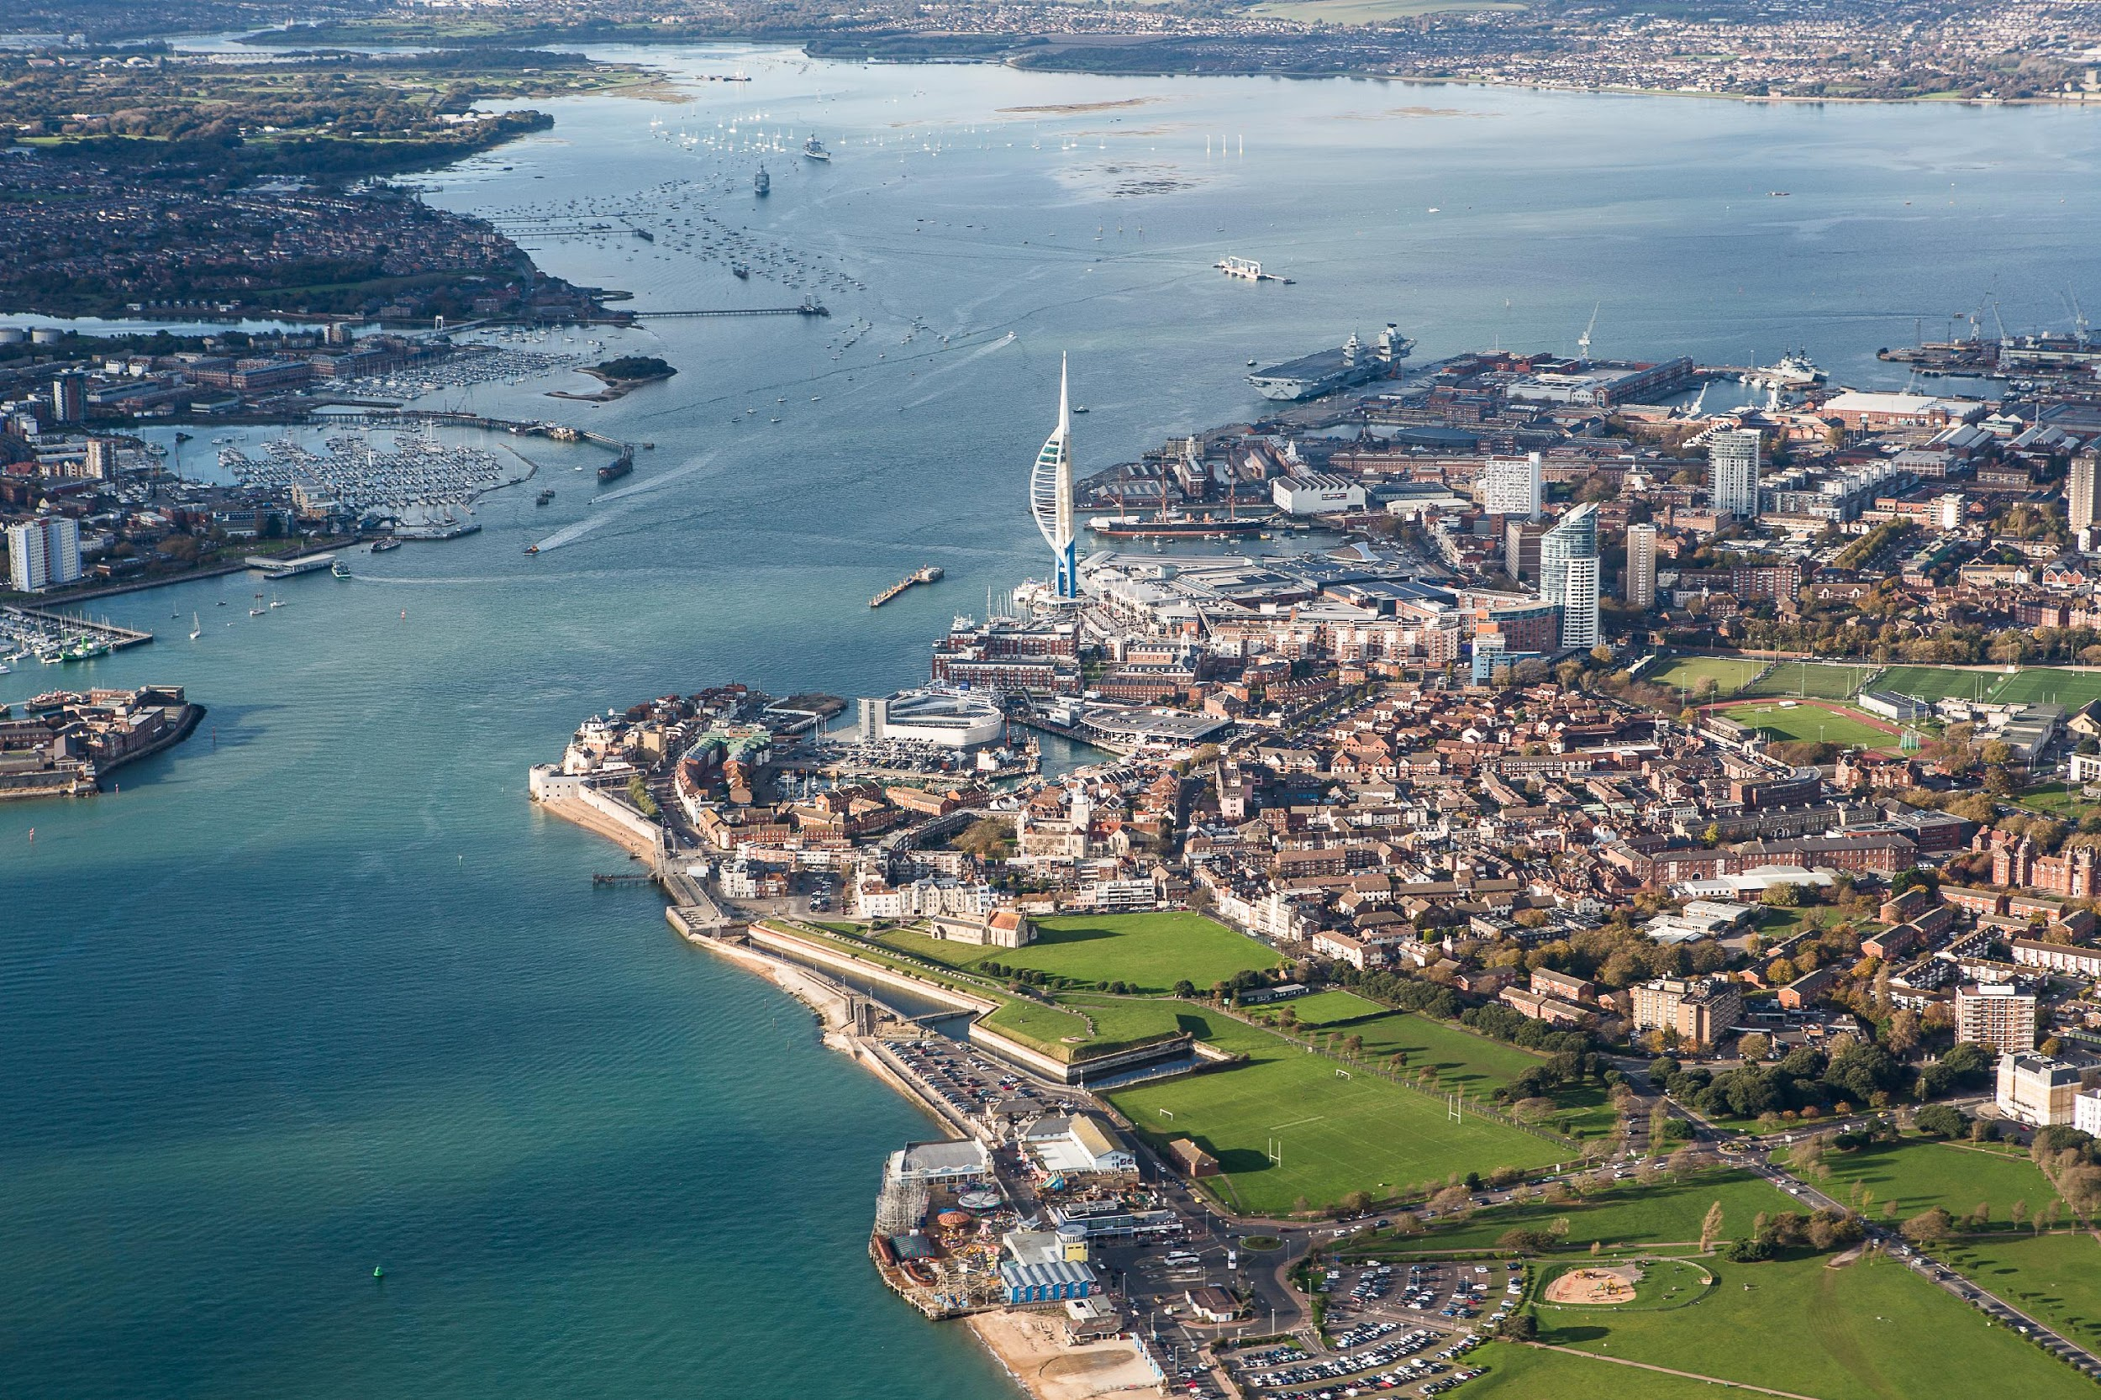

Slide 6
Faculty of Business and Law
Over 5,100 students, 240 academic faculty and 80 administrative staff
Areas of expertise
Accounting
Economics
Enterprise and Innovation
Finance
Human Resource Management
Law
Leadership
Marketing and Sales
Operations and Logistics
Organisational Studies
Strategy
Systems Management
Contact bal-exchange@port.ac.uk for a list of exchange/study abroad modules

Slide 7
BAL credentials
EPAS Accreditation awarded for six of our undergraduate business programmes and MSc Business and Management
Chartered Institute of Personnel and Development (CIPD) Approved Centre for over 30 years
Recognition by most major UK professional bodies

Slide 8
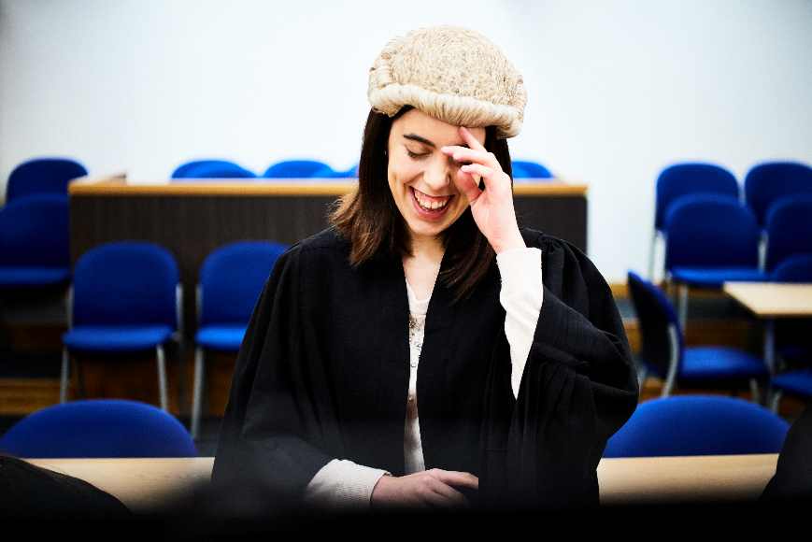
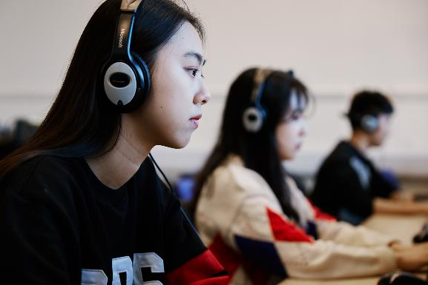
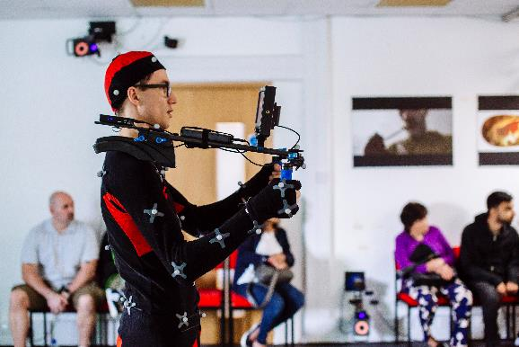
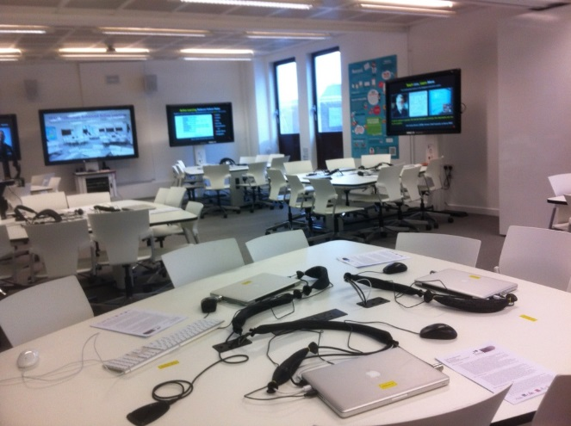
Mock Courtroom
Language Lab
Motion capture Suite
Learning
TEAL (Technology Advance Active Learning) Studio
Bloomberg Suite

Slide 9
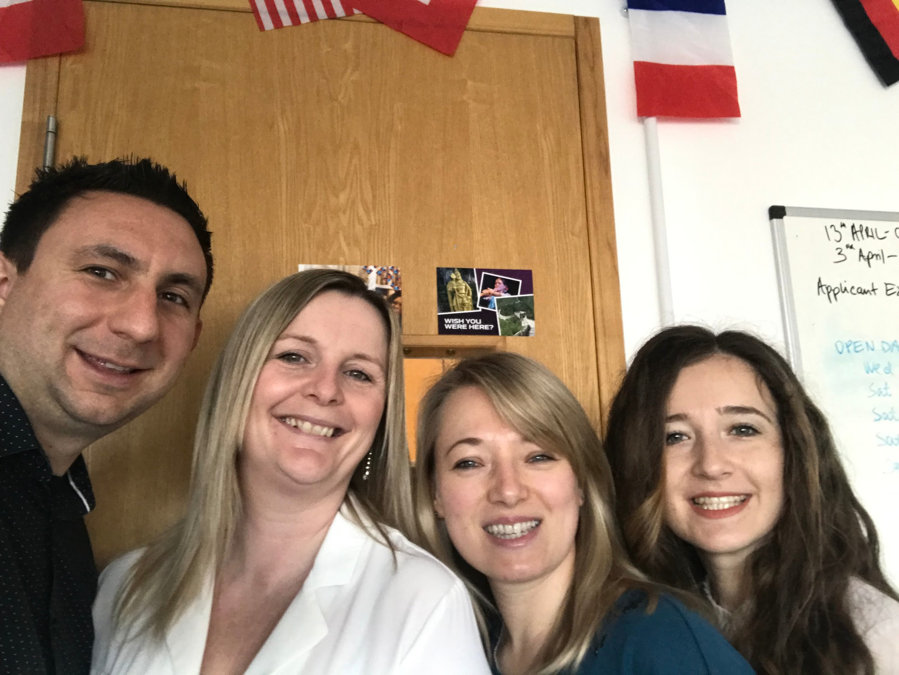
BAL Global Support Office
Dedicated Team within BAL supports exchange students and exchange partnerships
From left to right:
Alex Cade – Global Support Officer
Mel Lang – Senior Global Support Officer
Monika Kraska – Team Leader (Global Engagement)
Sherry Choban – Global Support Officer

Slide 10
International Student Support
Airport pick-up from London Heathrow
Places in university halls of residence
International orientation programme
Ongoing support from International Student Advisers
Mix and Match social networking group

Slide 11
Student Support within BAL
Personal Tutoring
Dedicated Incoming Exchange Students Coordinator
One-to-one, academic & pastoral support
Study Support
In class, drop-in, online and study skills sessions
Academic writing, presentations, time management, exam preparation
Technical Support
Drop-in support for software, business simulations and printing
Student Engagement Officers
Welfare and well-being
English for Academic Purposes
In-sessional English language tuition and support

Slide 12
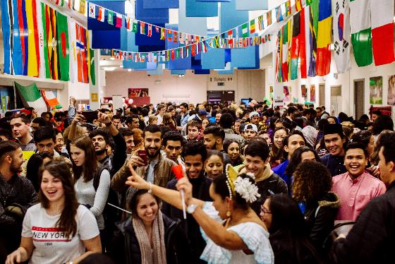
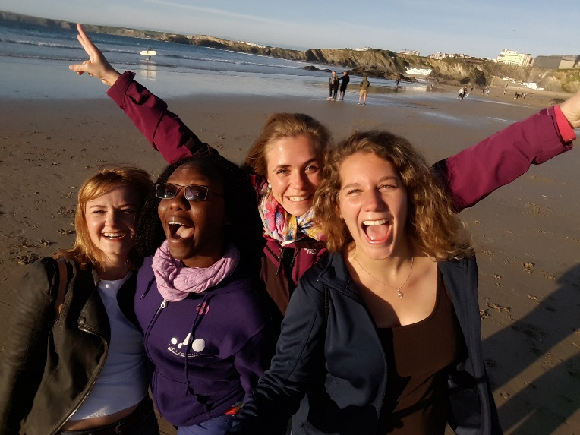
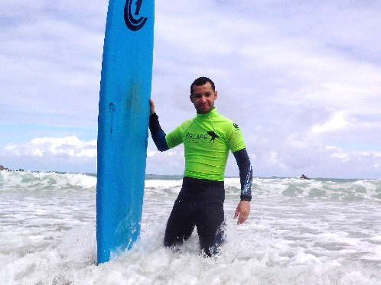
Social Events

Slide 13
STUDENTS’ UNION
150 sports clubs and societies for all interests
Anime
Art and Design
Breakdancing
Cuban Salsa
Football
Gaming
Gospel Choir
Greek and Cypriot
Islamic
Judo
Kenyan
Malaysian
Music
Nigerian
Photography
Rowing
Sky Diving
Water Pro
And many others!

Slide 14
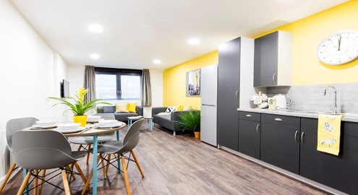
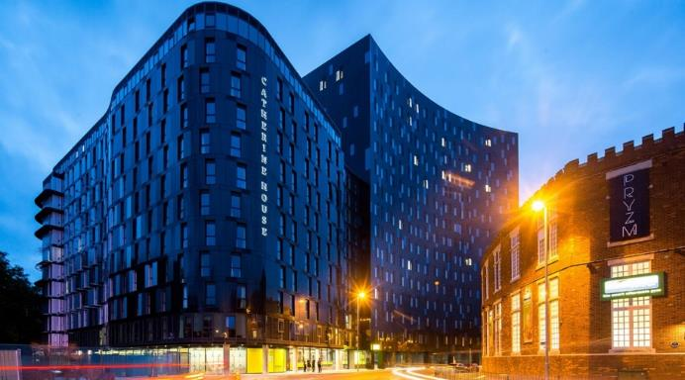
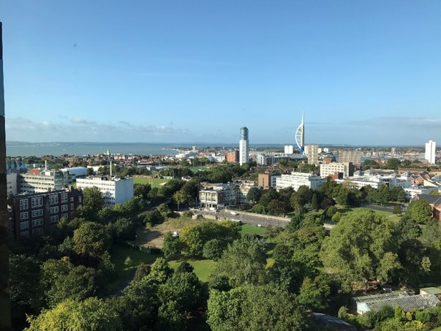
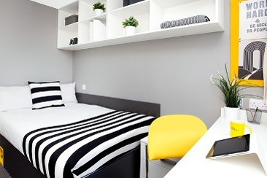
Accommodation
Guaranteed room in halls of residence for first year of study*
Halls within walking distance of main University buildings
Prices range from £95 to £168 per week
Private accommodation also available
*when you make us your firm choice and meet any accommodation deadlines

Slide 15
Locations
15
Rees Hall
Located near the seafront within a 10-15 minute walk of University buildings
Guildhall Halls
Located in the city centre within a 3-5 minute walk of University buildings
Bateson Hall
Harry Law Hall
Margaret Rule Hall
Catherine House
Trafalgar Hall
James Watson Hall
Greetham Street Hall

Slide 16
Contact Us
port.ac.uk/bal
@BAL_INTL
@uopglobal
@uniofportsmouth
myworldinportsmouth.com
Bal-exchange@port.ac.uk
#balglobal

Slide 17
Please Click on this link for more info:
https://docs.google.com/presentation/d/1XiddXCuhLlYdcckELmwSOVorQMmBybTnPy_6mU1rL4I/edit?usp=sharing
Tips by current Erasmus student Muhammad Usman from BAE Tor Vergata at University of Portsmouth.
Accommodation Search
Units Selections
Travelling Arrangements
Language support
Study support
Do’s and Don’ts
Contact me:
00393512719241
usmanarshad158@gmail.com

