Slide 1

Organizational Choices in Family Business
Prof. Giulia Flamini

Slide 2
Women in family business
Lecture 5

Slide 3
Agenda
• Women in family business
• Glass ceiling
• Women’s involvement in family firms

Slide 4
Women’s Involvement in Family
We define Women’s Involvement in Family Firms as any act or process whereby women take part in the life of a family firm
A growing number of women are entering family business today
A strong belief exists that these women con-front difficulty in family business just because they are women
Women in family enterprises are more readily constrained by traditional female roles than women who do not work with their families
Female offspring do not receive the same encouragement, opportunity, and education as male off-spring. This double standard prevents women from moving toward an executive or ownership position in the business
Women in family business are a microcosm of society: problems facing females working with family members reflect the same gender issues confronting other women in their business and family lives

Slide 5
Role conflicts
Along with the advantages of women working in the family business come the disadvantages
“Role” or “role conflict” or “role carryover”, or “role confusion”: refer to the two incompatible roles (business and family) contained in family business relationships. Many believe that women are particularly vulnerable to so-called role conflict, because they struggle with the expected family role versus the expected business role. Women’s roles within networks are influenced by traditional expectations of women’s family and work responsibilities”: Women are expected to be always available to listen and respond but have no legitimate authority to question or to challenge; women receive rewards for service not for independent action; women are expected to be nurturing, noncritical, and accepting of others.
Roles as conflictual for women who choose to work in the family firm; they experience double messages from their families. : “Dedicate yourself fully to the business, but give the family children”; “Be independent and autonomous and behave like a businessman, but be dependent, take care of the family, and behave like a mother”
The no-win choice for a female in business is between accepting a more traditional role and attempting a self-promotional attitude to bring vitality and respect to her business role. If she chooses the traditional role to maintain harmonious relations with family members, she sacrifices her career objectives

Slide 6
Rules
As more women become involved in family business, they challenge one of the most sacred family business rules: “primogeniture” or the transfer of leadership from father to the first-born son
As more managerial women enter family businesses, the primogeniture rule less automatic than in the past
Daughters, more than younger sons, face complex challenges by skeptical parents and siblings
Fathers put up the most significant hurdles, as they place more pressure on daughters succeeding to power than on sons
daughters are usually passed over as potential successors unless they are forced into leadership through a crisis

Slide 7
Psychological Characteristics
Role and rule conflict develop from the expected behavior of women
Females offer unique contributions, especially in management, to their family businesses
Women in family business exhibit loyalty to the business, concern for family members, and a sensitivity to the needs of others. These attributes, make women proficient at “peacekeeping” or solving problems and conflicts among family members.
BUT
Women in family business hold back on their business capabilities because of uncertainty of how they, as females, should behave
Women’s feelings of esteem and self-worth become confused over how they want to act and how they think they should act in a family business
Women repress any attempts to become as successful as their male counterparts, because accomplished businesswomen are viewed as too masculine and aggressive
The lack of separation and individuation for females’ inability to affirm business roles. The result is that women in family business, remain entrapped in rigid, “family” roles unless they separate and individuate from their families.
Women, by nature, may expect more “collaboration, cooperation, and interaction”

Slide 8
Invisibility and Visibility
Many women feel invisible in the family business because they are not viewed by others, whether within or outside the business, in the same way as male members
This happens frequently with female partners in husband-and-wife businesses.
The assumption by the outside world is that women hold important positions because they are married to the boss. Even when their credentials are equal or better than their husbands’, these women find other business people by passing them and looking to their spouses for final decisions.
women’s invisibility in family companies on two factors working together simultaneously: One is the continuing stereotyping and discrimination that are the result of prejudices in society and are reflected and expressed within the family business system. The second factor is women’s own limiting attitudes toward their potential and roles, attitudes derived largely from the way they have been socialized

Slide 9
the glass ceiling
The term ‘glass ceiling’ refers to situations where the advancement of a qualified person within the hierarchy of an organization is stopped at a lower level. Usually, this situation refers to some form of discrimination, most commonly sexism or racism. Evidence suggests that women are typically confronted by the ‘glass ceiling’. Glass ceiling is an invisible barrier preventing their rise into leadership positions in enterprises
Family businesses should be more favorable contexts for removing the glass ceiling for women belonging to the owner family
The family can give a woman financial resources, consolidated relationships based on trust, knowledge and socialization into the entrepreneurial culture. At the same time, it could be also a context of constraint and economic exploitation
Family firms are characterized by women’s tendency to be in charge of operating and supporting roles, instead of managerial ones, as a consequence of patriarchy.
In family firms, women’s invisibility refers to the fact that women’s professional capabilities are generally not valued, as a result of both the discrimination, resulting from the diffused social bias against the female
Gender and the socialization process followed by women belonging to the family, which generally do not attend economics and business schools and do not make previous experience outside the family firm. This may make it difficult for women to develop the necessary attitudes for coping with managerial and governance roles.
Family firm structures and mechanisms could be in place to help women to cope with the conflict between work and family roles

Slide 10
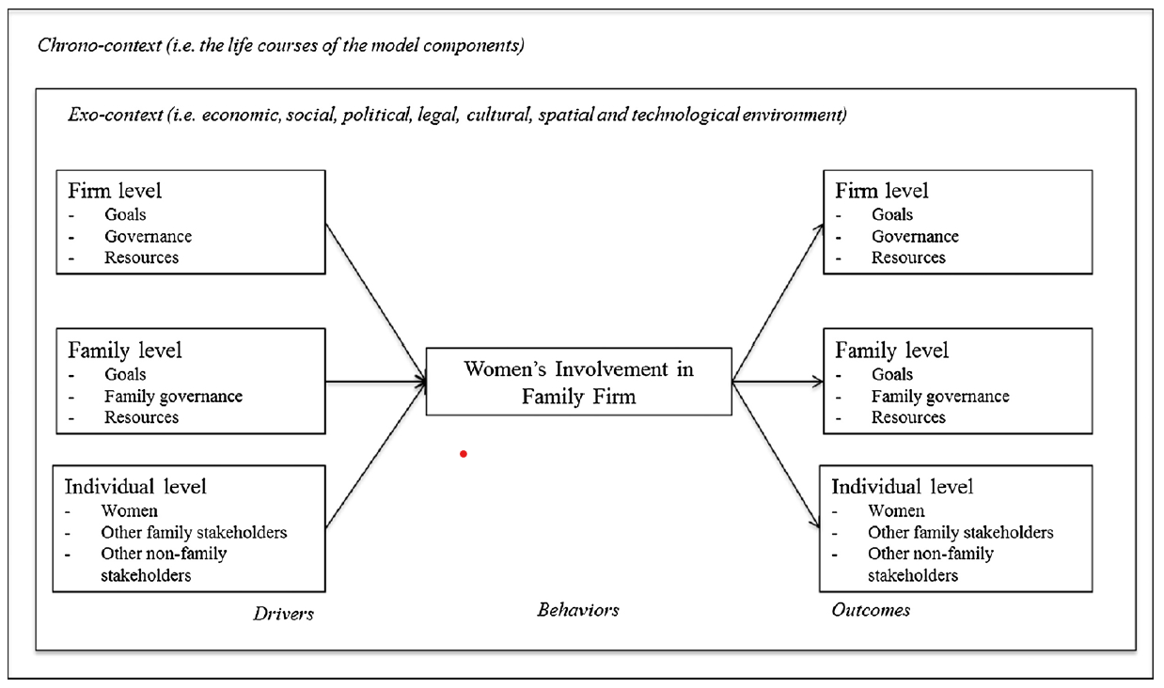
women’s involvement in family firms
women’s involvement in family firms as a behavior influenced by some specific drivers and able to produce outcomes
Driver: any factor that has an impact on
women’s involvement in family firms
Outcome: is any effect
engendered by women’s involvement in family firms

Slide 11
A classification of the four types of women’s involvement in family firms

Slide 12
Women’s entrepreneurial entry in family firms
No drivers emerge at the firm level
Drivers of women’s entrepreneurial entry in family firms: the main drivers of women’s entrepreneurial entry in family business at the family level are spousal support, family tradition, and culture
Individual level: Women’s personal characteristics (entrepreneurial imagination, empathy, modularity, and self-organization) and education level, previous entrepreneurial experience, and alertness, (i.e. the ability of women to identify opportunities and exploit the resources)act as drivers of women’s entrepreneurial entry in family business
An important driver that may hinder women’s entrepreneurial entry in family firms is the so-called “women invisibility” within the organization, i.e. lack of recognition of their critical role in the business: some women may think that launching a family business is not worthwhile if they believe that their role would not be recognized
An additional driver affecting women’s entrepreneurial entry in family business is the gender of the parent who is self-employed, as only when the father is self-employed does the likelihood of the daughter becoming an entrepreneur increase

Slide 13
Outcomes of women’s entrepreneurial entry in family firms
Relatively few outcomes have emerged
At the firm level, the performance of female-controlled family firms is positively affected by the female entrepreneur’s age and her ability to obtain family support, a relevant condition for coping with personal and business problems. Looking at strategic choices, women tend to prefer starting family businesses in more familiar fields. family firms owned by women usually focus on one industry. Women leaders in copreneurial ventures appear to be oriented towards growth rather than meeting their living standards, at least in high-tech industries
At family level the outcomes include marriage success (i.e. EQUITY), as this strongly depends on women's work-life balance. Equality between copreneurs, asserting that the skills, responsibilities, and roles of the female and male partners are often complementary and thus create value not only for the business but also for the family

Slide 14
Women’s succession in family firms
At the family level, the main drivers of women’s succession is related to family composition: intra-family successions are significantly more likely to occur when the predecessor has a son, although female family successors seem to be equipped with significantly higher levels of human capital. Consistently, the father's preference for male family members as successors is an additional factor that may inhibit female succession. Conversely, some drivers support the relationship between fathers and daughters, such as early socialization in the family business, better communication, and the quality of the relationship between incumbent and successor. Father-daughter relationships are generally not as competitive as father-son relationships, thus building a good relationship with fathers/husbands should be easier for daughters compared to sons
At the individual level, personality traits play a relevant role in female succession: the more the daughter is agreeable, i.e. caring, altruistic, and trusting, the more she would prefer a job outside the family business.
women’s perception of gender inequality affects the way female leaders prioritize familial rather than industrial engagement, and may lead to less legitimacy with respect to males in the eyes of relatives and firm stakeholders. Last, women’s rivalry with non-family employees could also negatively affect father-daughter succession, since employees may feel threatened by the daughter’s role as “second-in-command”. Something similar may occur with mothers, who feel threatened by the daughter’s role as the father’s confidant (Dumas, 1992).
is that it is more difficult for a female CEO than a male CEO to choose the only son/daughter-in-law as successor when he/she is not ambitious, assertive and competent: when a daughter-in-law becomes the successor, it is usually because she has outstanding skills

Slide 15
Women’s management styles and approaches to leadership
female entrepreneurs usually establish their firms in the service industry and run small firms, with lower levels of profitability
Mutual empowerment, collaboration, information sharing, empathy and nurturing characterize management styles in female-owned firms
These characteristics are typical of the so-called holistic manager.
However, research seldom investigated the distinctive characteristics of firms owned and managed by women

Slide 16
Women’s management styles and approaches to leadership
The family firm context is friendly, allowing women to exploit their potential
family firms give women opportunities to build flexible schedules in order to combine their professional responsibilities with the household ones, creating a supportive context and more chance of accessing positions of responsibility, professional challenge, and opportunities for personal growth.
Family relationships nurture a fruitful training ground for women for their interactions with customers, suppliers, and employees.
Family firm is an ideal environment for preparing women for leadership, as they have a natural mentor, their father or mother
However, the literature and empirical evidence revealed that women’s presence in ownership does not ensure a significant influence on a firm’s decision-making processes.

Slide 17
Outcomes of women’s presence in family firms
Several possible outcomes of women’s presence in family firms are found
At the firm level, some scholars find that women’s presence on boards seems to have a negative impact on family firm performance, since women are more risk-averse — a key performance driver . Moreover, in case of divorce, the financial performance of small family firms may decrease substantially.
Conversely, find that female-led companies perform significantly better at high levels of female directorship (i.e. percentage of female directors), especially when female directors do not belong to the family.
women managers know how to handle conflict between socioemotional and financial goals better than men, thus improving firm performance

