Slide 1
Class 7 Learning
Learning, Self-Management and Other Competencies (Chapter 12)

Slide 2
Content
Traits, Competencies and Abilities
Are entrepreneurs born, or are they made?
Entrepreneurial behavior can be developed
8 abilities successful entrepreneurs have in common;
Entrepreneurs, through the creation of new activities, promote the development of the economy;
Failures
Failure Experiences of Entrepreneurs;
Four categories of business failure
How Many Business Survive?
Top 6 Reasons New Businesses Fail…Cont’d
Top Reasons New Businesses Fail…
Why business fail? Seniority of firms!
Failing - A cultural issue
Entrepreneurial Learning - Failures may lead to the development of entrepreneurial knowledge
Entrepreneurial Learning
Entrepreneurial Classroom
Action Learning ( AL)
Theories of Learning – Conceptual Conditioning
Theories of Learning – Classical Conditioning
Theories of Learning – Operant Conditioning
Theories of Learning – Social Learning
Corridor Principle
Managerial and Professional Learning

Slide 3
TRAITS , COMPETENCIES and ABILITIES
Are entrepreneurs born, or are they made?

Slide 4
Are entrepreneurs born, or are they made?
Entrepreneurial Traits
Certain characteristics are common of successful entrepreneurs, including
Risk Taking or even better - Risk Acceptance
Achievement Orientation, and
Creativity and Innovation.
Notes:
Leishman,C (2015) All successful entrepreneurs have these competencies. Available at : https://resources.hrsg.ca/blog/all-successful-entrepreneurs-have-these-competencies

Slide 5
Traits are “component of a person's behavior that is assumed to serve as an explanation of his or her enduring personal characteristics”
1. Passion
This is the most significant characteristic that every entrepreneur has, and for obvious reasons. They are successful because they love what they do. These entrepreneurs put all the extra hours they have into the business to make it successful and flourish. It is a pleasure for them to see the results of their labor, which goes well beyond the money received.
2. Strong work ethic
Entrepreneurs who are successful make sure that they are always the one who is first to the office and the last one to leave.
These people are those who ensure that they come to the office during their off days, if needed, just to ensure that the outcomes meet their expectations. The successful entrepreneurs are those who always have their mind in their work!
. 3. Strong people skills – To be discussed
A successful entrepreneur is someone who has excellent communication skills for selling the products to customers and motivating the employees. Yes, most entrepreneurs who have the power to motivate their employees can see their business grow within no time.
4. Determination
The successful entrepreneurs are never greatly impacted by the defeats they encounter. For them, failure is like an opening for a success story, and hence, they try again and again.
5. Creativity
One of the main aspects of creativity is the ability to find a relationship between two unrelated situations or events. They usually come up with the solutions of these problems that are a combination of other things.
Notes:
https://medium.com/swlh/10-must-have-traits-of-a-successful-entrepreneur-d46519452b0e

Slide 6
Traits…Cont’d
. Competitiveness
The number of companies formed are increasing every month and every year, as every entrepreneur feels that they can do a much better job than others. They run with the aim that they need to win at the sport they play and win the business that they are creating or have created. It is an entrepreneur that highlights the track record of success of their company.
7. Self Starter
Every successful entrepreneur knows that if something has to be done, it needs to be done by themselves. Parameters are set by them, and they ensure that the projects are following that path. They do not wait for someone to permit them and are highly proactive
8. Open Minded
For those entrepreneurs that are successful or are following others who have been successful, understand that each situation and event is a business opportunity. There are new ideas that continually come out regarding new potential businesses, people skills, efficiency, and workflows. These people have the capability to see all that is around them and direct the focus towards their objectives and goals.
9. Confidence
A successful entrepreneur never asks the question or keeps doubts in their mind about if they can succeed or if they are even worthy of success. They are normally confident enough that their knowledge and their know-how will help them make their business idea a success. And they radiate this confidence in everything that they do for the business.
10. Disciplined
Successful entrepreneurs always focus their energy on making the business work, and for eliminating the distractions or obstacles to their goals. Their overarching strategies help them to reach the goals they have while they outline the plan to achieve the final outcome. Moreover, entrepreneurs become successful as they are disciplined to always make new steps every day towards the accomplishment of their goals.
Other than these traits, every successful entrepreneur just wants to see what is at the top of the business mountain and they will pick up everything they get on the path while on their way up. But that is not where their determination ends.
As soon as they see it, they want to move ahead and see more. One of the most important things about successful entrepreneurs is that they know exactly how to talk to their employees. These are all the reasons why their business soars.

Slide 7
1) Ability 2) Skills 3) Competencies
Ability is possession of the means or skill to do something.
Ability is the power or aptitude to perform physical or mental activities that are often affiliated with a particular profession or trade such as computer programming, plumbing, calculus, and so forth. Although organizations may be adept at measuring results, skills and knowledge regarding one's performance, they are often negligent in recognizing employees' abilities or aptitudes, especially those outside of the traditional job design.
Skill can be understand as knowledge or expertise or potential ability to do something well; (1)
A skill is a developed proficiency or agility in mental operations or physical processes that is often acquired through specialized training; the execution of these skills results in successful performance

Slide 8
1) Ability 2) Skills 3)Competencies…Cont’d
Competency: The combination of observable and measurable knowledge, skills, abilities and personal attributes that contribute to enhanced employee performance and ultimately result in organizational success. To understand competencies, it is important to define the various components of competencies.
Competency - the ability to do something successfully or efficiently.
Skill or Knowledge is the cognizance of facts, truths and principles gained from formal training and/or experience. Application and sharing of one's knowledge base is critical to individual and organizational success.

Slide 9
Entrepreneurial behavior can be developed through competencies, for instance…
Hackathon https://www.youtube.com/watch?v=qj4DQfYx2Hg
Through practice, aspiring entrepreneurs can apply key business knowledge using their competencies to gain essential habits. With enough practice, these habits become the ‘driving force’ of successful entrepreneurial ventures.
Creativity and Innovation - The entrepreneur expresses a willingness to do things differently. He is able to create new ideas, solutions, and approaches to ongoing challenges.
Fostering Learning and Development - Entrepreneurs with this competency share their knowledge and expertise to support learning and development.
Business Perspective -Entrepreneurs are able to articulate how their own responsibilities, activities, and decisions relate to the success of the business.
Using Information Technology - Entrepreneurs must be competent in the use of basic computer hardware and software (e.g. spreadsheets, word processing and on line marketing)
Notes:
Leishman,C (2015) All successful entrepreneurs have these competencies. Available at : https://resources.hrsg.ca/blog/all-successful-entrepreneurs-have-these-competencies

Slide 10
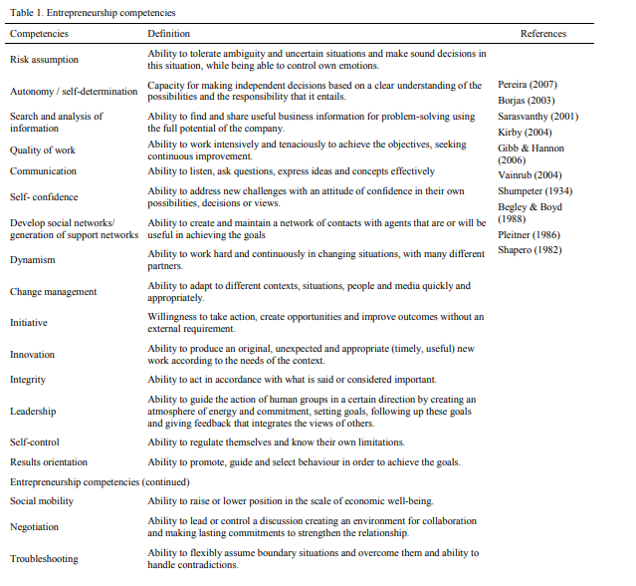

Notes:
Roblesa.L ,Zárraga-Rodrígueza,M(2015) *Key competencies for Entrepreneurship. 2nd GLOBAL CONFERENCE on BUSINESS, ECONOMICS, MANAGEMENT and TOURISM, 30-31 October 2014, Prague, Czech Republic

Slide 11
Suggestions for Traits and Competencies for successful entrepreneurs ( 1)
Critical Thinking;
Courage;
Edge;
Respect to a professional level ( Without detriment to yourself);
Notes:
(M. Bojadjiev)

Slide 12


“8 abilities successful entrepreneurs have in common!”
1) Resiliency. ... ability to survive the ups and downs
Noble" in connection with boxing was almost certainly used for the first time by the original boxing champion of England, James Figg of Oxfordshire.
To promote his London Boxing Academy, he had business cards made.
These, became the first known form of advertising associated with the sport.
The caption on the cards referred to Figg as "master of the noble science of defense".
Notes:
( 1) resiliency defined as resistant to risk factors https://writingexplained.org/resilience-vs-resiliency-difference
https://www.forbes.com/sites/aileron/2013/11/26/the-top-skills-every-entrepreneur-needs/#3e20f97a76e3

Slide 13
“8 abilities successful entrepreneurs have in common!”
2) Focus. ... After setting a vision, knowing how to focus” on the very next step
3) Sell... They are either selling their ideas, products or services to customers, investors or employees.
Danger of losing focus
Danger of focusing on the effect, not cause;

Slide 14
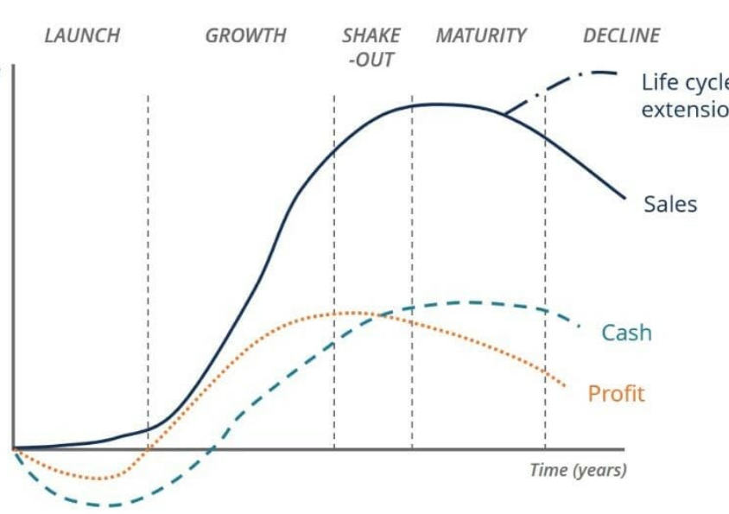
“8 abilities successful entrepreneurs have in common!”
4) Long Term Orientation
What is the Business Life Cycle?
The business life cycle is the progression of a business and its phases over time, and is most commonly divided into five stages: launch, growth, shake-out, maturity, and decline.
4) Invest for the long-term... Mistake is to focus only on what comes next, rather than where the company needs to go. Overnight success may take 7 to 10 years.
Discuss: Does a small company have capacities to focus on the long term?
Your professor believes that is not viable to do anything other than survival strategy!
5) Find and manage people. ...
Entrepreneurs need to learn to network to meet the right people.
How can they motivate?
Notes:
https://corporatefinanceinstitute.com/resources/knowledge/finance/business-life-cycle/

Slide 15
Eight abilities successful entrepreneurs have in common!....Cont’d
6) Learn...
7) Self-reflection…. Find time to reflect on the past and plan for the future. Always working only leads to burnout!
8) Self-reliance: While there is a lot of help for the entrepreneur, in the end, they need to be resourceful enough to depend on themselves.
Learn, Think Grow

Slide 16
Entrepreneurs, through the creation of new activities, promote the development of the economy.
Hence entrepreneurs are strategic resources for organizations and for nations
It is possible to train and develop the entrepreneurial attitude.
Entrepreneurial behavior is the result of a motivation to achieve a goal and the competencies necessary to achieve it.
There are many competencies related with entrepreneurship and these competencies can be acquired and developed through learning. Entrepreneurial competencies affect company performance and it is important to identify the entrepreneur’s competencies so that both organizations and institutions of higher education can work in developing them. This way the quality of entrepreneurship in an economy could be increased.

Slide 17
FAILURE

Slide 18
Failure Experiences of Entrepreneurs:
Failure as ‘deviation from expected and desired result.”
Failure may occur when the entrepreneur underperforms in terms of critical processes or when desired targets are not achieved.
“Failure represents one of the most difficult, complex and yet valuable learning experiences that entrepreneurs will ever have the (miss)fortune to engage in”
Notes:
Atsan,N (2016) Failure Experiences of Entrepreneurs: Causes and Learning Outcomes. 12th International Strategic Management Conference, ISMC 2016, 28-30 October 2016, Antalya, Turkey. Procedia - Social and Behavioral Sciences 235 ( 2016 ) 435 – 442. Available online at www.sciencedirect.com

Slide 19
Platt (1985) offers four categories of business failure in increasing severity:
1. Opportunity losses; minimal earnings
2. Negative profits; losing money
3. Technical insolvency; unable to meet current obligations
4. Bankruptcy
Likewise, the process of failing can involve making "one over­whelming disastrous decision that leads to rapid demise" or making a "series of ill-conceived choices that may result from poor management or from the onset of panic following earlier mistakes" (Platt, 1985, pp. 1-2).

Slide 20
How Many Business Survive?
Small Business Administration Data ( Small Business Administration)
30% of new businesses fail during the first two years of being open,
50% during the first five years and
66% during the first 10.
75% make 15 years
However, not all of these businesses need to fail.
With the right planning, funding and flexibility, businesses have a better chance of succeeding. We'll go through some of the biggest mistakes that start-ups can make and figure out how to improve your chances of success.
Notes:
https://www.investopedia.com/slide-show/top-6-reasons-new-businesses-fail/

Slide 21
Top 6 Reasons New Businesses Fail
Reason #1: Not Investigating the Market – To Be discussed, for instance, was there a market for tablets?
Reason #2 & #5: Poor Business plan – and not having a contingency plan
Reason #3: Too Little Financing – or Too Expensive – Shark Loans
Reason #4: Bad Location, Internet Presence and Marketing – Location + Web
Reason #6: Expanding Too Fast or Too slow
Notes:
https://www.investopedia.com/slide-show/top-6-reasons-new-businesses-fail/

Slide 22
Top Reasons New Businesses Fail…
Other Perspective!
Internal factors:
Managerial incompetence
Poor management
Overconfidence and excessive risk taking tendency
Poor financial planning, spending money on the wrong things.
External factors:
Inadequate economic circumstances
Government policies
Lack of financial resources

Slide 23
Why business fail? Seniority of firms!
The younger firms fail more often due to internal causes, while mature firms fail largely due to external causes.
Immature firms fail due more to their lack of experience or limited resources.
Successful young firms often fail due to a lack of financial resources
Mature firms are more likely to fail due to changes in their environment which their rigid routines are unable to adjust:
Nokia, Black Berry, Chrysler,

Slide 24
Failing - A cultural issue
“Almost anywhere else, a business failure taints a career, hurting relationships and hampering efforts to start a new.
Here, though, perhaps the only dishonor is not to try again. Failed high-tech entrepreneurs write articles for trade magazines, give interviews for books on high-tech history, entertain job offers and establish new ventures of their own.
They ski in Aspen, sunbathe in the South Seas, and when time permits, they read their fan mail.”

Slide 25
Entrepreneurial Learning - Failures may lead to the development of entrepreneurial knowledge as well as founding experiences.
Entrepreneurs’ life and work experiences shape their attitudes towards failure.
Prior entrepreneurial experience as well as experience closing down a business are associated with more positive attitudes toward failure.
Learning is emphasized as a process and recovery and re-emergence from failure is seen as a function of distinctive higher level learning processes that allow entrepreneurs to learn about themselves and entrepreneurship.
The two learning outcomes are: learning how to recognize opportunities and learning how to overcome traditional obstacles when organizing and managing new ventures, i.e., the exploitation of opportunities.
Notes:
Atsan,N (2016) Failure Experiences of Entrepreneurs: Causes and Learning Outcomes. 12th International Strategic Management Conference, ISMC 2016, 28-30 October 2016, Antalya, Turkey. Procedia - Social and Behavioral Sciences 235 ( 2016 ) 435 – 442. Available online at www.sciencedirect.com

Slide 26
ENTREPRNEURIAL LEARNING

Slide 27
Entrepreneurial Classroom
Entrepreneurs live in a very concrete classroom, their enterprise .
It is filled, ideally, with many moments of success and good judgment, but more important for this discussion it also includes a supply of mistakes, feedback, failures, and other lessons
How entrepreneurs learn – PROCESS
What entrepreneurs learn -CONTENT

Slide 28
Entrepreneurial Classroom Cont’d – Learning from mistakes
Many important lessons about business and life in general seem to come from our experiences rather than from books or lectures.
We seem to learn better from our mistakes than from our progress or success.
We make sense of our experiences (admittedly with considerable psychological bias and rationalization) and we correct our decision making or change our behavior to prevent the same mistake from happening again.
We live by the axiom: "If it isn’t broken, don’t fix it."
Entrepreneurs live in a very concrete classroom, their enterprise .

Slide 29
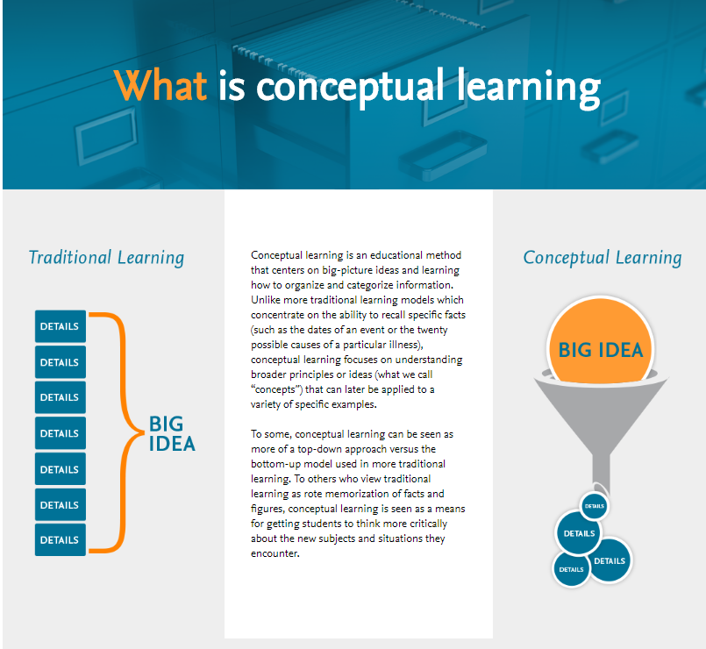
1) Conceptual Learning - Importance
  Conceptual learning is an educational method that centers on big-picture ideas and learning how to organize and categorize information.
  Unlike more traditional learning models which concentrate on the ability to recall specific facts (such as the dates of an event or the twenty possible causes of a particular illness), conceptual learning focuses on understanding broader principles or ideas (what we call “concepts”) that can later be applied to a variety of specific examples.
Notes:
https://evolve.elsevier.com/education/concept-based-curriculum/conceptual-learning-definition/

Slide 30
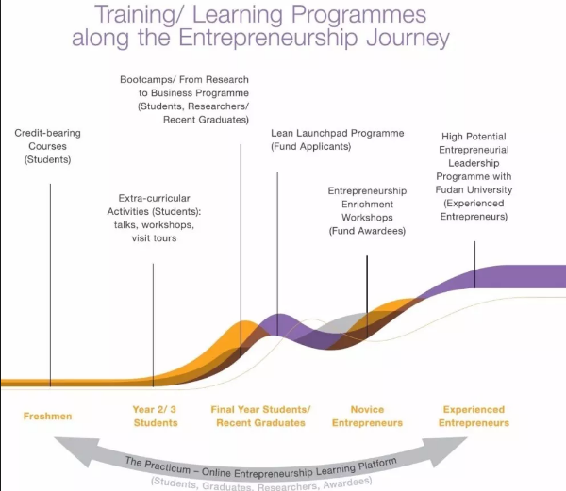
1.1 CONCEPTUAL LEARNING
. On one side is the argument that formal business education, and particularly the MBA, actually turns individuals away from entrepreneurship by reinforcing risk aversion and skills, attitudes,.
On other side is permanent growth of entrepreneurial courses

Slide 31
2. Action Learning ( AL)
AL is a process and program used by a growing number of organizations and individuals around the world to resolve complex problems and challenges as well as develop individual and team skills, knowledge and attitudes .
First developed by Reginald Revans for coalmine workers in Wales and England in the 1940s , AL has since been extensively used in leadership and management development programs across the globe.
It may be loosely described as ‘learning in and through action,’ implying that learners (usually practicing managers) reflect on the action they engage in and its outcomes (Passfield 2002).
Notes:
Janice Byrne et all “Training corporate entrepreneurs: an action learning approach” ( 2016 ), Springer Science+Business Media New York 2016 ( www.ebsco.com)

Slide 32
2.1 Action Learning ( AL) Cont’d
Entrepreneurs are characteristically action-oriented, learning from trial-and-error ( 1)
In the language of adult learning theory, they make many "active experiments" (i.e., accepting risks, acting under uncertainty) thereby generating many "concrete experiences" (e.g., ventures, changes, new relationships)
Miles and Randolph found that early failures result in greater organizational learning and that action learning is a better strategy in new and different settings, as when entering new markets with new products.
Notes:
(Lessem, 1983).

Slide 33
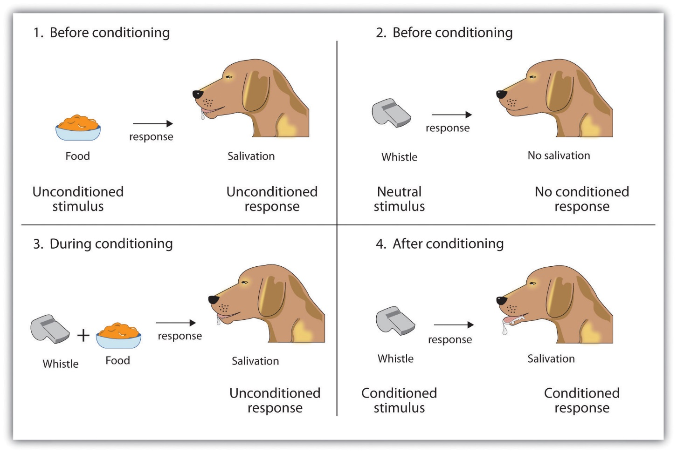
3) Theories of Learning – Classical Conditioning
(Pavlov)
A type of conditioning in which an individual responds to some stimulus that would not ordinarily produce such a response

Slide 34
4) Theories of Learning (cont’d)
Operant Conditioning
The Gothowitz Deviation Operant Conditioning.mp4
A type of conditioning in which desired voluntary behavior leads to a reward or prevents a punishment
Key Concepts
Reflexive (unlearned) behavior
Conditioned (learned) behavior
Reinforcement

Slide 35
4) Operant Conditioning
Shaping Behavior Through Reinforcement
Positive reinforcement
  Providing a reward for a desired behavior ( salary, bonus)
Negative reinforcement
  Removing an unpleasant consequence when the desired behavior occurs
  ( parent take the phone from his kid, but returns if the kids get an A)
Punishment
  Applying an undesirable condition to eliminate an undesirable behavior
  (kid has got an F, so parents take the phone as punishment)
Extinction
  Withholding reinforcement of a behavior to cause its cessation
  (stop paying extra hours)

Slide 36
Theories of Learning Social-Learning Theory
  People can learn through observation and direct experience
Bandura's Social Learning Theory posits that people learn from one another, via observation, imitation, and modeling.
The theory has often been called a bridge between behaviorist and cognitive learning theories because it encompasses attention, memory, and motivation. Jun 19, 2015
NECESSARY CONDITIONS FOR EFFECTIVE MODELING
Attention — various factors increase or decrease the amount of attention paid. Includes distinctiveness, affective valence, prevalence, complexity, functional value. One’s characteristics (e.g. sensory capacities, arousal level, perceptual set, past reinforcement) affect attention.
Retention — remembering what you paid attention to. Includes symbolic coding, mental images, cognitive organization, symbolic rehearsal, motor rehearsal
Reproduction — reproducing the image. Including physical capabilities, and self-observation of reproduction.
Motivation — having a good reason to imitate. Includes motives such as past (i.e. traditional behaviorism), promised (imagined incentives) and vicarious (seeing and recalling the reinforced model)
Notes:
https://www.learning-theories.com/social-learning-theory-bandura.html#concepts

Slide 37
Theories of Learning
Social-Learning Theory Cont’d
KEY CONCEPTS People learn through observing others’ behavior, attitudes, and outcomes of those behaviors^{[1]}.
Vicarious Learning
“Most human behavior is learned observationally through modeling: from observing others, one forms an idea of how new behaviors are performed, and on later occasions this coded information serves as a guide for action.” (Bandura).
Social learning theory explains human behavior in terms of continuous reciprocal interaction between
1) cognitive,
2) behavioral, and
3) environmental influences.
Notes:
https://www.learning-theories.com/social-learning-theory-bandura.html

Slide 38
The Corridor Principle

Slide 39

The Corridor Principle 1
Imagine you’re looking down a corridor.
It’s long, dark and disappears into the distance.

Slide 40
The Corridor Principle 1……. Cont’d
On the other side of these doors are opportunities.
Opportunities to
1) produce new knowledge about improving habits…
2) Opportunities to gain new insights into your capabilities as an individual
3) Opportunities to improve the actions you’re taking toward your goal
4) Opportunities that we could not have seen and/or could not have pursued had we not taken action earlier
Now imagine another person who has an opportunity to proceed down the same corridor.
She is unwilling to proceed down the corridor of uncertainty until she can be assured that she will be successful—something that will never happen.
The question is obvious: which person do you identify with more?
The takeaway?
The most successful graduates were those who created multiple ventures and lengthened the duration of their entrepreneurial careers by using what Ronstadt calls the “Corridor Principle.”
Notes:
[1] Ronstadt, R. (1988) ‘The Corridor Principle’, Journal of Business Venturing, 3(1), pp. 31-40.
Clear, J (2012) Successful People Start Before They Feel Ready, Available at: http://jamesclear.com/successful-people-start-before-they-feel-ready

Slide 41
The Corridor Principle 2
The Corridor Principle states that the mere act of starting a venture enables entrepreneurs to see other venture opportunities they could neither see nor take advantage of until they had started their initial venture.
Whether studying the entrepreneurial process or planning to start an entrepreneurial career, a long-term view should be taken, one that includes the likely possibility of multiple ventures.
The minimum economic returns of earlier ventures can be lower than previously thought if these ventures provide entry to subsequent ventures that possess higher (more acceptable) returns to the entrepreneur
Notes:
https://www.sciencedirect.com/science/article/abs/pii/0883902688900286

Slide 42
10 Self Management Tips for Successful Entrepreneurs
1. Outsource what you can
2. Focus on one thing at a time
3. Prioritize the time-sensitive issues
4. Schedule high brain tasks in your prime time
5. Get an outside perspective
6. Protect yourself
7. Don’t get stuck
8. Do the jobs that move you forward
9. Rank for productivity
10. Define roles and delegate

Slide 43
References:
Atsan,N (2016) Failure Experiences of Entrepreneurs: Causes and Learning Outcomes. 12th International Strategic Management Conference, ISMC 2016, 28-30 October 2016, Antalya, Turkey. Procedia - Social and Behavioral Sciences 235 ( 2016 ) 435 – 442. Available online at www.sciencedirect.com
Leishman,C (2015) All successful entrepreneurs have these competencies. Available at : https://resources.hrsg.ca/blog/all-successful-entrepreneurs-have-these-competencies
Roblesa.L ,Zárraga-Rodrígueza,M(2015) *Key competencies for Entrepreneuership. 2nd GLOBAL CONFERENCE on BUSINESS, ECONOMICS, MANAGEMENT and TOURISM, 30-31 October 2014, Prague, Czech Republic. Available online at www.sciencedirect.com
[1] Ronstadt, R. (1988) ‘The Corridor Principle’, Journal of Business Venturing, 3(1), pp. 31-40.
Clear, J (2012) Successful People Start Before They Feel Ready, Available at: http://jamesclear.com/successful-people-start-before-they-feel-ready

Slide 44
Learning Outcomes – After studying this chapter you should be able to …
Understand the concepts of “traits” and which traits are expected for entrepreneurs?
Understand the concepts of competencies” and competences that are expected for entrepreneurs?
Understand the common “abilities” of entrepreneurs? Discuss resiliency and at least three other “abilities”
Understand the concept of “failure” and main reasons why business fail.
Understand why business fail, cultural implications of failure and failure as a learning opportunity.
Understand pros and cons of Classroom education, Conceptual education and Action Learning
Understand Classical Conditioning and Social Learning Theories
Understand Operant Conditioning and Reinforcement Theories
Understand the concept of ‘learning opportunities” discuss through the “corridor principle”

