Slide 1

Consumer Choices
Decision Process
Professor Ilijana Petrovska
Visiting professor @ Tor Vergata

Slide 2
Learning Objectives
9.1 The three categories of consumer decision-making are cognitive, habitual, and affective.
9.2 A cognitive purchase decision is the outcome of a series of stages that results in the selection of one product over competing options.
9.3 We often rely on rules-of-thumb to make decisions.
9.4 The way information about a product choice is framed can prime a decision even when the consumer is unaware of this influence.

Slide 3
Learning Objective 9.1
The three categories of consumer decision-making are cognitive, habitual, and affective.
Notes:
The first learning objective in this chapter points out that consumers make decisions in different ways. Some of our decisions are highly rational. Others are made by habit. Still others are made on the basis of emotion.

Slide 4
Problem?
Consumer hyperchoice
  forces us to make repeated decisions that may drain psychological energy while decreasing our abilities to make smart choices.
Constructive processing
  argues that we evaluate the effort we’ll need to make a particular choice and then tailor the amount of cognitive “effort” we expend to get the job done.
Mental budget
  that helps us to estimate what we will consume over time so that we can regulate what we do in the present

Slide 5
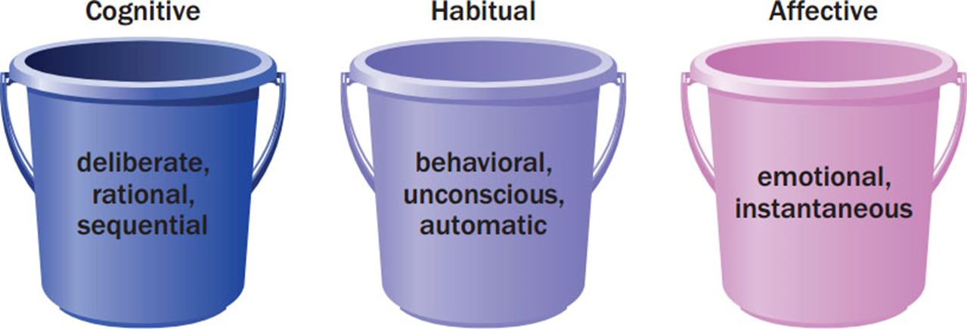
Figure 9.1 Three Types of Decision-Making
Figure 9.1 The Three “Buckets” of Consumer Decision Making
Notes:
This image illustrates the three types of decision-making: cognitive, habitual, and affective.

Slide 6
Self-Regulation
Implementation intentions
  A person’s efforts to change or maintain his or her actions over time (as dieting, living on a budget, training to run a marathon), involve careful planning that is a form of self-regulation.
  These “if-then” plans or implementation intentions may dictate how much weight we give to different kinds of information (emotional or cognitive), a timetable to carry out a decision, or even how we will deal with disruptive influences that might interfere with our plans (like a bossy salesperson who tries to steer us to a different choice).
Counteractive construal
  when they exaggerate the negative aspects of behaviors that will interfere with the ultimate goal.
Notes:
A person’s efforts to change or maintain his or her actions over time, whether these involve dieting, living on a budget, or training to run a marathon, involve careful planning that is a form of self-regulation.
These “if-then” plans or implementation intentions may dictate how much weight we give to different kinds of information (emotional or cognitive), a timetable to carry out a decision, or even how we will deal with disruptive influences that might interfere with our plans (like a bossy salesperson who tries to steer us to a different choice).
Counteractive construal when they exaggerate the negative aspects of behaviors that will interfere with the ultimate goal.
A feedback loop is when we provide people with information about their actions in real time, and then give them a chance to change those actions so that you push them to improve.
“Morning Morality Effect shows that people are more likely to cheat, lie, or even commit fraud in the afternoon than in the morning.
Executive control center that we use for important decision making, including moral judgments, can be worn down or distracted even by simple tasks like memorizing numbers.

Slide 7
Cognitive purchase decision
A cognitive purchase decision is the outcome of a series of stages that results in the selection of one product over competing options.
Traditional perspective - decision-making from an information-processing.
People calmly and carefully integrate as much information as possible:
  what they already know about a product,
  weigh the pluses and minuses of each alternative, and
  arrive at a satisfactory decision.
The economics of information perspective assumes that we collect just as much data as we need to make an informed decision.

Slide 8
Steps in the Decision-Making Process
Problem recognition
Information search
Evaluation of alternatives
Product choice
Notes:
These are the basic four steps in the decision making process. The next several slides provide more details on these steps.
Problem recognition occurs when we experience a significant difference between the current state of affairs and some state we desire. Information search is the process by which we survey the environment for data to make a reasonable decision. In the third stage, the consumer evaluates the alternatives. Then a choice is made. The choice may be from among product choices as well as to buy or not.

Slide 9

Stage 1: Problem Recognition
Occurs when consumer sees difference between current state and ideal state
  Need recognition: Actual state declines
  Opportunity recognition: Ideal state moves upward
Notes:
Problem recognition is the first stage. It can occur when a consumer’s state of being declines (which then triggers a desire to return to normalcy) or when a consumer recognizes an ideal state he or she wishes to achieve.

Slide 10

Stage 2: Information Search
The process by which we survey the environment for appropriate data to make a reasonable decision.
Prepurchase or ongoing search
Internal or external search
Online search and cybermediaries
Notes:
Once we know we have a problem, we search out how we can solve the problem. These searches will typically take place before purchase (prepurchase). However, many people just enjoy searching information and they conduct ongoing searches even if a purchase is not immediately forthcoming. Internal searches are based on our own memory banks while external sources come from other sources. Search engines have made vast amounts of information available to us as we search out product information. We may rely on cybermediaries to help narrow and filter the options that are available. Intelligent agents are sophisticated software programs that use collaborative filtering technologies to learn from past user behavior in order to recommend new purchases.

Slide 11
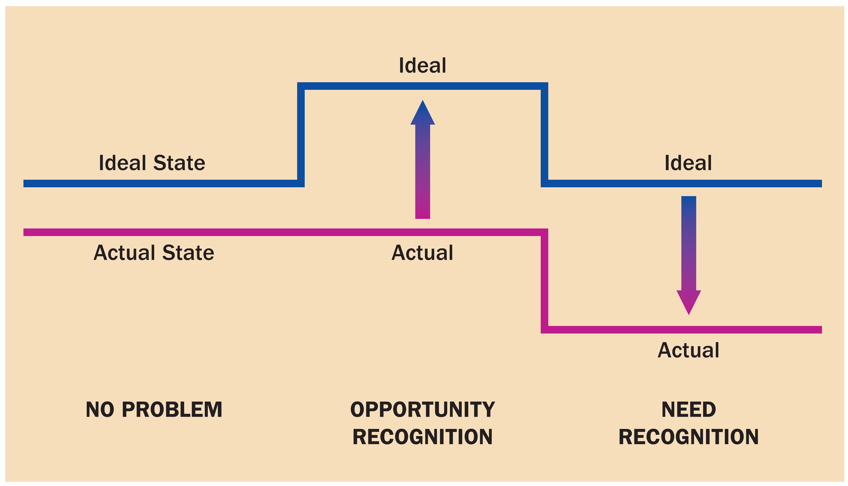
Figure 9.3 Problem Recognition
Figure 9.3 Problem Recognition: Shifts in Actual or Ideal States Does
Notes:
This figure illustrates the two causes of problem recognition. The person experiences a decline in the quality of his actual state or an increase in the desire for his ideal state.

Slide 12
Figure 9.4 Amount of Information Search and Product Knowledge
Figure 9.4 The Relationship Between Amount of Information Search and Product Knowledge
Moderately knowledgeable consumers
Notes:
This figure shows us that there is an inverted-U relationship between knowledge and external search effort. People with very limited expertise may not feel they are competent to search extensively. Experts have a better sense of what information is relevant so they engage in selective search. Novice consumers tend to process information in terms of the big picture instead of detailed information. Who searches the most? Moderately knowledgeable consumers.

Slide 13
Step 3: Evaluate Alternatives
Evoked Set -The alternatives a consumer knows about is the evoked set.
Consideration Set - The ones actually considered make up the consideration set.

Slide 14
For Reflection
Is it a problem that consumers have too many choices?
Would it be better to have less choices?
How does it affect consumer decision-making?
Sunstein C. R. (2014) Why Nudge? The politics of Libertarian Paternalism. Yale University Press
Greenfield K. (2011) The myth of choice. Personal responsibility in a world of limits. Yale University Press

Slide 15
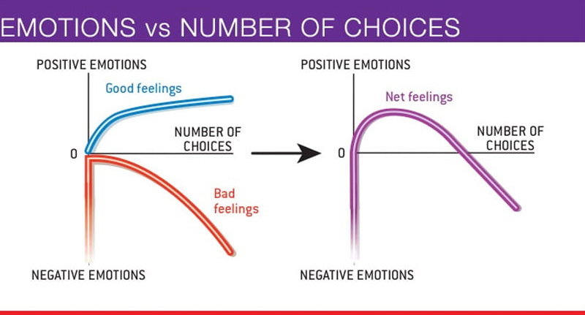
Paradox of Choice
JAM EXPERIMENT
  About 30% of people who tried one of 6 flavors bought the jam afterwards, in the case of the more extensive options it was 10x less – only 3% of people went on to make a purchase.

Slide 16

Exhibit 9.3 - Sales Promotions

Slide 17

Exhibit 9.4 - Using Quality to Encourage Brand Loyalty

Slide 18

Exhibit 9.5 - Price as a
Simplifying Strategy

Slide 19
Evaluative Criteria
Table 9.1 Hypothetical Alternatives for a T V Set
Brand Ratings
Attribute | Importance Ranking | Prime Wave | Precision | Kamashita
Size of screen | 1 | Excellent | Excellent | Excellent
Stereo broadcast capability | 2 | Poor | Excellent | Good
Brand reputation | 3 | Excellent | Excellent | Poor
Onscreen programming | 4 | Excellent | Poor | Poor
Cable-ready capability | 5 | Good | Good | Good
Sleep timer | 6 | Excellent | Poor | Good
Notes:
When evaluating alternatives, consumers may focus on one or two product features while ignoring others. This helps us narrow down our options. Evaluative criteria are the dimensions we use to judge the merits of competing options. Determinant attributes are the features that we actually use to differentiate among our choices. Marketers often educate consumers about which criteria they should use as determinant attributes.

Slide 20
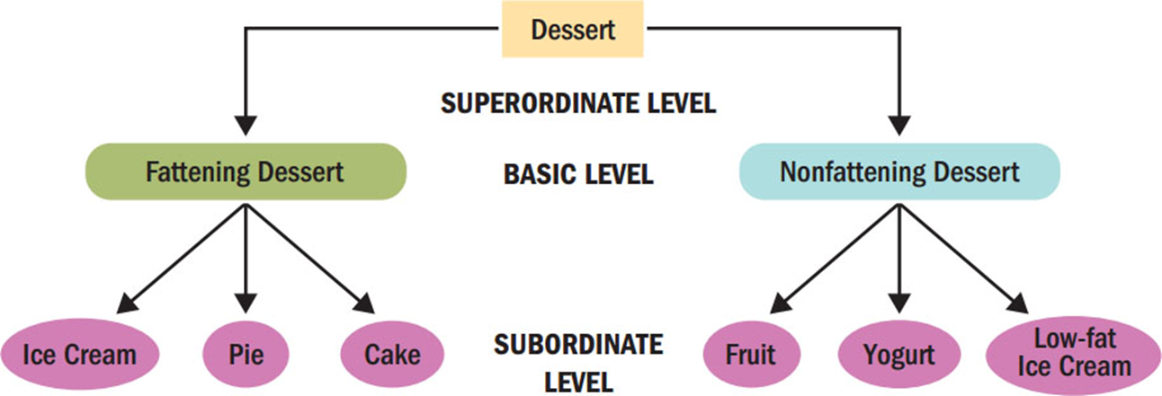
Figure 9.5 Levels of Categorization

Slide 21
Compensatory Rule
Simple additive rule leads to the option with the largest number of positive attributes
Weighted additive rule allows consumer to take into account the relative importance by weighting.

Slide 22
Noncompensatory Decision Rules
Lexicographic rule: consumers select the brand that is the best on the most important attribute
Elimination-by-aspects rule: must have a specific feature to be chosen
Conjunctive rule: entails processing by brand
Notes:
When we need to use more consideration before making a decision (an extensive problem), we can categorize our decision rules into compensatory and noncompensatory. Noncompensatory decision rules suggest that a product that is low on one attribute cannot compensate for that weakness with a strength on another attribute.

Slide 23
Heuristics
Covariation
Country of Origin
Familiar Brand Names
Higher Prices
Notes:
Covariation infers hidden dimensions of products from attributes we observe. The signal communicates an underlying quality. For instance, someone selling a used car will try to make the car look clean because cleanliness may be associated with reliability. Country of origin is often a determinant attribute in the decision-making process. Consumers think of Switzerland for precision in watches, Italy for leather goods, and France for wine. Familiar brand names can serve as a shortcut as can higher prices, which consumers may assume suggest higher quality.

Slide 24
Product Choice
Step 4: Product choice
  Feature creep - complexity of features that products provide.
Step 5: Postpurchase evaluation
Neuromarketing - uses functional magnetic resonance imaging (or fMRI), a brain-scanning device that tracks blood flow as we perform mental tasks to take an up-close look at how our brains respond to marketing messages and product design features.

Slide 25

Online Decision Making
Cybermediary
Intelligent agents
Search engines
Search engine optimization
Notes:
A cybermediary often is the answer. This term describes a Web site or app that helps to filter and organize online market information so that customers can identify and evaluate alternatives more efficiently.
Intelligent agents are sophisticated software programs that use collaborative filtering technologies to learn from past user behavior to recommend new purchases.
Search engine optimization (SEO) refers to the procedures companies use to design the content of Web sites and posts to maximize the likelihood that their content will show up when someone searches for a relevant term.
Long tail is that we no longer need to rely solely on big hits (such as blockbuster movies or best-selling books) to find profits.

Slide 26
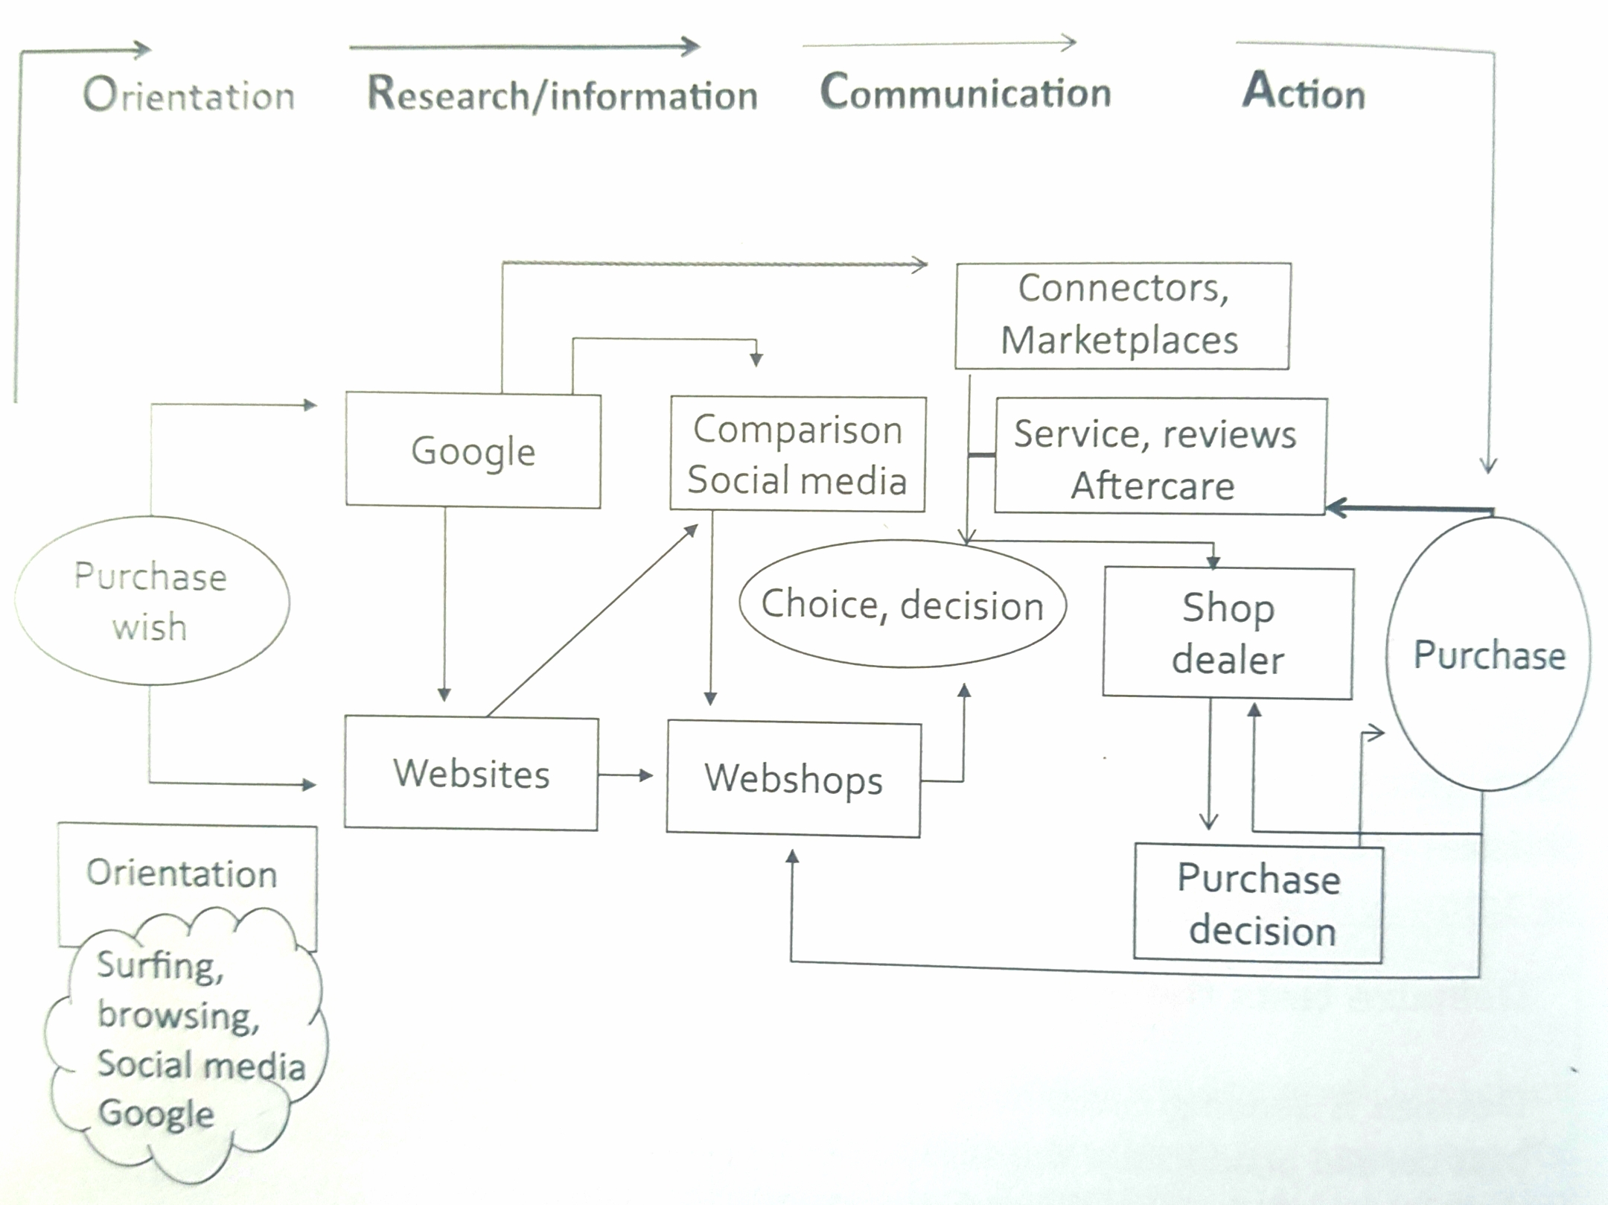
Customer purchasing process

Slide 27
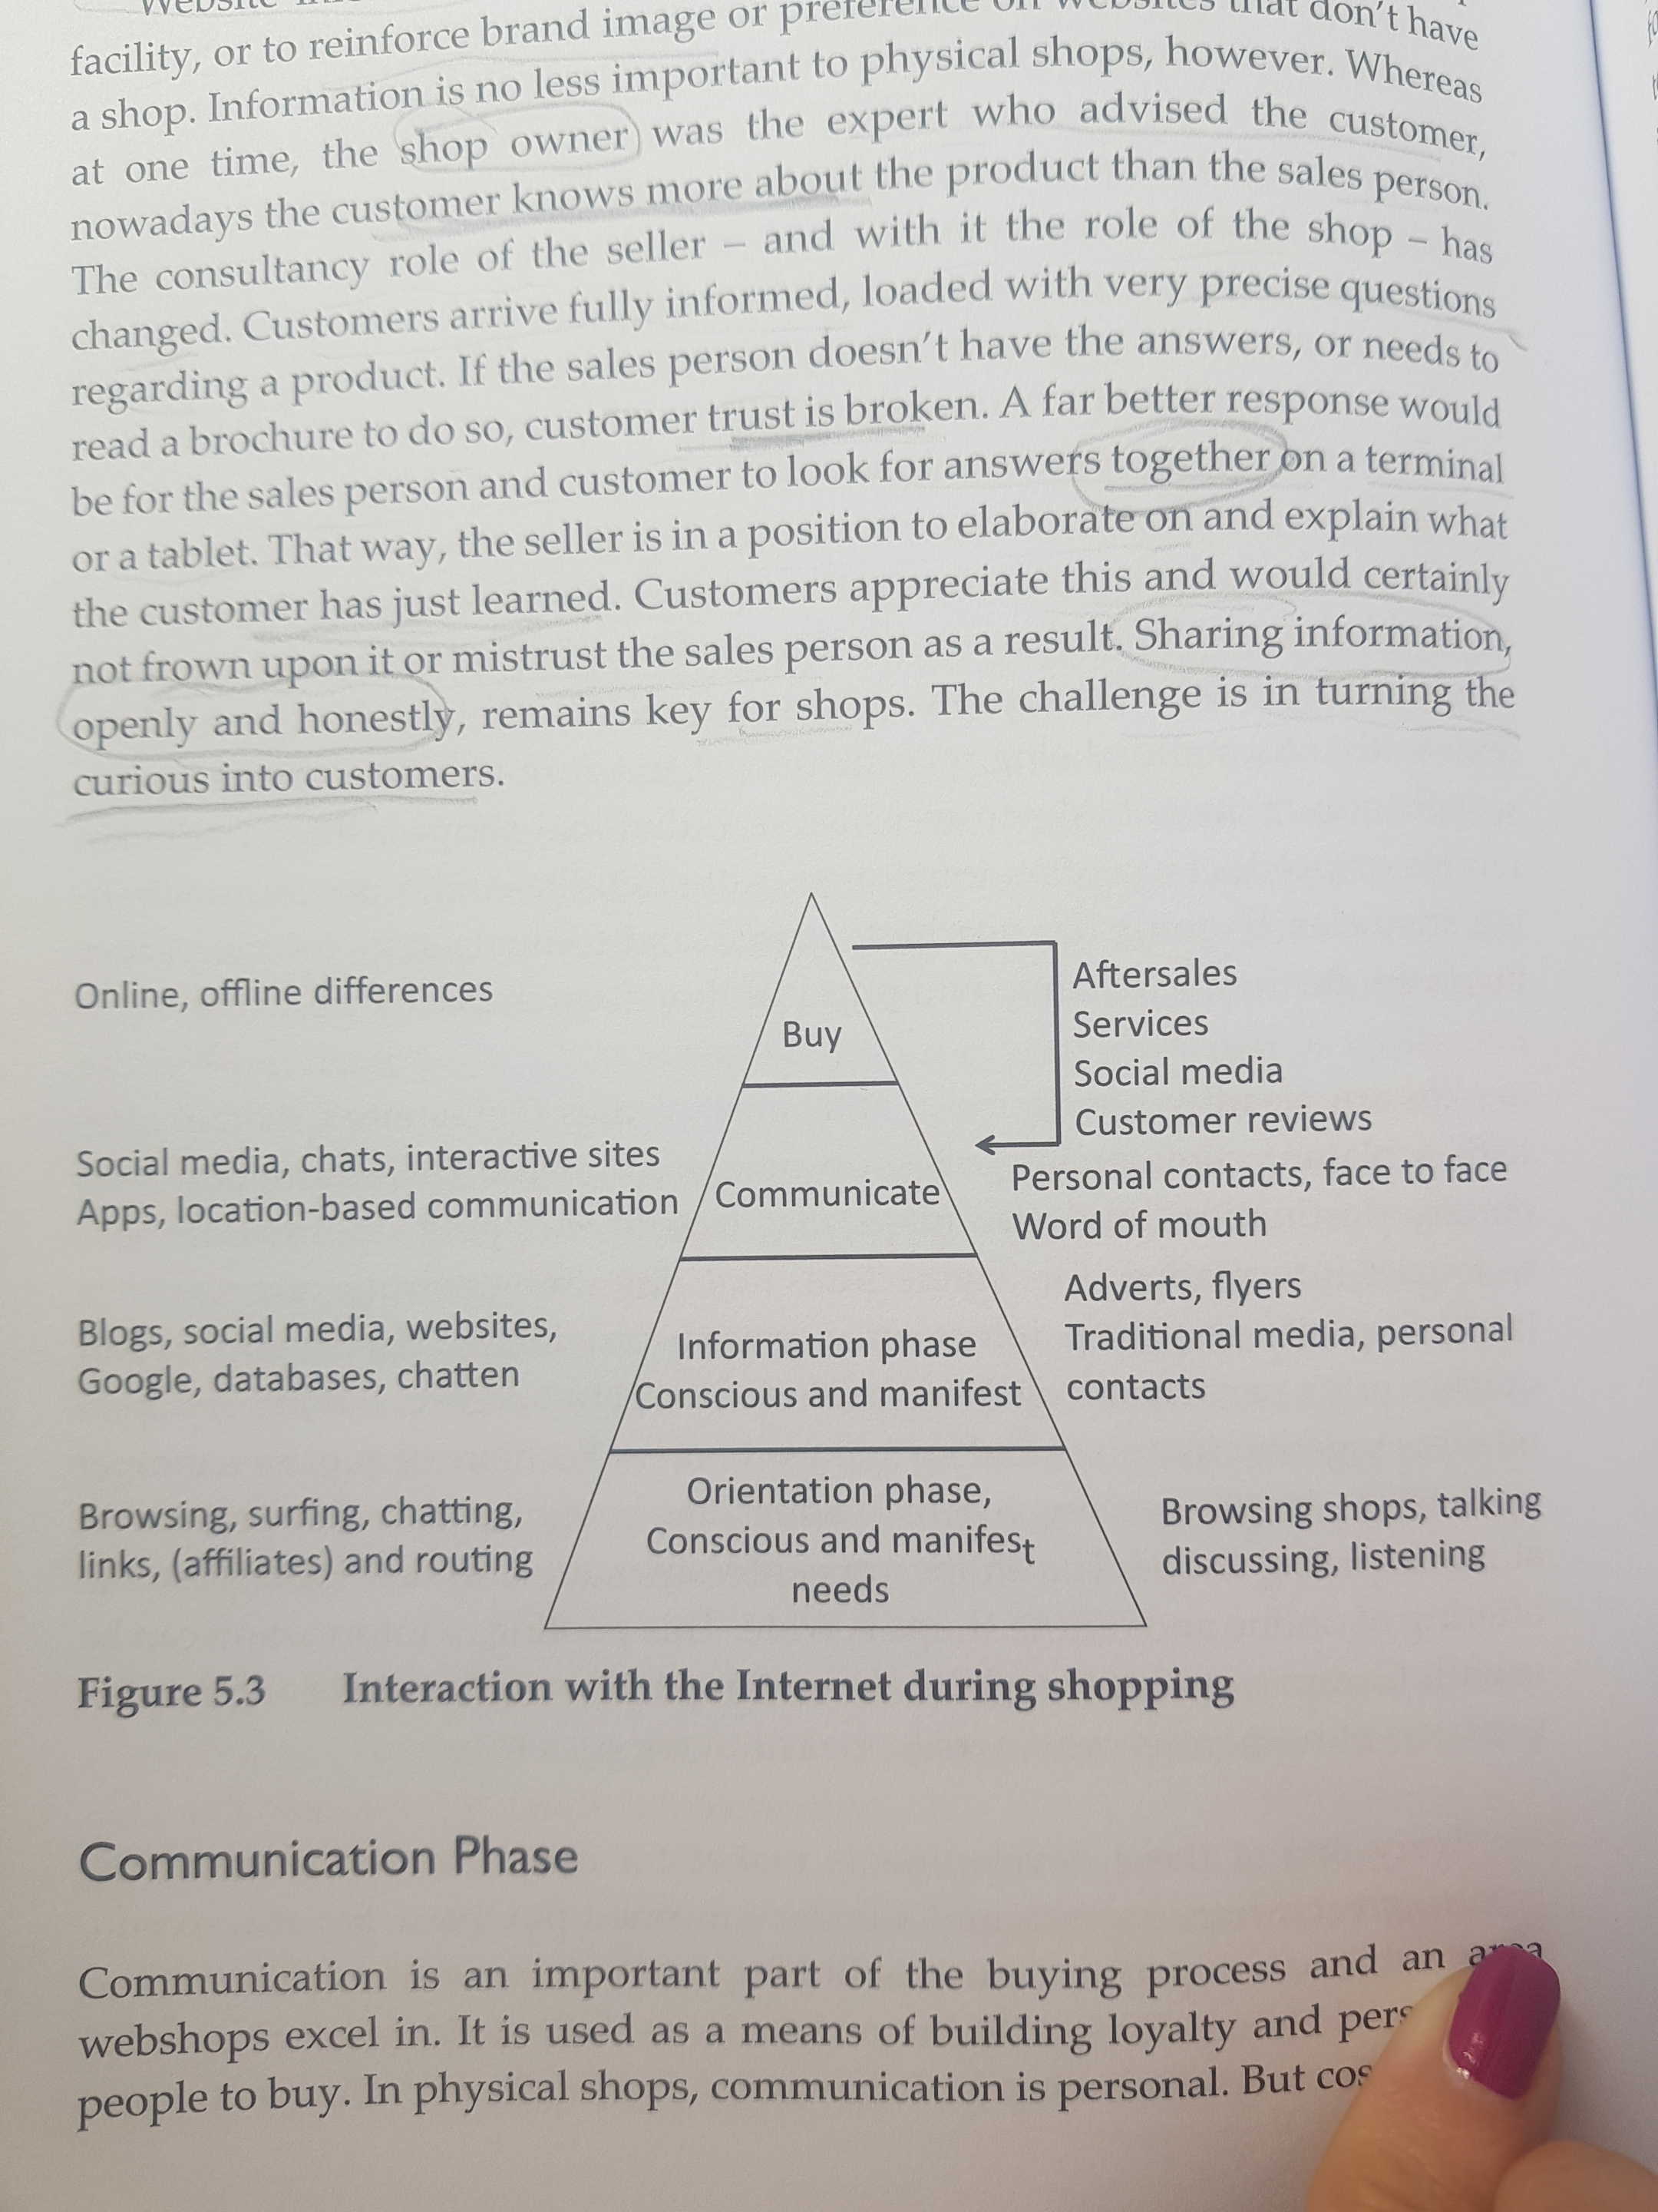
Interaction with Internet during shopping

Slide 28
Biases in Decision-Making Process
Mental accounting: framing a problem in terms of gains/losses influences our decisions
Sunk-cost fallacy: We are reluctant to waste something we have paid for
Loss aversion: We emphasize losses more than gains
Prospect theory: risk differs when we face gains versus losses
Notes:
Cognitive decision making seeks a maximizing solution but often times consumers are happy to exert less energy for decisions in exchange for a satisficing solution. This “good enough” perspective on decision making is called bounded rationality. The study of decisions is called behavioral economics.
Many of these decisions illustrate the principles of mental accounting.

Slide 29
For Reflection
When have you made a high involvement decision on the basis of affect?
Were you in a maximizing mode or satisficing mode?

Slide 30
For Review
The three categories of consumer decision-making are cognitive, habitual, and affective.
A cognitive purchase decision is the outcome of a series of stages that results in the selection of one product over competing options.
We often rely on rules-of-thumb to make decisions.
The way information about a product choice is framed can prime a decision even when the consumer is unaware of this influence.
Notes:
In this chapter, we focused on four learning objectives. We learned the three categories of consumer decisions. We learned the stages in the cognitive decision-making process.

Slide 31

Thank you!
Any questions?

