Slide 1

Consumer Choices
Customer Journey
Professor Ilijana Petrovska
Visiting professor @ Tor Vergata

Slide 2
Customer Insights

Slide 3
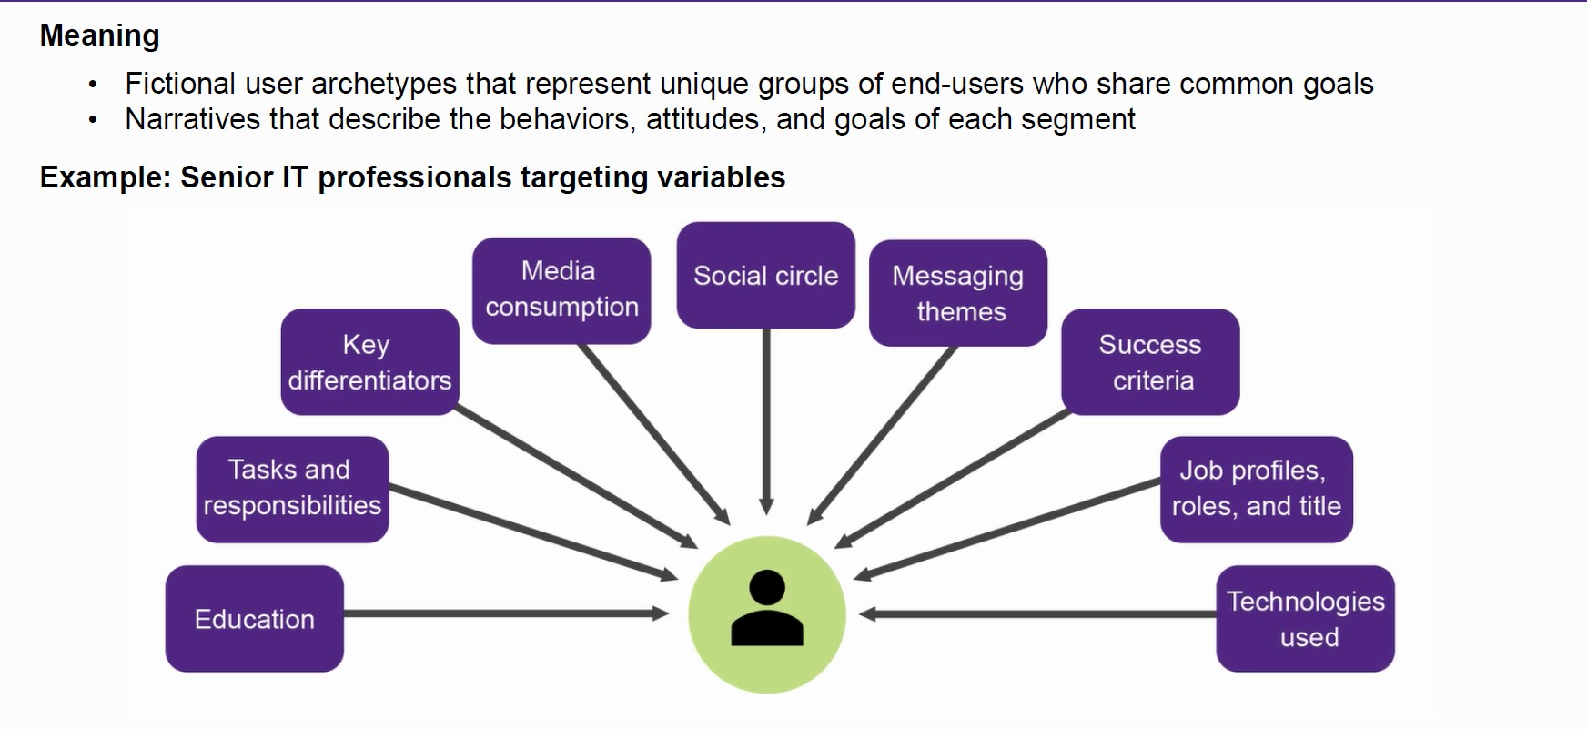
Segment Personas

Slide 4
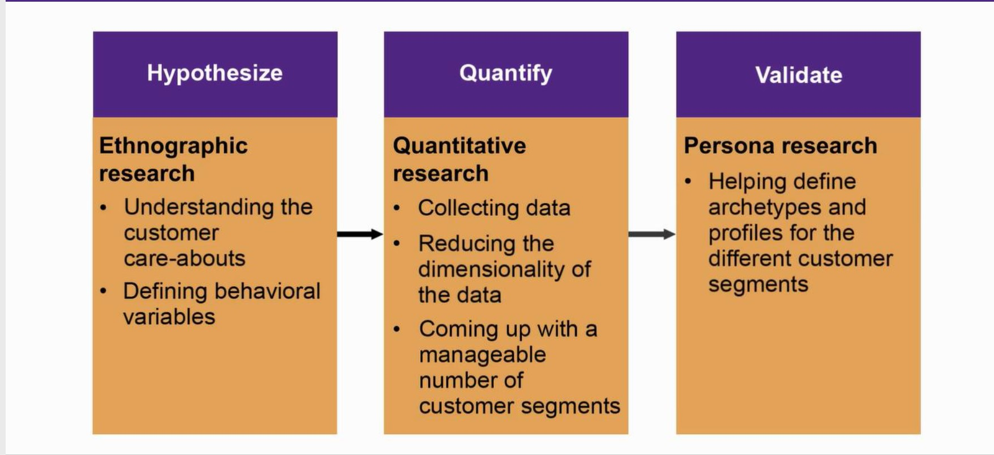
Segmentation Process Overview

Slide 5
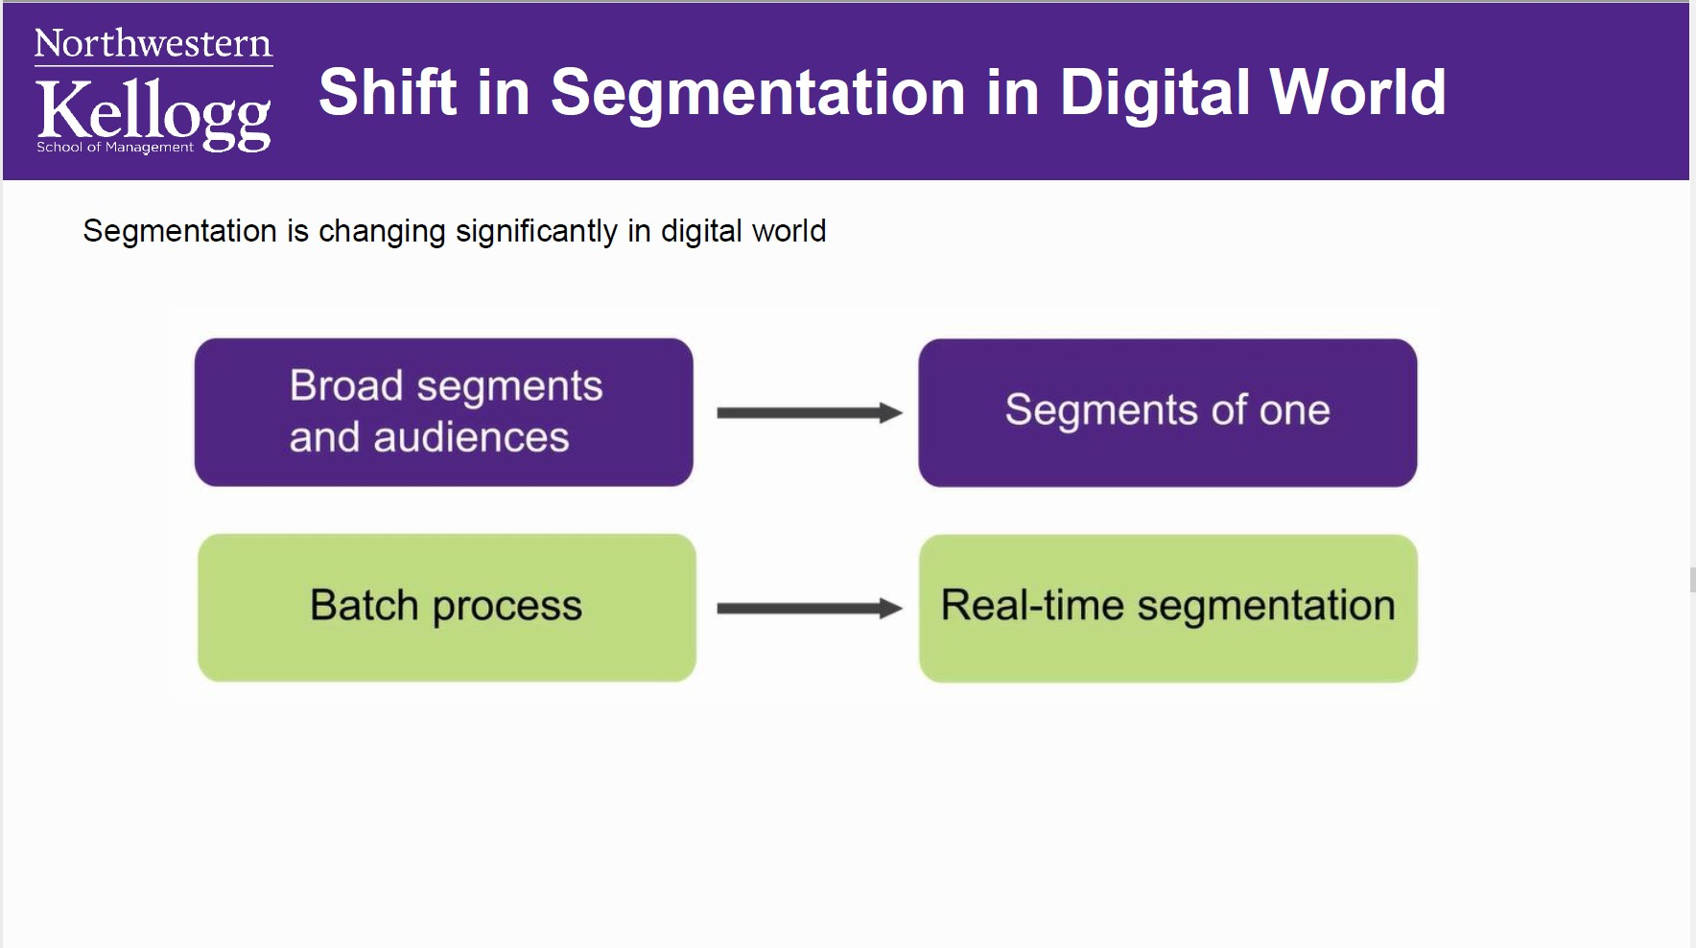

Slide 6
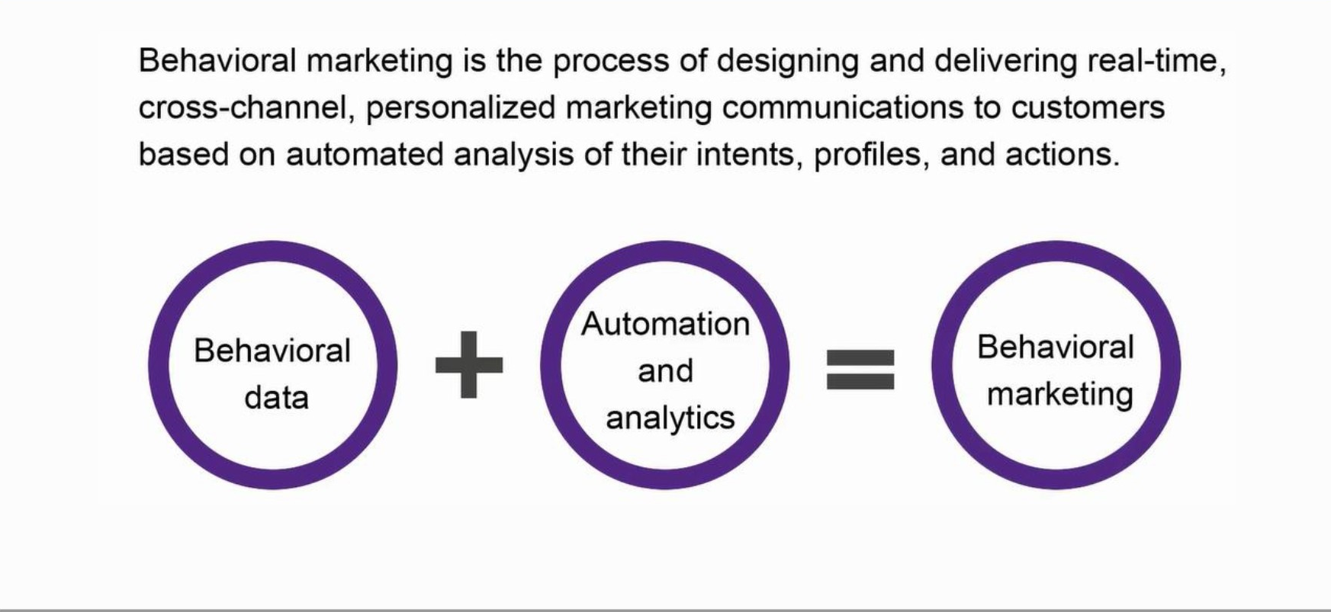
Behavioral marketing

Slide 7
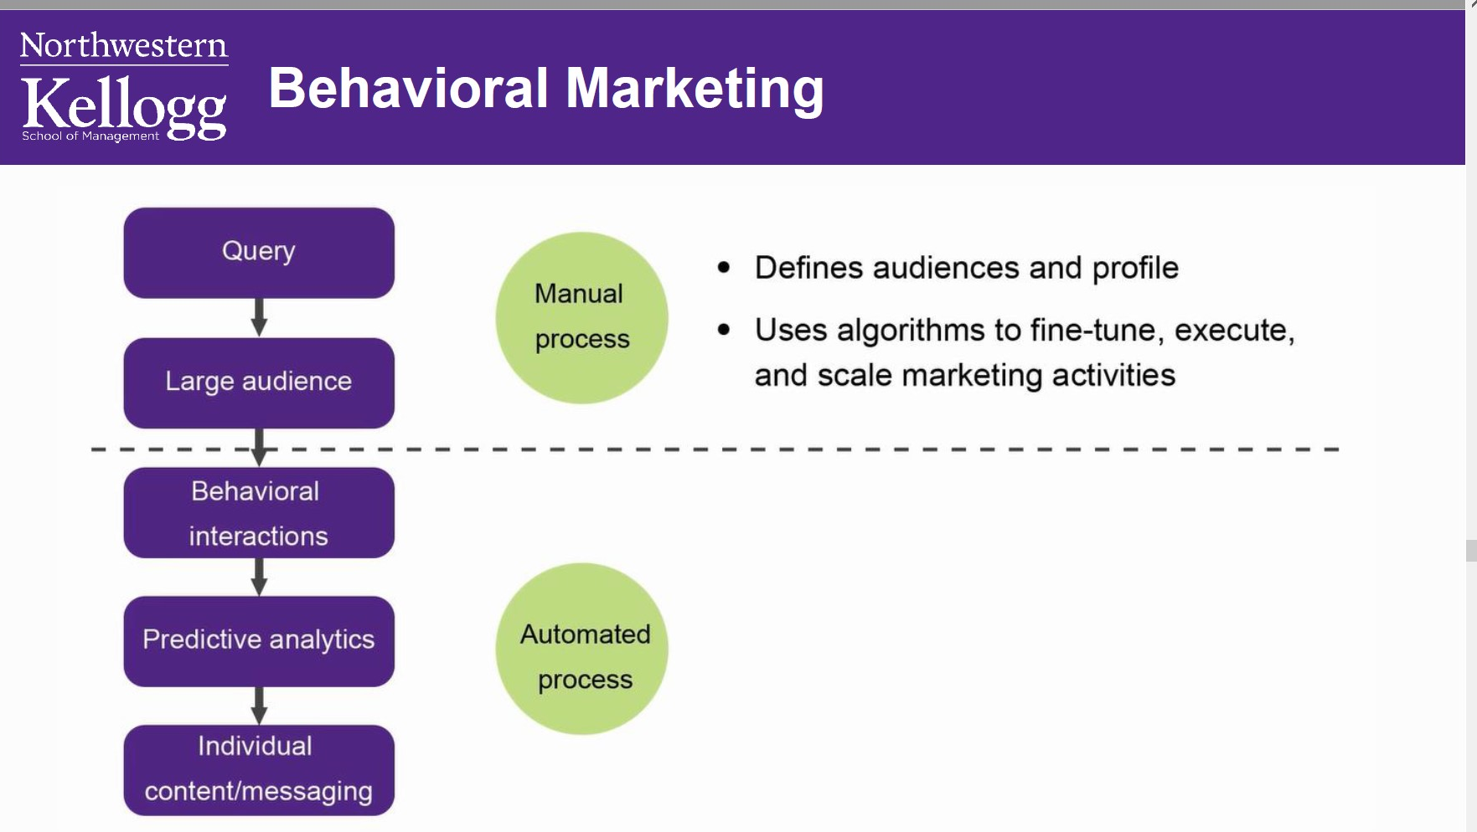

Slide 8
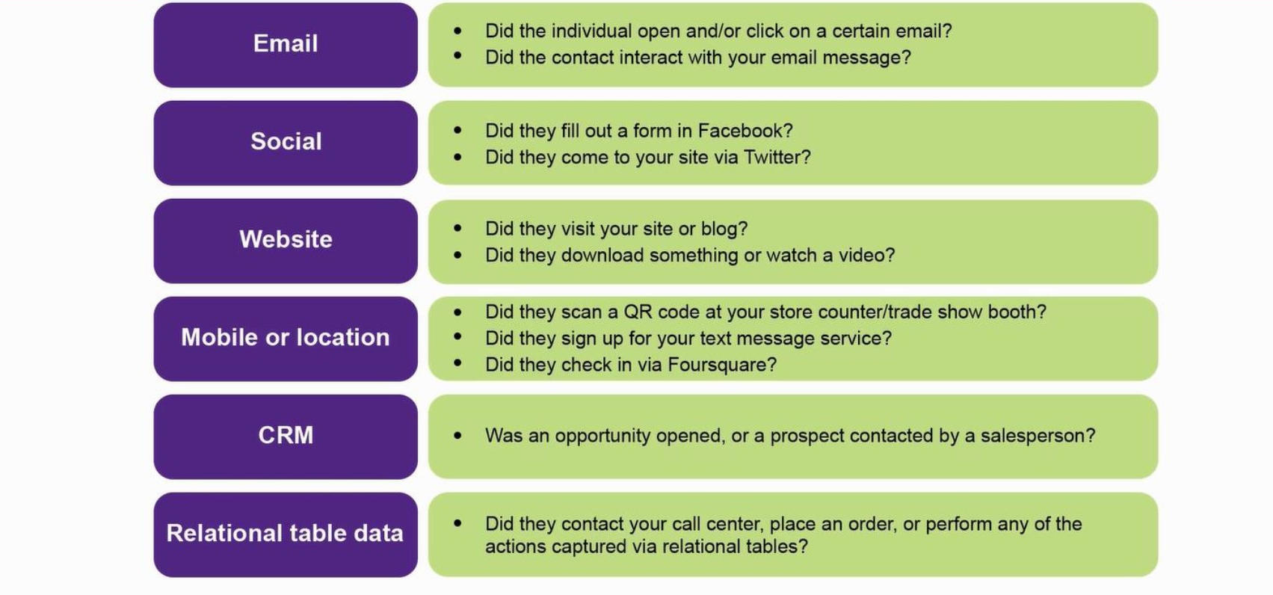
Examples of Behavioral variables

Slide 9
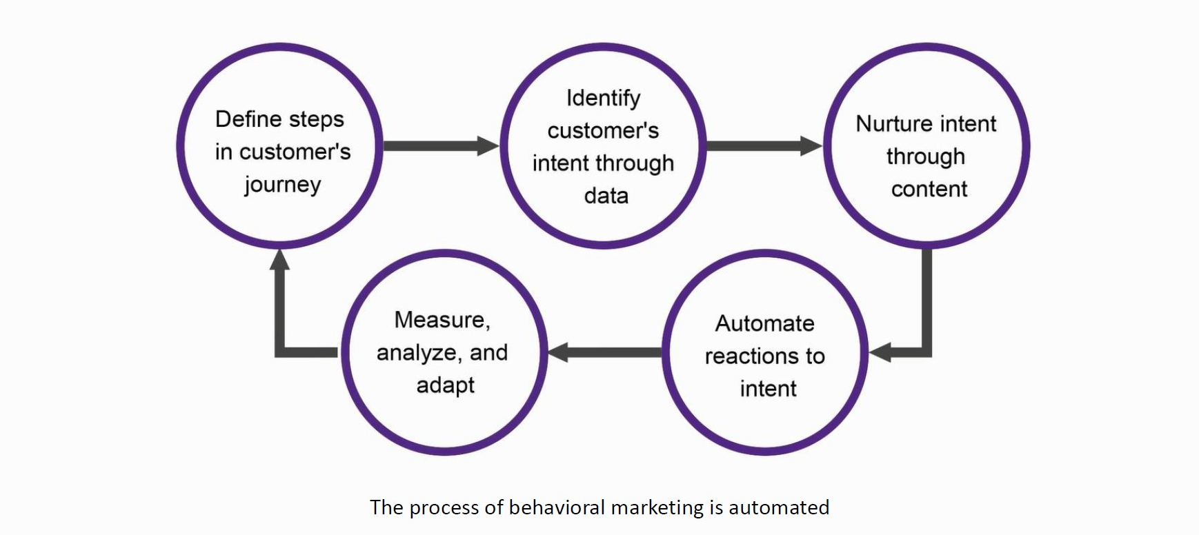
Behavioral Marketing process

Slide 10
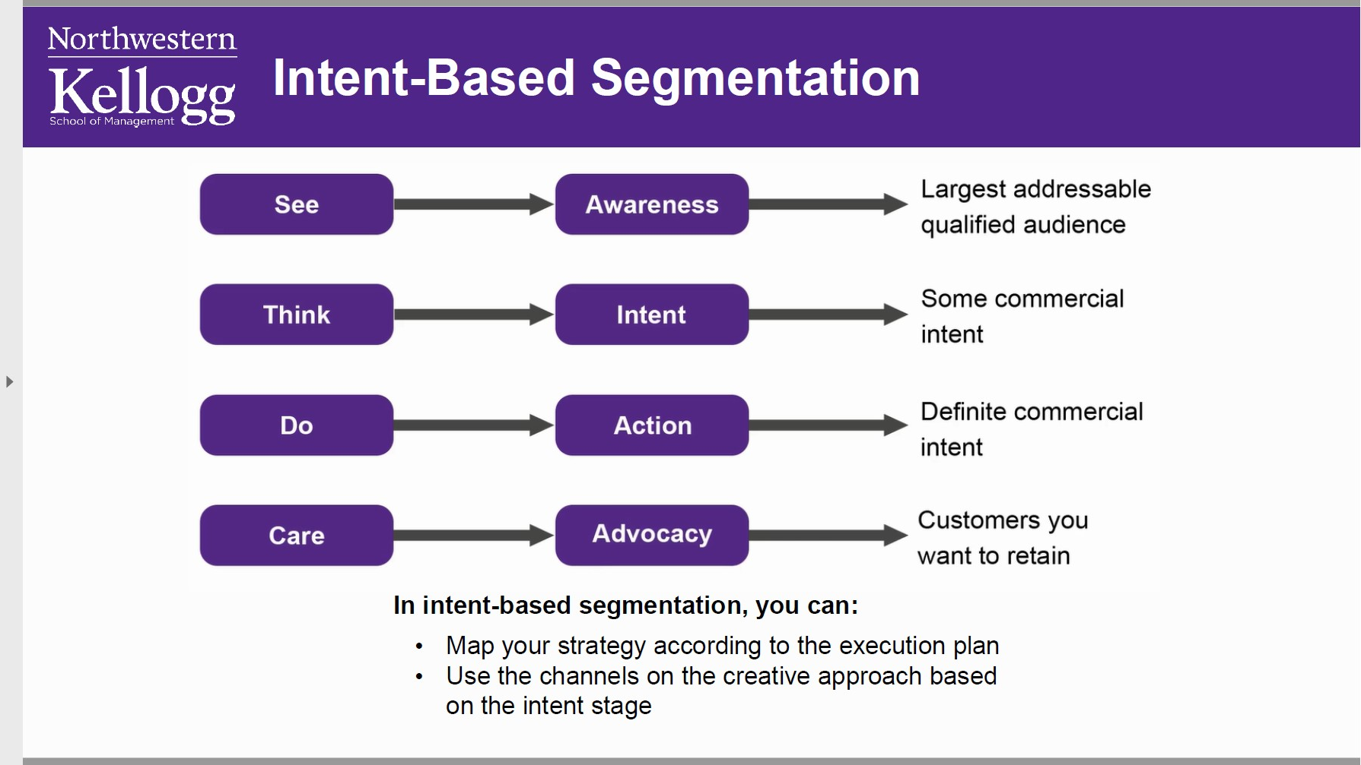

Slide 11
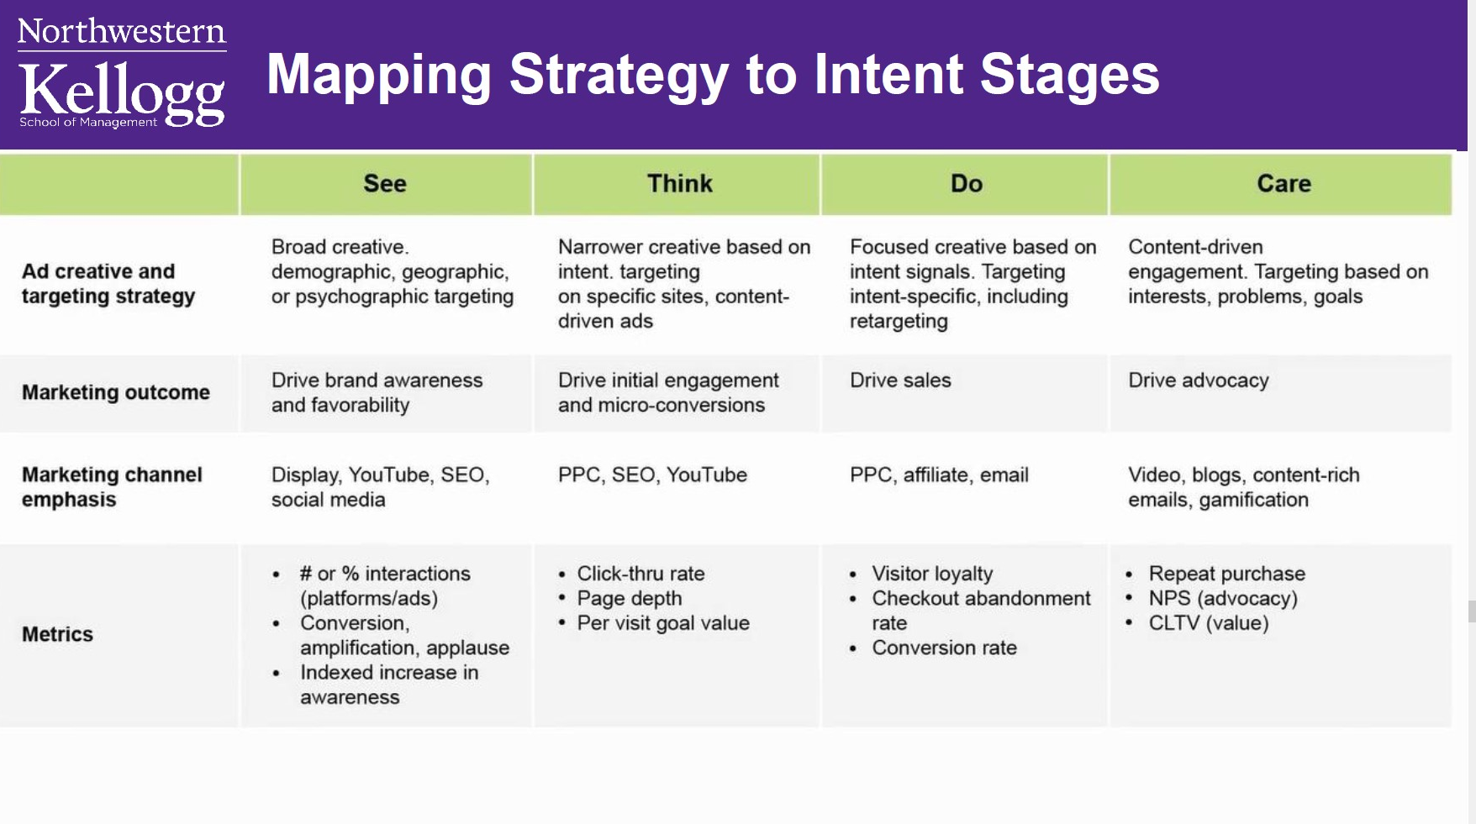

Slide 12
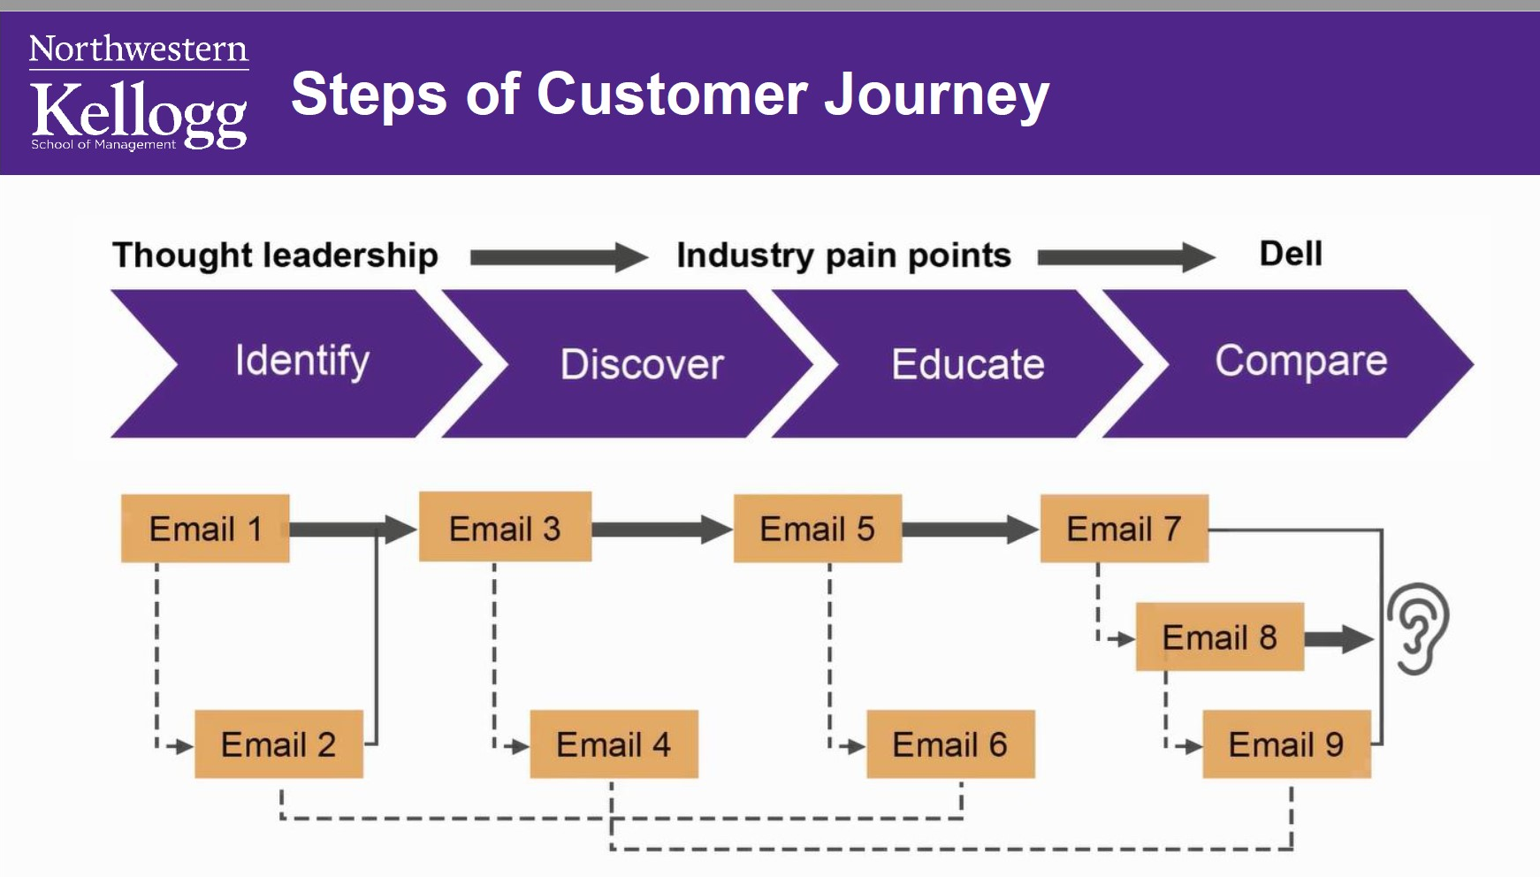

Slide 13
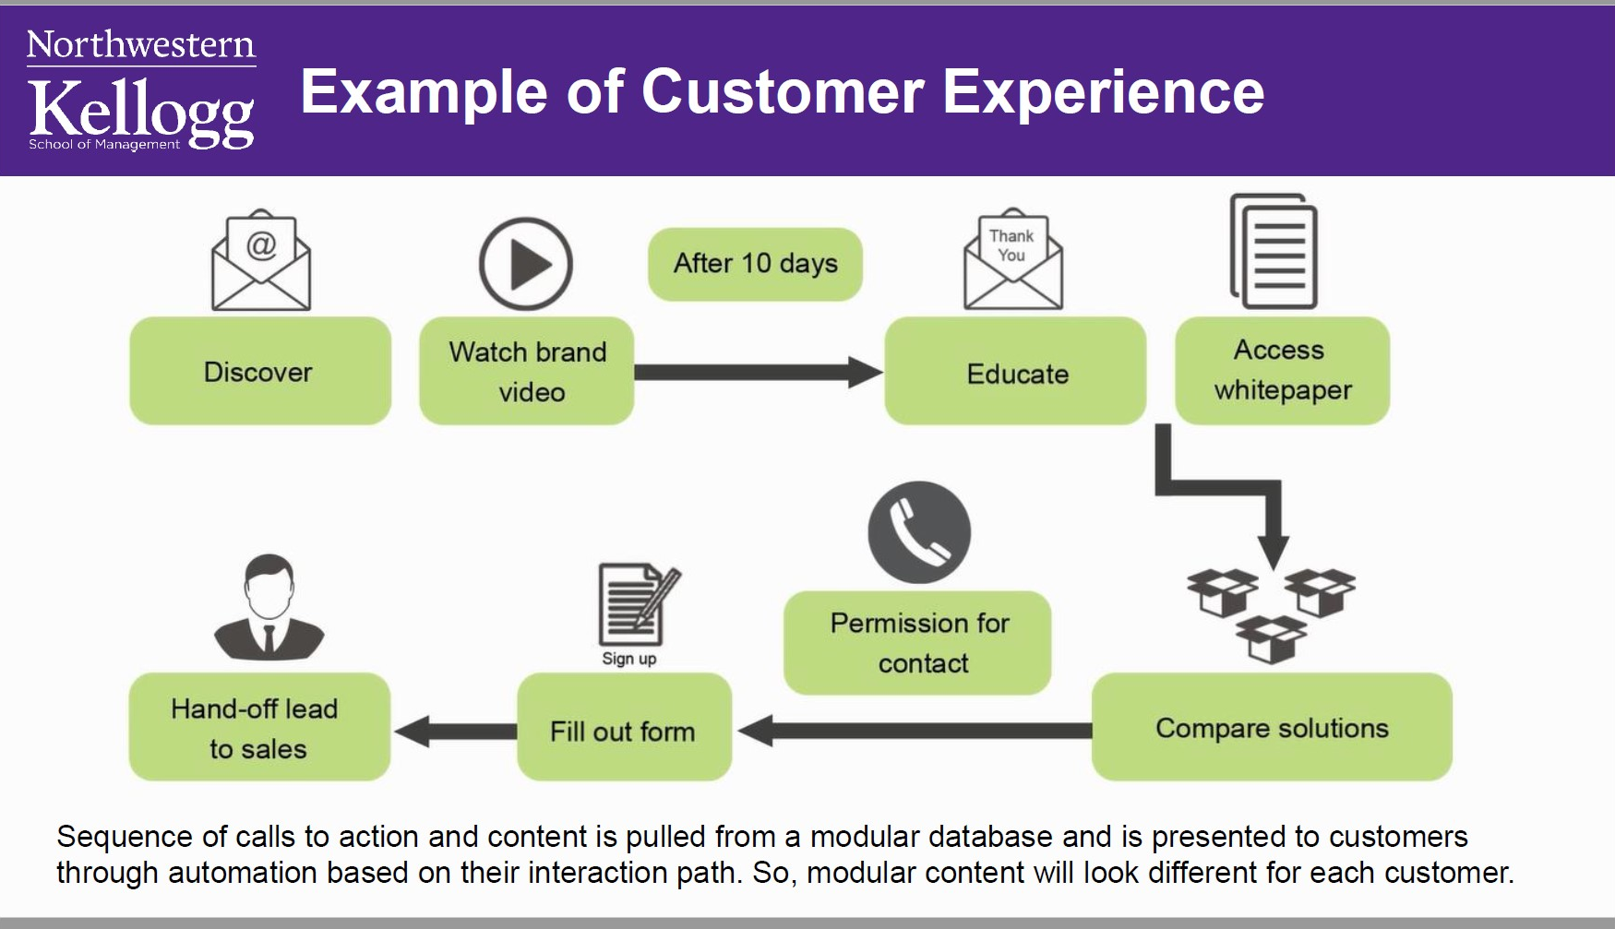

Slide 14
The Customer Journey
& content Strategy

Slide 15
User Persona profile
Who is my ideal customer?
What are the current behavior patterns of my users?
What are the needs and goals of my users?
What issues and pain-points do they currently face within the given context?

Slide 16
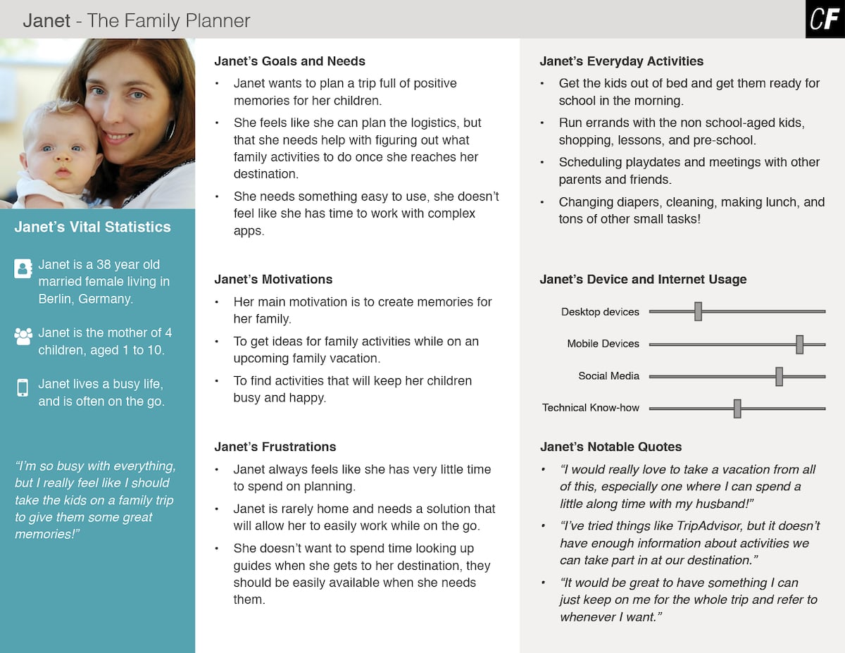

Slide 17
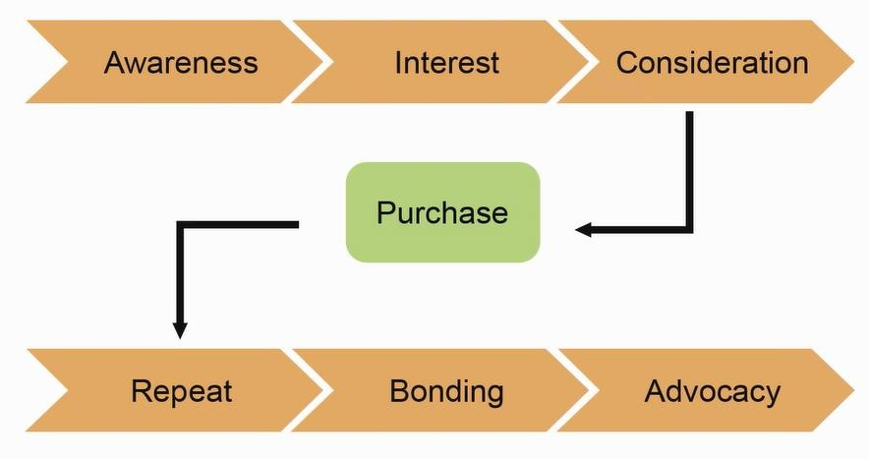
Customer Buying Journey in Pre-Digital World

Slide 18

Micro Moment/Now Moment
Customer journey now can be more complex as it is non-linear and involves more devices, touch points, and channel.
Customers now interacts in small increments throughout the day, as they glance through their phones hundred times in a day.

Slide 19

Micro Moments

Slide 20
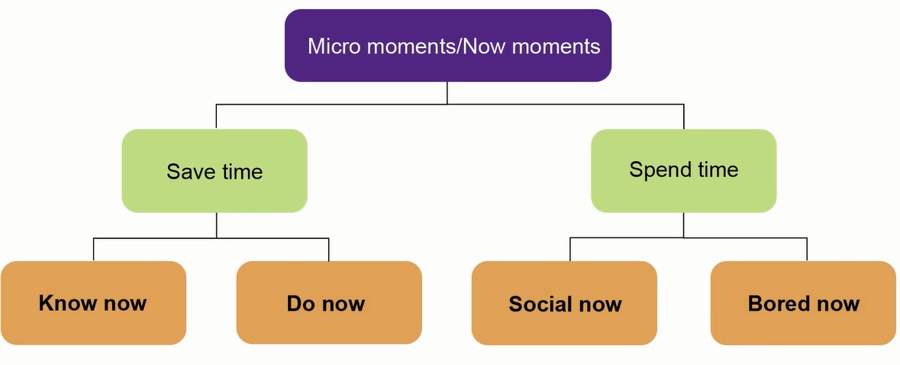
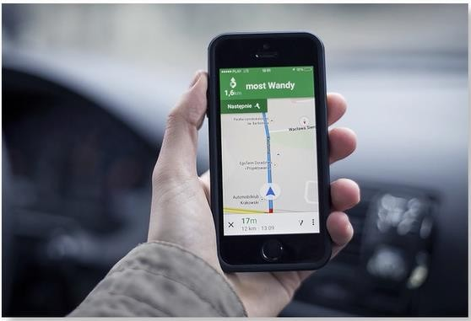


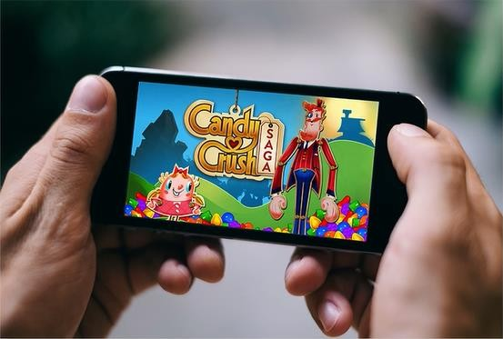
Types of Moments
Example: Finding route
Example: Making transactions
Example: Checking social updates
Example: Playing games

Slide 21

Three Principles of Effective Engagement

Slide 22
Mapping the Customer Journey
Customer journey map is a visual illustration of the activities, expectations, emotions, and perceptions that customers experience throughout their relationship with a company's products, services, and people
It is important to define customer journey map from the customer's perspective. A customer journey map includes:
Customer's experience
Customer's needs and wants
Customer's information needs
Customer's action - what are they doing, thinking, and feeling

Slide 23
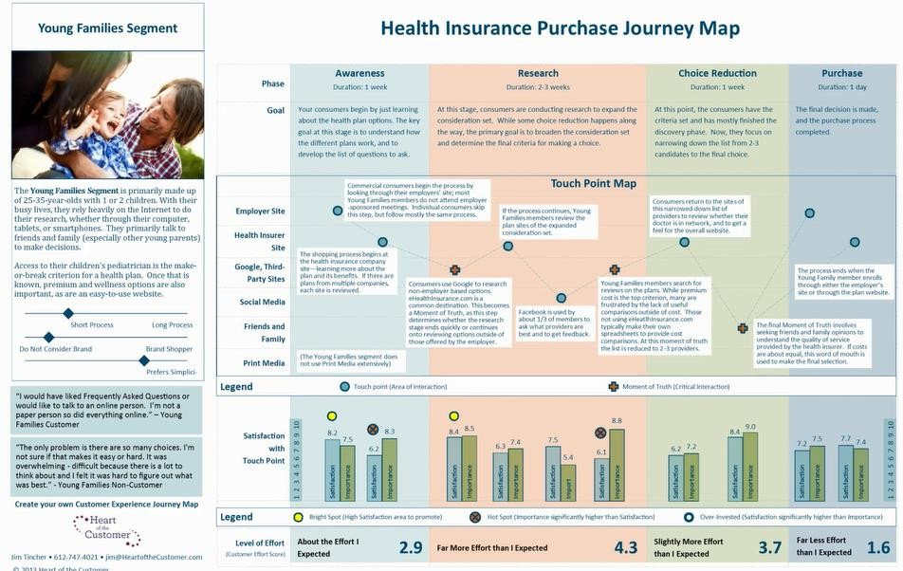
A Customer Journey Map: Example
Stages customer will go through
Customer Persona

Slide 24
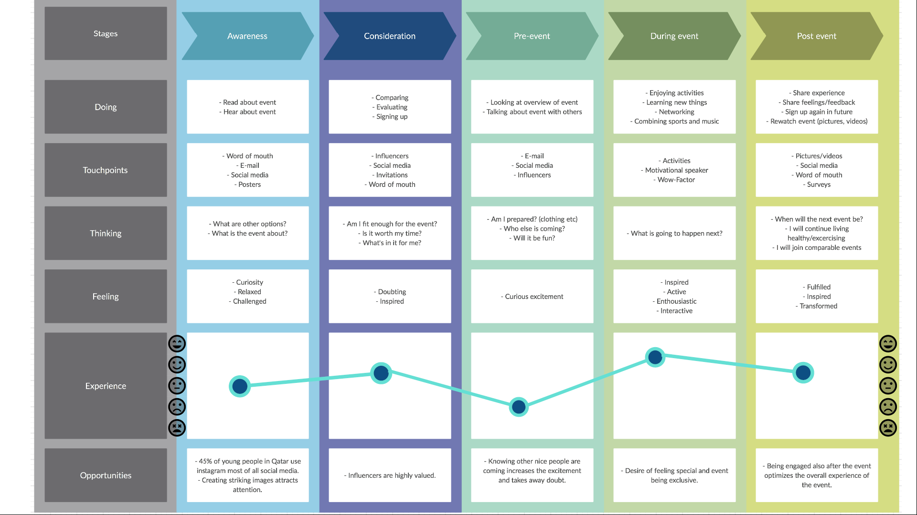

Slide 25
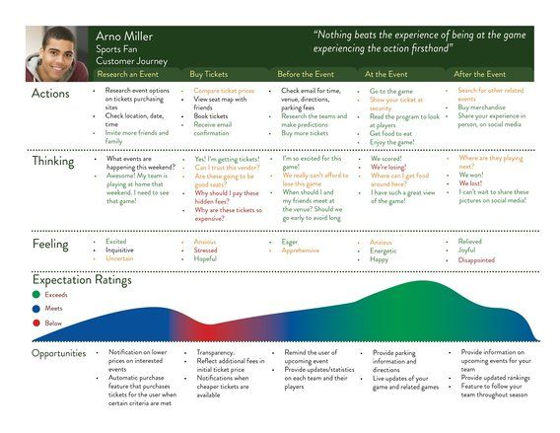

Slide 26
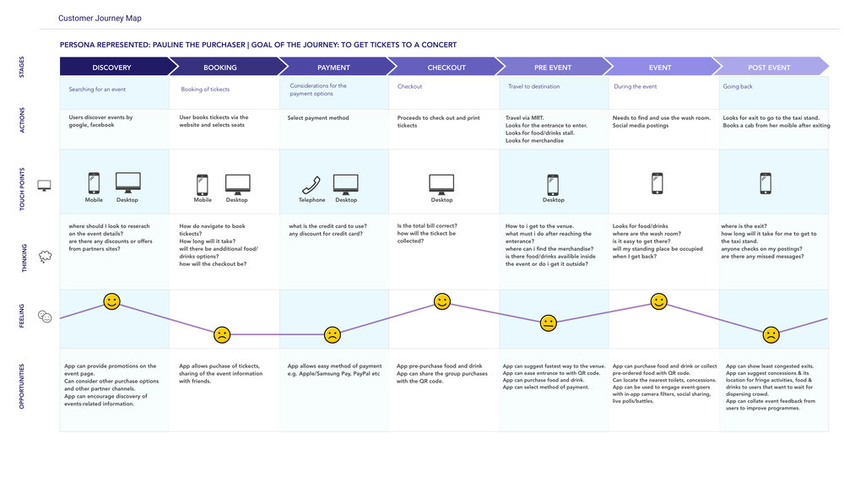

Slide 27




Tips for Customer Journey Mapping
Base it on direct customer observation
Be specific to a customer segment or persona
Reflect customer goals
Focus on emotions, not just cognition and action
Consider both online and offline experiences
Look at all touch points
Highlight the key moments of truth
Resonate with your brand promise
Record the time customers take to go through the different stages
Reflect customer verbatims
Include non-customers
Example: AT&T came up with concept of having greeter for every customer that walked-in
Example: Zara surveyed customer who walked away without buying anything from the store

Slide 28
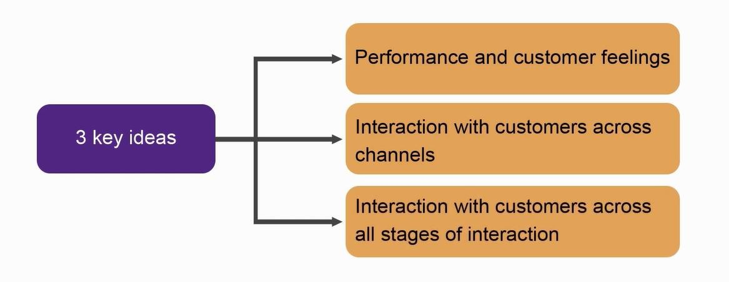
Defining Customer Experience
Innovations can happen across all stages of customer journey
A blend of company's physical performance and customer emotions across all the touchpoints and moments of truth
Customer experience is a combination of the intangible and the emotional as well as the tangible and physical aspects of experience

Slide 29
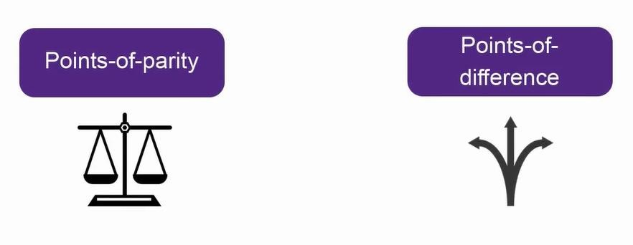
Customer Experience: Differentiators
Points of parity are aspects of the customer experience that customers view as necessary
Point of difference is an aspect of the customer experience that is uniquely associated with your offering where you can create surprise and delight

Slide 30
Tips for Customer Experience
Identify the biggest customer problem areas:
Think systematically about
how to improve the customer experience by:
Fulfillment
Returns
Budget
Decision-making
Raining certain factors
Reducing certain factors
Adding certain factors
Eliminating points of pain
Focus the innovations on targeted areas of customer experience

Slide 31
ERRC Grid
ERRC is a matrix that can be used to identify innovation opportunities in your EVENT
E
Eliminate
R
Raise
R
Reuse
C
Create

Slide 32
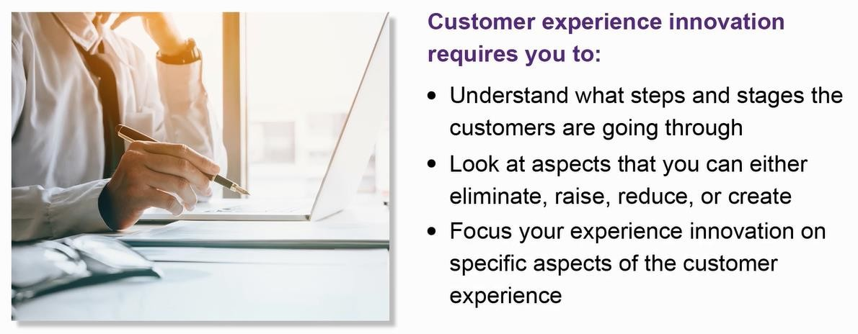
Summarizing Customer Experience Innovation

Slide 33
Customer Journey Map examples

Slide 34
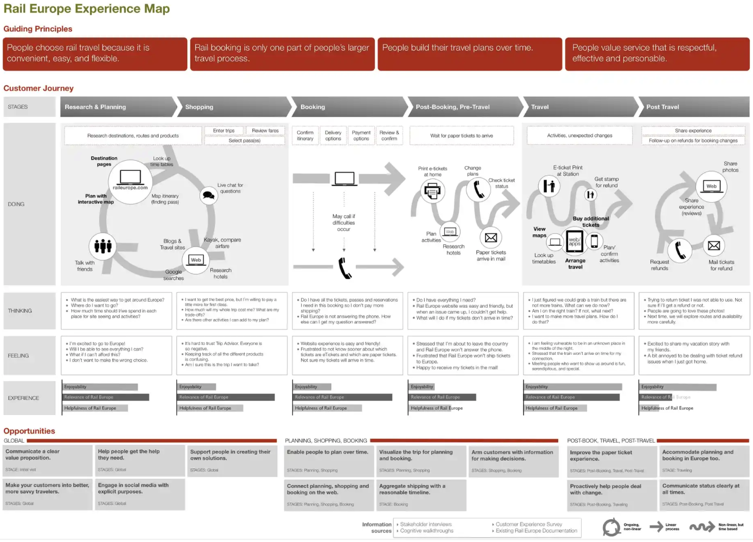

Slide 35
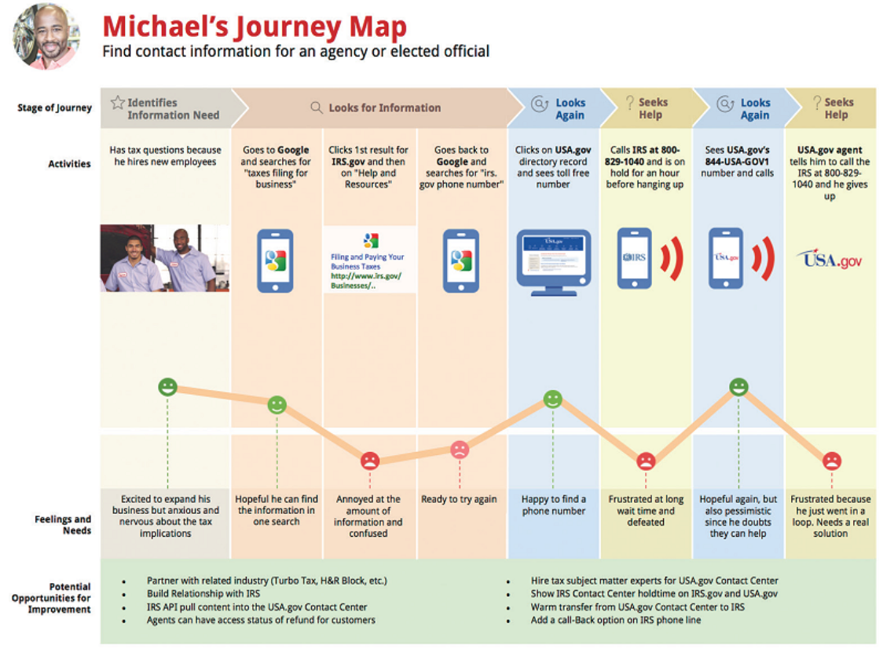

Slide 36
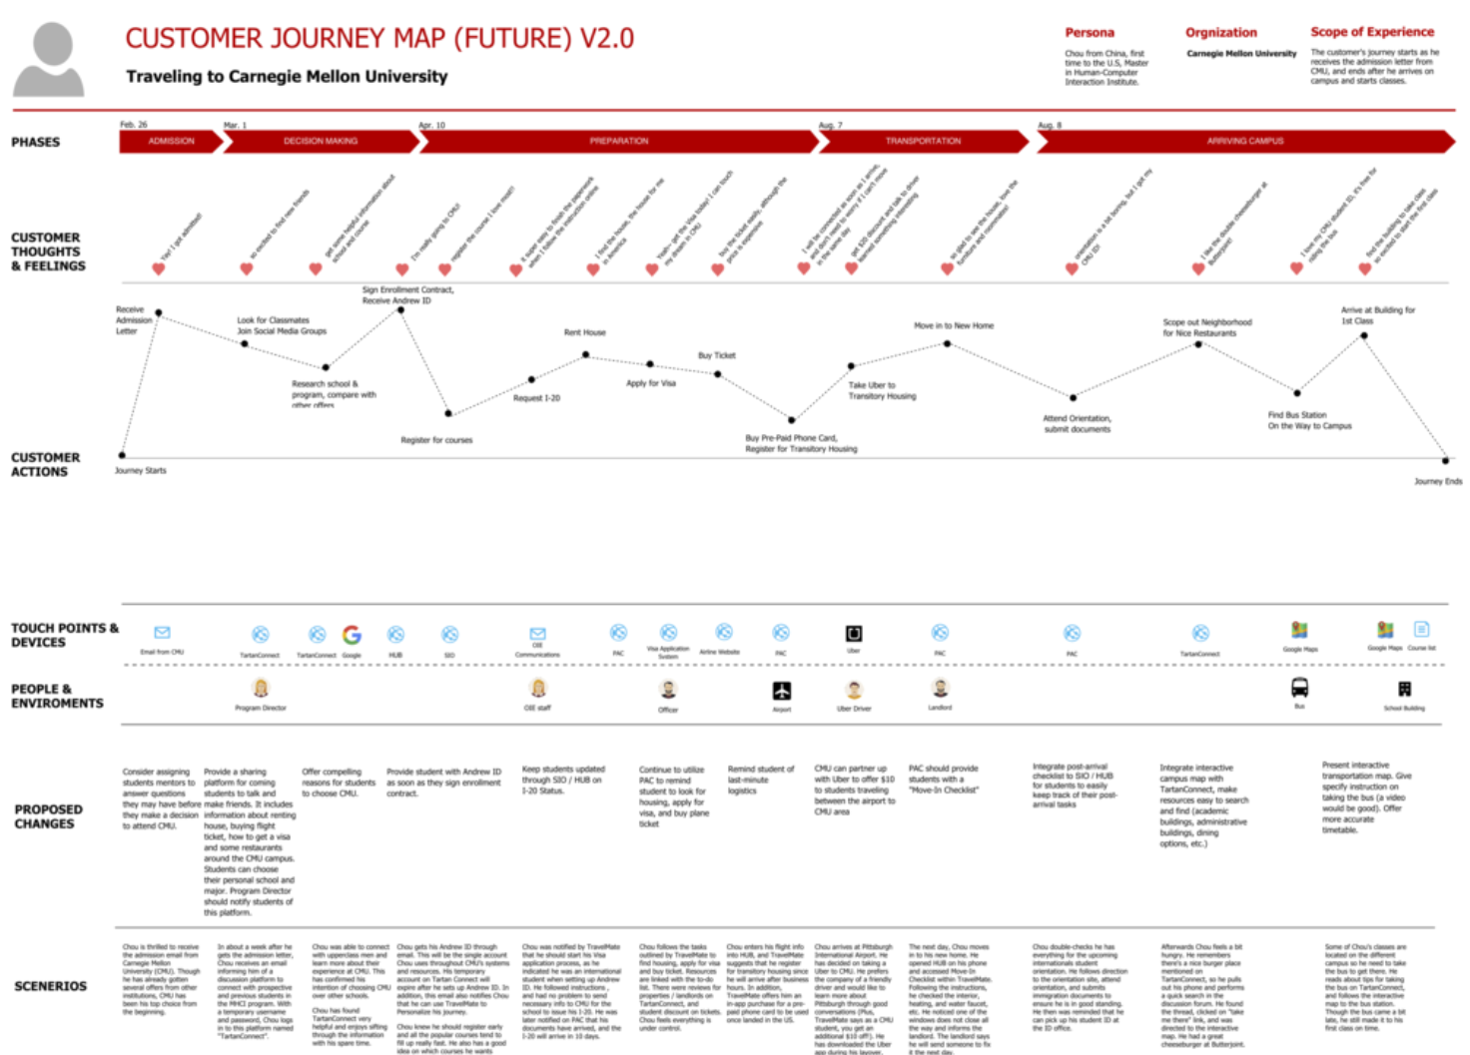

Slide 37
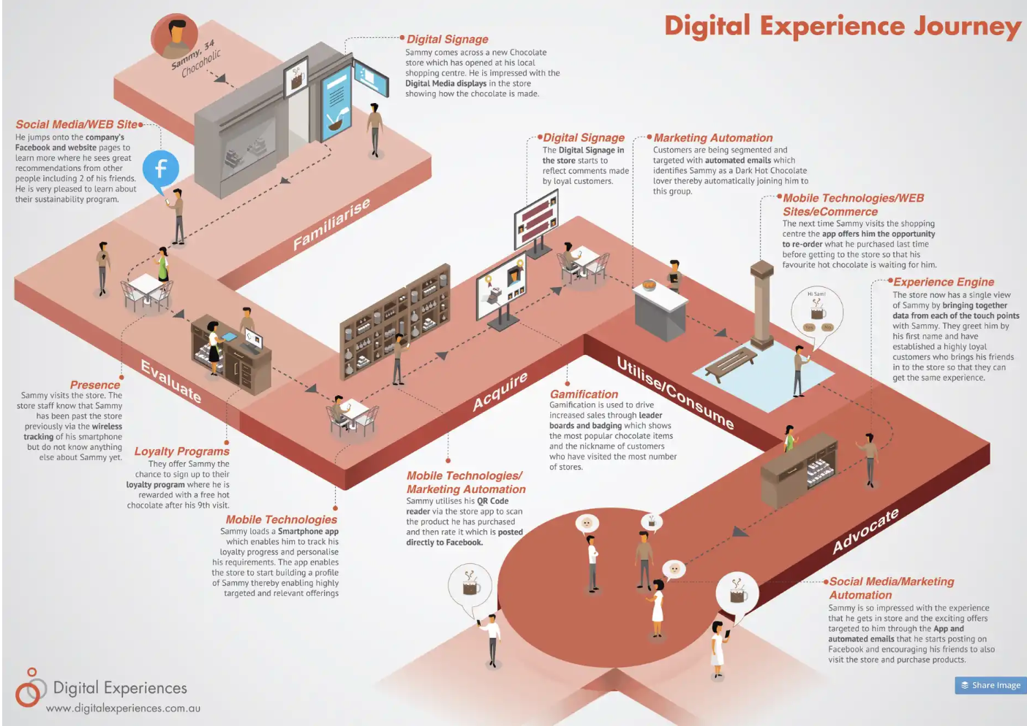
Caio’s comments:
I’m not a fan of this model but might be ok if you’re presenting your customer journey to a larger audience and want to be very user friendly or visually appealing

Slide 38
Template
Persona: XXXX age: xxxx Job: Xxxxx Interests: Xxxxx | Phase 1 | Phase 2 | Phase 3 | Phase 4 | Phase 5
1. Customer thoughts & feelings | xx | xx | xx | xx | xx
2. Customer actions | xx | xx | xx | xx | xx
3. Customer touchpoints | xx | xx | xx | xx | xx
4. Proposed changes | xx | xx | xx | xx | xx

Slide 39
In class Group Work
Develop Customer Journey Map
Customer Insights
User Persona
Customer Journey

Slide 40
Group Activity – 25 minutes
Analyse the case & exhibits, and define the situation, using the topics covered
Develop User Persona
Develop a Customer Journey
Answer the questions:
How do you think Parvesh Debuka should react to the situation associated with Paper Boat?
Is Paper boat for kids, family or adults? How does it convey its unique positioning? Nostalgia or ethnic connection?
Describe the 4Ps situation and what could be improved using the previous analysis?

Slide 41
Group Presentations
Poster presentations 5 minutes

Slide 42
References
Blogs
What is the Customer Journey and Why Do You Need to Create One? Crazy Egg https://www.crazyegg.com/blog/customer-journey/ (Links to an external site.) How to Create an Effective Customer Journey Map, Hubspot blog https://blog.hubspot.com/service/customer-journey-map (Links to an external site.) Customer Journey Maps: A Step-by-Step Guide, CXL Institute https://conversionxl.com/blog/customer-journey-maps/ (Links to an external site.) How to Develop a Content Strategy: A Start to Finish Guide, Hubspot https://blog.hubspot.com/marketing/content-marketing-plan (Links to an external site.) Content Strategy: A Development Guide, Neil Patel https://neilpatel.com/blog/content-strategy-a-development-guide/

Slide 43

Thank you!
Any questions?

