Slide 1
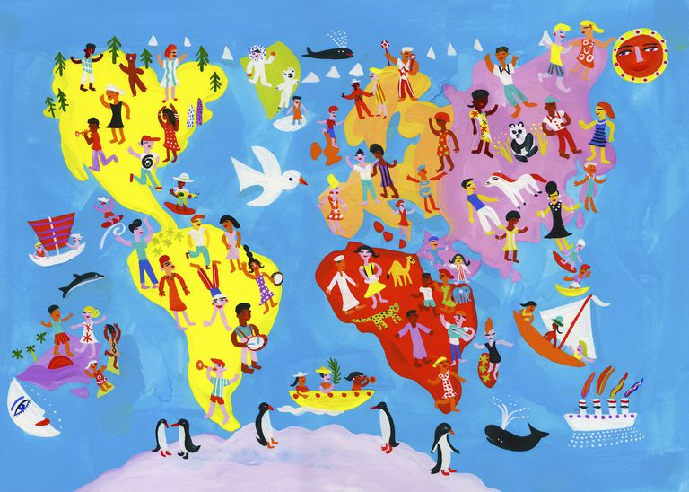
Consumer Choices
Income, Culture
Consumer Choices Theories
Professor Ilijana Petrovska
Visiting professor @ Tor Vergata

Slide 2
Agenda
Group presentations
Income
Culture
Wrap Up

Slide 3
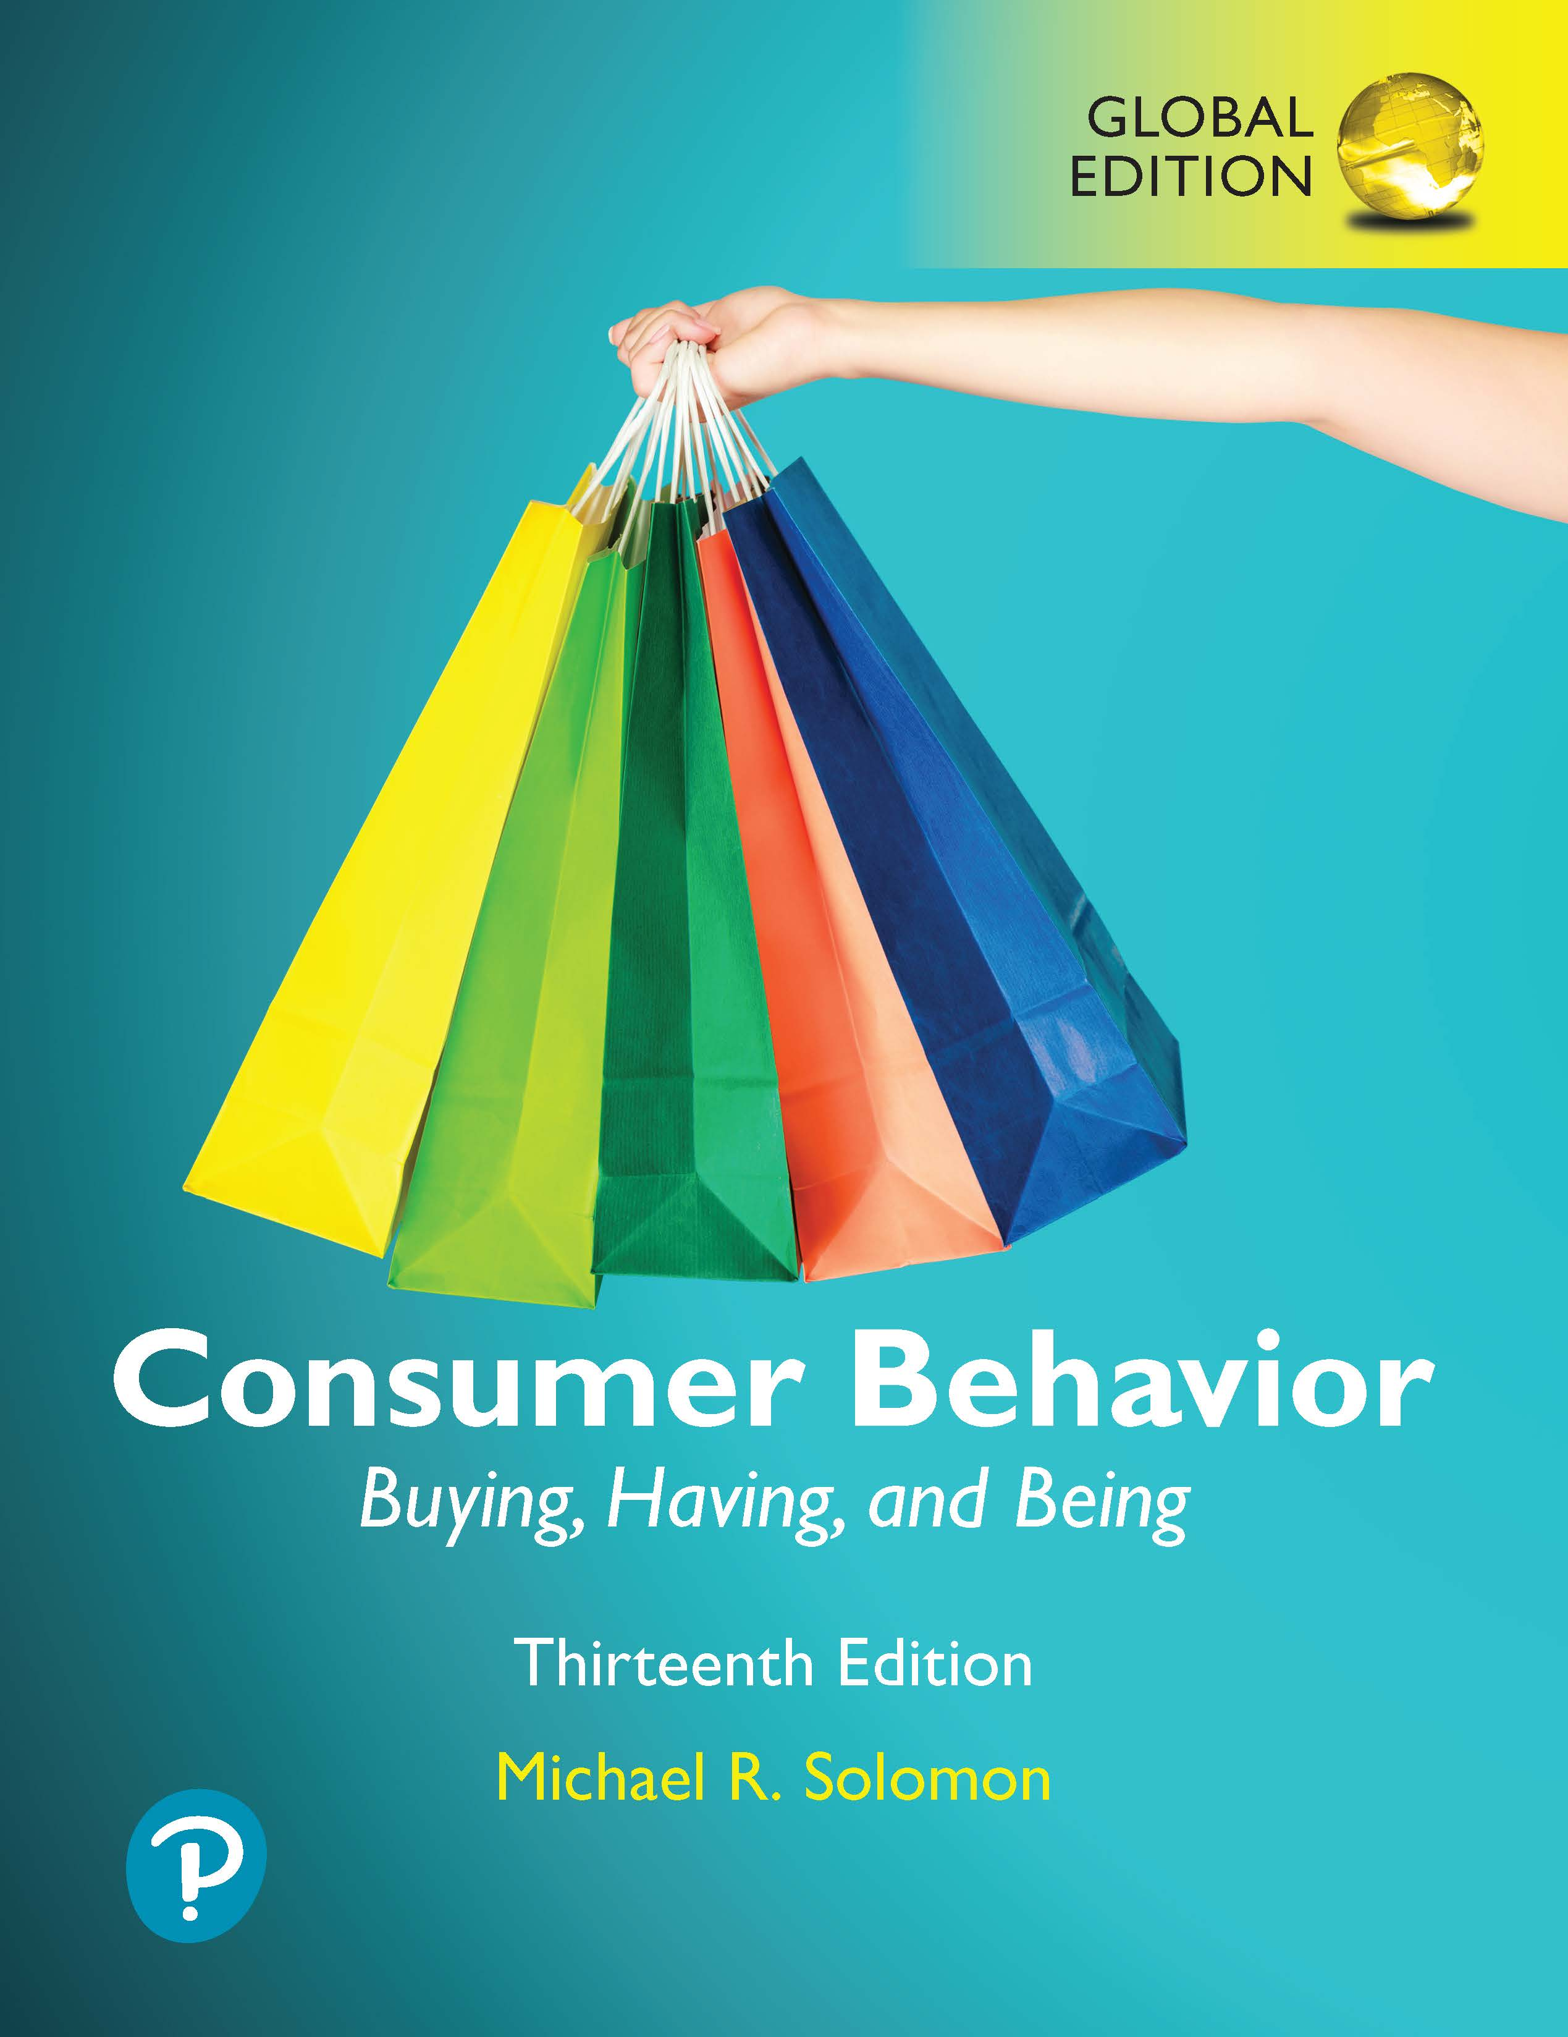
Consumer Behavior: Buying, Having, and Being
Thirteenth Edition, Global Edition
Chapter 12
Income and Social Class
    Slides in this presentation contain hyperlinks. JAWS users should be able to get a list of links by using INSERT+F7
Copyright © 2020 Pearson Education Ltd. All Rights Reserved.
Notes:
If this PowerPoint presentation contains mathematical equations, you may need to check that your computer has the following installed:
1) MathType Plugin
2) Math Player (free versions available)
3) NVDA Reader (free versions available)

Slide 4

Utility Maximization Theory

Slide 5
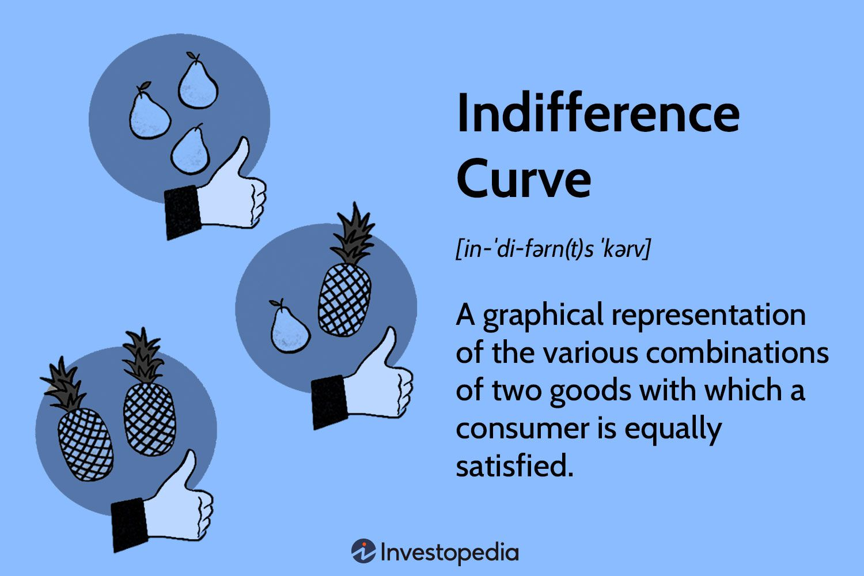
Indifference Curve Analysis

Slide 6
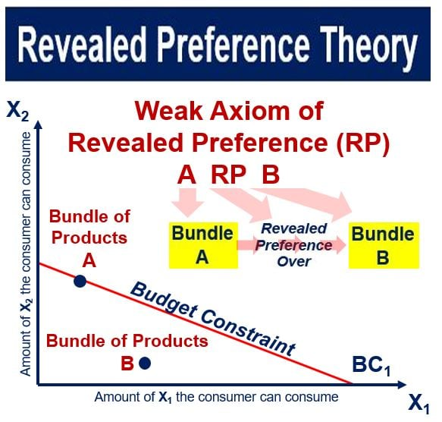
Notes:
by Paul Samuelson in 1938

Slide 7
Consumer Confidence
Behavioral economics is also called economic psychology. It is the study of the human side of economic decisions.
Factors affecting savings rate:
Pessimism/optimism
World events
Cultural differences in attitudes toward savings
Notes:
Behavioral economics is also called economic psychology. It is the study of the human side of economic decisions. Consumers’ beliefs about what the future holds are an indicator of consumer confidence. Consumer confidence is a measure of how optimistic or pessimistic people are about the future health of the economy and how they predict they’ll fare down the road. When people are optimistic about the future, they tend to reduce their savings rate. In addition, world events and culture affect overall savings rates. The person depicted in the Bianco ad is tired of hearing about the financial crisis.
Behavioral Economics Theories
They challenge the assumption of rational decision-making and incorporate factors such as biases, heuristics, and framing effects. Examples include Prospect Theory, which considers how people perceive gains and losses, and the concept of bounded rationality, which suggests that decision-making is limited by the information available, cognitive limitations of the mind, and time constraints.

Slide 8
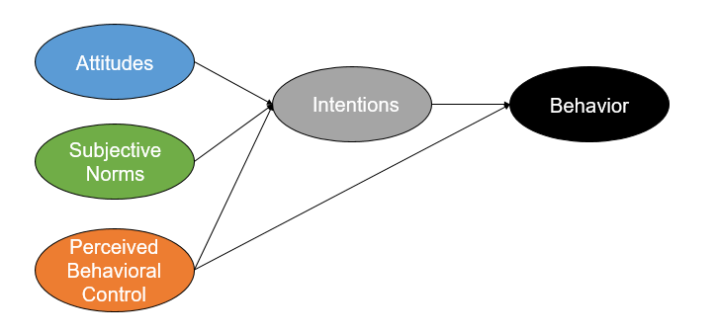
The Theory of Planned Behavior
by Icek Ajzen in 1985
Notes:
The Theory of Planned Behavior was proposed by Icek Ajzen in 1985. This theory is an extension of his earlier work on the Theory of Reasoned Action, which Ajzen developed with Martin Fishbein in the late 1970s. The Theory of Planned Behavior is widely used to predict and understand human behavior in various contexts, emphasizing the role of intention, perceived behavioral control, attitude toward the behavior, and subjective norms in the decision-making process.

Slide 9
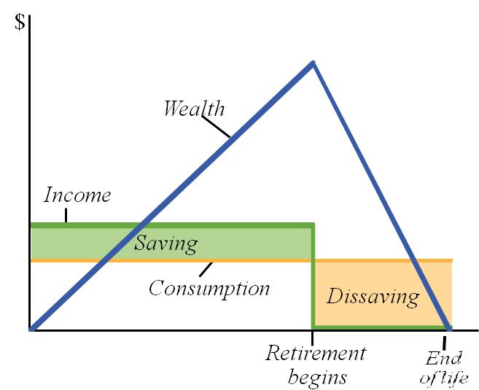
Consumption and Savings Decisions (Life-Cycle Hypothesis):
Notes:
This theory, related to intertemporal choice, examines how consumers plan their consumption and savings over their lifetime, taking into account expected lifetime income, to smooth out consumption as much as possible.

Slide 10
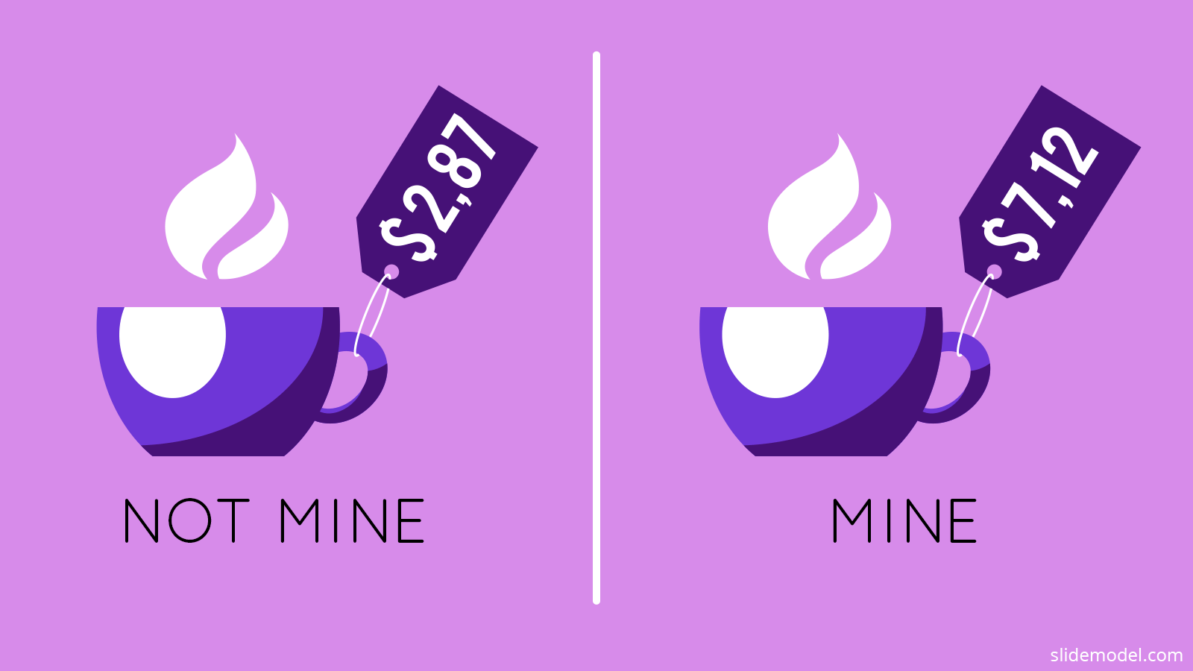
Endowment Effect and Loss Aversion
Two Behavioral Economics principles:
The endowment effect
  “Ownership creates satisfaction”
Loss aversion
  “People are more motivated by avoiding a loss than acquiring a similar gain”

Slide 11

Consumer View of Luxury Goods
Luxury is functional - enduring
Luxury is a reward – “I’ve made it”
Luxury is indulgence – emotional - indulgence
Notes:
SBI divides consumers into three groups based on their attitudes toward luxury. Consumers who use their money to buy things that will last and have enduring value view luxury as functional. Those who use luxury goods to say “I’ve made it” view luxury as a reward. Those who seek out luxury goods in order to illustrate their individuality take an emotional approach to luxury spending and view luxury as indulgence.

Slide 12
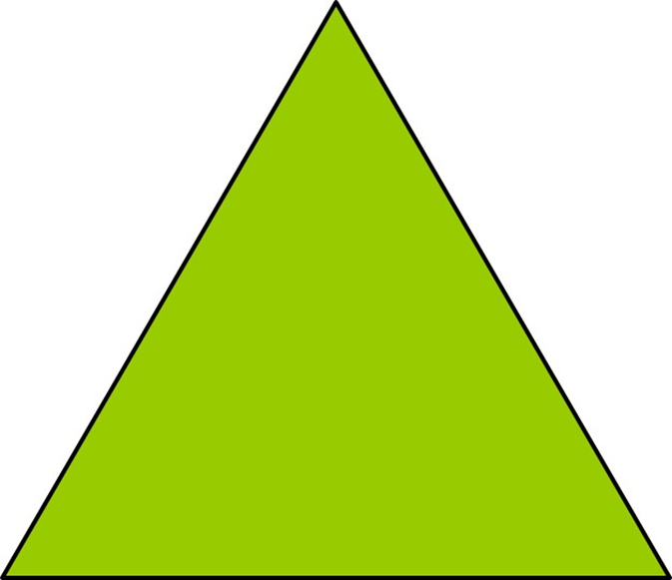
The Income Pyramid
Top of the Pyramid
Bottom of the Pyramid
78% of the global population = low income consumers
whose purchasing power is under $10,000 per year.
Notes:
We typically assume that marketers are targeting consumers at the top of the pyramid. Those are consumers with the highest incomes but they are also a small percentage of the world market. There are also marketers targeting the bottom of the pyramid. 78% of the global population is low income consumers whose purchasing power is under $10,000 per year.

Slide 13
Figure 12.1 The 4 A s
Source: Anderson and Niels Billou, “Serving the World’s Poor: Innovation at the Base of the Economic Pyramid,” Journal of Business Strategy 28, 2: 14–21, reprinted in A. T. Kearney, Serving the Low-Income Consumer: How to Tackle This Mostly Ignored Market, 2011, atkearney com
Notes:
This figure illustrates how marketers can market to low-income consumers. The As include awareness, affordability, availability, and acceptability.

Slide 14
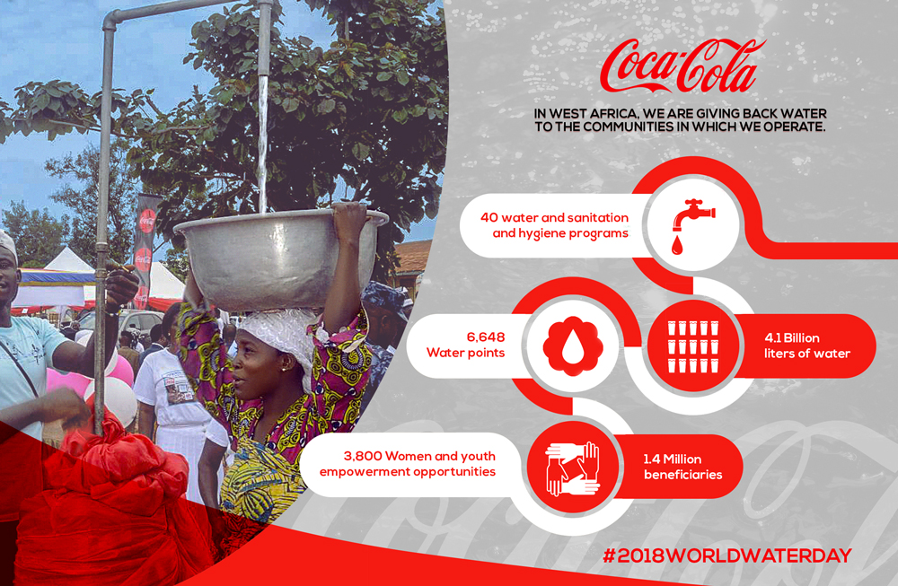

Slide 15

RAIN: Water and Sanitation project

Slide 16
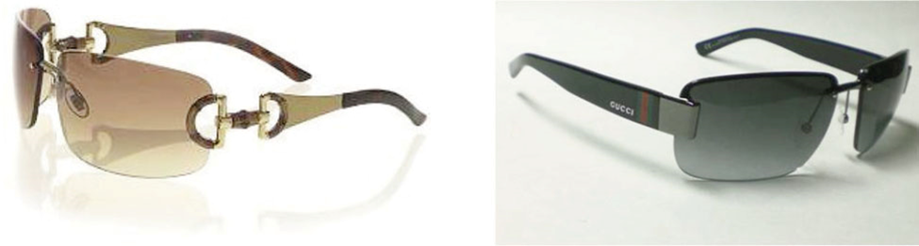
How Brand Loyal Consumers Deal with Counterfeiting
Flight – stop using the brand
Reclamation – try to re-establish relationship with the real brand
Abranding - minimize the visibility of their luxury goods
Source: Young Jee Han, Joseph C. Nunes, and Xavier Drèze (2010), “Signaling Status with Luxury Goods: The Role of Brand Prominence,” Journal of Marketing 74 (July), 15–30, from Figures 2 and 3.
Notes:
How do people who buy luxury goods handle it when that brand is counterfeited? They may flight, reclaim, or abrand. Flight means they stop using the brand. Reclamation means they try to establish their long-term relationship with the real brand. Abrand means they minimize the visibility of their luxury goods so that only those who also have the real thing know that they also have the real thing.

Slide 17
Consumer Behavior: Buying, Having, and Being
Thirteenth Edition, Global Edition
Chapter 14
Culture
Copyright © 2020 Pearson Education Ltd. All Rights Reserved.

Slide 18
What is Culture?
Culture is the accumulation of shared meanings, rituals, norms, and traditions
Culture is a society’s personality
Notes:
Culture includes abstract ideas such as values and ethics and material objects like cars and clothing. It is the shared meaning of our rituals, norms, and traditions among members of a society or organization. The effects of culture on consumer behavior can be so powerful that it’s sometimes difficult to grasp the importance and relevance of culture. We typically notice cultural effects the most when we are immersed in a different one and feel the effects of culture shock.

Slide 19
Culture Production System - CPS
A culture production system is the set of individuals and organizations that create and market a cultural product.
It has three major subsystems:
Creative
Managerial
Communications
Notes:
No single person or company can create popular culture. Instead, many people and organizations contribute to each new trend. A culture production system (CPS) is this set of people and organizations who create cultural meaning. The system has three major subsystems.
The creative subsystem generates new symbols and products.
The managerial subsystem selects, makes, produces, and manages the distribution of new symbols and products.
A communications subsystem gives meaning to the new product and provide it with a symbolic set of attributes.

Slide 20
Myths
Myths are stories with symbolic elements that represent the shared emotions/ideals of a culture.
Story characteristics:
Conflict between opposing forces
Outcome is moral guide for people
Myth reduces anxiety by providing guidelines
Notes:
Most of us know a variety of myths that we grew up hearing but we may not know their origins. Typically myths came about to serve as a guide for the listeners. From hearing the story, we can learn right from wrong and how to deal with wrong when we face it. The origins of myths can be surprising. For instance, the original Little Red Riding Hood told the story of a girl who meets a werewolf on the way to her granny’s house. The werewolf has killed granny, and stored her flesh and blood. Red Riding Hood snacks on granny’s remains and then sleeps with the wolf! Some versions even suggest that the wolf was grandpa. Thus, Little Red Riding Hood is a myth that guides the reader from partaking in incest and loose behavior.

Slide 21
Functions of Myths
Metaphysical
Help explain origins of existence
Cosmological
Emphasize that all components of the universe are part of a single picture
Sociological
Maintain social order by authorizing a social code to be followed by members of a culture
Psychological
Provide models for personal conduct
Notes:
Myths serve four interrelated functions in a culture. These are noted on the slide.

Slide 22
Myths Abound in Modern Popular Culture
Myths are often found in comic books, movies, holidays, and commercials
Monomyths: a myth that is common to many cultures (e.g., Spiderman and Superman)
Many movies/commercials present characters and plot structures that follow mythic patterns
Notes:
Myths are very popular. One example is the popularity of Disney weddings. Brides dress as princesses and ride to the wedding pavilion in a horse-drawn carriage complete with footmen.
Some fictional figures embody such fundamental properties that they become a monomyth. A monomyth is a myth that is common to many cultures. For instance, Superman is a monomyth. Many famous movies and television shows build on mythic themes. Gone With the Wind builds upon the romance of war and illustrates a lost era where man and nature existed in harmony. E.T. represents a familiar myth of messianic visitation. Star Trek builds on the story of the New England Puritans who explored the final frontier. Even ads can represent mythic themes.

Slide 23
For Reflection (3 of 7)
Identify modern day myths that corporations create.
How do they communicate these stories to consumers?

Slide 24
Rituals
Rituals are sets of multiple, symbolic behaviors that occur in a fixed sequence and that tend to be repeated periodically.
Many consumer activities are ritualistic.
Trips to Starbucks
Sunday brunch
Notes:
When you hear the word, ritual, you may think of something formal and serious like the ritual of taking communion at church. In reality, consumers have many ritualistic activities. Having Sunday brunch, going daily to Starbucks, and tailgating before football games are all examples of commonplace rituals.

Slide 25
Common Rituals
Grooming
Gift-giving
Holiday
Rites of passage
Notes:
Many of our ongoing traditions contain rituals. For instance, when you get ready for work or school each day, you likely have things you always do as part of getting ready. In giving gifts, you may have rituals. For instance, you might always give a certain type of gift or card. During the holidays, families typically have set rituals for who will start the meal, and so on. Lastly, during rites of passage like weddings and graduations, we typically have rituals we follow.

Slide 26
Gift-Giving Stages
Gestation
Presentation
Reformulation
Notes:
Gift-giving has three distinct stages. During gestation, the giver procures an item to mark some event. The event might be structural, meaning that is culturally dictated such as Christmas, or it may be emergent. The second stage is presentation which is the actual stage of gift exchange. The final stage is reformulation, in which the giver and receiver redefine the bond of the relationship based on the impact of the gift exchange.

Slide 27
Global Consumer Culture
What drives consumers in other cultures?
Global consumer culture – unites consumers around the world by their common devotion to brand-name consumer goods, movie stars, celebrities, and leisure activities.

Slide 28
For Reflection (7 of 7)
What is and what should be the role of fashion in our society?
How important is it for people to be in style?
What are the pros and cons of keeping up with the latest fashions?

Slide 29
Adopt a Standardized Strategy
Emic perspective
National character
Consumer style
Notes:
Disney’s experience supports the view of marketers who endorse an emic perspective that stresses variations across cultures. They feel that each culture is unique, with its own value system, conventions, and regulations. This perspective argues that each country has a national character, a distinctive set of behavior and personality characteristics.
Consumer style: A pattern of behaviors, attitudes, and opinions that influences all of a person’s consumption activities—including attitudes toward advertising, preferred channels of information and purchase, brand loyalty, and price consciousness.

Slide 30
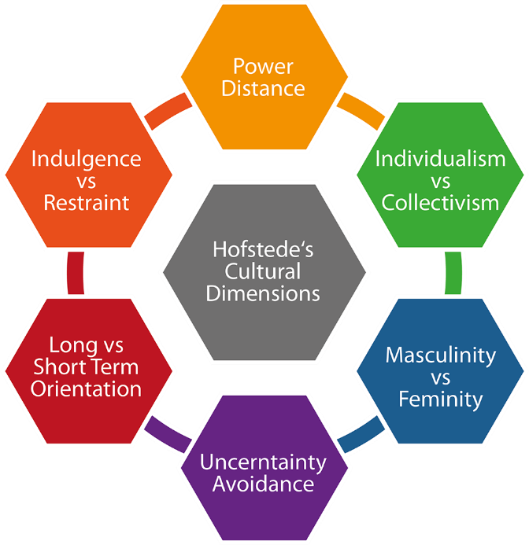
Hofstede Dimensions of National Culture
Notes:
Hofstede’s dimensions are among the most widely used measures for understanding cross-cultural values.
Power distance is the extent to which the less powerful members of organizations and institutions (like the family) accept and expect that power is distributed unequally. Individualism is the degree to which individuals are integrated into groups. Masculinity is the distribution of roles between the genders. Uncertainty avoidance is a society’s tolerance for uncertainty and ambiguity. Long-term orientation refers to values associated with Long-Term Orientation are thrift and perseverance; values associated with Short-Term Orientation are respect for tradition, fulfilling social obligations, and protecting one’s “face.” Indulgence versus restraint is the extent to which a society allows relatively free gratification of basic and natural human drives related to enjoying life and having fun. A culture high on restraint suppresses gratification of needs and regulates it by means of strict social norms.

Slide 31
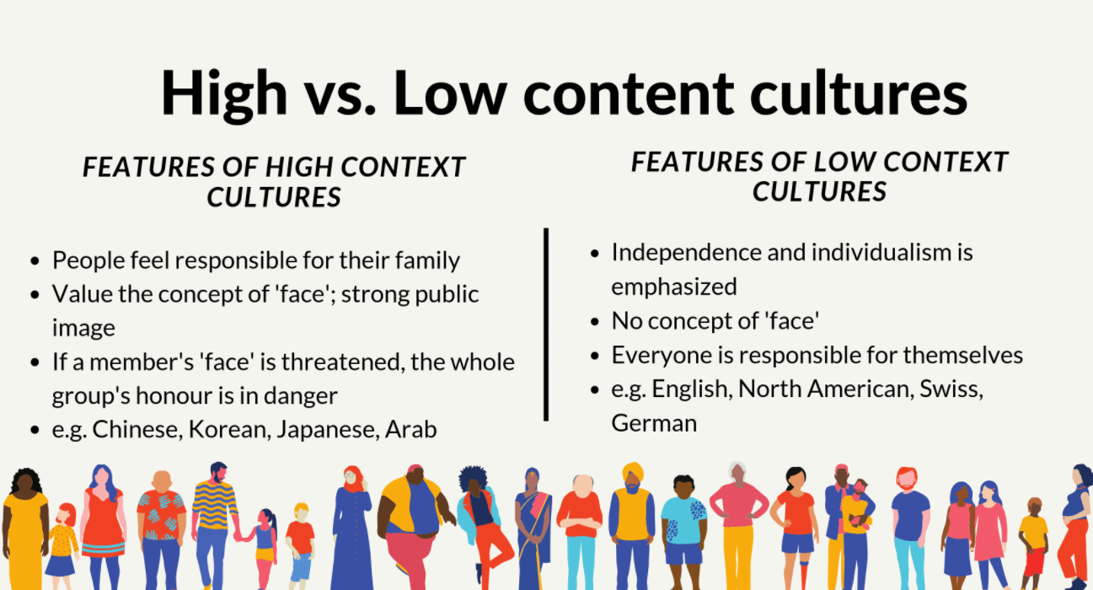
Hall’s High vs. Low Context Cultures

Slide 32
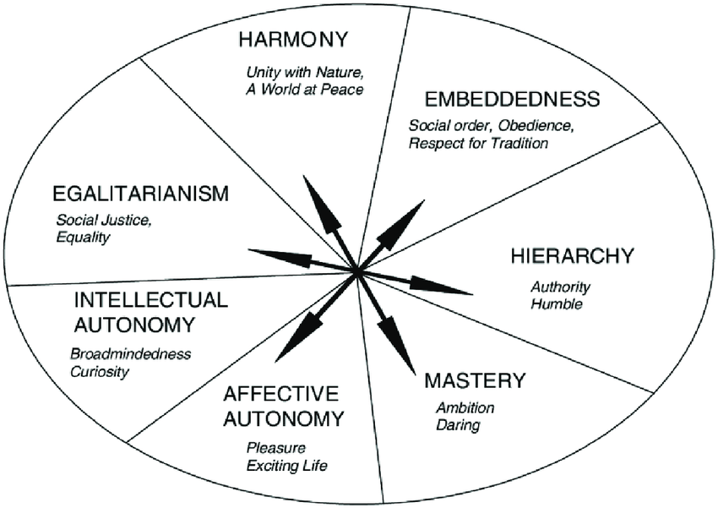
Schwartz's Theory of Cultural Values:

Slide 33
Global Marketing
Global citizens
Global dreamers
Antiglobals
Global agnostics
Consumer Ethnocentrism
Global Consumer Culture Theory (GCCT)
Social Identity Theory and Consumer Tribe Theory
Notes:
Global citizens—The largest segment (55 percent of consumers) uses the global success of a company as a signal of quality and innovation. At the same time, they are concerned about whether companies behave responsibly on issues such as consumer health, the environment, and worker rights.
Global dreamers—The second-largest segment, at 23 percent, consists of consumers who see global brands as quality products and readily buy into the myths they author. They aren’t nearly as concerned with social responsibility as are the global citizens.
Antiglobals—Thirteen percent of consumers are skeptical that transnational companies deliver higher-quality goods. They dislike brands that preach U.S. values, and they don’t trust global companies to behave responsibly. They try to avoid doing business with transnational firms.
Global agnostics—The remaining 9 percent of consumers don’t base purchase decisions on a brand’s global attributes. Instead, they evaluate a global product by the same criteria they use to judge local brands and don’t regard its global nature as meriting special consideration.

Slide 34
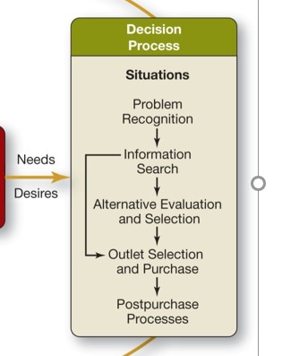
What choices we have? What decisions we make in each stage?

Slide 35
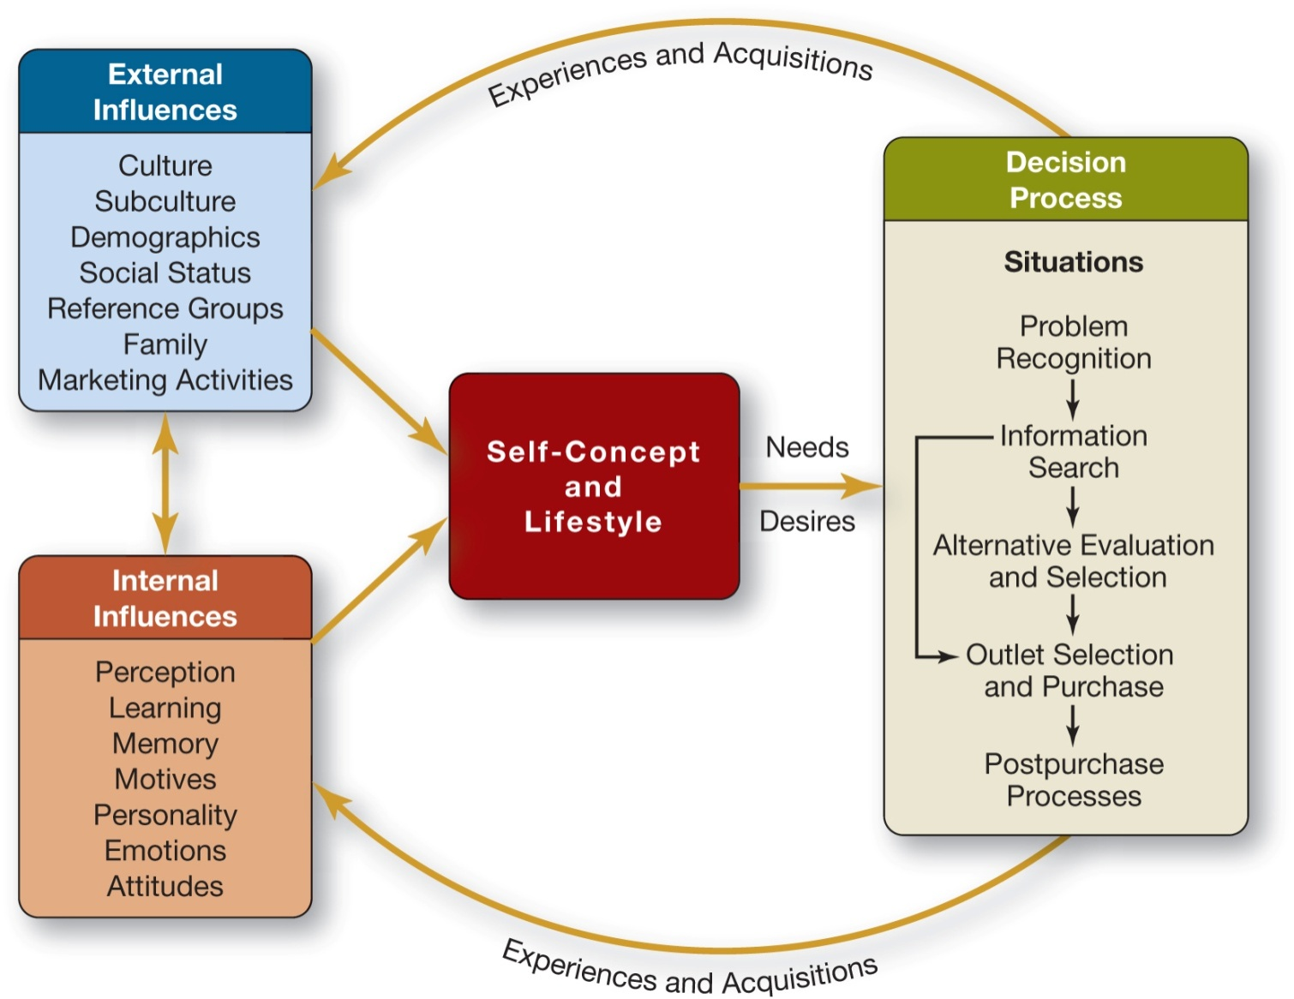
PART I: INTRODUCTION
1-35
Notes:
How the life in 21st century influence on the Decision process? Different types of problems, Different and multimedia information search, different and multi channel outlets, different post-purchase communication
Marketing 2 Consumers shift into Marketing4 Consumers

Slide 36

Summary
We need to understand our consumer choices what would you consider from this course?
Write & share

Slide 37
Wrap Up!
What are you going to apply into your personal life?
What are you going to apply into your professional life?
Take the Quiz!

Slide 38

THANK YOU!
Forever Your Mentor!
Get Connected! on LinkedIn
Instagram - ilijanka petrovska@uacs.edu.mk

