Slide 1
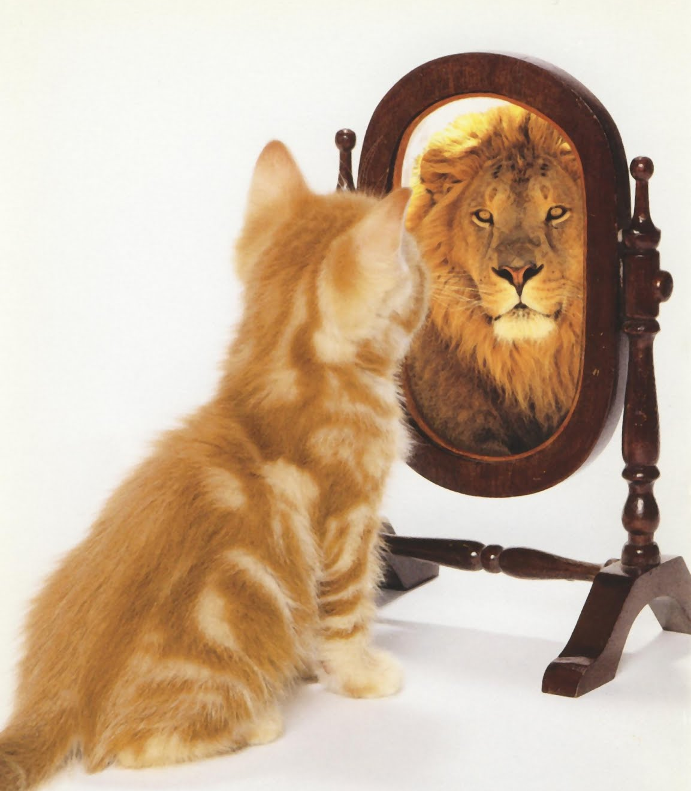
Consumer Choices
The Self concept
Prof. Ilijana Petrovska
Visiting professor @ Tor Vergata

Slide 2

SELF CONCEPT
The self-concept strongly influences consumer behavior.
Notes:
In our first objective, we learn about the meaning of self-concept.

Slide 3
What Is Self-Concept?
Self-concept summarizes the beliefs a person holds about his own attributes and how he evaluates the self on these qualities.
Collective Self
Identity
Notes:
Although your overall self-concept may be positive, there certainly are parts of it you evaluate more positively than others. The self-concept is a very complex structure. We describe attributes of self-concept along such dimensions as content (e.g., facial attractiveness versus mental aptitude), positivity (i.e., self-esteem), intensity and stability over time, and accuracy (i.e., the Degree to which one’s self-assessment corresponds to reality).
Collective self, where a person derives his or her identity in large measure from a social group.
Identity is any category label with which a consumer self-associates that is amenable to a clear picture of what a person in that category looks like, thinks, feels and does.

Slide 4
What Is Self-Esteem?
Self-esteem refers to the positivity of a person’s self-concept. People with low self-esteem expect that they will not perform very well, and they will try to avoid embarrassment, failure, and rejection.
Social comparison
Notes:
When it developed a new line of snack cakes, Sara Lee found that consumers low with self-esteem preferred portion-controlled snack items because they felt they lacked self-control. In contrast, a more recent study found that individuals who are made to feel powerful spend more money on themselves (“because I’m worth it!”), whereas those who experience a feeling of powerlessness spend more on others than on themselves.
Social comparison is when a person tries to evaluate her appearance by comparing it to the people depicted in these artificial images.

Slide 5
Real and Ideal Selves
Ideal self: our conception of how we would like to be
Actual self: our more realistic appraisal of the qualities we have
Products can:
  Help us reach ideal self
  Be consistent with actual self
Impression management means that we work to “manage” what others think of us
Notes:
We choose some products because we think they are consistent with our actual self, while we buy others to help us reach an ideal standard. We may strategically choose clothing and other products to show off to others. In other words, we are managing their impression of us with our product choices.

Slide 6
Multiple Selves (1 of 2)
Marketers pitch products needed to facilitate active role identities.
Behavioral learning theories focus on stimulus-response connections
Cognitive theories focus on consumers as problem solvers who learn when they observe relationships
Notes:
We all have multiple roles we play in our lives. We may have as many selves as we do different social roles. If each person potentially has many social selves, how does each develop? How do we decide which to activate at any point in time? Symbolic interactionism stresses that relationships with other people play a large part in forming the self.
The dramaturgical perspective on consumer behavior views people as actors who play different roles.
Torn self, where respondents struggle with retaining an authentic culture while still enjoying Western freedom (and dealing with assumptions of others who believe they might be terrorists).
Symbolic interactionism stresses that relationships with other people play a large part to form the self.

Slide 7
Looking-Glass Self
Self-fulfilling prophecy
Sociologists call the process of imagining others’ reactions “taking the role of the other,”
Notes:
Sociologists call the process of imagining others’ reactions “taking the role of the other,” or the looking-glass self. According to this view, our desire to define ourselves operates as a sort of psychological sonar. We take readings of our own identity when we “bounce” signals off others and try to project their impression of us. Like the distorted mirrors in a funhouse, our appraisal of who we are varies depending on whose perspective we consider and how accurately we predict their evaluations of us. A confident career woman may sit morosely at a nightclub, imagining that others see her as a dowdy, unattractive woman with little sex appeal (regardless of whether these perceptions are true). A self-fulfilling prophecy like the one we described comes into play here because these “signals” influence the woman’s actual behavior.

Slide 8
Self-Consciousness
Public self-consciousness
Self monitors
Selfie
Meerkating
Empty self
Notes:
Public self-consciousness relates to the extent in which a person expresses interest in clothing and the use of cosmetics.
High self-monitors are more attuned to how they present themselves in their social environments, and their estimates of how others will perceive their product choices influence what they choose to buy.
A selfie, or a picture a smartphone user takes of himself or herself on a smartphone (whether or not it’s attached to a “selfie stick”) is a common form of communication, especially for Millennials.
Meerkating describes the act of someone shooting a live video stream, has become a verb as thousands of people create their own running self-documentaries.
Empty self relates to the decline of shared points of reference over the last 50 years as we witnessed a decline in family, community, and traditions.

Slide 9
You Are What You Consume
Social identity as individual consumption behaviors
  Question: Who am I now?
  Answer: To some extent, your possessions!
Inference of personality based on consumption patterns
Symbolic self-completion theory - People who have an incomplete self-definition complete the identity by acquisition
Notes:
Identity marketing is a promotional strategy where consumers alter some aspects of their selves to advertise for a branded product.
For instance, Air New Zealand created “cranial billboards” in exchange for a round-trip ticket to New Zealand. 30 participants shaved their heads and walked around with an ad for the airline on their skulls. The Casa Sanchez restaurant in San Francisco gives free lunches for life to anyone who gets its logo tattooed on their body. The restaurant estimates that the cost of the identity marketing promotion is $5.8 million – in terms of the free lunches redeemed.
The reflected self helps shape self-concept, which implies that people see themselves as they imagine others see them. Because what others see includes a person’s clothing, jewelry, furniture, car, and so on, it stands to reason that these products also help to create the perceived self. A consumer’s possessions place her into a social role which helps to answer the question, “Who am I now?”
People use an individual’s consumption behaviors to identify that person’s social identity. In addition to looking at clothes and grooming habits, we make inferences about personality based on choices of leisure activities, food preferences, and home decorating choices.
When we use objects to maintain our self-concept, we tend to become attached to those objects. For example, someone who drives a Mini Cooper may rely upon the image of Mini to relay information about his or her own identity (as a fun, distinctive, stylish person). The more the person relies upon the possession as a way of defining and supporting his or her identity, the more attached the person will be to the possession.
Symbolic self-completion theory suggests that people who have an incomplete self-definition tend to complete this identity when they acquire and display symbols they associate with that role.

Slide 10
Self/Product Congruence
Consumers demonstrate their values through their purchase behavior
Self-image congruence models: we choose products when attributes matches the self
Product Usage = Self-Image
Notes:
Research supports this idea that there is a match between product usage and self-image. In one study, car owners’ rating of themselves tended to match their perceptions of their cars. In another study, observers were able to match photos of male and female drivers to the cars they drove 70% of the time.

Slide 11
For Reflection (1 of 5)
Advertising can utilize a consumer’s self-esteem in promoting a product by offering the product as a remedy to low self-esteem. Self-esteem advertising: products provide remedy to low self-esteem.
How effective do you think this form of advertising is?

Slide 12
The Levels of the Extended Self
Individual: personal possessions (cars, clothing)
Family: residence and furnishings
Community: neighborhood or town where you live
Group: social or other groups
Notes:
The external objects that we consider a part of us make up our extended selves. Many material objects can help to form a person’s identity.

Slide 13
The Digital Self
Wearable computing
Virtual makeover
Avatars
Notes:
People can construct digital versions of their selves online. We use digital footprints, lifestreams, and profiles to do this.
Wearable computing are when we wear devices on our wrist like the Apple Watch.
Virtual makeovers are platforms that allow the shopper to superimpose images on their faces or bodies so that they can quickly and easily see how products would alter appearance, without taking the risk of actually buying the item first.

Slide 14
GROUP WORK
Individually: Construct a “consumption biography” of a friend, family member or a classmate … your choice!
Make a list of his/her most favorite possessions and the student next to you can describe this person’s personality just from the information provided by this catalogue.

Slide 15
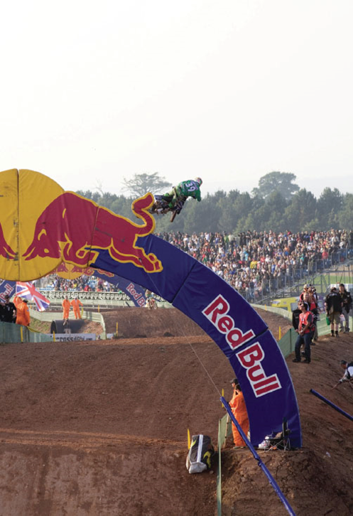
Understanding Consumers
Demographics:
  Age
  Gender
  Family structure
  Social class/income
  Race/ethnicity
  Geography
  Lifestyles
  behaviors
Notes:
Demographics are statistics that measure observable aspects of a population. Some of the most common demographic measures are age, gender, family structure, social class, race or ethnicity, and geography. Even lifestyles can be useful to marketers in that consumers may share demographic characteristics but have very different lifestyles. Marketers try to understand their customers and develop lifelong relationships. Marketers who follow this approach are said to follow the philosophy of relationship marketing.
They may also utilize database marketing in order to track consumers’ buying habits.

Slide 16
Behavioral Marketing trends
Here are just some of the data sources behavioral marketing can use:
Website analytics – Google analytics and trends
Web cookies - Browsing and search history
IP addresses
Social media data (posts, likes, about page, friends, etc.) Analytics and Sentiment analysis
Videos watched

Slide 17
User Persona profile
Who is my ideal customer?
What are the current behavior patterns of my users?
What are the needs and goals of my users?
What issues and pain-points do they currently face within the given context?

Slide 18
What is a user persona?
Is a semi-fictional character based on your current (or ideal) customer. Personas can be created by talking to users and segmenting to improve your product, site and brand marketing.
Demographic segmentation dividing the market into age, gender, family size, family life cycle, income, occupation, education, religion, race, generation and nationality
Psychographic segmentation dividing the market based on social class, lifestyle or personality characteristics

Slide 19
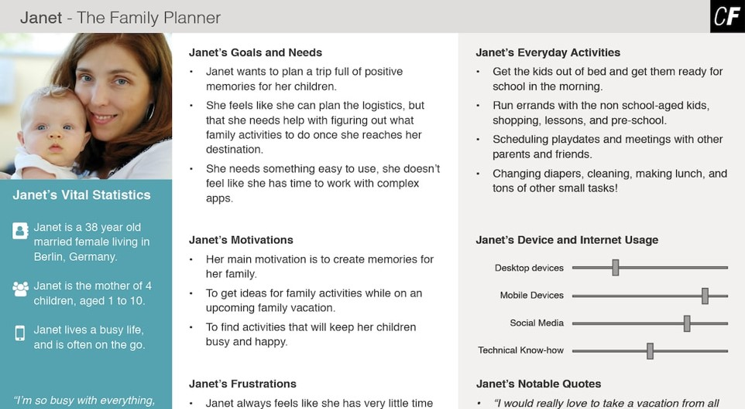
User Persona

Slide 20
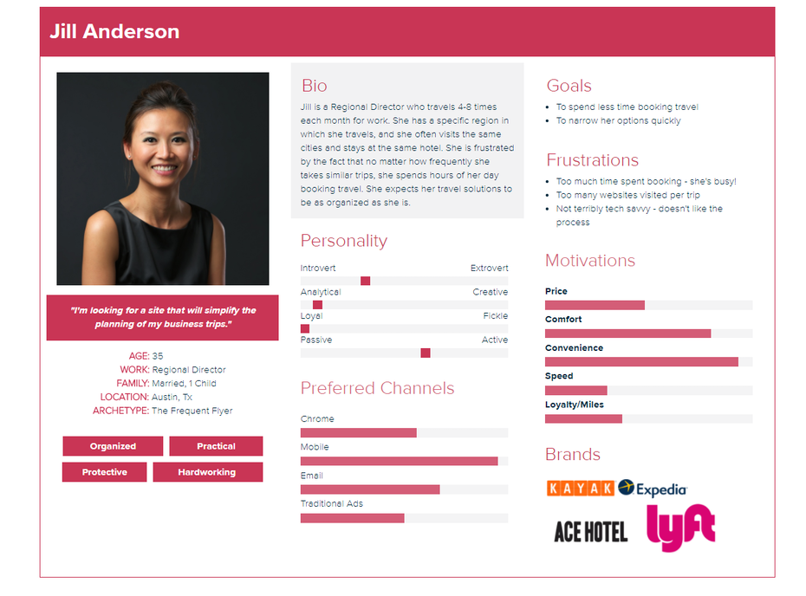

Slide 21
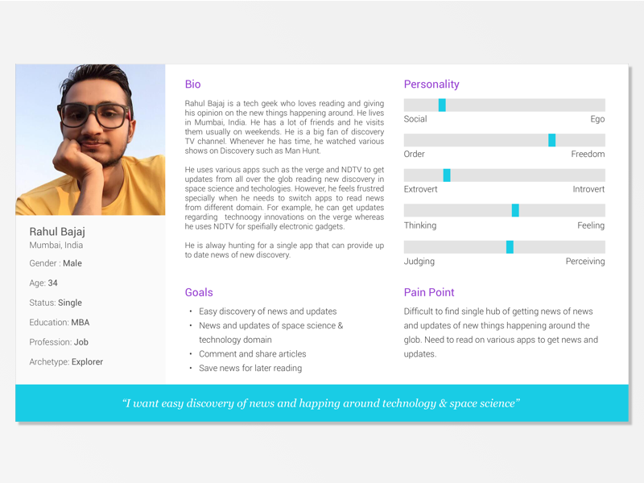

Slide 22
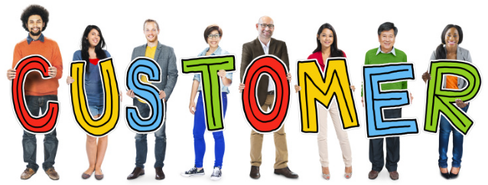
Develop personas
Start small – Start by identifying one persona. You can always create sub-personas later
1
Remember, we’re not trying to represent every guest – Focus on few traits
2
Don’t get to hung up on the usual labels – (e.g. Male vs Female)
3
Personas are dynamic,– you’re building a starting point, revisit personas and make necessary changes
4

Slide 23
Group project User persona
Identify the best platform to develop your Brand User Persona & Develop a User persona – for next class!!!

Slide 24
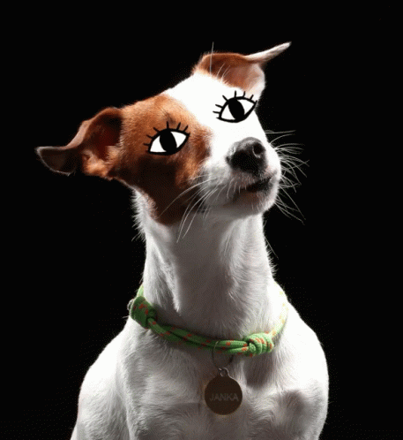
Thank you!
Any questions?

