Slide 1

Customer Journey
Professor Ilijana Petrovska
Visiting professor @ Tor Vergata

Slide 2
AGENDA
User persona & Customer Journey ppt – 20 minutes
GROUP WORK – 20 minutes
Customer Journey

Slide 3
Dark Patterns, Ethics & Regulation
Concepts of choice architecture, defaults, dark patterns, and friction.
Real-world examples:
Instagram infinite scroll (attention traps),
Amazon’s checkout UI (default subscriptions),
Netflix autoplay,
Apple screen time prompts.

Slide 4
From Nudging to Regulation
Dark patterns and the EU Digital Services Act (DSA)
Ethical UX vs growth hacking
Consumer protection in digital markets
Suggested deliverable
Mini audit: “Is this UX legal, ethical, or manipulative?”

Slide 5
Customer Insights

Slide 6
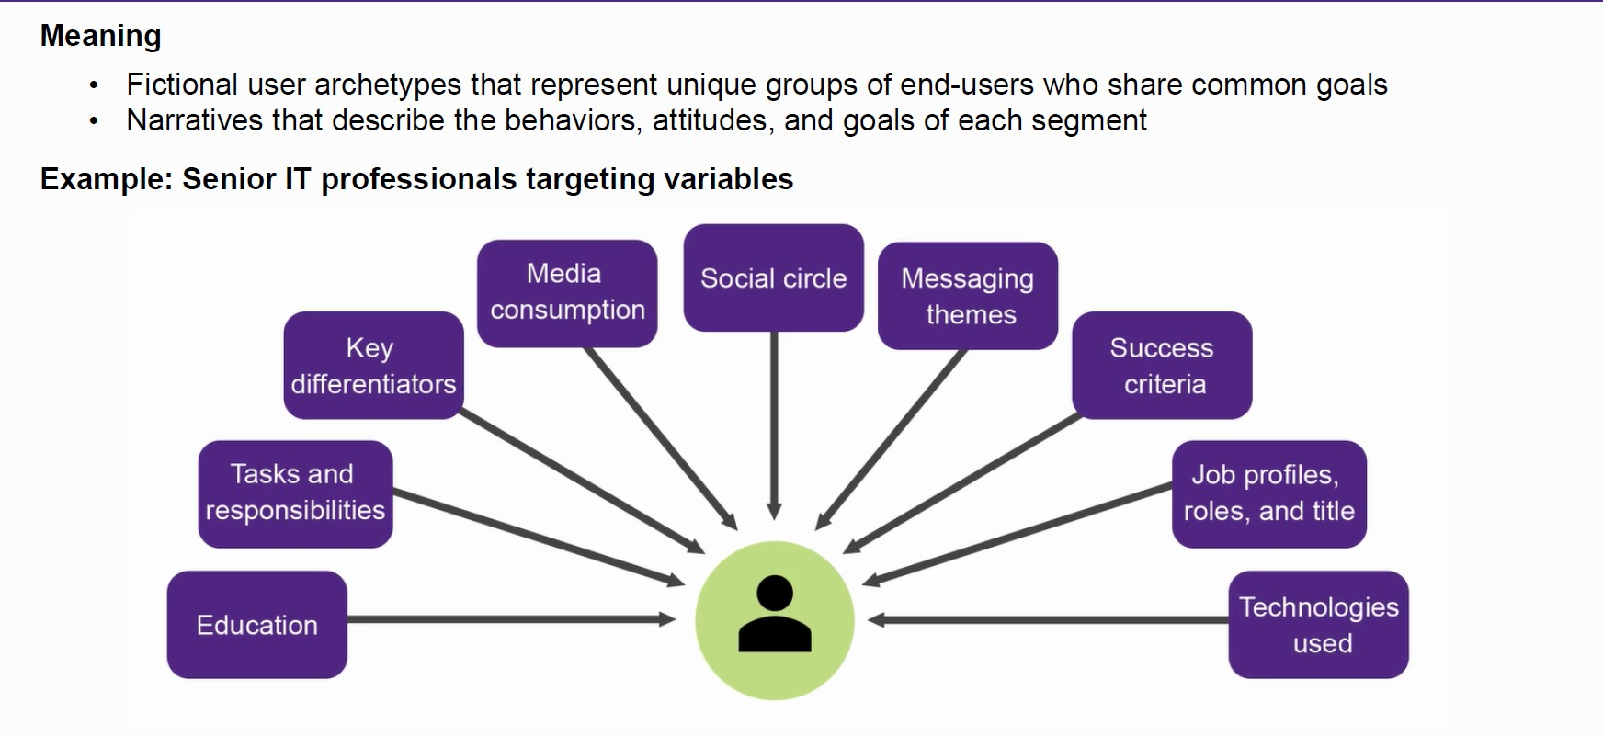
Segment Personas

Slide 7
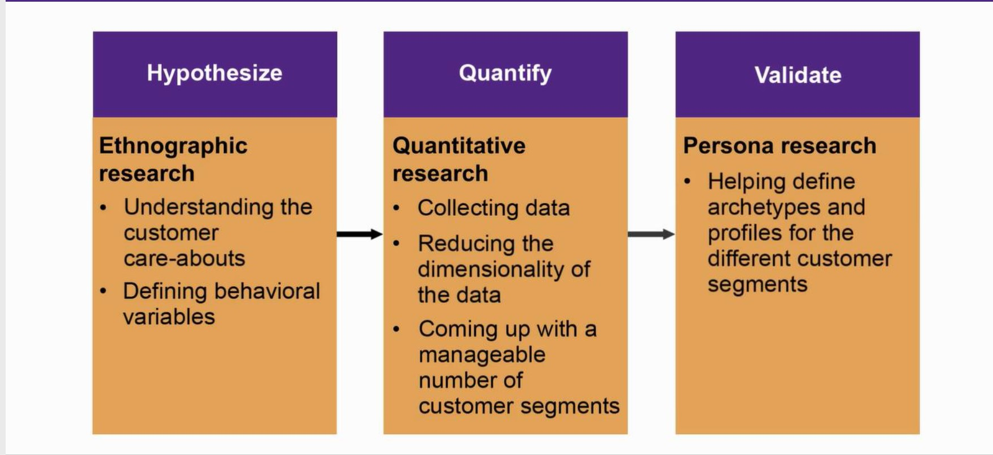
Segmentation Process Overview

Slide 8
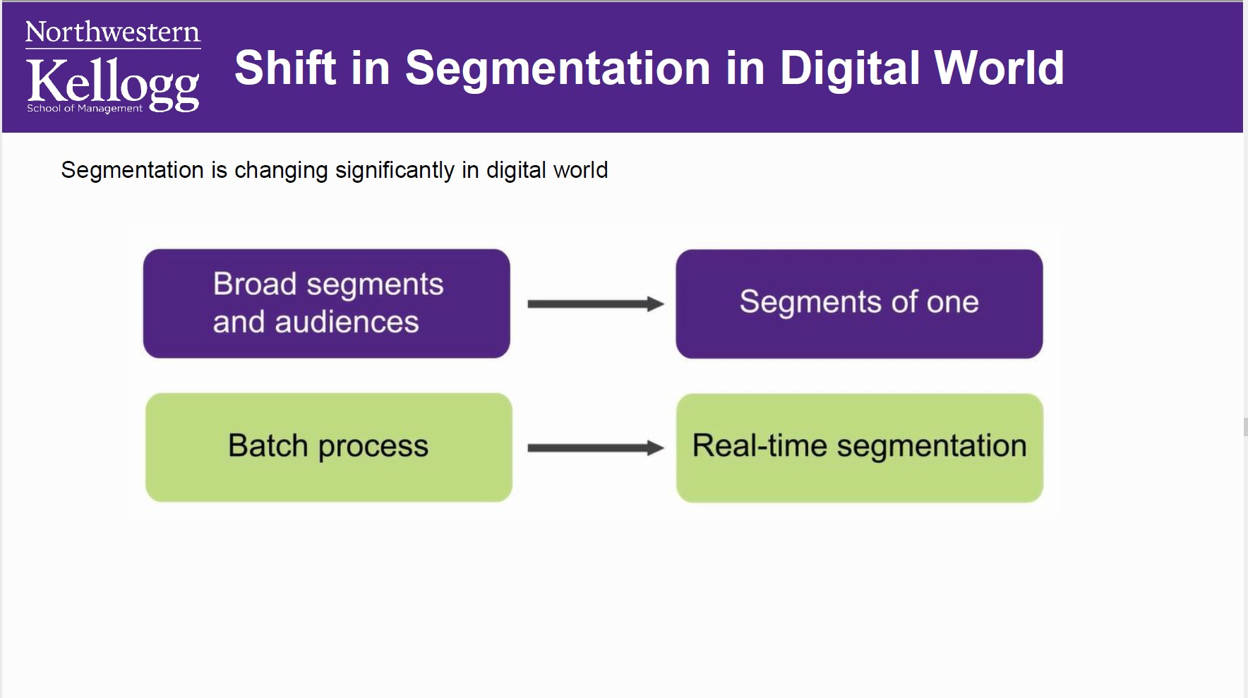

Slide 9
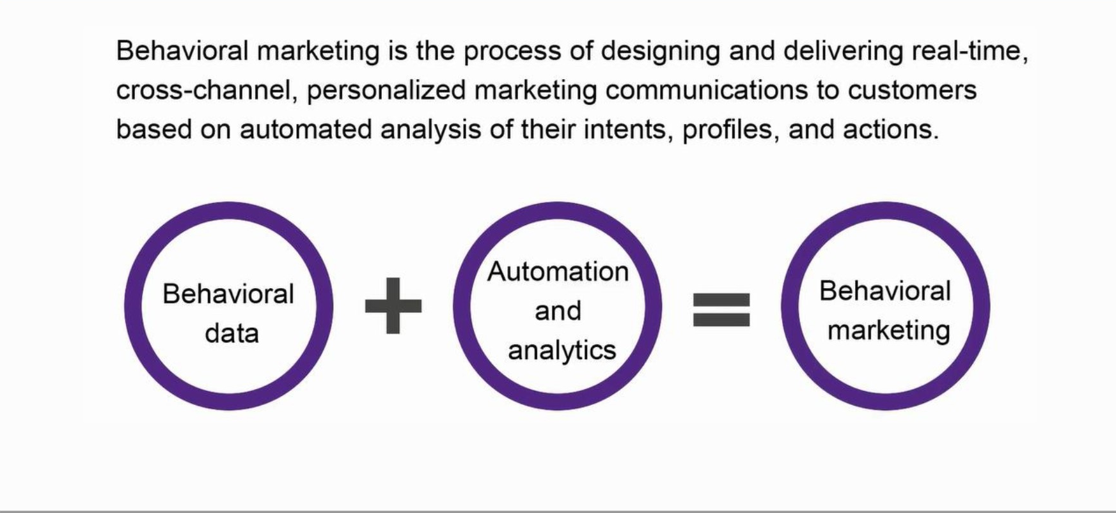
Behavioral marketing

Slide 10
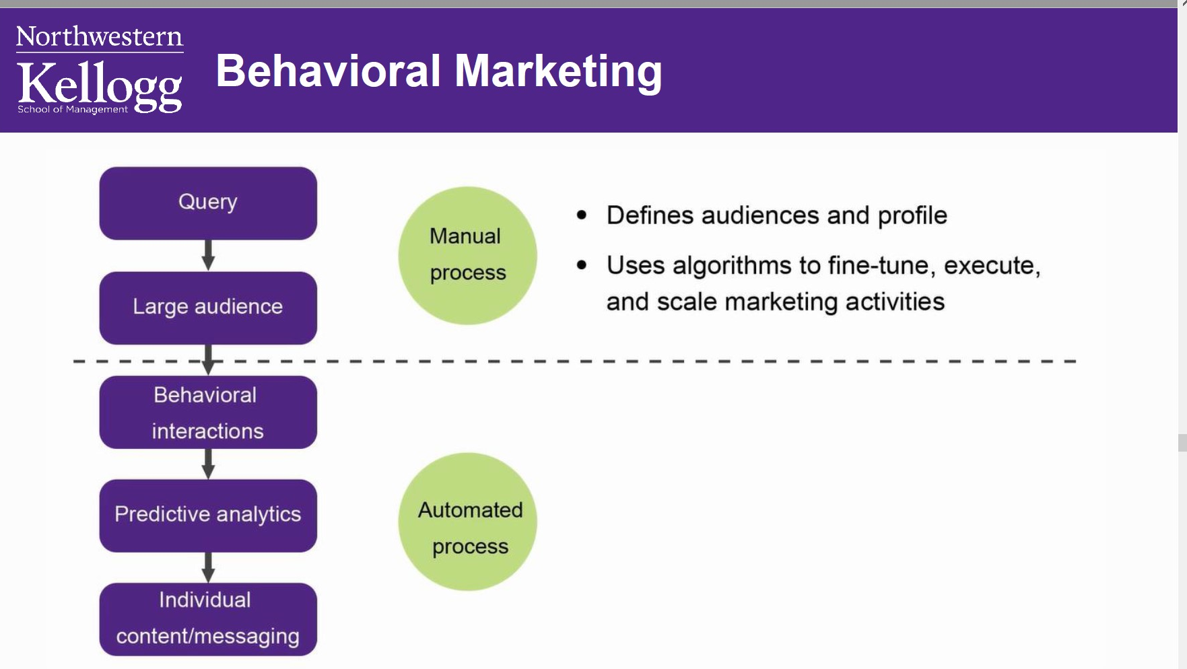

Slide 11
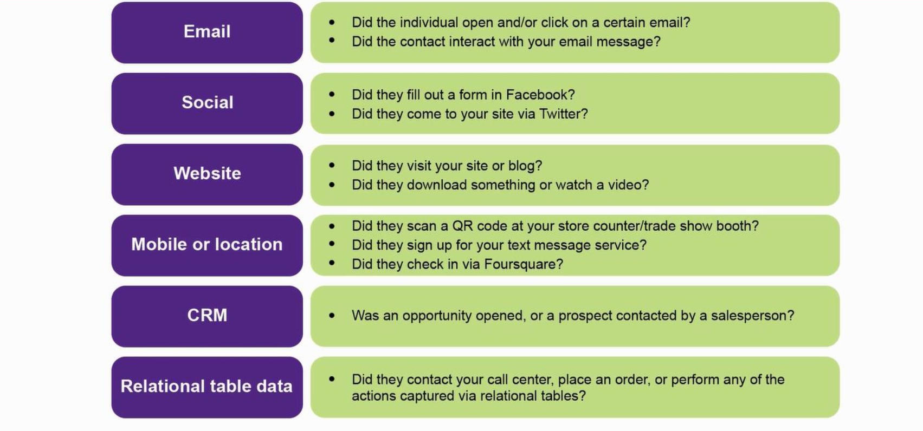
Examples of Behavioral variables

Slide 12
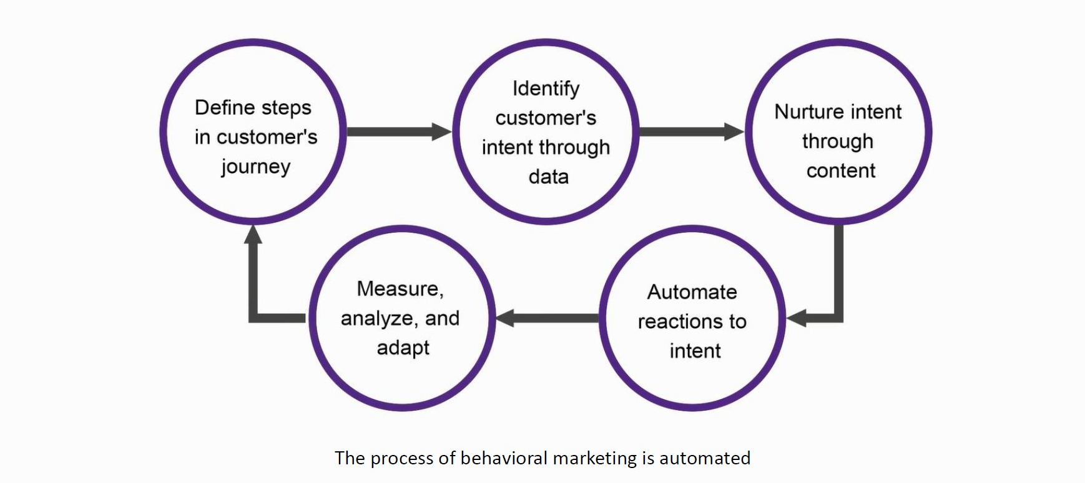
Behavioral Marketing process

Slide 13
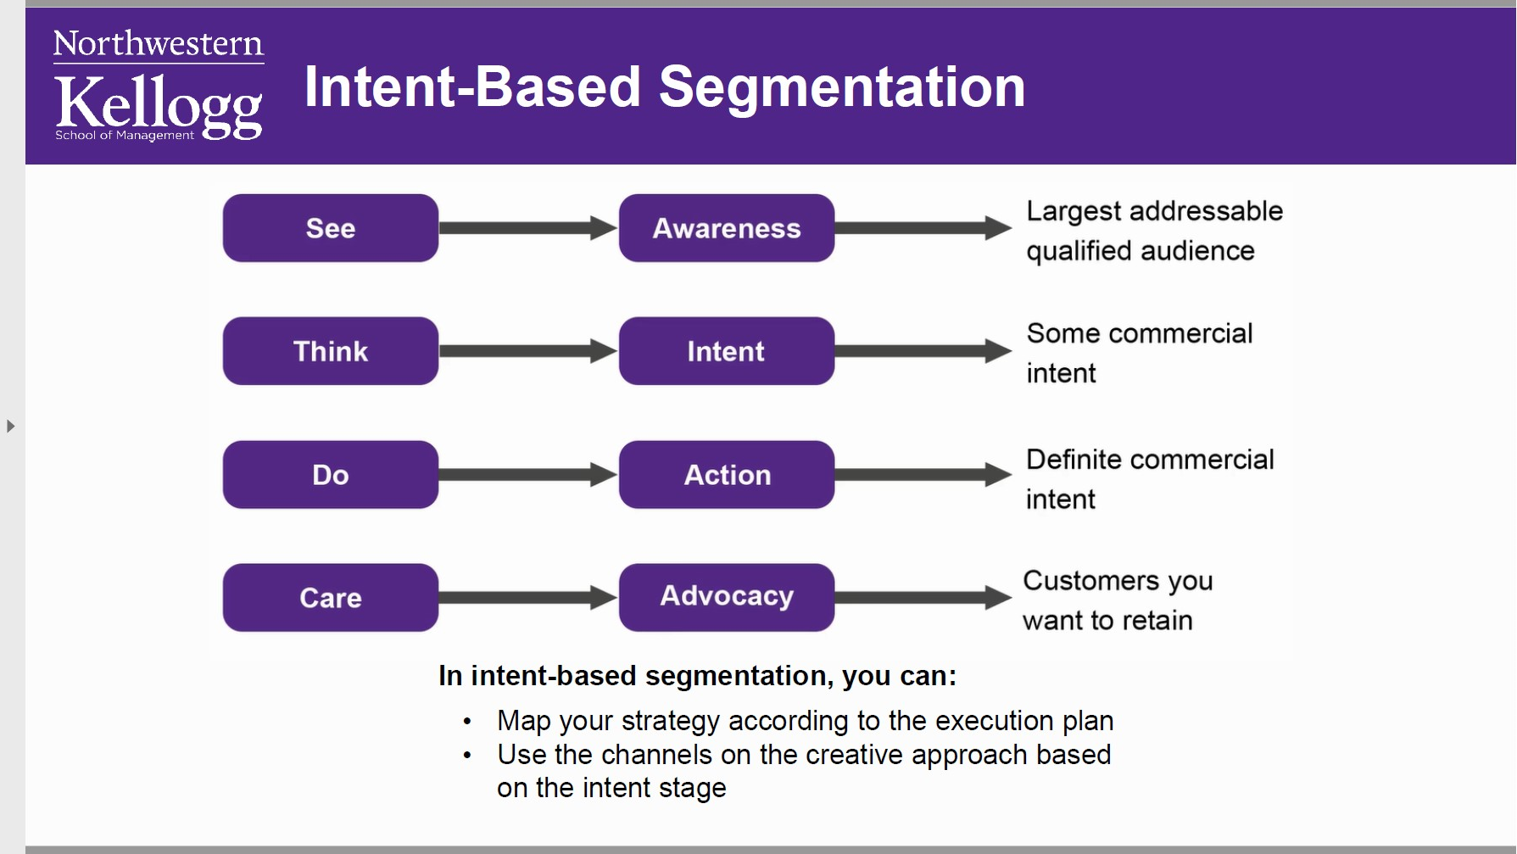

Slide 14
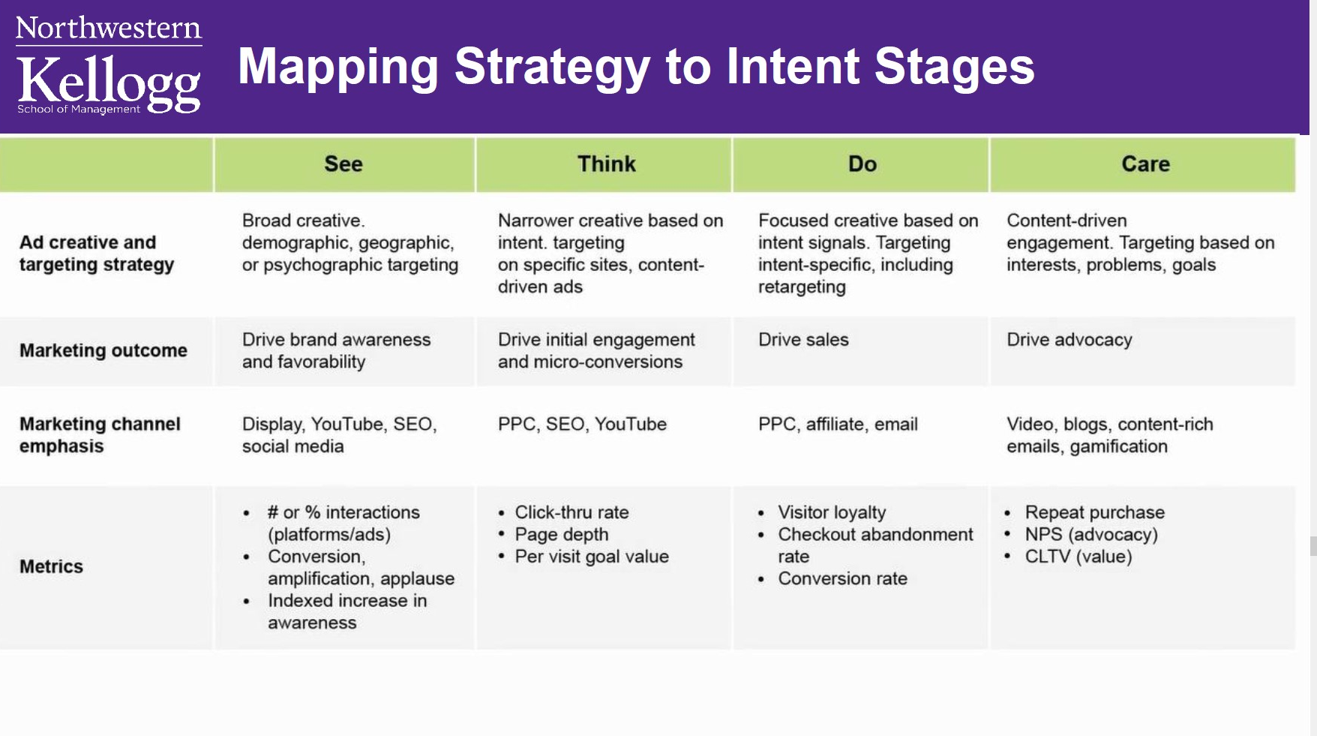

Slide 15
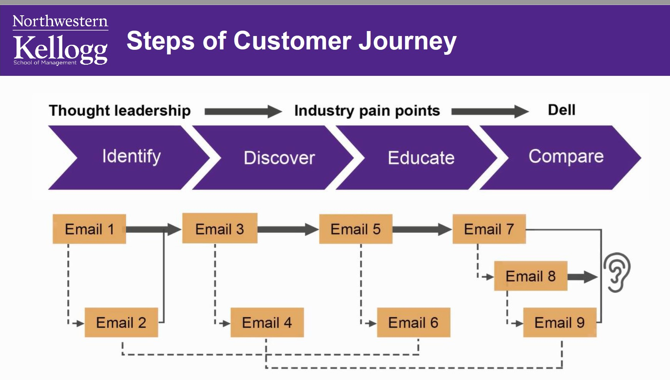

Slide 16
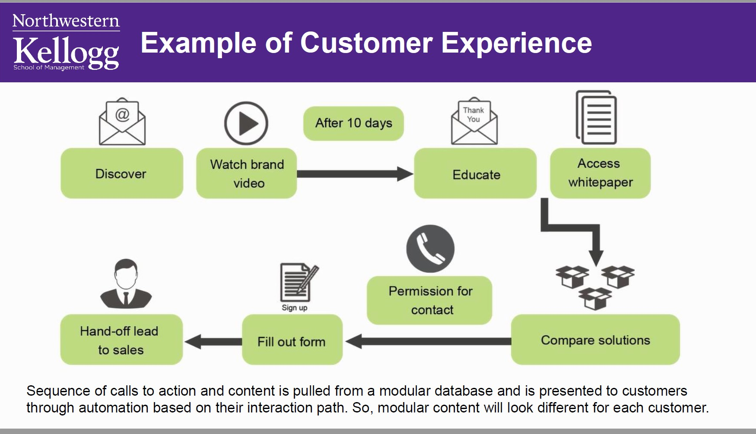

Slide 17
The Customer Journey
& content Strategy

Slide 18
User Persona profile
Who is my ideal customer?
What are the current behavior patterns of my users?
What are the needs and goals of my users?
What issues and pain-points do they currently face within the given context?

Slide 19
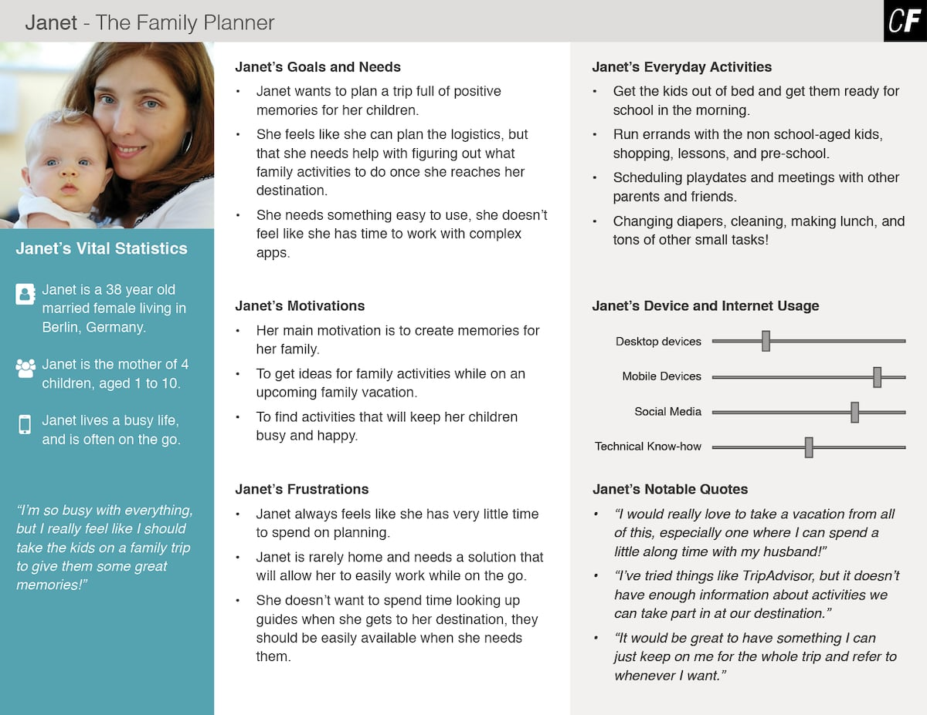

Slide 20
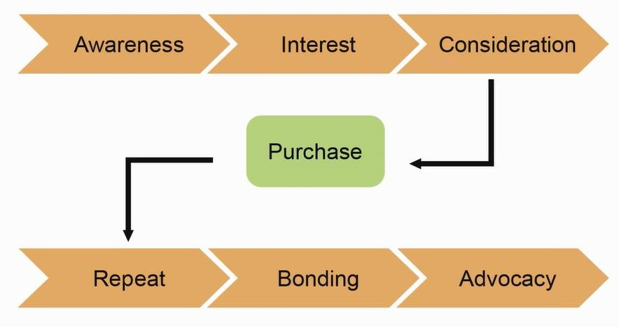
Customer Buying Journey in Pre-Digital World

Slide 21
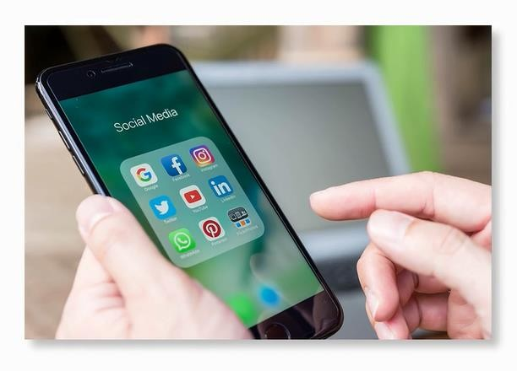
Micro Moment/Now Moment
Customer journey now can be more complex as it is non-linear and involves more devices, touch points, and channel.
Customers now interacts in small increments throughout the day, as they glance through their phones hundred times in a day.

Slide 22
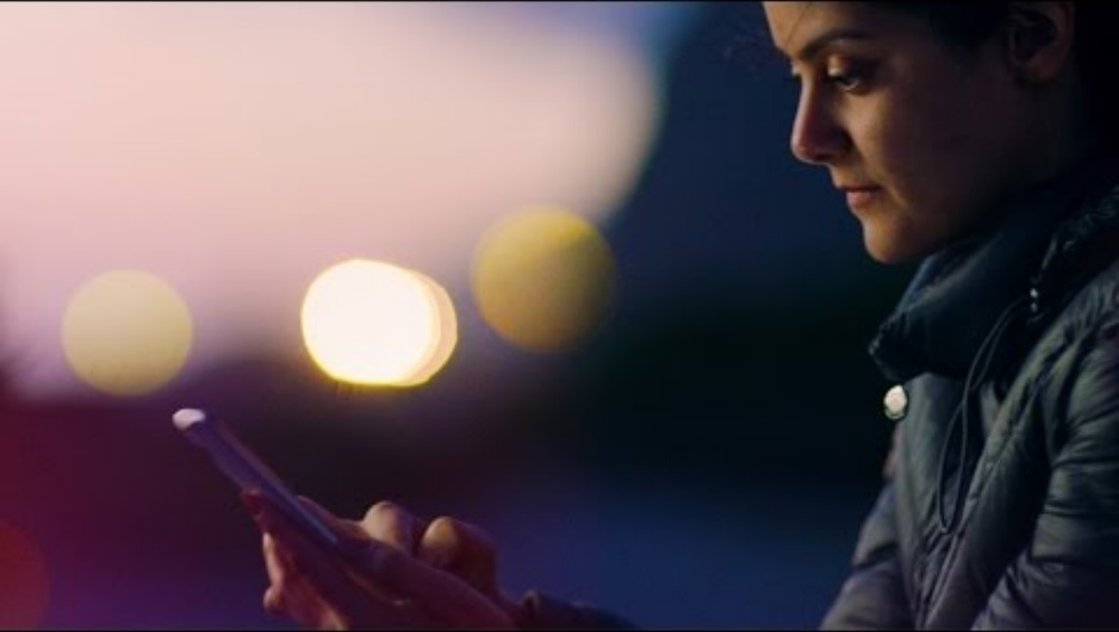
Micro Moments

Slide 23
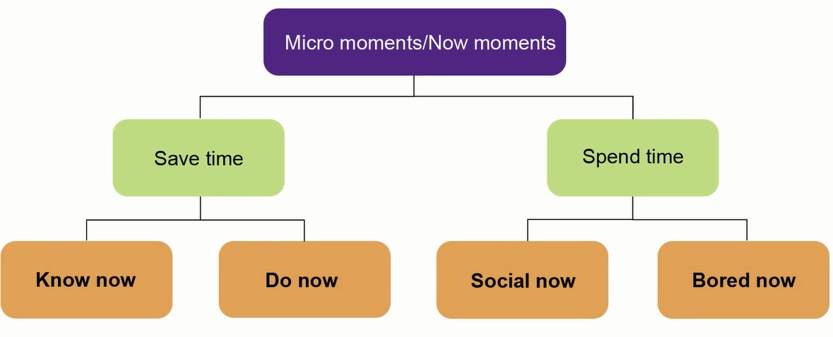
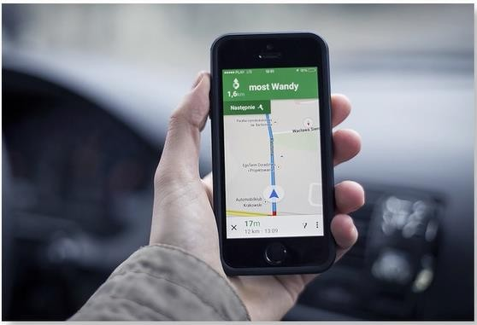
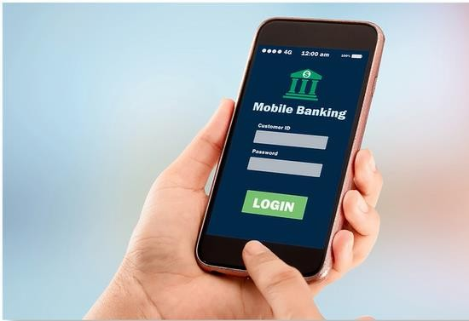

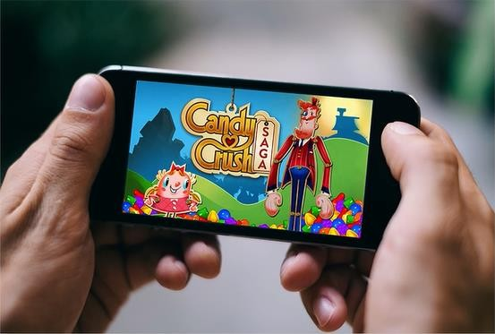
Types of Moments
Example: Finding route
Example: Making transactions
Example: Checking social updates
Example: Playing games

Slide 24

Three Principles of Effective Engagement

Slide 25
Mapping the Customer Journey
Customer journey map is a visual illustration of the activities, expectations, emotions, and perceptions that customers experience throughout their relationship with a company's products, services, and people
It is important to define customer journey map from the customer's perspective. A customer journey map includes:
Customer's experience
Customer's needs and wants
Customer's information needs
Customer's action - what are they doing, thinking, and feeling

Slide 26
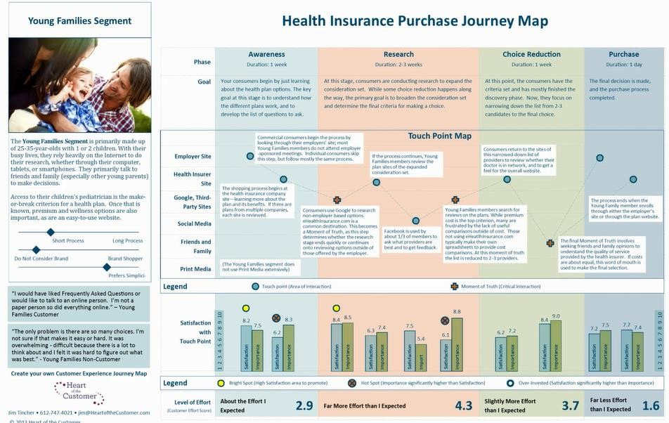
A Customer Journey Map: Example
Stages customer will go through
Customer Persona

Slide 27
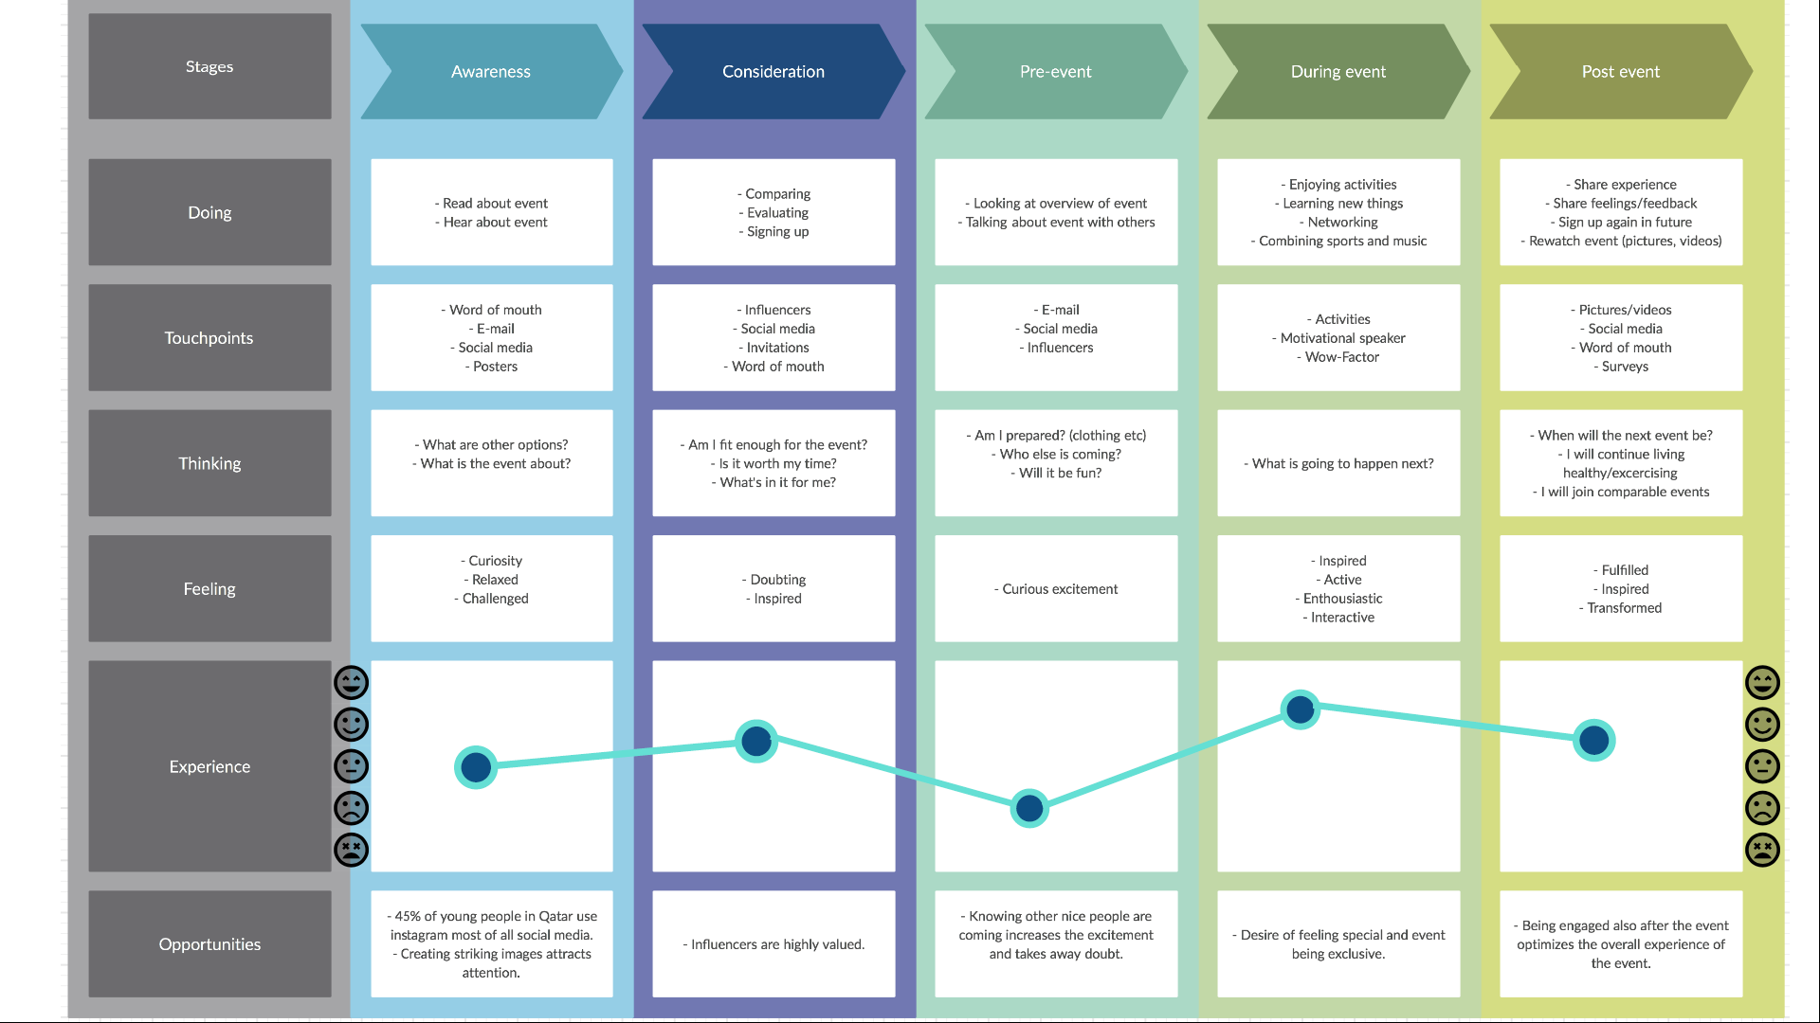

Slide 28
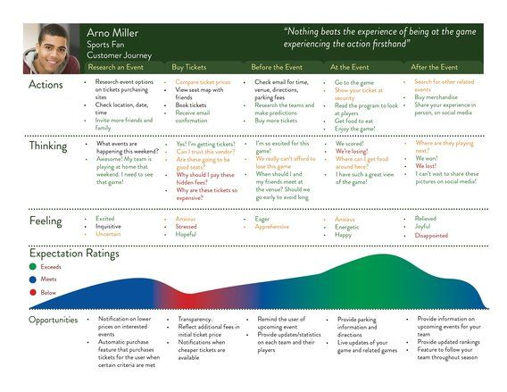

Slide 29
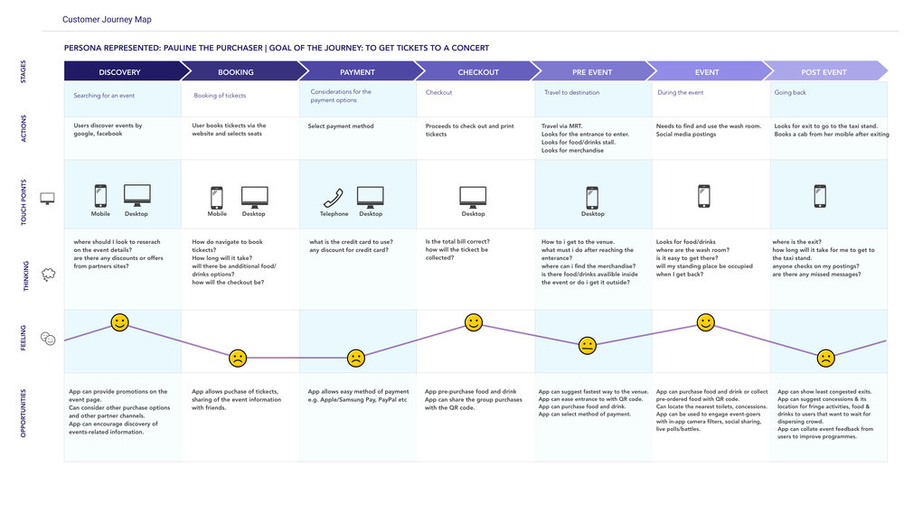

Slide 30




Tips for Customer Journey Mapping
Base it on direct customer observation
Be specific to a customer segment or persona
Reflect customer goals
Focus on emotions, not just cognition and action
Consider both online and offline experiences
Look at all touch points
Highlight the key moments of truth
Resonate with your brand promise
Record the time customers take to go through the different stages
Reflect customer verbatims
Include non-customers
Example: AT&T came up with concept of having greeter for every customer that walked-in
Example: Zara surveyed customer who walked away without buying anything from the store

Slide 31
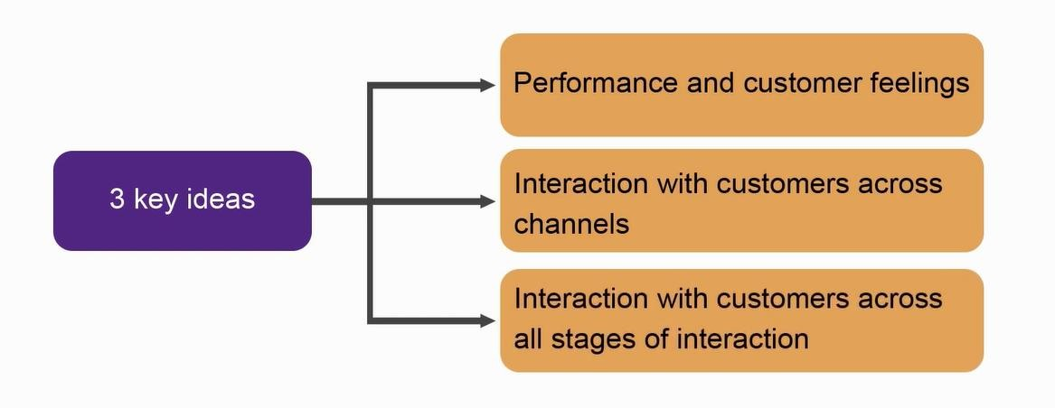
Defining Customer Experience
Innovations can happen across all stages of customer journey
A blend of company's physical performance and customer emotions across all the touchpoints and moments of truth
Customer experience is a combination of the intangible and the emotional as well as the tangible and physical aspects of experience

Slide 32
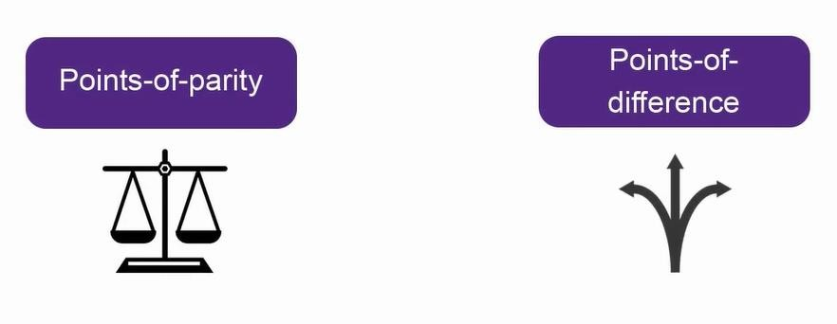
Customer Experience: Differentiators
Points of parity are aspects of the customer experience that customers view as necessary
Point of difference is an aspect of the customer experience that is uniquely associated with your offering where you can create surprise and delight

Slide 33
Tips for Customer Experience
Identify the biggest customer problem areas:
Think systematically about
how to improve the customer experience by:
Fulfillment
Returns
Budget
Decision-making
Raining certain factors
Reducing certain factors
Adding certain factors
Eliminating points of pain
Focus the innovations on targeted areas of customer experience

Slide 34
ERRC Grid
ERRC is a matrix that can be used to identify innovation opportunities in your EVENT
E
Eliminate
R
Raise
R
Reuse
C
Create

Slide 35
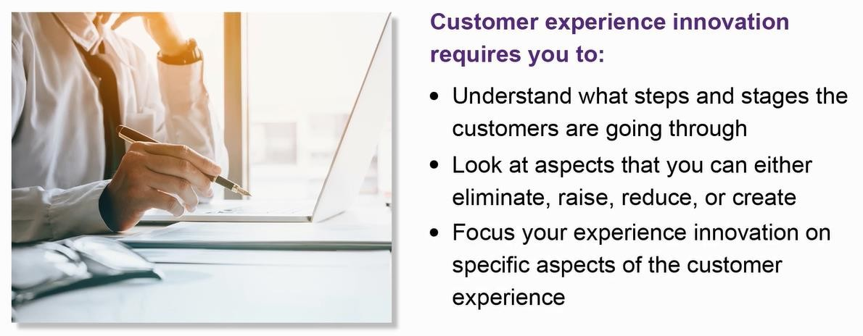
Summarizing Customer Experience Innovation

Slide 36
Customer Journey Map examples

Slide 37
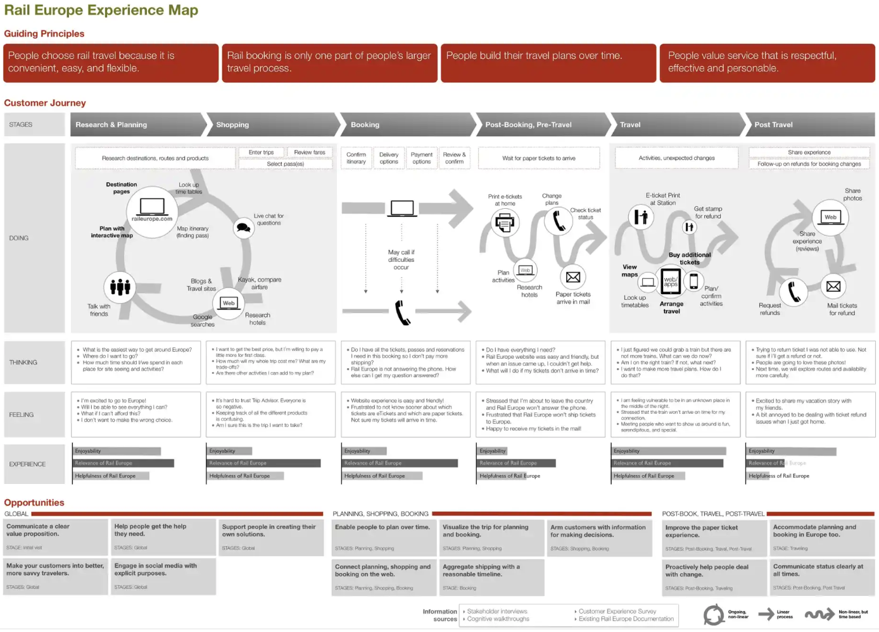

Slide 38
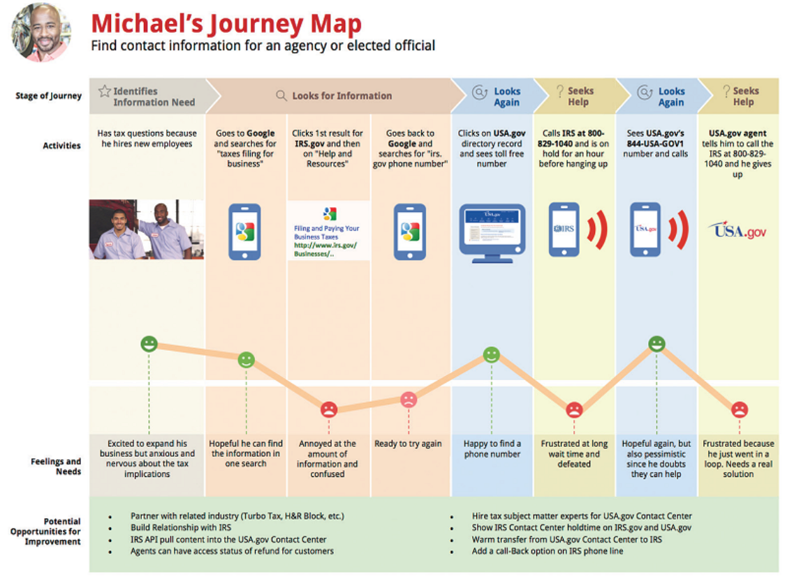

Slide 39
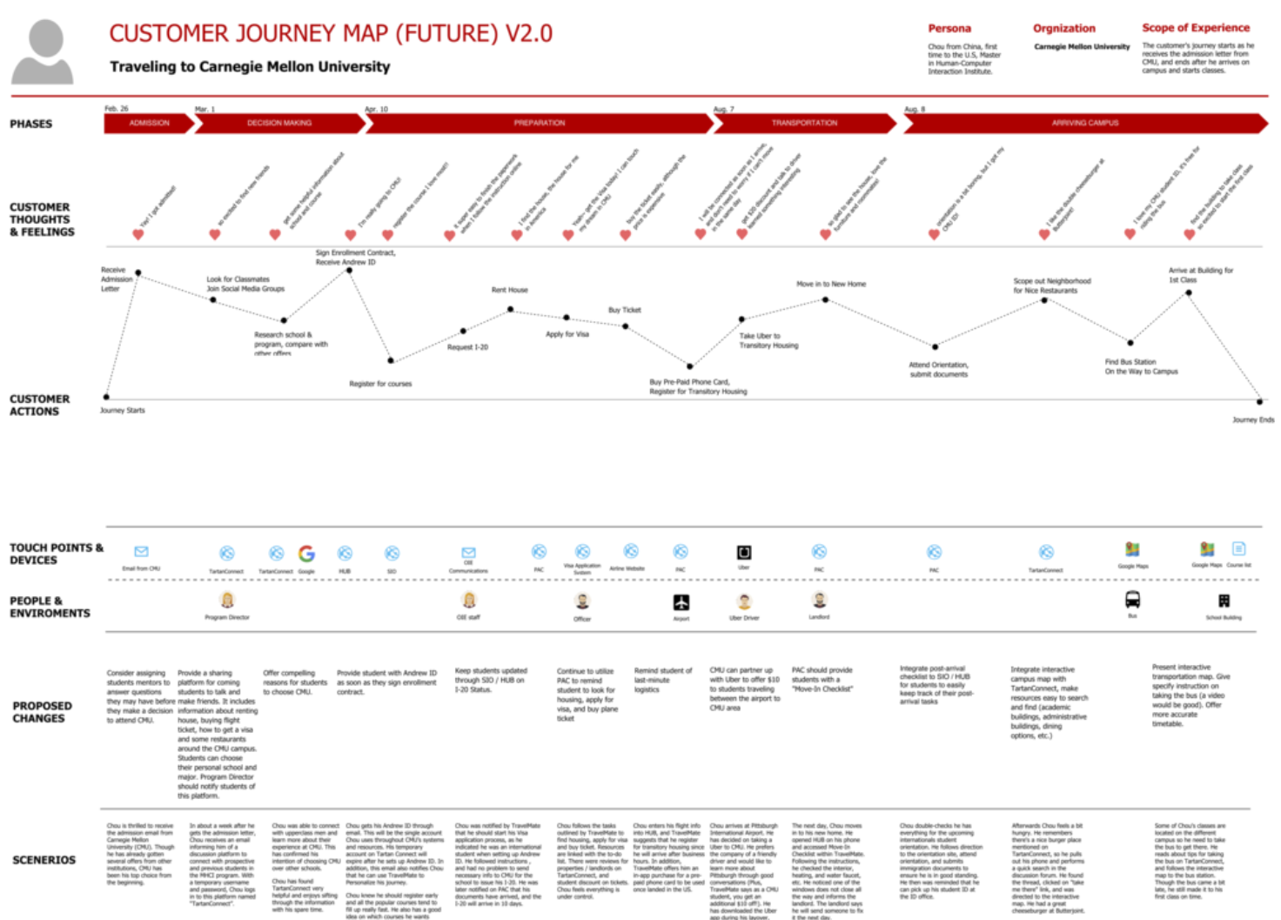

Slide 40
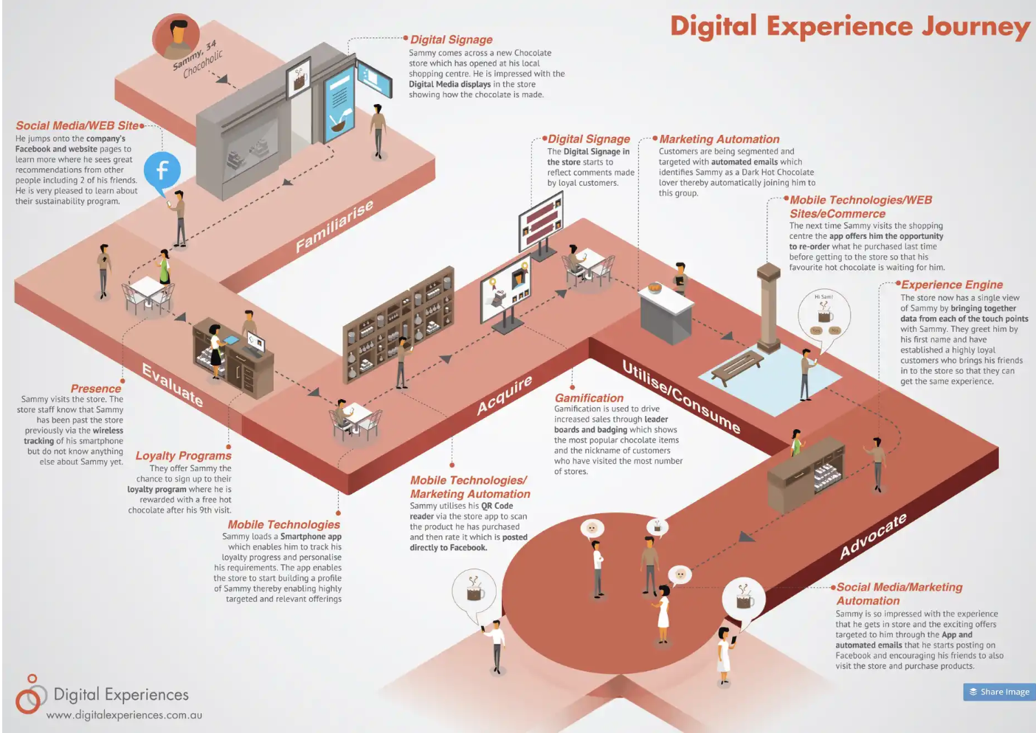
Caio’s comments:
I’m not a fan of this model but might be ok if you’re presenting your customer journey to a larger audience and want to be very user friendly or visually appealing

Slide 41
Template
Persona: XXXX age: xxxx Job: Xxxxx Interests: Xxxxx | Phase 1 | Phase 2 | Phase 3 | Phase 4 | Phase 5
1. Customer thoughts & feelings | xx | xx | xx | xx | xx
2. Customer actions | xx | xx | xx | xx | xx
3. Customer touchpoints | xx | xx | xx | xx | xx
4. Proposed changes | xx | xx | xx | xx | xx

Slide 42
In class Group Work
Develop Customer Journey Map
Customer Insights
User Persona
Customer Journey

Slide 43
Customer Journey for Paper Boat
Identify a platform for developing User persona and Customer Journey (Figma, Xtensio, Canva, Miro – use AI) – 10 minutes
Develop User Persona – 10 minutes
Develop a Customer Journey Only Stages, Touch points and Pain points for each stage – 10 minutes
Upload individually on MS Teams assignments due Monday 12 pm

Slide 44
Next
Final Project Q&A
Peer Evaluation on MS Teams
Reflection log due Monday 9th of March

Slide 45
References
Blogs
What is the Customer Journey and Why Do You Need to Create One? Crazy Egg https://www.crazyegg.com/blog/customer-journey/ (Links to an external site.) How to Create an Effective Customer Journey Map, Hubspot blog https://blog.hubspot.com/service/customer-journey-map (Links to an external site.) Customer Journey Maps: A Step-by-Step Guide, CXL Institute https://conversionxl.com/blog/customer-journey-maps/ (Links to an external site.) How to Develop a Content Strategy: A Start to Finish Guide, Hubspot https://blog.hubspot.com/marketing/content-marketing-plan (Links to an external site.) Content Strategy: A Development Guide, Neil Patel https://neilpatel.com/blog/content-strategy-a-development-guide/

Slide 46

Thank you!
Any questions?

