Slide 1
Consumer Choices
Summary
Professor Ilijana Petrovska
Visiting professor @ Tor Vergata

Slide 2
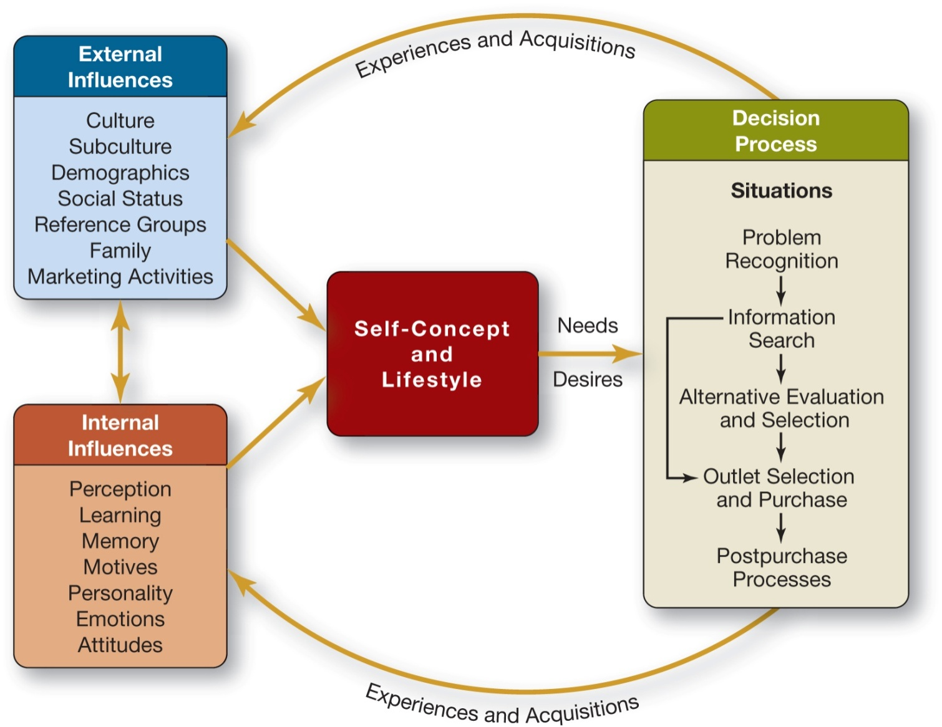
PART I: INTRODUCTION
1-2
Notes:
How the life in 21st century influence on the Decision process? Different types of problems, Different and multimedia information search, different and multi channel outlets, different post-purchase communication
Marketing 2 Consumers shift into Marketing4 Consumers

Slide 3
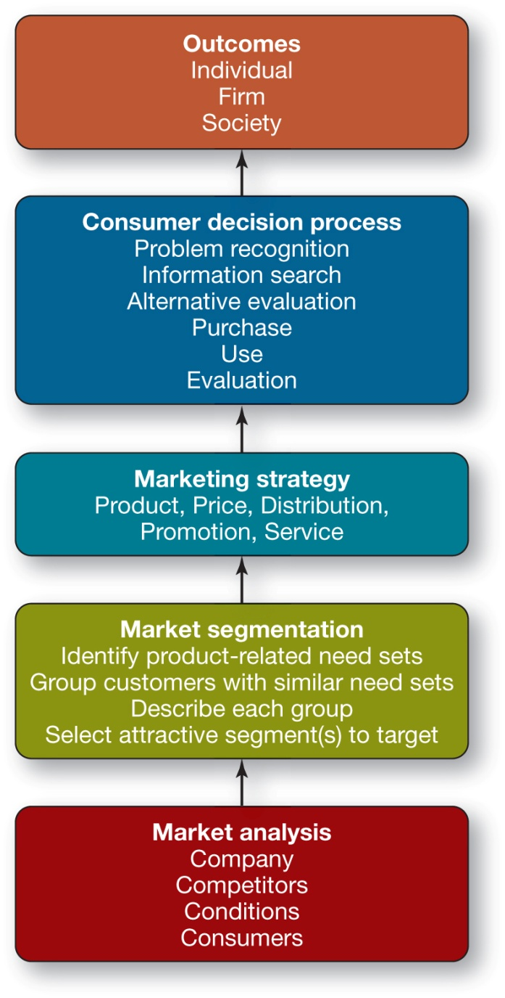
4. Marketing Strategy and Consumer Behavior
1-3

Slide 4
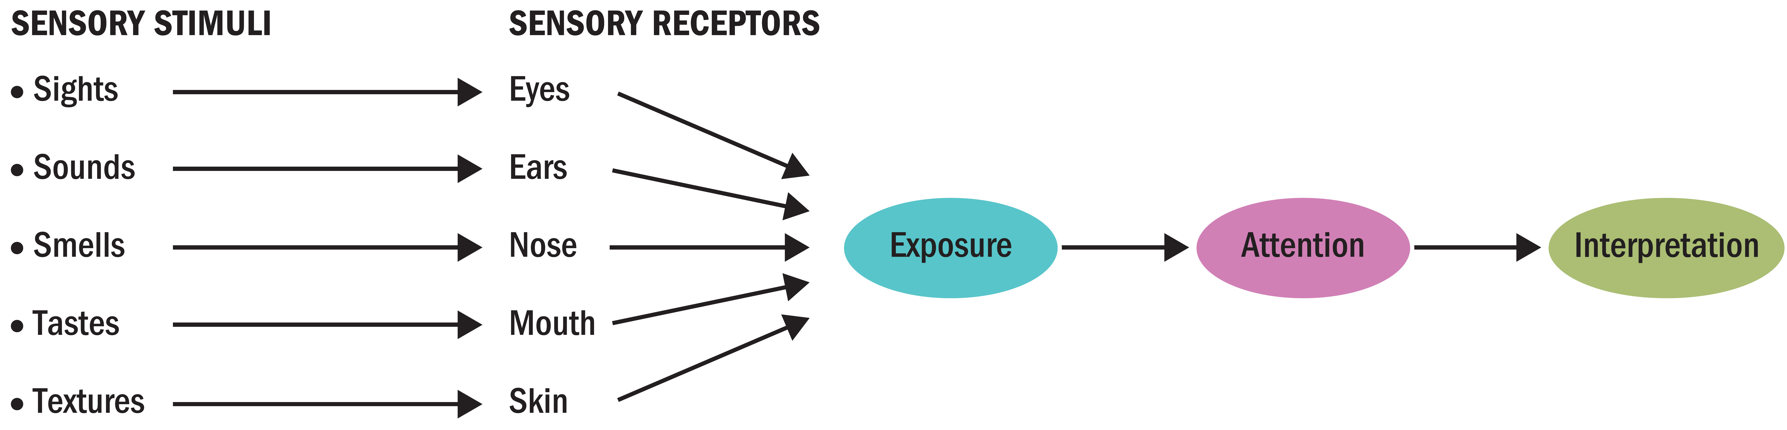
Figure 3.1 - Perceptual Process
Notes:
Figure 3.1 shows how as consumers we are exposed to sensory stimuli through our sensory receptors. We then interpret those stimuli to which we paid attention. This image also emphasizes the three key stages of perception: exposure, attention, and interpretation.

Slide 5
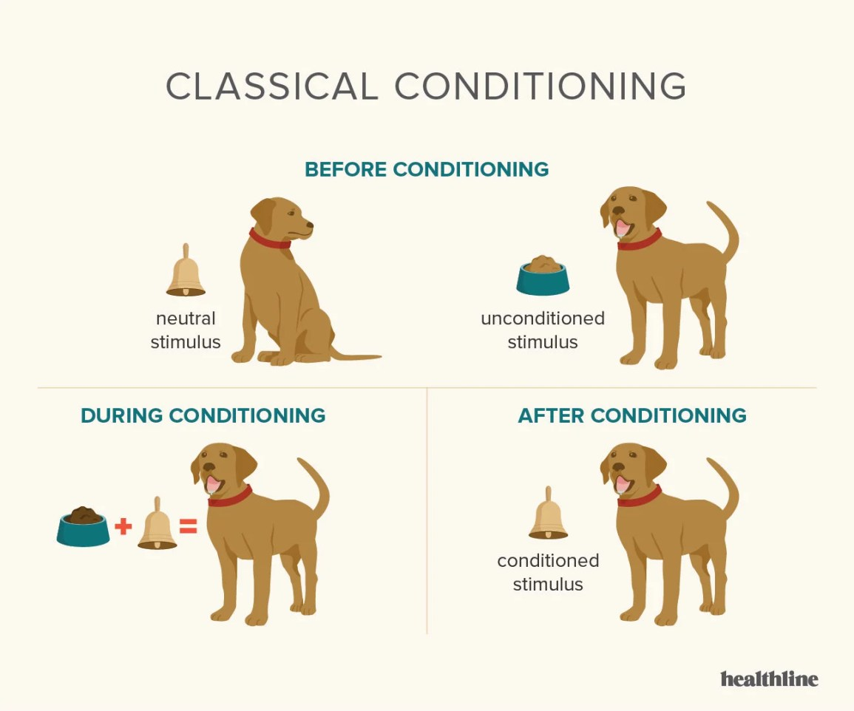

Slide 6
1.2. How Does Instrumental Conditioning Occur?
Positive reinforcement
comes in the form of a reward
Negative reinforcement
shows how a negative outcome can be avoided
Punishment
when unpleasant events follow a response
Notes:
Instrumental conditioning (or operant conditioning) occurs when we learn to perform behaviors that produce positive outcomes and avoid those that yield negative outcomes. Whereas responses in classical conditioning are involuntary and fairly simple, we make those in instrumental conditioning deliberately to obtain a goal. We may learn the desired behavior over a period of time as a shaping process rewards our intermediate actions.
Instrumental conditioning occurs in one of three ways: 1) positive reinforcement, 2) negative reinforcement, and 3) punishment. Positive reinforcement comes in the form of a reward. Negative reinforcement shows how a negative outcome can be avoided. Punishment occurs when unpleasant events follow a response.
Extinction occurs when there is no reinforcement. In other words, the conditioning is not activated because it is not reinforced.

Slide 7
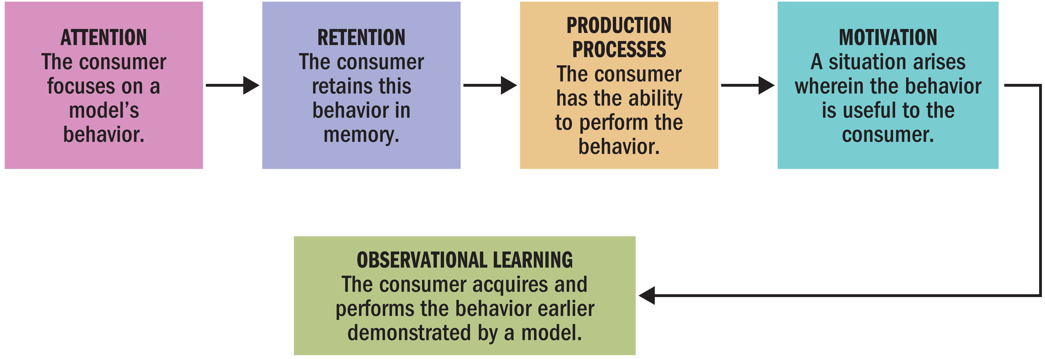
Cognitive Learning Theory (2 of 2)
2. We learn about products by observing others’ behavior.
Notes:
Observational learning occurs when we watch the actions of others and note the reinforcements they receive for their behaviors. In these situations, learning occurs as a result of vicarious rather than direct experience. People store these observations in memory as they accumulate knowledge and then they use this information at a later point to guide their own behavior. Modeling is the process of imitating the behavior of others.
In the figure illustrated, you can see that for a marketer to instigate observational learning, four conditions must be met. First, the consumer’s attention must be directed to the appropriate model and that person must be someone the consumer wishes to emulate. Second, the consumer must remember what the model says or does. Third, the consumer must convert this information into actions. Fourth, the consumer must be motivated to perform these actions.

Slide 8
Memory and Retrieval
Memory can be subject to:
  Selection
  Confusion
  Distortion
Enhancing retrieval
  Characteristics of the stimulus
  What the stimulus is linked to
  Way the stimulus is processed
  Consumer characteristics

Slide 9



Algorithmic consumerism
Does data-driven marketing give consumers what they want? or does it tell consumers what to want?

Slide 10
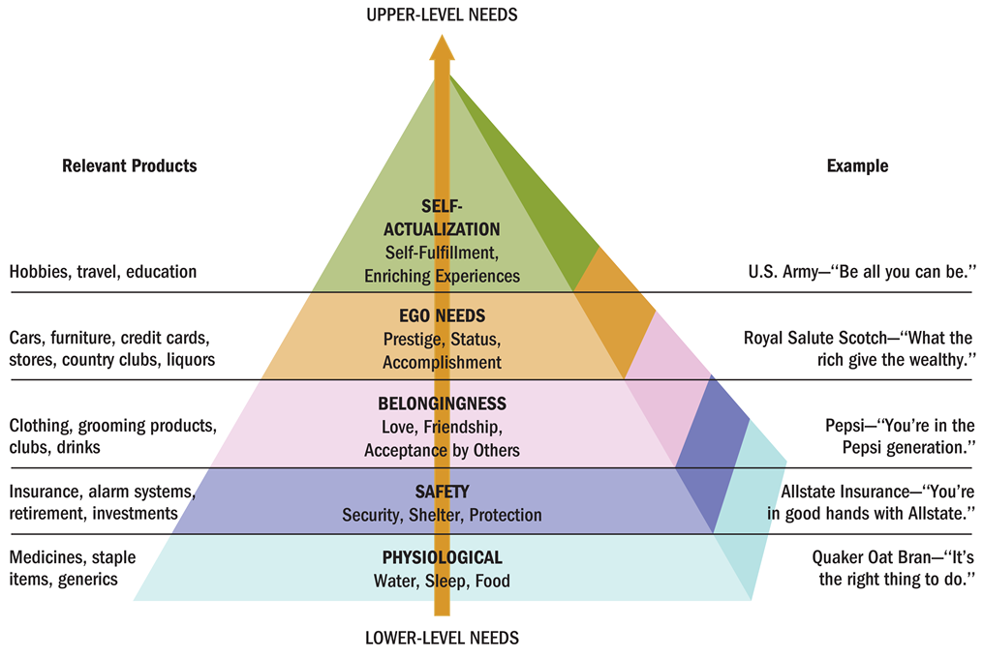
Figure 5.2 Maslow’s Hierarchy of Needs

Slide 11
3. McGuire’s Psychological Motives
Criteria:
Cognitive vs. Affective
Preservation vs. Growth
Active/Passive
Internal / External

Slide 12
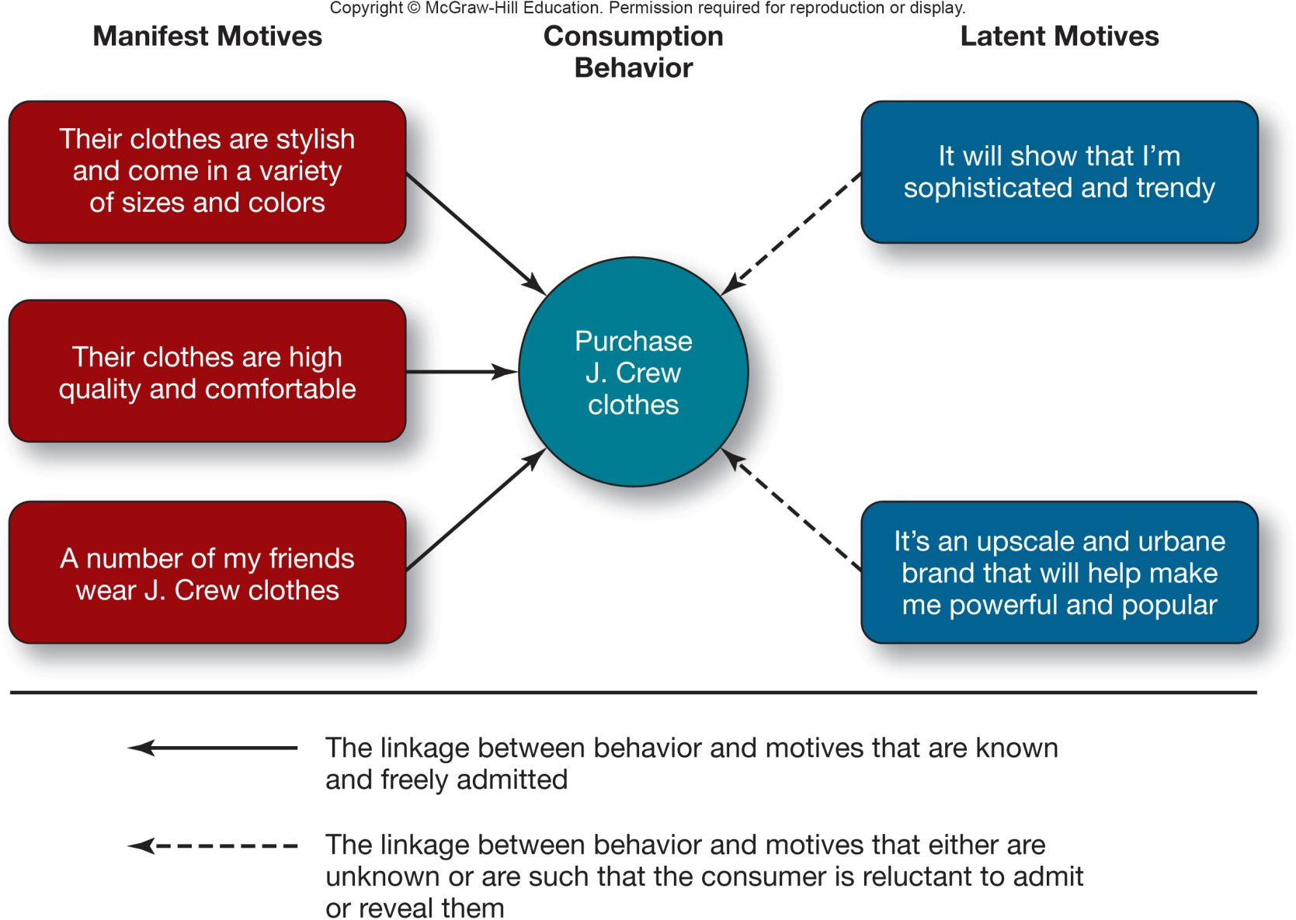
4. Motivation Theory and Marketing Strategy
4. Latent and Manifest Motives in a Purchase Situation
10-12

Slide 13
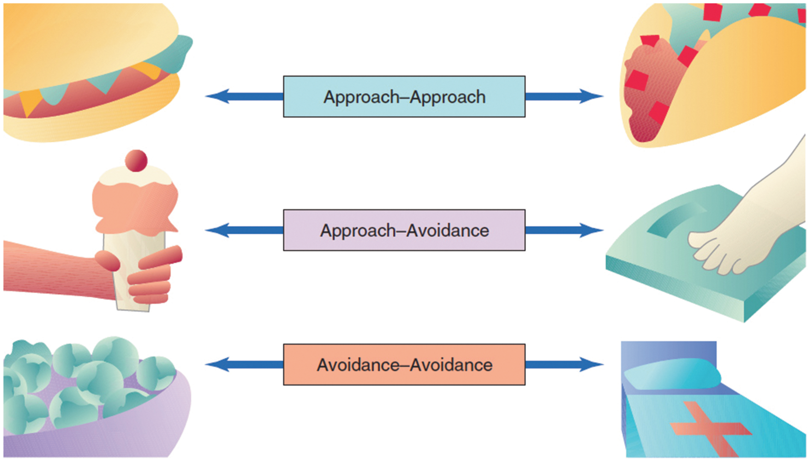
5. Motivational Conflicts
The theory of cognitive dissonance is based on the premise that people have a need for order and consistency in their lives and that a state of dissonance (tension) exists when beliefs or behaviors conflict with one another.
Notes:
A person has an approach–approach conflict when he or she must choose between two desirable alternatives. A student might be torn between going home for the holidays and going on a skiing trip with friends.
An approach–avoidance conflict occurs when we desire a goal but wish to avoid it at the same time.
Marketers frequently address an avoidance–avoidance conflict with messages that stress the unforeseen benefits of choosing one option (e.g., when they emphasize special credit plans to ease the pain of car payments).

Slide 14
Motivation Theory and Marketing Strategy
Situational Component Related to Regulatory Focus
Online Travel Shopping
Prevention-Focused Ad
  Worked best for last-minute shoppers
Promotion-Focused Ad
  Worked best for shoppers buying for future travel
10-14

Slide 15

7. Consumer Involvement
Involvement
Inertia
Cult products
Notes:
Involvement is “a person’s perceived relevance of the object based on their inherent needs, values, and interests.”
Inertia describes consumption at the low end of involvement, where we make decisions out of habit because we lack the motivation to consider alternatives.
Cult products such as Apple—or Hydrox, Harley-Davidson, Jones Soda, Chick-Fil-A, Manolo Blahnik designer shoes (think Carrie on Sex and the City), and the Boston Red Sox—command fierce consumer loyalty, devotion, and maybe even worship by consumers. A large majority of consumers agree that they are willing to pay more for a brand when they feel a personal connection to the company.

Slide 16
Personality
Multitrait Approach
  The Five-Factor Model is the most commonly used by marketers and identifies five basic traits that are formed by genetics and early learning.
Single Trait Approach
  Consumer Ethnocentrism
  Need for Cognition
  Consumers’ Need for Uniqueness
10-16

Slide 17
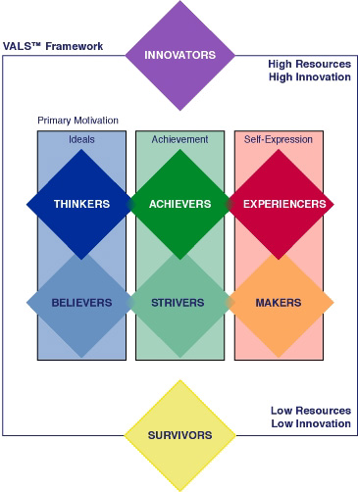
The VALSTM System
VALS provides a systematic classification of U.S. adults into eight distinct consumer segments.
VALS is based on enduring psychological characteristics that correlate with purchase patterns.
12-17

Slide 18
Functional Theory of Attitudes
Utilitarian Function:
Relates to rewards and punishments
Value-Expressive Function:
Expresses consumer’s values or self-concept
E G O-Defensive Function:
Protect ourselves from external threats or internal feelings
Knowledge Function:
Need for order, structure, or meaning

Slide 19
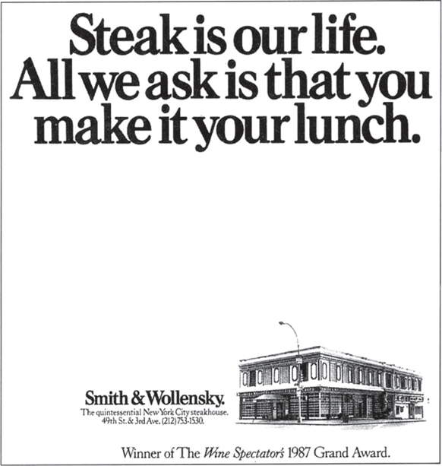
The A B C Model of Attitudes
Attitudes are more complex than they first appear.
An attitude has three components:
  Affect: the way a consumer feels about an attitude object
  Behavior: person’s intentions to do something with regard to an attitude object
  Cognition: beliefs a consumer has about an attitude object
Notes:
An attitude has three components:
Affect: the way a consumer feels about an attitude object
Behavior: person’s intentions to do something with regard to an attitude object
Cognition: beliefs a consumer has about an attitude object
Which comes first: knowing, feeling, or doing? It turns out that each element may lead things off depending on the situation. The hierarchies of effects show the relative impact of the three components. Each hierarchy shows a fixed sequence of steps which can occur in route to an attitude.
The standard learning hierarchy shown first assumes that a person approaches a product decision as a problem-solving process. She first forms beliefs based on knowledge, then evaluates the beliefs and forms feelings about the product. She then engages in relevant behavior.
The low-involvement hierarchy assumes the consumer initially does not have strong preferences for one brand over another and instead forms an evaluation only after she has bought the product.
The experiential hierarchy of effects says we act on our emotional reactions.

Slide 20
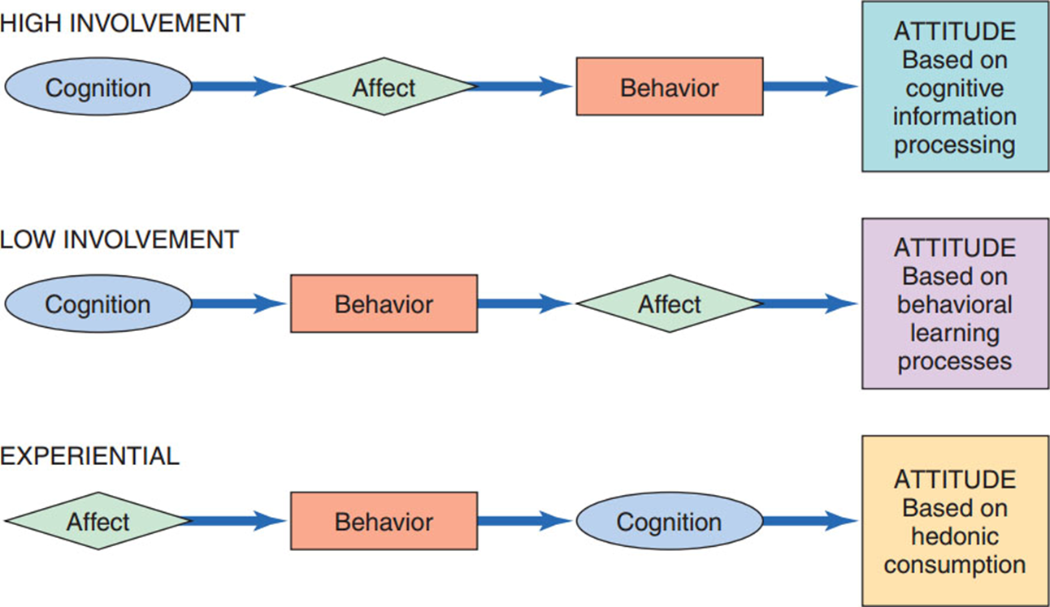
Figure 8.1: Three Hierarchies of Effects

Slide 21
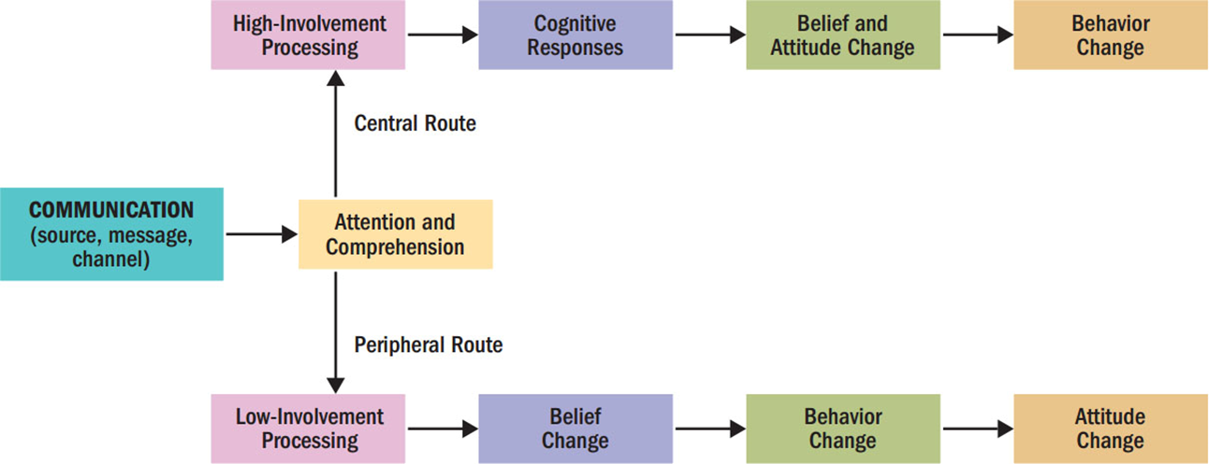
E L M
Figure 8.6 The Elaboration Likelihood Model (E L M) of Persuasion
Notes:
The elaboration likelihood model, known as the ELM, assumes that under conditions of high involvement, we will take the central route to persuasion, but under conditions of low involvement, we will take a peripheral route. The central route is focused on the consumer’s cognitive response to the message. The peripheral route focuses on other cues to decide how to react to the message.

Slide 22

SELF CONCEPT
The self-concept strongly influences consumer behavior.
Notes:
In our first objective, we learn about the meaning of self-concept.

Slide 23
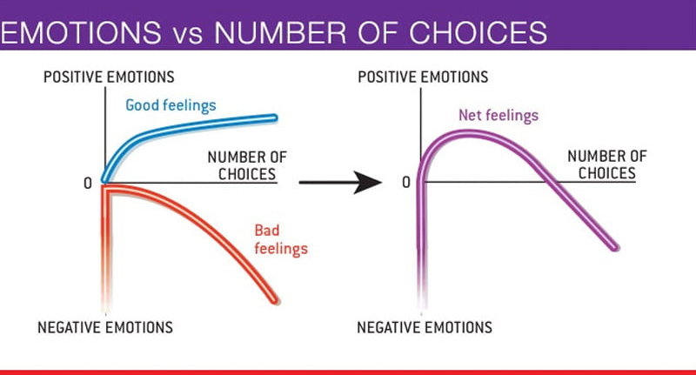
Paradox of Choice
JAM EXPERIMENT
  About 30% of people who tried one of 6 flavors bought the jam afterwards, in the case of the more extensive options it was 10x less – only 3% of people went on to make a purchase.

Slide 24
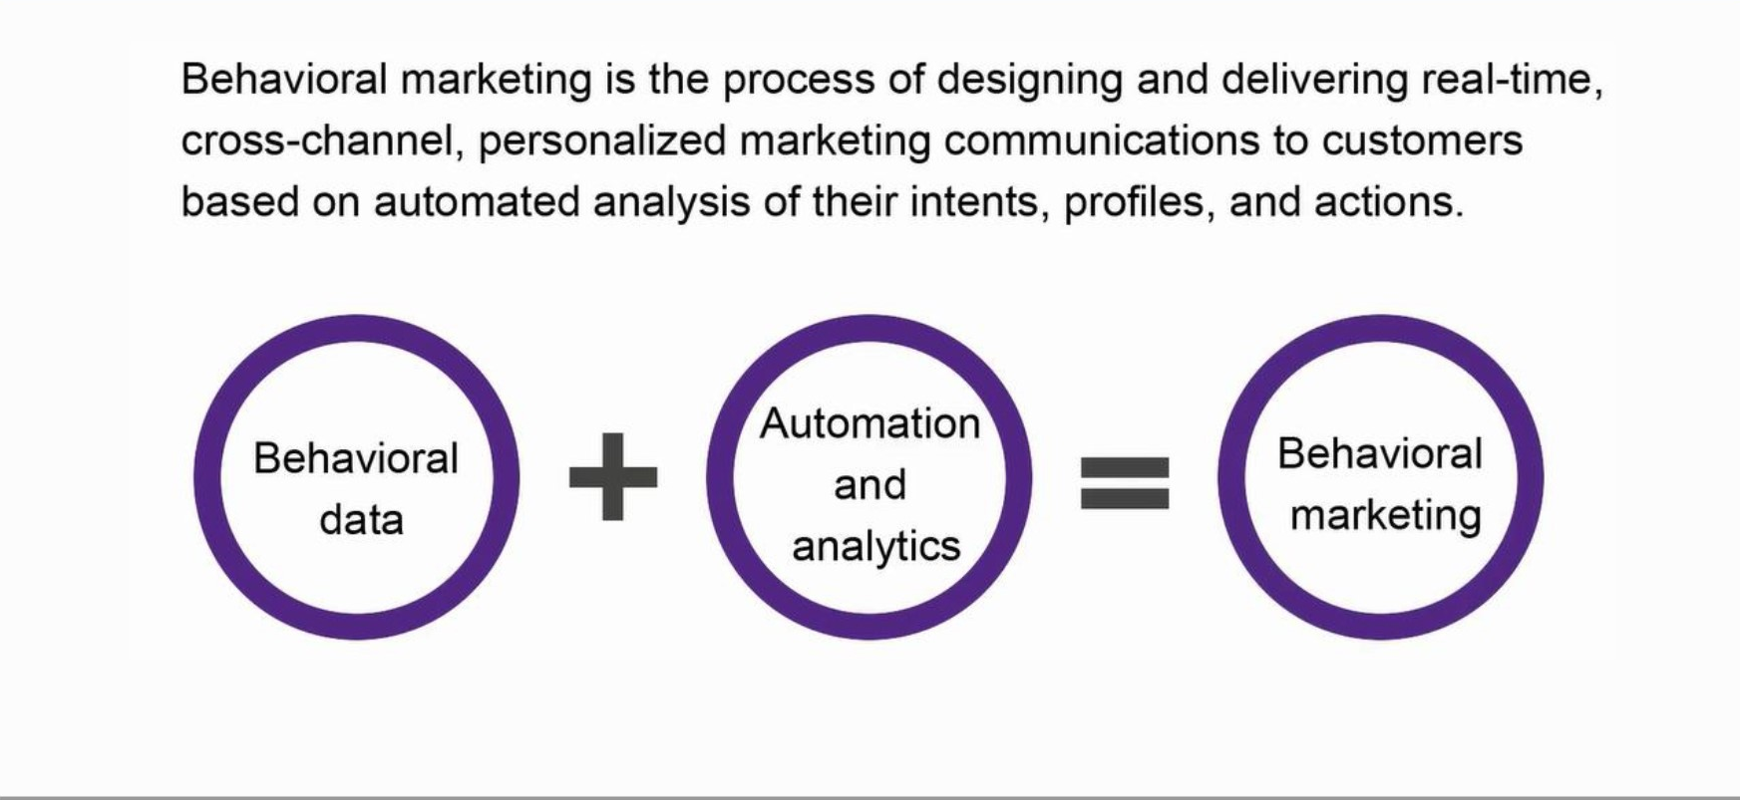
Behavioral marketing

Slide 25
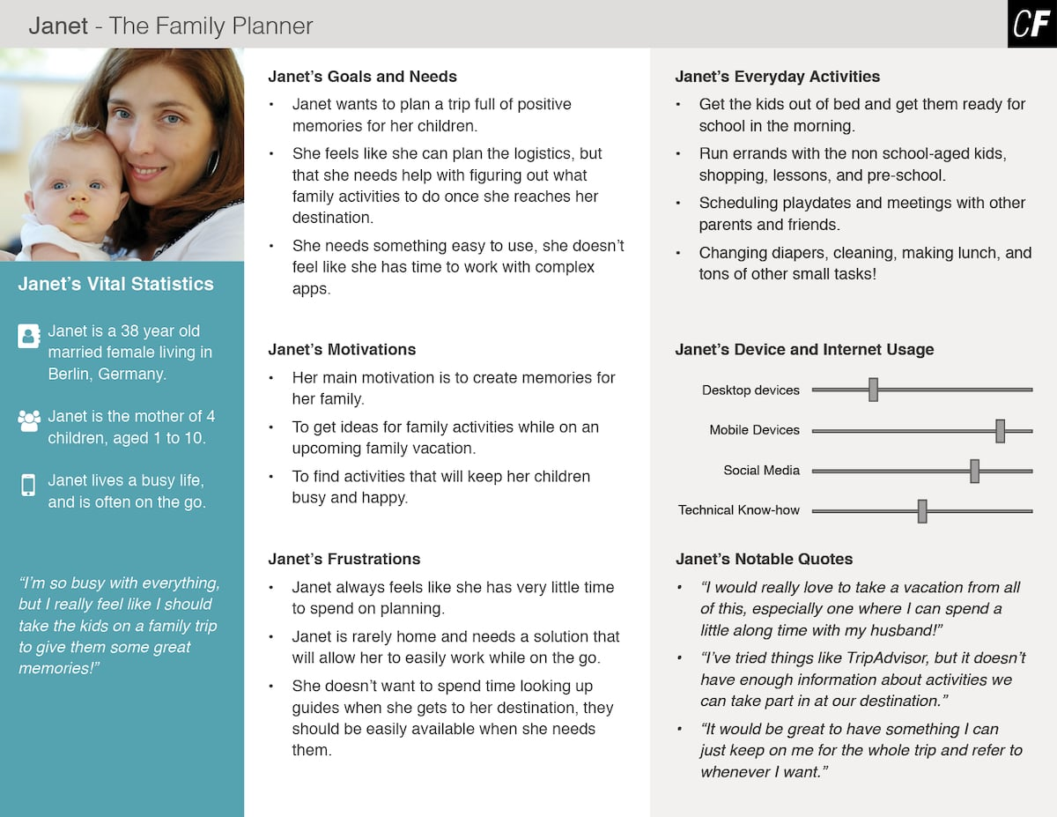

Slide 26
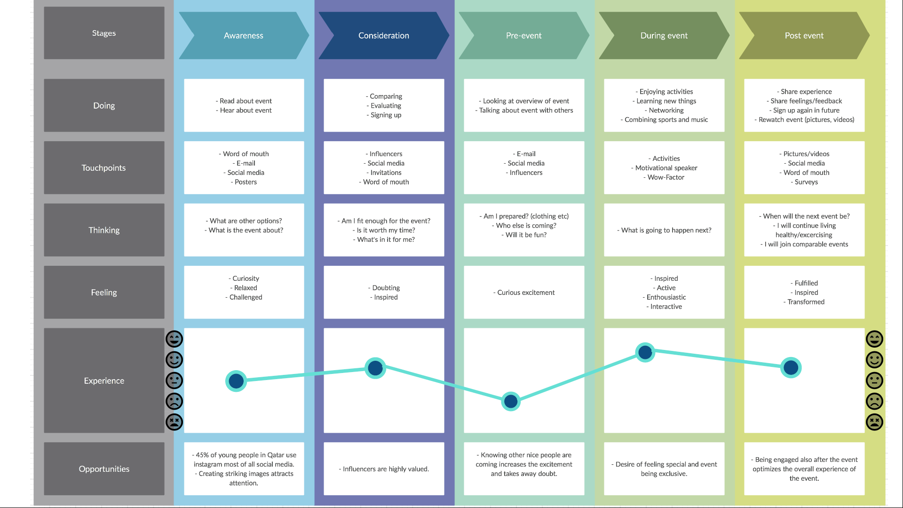

Slide 27
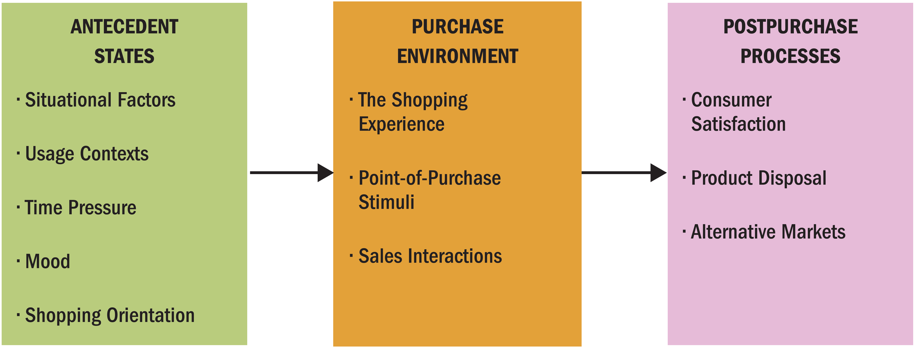
Purchase and Postpurchase Activities
A consumer’s choices are affected by many personal factors…and the sale doesn’t end at the time of purchase.
Figure 10.1 Issues Related to Purchase and Post purchase Activities
Notes:
Figure 10.1 illustrates that many contextual factors affect our choices. These might include mood, whether we feel time pressure to make a purchase, and the reason we need the product. Salespeople could play a role in our decisions, too.

Slide 28
Membership Versus Aspirational Reference Groups
Membership reference groups
People the consumer actually knows
Advertisers use “ordinary people”
Aspirational reference groups
People the consumer doesn’t know but admire
Advertisers use celebrity spokespeople
Notes:
Membership reference groups are people we know like our families, friendship groups, and colleagues. Because we tend to compare ourselves with similar others, many promotional strategies include ordinary people. Seeing the consumption activities of others acts as a form of social influence. Aspirational reference groups are people we admire. They may be successful businesspeople, athletes, or performers.

Slide 29
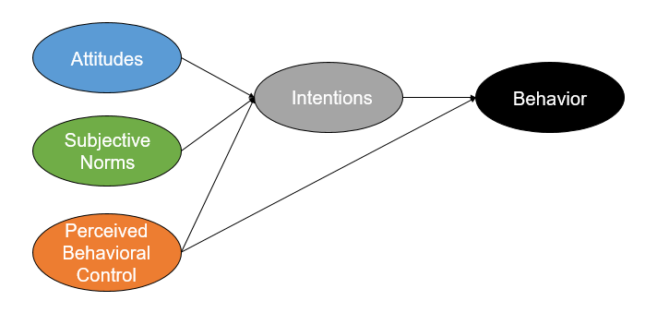
The Theory of Planned Behavior
by Icek Ajzen in 1985
Notes:
The Theory of Planned Behavior was proposed by Icek Ajzen in 1985. This theory is an extension of his earlier work on the Theory of Reasoned Action, which Ajzen developed with Martin Fishbein in the late 1970s. The Theory of Planned Behavior is widely used to predict and understand human behavior in various contexts, emphasizing the role of intention, perceived behavioral control, attitude toward the behavior, and subjective norms in the decision-making process.

Slide 30
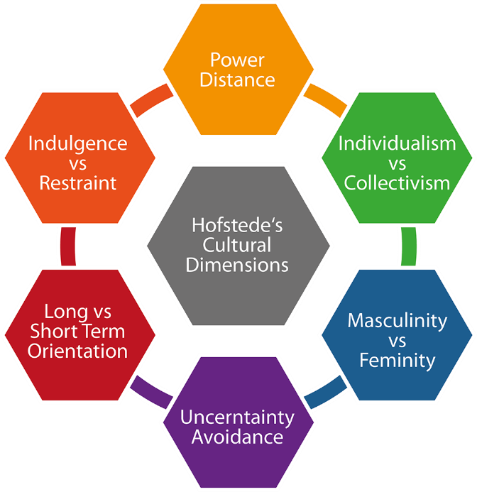
Hofstede Dimensions of National Culture
Notes:
Hofstede’s dimensions are among the most widely used measures for understanding cross-cultural values.
Power distance is the extent to which the less powerful members of organizations and institutions (like the family) accept and expect that power is distributed unequally. Individualism is the degree to which individuals are integrated into groups. Masculinity is the distribution of roles between the genders. Uncertainty avoidance is a society’s tolerance for uncertainty and ambiguity. Long-term orientation refers to values associated with Long-Term Orientation are thrift and perseverance; values associated with Short-Term Orientation are respect for tradition, fulfilling social obligations, and protecting one’s “face.” Indulgence versus restraint is the extent to which a society allows relatively free gratification of basic and natural human drives related to enjoying life and having fun. A culture high on restraint suppresses gratification of needs and regulates it by means of strict social norms.

Slide 31
🔑 Key Takeaways:
Consumers are not just buyers—they are humans shaped by identity, context, and emotion.
Effective marketing starts with understanding people, not pushing products.
In the digital age, choice architecture and nudging are powerful—but they come with ethical responsibility.
Tools matter, but empathy and curiosity are your biggest assets.

Slide 32
Did you Achieved the
Learning objectives?
Learn the fundamental principles and theories in consumer behaviour and consumer choices
Develop abilities to apply consumer behaviour concepts to marketing problems;
Understand the basic analytical tools that can be used to investigate consumer choices.

Slide 33
And Learning outcomes?
Conduct small scale independent research
Develop customer journey mapping relevant to marketing;
Critically apply the knowledge in the decision connected to various consumer behaviour situations.

Slide 34

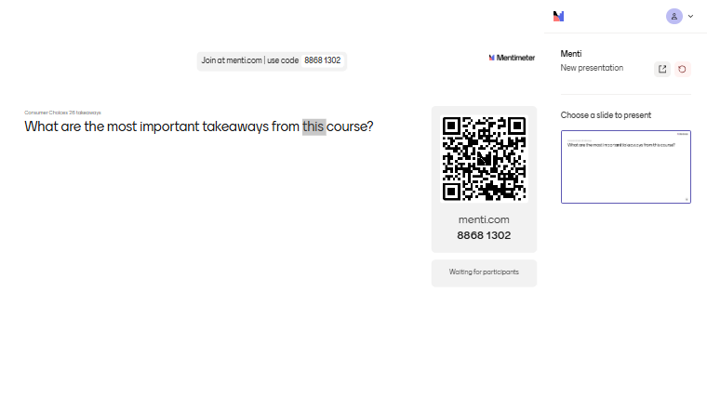
what would you consider from this course?
Write & share

Slide 35
Wrap Up!
What are you going to apply into your personal life?
What are you going to apply into your professional life?
Take the Quiz!

Slide 36
Thank you
For your energy, ideas, and engagement!
I wish you curiosity, courage, and clarity in your future journeys—academic and beyond.
Professor Ilijana Petrovska
Spring 2026

Slide 37


THANK YOU!
Forever Your Mentor!
Get Connected!
LinkedIn
Instagram petrovska@uacs.edu.mk ilijanata@gmail.com

