Slide 1

HUMAN RESOURCE
MANAGEMENT STRATEGY IN
FAMILY BUSINESS
Prof. Giulia Flamini

Slide 2
Strategic management in family business
Lecture 11

Slide 3
Agenda
Typical strengths and weakness of family firms
Socioemotional Wealth
Agency perspective
Resource-based perspective
Organizational identity perspective
Institutional perspective

Slide 4
Typical strength of family firms
Fewer conflicts of interest between owners and managers: there is an alignment of interests of owners and managers who are from the same family. Interest alignment may spare family firms costly control and incentive mechanisms and lead to fewer agency conflicts between owner and manager
Efficient leadership: includes the ability to take and enforce decisions more quickly because of the family’s powerful position and trusting relationship and shared goals and values among the family managers involved
Resources advantages: familiness
Long-term orientation and continuity: family firms tend to pursue long-term goals
Culture of commitment and support: harmony and benevolence often give rise to a very particular form of corporate culture based on commitment among family and nonfamily employees
Identity and reputation: family owner-managers stake their money and often even their personal names and reputations on the firm

Slide 5
Typical weaknesses of family firms
Dependence on family: the firm may be exploited or mismanaged by incompetent or even unethical owner-managers. Conflicts between family members can be very destructive.
Agency costs because of altruism: nepotism and free riding
Succession Challenges: only 30% of the all family firms survive after the first succession and only the 3% of family firms survive after the third succession
Resources constraints: there are limited positions for non-family talent and the problem of «glass celling»
Decline entrepreneurial orientation: family orientation, and hence an excessive focus on harmony and continuity, may lead to the sort of complacency that is incompatible with entrepreneurship
Role ambiguity: actors in family firms often have to play multiple roles

Slide 6
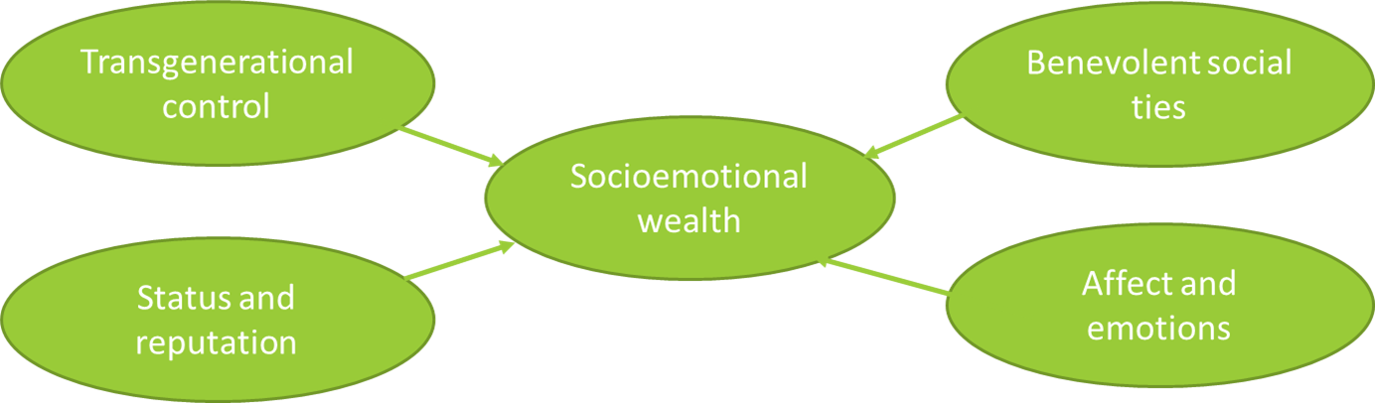
Socioemotional wealth
SEW is widely used as an umbrella term to describe the phenomenon of nonfinancial goals in family firms. SEW is defined as the total stock of affect that the family has vested in the firm (Gomez-Mejia et al. 2007). Ultimately, this boils down to the idea of the family’s emotional attachment to the firm, which is similar to the concept of ‘emotional value’ (Zellweger and Astrachan 2008). SEW is said to consist of four distinct dimensions:
Transgenerational control: captures the utility a family has by controlling the firm with the intent to pass it on to future generations
Benevolent social ties: captures the degree to which members of controlling families value relationships with individuals characterised by goodwill, mutual support, benevolence and loyalty
Identity and reputation: captures the degree to which the controlling family extract value from identifying or being identified with the firm
Emotions and affect: captures the satisfaction to which the family owners feel from the connection to the firm and by their efforts to help it grow

Slide 7
Distinctiveness of financial and socioemotional viewpoints
Family firms care for both financial goals (maximization of financial wealth) and socioemotional goals (preservation of SEW):
From the financial viewpoint, firms should try to improve their status by maximizing the financial wealth of the owners. In this assessment, actors should be completely rational, as they have access to all relevant information; that is, they should focus on the maximum expected return given the associated risks. From this point of view, taking risks is considered desirable as risks are compensated at adequate returns
Form the socioemotional point, firms should try to preserve the family’s current endowment of SEW. who prioritizes SEW understands that this wealth is dependent upon the long-term survival of the firm, which in turn depends upon financial performance. But while for the financially motivated actor financial performance is the relevant output measure, for the socioemotionally motivated actor it is an input measure

Slide 8
Aligned interests of family owners and family managers
The agency perspective is one of the approaches most often used to explain the competitiveness of family firms. Agency theory is primarily concerned with the efficient governance of the firm, and therein in particular with the collaboration between owners and managers. What is called ‘principal–agent agency costs’ are the costs that arise for owners if they wish to ensure that managers act in the owners’ interests:
Traditionally, family firms are said to have low principal–agent agency costs:
In many family firms owners are also managers (i.e., owner- managed family firms), whereby the interests of owners and managers are naturally aligned. Those who own the company also manage it, which makes expensive monitoring and incentive schemes unnecessary
Even when owners and managers are not the same people but belong to the same family (e.g., when parents are owners and children are managers), the trust, benevolence and information exchange that is unique to family relationships should align their interests and again make control and incentive systems unnecessary
Given these two mechanisms, family firms that have family members in both ownership and management positions should have a natural competitive advantage. Family firms should outperform nonfamily firms because they can spare themselves expensive monitoring of and incentive compensation for the managers

Slide 9
Family business agency problems
When owners and managers are family members, family firms suffer from distinct agency problems. These problems can appear:
Misaligned interests of family owners and family managers
Family owners harming nonfamily managers
Family owners monitoring nonfamily managers
Family owners expropriating nonfamily minority owners
Family owners in conflict with each other

Slide 10
The resource-based perspective
The resource-based view assumes that resources are the foundation of firms’ sustained competitive advantage and performance (Barney 1991)
To generate a sustainable competitive advantage, firms must possess and combine resources that are at once valuable, rare, inimitable and non- substitutable
To build a sustainable competitive advantage, firms have to take a dynamic approach in the use of resources. Resources can be built, acquired, reconfigured, traded and disposed

Slide 11
Family firm competitiveness from a resource-based perspective
The resource-based perspective explains performance variation among family firms by suggesting that to different degrees family firms possess valuable, rare, inimitable and non-substitutable resources
Positive familiness, defined as the family’s positive influence on the firm’s resource base, often comes in the form of patient financial capital, deep tacit knowledge, experienced employees, strong networks, unique physical assets and reputational capital
What matters for success, however, is not only resource endowment, but also resource configuration abilities, such as resource selection, bundling and leveraging
Family firms are normally at a disadvantage in the deployment of new resources and the shedding of existing resources. Familiness is tied to the competitive advantage of companies through the pursuit of business strategies in which resources are configured

Slide 12
The definition of Familiness
Family firms possess unique types of resources as a result of the interaction between the family and the firm ➔ ‘familiness’ (Habbershon and Williams 1999)
The family’s contribution of resources matters for performance, but also the family’s configuration of resources (Sirmon and Hitt 2003). While the resource endowments of a firm may be important, these resources must also be configured effectively through an appropriate strategy to achieve a competitive advantage

Slide 13
Which is the competitive advantage of family firms?
It is a central observation of many family business practitioners and researchers that family firms pursue nonfinancial goals alongside financial ones. This particular feature has even been considered to be a defining element of family firms (Chua, Chrisman and Sharma 1999)
However, the question of what firms’ nonfinancial goals actually are remains contested. Also, while many argue that these goals matter for strategic decision making and ultimately for a family firm’s success, more insight is needed into how these nonfinancial goals alter strategic decision making

Slide 14
The organizational identity perspective
It focuses on what an organization stands for and on how it is perceived
It captures the most central, distinctive and enduring aspects of an organization (Albert and Whetten 1985)
It describes the collective behaviour and identity of the firm and provides a sense of continuity and of distinctiveness
It is said to reside in the organization’s history and values, and is expressed through interactions within the firm and with actors outside the firm
In addition to identifying ‘who we are’ as an organization (as opposed to those outside the organization), it also determines how members of the firm should behave and how outsiders should relate to them
It shapes and is shaped by the firm’s strategy

Slide 15
The particular relevance of identity and identification in family firm
There are a positive link between family firm identity and firm success? Why organizational identity is particularly relevant in the family firm context?
The family’s history is often tightly interwoven with the firm’s history, with the result that the family and firm’s images and reputations are tightly connected as well. The identities of the family and the firm become mutually dependent, and observers such as clients, suppliers and the wider public directly associate the controlling family with the firm and vice versa
When family members link their identity to that of the firm, they may benefit from the firm’s reputation. Being seen as part of the family firm’s success will inflate family members’ self-esteem. Family firm identity then becomes a source of nonfinancial, that is, SEW
A favorable family firm identity reflects positively on the family, while a negative family firm identity tarnishes the family’s identity and public reputation

Slide 16
The institutional perspective
It explains the variance in the presence and ultimately the success of family firms under various institutional regimes
Its advocates suggest that institutions, defined by the formal and informal ‘rules of the game’ (North 1990; Scott 1995), can both enable and constrain organizational actions
Institutions matter because they reduce transaction costs and uncertainty (North 1990; Williamson 1985)
The institutional perspective supports that firms perform best when they are able to adapt to the institutional environment in which they are embedded
The institutional perspective focuses on:
The micro level: the strategic choices of individual firms vs. the generally accepted strategic choices within a field
The macro level: the prevalence/absence of certain types of organizations in economic systems such as countries

Slide 17
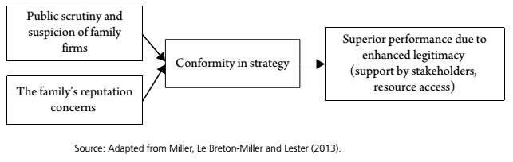
The micro view: strategic conformity of family firms
The micro view of institutional theory contends that firms’ governance structures will determine whether strategic or institutional rationales prevail in their strategic decisions
The institutional argument at the micro level maintains that family firms have incentives to adopt conformist strategies because of public scrutiny and suspicion as well as the family owner’s intrinsic motivation to appear legitimate

Slide 18
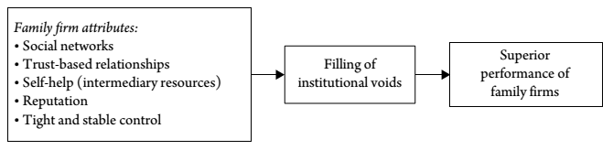
The macro view: family firms under various institutional regimes
It explains also macro-level differences, as the prevalence but also the prosperity of family firms in certain regions around the globe
This view emphasizes the opportunities that family blockholders may have for graft, abuse of power and the exploitation of their position for personal financial benefit at the expense of other stakeholders
The core is that family firms can provide compensational practices that offset the disadvantages that firms face when trying to do business in weak institutional environments

Slide 19
Family firm competitiveness from an institutional perspective
The institutional perspective suggests that family firm performance hinges on the firms’ ability to comply with and adapt to the institutional context in which they are embedded:
The micro view suggests that family firms have incentives to seek legitimacy from their stakeholders, which they achieve by conforming to industry standards and hence generally accepted ways of doing business. The pursuit of conformity ultimately contributes to performance via improved resource access and community support
The macro view emphasizes that family firms are particularly good at filling institutional voids, for instance when property rights are insufficiently protected or labour and capital markets are dysfunctional. Family business groups are particularly suited to internalize activities that are otherwise absent owing to limitations in a society’s institutions that jeopardize transactions between arm’s-length trading partners

