Slide 1

Human Resource Management Strategy in Family Business
Prof. Giulia Flamini

Slide 2
Innovation and Change in family business
Lecture 12

Slide 3
Agenda
Family Firm life cycle and evolution of business management
Family Succession
Change management in family firms
Professionalization

Slide 4
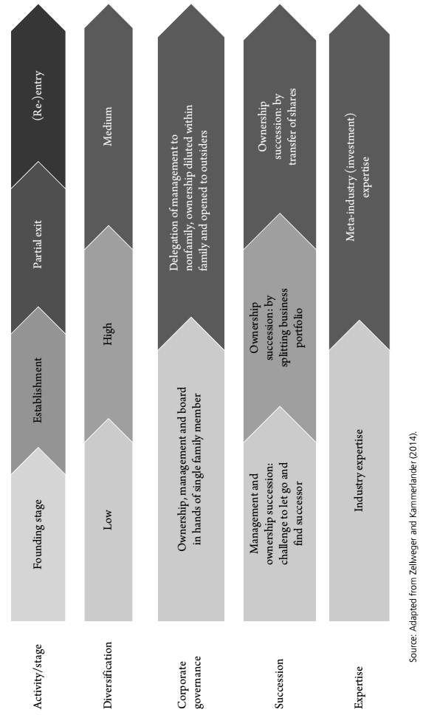
Family Business life cycle and evolution of
business management
The evolution of business management starts with the founding stage, and then moves through the buying and building stage to the selective exit and re-entry stage
For each of these stages, we can map the typical diversification level, corporate governance structures, succession and required expertise

Slide 5
Change and adaptation in family firms (1/2)
Change and adaptation are essential prerequisites for prospering and surviving in today’s dynamic marketplace
Owners and managers of family firms often emphasize the importance of stability and sticking to the firm’s traditional roots-recipes that have guaranteed outperformance in the past
In today’s volatile and uncertain world, an excessive focus on tradition can be a serious threat to family firms, as it can impede the implementation of required changes within the organizations
Family firms possess some advantages when it comes to dealing with change:
  The family firm’s focus on socioemotional wealth (SEW) induces it to pursue specific goals
  This focus endows the firm with several abilities and constraints that either foster or impede organizational change

Slide 6
Change and adaptation in family firms (2/2)
In the sensemaking process (Thomas, Clark and Gioia 1993), key decision makers, such as the family firm’s CEO, need to:
Recognize the need to change
Interpret it as a relevant trend that requires a reaction
Make a decision about how to adapt
The organization needs to implement the proposed changes

Slide 7
Succession
Succession impacts a wide set of stakeholders
These stakeholders may have distinct expectations: financial and non-financial perspectives
Family business succession: a parallel transfer of ownership and management of a firm from one family generation to the next

Slide 8
Opportunities and challenges of succession options
Relevance of the SEW that the family has tied up in the firm
In many cases, and often as a consequence of firm growth, live pattern of succession choices alters overtime:
  First generation family firms are often passed down within the family
  As a family firm increases in size and complexity, management is often shared with and then completely handed over to nonfamily managers
  With growing funding needs, ownership is progressively opened up to nonfamily investors, ultimately culminating in the sale of the firm and the complete exit of the family
Over time, financial considerations usually come to the fore, while socioemotional concerns around the core business tend to recede

Slide 9
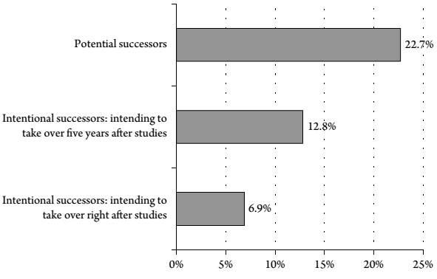
Declining relevance of infra-family succession
Overall, next-generation family members do not show a strong intention to take over the business
Causes:
  Decreasing family size: low fertility in OECD countries (in 2012 was 1.76 births per woman, while it was 3.04 in 1970)
  Changing family structures: divorce rate and personal life
  Individualism in society: ties between individuals are looser and independence
  Multioptional society: career patterns are less linear and search for self-realization
  Demographic trends: aging of the workforce
Succession intention immediately after graduation and five years later
Source: Zellweger, Sieger and Englisch (2012)

Slide 10
Sources of complexity in family business succession
(1/2)
Multiple stakeholders with diverging claims: individual incumbent owners, harmony within the family, wide set of stakeholders, etc.
Role complexity: the incumbent entrepreneur is a decision maker who occupies several roles simultaneously with possible competing claims
Not one, but multiple successions: ownership, board, management, and wealth succession. Transfer price affects the amount of wealth to distribute within the family with fairness
Technical complexity: a multitude of topics and technical questions across a broad range of disciplines

Slide 11
Sources of complexity in family business succession
(2/2)
Imperfect capital market: lack of liquidity and transparency:
  Many private firm characteristics are hidden
  It takes place in a private context, often through a specialized broker or advisor
  The valuation is based on justifiable proxies and assumptions
Information asymmetries:
  On the side of the buyer/successor in relation to the quality of the firm
  Most sellers/incumbent owners of private firms are concerned with the successful and independent continuation of their firms
  For the growing number of transfers outside the family ➔ successors must signal their abilities and incumbents must screen successors in some way before closing the transaction
Long and often uncertain timeframe for completion:
  Searching for, selecting, training a potential successor, preparing the incumbents retirement, negotiating a contract, etc.
  Ten years for the full completion with momentary setbacks, or shorter tune

Slide 12
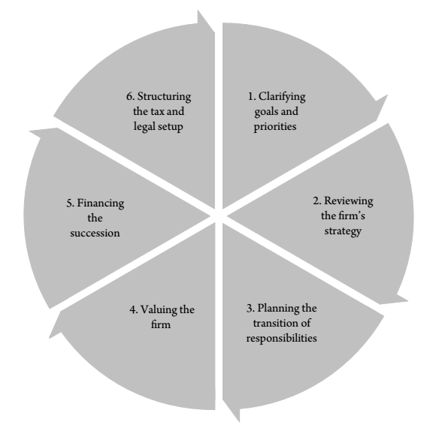
Structuring the succession process: succession framework
The sources of complexity bring us closer to structured approach to succession in family business
Any structured approach needs to incorporate a logical sequence starting with broad questions in which values, preferences and boundary conditions for the involved parties are explicit
It is important to start the succession process by reflecting on and choosing the preferred succession option
The first two steps are the most time consuming. They are also the most critical ones in terms of keeping related decision processes on track (or delaying them)

Slide 13
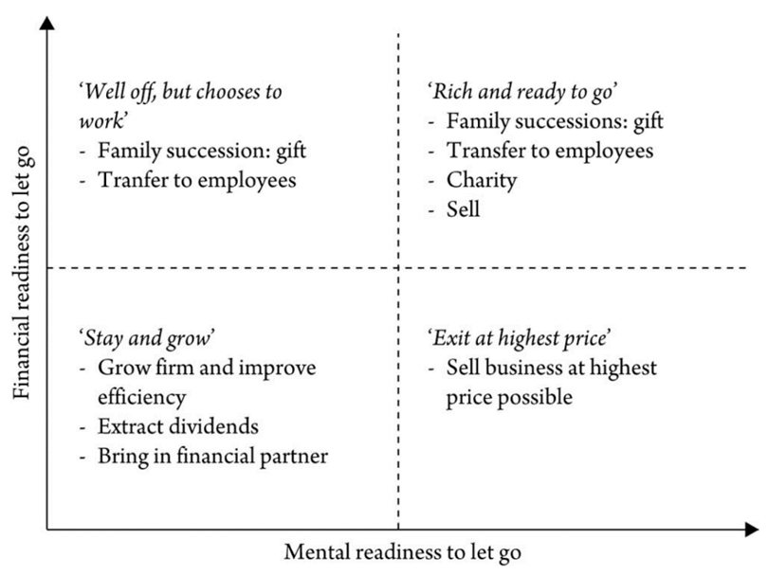
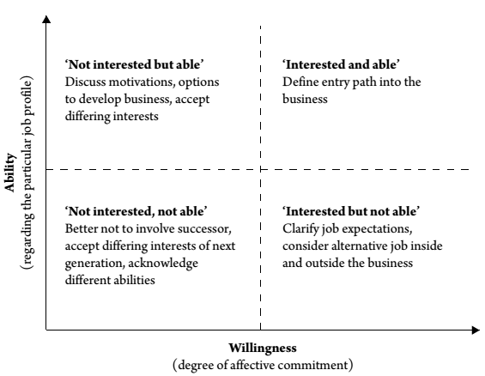
Clarifying goals and priorities-options
Incumbent
Successor

Slide 14
Reviewing the firm's strategy
The involved parties have to deal with the current and future strategy of the firm
Reviewing the firm’s strategy prepares the firm for succession from a business management point of view
The goal is to make the firm an attractive target for a transfer of control, whether from within or outside the family
Three important questions both for the incumbent and the successor
  What are the current strengths and weaknesses of the firm?
  What are the future opportunities and threats for the firm?
  Which parts of the firm are to be passed on?
Firms often follow a lifecycle inception, throughout this process, organizations often mirror the incumbent’s goals, preferences, aspirations and abilities

Slide 15
Planning the transition of responsibilities
It is critical to define how governance and functional roles are passed down from incumbent to successor
The parallel involvement of the incumbent and successor:
  can create misunderstandings about roles and responsibilities, confusion about who is in control, and frustration and irritation on the part of the incumbent, successor, employees and further stakeholders
  also represents a unique opportunity to pass on relevant resources, such as knowledge and networks
  Management and ownership is passed along in sequential steps
  The average length is 6.5 years for intra family successions, 3.3 years for transfers to employees and 1.6 years for sales

Slide 16
The Professionalization
The concept of professionalization is studied in the general business literature, tends to be understood in an organizational development context.
As firms evolve through the organizational life cycle, the complexity of firm operations increases as well as the demand for more sophisticated management and organizational systems.
there is a shift toward firm professionalization, which enables the firm to progress to the next level

Slide 17
Professionalization in family business
The family business literature has a tendency to equate professionalization solely with the entrance of an external, nonfamily manager
Family firms are often reluctant to hire external nonfamily managers, given the focus of many family firm owners to keep control of the firm by also conducting the firm’s management
BUT
As externals enter the business, family involvement decreases, shifting the firm to another type, and making them—almost instantly—professional. These family firm types need to be adjusted in accordance with the actual, multidimensional construct of professionalization, as indicated in the general literature

Slide 18
Professionalization in family business
The concept of professionalization in family business is related to:
the entrance of external managers but also encompasses
the establishment of effective governance structures such as boards and councils,
the professionalization of the board by the appointment of nonfamily and external board members,
The delegation of control and decentralization of authority,
the establishment of formal financial control mechanisms,
the establishment of formal human resource control mechanisms.

