Slide 1

Human Resource Management Strategy in Family Business
Prof. Giulia Flamini

Slide 2
HRM in family firms
Lecture 14

Slide 3
Agenda
HRM debate and premises
Main streams on HRM systems in family businesses
Main theories

Slide 4
HRM debate & premises (1/4)
Literature on HRM in family firms presents several scientific and managerial contributions
➔ However, many papers underline the paucity of HRM issues in family business research
They seem to fail in providing a solid base in building up a theoretical, an empirical, and a managerial "tool box" for practitioners to face the family firms’ challenges in managing people (Welsch, 1993)
In the last decade, the number of publications has extremely increased

Slide 5
HRM debate & Premises (2/4)
HRM systems as a source of competitive advantage (Karami, Jones, and Kakadadse, 2008; Zakaria and Analoui, 2002; Ferris, et al., 1999).
Sustainable competitive advantages come from a continuous accumulation of distinctive competencies in managing HR (Shaw, Park, and Kim, 2013; Coff and Kryscynski, 2011; Ployhart, Weekley, and Baughman, 2006; Coff, 2002; Coff, 1997; Prahalad, 1983) due to different relationships between HR practices and performance (Almajali et al., 2016; Alfes, Truss, Soane, Rees, and Gatenby, 2013; Buller and McEvoy, 2012; Georgiadis and Pitelis, 2012; Lawler, Chen, Wu, Bae, and Bai, 2011; Dimba, 2010; Bjorkman and Lervik, 2007; Sun, Aryee, and Law, 2007; Wright, Gardner, Moynihan, and Allen, 2005; Datta, Guthrie, and Wright, 2005; Combs, Liu, Hall, and Ketchen, 2006; Boselie, Dietz, and Boon, 2005; Price 2004; Singh, 2004; Batt, 2002; Becker and Gerhart, 1996; Huselid, 1995; Arthur, 1994).
RBV (Barney, 1991; Penrose 1951) represents the main theoretical reference (Buller, Glenn and McEvoy, 2012; Beltran-Martin, Roca-Puig, Escrig-Tena, and Bou-Llusar, 2009; Phan, Chan, and Lee, 2005; Barney and Wright, 1998; Boxall, 1996; Barney, 1991).

Slide 6
David Guest model of the link between HRM and performance
HR effectiveness
Business Strategy
HR outcomes:
Employee competence, commitment and flexibility
Quality of goods and services
HR practices
Financial performance
productivity
HR Strategy

Slide 7
HRM debate & Premisses (3/4)
Four different approaches can explain the relationship between HRM systems and firm performance: the universalistic, the contingency, the configurational, and the contextual one (Zakaria, 2011; Youndt, Snell, Dean and Lepak 1996; Innes, Wilsner, Delery and Doty, 1996).
HR professional roles in the strategic formulation process (Ulrich et al., 2013; McLean and Collins, 2011; Nankervis, Canpton, and Savery, 2002; Grundy, 1998; Beer 1997; Tyson, 1997; Martell et al. 1996; Tyson, 1995; Martell and Carral, 1995; Walker, 1992):
  Handling business nuances, knowing the firm strategy,
  Building trusted relationships with workers trough clear, consistent, and impactful communication and interaction,
  Representing and communicating firm values,
  Leading workers in organisational changes,
  Integrating organisational structure and environment,
  Managing technology, leveraging relationships.

Slide 8
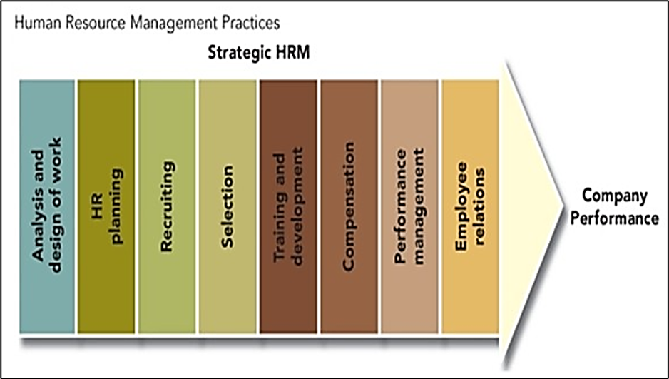
HRM debate & Premisses (4/4)
The universalistic perspective: organizations should adopt the best approach with develops the relationships between the individual «best» practices and firm performance. ➔There is a set of «best practices» that are universal in the sense that they are best in any situations
The contingency perspective: HR policies must be consistent with other aspects of the organization
The configurational perspective: is an holistic approach which emphasizes the important of the pattern of HR practices and is concerned with how this pattern of independent variables is related to the dependent variable of organizational performance (Delery & Doty 1996)

Slide 9
Main streams on HRM systems in family businesses
Narrow scope of the debate on professionalization of HRM systems in FF
    Preparing and training next generations of family employees
    Recruiting and selection of family employees
    Remuneration of family employees and non-family ones
HRM systems mainly devoted to maintenance of TMTs and governance bodies within the family domain
    Identification, selection, and remuneration of family CEOs
    Selection and remuneration of family BoD members
    Managing leadership transitions, both in the ownership domain and in the governance one

Slide 10
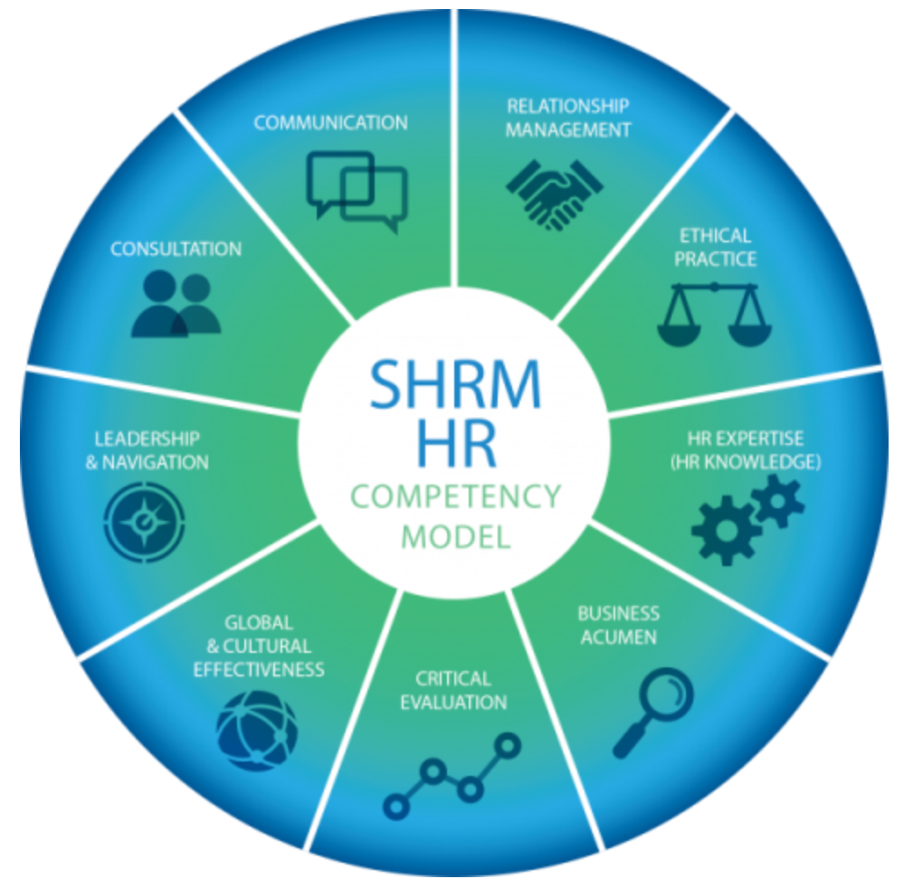
SHRM Competency Model

Slide 11
Main theories to manage HR (1/4)
Scholars adopted FB theoris:
  Agency Theory (Xianga, Worthington, and Higgs 2014; Dawson, 2011; Carrasco-Hernandez and Sánchez-Marín 2007; Schulze, Lubatkin, and Dino, 2003)
  Stewardship Theory (Combs et al., 2010; Eddleston et al., 2008; Sarathy, 2008; Miller et al., 2008)
  Resource Based View (Kok, Uhlaner, and Thurik, 2006; Dyer, 2006; Poza, Hanlon, and Kishida, 2004; Cascio, 1992; Schuster, 1985)
  SEW (Wandeker Kof et al., 2015; Achleitner et al., 2014; Cruz et al., 2014; Berrone et al., 1992).
All these topics are connected with loyalty and belonging to an organization of all the employees, both family and non family ones.

Slide 12
Main theories to manage HR (2/4)
In HRM for family businesses, two different theoretical points of view prevail (Neckerbrouck et al., 2018): the stewardship and agency perspectives (e.g., Cater et al., 2019; Damiani et al., 2018; Chrisman et al., 2017)
In Strategic Human Resource Management research two different theoretical points of view also prevail (Lepak et al., 2006) commitment- and control-based HRM systems
Very few studies consider the different roles that family members (e.g., Gottschalck et al., 2019; Steijvers et al., 2017; Pittino et al., 2016), as well as non-family managers (e.g., Chrisman et al., 2017; Steijvers et al., 2017; Hauff et al., 2014) might have on HRM systems in family firms ➔ Family context influences to HRM

Slide 13
Main theories to manage HR (3/4)
When a prevalent agency environment and self-interested (agentic) behaviors of family members prevail, family firm demonstrate less of an intention to adopt commitment-based HRM systems (Neckerbrouck et al., 2018). In such a case, control-based HRM systems minimize the costs of monitoring and replacing employees, ensuring efficient wages and an adequate work effort ➔ family firms may be more productive (Macduffie, 1995)
Investing in developing a stewardship environment and creating good, long-term employee relationships, commitment-based HRM-oriented family firms are likely to show higher rates of employee retention and productivity (Baù et al., 2020) ➔ This may positively impact upon employee retention
Combined commitment- and control-based HRM systems seem to leverage employees' competencies and motivate and empower them (Ghosh and Gurunathan, 2015), allowing for teamwork and flexibility and maintaining higher levels of employee retention and, at the same time, employee productivity (Chadwick et al., 2015)
Unfortunately, family firm may maintain an ambiguous stewardship approach, characterized by family-executive entrenchment. Family stewards may hire a family member rather than the best-qualified candidate for a job facing lower levels of nonfamily employee job satisfaction and retention (Gottschalck et al., 2019; Cater et al., 2019). Consequently, family SMEs show both costs in replacing those who withdraw and noneconomic costs, such as worse organizational climate and lost organizational memory.
In sum, family firms exhibit predominantly agentic, control-based behaviors when managing people (Vardaman et al., 2018). The stewardship perspective suggests that family firm must invest in commitment-based HRM systems in order to foster nonfamily–family interactions to counterbalance these harmful effects and HRM systems may not lead to higher employee productivity (Gooderham et al., 2008).

Slide 14
Main theories to manage HR (4/4)
While family firms may suffer from mismanagement due to the inefficient selection of family executives, their stronger attachment to the firm benefits all stakeholders by placing the firm's objectives before personal goals
The stewardship behavior of family SMEs may prevail (Damiani et al., 2018), and some family businesses effectively react and introduce formal HRM practices by providing superior training on the job, inclusiveness, job security, and employee support ➔ allow for a more in-depth knowledge of the employee, an increased ability to discipline and monitor family managers, and a greater capacity to exploit profitable opportunities as a result of flexibility. Only in such a case are family owners and family managers unambiguously related to higher employee productivity (Damiani et al., 2018)
Combining commitment-based HRM practices with family managers' emotional involvement enhances communication, increases the transmission of tacit knowledge, and aids the mobilization of human resources (Damiani et al., 2018) ➔ family SMEs are more likely to attract and retain high-quality employees, increasing labor productivity (Chrisman et al., 2017)
Family SMEs adopting such a strategy should allow for some HRM professionalization, demonstrating an adequate allocation of HRM resources (Hauff et al., 2014)

