Slide 1
Political Science, Law and History
Second semester, second year
International Relations
First Semester, third year
Fundamental Rights
Political Systems
Global History
Second Semester, third year
18 CFU you can choose among all the courses taught in English in our University
(if from other faculties, necessary approval by the GG Coordinator)

Slide 2


Greta Albertari
During GG I specialized in Legal studies (in 2017). This allowed me to have access to
a Master in International and European Law at the University of Amsterdam.
After that I enrolled for a second 1-year Master in International Migration and Refugee Law at the Vrije Universiteit van Amsterdam. They are both LLM which gave me a legal professional
qualification.
I believe that the bachelor in GG allowed me to have a broad understanding of the phenomena addressed during my studies. I often had the feeling that, in the Masters, topics were addressed from a purely legal perspective,
sometimes missing the broader picture. I felt privileged in having this broader picture already present in my mind, thanks to Global. Although I found myself with some knowledge gaps concerning legal technicalities
I believe that the forma mentis we built in GG allowed me to fill these gap and perfectly go on with my studies. Overall, I am very satisfied with my mixed academic background.
I am currently in the Greek island of Chios, working for the NGO Equal
Rights Beyond Borders. What we do is providing specialized legal assistance
to asylum seekers present in the EU hotspot of Vial.
If I had to point out a critical issue of my bachelor in Global Governance,
I would say that it concerned the number of law credits necessary to access to many law masters.
During my third year of Global, I had to add an additional extra-curricular course to my bachelor
in order to add 6 CFU to my legal credits. This was due to the fact that a minimum of 45 (but most
likely 60) CFU in legal subjects are required in order to have access to
LLMs across Europe. Therefore, I would recommend to make it clear with
students that intend to pursue a legal path. They should plan their course
of study in advance in order to be able to gather this minimum amount of
credits.

Slide 3
Martina Forbicini
After attending the majors in Global Flows and graduating in July 2019, I decided to undertake a gap year: I am currently working as a trainee at Bioversity International. It is an international non-profit organization that deals with agricultural biodiversity research. I am attaching the website: https://www.bioversityinternational.org/ to get a more complete idea.
After attending the course in Global Law and that of International Relations (taught by Meloni, Carbone and Bindi) I can say that both were very useful as a preliminary basis to understand the functioning of an international organization like this where I am doing the training. I believe, however, that a greater focus is needed on a practical level, with more examples deriving from the work carried out by the different subjects of international law: for example, having more information on how agreements are stipulated, studying the various phases that precede the final signature. In general, I believe that the practical part of these courses should be strengthened, perhaps offering more case studies to refer to.
In general, the Global Governance course, thanks to its interdisciplinary nature, has allowed me to acquire skills in various fields, which I can now use in a transversal manner. Furthermore, working at Bioversity International, with a completely international staff, was rather easy, thanks to the percentage of international students attending Global Governance and the opportunities offered by the course abroad (internships, Erasmus, Overseas ...).
In December I will move to Portugal to work in two environmental conservation projects with two NGOs, before continuing my university career with a Master's Degree in Northern Europe on environmental sustainability. I'm not sure about my future job but I would like to continue working with international organizations. I am sure that what I learned during the three years will also be helpful in these upcoming experiences.

Slide 4
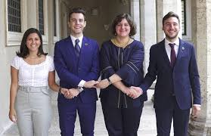
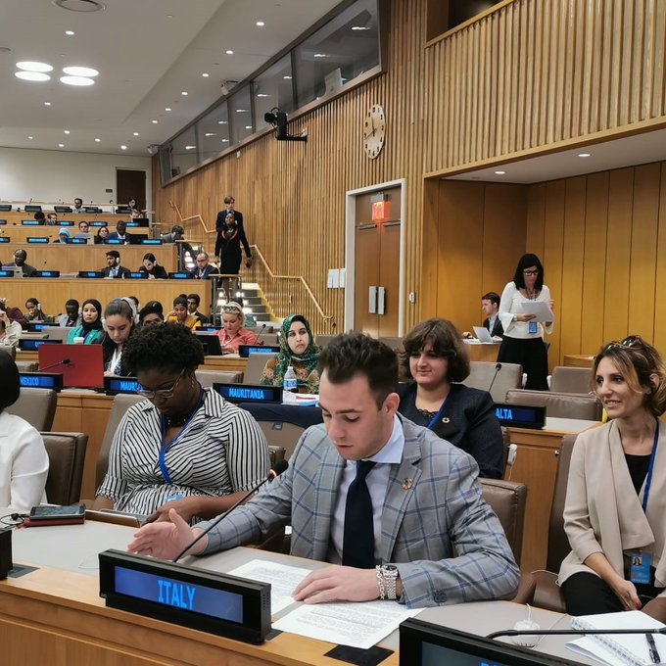
Giulia Parenti
Good morning to everyone from New York, I’m Giulia Parenti, currently the Youth Delegate of Italy to the United Nations. I graduated in Global Governance in 2017 and now I am about to finish my Master Degree in International relations and Diplomatic affairs - major in International Security - as I’d like to become a diplomat or a policy maker in a broader sense. Global Governance has for sure helped me to have the full picture crystal clear when discussing about social or political topics and to consider always every angle of a problem due to its interdisciplinarity that you’ll inevitably acquire not only as subject to study but as a way of thinking. Speaking about the post GG period, at a university level it has not created me huge problems as I had the possibility to take courses to fill the gap of GG like in-depth courses in History of International Relations and International Relations theories. If I have to find a flaw is that other “normal” Political Sciences Courses offer you courses on a second and third language and maybe I’ll face some problems in preparing for the entry test for the Diplomatic career on Italian Constitutional Law, but I think in this case a book will make up for it.

Slide 5
Political Science, Law and History
Second semester, second year
International Relations
-presentation by Ambassador Meloni-
First Semester, third year
Fundamental Rights
Political Systems
Global History
Second Semester, third year
18 CFU you can choose among all the courses taught in English in our University
(if from other faculties, necessary approval by the GG Coordinator)

Slide 6
FUNDAMENTAL RIGHTS – Prof. Andrea Buratti
Topic 1 Fundamental Rights at the beginning of western constitutionalism
1. “Liberty before liberalism”: the ancient roots of modern theory of fundamental
rights; liberties of the ancients and liberties of the moderns. The different
traditions of western constitutionalism.
Topic 2 The European tradition
2. The generations of rights and the constitutional guarantees of rights.
3. Fundamental rights and constitutional justice in the post II World War. The open
constitutional state and the European Convention for the protection of human
rights.
4. The German experience: the notion of Grundrechte. The proportionality principle.
The increasing relevance of the direct access to the BVG.
5. The Italian experience: introduction and case-law analysis (ICC, Judg. n.
238/2014).
6. The Spanish experience: introduction and case-law analysis (ETC, Judg. n.
48/2003).
7. The French Experience: the republican tradition and the bloc de constitutionalitè; the
relevance of the ECHR; the reform of the Conseil Constitutionnel.
8. The UK experience: the Human Rights Act and the Constitutional Reform Act.

Slide 7
Topic 3 The American tradition
9. The philosophical foundations of American tradition of fundamental rights. The
judicial review of legislation.
10. From the Bill of Rights to the 14th Amendment.
11. The equal protection clause.
12. Incorporation and the due process clause.
13. A new role for human dignity?
Topic 4 The international protection of fundamental rights
14. The post II World War and the spreading of human rights: the international
system of protection of fundamental rights.
15. New traditions of fundamental rights and the role of comparative judicial
dialogue: the cases of Israel and India.
16. International criminal justice
17. American Convention of Human Rights (1969)
18. African Charter of the Rights of Men and Peoples (1981)
Topic 5 Courts and rights: the European supranational scenario
19. Rights and courts in the European laboratory: integration of EU law and ECHR
in national legal orders.
20. The European Convention on Human Rights and the Strasbourg Court: origins,
development, transformations.
21. Case-law analyses.
22. Case-law analysis.
23. The EU system of protection of fundamental rights: the common constitutional
traditions as general principles of EU law.
24. Case-law analysis.
25. The Charter of Nice.

Slide 8
Comparing political systems
Emilie Frenkiel
Emilie.frenkiel@u-pec.fr
- Introduction to main concepts of political science with a focus on the public sphere, democracy, authoritarianism, democracy, representation, participation, informed citizenry and the good society.
- Special emphasis on the evolution and the diversity of political situations and attention to not only national but also local and global scales.
- Particular interest in Asian countries (including China, India, Japan, Taiwan).

Slide 9
Main objectives for this course:
providing students with the broad context needed for analyzing the political situation of any country.
understanding the main criteria and tools used to compare and rank countries in the world.
Grasping and reflecting on the role media and social media play in politics, what makes a non-democracy but also a democracy more democratic, what makes a stable democracy, the crisis of representation, populism, strongman politics and so on.

Slide 10
Why study Global History?
To shape the future you need to understand the present
To read the present you need to know the past: how and why we got here

Slide 11

History & Global Governance
Global Governance = process of shaping rules and practices intended to regulate global-scale interactions
political and economic cooperation among a variety of actors
responses to problems that transcend one state or region
institutions (IOs, ROs, Int’l regimes; NGOs…)
Historical perspective:
  Globalisation not a XXI Century process
  Current IOs and ROs born in post WW II era
  Today’s power relations are rooted in past decades (East-West, North-South; Middle-East…)

Slide 12
Global History
How world interdependence has been organized 1945🡪 2000s
  the process of making rules and regulations
  the institutions of cooperation (IOs, ROs, Int’l regimes)
  Interactions and cooperation (or not) between major actors and institutions to address/regulate global issues
Power distribution and power shifts and their implications
Roots of current problems and debates
Legacies of past experiences

Slide 13
A special focus on Europe
The EU is one of the 3 most important economic, political, and normative actors in the world!
We will
Appraise the process of European integration since 1950s
Explore EU mechanisms and policies
Assess implications of EU for both member states and third countries
Explore EU’s role(s) in Global Governance
Evaluate EU as a possible model

Slide 14
To cover the 18 “free choice” CFUs all GG courses are available,
either from the fundamentals of other Majors
or from the list of optional courses that will be activated.
It is also possible to choose among the BA courses
taught in English in Tor Vergata University (as for now, in this list
they are written in red – beware, the others are MA courses,
so not available for the optional 18 CFUs
Business administration and economics
Engineering Sciences
Art History in Rome, from Late Antiquity to the Present
Economics
Business administration
European economy and business law
Chemical Nano-Engineering
Finance and banking
Clinical Psychosexology
ICT and Internet Engineering
Mechatronics Engineering
Physical activity and health promotion
Science in Biotechnology
Tourism Strategy, Cultural Heritage and Made in Italy

