Slide 1
Cultural Diplomacy from the inside out
Experiences from the “field”
Cecilia Piccioni

Slide 2
Cultural Diplomacy: a definition
NOTHING NEW UNDER THE SUN

Slide 3
Although the term “cultural diplomacy” has only recently been established, cultural diplomacy (CD) or “diplomacy between cultures” has been a practice in place for centuries consistently contributing to improve relations between different, often divergent, groups → our history is full of examples of “informal ambassadors” or early “cultural diplomats” (explorers, travelers, traders, artists, missionaries…).
WHAT’S NEW THEN?
The main novelty lies in the fact that CD is no longer relegated to the periphery of the international relations discipline, BUT it has established itself as a stand-alone theory and practice.
./.

Slide 4
Therefore, we could define CD as:
  “a course of actions, based on and utilizing the exchange of ideas, values, traditions, and other aspects of culture or identity, to strengthen relationships, enhance socio-cultural cooperation, promote national interests and beyond”.
By its very nature CD is not the exclusive means of some BUT can be practiced by the public sector, private sector or civil society.
What CD is for in our increasingly globalized, interdependent world?
CD IS KEY TO FOSTERING PEACE AND STABILITY. IT HAS A UNIQUE ABILITY TO INFLUENCE THE “GLOBAL PUBLIC OPINION” AND IDEOLOGY OF INDIVIDUALS, COMMUNITIES, CULTURES OR NATIONS.
./.

Slide 5
… TO FOSTER PEACE AND STABILITY CD ACTS THROUGH:
  RESPECT & RECOGNITION OF CULTURAL DIVERSITY & HERITAGE
  GLOBAL INTERCULTURAL DIALOGUE
  JUSTICE, EQUALITY & INTERDEPENDENCE
  PROTECTION OF INTERNATIONAL HR
  This is when the renowned definition of “soft power” by Joseph Nye comes in handy: “the ability to persuade through culture, values, ideas, as opposed to “hard power”, which conquers or coerces through military might”.
  Indeed, the increased interconnection of our world calls for cooperation on a new level and this is where the role of CD as a form of Soft power becomes significant. On this basis, it functions as a necessary component of political or economic diplomacy.
  ./.

Slide 6
If seen as a multifaceted picture of the different aspects of a Nation’s culture (wealth, scientific and tech advances, competitiveness at all levels) CD embodies a demonstration of National Power → with clear implications for a Nation’s ability to ensure the pursue of its national interest.
  MOREOVER
….increasing interconnection and the quest for new paradigms of sustainability highlight also the need for the private sector to embrace the different values and needs of diverse cultures and societies.

Slide 7
THEREFORE
MANY ARE THE REASONS FOR THE PRIVATE SECTOR ACTORS TO ADOPT CD MODELS INTO THEIR AGENDA:
  in the era of growing social awareness, corporates with culturally sensitive marketing plans could enjoy a positive public opinion and good image → that will mirror on their market share and financial performances;
  companies expanding abroad could benefit significantly from researching into cultural differences of the host country.
  CD’S TOOL KIT IS VERY DIVERSE AND RICH AND BENEFITS FROM EVERY ASPECT OF A NATION’S CULTURE (ARTS, EDUCATION, EXCHANGES, DIALOGUE, RELIGIOUS DIPLOMACY…)

Slide 8
Applied Cultural Diplomacy
THE CASE OF ITALY
A TOOLKIT

Slide 9
Culture is an essential element of Italian identity and is a heritage to be drawn on to face nowadays challenges. The Italian language and scientific research, are part of it.
Culture, economy, science are today more than ever the 3 pillars that support and promote the competitiveness of a country. The use of CD must therefore imply an increasingly integrated approach.
Cultural promotion plays a fundamental role in the Italian foreign policy.
All the subjects and initiatives of cultural promotion carried out by the MAECI report to the DG for the promotion of the Country System, including:

Slide 10
  Italian Institutes of Culture that take care of relations with the cultural institutions of the accreditation countries and promote Italian culture and language in 61 countries;
  Italian schools abroad, which reach 90% of foreign students;
  network of Scientific Attachés;
  Cultural and Scientific Agreements and Protocols;
  scholarships that open our universities to foreign students;
  archaeological missions;
  support to UNESCO, of which Italy is a main sponsor;
  Italian National Commission for UNESCO;
  translation awards, the Italian Language Week in the World, and the Dante Alighieri network;

Slide 11
Italy actively collaborates with international organizations - UN family, in particular UNESCO - to support their cultural cooperation activities.
MAECI supports Italian archaeological, anthropological and ethnological missions abroad. Besides their natural goal, these missions are also valuable for training local operators and enhancing technology transfer in sectors where Italy is leader.
As one of the countries most affected by the illegal export of cultural and archaeological goods Italy has developed legal, investigative and organizational tools to fight this phenomenon → MAECI and its network, Ministry of Cultural Heritage, Carabinieri are the frontrunners when it comes to recover goods stolen from the our heritage.

Slide 12
The promotion of the Italian language abroad is one of the main tools available to our country and plays a key role in Italian foreign policy.
  Knowledge of the Italian language is the key to getting in touch with our culture in a broad sense. Over 2 million foreigners study Italian to get closer to our heritage.
  There is a strong link between Italian and Made in Italy. Italian is the second most used language for commercial signs in the world (even in economic sectors not just in the traditional ones).
INNOVATION AND RESEARCH
MAECI promotes the internationalization of Italian research and scientific diplomacy as key tools for the development of cooperation between Italy and the rest of the world.
INNOVITALIA, ITALIAN RESEARCH IN THE WORLD
Innovitalia 3.0 is a platform shared between MAECI and MIUR aimed at encouraging the sharing of information and networking between Italian researchers abroad and the Country System of Research and Innovation.

Slide 13
Cultural Diplomacy
ITALY-VIETNAM RELATIONS:
FROM THEORY TO PRACTICE

Slide 14
HOW CAN YOU MAKE THINGS HAPPEN?
You have to:
  get to know exactly what the missing pieces in your jigsaw are
  look for authentic reading keys to better understand where you are
  draw a doable roadmap
  never forget the relevance of an integrated approach
  …and don’t get scared when realizing that…theory could be just a suggestion!!! ☺

Slide 15
I AM BEAUTIFUL, YOU TOO…
Hanoi, November 21, 2015
Video link
https://youtu.be/_Xo5njjh39I

Slide 16
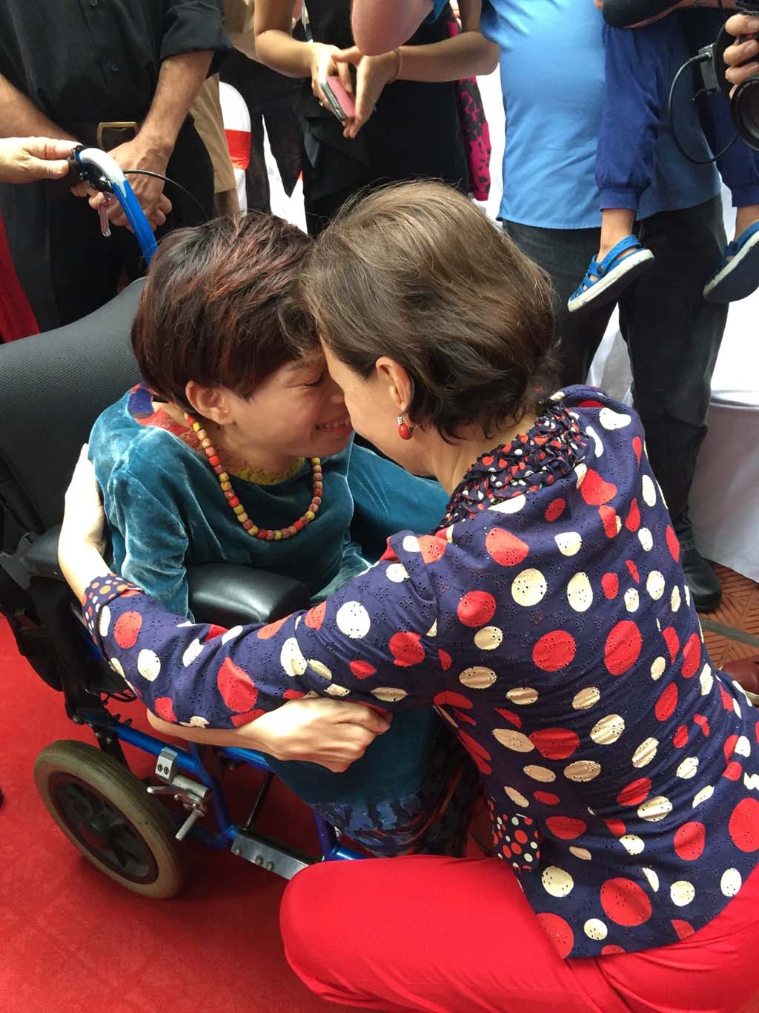

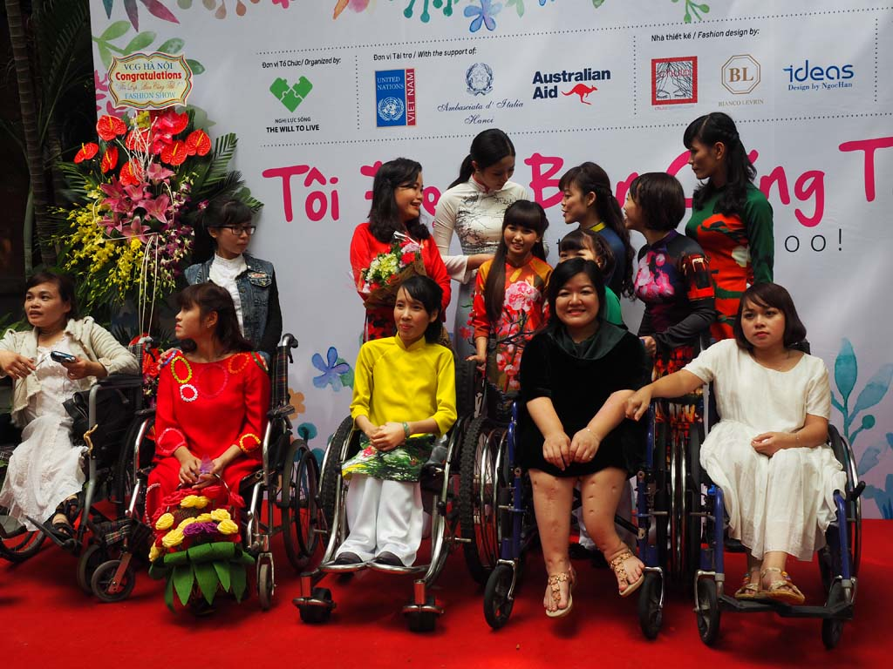
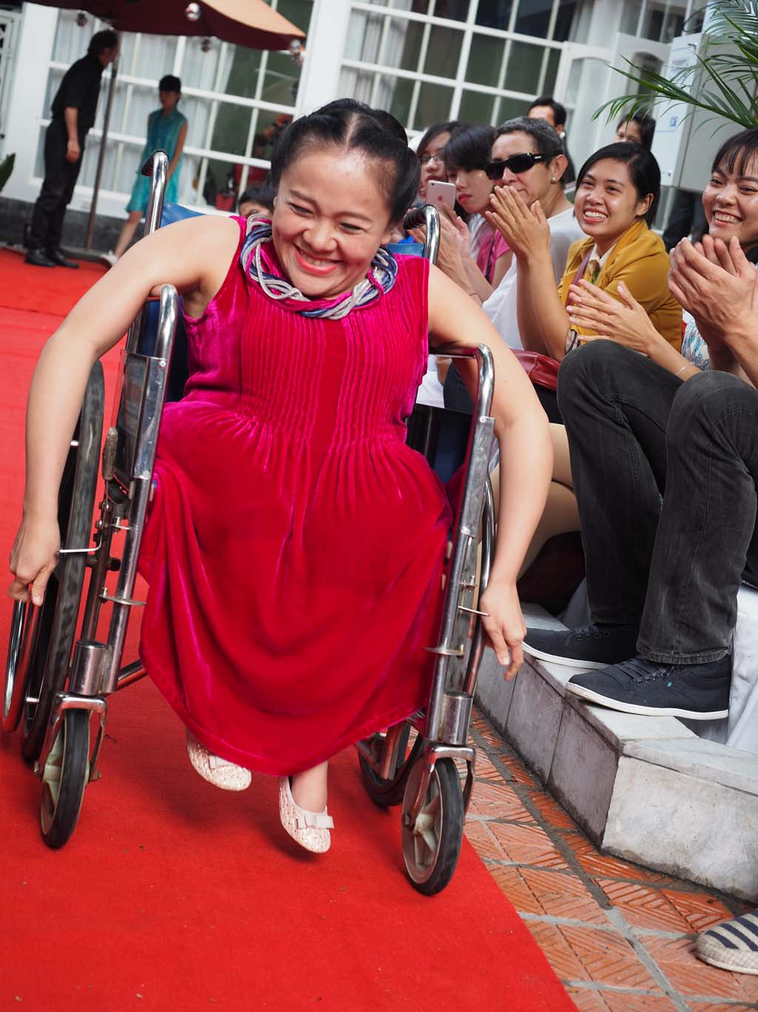
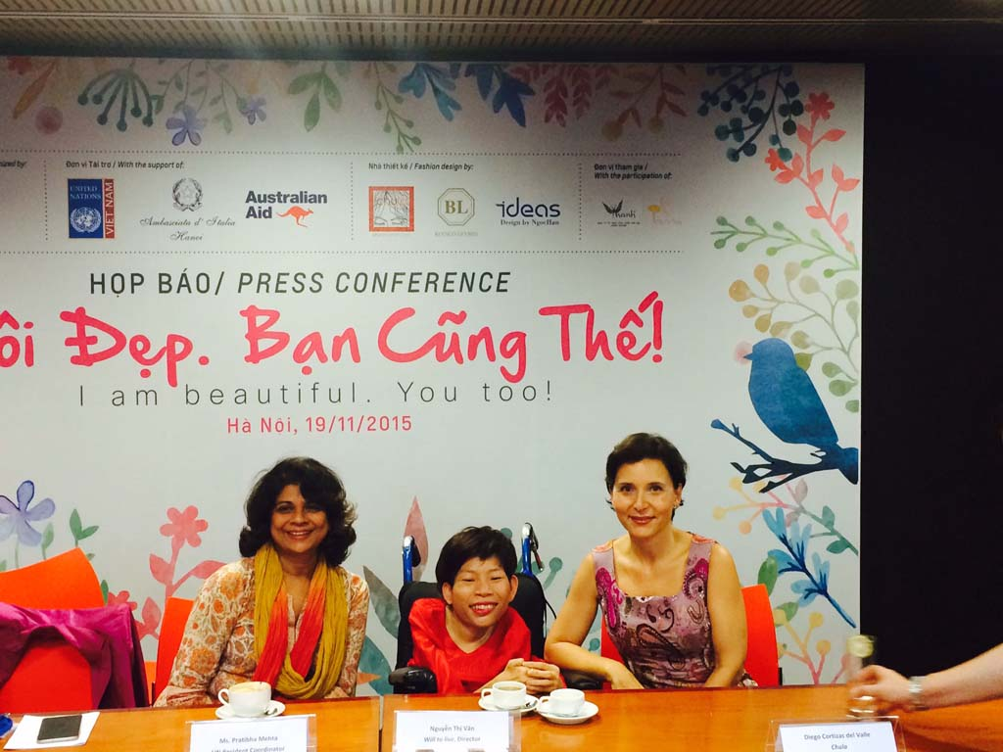
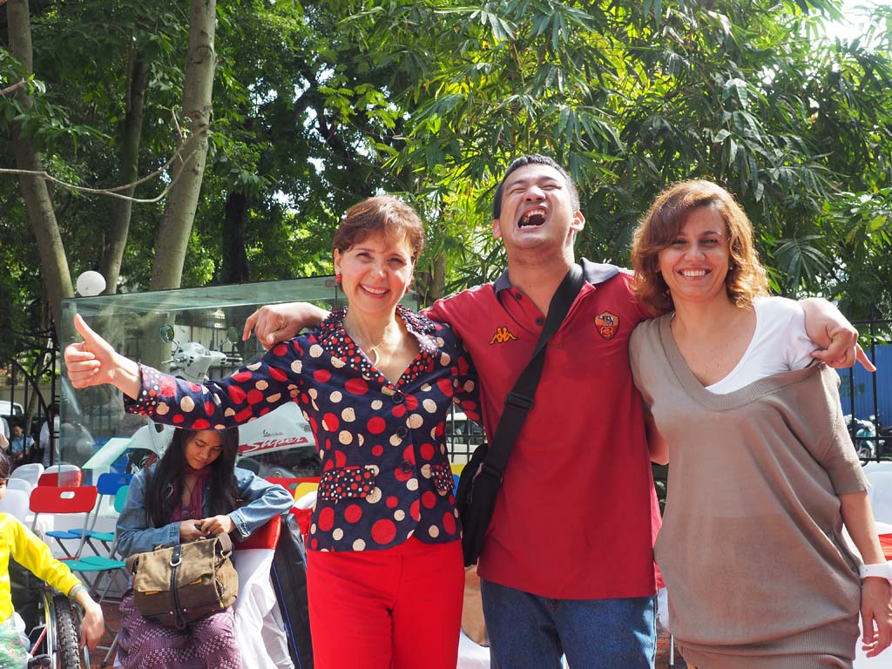
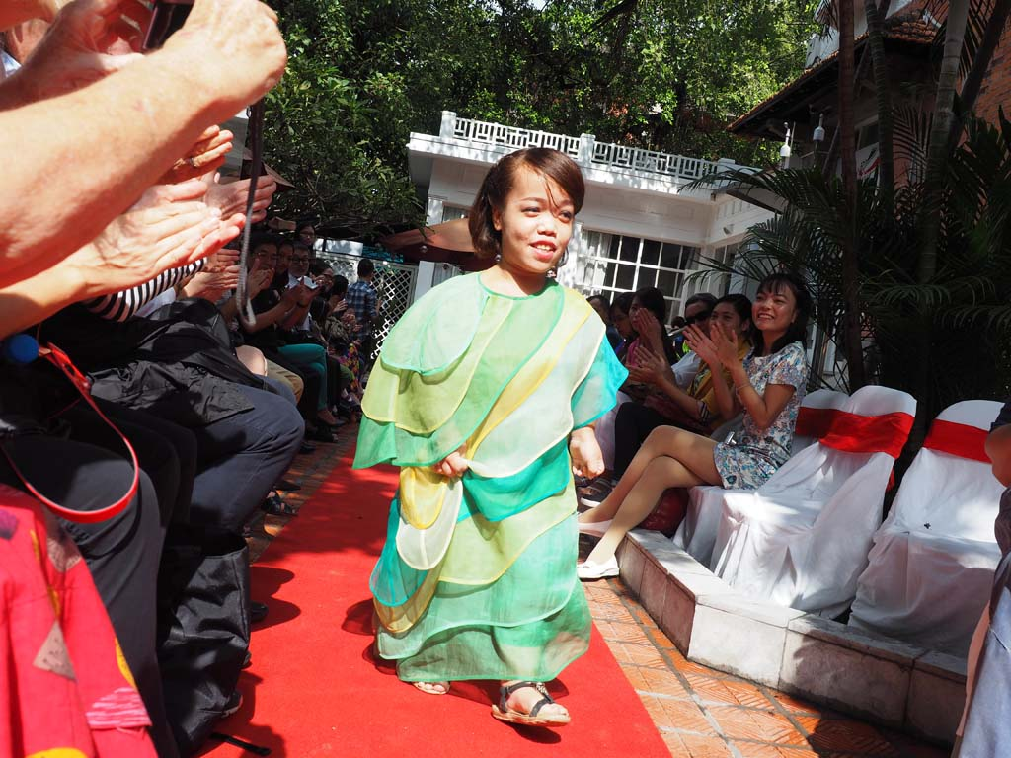

Slide 17
We launched the initiative of a fashion show, the first in the country's history, dedicated to models with disabilities.
the event had a tri-fold purpose:
  to raise the level of Vietnamese awareness on supporting the most fragile layers of the population;
  to strengthen collaboration at a multi-bi-lateral level btw Italy and Vietnam;
  to raise the visibility of Italy in Vietnam on human rights issues.
The initiative proved to be a significant success and has contributed to:
  increase the reputation of the Italian system in Vietnam;
  involve private sector operators (fashion industry related stakeholders) in an operation from which they’ve benefited in reputational and business terms
  create a constituency (UN in Vietnam, Australian Embassy) which has intensified its efforts in favor of disabled people in the country.

Slide 18
RAFFAELLO OPERA OMNIA…
Hanoi, June 1, 2017
Video link
https://www.youtube.com/watch?v=d_xzvNw_w1s&feature=youtu.be

Slide 19
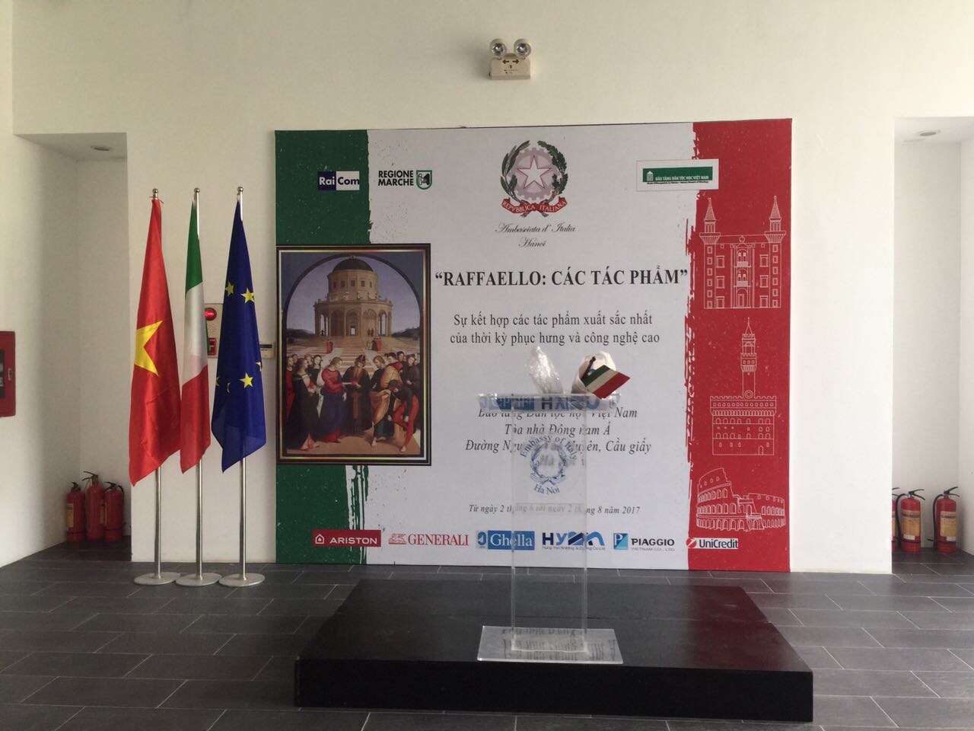

Slide 20
For the first time ever we brought to Asia, the exhibition “Opera Omnia: Raffaello”, an unprecedented combination of 35 of the most iconic masterpieces of Raffaello, and Italian technology.
In bringing the project to Hanoi we wanted to engage with Vietnam in the cultural promotional activities, within a genuine partnership, highlighting the value of sharing good practices and knowledge.
We showcased high-definition “digital paintings” and true-to-scale reproductions of Raffaello’s masterpieces, recreating any piece while remaining absolutely true to the originals.
The combination of Raffaello’s art with the skills of our digital experts serves the goal of disseminating precious treasures as well as of nurturing tradition with technology encapsulating Italian modern ingenuity.

Slide 21
Cultural diplomacy & the private sector:
FINCANTIERI
&
FINCANTIERI FOUNDATION

Slide 22
FINCANTIERI
Fincantieri by the very nature of its mission and activities incorporates the use of cultural diplomacy in its agenda. Indeed:
    having developed a distinct international vocation, it attaches value to the knowledge of the local situations in which it is called to operate (e.g. Vietnam/Vung Tau shipyard),
    Fincantieri's products incorporate a cultural/technological/scientific content of the highest level. Every naval unit, civil or military, that comes out of one of the Group's shipyards is a "showcase" of Made in Italy, a CULTURAL AMBASSADOR of our know-how.
    In addition, Fincantieri plays a key role in spreading and amplifying an idea of "European" industrial culture inspired by the principles of quality, innovation, and EU competitiveness (FNC/Chantiers)

Slide 23
FINCANTIERI FOUNDATION
The Fincantieri Foundation was established in 2008 to promote the restoration and preservation of the Group's historical heritage (historical documents, military and civil construction and industrial archaeology products).
It has allowed the recovery of uncountable publications, technical drawings and images related to the industrial production of shipbuilding, documents produced in Italian shipyards since the end of the 19th century.
Through conferences and exhibitions, it contributes to the diffusion and enhancement of Fincantieri's historical heritage → an ideal bridge between the world of culture and the business world.
The Foundation also pursues social solidarity goals promoting cultural activities aimed at the well-being, education and support of Fincantieri’s employees and of the areas where the group is present.

Slide 24
FINCANTIERI FOUNDATION – TODAY…
In 2016, the Foundation opened "ART ON SHIPS-IL VARO DELL'UTOPIA" to celebrate the 100th anniversary of Monfalcone shipyard .
Through the transatlantic liners built by Fincantieri and the artifacts of iconic artists on board, the initiative aimed at enhancing one of the highest artistic and technological expressions of the time.
The exhibit main goal was to highlighting the link btw the shipbuilding industry and artistic production, expressed in the creation of real floating art galleries on cruise ships of the '60s. The Leonardo, Michelangelo and Raffaello, turned out to be true international floating showcases. All the unique artistic realizations on the ships spread in the world the quality of "making" recognized to the "Made in Italy".

Slide 25
….FINCANTIERI FOUNDATION – TOMORROW!
....recovering, preserving, sharing Fincantieri’s heritage is in itself a mission, as well as as is that of supporting the local communities where it acts.
However, today the Foundation's task could also develop along less obvious and innovative lines.
In particular:
  1.) to favor through its action the dissemination and further articulation of a European industrial culture (also of Defense);
  2.) to spread and raise awareness on the issues of sustainability at 360^ (economic, social, environmental);
  3.) to promote the dissemination of Fincantieri CSR good practices thus enhancing its “culture” in a world increasingly in need of actors ready to do their part to fill the gaps produced by the rising inequalities.

Slide 26
TAKE-HOME MESSAGES
The effectiveness of CD today depends essentially on the ability to use its toolkits within the framework of an integrated cultural/economic/promotional approach.
Even the richest and most extraordinary cultural heritage of a Nation is worthless unless it is used as a catalyst to promote its national interest!

Slide 27
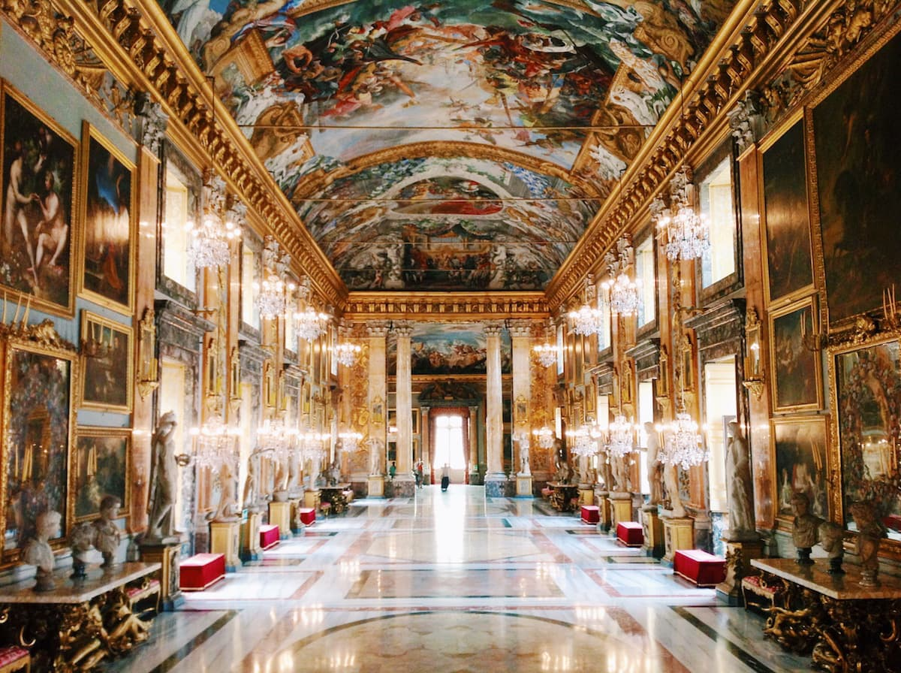
Q&A Session
il

