Slide 1
Applied English

Slide 2
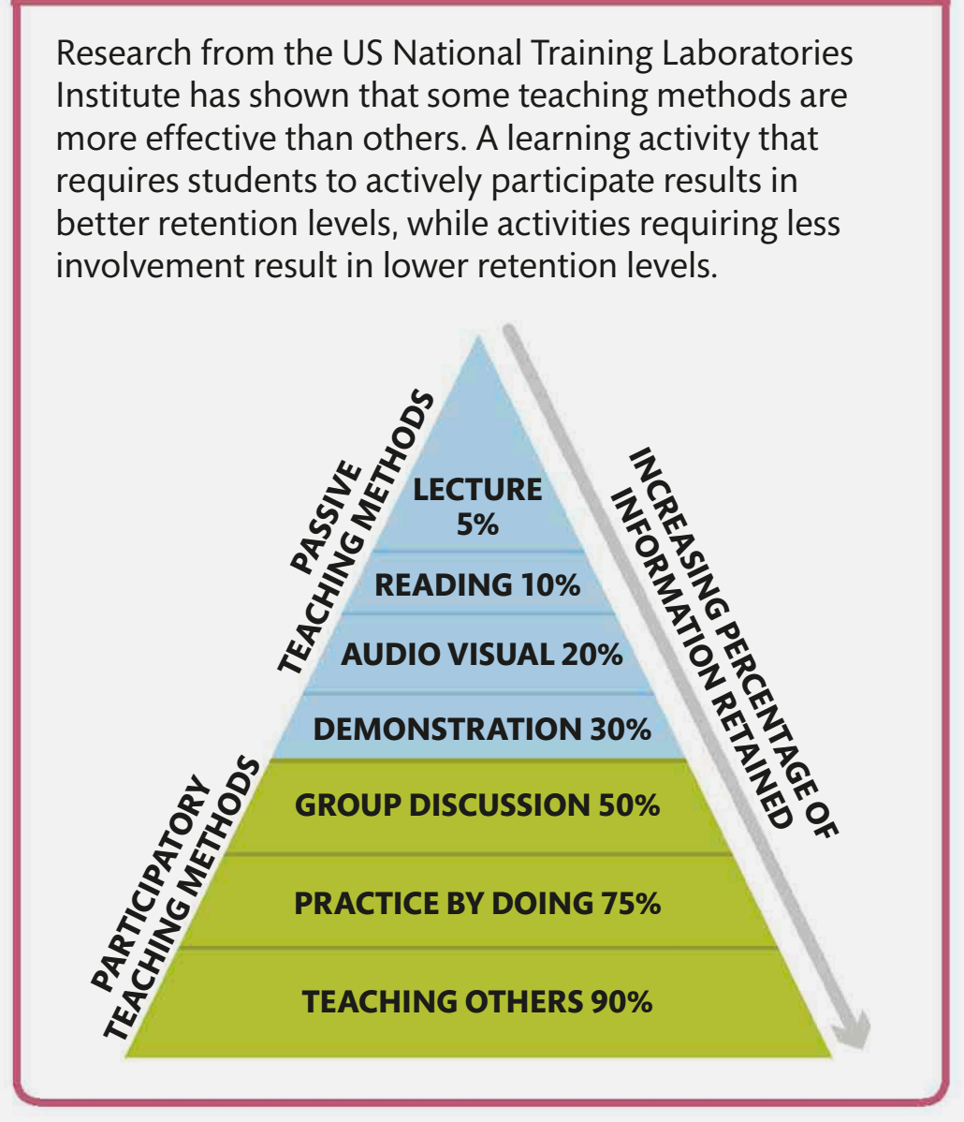

Slide 3
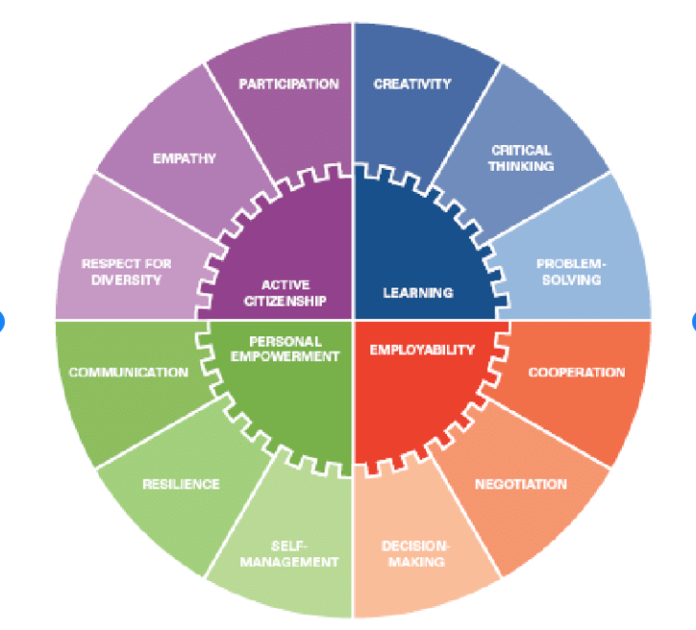

Slide 4
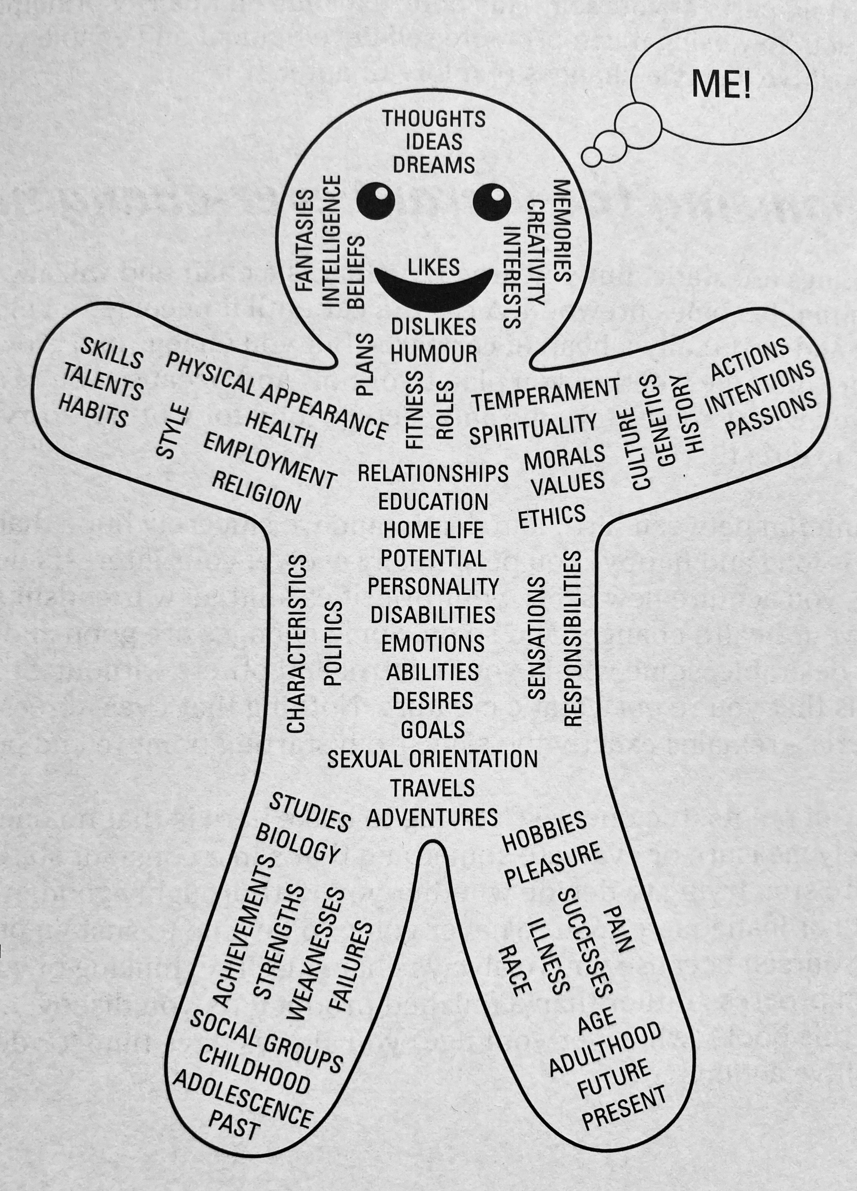

Slide 6
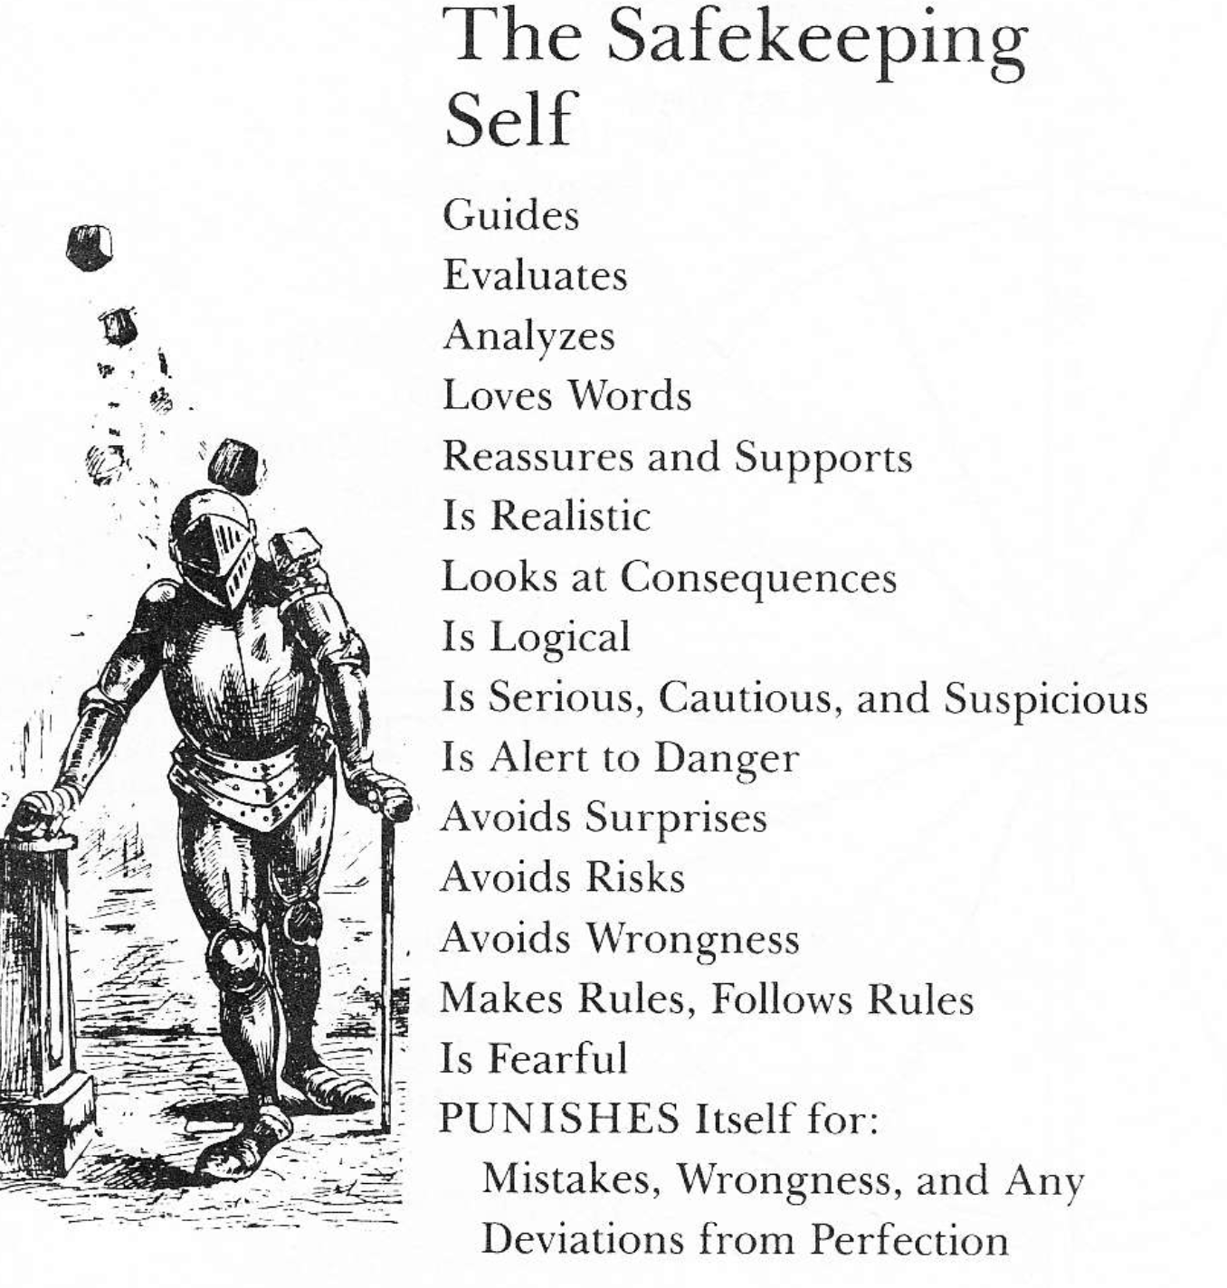

Slide 7
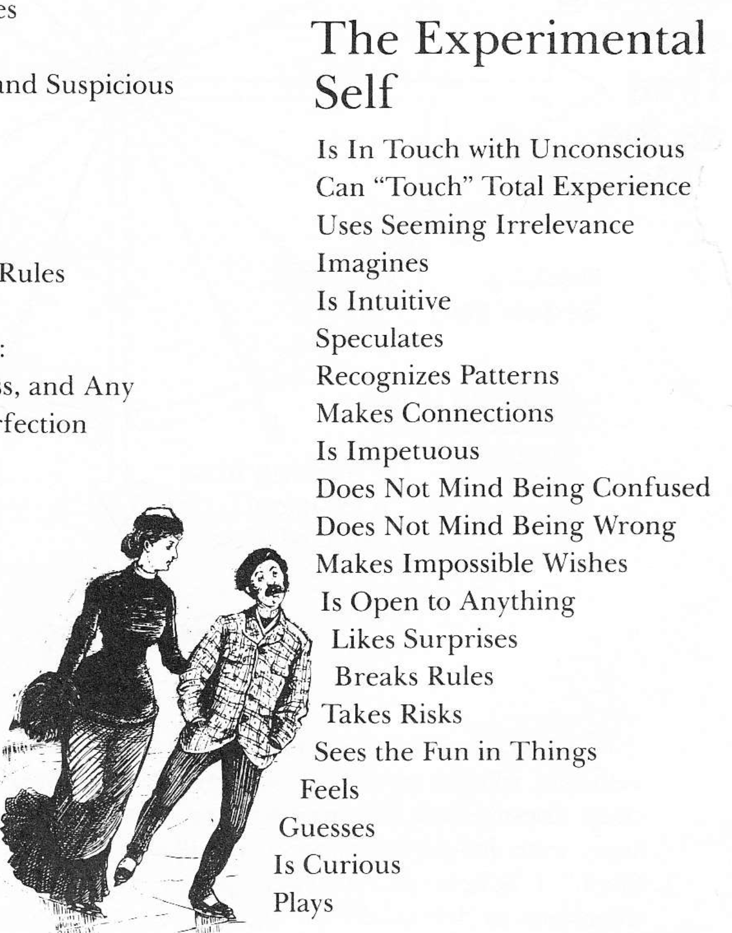

Slide 8
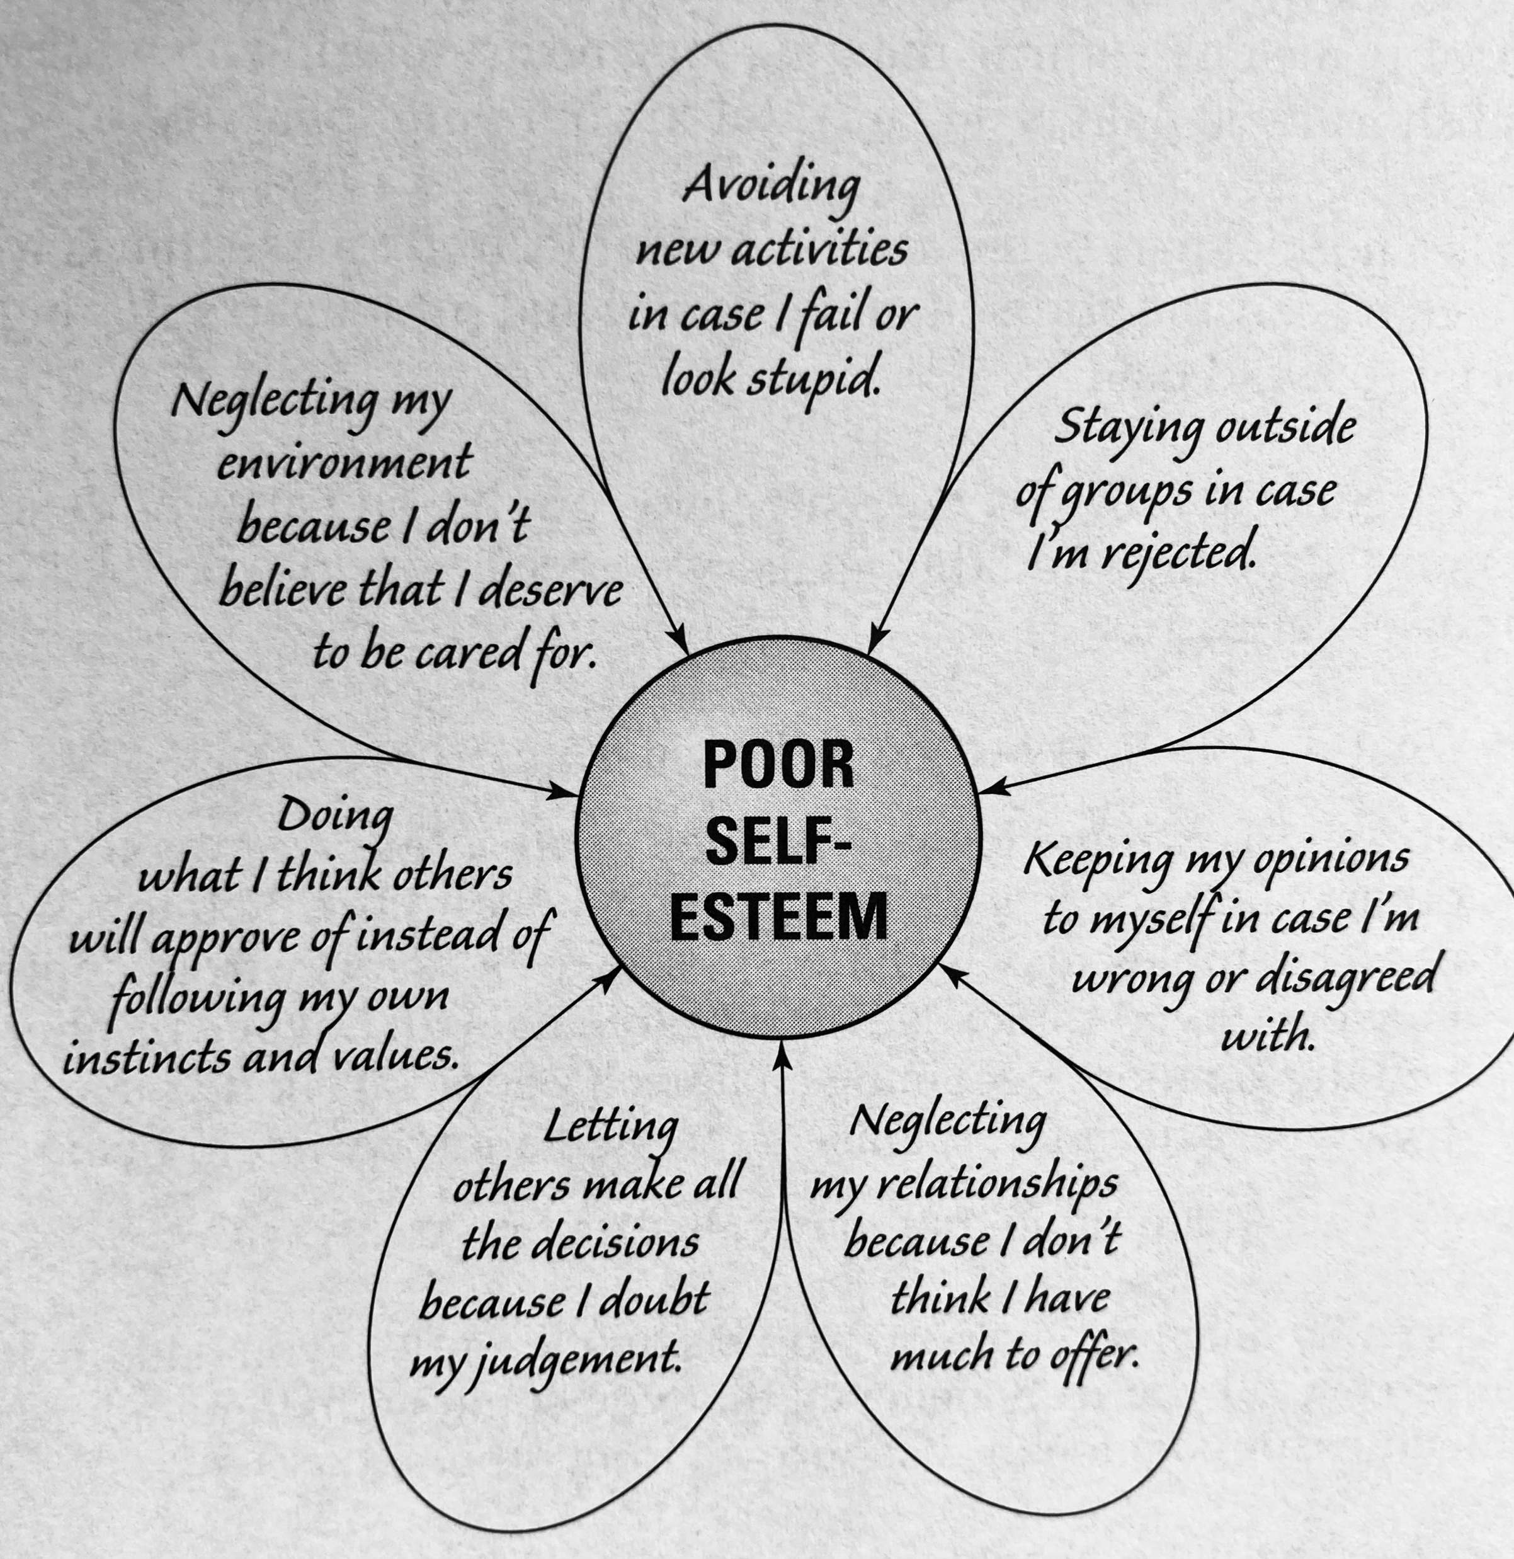

Slide 9
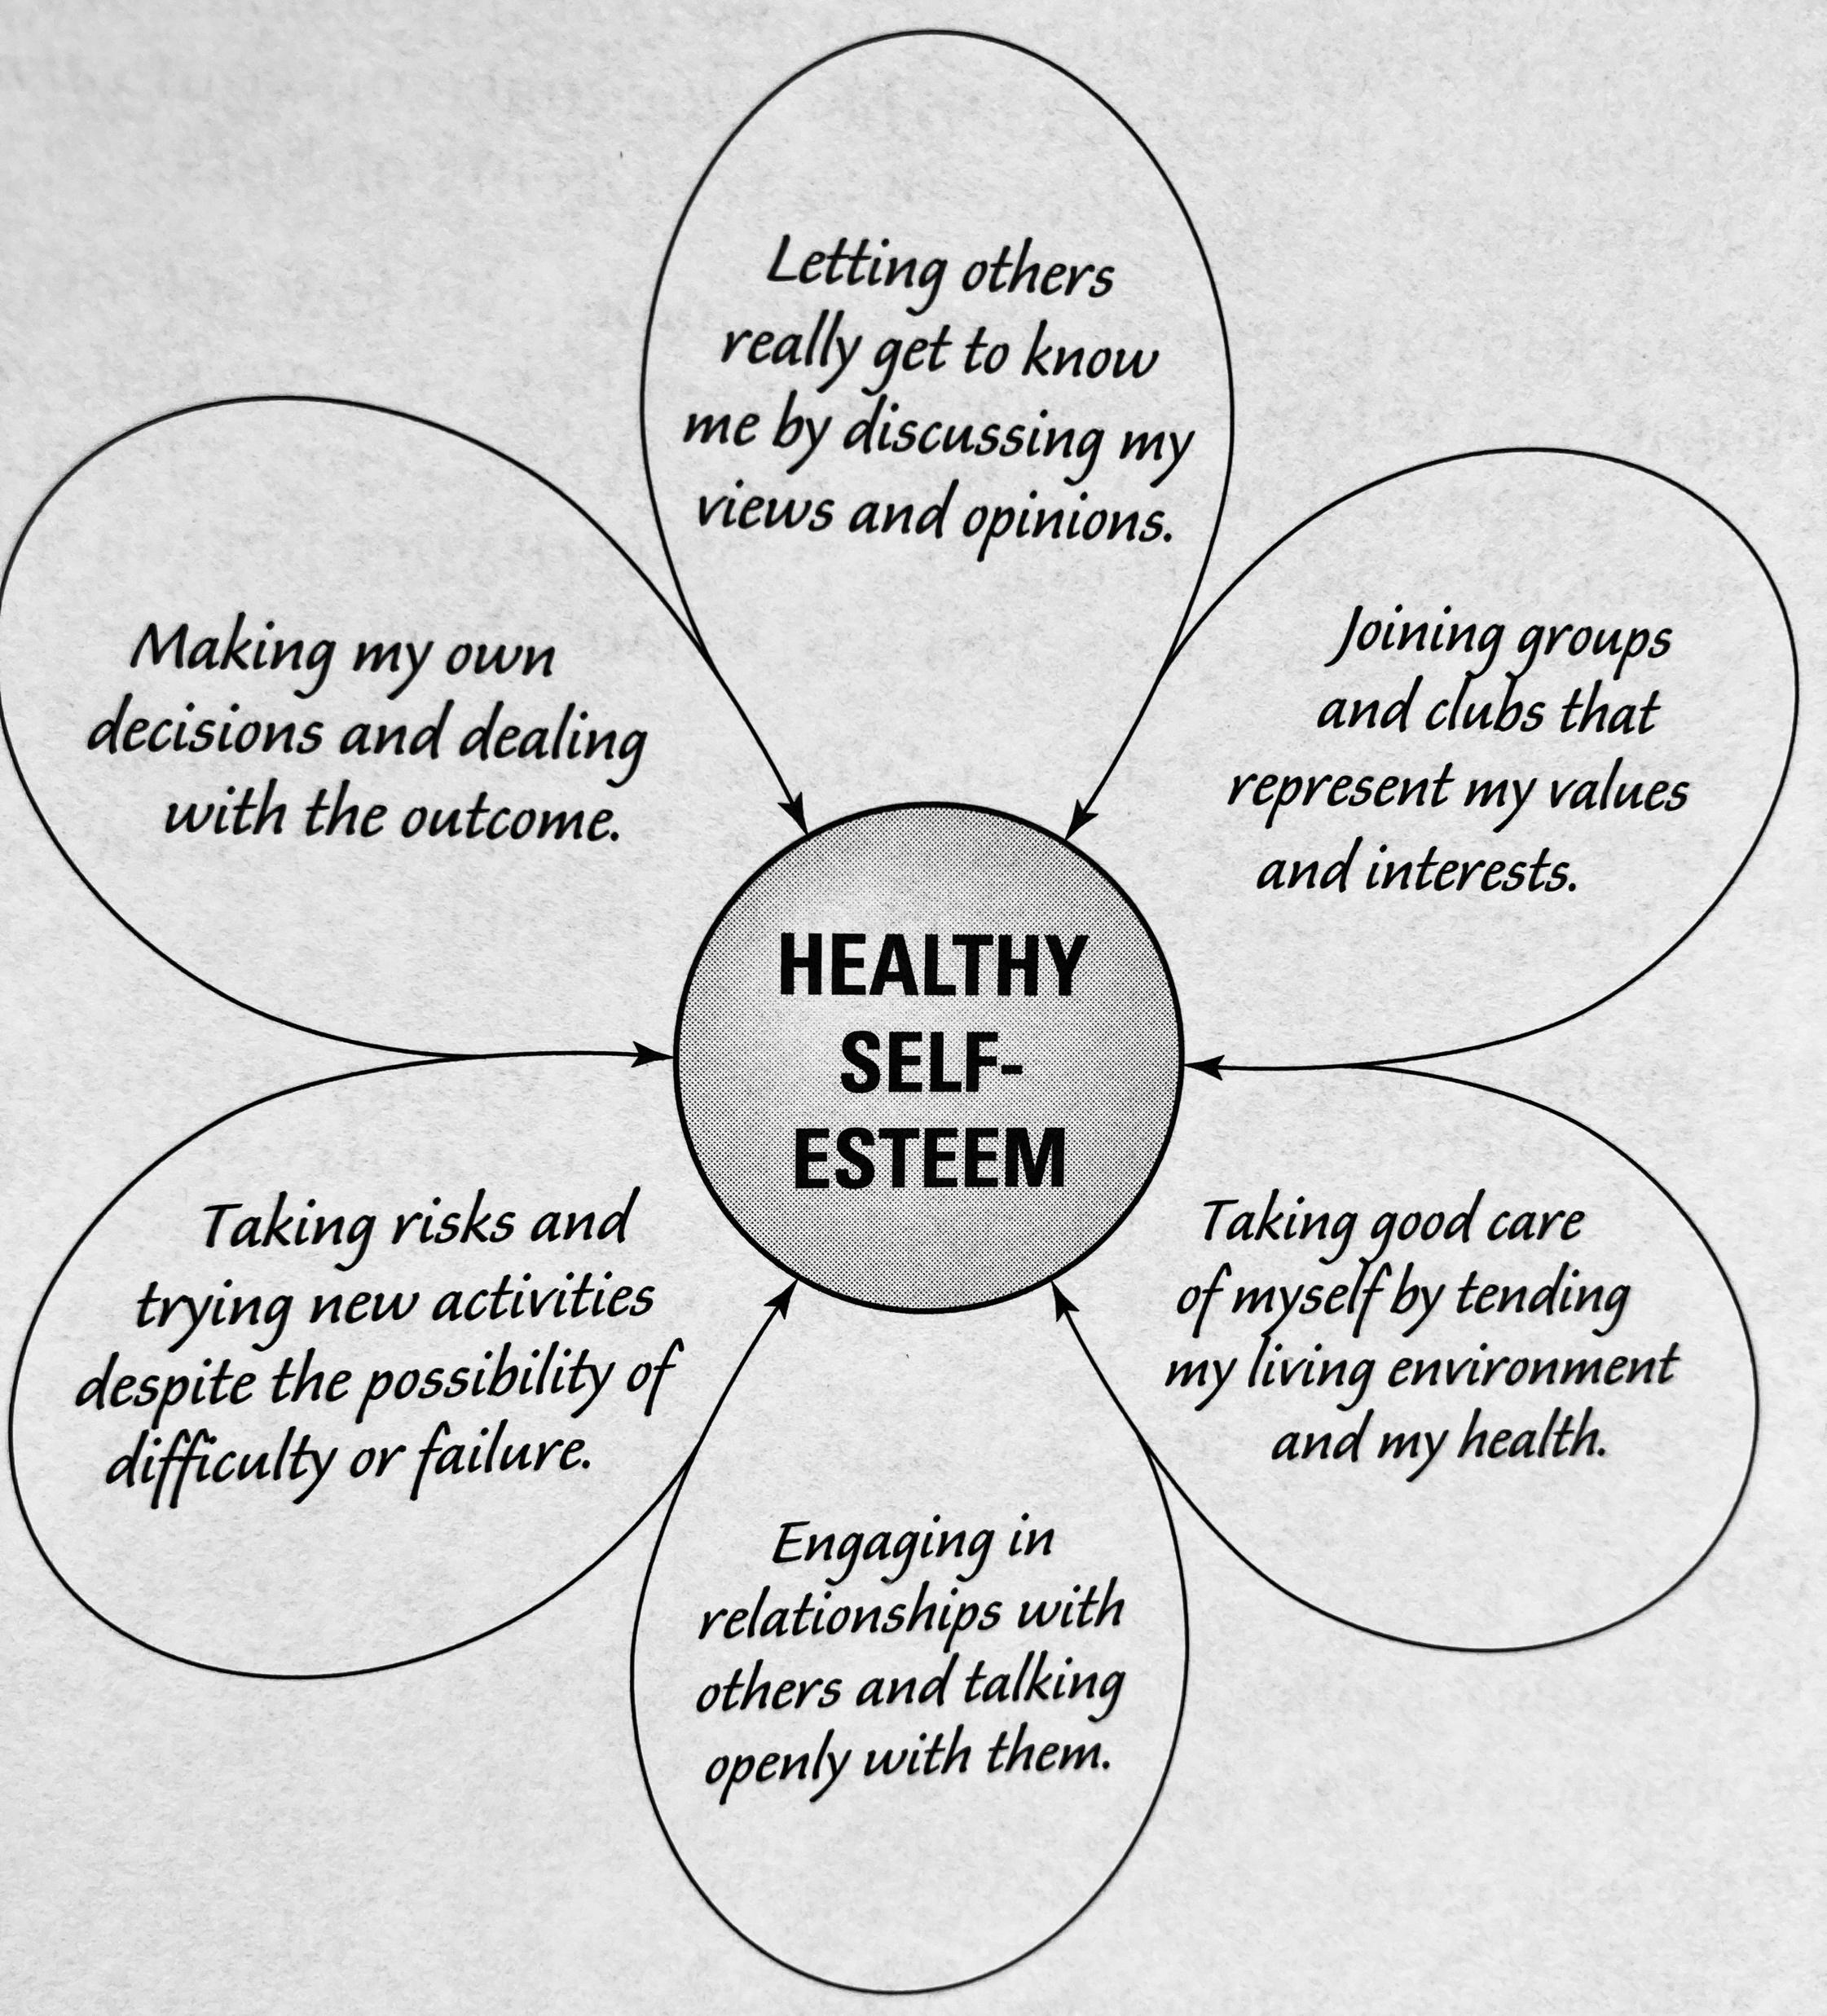

Slide 10
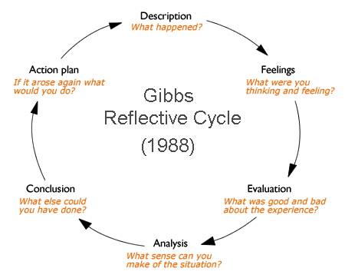

Slide 11
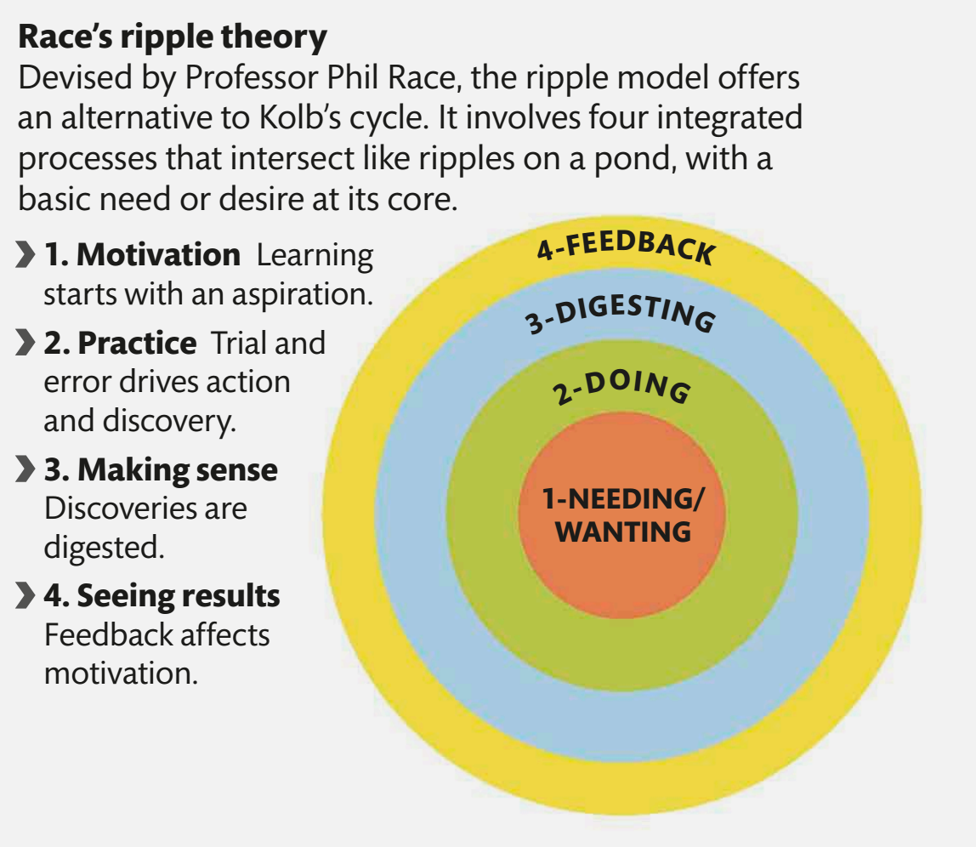

Slide 14
Scots
Aye
Wee

Slide 15
Scots
Lad
  (Braw, Eesome, Weel
  Lookit)
Lassie
(Bonnie, Sonsie)

Slide 16
Scots
Haud yer Wheesht!

Slide 18
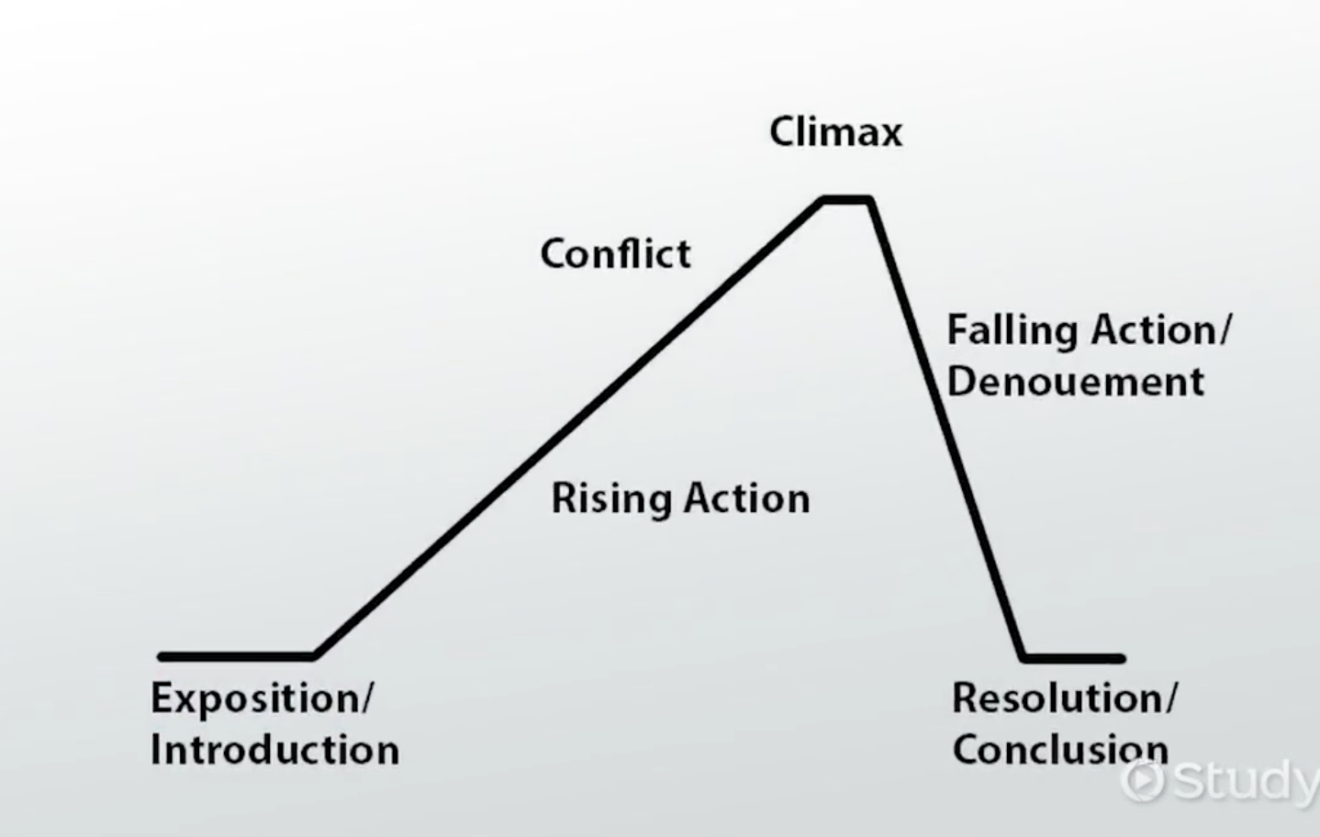

Slide 19
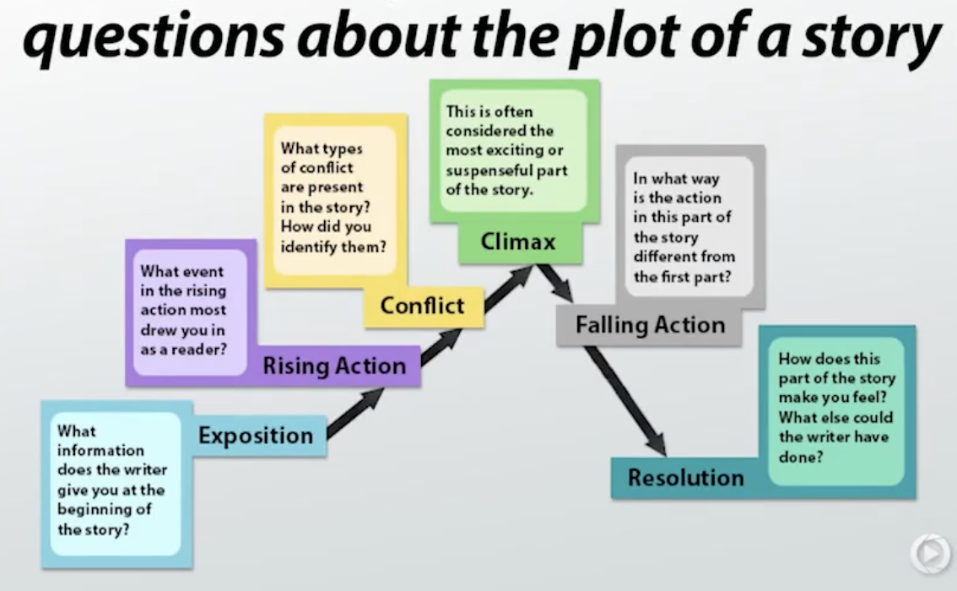

Slide 20


