Slide 1
Accounting

Slide 2

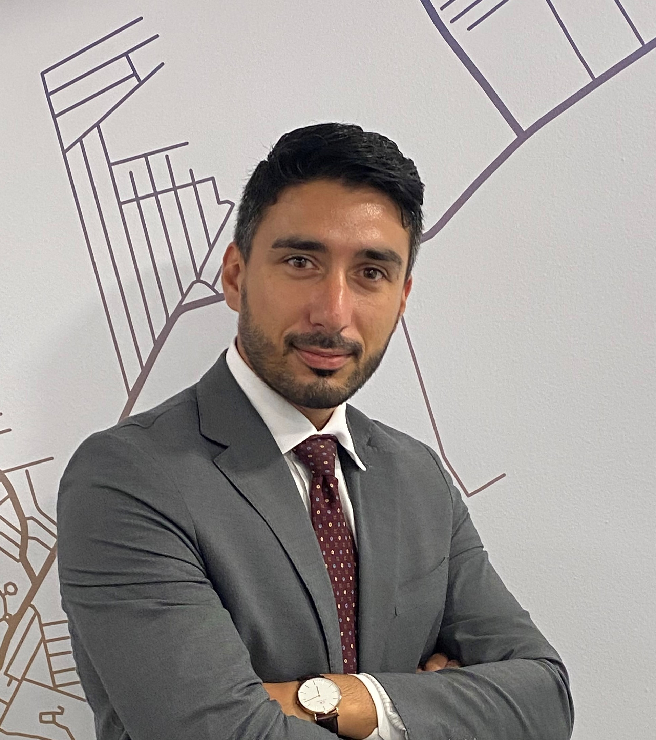
Accounting
Maria Ginevra De Romanis
Practice on accounting
Francesco Lucà

Slide 3
Focus
This course will provide you with the basic knowledge of accounting.
At the end you should be able to read and understand the information contained in a financial statement and to understand how the businesses operate.
Understanding how the businesses operate in last instance should suggest you if you will to cooperate with that company or not.
Thus, whatever will be your professional career, you always might be requested to analyze the financial information contained in the financial statements.

Slide 4
Topic
Topic 1 – How companies’ operations are translated into numbers, an introduction to the Financial Statements
Topic 2 – Basis for accounting, double entries
Topic 3 – Accounting principles, the composition of a Financial Statements and related assertions
Topic 4 – Balance Sheet: composition, key accounts representation and valuation under IFRS and Italian GAAP
Topic 5 – Income Statement: composition, key accounts representation and valuation under IFRS and Italian GAAP
Topic 6 – Cash Flow Statements: structure and composition
Topic 7 – The role of valuation, assumption and estimates
Topic 8 – Reading the financial statement driven by professional skepticism: an introduction to financial statements analysis.

Slide 5
Textbooks
Oral lessons provide for each Topic a summary of basic notions and methods, and some worked examples.
The main teaching material will be shared with the class, among IFRS and selected documents provided to the students.
Further, you may consult:
Financial Accounting and Reporting – Barry Elliot and Jamie Elliot - 18th Edition – Pearson
Basic Accounting – Nishat Azmat and Andy Limer – Teach Yourself
Updates on some standards will be provided to students and are reachable at www.ifrs.org

Slide 6
Assessment
The exam will foresee different modalities according to the status of attending or non-attending students.
Written examination in the “Mid-Term” session*
Written and Oral examination at regular session for no attending students
Non-attending students are allowed to participate to the two exams sessions.
Students that fail the mid-term are allowed to participate to the second exam session only as attending students.
The exam for attending students will be written only.
*The mid-term session will be weighted based on the progress of lessons and it will be communicated at least one week before the mid-term date once defined. The weight of mid-term grade will be considered between 20% and 50% anyway. Based on the progress of the course, once the date will be defined, we will define the mix of theorical and practical content of the mid-term exam

Slide 7
Office hours
Office hours
Upon appointment by email
Prof. De Romanis mderomanis@deloitte.it
Francesco Lucà Francesco.luca@it.ey.com

