Slide 1
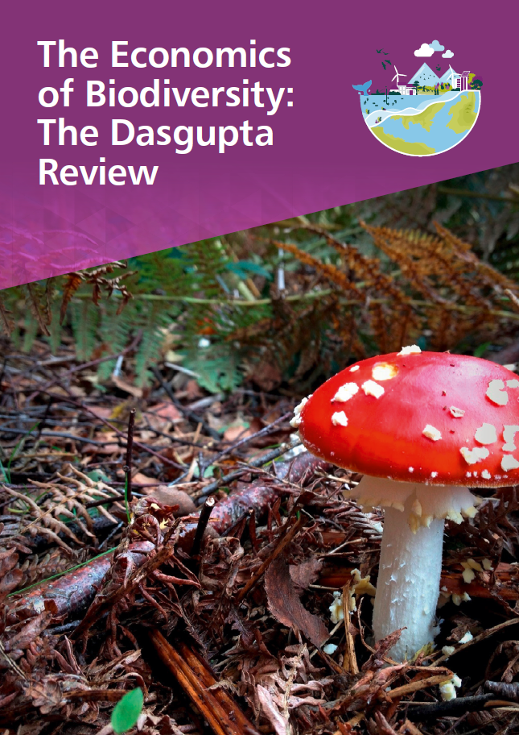
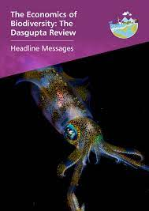
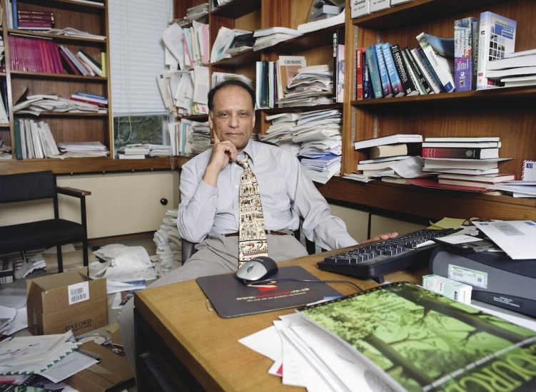
The Economics of Biodiversity:
the Dasgupta Report for the G7 2021

Slide 2
The Economics of Biodiversity: The Dasgupta Review Headline Messages
1. Our economies, livelihoods and well-being all depend on our most precious asset: Nature.
We are part of Nature, not separate from it. We rely on Nature a) to provide us with food, water and shelter; b) regulate our climate and disease; c) maintain nutrient cycles and oxygen production; and d) provide us with spiritual fulfilment and opportunities for recreation and recuperation, which can enhance our health and well-being. We also use the planet as a sink for our waste products, such as carbon dioxide, plastics and other forms of waste, including pollution.
Nature is therefore an asset, just as produced capital (roads, buildings and factories) and human capital (health, knowledge and skills) are assets. Like education and health, however, Nature is more than an economic good: many value its very existence and recognise its intrinsic worth too.
Biodiversity enables Nature to be productive, resilient and adaptable. Just as diversity within a portfolio of financial assets reduces risk and uncertainty, so diversity within a portfolio of natural assets increases Nature’s resilience to shocks, reducing the risks to Nature’s services. Reduce biodiversity, and Nature and humanity suffer.

Slide 3
The Economics of Biodiversity: The Dasgupta Review Headline Messages
2. We have collectively failed to engage with Nature sustainably, to the extent that our demands far exceed its capacity to supply us with the goods and services we all rely on.
We are all asset managers. Individuals, businesses, governments and international organisations all manage assets through our spending and investment decisions.
Collectively, however, we have failed to manage our global portfolio of assets sustainably. Estimates show that between 1992 and 2014, produced capital per person doubled, and human capital per person increased by about 13% globally; but the stock of natural capital per person declined by nearly 40%. Accumulating produced and human capital at the expense of natural capital is what economic growth and development has come to mean for many people. In other words, while humanity has prospered immensely in recent decades, the ways in which we have achieved such prosperity means that it has come at a devastating cost to Nature. Estimates of our total impact on Nature suggest that we would require 1.6 Earths to maintain the world’s current living standards.
The Review calls the imbalance between our demands and Nature’s supply the ‘Impact Inequality’. Those demands are affected by the size and composition of our individual demands, the size of the human population, and the efficiency with which we both convert Nature’s services to meet our demands and return our waste back into Nature. Nature’s supply is affected by the ‘stock’ of natural assets and its ability to regenerate.

Slide 4
The Economics of Biodiversity: The Dasgupta Review Headline Messages
3. Our unsustainable engagement with Nature is endangering the prosperity of current and future generations.
Biodiversity is declining faster than at any time in human history. Current extinction rates, for example, are around 100 to 1,000 times higher than the baseline rate, and they are increasing. Such declines are undermining Nature’s productivity, resilience and adaptability, and are in turn fuelling extreme risk and uncertainty for our economies and well-being. The devastating impacts of COVID-19 and other emerging infectious diseases – of which land-use change and species exploitation are major drivers – could prove to be just the tip of the iceberg if we continue on our current path.
Many ecosystems, from tropical forests to coral reefs, have already been degraded beyond repair, or are at imminent risk of ‘tipping points’. These tipping points could have catastrophic consequences for our economies and well-being; and it is costly and difficult, if not impossible, to coax an ecosystem back to health once it has tipped into a new state. Low income countries, whose economies are more reliant than high income countries on Nature’s goods and services from within their own borders, stand to lose the most.
Reversing these trends requires action now. To do so would be significantly less costly than delay, and would help us to achieve wider societal goals, including addressing climate change (itself a major driver of biodiversity loss) and alleviating poverty.

Slide 5
The Economics of Biodiversity: The Dasgupta Review Headline Messages
4. At the heart of the problem lies deep-rooted, widespread institutional failure.
Nature’s worth to society – the true value of the various goods and services it provides – is not reflected in market prices because much of it is open to all at no monetary charge. These pricing distortions have led us to invest relatively more in other assets, such as produced capital, and underinvest in our natural assets.
Moreover, aspects of Nature are mobile; some are invisible, such as in the soils; and many are silent. These features mean that the effects of many of our actions on ourselves and others – including our descendants – are hard to trace and go unaccounted for, giving rise to widespread ‘externalities’ and making it hard for markets to function well.
But this is not simply a market failure: it is a broader institutional failure too. Many of our institutions have proved unfit to manage the externalities. Governments almost everywhere exacerbate the problem by paying people more to exploit Nature than to protect it, and to prioritise unsustainable economic activities. A conservative estimate of the total cost globally of subsidies that damage Nature is around 4 to 6 trillion US$ per year. And we lack the institutional arrangements needed to protect global public goods, such as the ocean or the world’s rainforests.
The 15th Conference of the Parties to the Convention on Biological Diversity (COP15) and the 26th Conference of the Parties to the UN Framework Convention on Climate Change (COP26) provide important opportunities to set a new, ambitious direction for the coming decade, and establish the right environment to deliver on commitments made and the institutional arrangements needed to ensure those commitments are met.

Slide 6
The Economics of Biodiversity: The Dasgupta Review Headline Messages
5. We need to change how we think, act and measure success.
Humanity faces an urgent choice. Continuing down our current path – where our demands on Nature far exceed its capacity to supply – presents extreme risks and uncertainty for our economies. Sustainable economic growth and development requires us to take a different path, where our engagements with Nature are not only sustainable, but also enhance our collective wealth and well-being and that of our descendants.
Choosing a sustainable path will require transformative change, underpinned by levels of ambition, coordination and political will akin to, or even greater than, those of the Marshall Plan. The change required should be geared towards three broad transitions.

Slide 7
The Economics of Biodiversity: The Dasgupta Review Headline Messages – Three Broad Transitions
i) Ensure that our demands on Nature do not exceed its supply, and that we increase Nature’s supply relative to its current level.
Food production is the most significant driver of terrestrial biodiversity loss. As the global population grows, the enormous problem of producing sufficient food in a sustainable manner will only intensify. Technological innovations and sustainable food production systems can decrease the sector’s contribution to climate change, land-use change and ocean degradation; reduce environmentally damaging inputs and waste; improve production system resilience, through methods such as precision agriculture, integrated pest management and molecular breeding techniques; and are likely to have a positive economic impact, including the creation of jobs. Demand for energy is a major contributor to climate change and resulting biodiversity loss. Decarbonising our energy systems is a necessary part of balancing demand and supply.
But if we are to avoid exceeding the limits of what Nature can provide on a sustainable basis while meeting the needs of the human population, we cannot rely on technology alone: consumption and production patterns will need to be fundamentally restructured. Breaking the links between damaging forms of consumption and production and Nature can be accelerated through a range of policies that change prices and behavioural norms, for example enforcing standards for re-use, recycling and sharing, and aligning environmental objectives along entire global supply chains.

Slide 8
The Economics of Biodiversity: The Dasgupta Review Headline Messages – Three Broad Transitions
i) Ensure that our demands on Nature do not exceed its supply, and that we increase Nature’s supply relative to its current level. (follows)
Growing human populations have significant implications for our demands on Nature, including for future patterns of global consumption. Fertility choices are influenced not only by individual preferences, they are also shaped by the choices of others. As well as improving women’s access to finance, information and education, support for community-based family planning programmes can shift preferences and behaviour, and accelerate the demographic transition. There has been significant underinvestment in such programmes. Addressing that shortfall, even if the effects may not be apparent in the short-term, is essential.
Conserving and restoring our natural assets will sustain and enhance their supply. It is less costly to conserve Nature than to restore it once damaged or degraded, all else being equal. In the face of significant risk and uncertainty about the consequences of degrading ecosystems, in many cases there is a strong economic rationale for quantity restrictions over pricing mechanisms. Expanding and improving the management of Protected Areas therefore has an essential role to play. Multi-functional landscapes and seascapes that provide ecosystem goods and services, and protect and enhance biodiversity, are also important. Large-scale and widespread investment in Nature-based Solutions would help us to address biodiversity loss and significantly contribute to climate change mitigation and adaptation, not to mention wider economic benefits, including creating jobs. As part of fiscal stimulus packages in the wake of COVID-19, investment in natural capital has the potential for quick returns. Moreover, natural capital forms the bulk of wealth in low income countries, and those on low incomes tend to rely more directly on Nature. And so conserving and restoring our natural assets also contributes to alleviating poverty.

Slide 9
The Economics of Biodiversity: The Dasgupta Review Headline Messages – Three Broad Transitions
ii) Change our measures of economic success to guide us on a more sustainable path.
Nature needs to enter economic and finance decision-making in the same way buildings, machines, roads and skills do. To do so ultimately requires changing our measures of economic success. As a measure of economic activity, Gross Domestic Product (GDP) is needed for short-run macroeconomic analysis and management. However, GDP does not account for the depreciation of assets, including the natural environment. As our primary measure of economic success, it therefore encourages us to pursue unsustainable economic growth and development.
The Review demonstrates that in order to judge whether economic development is sustainable, an inclusive measure of wealth is needed. By measuring our wealth in terms of all assets, including natural assets, ‘inclusive wealth’ provides a clear and coherent measure that corresponds directly with the well-being of current and future generations. This approach accounts for the benefits from investing in natural assets and illuminates the trade-offs and interactions between investments in different assets.
Introducing natural capital into national accounting systems would be a critical step towards making inclusive wealth our measure of progress. Frameworks for natural capital accounting and assessment exist and are at different stages of development, and while significant problems of design and measurement remain, this should not deter governments and businesses from supporting and embracing them. Increased investment in physical accounts and valuation would improve the quality of natural capital accounts. Standardisation of data and modelling approaches, and technical support, would make it easier to embed natural capital accounting in national economic accounts, and, above all, use the information to improve decision-making at scale around the world.

Slide 10
The Economics of Biodiversity: The Dasgupta Review Headline Messages – Three Broad Transitions
iii) Transform our institutions and systems – in particular our finance and education systems – to enable these changes and sustain them for future generations.
Information required for managing ecosystems is asymmetrically distributed: much is uniquely understood and best managed by local communities, but important perspectives are also held among national governments, international organisations and along global supply chains. Institutional arrangements that enable sustainable engagement with ecosystems are ‘polycentric’. They pool knowledge and perspectives among and across different levels – global, regional, national and local – and from different organisations, communities and individuals. In doing so, they enable relevant information to flow, and allow for collaborative planning, participation and coordination.
Ecosystems that are global public goods raise problems, the solutions for which transcend national seats of governance. The Review points to the need for supra-national institutional arrangements. There are two broad classes of cases to consider. For those ecosystems (biomes, more accurately) that are located within national boundaries (for example, tropical rainforests), a system of payments to nations for protecting the ecosystems on which we all rely should be explored. For ecosystems that lie outside national boundaries (for example, the oceans beyond exclusive economic zones), imposing charges, or rents, for their use (for example, ocean traffic and ocean fisheries) and prohibiting their use in ecologically sensitive areas should be instituted. It may even be that the revenue generated from the latter system of international governance is able to pay for the former system of international governance.

Slide 11
The Economics of Biodiversity: The Dasgupta Review Headline Messages – Three Broad Transitions
iii) Transform our institutions and systems – in particular our finance and education systems – to enable these changes and sustain them for future generations. [follows]
Enabling the changes we need will also require collective and sustained action to transform the systems that underpin our engagements with Nature, above all our financial and education systems. Our global financial system is critical to supporting a more sustainable engagement with Nature. Financial flows devoted to enhancing our natural assets are small and are dwarfed by subsidies and other financial flows that harm these assets. We need a financial system that channels financial investments – public and private – towards economic activities that enhance our stock of natural assets and encourage sustainable consumption and production activities. Governments, central banks, international financial institutions and private financial institutions all have a role to play.
Financial actors can also help us manage and mitigate the risks and uncertainty that result from our unsustainable engagement with Nature. Businesses and financial institutions can do this by accounting for dependencies and impacts on Nature in their activities; and through the measurement and disclosure, not only of climate-related financial risks but Nature-related financial risks too. And central banks and financial regulators can support increased understanding by assessing the systemic extent of Nature-related financial risks. What is ultimately required is a set of global standards underpinned by credible, decision-grade data, which businesses and financial institutions can use to fully integrate Nature-related considerations into their decision-making, and assess and disclose their use of, and impact on, Nature.

Slide 12
The Economics of Biodiversity: The Dasgupta Review Headline Messages – Three Broad Transitions
iii) Transform our institutions and systems – in particular our finance and education systems – to enable these changes and sustain them for future generations. [follows – last slide]
However, relying on institutions alone to curb our excesses will not be enough. The discipline to draw on Nature sustainably must, ultimately, be provided by us as individuals. But societal change – particularly growing urbanisation – has meant that many people have grown distant from Nature. Interventions to enable people to understand and connect with Nature would not only improve our health and well-being, but also help empower citizens to make informed choices and demand the change that is needed; for example by insisting that financiers invest our money sustainably and that firms disclose environmental conditions along their supply chains, and even boycotting products that do not meet certain standards. Establishing the natural world in education policy is therefore essential. The development and design of environmental education programmes can help to achieve tangible impact, for example by focusing on local issues, and collaborating with scientists and community organisations.

Slide 13
The Economics of Biodiversity: The Dasgupta Review Headline Messages – Conclusions
Transformative change is possible – we and our descendants deserve nothing less.
At their core, the problems we face today are no different from those our ancestors faced: how to find a balance between what humanity takes from Nature and what we leave behind for our descendants. While our ancestors were incapable of affecting the Earth system as a whole, we are doing just that.
The transformative change needed in choosing the sustainable path requires the sustained commitment of actors at all levels. It also involves hard choices. Standard economic models view our choices as self-centred. There is growing evidence, however, that our preferences are affected by the choices of others – they are ‘socially embedded’. Since we look to others when acting, the necessary changes are not only possible, but are likely to be less costly and less difficult than often imagined.
The success stories from around the world highlighted throughout the Review show us what is possible. They also demonstrate that the same ingenuity that has led us to make demands on Nature that are so large, so damaging and over such a short period, can be redeployed to bring about transformative change, perhaps even in just as short a time. We and our descendants deserve nothing less.

Slide 14
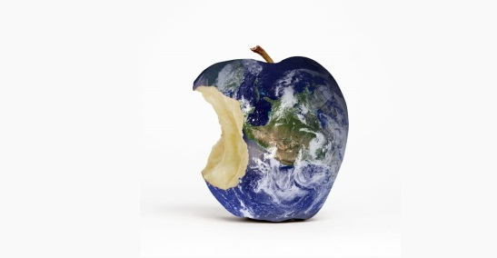
The Adam Smith Society
30 June 2021
Professor Nicholas Stern, LSE, and past Chief Economist, Bank of England
The Dasgupta Review shows that we are taking out much more from the Earth than it can stand, we are running it down fast, and we will pay the price. With its clear, comprehensive and conceptually well-founded framework, it provides the foundation for urgent action needed now to tackle the interconnected challenges of climate change and biodiversity loss.
Sunny Verghese, Co-Founder CEO of Olam International, Chair of the World Business Council for Sustainable Development
Now more than ever, it is vital to recognise the interdependence of protecting our natural resources and improving social equality alongside global prosperity. Economic growth and sustainable development must not be viewed as a binary choice. Businesses and policymakers must urgently and collectively work to drive changes that will conserve our world now and for the future. Businesses must accelerate their reporting to account for their natural and social capitals, while governments must establish clear policies to promote and incentivise investment to conserve our natural world. The Dasgupta Review shows clearly that if we are to reverse – and restore – the negative impacts on our planet and people, we cannot wait to do the right thing.
Pavan Sukhdev, CEO GIST Impact; Goodwill Ambassador, UNEP; former Study Leader, TEEB; past economist at Deutsche B.
The economic invisibility of nature, despite its many and valuable contributions to human well-being, continues to plague the worlds of policy-making and business decision-making and drives the accelerating losses of biodiversity and ecosystem services that, regrettably, we continue to see to this day. Correcting this problem at its root requires changing how we value and account for natural capital in every dimension of human endeavour. It is therefore heartening to see the publication of the Dasgupta Review, a timely and trenchant reminder about why and how we must change the way we make policy, do business and account for our true wealth, if human society is to continue to thrive on earth.

