Slide 1
Comparing political systems
Global Governance B.A.
Emilie Frenkiel
Emilie.frenkiel@u-pec.fr
Farah Kebbe Baghdadi
farahbaghdadi89@gmail.com

Slide 2
Description of the course
This course is an introduction to the comparative study of politics. It aims at familiarizing students with the main concepts of political science with a focus on the concepts of public sphere, democracy, authoritarianism, democracy, representation and participation. With special emphasis on the evolution and the diversity of political situations and attention to not only national but also local and global scales, we will compare and contrast the political regimes of various countries of the world, the roles of key political actors, political institutions, political processes and patterns of political competition. We will be particularly interested in Asian countries (including China, India, Japan, Taiwan) and the Middle East (Syria, Saudi Arabia, Iran and Lebanon). The main objective for this course is to provide students with the broad context needed for analyzing the political phenomena of any country and understand the main criteria and tools used to compare and rank countries in the world, as well as what we mean by democracy, the role media and social media play in democracy, what makes a non-democracy become more democratic, what makes a stable democracy and so on.

Slide 3
Teaching Method
Lectures : major political concepts, institutions, processes, theories & case studies taken both from consolidated democracies, more recent democracies and authoritarian countries like China.
Active participation is demanded on the part of students.
practical study based on class discussions, text commentaries in class and at home, as well as collective oral presentations on specific countries.

Slide 4
Assessment
mid-term oral exam (30%).
final exam: a written text commentary (40%).
Collective comparative report (30%).
actively take part in class discussions

Slide 5
Collective comparative reports
China / Taiwan
China/Russia
Saudi Arabia/Iran
Syria/Lebanon
US/Canada
US/UK
France/Switzerland
India/Pakistan
Japan/South Korea
Thailand/Myanmar
Brazil/Argentina
Nigeria/South Africa

Slide 6
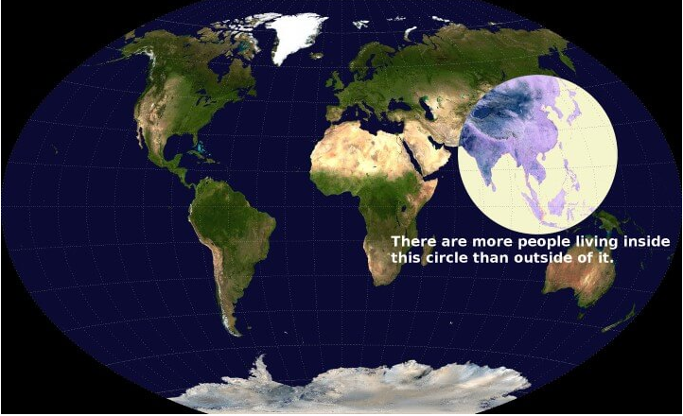
More People Live Inside This Circle Than Outside Of It
Notes:
Changing ocracyographics China/india https://twitter.com/twitter/statuses/913875704252649472

Slide 7
Compare the two countries in line with the good society’s approach
Main characteristics (geography, history, demographics etc.)
Relevant international rankings and good society approach
the countries’s institutions, political and social life
Press review of last events and current situation

Slide 8
Collective reports
Team work
We will be assessing the quality of the content, of your research, analysis, communication & coordination skills, the coherence of the report, the relevance of your choices (selective description and comparison) as well as your capacity to connect it with the course.

Slide 9
Text/video commentary
introduce, contextualize and summarize the document
Identify 2 or 3 salient points, connect them with concepts, issues, examples discussed in class or elsewhere.
We will assess your understanding of the text/video, your analytical, problematizing and communication skills

Slide 10
problématique
Main angle, question or set of questions that guides your text or report
It is used as an organizing thread holding your various ideas together
When reading a document, first list the most salient points and comments that come to mind and try and find a way to connect them.
There are always various possibilities. Choose one according to their relevance, your capacity and preferences

Slide 11
Brainstorming
What is politics?
Do you like politics?
Do you read on politics? How do you keep yourselves informed?
Are you interested in your own country’s politics only?
Why do we compare countries and political systems?

Slide 12
Alexis de Tocqueville (1805-1859)
“Although I very rarely spoke of France in my book, I did not write one page of it without having her, so to speak, before my eyes”
“Without comparisons to make, the mind does not know how to proceed”
Comparing: only way to fully understand our own political system

Slide 13
Why we compare
Comparison is the methodological core of scientific study of politics:
  compare the past and present
  compare experiences of various nations
  develop explanation
  test theories
  counteract ethnocentrism
Notes:
Parenthèse début chapitre 2
Compartive politics: syst study of vt and politics in diff countries, designed to better understand them by drawing out their contrasts and similarities

Slide 14
What we compare
States
Geography (regions)
History (duration)
Sequencing of political development
Economic development
Quality of governance
Notes:
Comparing political regimes p. 6-17 40-

Slide 15
Origins of comparative politics
Plato (normative, what should be)
Aristotle (empirical study of what best promoted stability):
Rule by | Legitimate form | Corrupt or degenerative form
one | monarchy | tyranny
few | aristocracy | oligarchy
many | polity | democracy
Notes:
Intro comparative politics and democracy p. 7

Slide 16
The main concepts
Politics
deals with
human decisions
Notes:
Chapter 1: Issues in comparative politics.
The process by which people negotiate and compete in the process of making and executing shared or collective decisions

Slide 17
Political decisions
Public
Authoritative
Notes:
Issues in comparative politics.

Slide 18
Definitions of politics
Individualistic/collectivist theories
Lasswell: « who gets what, when, how »
David Easton: « the authoritative allocation of value ».
Bertrand de Jouvenal: « man moving man »
Bernard Crick: « a way of ruling divided societies by a process of free discussion and without undue violence »

Slide 19
Public sphere
The place where political debate and the confrontation of private opinions take place
A political practice, a form of communication and circulation of various points of view
Political philosophy concept. (Öffentlichkeit) Jürgen Habermas in the 1960s.

Slide 20
Public sphere
Intermediary sphere between private life and the monarchical state (culture of secrecy, arbitrary, denoucning others)
Late 18th century Europe: educated men read newspapers, exchange books and arguments in literary salons and cafés.
Their use of reason founded on the publicity (the fact of being made public) of debates, a model of good government and of law that can be used against the arbitrariness of kings emerges.

Slide 21
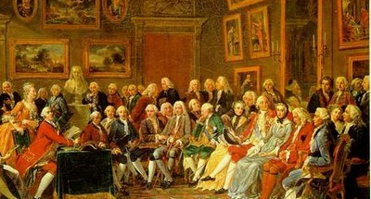
Madame Goeffrin’s Salon , in 1755 by Lemonnier
Notes:
Riche bourgeoise, elle reçoit dans son hôtel de la rue Saint-Honoré les artistes, écrivains, savants de son temps de 1749 à 1777. Elle fréquentait dés 1730 le Salon de Madame de Tencin, et prit la suite de celle-ci, comme l'avait fait Madame Tencin avec Madame de Lambert. Se côtoient chez elle Marivaux, Marmontel, Grimm, d'Holbach, Helvétius et d'Alembert, mais aussi Boucher, Van Loo, etc . Elle subventionne l'Encyclopédie, et sait tempérer leurs élans contestataires, car son éducation classique se refuse à certaines idées nouvelles.

Slide 22
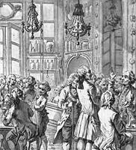
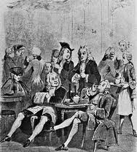
Discussions at the Procope café
Notes:
Le café attire des auteurs comme Voltaire ou Rousseau, qui y ont leurs habitudes7,8,9. La « légende » du café dit que Diderot y écrivit des articles de l’Encyclopédie, que Benjamin Franklin y prépara « le projet d’alliance de Louis XVI avec la nouvelle République » selon une plaque commémorative10, et qu’il y aurait conçu des éléments de la future Constitution des États-Unis11. Montesquieu fait allusion au café Procope dans la 36e des Lettres persanes12 : « Le café est très en usage à Paris : il y a un grand nombre de maisons publiques où on le distribue. Dans quelques unes de ces maisons on dit des nouvelles, dans d’autres on joue aux échecs. Il y en a une où l’on apprête le café de telle manière qu’il donne de l’esprit à ceux qui en prennent : au moins, de tous ceux qui en sortent, il n’y a personne qui ne croie qu’il en a quatre fois plus que lorsqu’il y est entré. » Habermas’ idealism and elitism criticitzed. Mass media=> degrading quality of the press and rational deliberation.

Slide 23
Public sphere
Publicity
Rationality
deliberation
Collective decisions
Notes:
Criticized because idealized. Male, elitist.

Slide 24
The dangers of a single story
Chimamanda Ngozi Adichie:
https://www.ted.com/talks/chimamanda_adichie_the_danger_of_a_single_story?
Americanah
Notes:
Did they work on it? Discussion. Feedback. Then Vice article/Haiti. Give other examples

Slide 25
How the news distorts our worldviews
Watch http://www.ted.com/talks/alisa_miller_shares_the_news_about_the_news?
Notes:
http://www.ted.com/talks/alisa_miller_shares_the_news_about_the_news?
Not a conspiration

Slide 26
Media as gatekeepers
People’s political perceptions derive largely from the media.
People’s mental pictures of events and policy problems, and even their images of political institutions and leaders, stem primarily from what they see and hear through the news media.
Gatekeepers= out of the countless possibilities each day, they determine which events will be covered and which ones will not.

Slide 27
The Media and agenda-setting
The term agenda setting (Max McCombs and Donald Shaw 1968) has been used to describe the media’s ability to influence what is on people’s minds.
By covering the same events, problems, issues, and leaders—simply by giving them space or time in the news—the media place them on the public agenda.
The press, as Bernard Cohen in The press and foreign policy notes, “may not be successful much of the time in telling people what to think, but it is stunningly successful in telling them what to think about.
Notes:
Agenda-setting theory describes the "ability [of the news media] to influence the salience of topics on the public agenda. » That is, if a news item is covered frequently and prominently, the audience will regard the issue as more important. Agenda-setting theory was formally developed by Max McCombs and Donald Shaw in a study on the 1968 American presidential election. In the 1968 "Chapel Hill study," Combs and Shaw demonstrated a strong correlation coefficient (r > .9) between what 100 residents of Chapel Hill, North Carolina thought was the most important election issue and what the local and national news media reported was the most important issue. By comparing the salience of issues in news content with the public's perceptions of the most important election issue, McCombs and Shaw were able to determine the degree to which the media determines public opinion.

Slide 28
Internet and social media impact
Eli Pariser Filter bubble
https://www.ted.com/talks/eli_pariser_beware_online_filter_bubbles?language=en
Cass Sunstein warns of fragmentation and loss of serendipity in news reading.

Slide 29
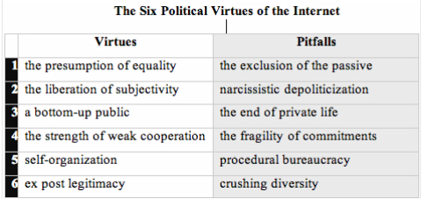
Dominique Cardon, « The Internet and its Democratic Virtues », Books and Ideas , 8 November 2012

