Slide 1
Applied English
WELCOME !
We invite you to…

Slide 2
Applied English invites you to…
Try things out
Discover
Experiment
Create
Celebrate
Dream
Provoke
Listen
Discuss
Question All
Make friends
Make an impact
Think outside box

Slide 3
Applied English invites you to…
Be amazed
Exchange ideas
Connect
Build community
Shape the future
Stir things up
Grow up
Reinvent yourself
Interweave
Debate
Solve together
Exit comfort zone
Let things go

Slide 4
Applied English invites you to…
Let things go wrong
Remain a work in progress
Learn from mistakes
Explore
Be courageous
Share
Enjoy
…

Slide 5
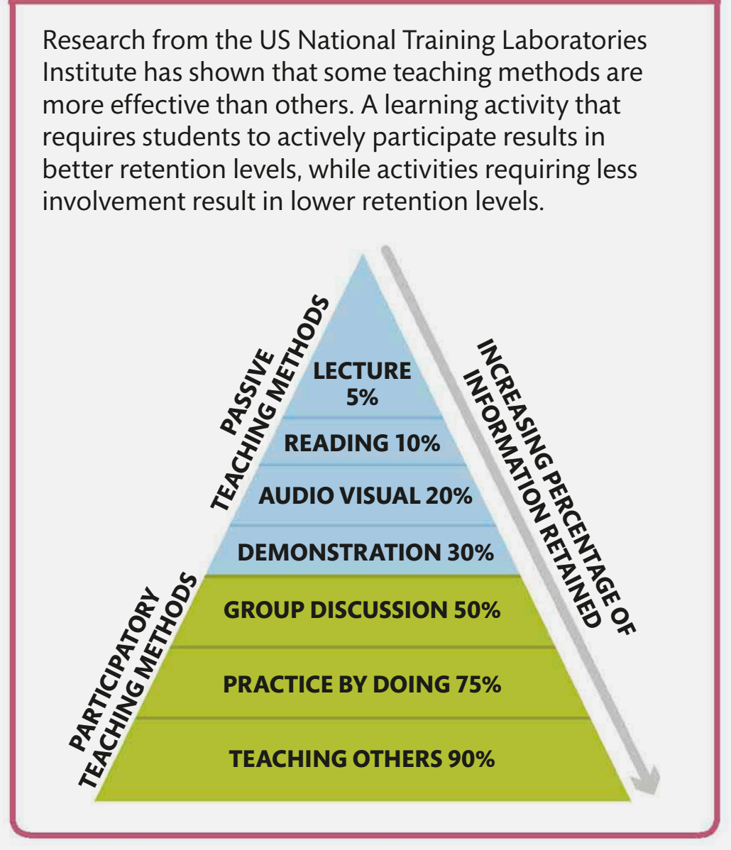

Slide 6
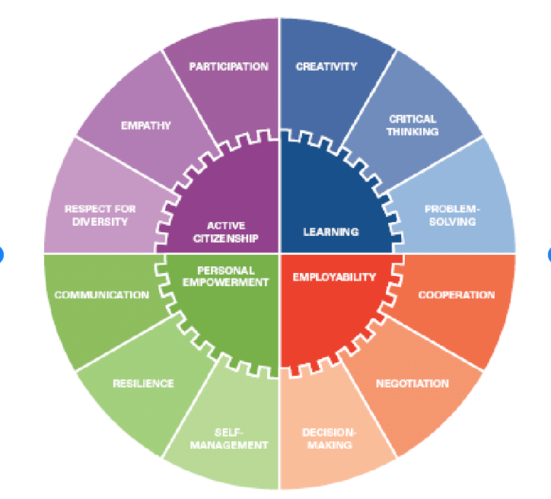

Slide 7
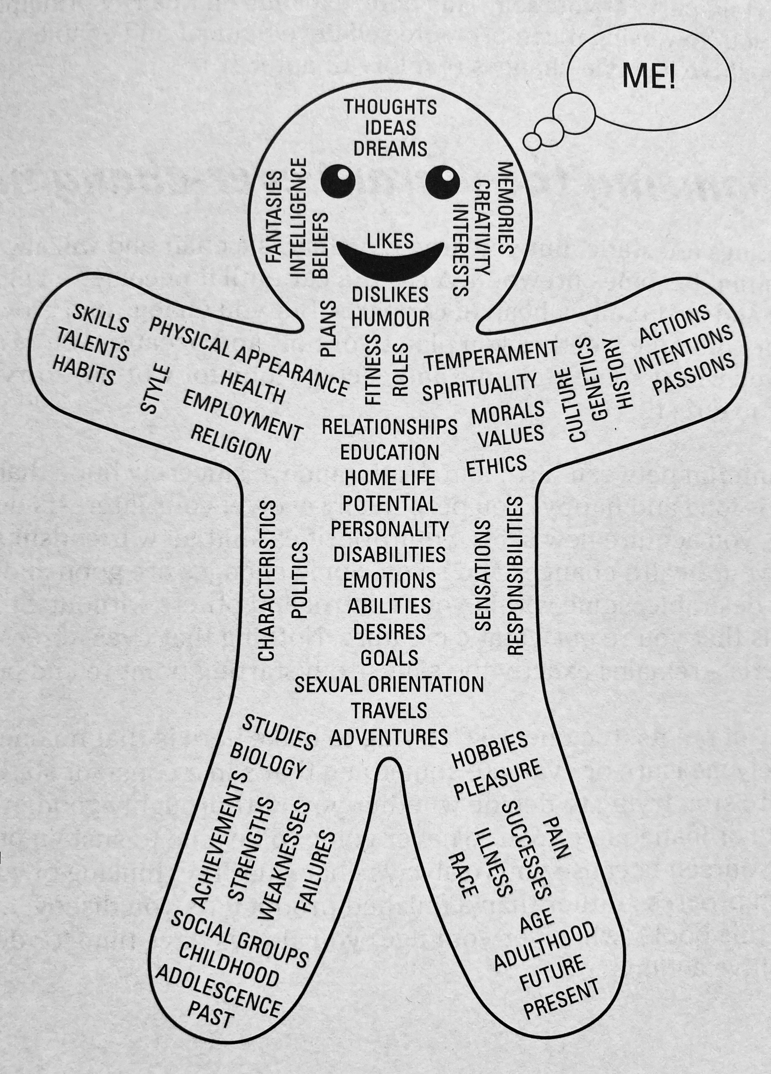

Slide 8
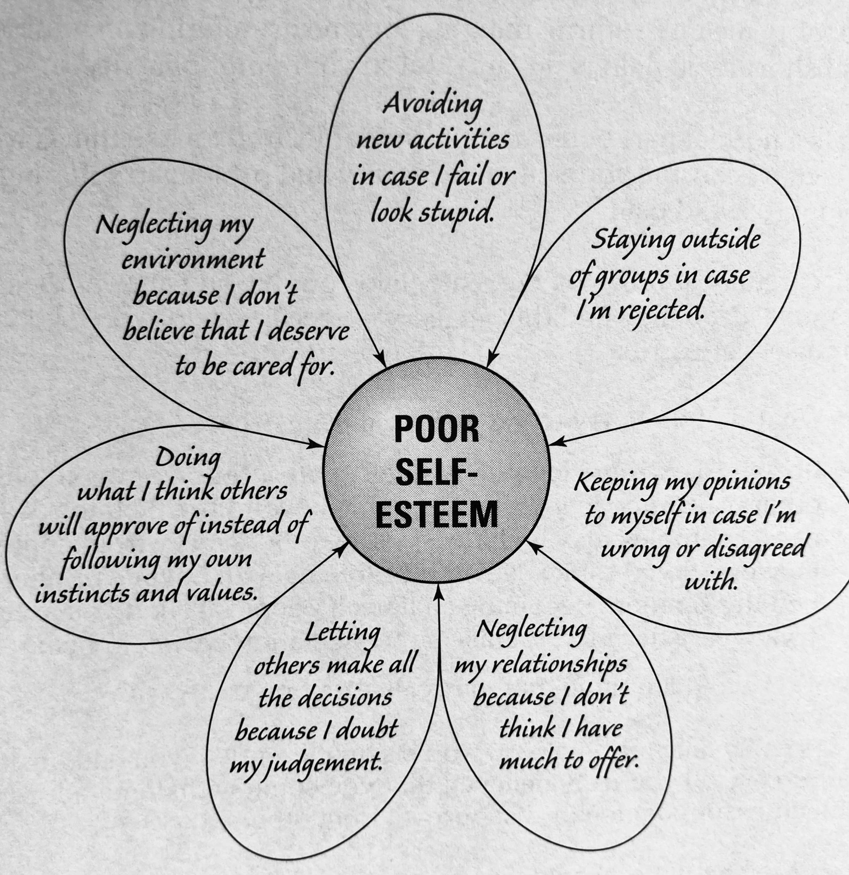

Slide 9
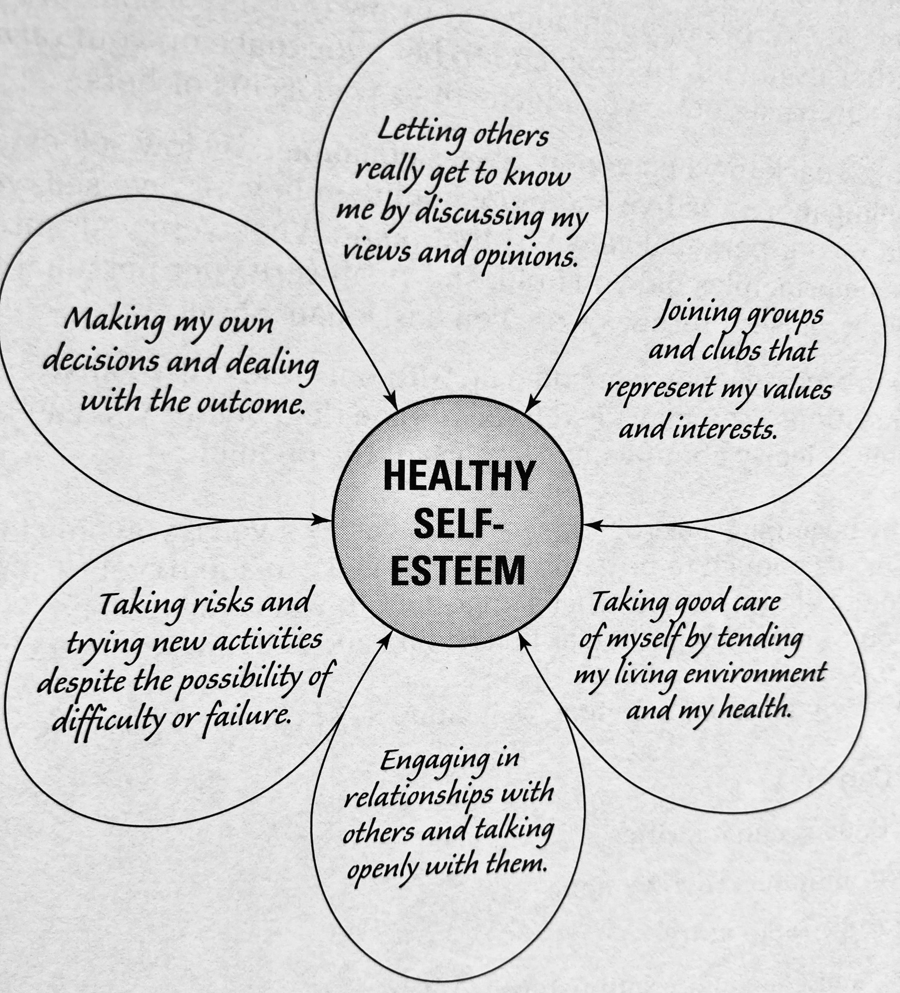

Slide 11
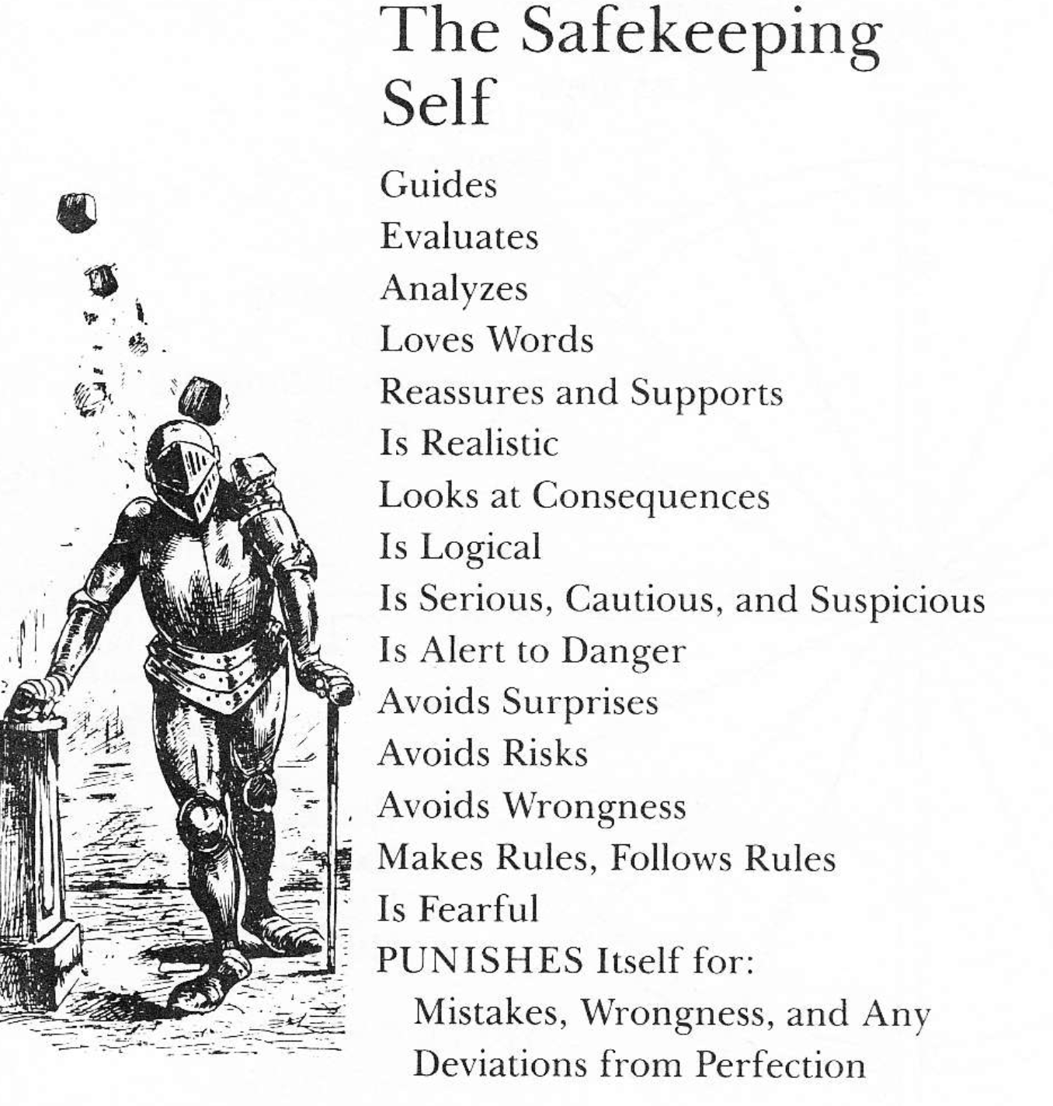

Slide 12
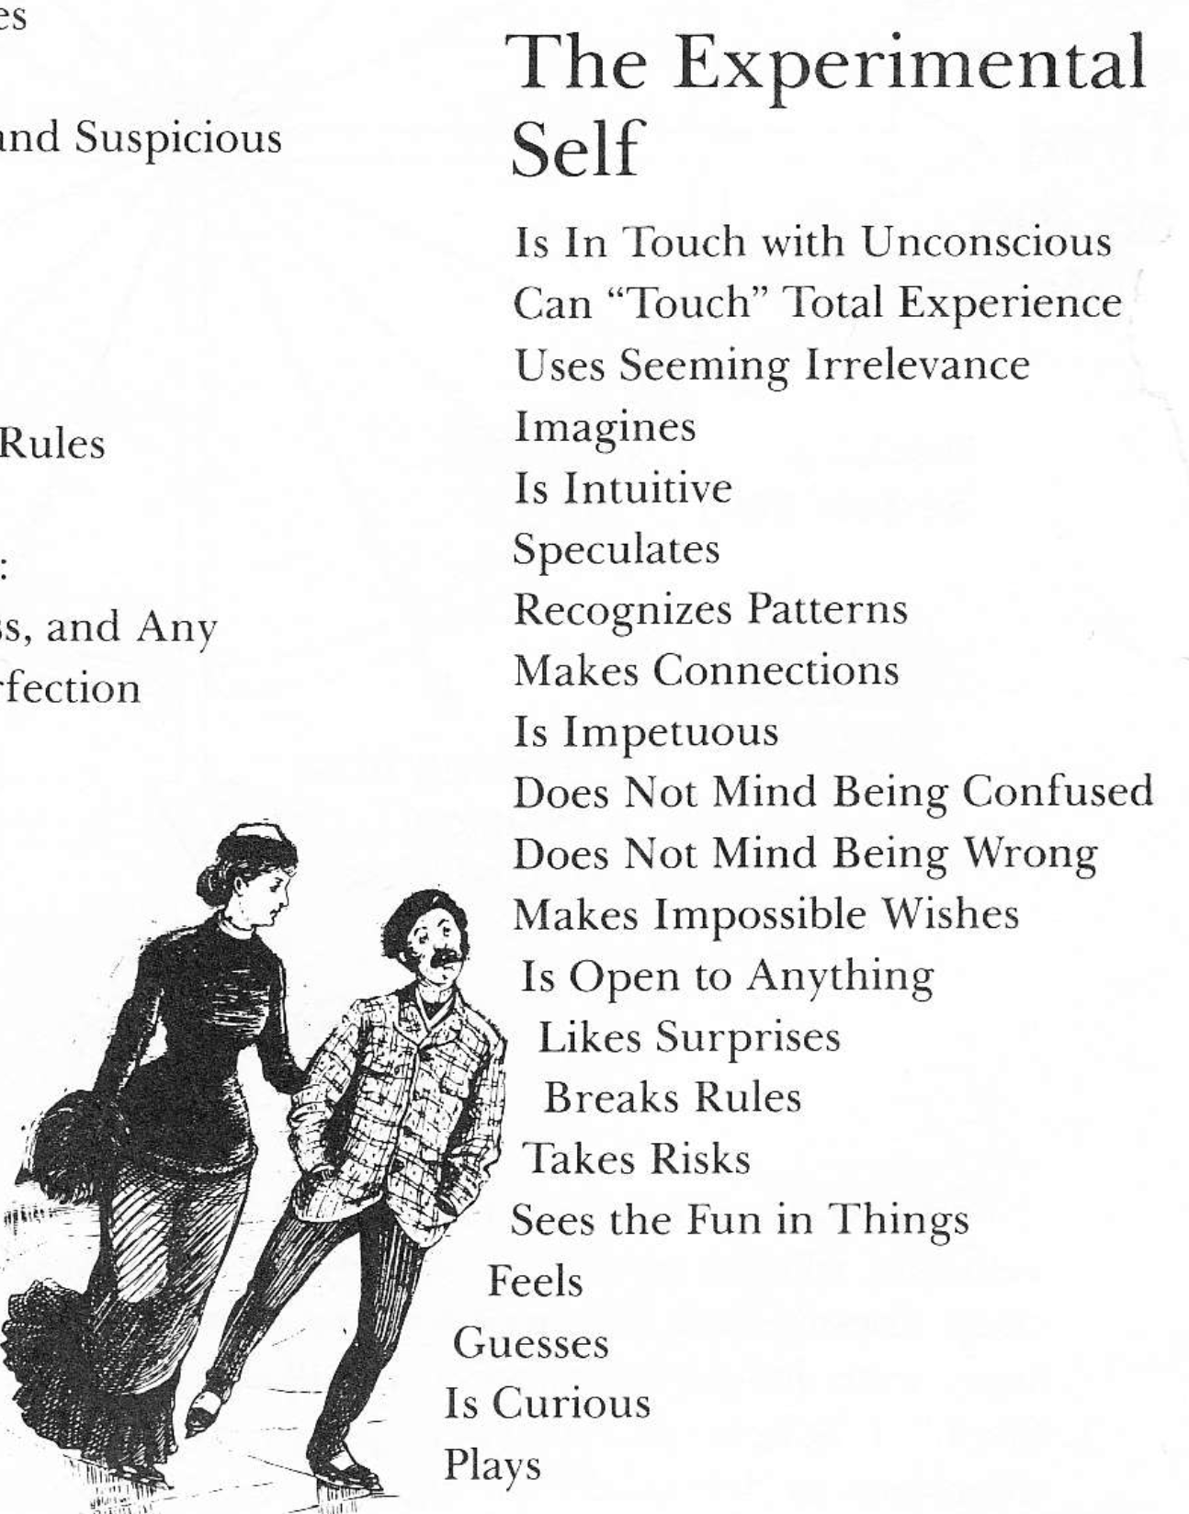

Slide 13
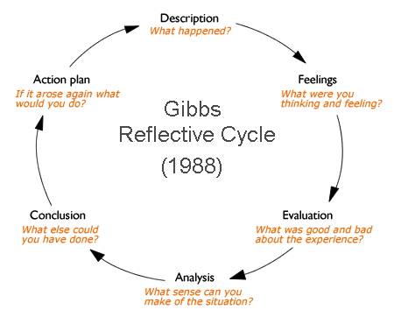

Slide 14
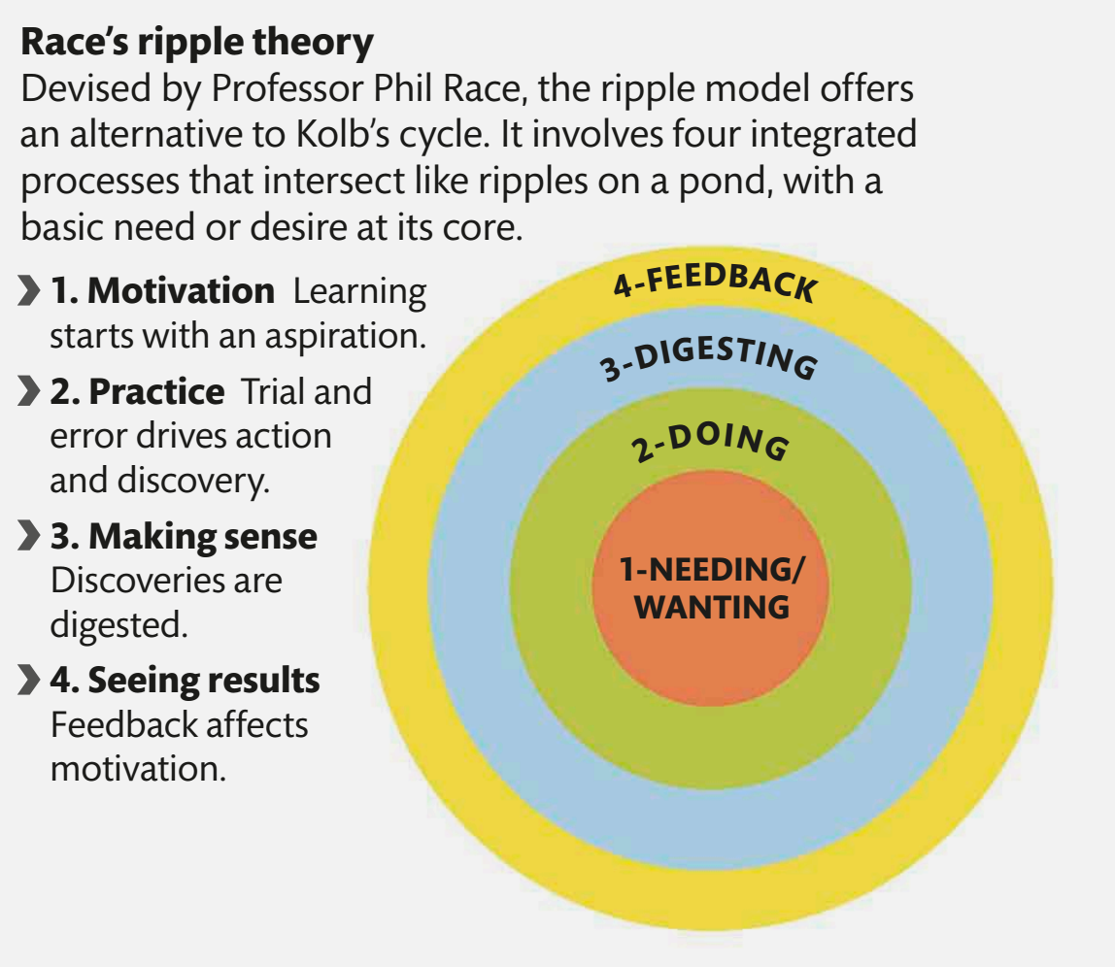

Slide 15
Scots
Aye
Wee

Slide 16
Scots
Lad
  (Braw, Eesome, Weel
  Lookit)
Lassie
(Bonnie, Sonsie)

Slide 17
Scots
Haud yer Wheesht!

Slide 18
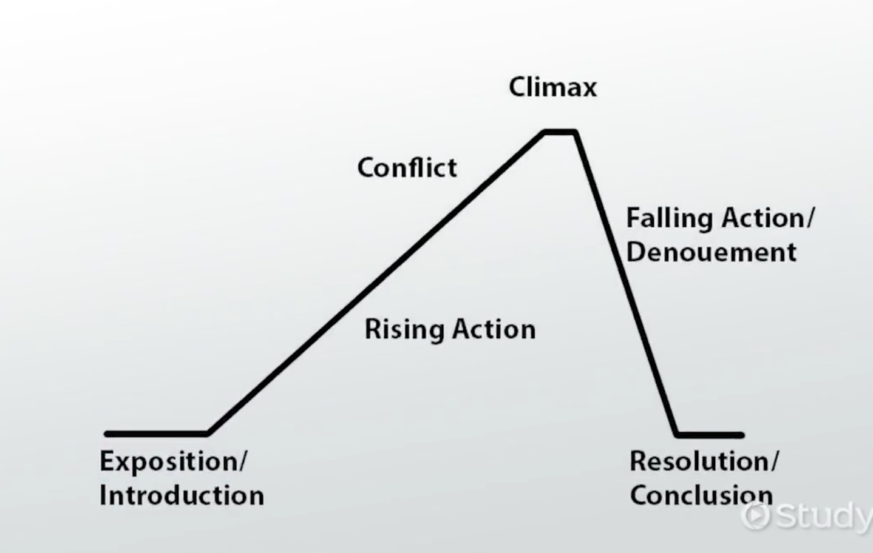

Slide 19
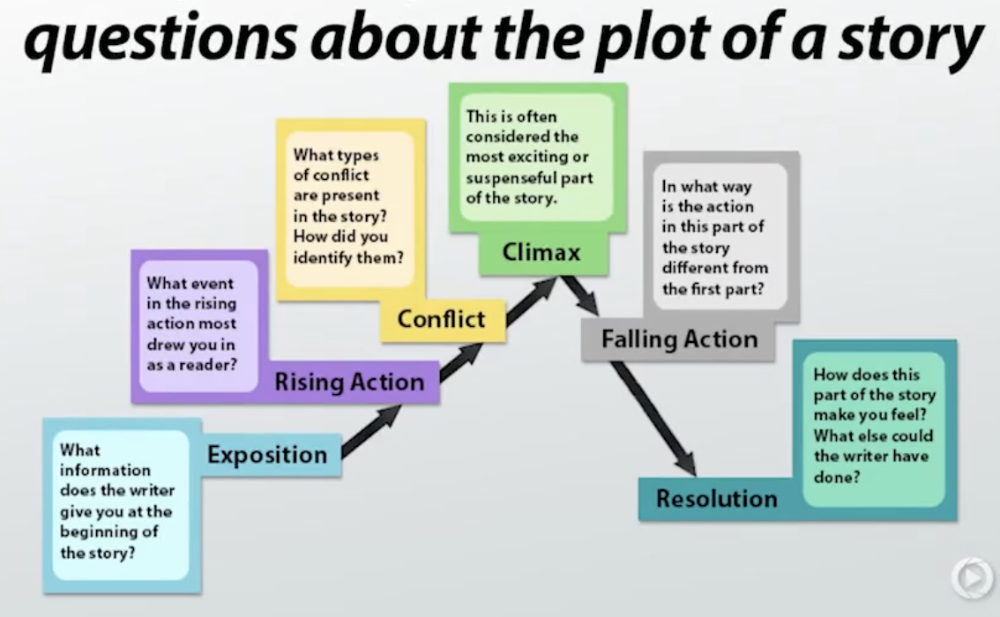

Slide 20
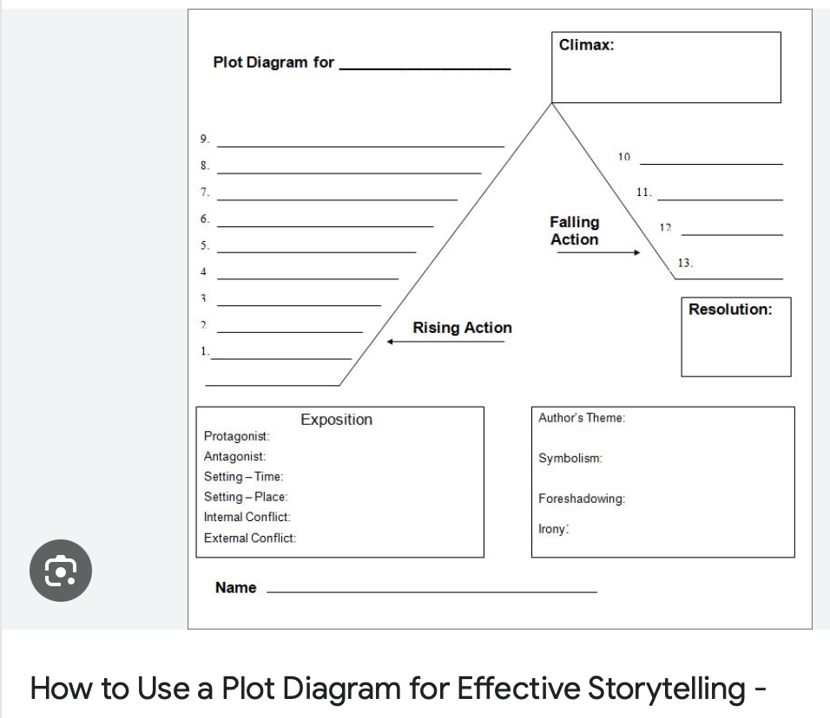

Slide 21
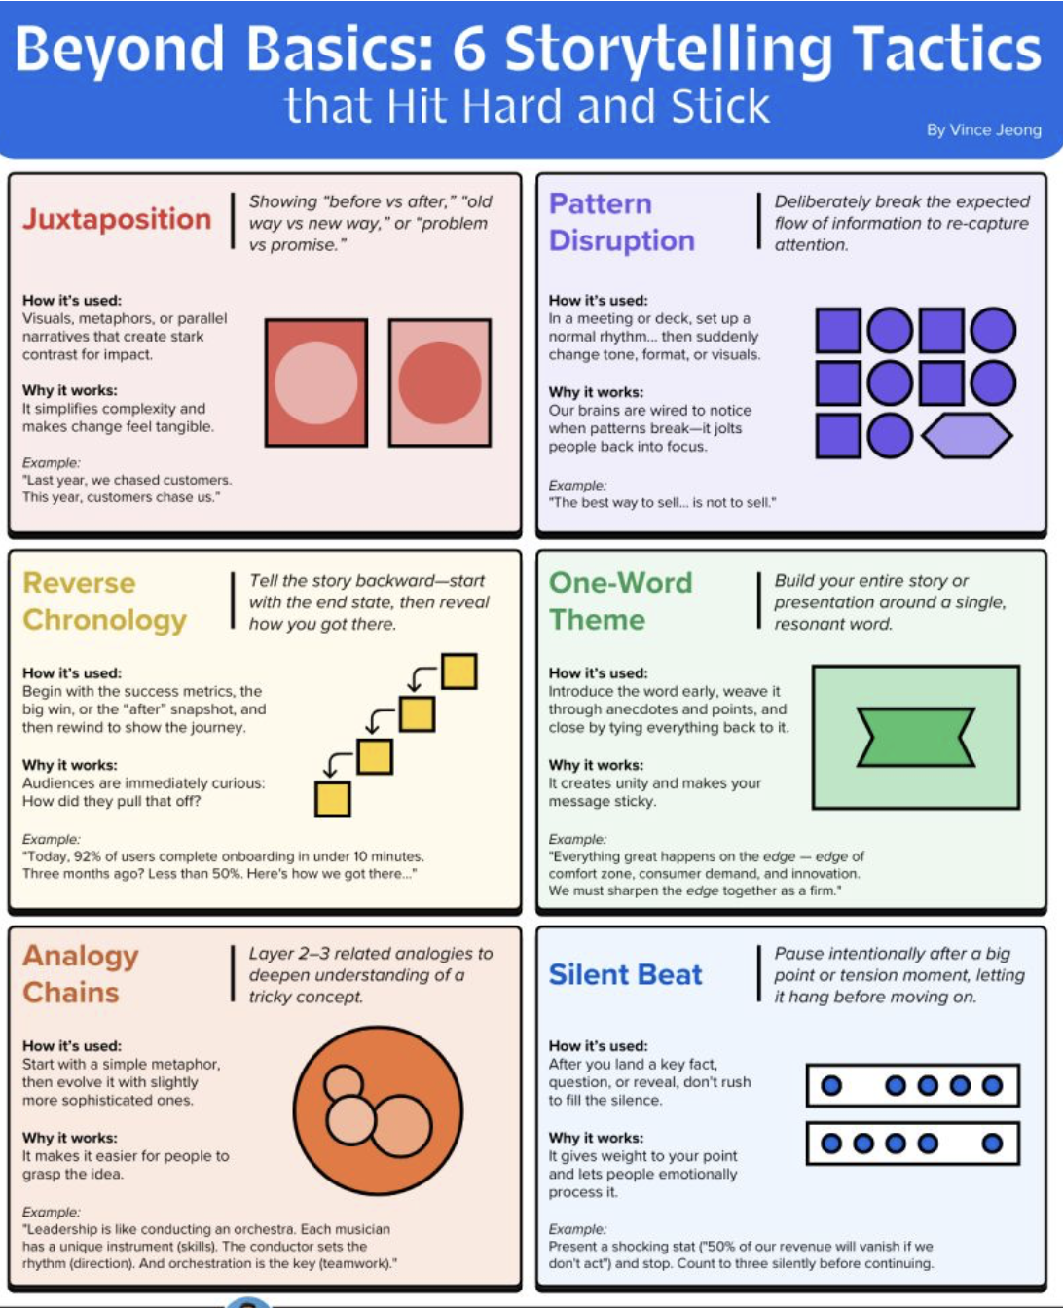

Slide 22


Slide 25
Charles Bukowski said:
'An intellectual says a simple thing in a complicated way….
… An artist says a complicated thing in a simple way.’

Slide 27
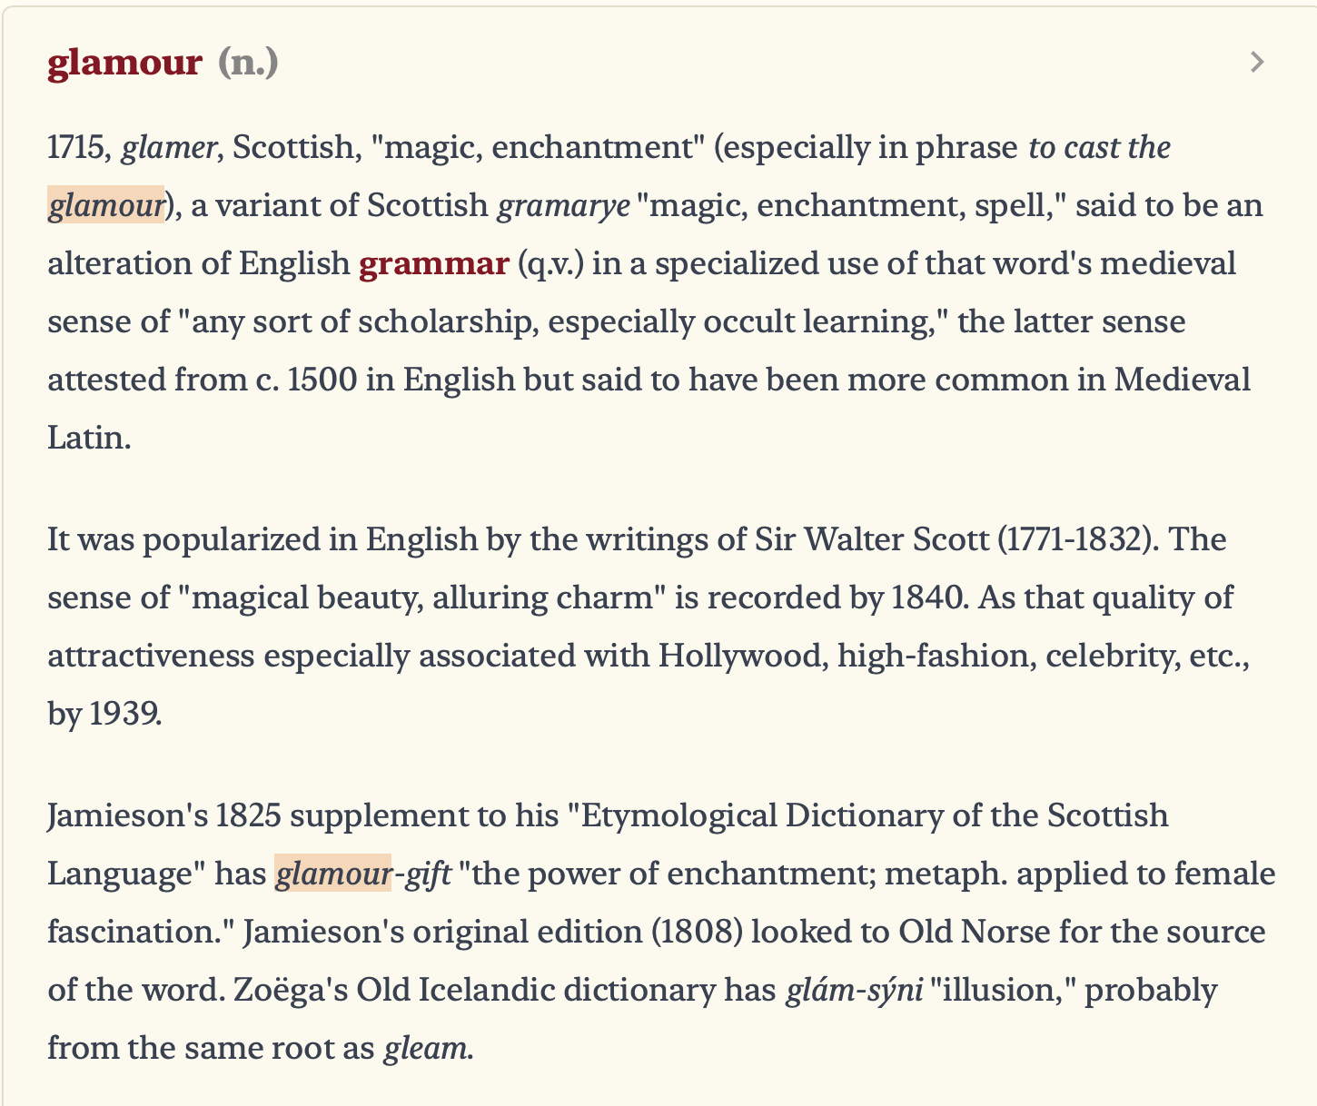

Slide 28
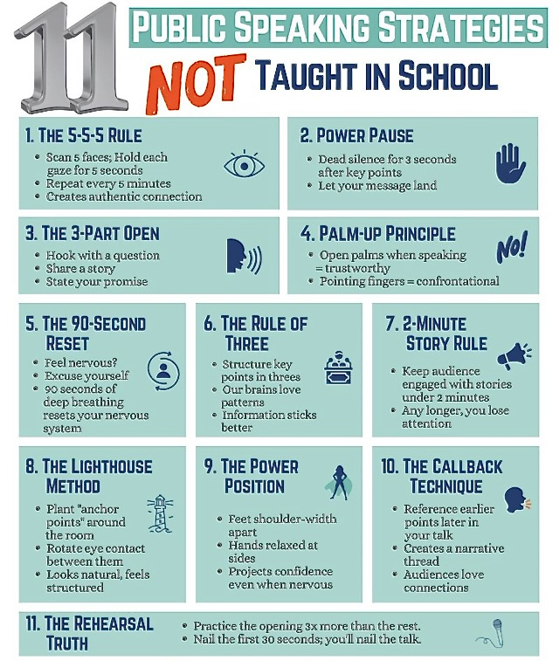

Slide 29


Slide 30
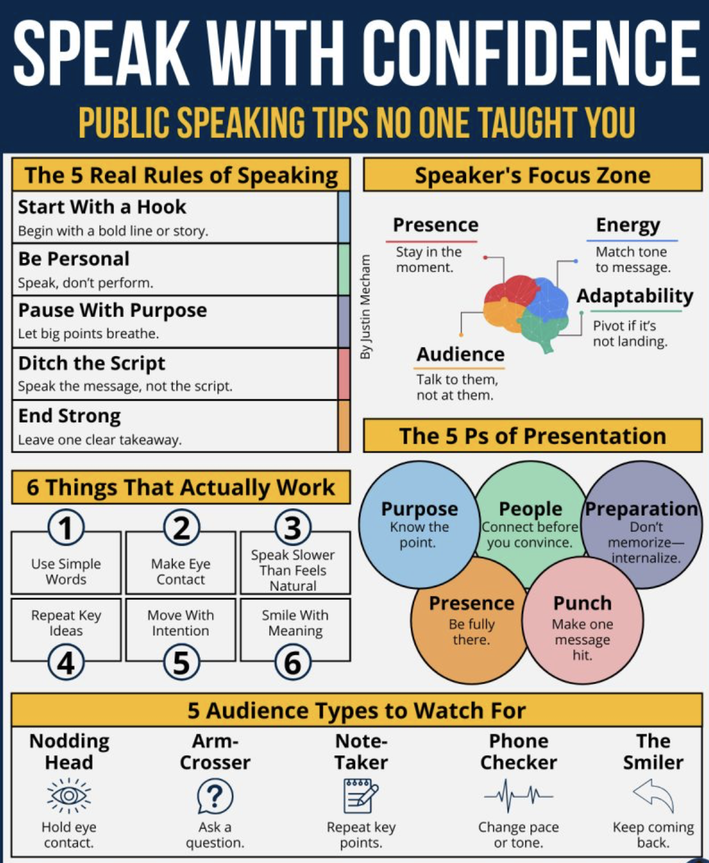

Slide 31


