Slide 1

Global Business Strategy and Responsibility: Historical Perspecitves
Session 5:
Theories, Frameworks and Concepts in Global Business
Professor Teresa da Silva Lopes

Slide 2
Objectives (Week 2)
Session 5 – Foreign Market Entry Strategies
Ability to explain the internationalisation process of firms:
Understand the trade-offs that exist between risk and control when choosing mode of entry of firms in foreign markets
Analyse the advantages and disadvantages of each mode of foreign entry
Concept of ‘transaction costs’ by Coase and Williamson
Session 6 – Theories, Frameworks and Concepts in Global Business
Provide you with tools to understand and interpret international business phenomena:
Why firms become MNEs – Internalization Theory (Buckley and Casson)
Eclectic (OLI) Paradigm (John Dunning)
Strategic Management of MNEs – New Internalization Theory (CSA-FSA) (Rugman)
The internationalization motivations of the MNE
To discuss the relevance of ‘liability of foreignness’ and ’liability of newness’
Session 7 – Introduction to the Case Study ‘Globalizing Consumer Durables: Singer Washing Machine before 1914’
Professor Teresa da Silva Lopes

Slide 3
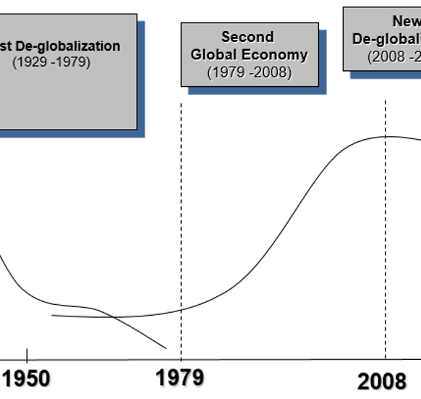
A Recap: World Business Context by 1960s
Second Global Economy
Fast economic growth; capital mobility; high receptivity.
Agents: service MNEs, resource MNEs, manufacturing MNEs
1960s - Theory of the MNE
MNEs profit-maximising ‘black boxes’
‘Representative firm’ - as unit of analysis
=> Need for development of new theories of the firm
Professor Teresa da Silva Lopes

Slide 4
FDI and the Theory of the MNE
Early FDI Theory (eg. MacDugall, 1958)
Aimed at explaining international capital movements until the end of 1950s
basis of the theory of portfolio investment: interest rates
=> capital moves in response to changes in interest rate differentials
each investor maximizes his profits by investing where returns are highest
frictionless, no transaction costs
But ? Many questions remained unanswered...
Why is so much of international trade organised within firms and not on markets?
Why do firms cross national boundaries’?
Why does the multinational corporation (MNE) exist?
How can foreign firms compete successfully with local firms, given the inherent advantage of local firms operating in their own environment?
Professor Teresa da Silva Lopes

Slide 5
MNEs in Theory: Stephen Hymer
(1960) – PhD thesis ‘International Operation of National Firms: A Study of FDI’
  Differentiated between portfolio investment and foreign direct investment (FDI) (until then not distinguished by classical economic theories)
  FDI involved the transfer of a whole package of resources and not simply finance (eg. assets, knowledge)
  Identified the presence of ‘Imperfections in markets’:
  - due to various factors such as monopolistic behavior, economies of scale, and barriers to entry.
  - they can lead to inefficiencies and distortions in the allocation of resources,
  Argued that firms needed to possess some kind of an advantage in order to operate and compete in an unfamiliar foreign environment.
  ‘Monopilistic advantage’ – benefit incurred to a firm that maintains a monopolistic power in the market.
  egs. superior knowledge about markets, superior resources, economies of scale (obtained either through horizontal or vertical FDI)
Professor Teresa da Silva Lopes

Slide 6


MNEs and Business History: Alfred Chandler (1990) and the Lens of Big Business
Chandler focuses the multi-unit enterprise:
- capacity to achieve economies of scale and scope in production
- capacity to achieve economies of scale and scope in distribution
- first mover advantages and the new oligopolistic competition
- necessary managerial hierarchy in place
=> These capabilities led to the continuous growth of the enterprise:
Defensive strategies (protect existing investments)
- horizontally acquired enterprises using same processes and making same products
- vertical integration – different levels of production (e.g. integration into mining of raw materials used in production)
Strategies relying on competitive capabilities
- expand geographically in different countries
- new products related to the firm’s existing technology or markets.
Professor Teresa da Silva Lopes

Slide 7
Vernon’s Product Life-Cycle Theory (1966)
Developed out of critique of neoclassical comparative advantage theory
(failure to deal with the role of innovation in the evolution of trade patterns, lack of attention to the role of economies of scale in determining such patterns)
The first dynamic interpretation of the determinants of, and relationship between, international trade and foreign production (FDI)
Based on the assumption that for most of the 20th century a very large proportion of the world’s new products had been developed by US firms, and sold first in the US market
This gave US firms incentives to develop new consumer products.
Ethnocentric view? World - US?
A. US
150
A: Early in the life cycle of a typical new product
- demand is starting to grow rapidly in the US,
demand in other advanced countries is limited to high-income groups
no incentive to produce abroad
just exports
100
Production
Imports
Quantity
Exports
50
Consumption
New product
Maturing product
Standardized product
Time
Stages of product development
Professor Teresa da Silva Lopes

Slide 8
Vernon’s Product Life-Cycle Theory (cont.)
B. Other Advanced Countries
150
B: Over time – demand for new products starts to develop in other advanced countries (eg. UK, France, Germany and Japan)
=> Incentives to produce in those markets (by host and foreign firms)
Exports
100
Quantity
Consumption
50
Production
Imports
C: US + other advanced markets mature
– product becomes more standardized + price becomes the main competitive weapon
other countries can obtain production advantages compared to the US
. first – other advanced countries
. after – developing countries
C. Developing countries
150
100
Exports
Quantity
50
Consumption
CONCLUSION:
Over time the US switches from being an exporter of the product to an importer as producion becomes concentrated in lower – cost foreign locations
Imports
Production
New product
Maturing product
Standardized product
Time
Stages pf product development
Professor Teresa da Silva Lopes

Slide 9
Internalization Theory (Buckley and Casson, 1976)
Draws on Transactions Cost Economics theory - asks why business transactions take place within a firm (hierarchy) rather than between independent firms in a market
Internatlization – is concerned with imperfections in the markets for intermediate products (embracing all the different types of goods or services that are transferred between one activity and another within the production process)
Aim => explain why the cross-border transactions of intermediate products (eg. components of cars etc) are organized by hierarchies rather than determined by market forces ⬄ explaining the boundaries of firms
Multinational hierarchies represent alternative mechanisms for arranging value added activities across national borders
Firms are likely to engage in FDI whenever they perceive that the net benefits of their joint ownership of domestic and foreign activities, and the transactions arising from them, are likely to exceed those offered by external trading relationships.
Internalisation theory also useful to explain vertical or horizontal integration accross borders.
Eg. Mining + manufacturing; agriculture + food processing
Eg. Consumer goods industries – to the inability of the market to ensure a seller of an intermediate product has sufficient control over the quality of the final product which may bear the seller’s brand name may be a reason for replacing that market by forward integration.
Professor Teresa da Silva Lopes

Slide 10
Theories of MNE:
I - The Eclectic Paradigm – OLI Paradigm (John Dunning, 1993)
O + L : Ownership (O) and Location (L) Advantages
- Ownership/Monopolistic advantages (Stephen Hymer, 1960)
- Product Life-Cycle (Raymond Vernon, mid-1960s, HBS)
I : Internalization (I) and the Boudaries of the Firm
- Imperfections in Markets (Hymer, 1960)
- Transaction costs (Coase, 1937, Williamson, 1975)
- Internalization Theory (Buckley and Casson, 1976)
All add to our understanding about the cross-border organisation of economic activities
Professor Teresa da Silva Lopes

Slide 11
Theories of MNE : Eclectic Paradigm
John Dunning’s (1980) Eclectic Paradigm - OLI Paradigm
=> Firms will engage in FDI if they possess:
O – Ownership advantages – egs. Tangible assets (capital, human resources) intangible assets (property rights, structure of the firm, superior knowledge)
L – Location advantages – egs. Cheap labour, natural resources, expanding market
I – Internalisation advantages – egs. avoid search/negotiating costs, overcome tariff barriers
- they derive such advantages from using internal administrative processes to effect transactions within the firm
OLI Paradigm incorporates numerous different factors as well as complementary/ conflicting theoretical approaches
OLI Paradigm has very little predictive power, but it is very realistic in reflecting the diversity and complexity of international business
Professor Teresa da Silva Lopes

Slide 12
Eclectic Paradigm (cont.)
Firms Advantages
Countries Advantages
O – Ownership Advantages
L – Location
property rights, intangible assets advantages
organizational structure of the firm
production technologies
organizational and marketing systems/ processes
innovatory capacity
marketing, know-how, finance skills
.....................
- spacial distribution of natural and created resource endowments and markets
international transport and communication costs
cross country ideological, language, cultural, political differences
.....................
I - Internalization
Aims to exploit market failures:
avoid search/ negotiating costs
avoid costs associated with asymmetries of information (eg. moral hazard (post contractual opportunism) and adverse selection; where moral hazard is the hidden detrimental action by external partners such as suppliers, buyers, and jv partners)
- avoid costs of broken contracts and ensuing litigation
need of seller to protect quality of intermediate or final products
to avoid or exploit government intervention (eg. tariffs)
......................
‘I Advantages’ largely determine what mode of entry (eg. exporting, JV, wholly owned subsidiary) the firm will adopt in a foreign market
Professor Teresa da Silva Lopes

Slide 13
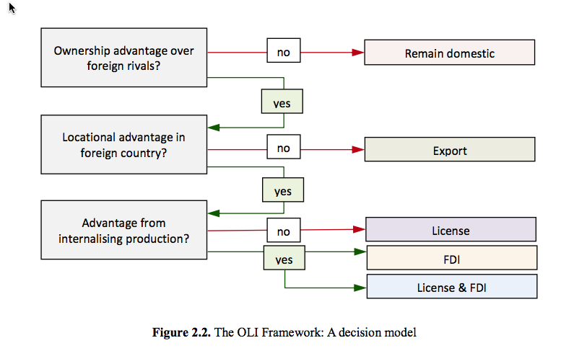
Eclectic Paradigm (cont.)
Source: Collison, Narula and Rugman (2017)
Professor Teresa da Silva Lopes

Slide 14
Example: British MNEs, 1929-1960s
UK Economy
- high income, large and standardized UK market fostered large firms, product differentiation and marketing skills
- competitiveness of consumer goods MNEs: confectionary (Cadbury, Rowntree); alcoholic beverages (United Distillers); pharmaceuticals (Beecham), other consumer goods
- low competitiveness in high tech industries: electrical and chemical sectors (US businesses - O advantages)
- general absence of managerial hierarchies – owner entrepreneurs played a major role in the internationalisation of production
O Advantages - UK firms relied on mature, relatively low-tech sectors
L Advantages - UK firms relied on Commonwealth markets: more competitive than indigenous firms, more favourable treatment than firms from other countries => MNEs safely growing and profitable
I Advantages - associated with market failures/imperfections in markets: risks and uncertainty
- resource seeking -> unintegrated firms vulnerable to sudden price increases and or supply interruptions eg. Lever – palm oil in Nigeria, Dunlop - Malaysian rubber
- market seeking -> from exports to FDI to control brand reputation, avoid imitations, take advantage of local incentives, responses to oligopolistic pressures (Dunlop in France vs. Michelin)
Professor Teresa da Silva Lopes

Slide 15
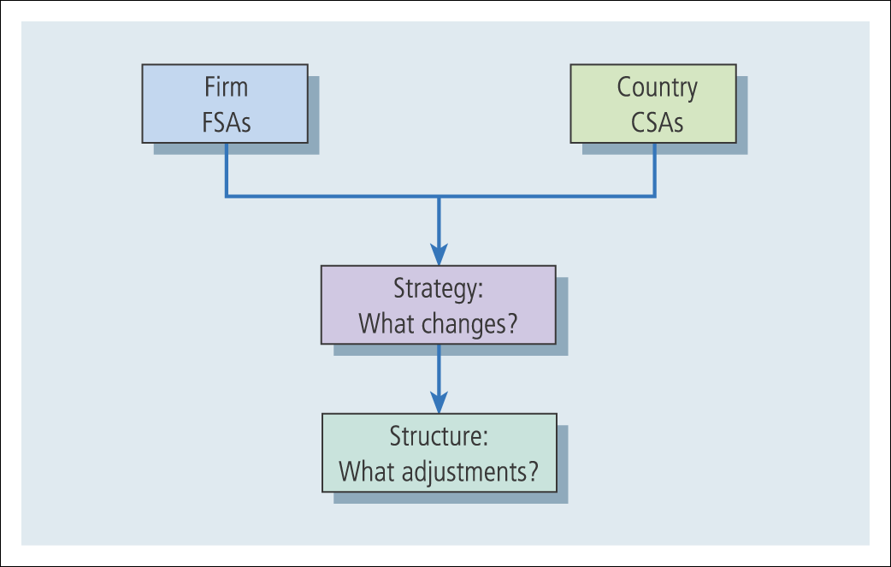
III –New Internalization Theory: FSA-CSA Matrix
Rugman, Verbeke and Nguyen (2011)
  => Relates to Global Strategy of MNEs:
  Firm-specific advantages (FSAs) - a unique capability proprietary to the organization
    It may be built upon product or process technology, production knowledge, managerial, marketing or distributional capabilities.
  Country-specific advantages (CSAs): country factors
    Natural resource endowments (minerals, energy and forests), the labour force and associated cultural factors, etc.
Collinson et al. (2017)
Professor Teresa da Silva Lopes

Slide 16
III - How does FSA/CSA matrix relate to Dunning’s OLI Paradigm?
Ownership factors (O) <-> FSAs
Location factors (L) <-> CSAs
Internalization factors (I) <-> FSAs
=> O and I, in practice, are integrated features of FSA management within the MNE that cannot be decoupled in strategic decision making.
Professor Teresa da Silva Lopes

Slide 17
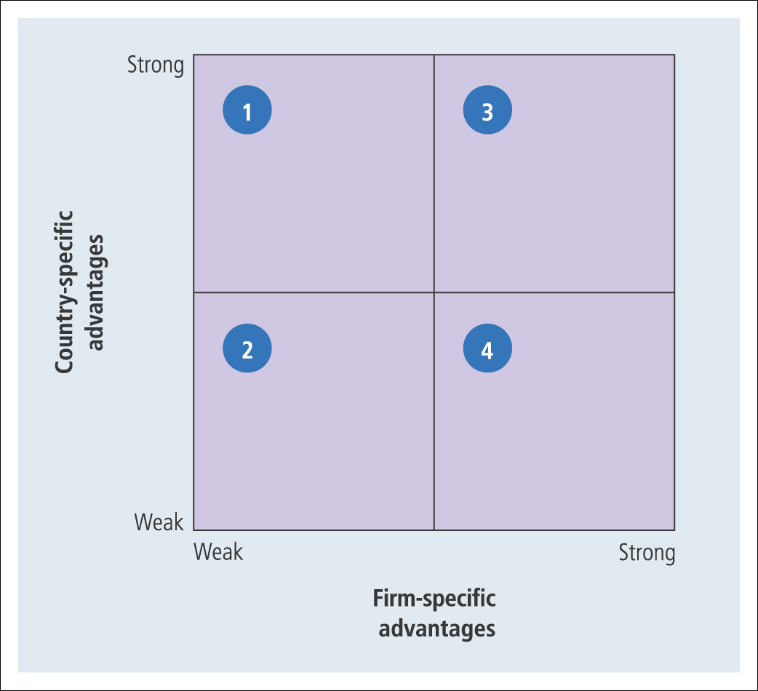
III - Rugman’s FSA-CSA Matrix
Quadrant 1: resource-based and/or mature, globally-oriented firms producing a commodity-type product ➔ cost leadership (Improving FSA can make them move to quadrant 3.)
Quadrant 2: inefficient, floundering firms with no consistent strategy, nor any intrinsic CSAs or FSAs ➔ no alternative but to exit or to restructure
Quadrant 3: follow any of the generic strategies ➔ both cost leadership or differentiation
Quadrant 4: differentiated firms with strong FSAs in marketing and customization ➔ differentiation (the CSA is not relevant)
Professor Teresa da Silva Lopes

Slide 18
II – Why firms become MNEs (by J. Dunning, 1993; Cazzura and Narula, 2015)
=> MNEs often have a combination of motivations when going abroad, depending on the market:
. Resource-seeking FDI - (to acquire resources of a higher quality and at a lower cost eg. natural resources, labour)
. Market-seeking FDI - (eg. secure market share and increase sales)
. Efficiency-seeking FDI - (eg. to obtain gains from common governance eg. ec. of scale and scope)
. Strategic Asset-eeking FDI - (to promote long-term strategic objectives)
. Escape Invesment - (escape restrictive legislation by home country, high levels of taxation etc.)
. Trade Supportive Investment - (eg facilitate exports and imports eg. Fdi in one european country to sell to the rest of Europe)
. Finance supportive Investment - (eg. to provide financial support to a business or project in another country)
. Management Supportive Investment - (eg. set up a regional office to improve efficiencies associaated with coordination of branch offices)
. Passive investment - (firms do not take control or decide in an active way)
Professor Teresa da Silva Lopes

Slide 19
Some related concepts:
‘Lack of fit’, ‘Liability of Newness’ and ‘Liability of Foreignness’,
Liability of Foreignness (Zaheer, 1995)
=> Relates to the social and economic costs arising when MNEs operate in an unfamiliar environment
. These costs originate in limited local knowledge and competitive disadvantage for a MNE subunit (there are many costs for a firm operating in a market overseas that a local firm would not incur).
. Similar to Hymer’s ‘costs of doing business abroad’.
. Examples: unfamiliarity, relational and discrimination hazards
Liability of Newness (Nelson and Winter, 1982)
=> refers to the challenges that new firms face when entering a market (domestic or MNE).
. These challenges can include lack of reputation, limited access to resources, unfamiliarity with the industry's norms and practices, and difficulties in establishing relationships with customers, suppliers, and other stakeholders.
. Explains why incumbents often maintain dominance in markets despite the potential for innovative newcomers to disrupt them.
Source: Sethi and Guisinger (2002)
Professor Teresa da Silva Lopes

Slide 20
Session 5 - Main Takeaways
Theories, Frameworks and Concepts in Global Business
This class introduces several important conceptual frameworks that provide you with with a toolbox to understand international business activities. Important concepts introduced include that of ownership advantages, location advantages, and internalization advantages, which are the pillars of two important frameworks: John Dunning’s Eclectic Paradigm (OLI) and Alan Rugman’s CSA-FSA framework (New Internalization Theory), which have many similarities and overlaps. John Dunning’s typology of the motives associated with firms’ strategies for entering foreign markets are also analysed. Michael Porter’s Competitive Advantage of Nations Diamond framework shows how firms can use their countries ‘Diamond’ to design competitive corporate strategies. Other concepts discussed in the class include ‘liability of foreignness’ which are also important in firms’ internationalization decisions.
Professor Teresa da Silva Lopes

