Slide 1

Global Business Strategy and Responsibility: Historical Perspecitves
Session 7:
Entrepreneurship and Responsibility in International Business
Professor Teresa da Silva Lopes

Slide 2
Objectives
Entrepreneurship and Responsibility in International Business
Session 7 – Entrepreneurship and responsibility in business
. Concepts of entrepreneur
. Women in business and women entrepreneurs
. Productive and unproductive entrepreneurship
. Can entrepreneurs and business help save civilization by being ‘deeply responsible’ and still be profitable?
. Creating shared value and the role of the corporation in society
Session 8 – The responsibility of international business in society
. Legitimacy of business in society is being questioned
. Deep responsibility in business vs corporate social responsibility vs philanthropy
. Business whitewashing and greenwashing
. ESGs
Session 9 – Women in business; CSR and deep responsibility; ESGs: Applications and discussions
Professor Teresa da Silva Lopes

Slide 3




Concept of Entrepreneur
Conventional definitions of entrepreneur (Schumpeter, 1911)
‘Someone who specialized in taking judgemental decision about the coordination of scare resources with an economic aim and under conditions of uncertainty”
Not necessarily a capitalist or an inventor, but someone who is not afraid of risk and gets things done and has an economic aim.
He innovates by relying on technology - when he introduces something new in the market, either a product, a service or a method.
He carries out ‘creative destruction’/ radical innovations – process of creating new industries tends to sweep away the pre-existing order. Eg. new products, new production methods, opening of new markets, and the development of new sources of supply.
Acknowledges incremental innovation.
Professor Teresa da Silva Lopes

Slide 4

Concept of Entrepreneur
Expanded definition of entrepreneur (Lopes and Casson, 2007)
Has the same characteristics as the ‘conventional entrepreneur’ with the additional capability to extend, rejuvenate, and globalize products and brands by applying different kinds of marketing knowledge (intelligence and skills required to manage brands and distribution channels)
=> Can be an employee acting in an entrepreneurial way - May work in a small, independent firm, or operate in a large firm from the outset as a manager
Professor Teresa da Silva Lopes

Slide 5
Women entrepreneurs?
Is there a distinction between male and female entrepreneurs:
- in their impact on global business over time?
- across various sectors?
- between different countries of origin?
What factors have contributed to the rise of women entrepreneurs?
What are the primary opportunities and challenges they face?
Professor Teresa da Silva Lopes

Slide 6
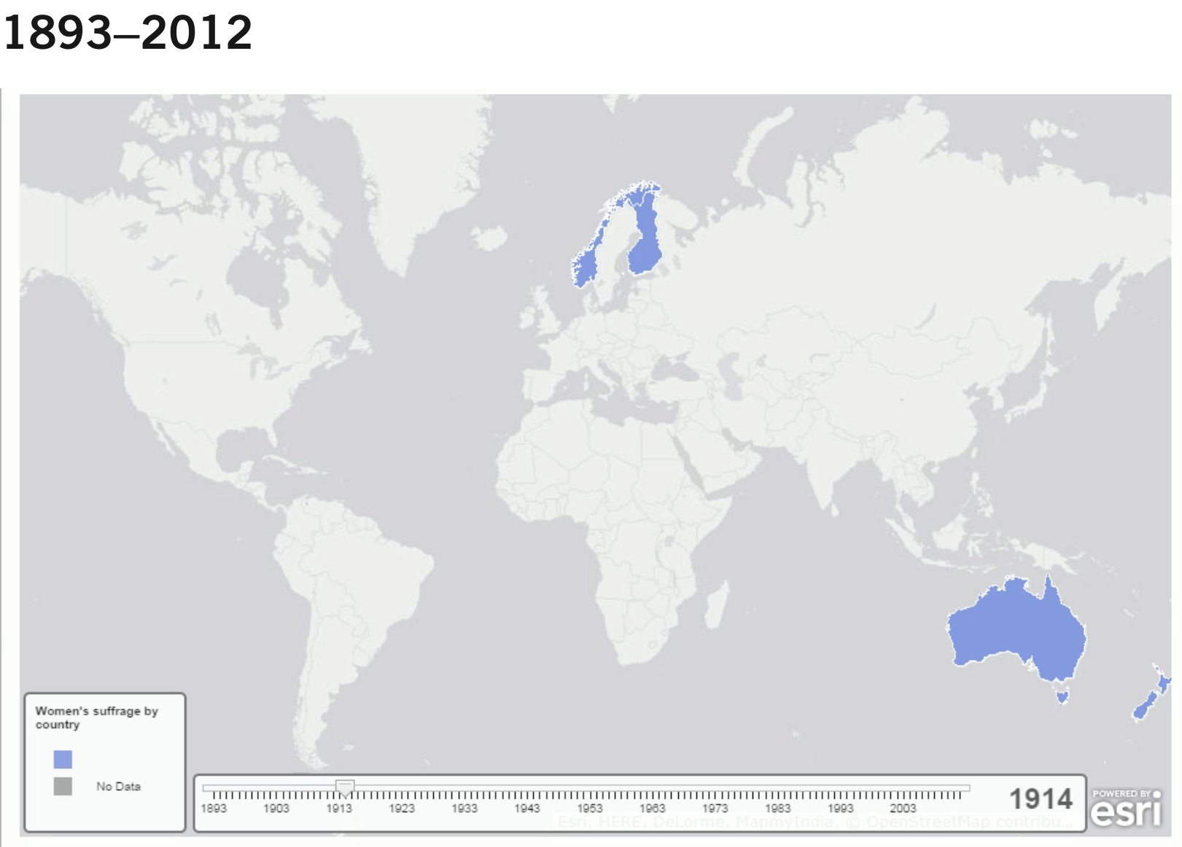
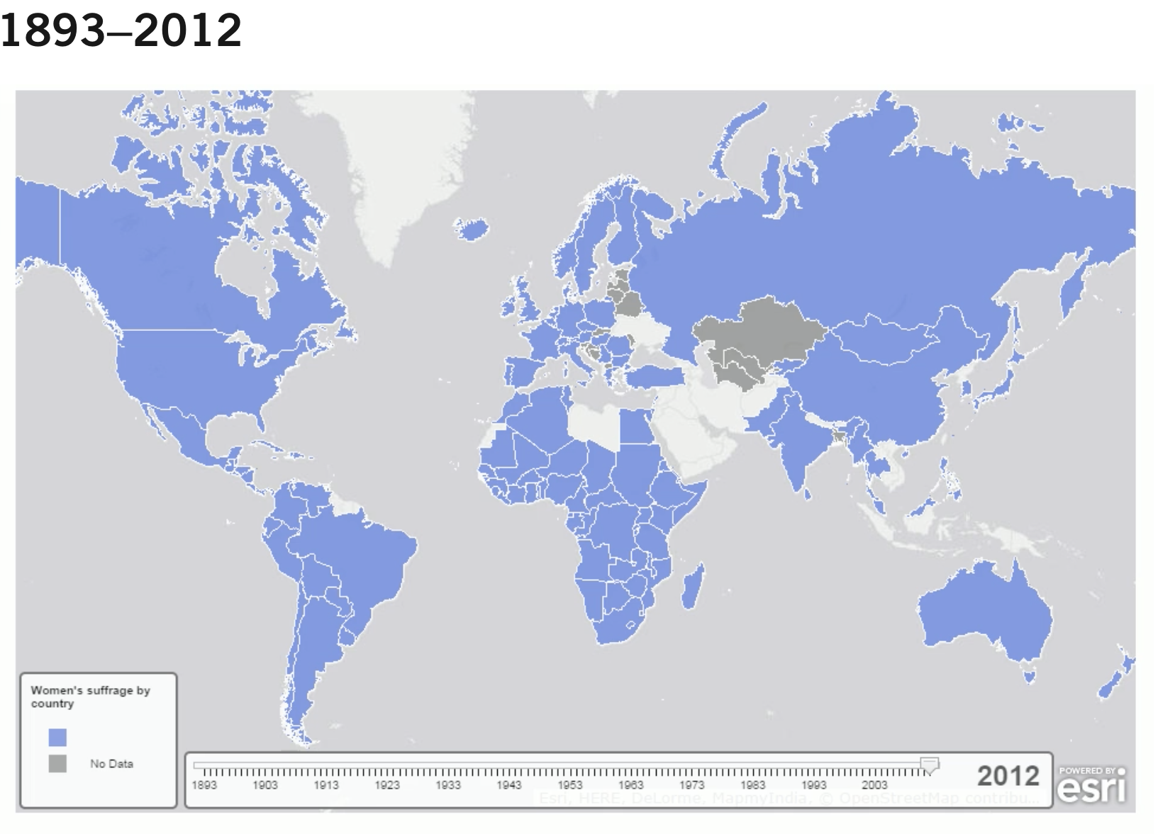
Women Suffrage by Country
Women's Suffrage by Country from 1893 - 2012
https://www.hbs.edu/businesshistory/courses/teaching-resources/historical-data-visualization/details?data_id=41
1893 - New Zealand first country in the world
1945 - Italy
Professor Teresa da Silva Lopes

Slide 7

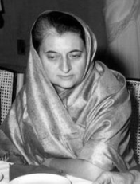

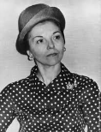
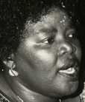
First Female Political Leaders
Sirimavo Bandaranaike -
prime minister of Sri Lanka - 1960, 1970, 1994
Indira Gandhi-
prime minister of India - 1966, 1980
Golda Meir –
prime minister of Israel - 1969
Isabel Peron - president of Argentina - 1974
Elisabeth Domitien –
prime minister of Central African Republic - 1975
Professor Teresa da Silva Lopes

Slide 8
Women in Business – some historical patterns (Yeager, 2019)
Historically necessity compelled women to ‘transgress’ common bourgeois conventions:
- Widows inherited business, or operated business for ill or injured husbands;
- Women represented families on boards of corporations, but most commonly they relied on male managers to generate steadily revenues etc
- Wives of corporate leaders were often involved in cultural organizations, health and charity-oriented non-profits, and the creation of foundations
- Historically – issues of power: ‘no woman should have authority over men’
Professor Teresa da Silva Lopes

Slide 9
Women in Business – some historical patterns (cont.)
Some historical facts from the western world - which industries?
- in sectors serving bourgeois women’s needs: dress and hat making or hair work,
- boarding houses, retail establishments serving meals laundries etc
- women replaced man as department store clerks, typists and telephone operators (late XIXc/early XXc)
- moving beyond these boundaries could happen through participation in associations and social movements => empowered women (mainly throughout XXc)
Professor Teresa da Silva Lopes

Slide 10

Women as Entrepreneurs behind Big Business
Stellar entrepreneurial successes:
- primarily in beauty – Helena Rubinstein (US, 1903); Estée Lauder (US, 1946), Simone Tata, Lakmé (India,1961)
- and fashion – Coco Chanel (France, 1910); Mary Quant (UK,1960s)
No women in leadership of large US/European corporations until 1970s
1972 Katharine Graham becomes first female CEO in a Fortune 500 company: The Washington Post Co
1977 The book The Managerial Woman by Kathleen Kellley becomes New York Times best seller.
Professor Teresa da Silva Lopes

Slide 11
Entrepreneur - Productive/Unproductive Framework (Baumol,1990)
Individual entrepreneurs can have multiple economic and societal impacts
Baumol (1990) suggests entrepreneurship takes many forms which have different outcomes on society:
- Productive (eg. innovation)
- Unproductive (eg. rent seeking; organised crime)
“Rules of the game” (set by institutions) explain why entrepreneurial activities are allocated to one form or another in a given time and country
Professor Teresa da Silva Lopes

Slide 12

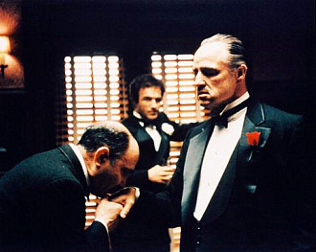


Productive or Unproductive entrepreneurship?
Professor Teresa da Silva Lopes

Slide 13
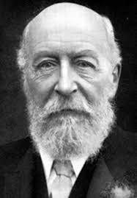


‘Productive’ entrepreneurship: George Cadbury (1839-1922)
Took over a small family chocolate business and built it into Britain’s largest chocolate company. A Quaker who did not drink alcohol, he saw drinking chocolate as offering an alternative to beer;
Like most Quakers, the highest possible ethical standards were followed;
Extensive welfare schemes for employees (like a few other big firms), but also recruited unionized workers (not usual at all);
Moved factory outside crowded Birmingham and created a garden village for employees, and others at Bournville;
Large-scale philanthropy - donated the entire Bournville housing estate to a trust (it is now one of largest non-profit housing trusts in Britain). A huge park and major hospital are also amongst his legacies;
Supported financially and in other ways campaigns against sweatshops and wars, and for the creation of an old age pension.
Professor Teresa da Silva Lopes

Slide 14
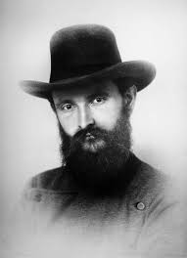

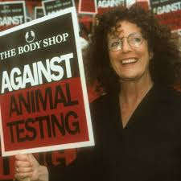

Productive/unproductive entrepreneurship – Is this distinction so clear?
Robert Bosch - founder of the German electrical firm Bosch GmbH – pursued respectful welfare policies, engaged in extensive philanthropy, sheltered the domestic resistance to the Nazis – but his firm profited from war, the Nazi war effort, and ended up employing slave labor
Anita Roddick - founder of the British beauty retailer The Body Shop, challenged gender stereotyping, avoided wasteful packaging, was an early mover in environmental reporting, and was a powerful advocate for good causes from saving the whales to supporting the Ogoni people in Nigeria. She also built her brand by fabrication and over-claiming.
Professor Teresa da Silva Lopes

Slide 15

The Common Features of Deeply Responsible Business Leaders
Choose industries that add social and ecological value
Humble relations with other stakeholders
Sustain and foster communities (operated outside the boundaries of the firm) (eg. Cadbury Bournville – job creation, education and cultural facilities etc)
The lobbied governments etc but for the benefit of society rather their own corporate interests
Financial profits were a means to an end, not an end in itself
- these business leaders values permeated organizations
Professor Teresa da Silva Lopes

Slide 16
Outcomes: Going from Local to Global business
=> It seems easier to be responsible if the firm is local.
Values seem to fade as businesses scale and globalize
eg. As The Body Shop grew and globalized, its values-driven business model was diluted
Being part of global a supply chain can create ethical challenges
eg. Cadbury in West Africa in the late XIXc
Professor Teresa da Silva Lopes

Slide 17
Can businesses de deeply responsible and still be competitive?
Porter and Kramer (2011)
Shared value
=>relates to corporate policies and operating strategies and practices that enhance the competitiveness of a company while simultaneously advancing the economic and social conditions in the communities in which it operates.
Requires New Skills:
Governments - learn how to regulate in ways that enable shared value rather than work against it
Managers - far deeper appreciation of societal needs; greater understanding of the true basis of company productivity; ability to collaborate across profit/non-profit boundaries
Corporations - redefine their purpose to create shared value, not just profit per se
Professor Teresa da Silva Lopes

Slide 18
Levels of Shared value by Businesses(Porter and Kramer, 2011)
1. Reconceiving customer needs, products, and markets to address societal needs
=> new opportunities to differentiate, innovate and grow
- design new products and services
Eg. environmental impact, safety, health, education, nutrition, living with disability, housing, financial security
- open new markets by serving unmet needs in underserved communities
(often requires redesigned products or different distribution methods)
2. Redefining productivity in the value chain
eg. improve employment in disadvantaged regions, minimise logistical impacts in distribution, energy and water use in production, limiting emissions and waste
3. Enabling local cluster development
(business cluster - geographical concentration of interconnected businesses; eg. Sillicon Valley)
- strengthen the links within the cluster => strengthens links with the community
Professor Teresa da Silva Lopes
Notes:
.

Slide 19
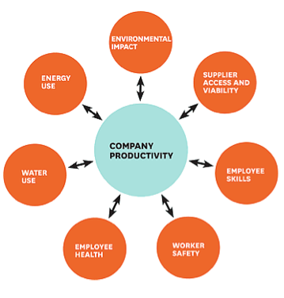
The connection between competitive advantage and social issues
Shared value opens-up new needs, new markets, and new value chain configurations
This creates new strategic positions, and new opportunities for extending existing positions
Source: Porter and Kramer (2011)
Professor Teresa da Silva Lopes

Slide 20
The connection between competitive advantage and social issues
Some examples
Employee health - eg. investing in a wellness program to employees => benefits employees and the firm minimizes absences and lost productivity.
Environmental impact - environmental performance can often be achieved with better technology at nominal incremental cost and can even yield net cost savings through enhanced resource utilization, process efficiency, and quality.
Energy and logistics - the use of energy efficiency is being re-examined whether it be in processes, transportation, buildings, supply chains, distribution channels or support services => leading to improvements in technology, recycling, etc
Water use - enabled by improving technology, will impact on all activities in the value chain.
Employee skills - living wage, safety, wellness, training, and opportunities for advancement for employees have a positive impact on productivity
Professor Teresa da Silva Lopes

Slide 21
Possible advantages for MNEs adopting a ‘shared value’ approach
- Develop new FSAs (Firm Specific Advantages), often building on existing FSAs, and improve performance
- Improve Location Advantages (L) (easier in emerging economies)
e.g. Nike partnering in local suppliers in emerging markets - help them better integrate in global supply chains, moving from transactional relations to cooperative/alliances.
- Create institutional spillovers and help fill institutional voids in foreign markets which are not host countries to their FDI; where FSAs may take a long time to materialize
e.g. sometimes the best location for value creation does not coincide with the best location for the MNE to enter in the short-run
- Change mode of entry and/or organizational form in host market
e.g. partner with other private sector entities, local governments etc, to create new ecosystems to address grand challenges such as poverty and inequality
- Legitimize the role of business in society again - improve the reputation of the MNE
=> issue of genuine value creation vs greenwashing
- Drives innovation and productivity growth in the global economy
Professor Teresa da Silva Lopes

Slide 22
Session 7 – Main Takeaways
Responsibility in international business
. Entrepreneurs have the potential to drive positive change, address global challenges and contribute to the betterment of society, but that requires adopting a deeply responsible approach, which takes into account the social, environmental, and ethical impacts of business decisions and operations, beyond just pursuing profit.
. Unproductive entrepreneurship, on the other hand, may involve activities that do not contribute positively to society, such as exploiting loopholes in regulations or engaging in unethical business practices for short-term gain.
. Historically, women's involvement in business and entrepreneurship was nearly negligible and concentrated in specific industries. However, starting from the 1970s, their presence in top positions began to gain prominence. Nevertheless, by the 2020s, significant disparities persisted.
. It is possible to be competitive and deeply responsible, by advancing social and economic conditions in society. However this approach can be more challenging when businesses operate at global level.
Professor Teresa da Silva Lopes

