Slide 1

Global Business Strategy and Responsibility: Historical Perspectives
Session 11
MNEs NonMarket Strategies in High Risk Environments
Professor Teresa da Silva Lopes

Slide 2
Objectives
Session 10 . Strategic Risk Management in Foreign Markets
- To critically discuss what is the meaning of a risky environment
- To offer an integrated analysis of the multiple unexpected risks that MNEs face in foreign markets
- To distinguish between mitigation and prevention strategies in IB
- To identify the different types of strategies and tactics that firms may use to manage risk in foreign markets
- Relation between MNEs FSAs and extraordinary risk management
Session 11. MNE Nonmarket Strategies in High-Risk Environments
- Why nonmarket strategies (NMS) by MNEs matter?
- Concept of nonmarket strategy (NMS)
- Comparing nonmarket strategies (NMSs) with market strategies (MS)
- Nonmarket strategies of political nature
- Nonmarket strategies of political, corporate and social responsibility
Session 12. Introduction of the Case Study – Octopus and the Generals: United fruit in Guatemala
Professor Teresa da Silva Lopes

Slide 3
Why do Nonmarket strategies by MNEs matter in IB?
Theory of IB emphasizes competitive strategies – which must be tailored to the structure and dynamics essentially of the economic market environment and to the competencies of the firm
=> Market strategies (MS) involve:
Egs. - Decisions associated with prices, quality, differentiation strategies (FSA/CSA framework)
- Internationalization choices of mode of entry; internalization decisions; partnerships etc (internalization theory)
=> And yet, Market strategies are not always possible:
- MNEs markets may be global, but political and social environments remain fragmented, grounded in national sovereign territoriality.
Professor Teresa da Silva Lopes

Slide 4
Why do Nonmarket Strategies matter in IB? (cont.)
=> Market strategies (MS) alone do not always work, in particular because we live in a VUCA world environment characterized by:
- deglobalisation
- nationalism
- authoritarianism
- protectionism
- expropriation of foreign property
- sudden changes in legislation concerning FDI
- re-organization of economic blocks
Professor Teresa da Silva Lopes

Slide 5
What are Non-Market Strategies (NMS)?
Refer to the actions undertaken by firms to improve their organizational performance by managing the political, institutional and societal context in which they operate (Boddewyn, 2003)
Include a wide variety of activities:
A – corporate political activities (CPA) (eg. building coalitions, lobbying legislators or regulators, making campaigns)
B – political, corporate, social and responsibility (CSR) (eg. mobilizing social actors to support/oppose particular initiatives)
Main aims of NMS by MNEs:
- to secure the provision of critical resources
- to gain the support of salient stakeholders
- to obtain organizational legitimacy (actions that are in accordance with local norms, values, beliefs and definitions)
- ultimately, the aim is to shape the MNE market environment and neutralize hostility (or potential hostility) in the host country by engaging in operations that benefit host government or influential stakeholders
NMS are not always successful, or moral/ethical and responsible (eg. corruption-bribing)
Professor Teresa da Silva Lopes

Slide 6
Comparing NMS vs Market Strategies (MS)
Comparing concepts and types of interaction
Market Strategy (MS) – concerted pattern of actions taken by the firm in the market environment to create value by improving economic performance.
- The market environment includes interactions between the firm and other partiers that are intermediated by markets or private agreements
- These interactions-are voluntary, involve economic transactions and the exchange of property
Non-Market Strategies (NMS) – concerted patterns of actions taken by the firm in relation to the government and the nonmarket environment to create value by improving its overall performance.
- The non-market environment includes interactions which are intermediated by the public, stakeholders, government, the media, and public institutions.
- These interactions - can be voluntary (when the firm adopts a policy of developing relationships with government officials), or involuntary (when government regulates an activity or activist groups organize a boycott of a firm’s product).
MS and NMS can: complement/extend eachother; conflict/tradeoff; overlap; influence eachother
Professor Teresa da Silva Lopes

Slide 7
Comparing NMS vs Market Strategies (MS)
2) Comparing the characteristics of the environment:
- For MS - emphasis mainly of key stakeholders: suppliers, customers, competitors
- For NMS - emphasis on multiple stakeholder interests: social, political, legal and cultural arrangements that constrain or facilitate firm activity
3) Comparing the characteristics of competition:
- MS (performance) – competition for resources, revenues, profits
- NMS (performance but other dimensions included – ethical behavior, policy attainment, social responsibility) – competition within or across industries; collaboration and competition with political and social actors.
Professor Teresa da Silva Lopes

Slide 8
A) NMS - Corporate Political Activity (CPA)
Alignment of MNEs operations with host country agenda
1.1. Embracing host country nationalism
1.2. Leveraging ‘Third’ country status
1.3. Building links with the host country elite
1.4. Collaboration with host country government repression policies
2. Hidden nonmarket strategies
3. Acting as a diplomatic broker between home and host country government
4. Obtaining home country support when operating abroad
=> Associated with political engagement (not always ethical or moral, even if legal)
Professor Teresa da Silva Lopes

Slide 9
1.1 Embracing host country nationalism
Economic nationalism
=> efforts by a government to increase domestic control over economic resources.
- Often considered in the IB literature as something that works against the interests of foreign MNEs as is often associated with expropriation of key industries.
- MNEs from non-key industries can embrace the policies that are leading the economic nationalist agenda to protect its own property
Eg. intense nationalism in Mexico between 1910s and 1950s
US General Electric – advertised Made in Mexico appliances
US Palmolive – packaging with ‘Our Lady of Guadalupe’, Mexico’s patron Saint
Professor Teresa da Silva Lopes

Slide 10
1.2 Leveraging ‘Third’ country status
‘Liability of country of origin’ – associated with challenges in the host country for MNEs by virtue of their specific home country identity (home country can be an advantage or disadvantage)
Eg. Siemens and Bayer in India between 1900s and 1940s
=> German firms (as Germany had no history of colonialism) were an attractive option for the pro-independence Indian elite who encouraged German MNEs to invest as a counterweight to British firms
Eg. British businesses in Latin American in large nineteenth century and early twentieth century Latin America, when the Anti-American sentiment was strong.
Professor Teresa da Silva Lopes

Slide 11
1.3 Building links with the host country Elite
=> A strategy for MNEs to incorporate members of the elite into the firms’ or as members of the board of directors.
- By approaching influential members of the host country elite:
. MNEs can legitimize their activities
. also contributes to reducing the ‘liability of foreignness’.
- While this strategy works in the short-term, it might not work in the medium-long term if there are radical changes in host-country leadership - elite connections become ‘liabilities’
Eg. 2 cases of strong political connections by MNEs with the elite in Chile in the 1930s:
. Standard Oil Company (US) + Royal Dutch Shell (NL/UK)+ COPEC (from Chile) – created a cartel in the 1930s (with members of the pro-industrialization party)
. ITT also entered Chile in the 1930s (powerful liberals and conservatives in the Board)
=> 1960s changes in politics eager to nationalize the oil and telecommunications industries
. Standard Oil and and Shell survived – shielded by COPEC
. ITT - expropriated
Professor Teresa da Silva Lopes

Slide 12
1.4 Collaboration with host country government repression policies
. There are cases of direct participation of MNEs in repressive policies as a strategy to align their operations to the host government agenda.
Eg. MNEs like Ford and General Motors manufactured and supplied essential components for the Nazi armed forces in the late 1930s and a Ford factory in Cologne used imprisoned labor.
Eg. Mercedes Benz and Ford Motor Co in Argentina during 1976-83 (right wing, military dictatorship regime) – collaboration of MNEs with the regime terror campaign
- Mercedes – shared information of activist workers with the military; allowed torture of prisoners in the facilities (some trade unionists disappeared from Buenos Aires factory)
- Ford – provided lists of workers suspected of having leftist affiliations, supplied vehicles to kidnap opposition members; created detention and torture centres inside the factory.
Professor Teresa da Silva Lopes

Slide 13
2. Hidden Non-Market Strategies
=> How firms manage secrecy can determine their competitive advantage
=> Includes NMS such as: corruption, bribery and ‘cloaking’
Cloaking – a strategy by which MNEs hide behind complex ownership structures, especially in contexts of home-host country conflict. This helps neutralize potential hostility based on its national origin, as a complex organizational structure makes it hard to trace back its actual origin.
- MNEs can obtain a corporate nationality different from their own to mitigate potential hostility
- MNEs can also establish its corporate nationality in another country in order to benefit from preferential trade agreements between the newly-adopted home country and other countries.
- cloaking can be an alternative to internalization
Eg. Germany WWI and WWII – Beiersdorf (GER) – need to operate in Germany and abroad +> moved Jewish mangers to the NL; created a ring organizational structure
Professor Teresa da Silva Lopes

Slide 14
3. Acting as a diplomat brokers between home and host countries
Diplomacy - refers to a set of strategies followed by MNEs to try to legitimize theiroperations with external stakeholders including multilateral institutions.
- some MNEs develop their own foreign policies to negotiate with host countries
- they can also attempt to influence foreign policy, by brokering negotiations between countries
- Useful when a economically and politically weak country is in negotiations with a richer, more powerful country.
Eg. Standard Oil of New Jersey and the 1903 loss of Panama by Colombia + and 1914 Jersey, for its own benefit, negotiated on Colombia’s behalf in the US to sway the latter to pay reparations to Colombia.
Professor Teresa da Silva Lopes

Slide 15
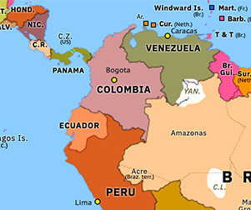
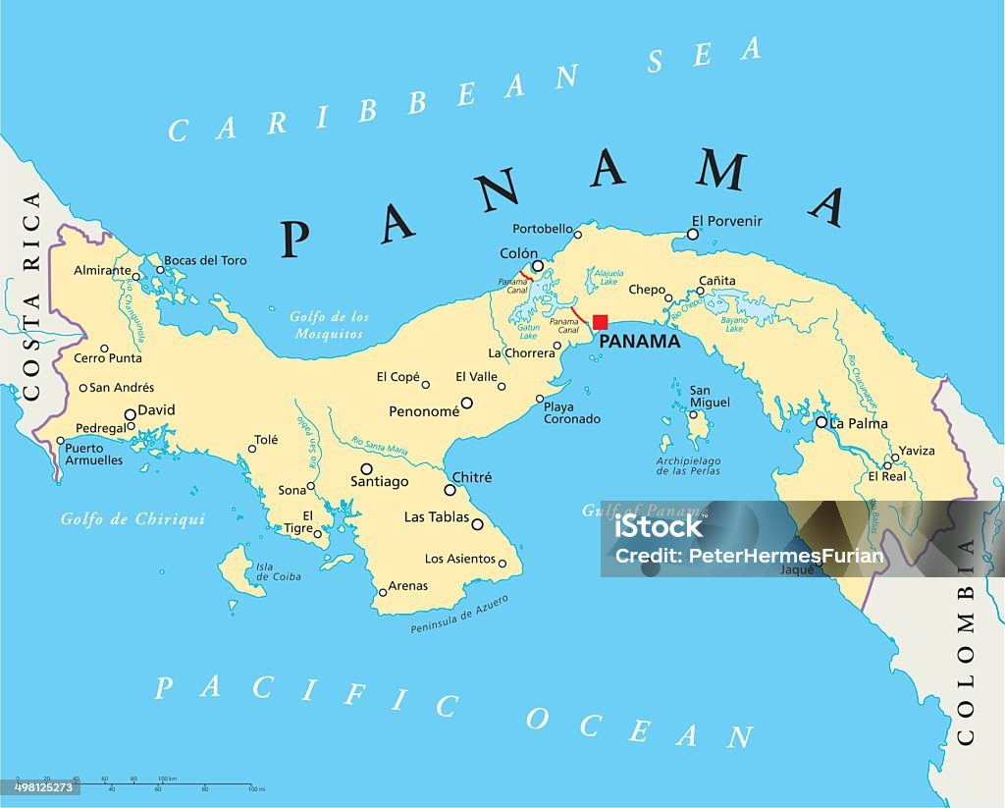
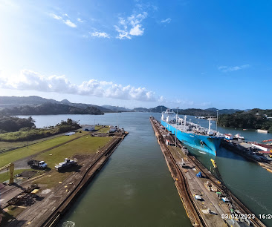

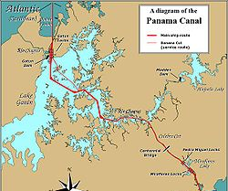
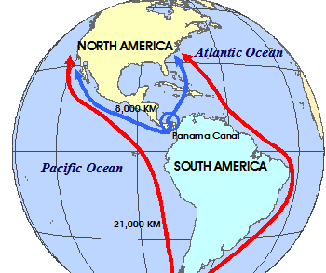

Slide 16
4. Obtaining home country support when operating abroad
. The support of a home country for its MNEs is contingent upon the wider evolution of the political environment both domestically and globally.
Eg. United Fruit in Guatemala (1954)
=> considered to be an example of American Imperialism in Latin America with the removal of Arbenz, a democratically elected president from power.
Professor Teresa da Silva Lopes

Slide 17
B) NMS of Political Corporate, Social and Responsibility (CSR)
=> Associated with the proactive political involvement by MNEs to enhance society, by improving relationships with stakeholders and through corporate social responsibility initiatives
Eg. Creation of social and environmental private regulation by MNEs
=> But NMS-CSR can also be considered to serve as a buffer (greenwashing?) to the potentially risky effects of politically related NMS – CPA, or to indirectly improve the performance of the MNE
Eg. in emerging markets – CSR activities used to strengthen political connections or geographic presence (but can be the other way round)
=> Institutional voids may lead consumers and interest group pressure firms to engage in political activity by working with non-governmental organizations (NGOs) and other parties to address insufficient social and environmental standards and norms
Eg. Social and environmental challenges such as water depletion, worker exploitation, child labour and deforestation which occur when governments are unwilling or unable to promote socially and environmentally responsible business practices.
. Firms tend more easily to justify CSR initiatives if they can explain how corporate giving will enhance customer satisfaction, sales and growth
Professor Teresa da Silva Lopes

Slide 18
NMS – CPA and CSA Combined
In a VUCA world, NMS have become of vital importance for MNE survival, organizational performance and even sustainable competitive advantage
NMS increasingly importance means that they need to be integrated in some way as part of organizations broad Market Strategies (MS) as they also affect performance
A major different between the two types of NMSs CPA and CSR is that:
- CSR – tends to be an open, often well publicized activity that can be imitated by others;
- CPA – less easy to imitate and is often conducted behind closed doors.
Companies are increasingly combining NMS (CSR or CPA):
Eg. 2015 - WV support of influx of refugees in Germany; early 2000s Lush cosmectics support for LGBT education in the USA
Professor Teresa da Silva Lopes

Slide 19
Session 11 – Main Takeaways
Market strategies aim to maximize performance taking into account suppliers, customers and competitors; non- market strategies, while having the same aims, address other environmental forces in more depth, including social, political, legal, cultural and responsible arrangements, taking into account the historical process. These can be important constraints and facilitators of firm activity.
The class addresses topics such as: how can MNEs develop strategies that espouse host-country nationalism; how can targeted host-country hostility be exploited by MNEs from third countries; what do secret nonmarket strategies entail; how do MNEs obtain their home country’s support when operating abroad; how do the MNEs’ host-country political ties shift from being an advantage to being a liability; how can a MNE intervene directly in international diplomacy.
Professor Teresa da Silva Lopes

