Slide 1

Global Business Strategy and Responsibility: Historical Perspectives
Session 13:
Multinational Strategies and the Evolution of Global Value Chains
Professor Teresa da Silva Lopes

Slide 2
Learning Objectives
Session 13 – Multinationals and the Evolution of Global Value Chains
- Understand the alternatives for offshoring and outsourcing of business operations
Assess the opportunities and risks associated with offshoring and outsourcing
Explain the relevance of supply chains and value chains in the evolution of international business strategies
Understand the dynamics and upgrading strategies within global value chains
Session 14 – Issues in the Governance of Global Value Chains
- Significance of risks and disruption in global value chains
- Achieving effective compliance in global value chains
Professor Teresa da Silva Lopes

Slide 3
Outsourcing vs. Offshoring
Outsourcing
. Is the market procurement of formerly in-house produced goods and services from legally independent supplier firms.
-> This is a ‘make or buy’ internalisation decision about control
. onshore outsourcing
. offshore outsourcing
Offshoring
. Performing or sourcing any part of an organization’s activities at or from a location outside the company’s home country.
-> Companies create captive centres offshore where the employees work for them, or outsource offshore where the employees work for the outsourcing provider
. captive offshoring
. offshore outsourcing
Professor Teresa da Silva Lopes

Slide 4
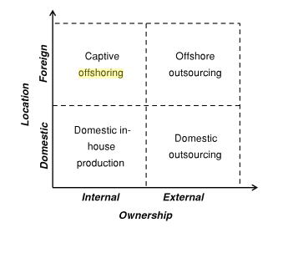
A Framework of Offshoring and Outsourcing
On-shore
Source: Bals et al (2013), ‘Exploring Layers of Complexity in Offshoring Research and Practice’, in Pedersen et al (eds.) The Offshoring Challenge. Springer
Professor Teresa da Silva Lopes

Slide 5
Concept of Reshoring
Reshoring is a business strategy that involves bringing back manufacturing or production processes that were previously moved offshore (typically to countries with lower labour costs) back to the home country
Motivations: cost considerations; improve quality control; supply chain resilience; lower chance of products being copies; smaller environmental impact; deal with geopolitics
Depends on: nature of industry, specific requirements of products, overall economic and geopolitical landscape
Different from – nearshoring, offshoring
Professor Teresa da Silva Lopes

Slide 6
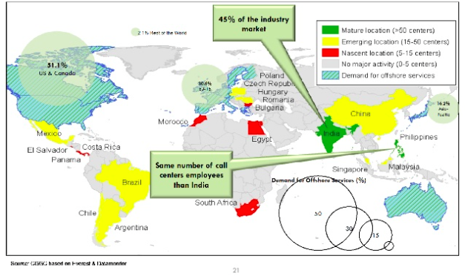
Supply and Demand of Offshore Services
Professor Teresa da Silva Lopes

Slide 7
Offshoring vs Outsourcing – Advantages and Risks
Offshoring
Getting work done in a different country
Benefits of offshoring are usually lower costs, better availability of skilled people, getting work done faster through a global talent pool.
Often criticized for transferring jobs to other countries. Other risks include geopolitical risk, language differences and poor communication etc
Outsourcing
Contracting work to an external organization
Usually, companies outsource to take advantage of specialized skills, cost efficiencies and labour flexibility
Misaligned interests of clients and vendors, increased reliance on third parties, lack of in-house knowledge of critical (not necessarily core) business operations
Professor Teresa da Silva Lopes

Slide 8
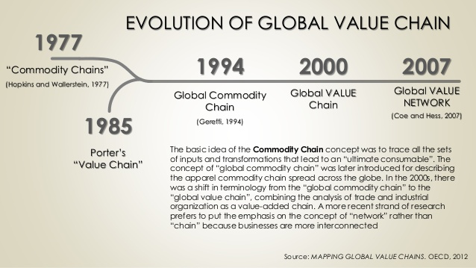
Global Value Chain Analysis
Professor Teresa da Silva Lopes

Slide 9
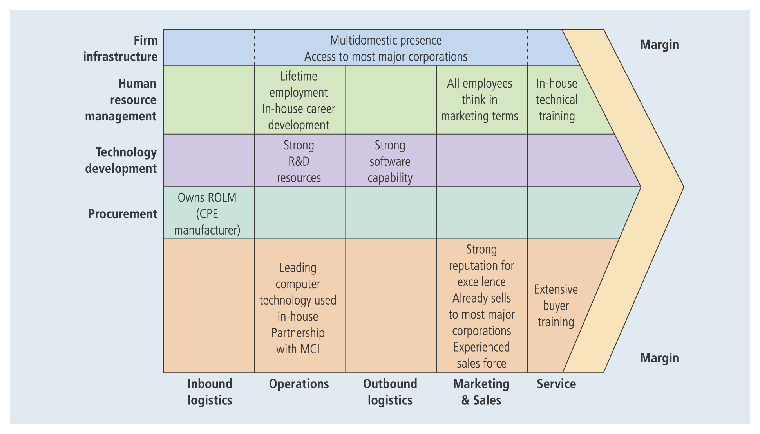
Porter’s Value Chain Framework
Where are the activities located globally?
The value chain for IBM
Source: Reported in Arnoldo C. Hax and Nicolas S. Majluf, The Strategy Concept and Process: A Pragmatic Approach (Englewood Cliffs, NJ: Prentice Hall, 1991), p. 82, Figure 8.4
Professor Teresa da Silva Lopes

Slide 10
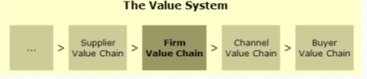
Why is Value Chain Analysis Useful?
Used to identify sources of competitive advantage of businesses and to determine the type of strategy that will be most effective (eg. cost advantage, product/service differentiation)
For understanding vertical-multi-stage activity needs for co-ordination
Includes the value-creating activities of all industry participants
Competitive advantage also depends of the management of connections with other firms’ value chains
Professor Teresa da Silva Lopes

Slide 11

Organizational Strategies within Global Value Chains: Levels of Integration
Hybrid Modes within GVC
Hierarchy
Market
Degree of power asymmetry
High
Low
Firm A
Firm A
Inputs
Inputs
Inputs
Inputs
Inputs
Firm A
Firm A
Procurement
Procurement
Procurement
Processing
Processing
Processing
Processing
Market
Firm B
. . .
Distribution
. . .
Distribution
Distribution
Distribution/Retail
Retail
Retail
Retail
Retail
Eg. BP (oil)
Eg. United Fruit (bananas)
Eg.Cadbury (cocoa)
Eg. Sandeman (port); Guimaraes (erva mate)
Vertical Competition for Control:
power relations; coordination; complexity of transactions
Professor Teresa da Silva Lopes

Slide 12
Global Value Chain as a Flexible Instrument
Where is the dynamics (changes over time)?
Where are the bottlenecks ?
Who creates value ? Who appropriates value?
Efficiency drivers?
Co-ordination?
Entrepreneurship and Innovation
Embeddedness
Procurers; producers; assemblers; wholesalers; retailers; …
Location; economies of scale.
How are the actors linked; how is the chain managed; what systems are used: JIT, IT
Degree of entrepreneurial activity; who innovates; any clusters
Context; how mobile are the actors; life cycle management
Professor Teresa da Silva Lopes

Slide 13
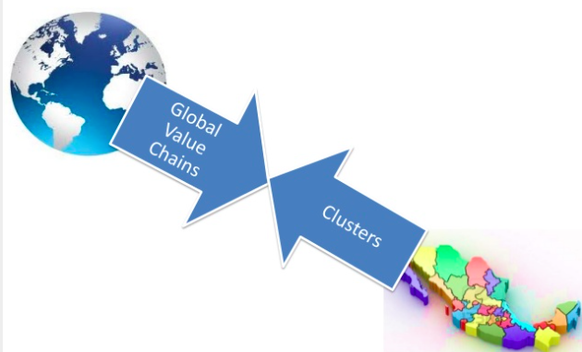
Linking Global Value Chains and Domestic Clusters
Professor Teresa da Silva Lopes

Slide 14
The ‘Smile’ Curve of Global Value Creation
Professor Teresa da Silva Lopes

Slide 15
Economic Upgrading within Global Value Chains
Strategies used by firms, clusters, and countries to improve their positions in global and regional value chains:
. Product upgrading – moving into more sophisticated product lines
eg. unit price of goods
. Process upgrading – transforms inputs into outputs more efficiently by reorganizing the production system or introducing superior technology
eg. productivity measures
. Functional upgrading – acquiring new functions (or abandoning existing ones) to increase the overall skill content of the activities
eg. backward/forward links
. Chain upgrading – entry or diversification into a new value chain by leveraging the knowledge and skills acquired in the current chain.
eg. economic diversification into new or related industries
GVC => Sustained growth
Economic, environmental, social upgrading
Professor Teresa da Silva Lopes

Slide 16
Session 12 – Main Takeaways
Multinational Strategies and Global Value Chains
The scope of global sourcing has expanded over time. Price was all that mattered at one time with respect to sourcing. Today, however, many companies consider not only price but also quality, reliability, and technology of components and products to be procured. Those companies design their sourcing decision based on the interplay between their competitive advantages and the comparative advantages of various sourcing locations for long-term gains.
The concept of global value chain is used to identify sources of competitive advantages of business and determine the types of strategies that are most effective. It is a key concept in a world characterized by businesses with disintegrated activities, spread across the world, involving many different types of agents vertically and horizontally inter-related.
Professor Teresa da Silva Lopes

