Slide 1

Global Business Strategy and Responsibility: Historical Perspectives
Session 16:
Diversification, Organizing Global Business Activities
Professor Teresa da Silva Lopes

Slide 2
Learning Objectives
Session 16 – Diversification, Organizing Global Business Activities
- understand and distinguish the motivations for related and unrelated diversification
- identify different types and evolution of organisation structures of MNEs
- ability to understand why and how organisational structures evolve as firms increase their international presence
- analyse the key structural variables that influence international organizational designs
- a grasp of the rationale for using different MNE organisational structures
Session 17 – Organizational Innovation; The Evolution of Tax Havens
- explain organizational innovation by MNEs
- an understanding about the evolution of tax havens
Session 18 – Introduction to the Case Study: Aristotle Onassis and the Greek Shipping Industry
Professor Teresa da Silva Lopes

Slide 3
Some reasons why firms diversify
Diversification
- involves spreading investments across different assets to reduce exposure to any single investment or risk.
Motives for Diversification:
- risk management strategy (risk spreading)
- growth
- profit (shareholder value)
Professor Teresa da Silva Lopes

Slide 4
Some reasons why firms diversify
Types of business diversification in terms of relatedness of activities:
. Related diversification
- strategy for adding related or similar product/service lines to existing core business, either through acquisition of competitors or through internal development of new products/services.
- 2 types of relatedness:
. operational relatedness – synergies from sharing resources across businesses (common distribution facilities, brands, joint R&D)
. strategic relatedness – synergies at the corporate level deriving from the ability to apply common management capabilities to different businesses.
. Unrelated diversification
=> when firms aim to continue growing after a core business has matured or declined
- to reduce cyclical fluctuations in sales revenues and cash flows
- managers often lack expertise or knowledge about their firms’ business
Professor Teresa da Silva Lopes

Slide 5
Trends in Diversification strategies
70.2 63.5 53.7 53.9 39.9 37.0
29.8 36.5 46.3 46.1 60.1 63.0
1949 1954 1959 1964 1969 1974
Source: Fortune 500
% of specialized companies (single-business, vertically-integrated and dominant business)
% of diversified companies (related business and unrelated business)
. 1950s -1970s – unrelated diversification was very popular
. From 1980s/1990s the trend reversed - large companies refocused upon their core businesses
Professor Teresa da Silva Lopes

Slide 6
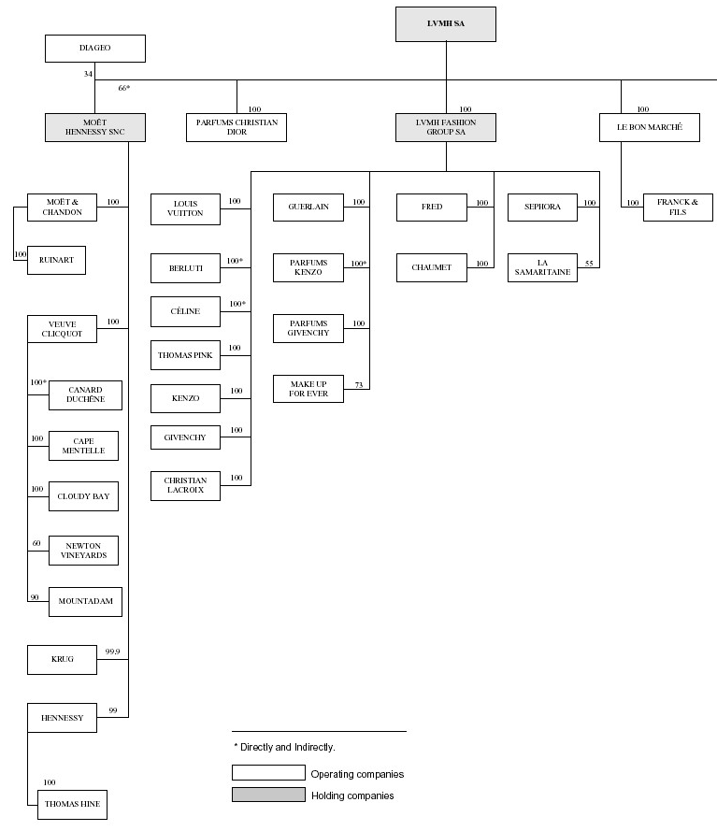
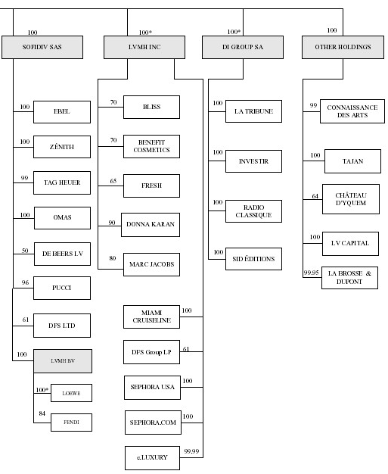
LVMH: A diversified MNE
LVMH Business Activities
(2002)
- haute-couture
- alcoholic beverages
- perfume
- jewelry
- cosmetics
- dept store
- media (press, radio…)
Source: LVMH – Form 20-F, 2002
Professor Teresa da Silva Lopes

Slide 7


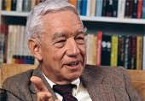



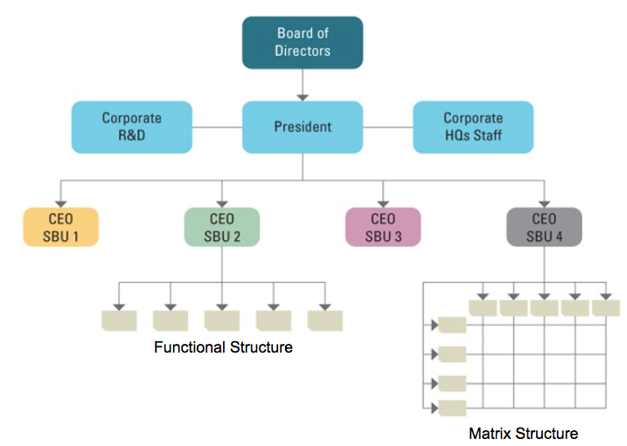
Structure Follows Strategy (A. Chandler, 1962)
Multi-Division Form (M Form)
Alfred Chandler
Professor Teresa da Silva Lopes

Slide 8
Internationalisation, strategy and structure
Does structure follow strategy? Or is it the other way round?
1. Structure follows strategy
Alfred Chandler (Strategy and Structure, 1962)
Based on 4 case studies of American conglomerates from the 1920s:
. Du Pont (chemicals); General Motors (automobile manufacturer); Standard Oil (energy); Sears Roebuck (retail)
all used the multi-division form (M Form) – semi-independent product or geographic groups
the need to restructure (design of the organization) arose from a strategic shift
driven by:
. new technologies (eg. rev. transportation and communications)
. and market changes (eg. product-market diversification => required divisionalisation.
Changes in strategy require a new or refashioned structure
2. But can Strategy follow Structure?
Rumelt (1974), Miller (1986), and others…
When an organization explicitly changed its structural arrangements, but not its strategy, diversification strategy nevertheless ultimately evolved to fit the firm's new organizational structure
Professor Teresa da Silva Lopes

Slide 9
Internationalisation, strategy and structure (cont.)
In determining the best structure, three questions must be answered:
  1. Can the company operate efficiently with domestic divisions or are international divisions also necessary?
  2. On what basis should the organization be structured:
  product, area, function, mixed or matrix?
  3. How can the necessary coordination and cooperation be most effectively achieved?
Professor Teresa da Silva Lopes

Slide 10
Internationalisation, strategy and structure (cont.)
Coordination processes
- The structure is designed to answer the question: What is to be done?
- The coordination processes impact on - decision making, communicating and controlling – help to make the structure work efficiently:
- Decision making: the process of choosing from among alternatives.
eg. large enterprise, low level of product diversification, highly competitive environment – favour centralization
- Communication: the process of transferring meanings from sender to receiver.
- Controlling: the process of determining that everything goes according to plan.
- The human resource management strategies also very important for MNEs
Professor Teresa da Silva Lopes

Slide 11
Key variables that influence international organisational designs
Which Organisational Structure => Analysis of key structural variables:
  the relative importance of international operations at the present time and what the projected situation might be within three to five years
  the firm’s past history and experience in the international arena
  the company’s business and product strategy
  the management’s philosophy of operating
  the firm’s ability to adjust to organizational changes
Professor Teresa da Silva Lopes

Slide 12
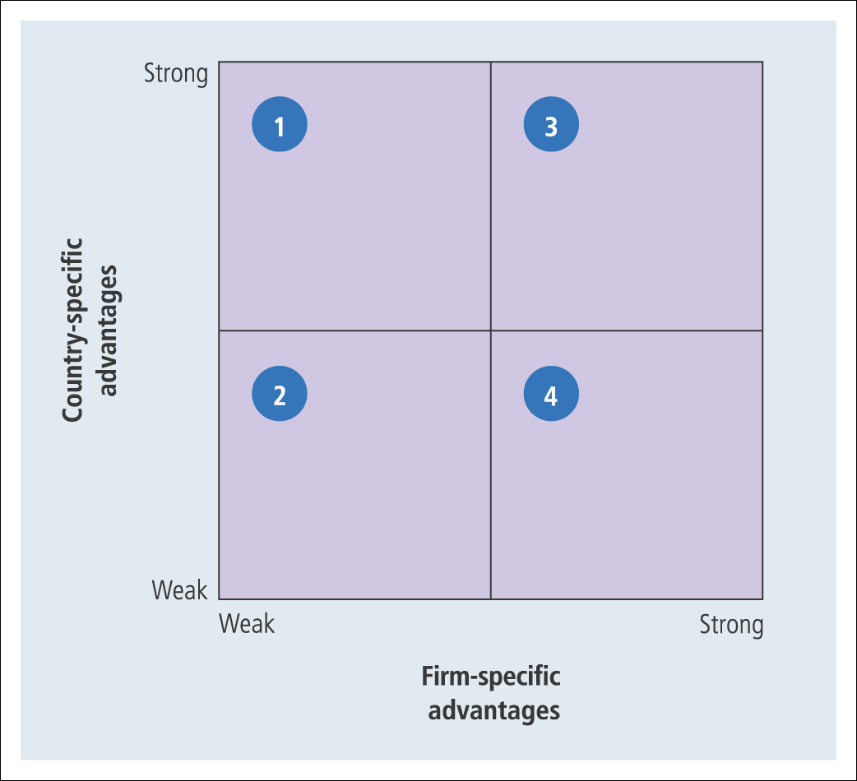
Types of organisational structures for the internalisationalised firm
Rugman’s Competitive Advantage Matrix – Related Organisational Structures
Quadrant 1 – cost leadership
a centralised and hierarchical structure usually followed by firms in cell 1 pursuing economic integration
Quadrant 2 - exit
Quadrant 4 – differentiation (building brands, investing in marketing)
the strategy of national responsiveness may require a decentralized organizational structure
Quadrant 3 – cost Leadership or differentiation
it may be necessary to combine the advantages of both a centralized and decentralized organizational structure – matrix structure (complementary assets need to be combined)
Professor Teresa da Silva Lopes

Slide 13
Types of organisational structures for the internalisationalised firm (cont.)
Bartlett and Ghoshal
Managing Across Borders: The Transnational Solution (HBS Press, 1991)
+
Global
organisation
Transnational
organisation
Global integration
International organisation
Multinational organisation
-
-
+
Domestic differentiation
Global integration (economic integration) – worldwide economies of scale are being obtained.
Domestic differentiation – adapt product/service to various foreign markets.
Professor Teresa da Silva Lopes

Slide 14
Organisational characteristics of different types of companies with international activities
Organisational
Characteristics
International
Multinational
Global
Transnational
Configuration of
assets and capabilities
Centralized core competences (country of origin)
Decentralised, some subsidiaries self-sufficient
Centralized on a global scale
Dispersed, interdependent, specialised
Role of overseas operations
To adapt and take advantage of the competencies of the parent company
To identify and exploit local opportunities
Implementing parent company strategies
Differentiated contributions by national units of integrated worldwide operations
Development and diffusion of knowledge
Knowledge developed at the centre and transferred to overseas units
Knowledge developed and retained within each unit
Knowledge developed and retained at the centre
Knowledge developed jointly and shared worldwide
Source: Bartlett & Ghoshal,1991
Professor Teresa da Silva Lopes

Slide 15
Adequacy of Organisational Structures for the Internationalised Firm
Worldwide
Product
division
+
Global
Matrix
Product
diversity
Area
division
International
division
-
% of foreign sales
Source: Bartlett & Ghoshal (1991)
Professor Teresa da Silva Lopes

Slide 16
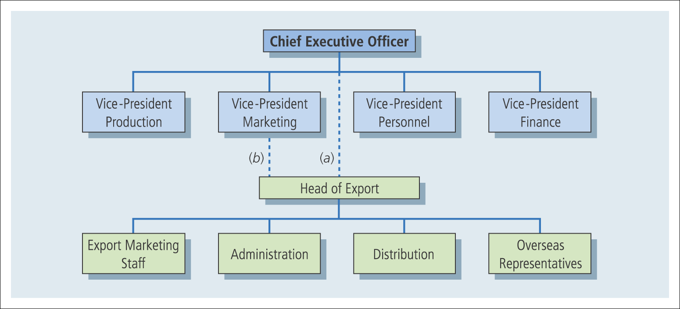
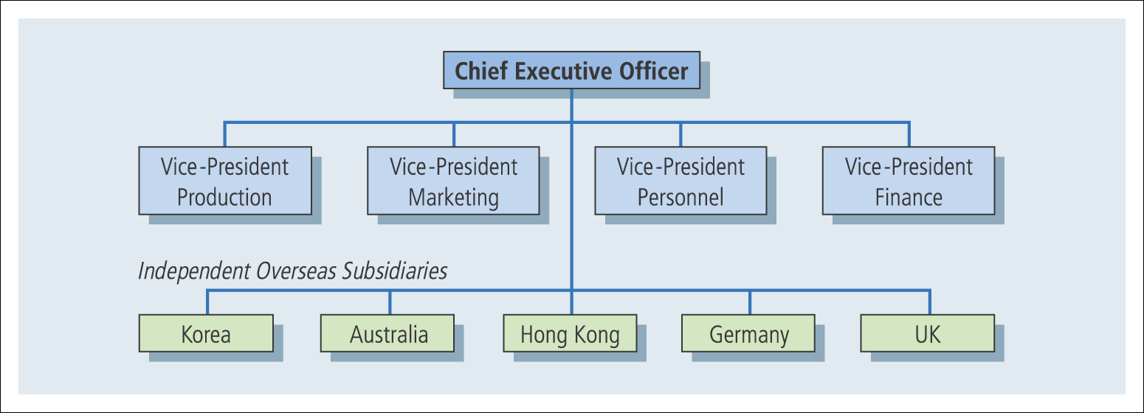
Types of Organisation Structures
Export or marketing department
. first international operations activities tend to be extensions of domestic operations
. focus on local market
Foreign subsidiary
. foreign direct investment – the early days
Professor Teresa da Silva Lopes

Slide 17
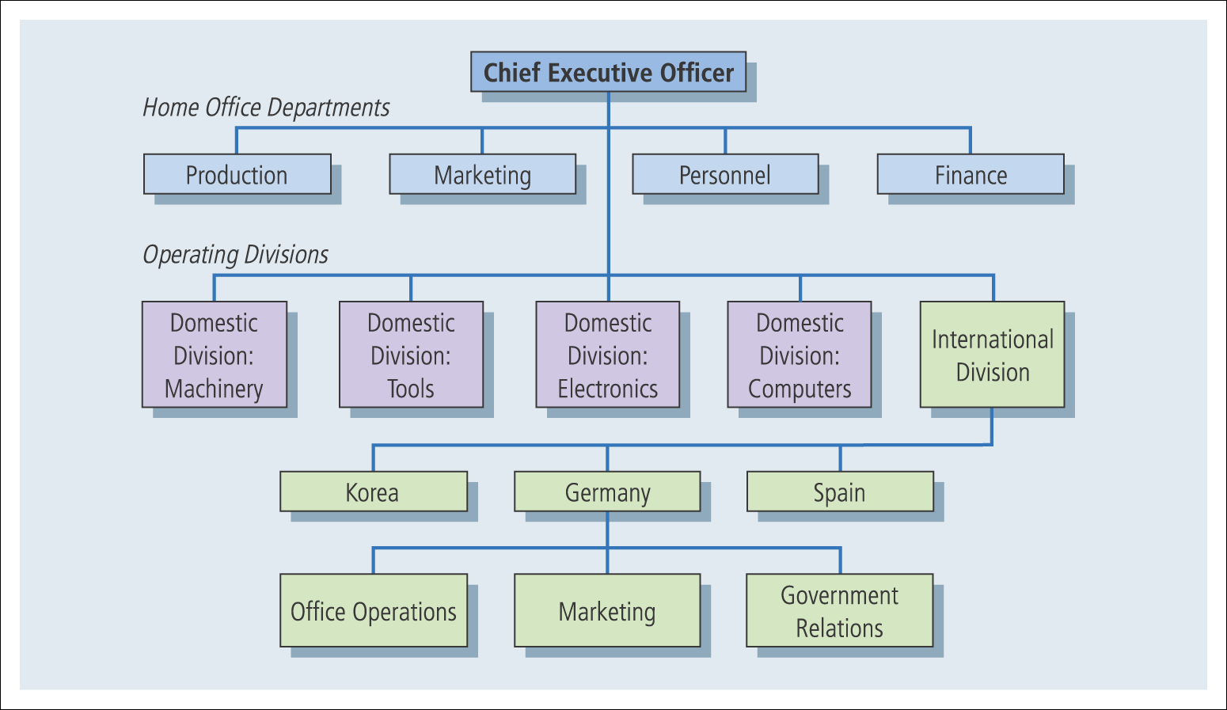
Types of Organisation Structures (cont.)
International division
centralizes all the international operations
advantages:
. reduces the CEO’s burden of direct operation of overseas subsidiaries and domestic operations;
. raises the status of overseas operations to that of the domestic divisions
Professor Teresa da Silva Lopes

Slide 18
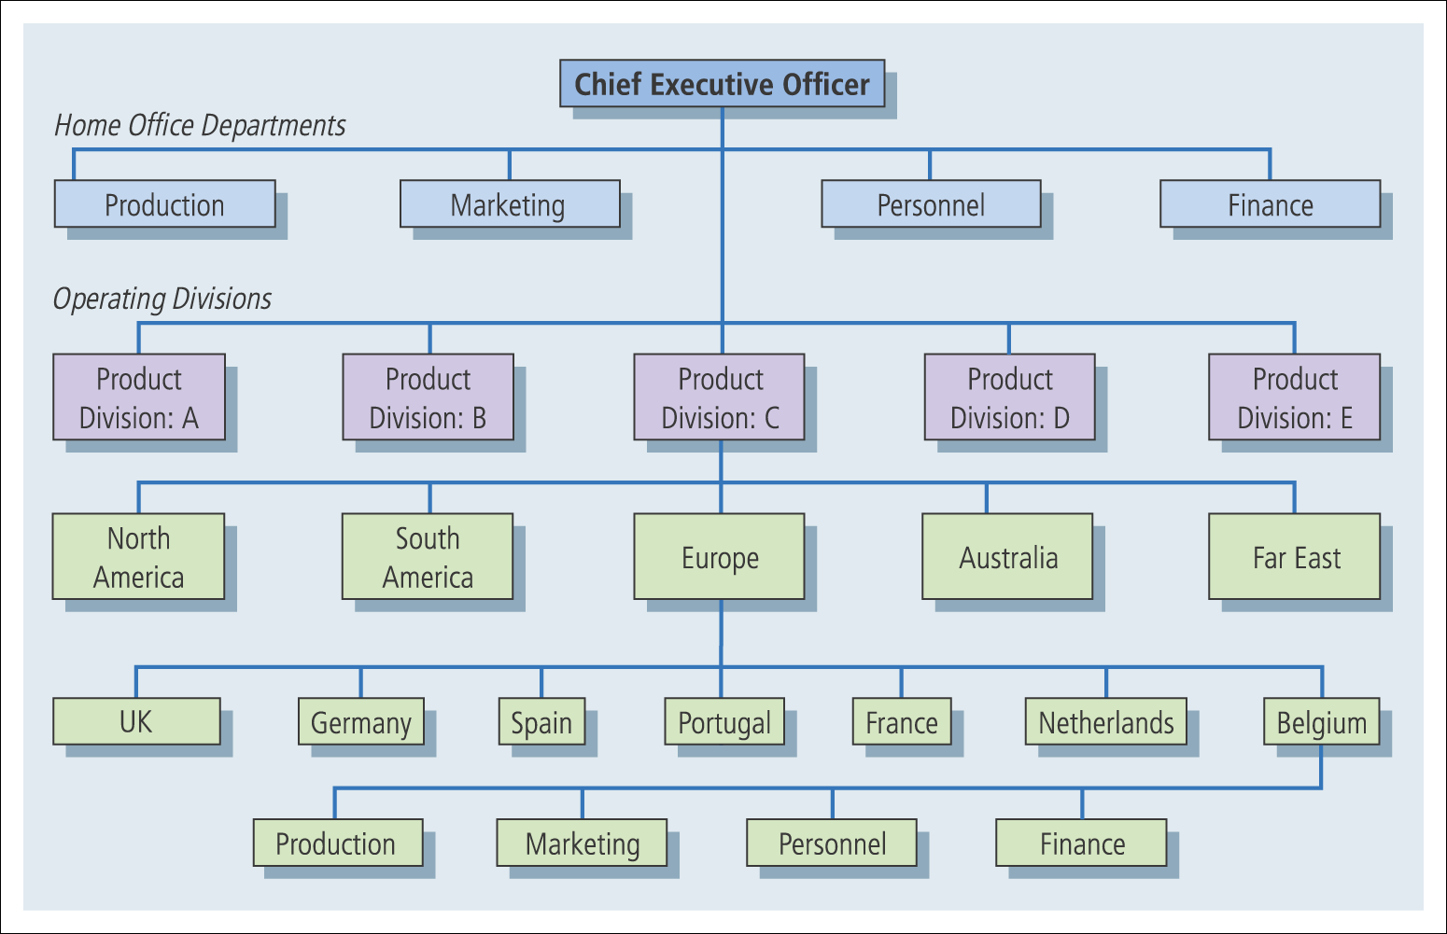
Types of Organisation Structures (cont.)
Global organisation structures
large percentage of revenues generated from overseas operations
- global in focus
- six types of global structures
1. Global product structure – domestic divisions are given worldwide responsibility for product groups
Professor Teresa da Silva Lopes

Slide 19
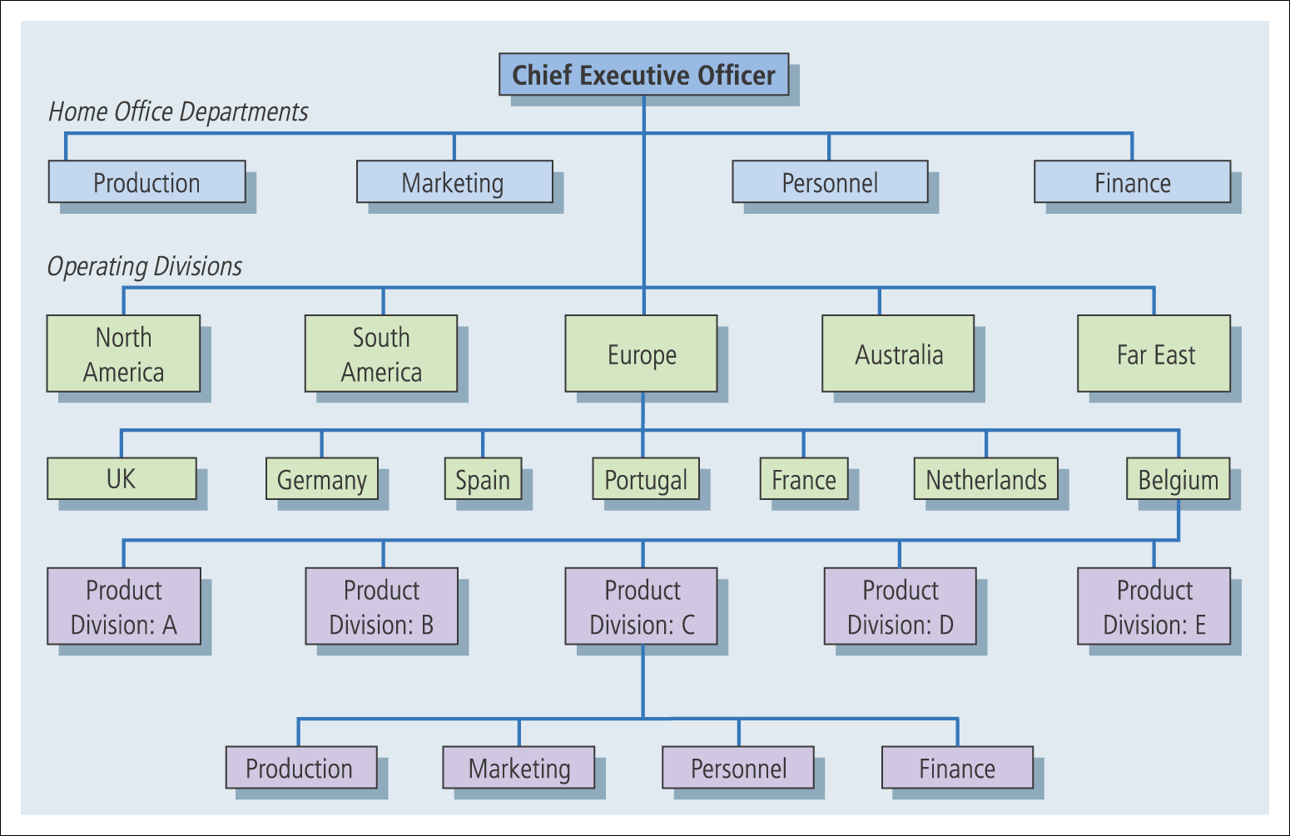
Types of Organisation Structures (cont.)
Global organisation structures (cont.)
2. Global area structure – primary operational responsibility is delegated to area managers, each of whom is responsible for a specific geographic region.
Professor Teresa da Silva Lopes

Slide 20
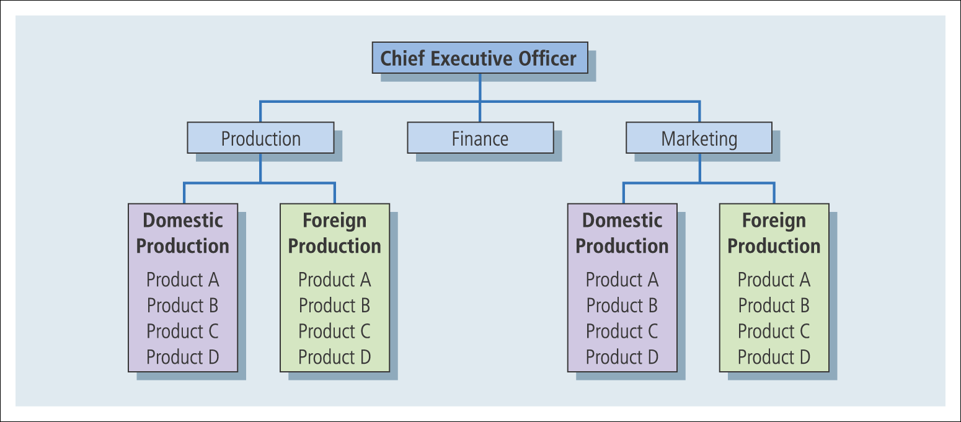
Types of Organisation Structures (cont.)
Global organisation structures (cont.)
3 - Global functional structure - builds around the basic tasks of the organization. For example, in manufacturing firms, production, marketing and finance are the three primary functions that must be carried out for the enterprise to survive.
Professor Teresa da Silva Lopes
Notes:
-

Slide 21
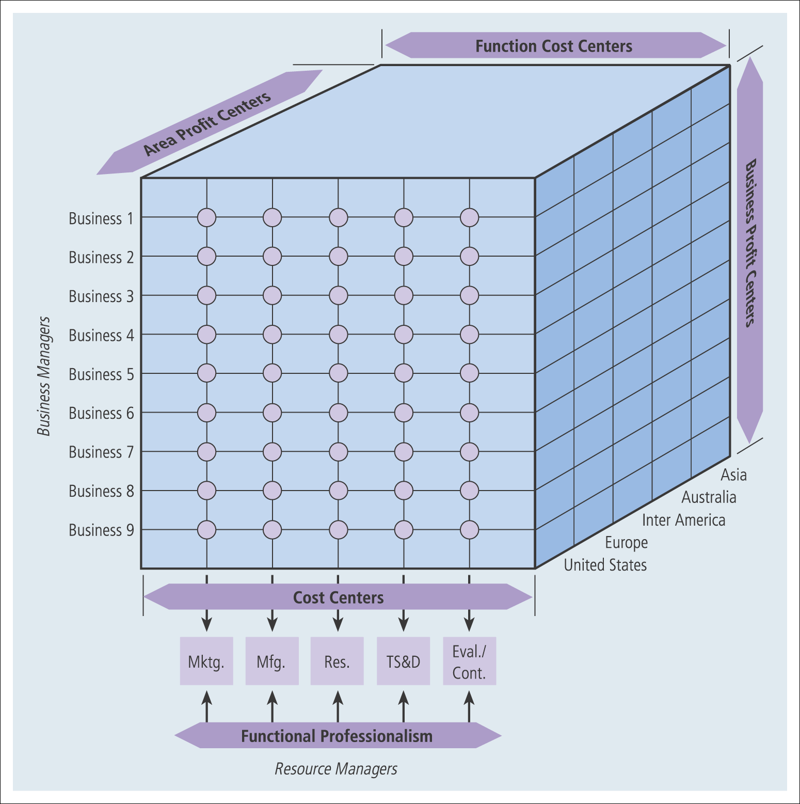
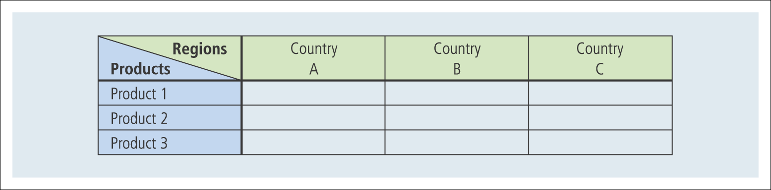
Types of Organisation Structures (cont.)
Global organisation structures
4 - Matrix structure - an organizational arrangement that blends two organizational responsibilities such as functional and product structures or regional and product structures.
Multinational matrix structure
Matrix structure
Problems:
Duplication
(problems of loyalty, dilution of authority)
Inter-divisional negotiations
Professor Teresa da Silva Lopes

Slide 22
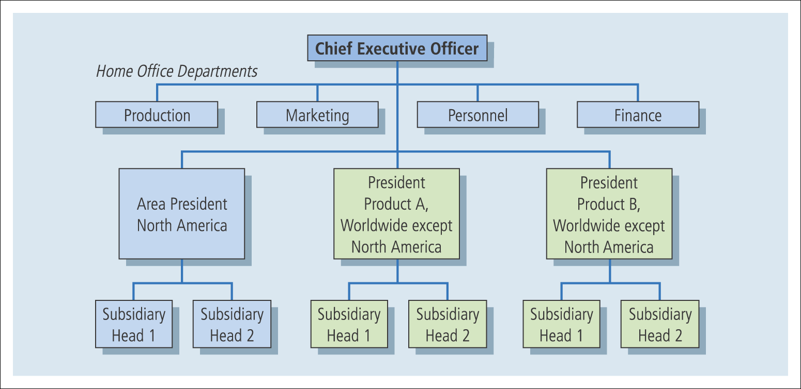
Types of Organisation Structures (cont.)
Global organisation structures
5 – Mixed structure - a hybrid organization design that combines structural arrangements in a way that best meets the needs of the enterprise.
Professor Teresa da Silva Lopes

Slide 23
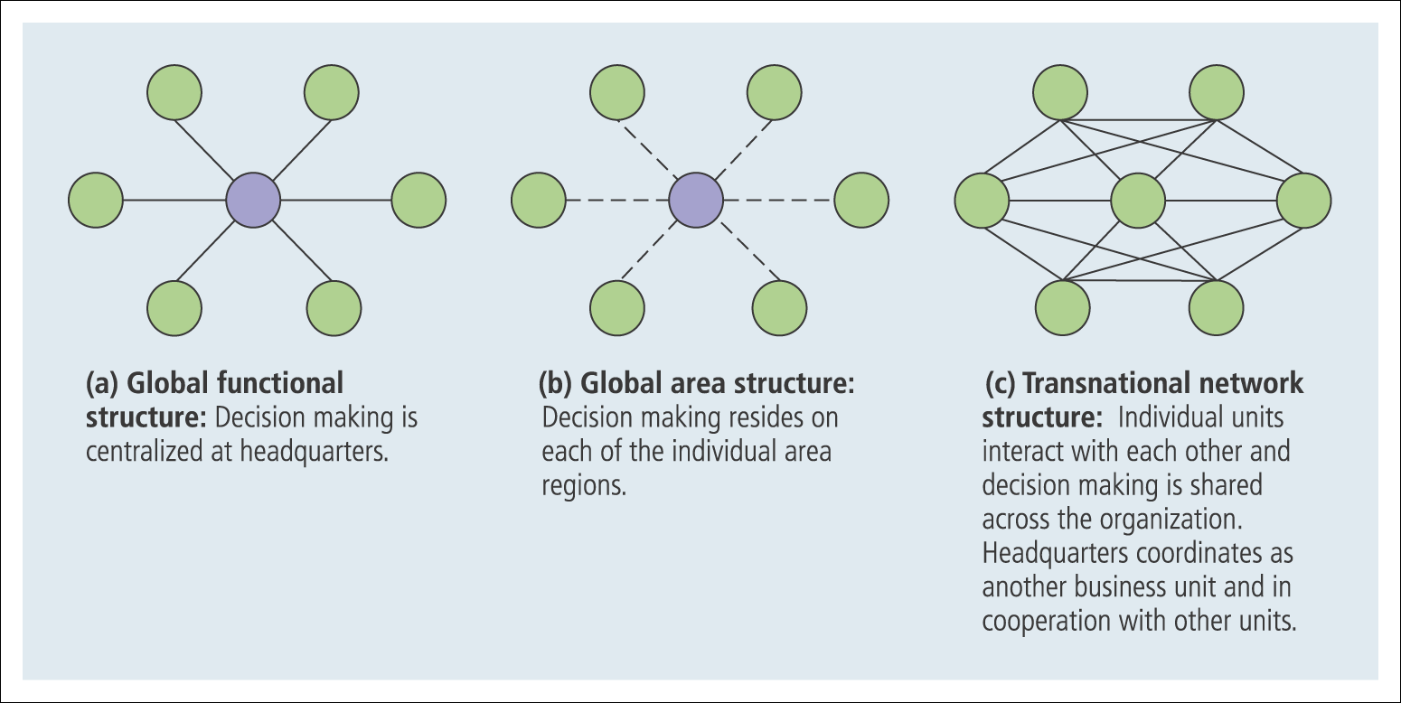
Types of Organisation Structures (cont.)
Global organisation structures
6. Transnational network structure
- ‘ borderless world’, ‘getting rid of headquarters mentality’ (Ohmae, 1990)
. Designed to help MNEs take advantage of global economies of scales while also being responsive to local customer demands.
  relies on a network arrangement to link the various worldwide subsidiaries
  decentralised strategy and operations, headquarters – global coordination of activities and allocation of resources.
. Three components:
(1) Dispersed subunits; (2) Specialized operation; (3) Interdependent relationships
. At the center of the transnational network structure are nodes, which are units charged with coordinating product, functional, and geographic information.
Professor Teresa da Silva Lopes

Slide 24
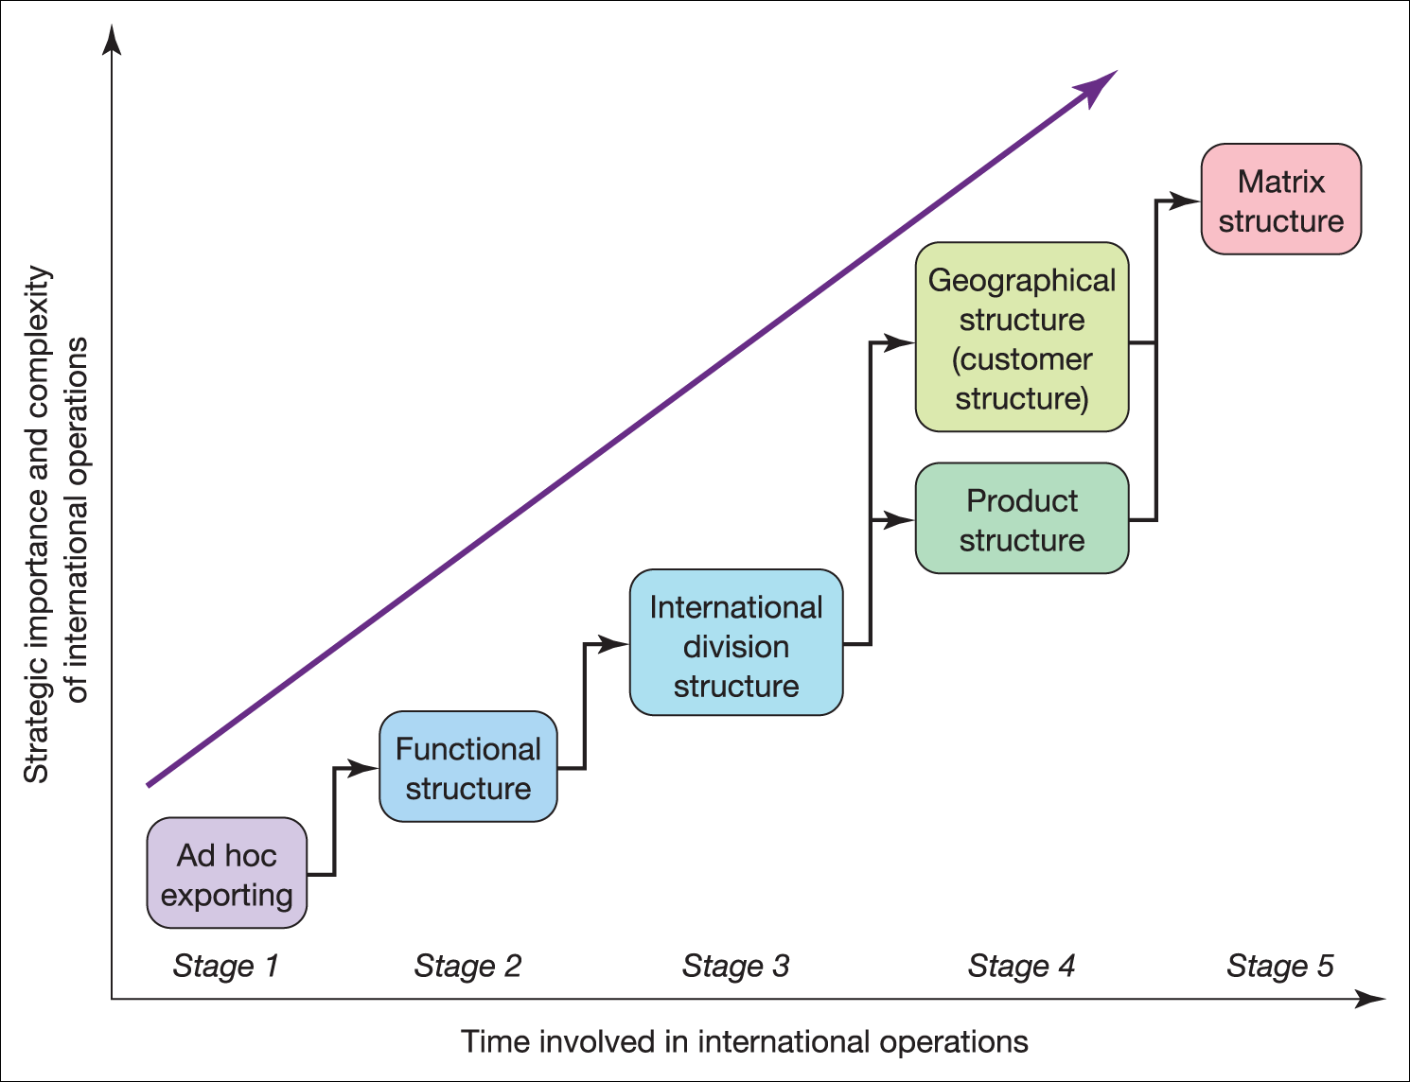
Figure 19.1 Structural evolution of international operations
Professor Teresa da Silva Lopes

Slide 25
Session 16 – Main Takeaways
Organising International Business Strategy
In business diversification, two main approaches are recognized: related and unrelated diversification. Diversification is a growth strategy, usually associated with complex organizational structures.
Since the publication of Alfred Chandler’s book ‘Strategy and Structure’ (1962), there is an unresolved debate about whether structure follows strategy or whether strategy follows structure. It is important to recognize the interconnections between the two.
In the organization processes of decision making one of the key areas of sideration is the amount of centralization or decentralization that will be used by the home office.
When firms’ cross borders, they are likely to adopt other types of organizational structures (eg. international division structure; global organizational structure), taking into account several key variables such as the relative importance of international operations; its past history and experience in the international arena; the company’s business and product strategy etc.
Professor Teresa da Silva Lopes

