Slide 1

Global Business Strategy and Responsibility: Historical Perspectives
Session 17:
Organizational Innovation; the Evolution of Tax Havens
Professor Teresa da Silva Lopes

Slide 2
Learning Objectives
Session 16 – Diversification, Organizing Global Business Activities
- understand and distinguish the motivations for related and unrelated diversification
- identify different types and evolution of organisation structures of MNEs
- ability to understand why ands how organisational structures evolve as firms increase their international presence
- analyse the key structural variables that influence international organizational designs
- a grasp of the rationale for using different MNE organisational structures
Session 17 – Organizational Innovation; the Evolution of Tax Havens
- explain organizational innovation by MNEs
- an understanding about evolution of tax havens
Session 18 – Introduction to the Case Study: Aristotle Onassis and the Greek Shipping Industry
Professor Teresa da Silva Lopes

Slide 3
Patterns – Design of HQs
1:
Co-Location
2: Legal Detachment
3: Financial Detachment
4: Strategic Detachment
5:
Distributed
HQ Role
Legal
Financial
Strategic
A
A
A
B
A
A
A
B
A
A
A
B
A
B
C
Examples
. Unilever
(1929)
. Nestle
(before WWII)
Legal:
-Anglo-Swiss
(Switzerland)
- Unilac
(Panama)
. Jardine Matheson (1832)
Financial (UK)
Legal (China)
Strategic (China)
. Anglo-Persian Oil Co. (1908)
Legal (UK)
Financial (UK)
Strategic (Iran)
. Nestle (WWII)
Legal (Panama)
Financial (SWI)
Strategic (US, SWI)
. Adidas
(1970s/80s)
Legal (Ger)
Financial (Ger)
Strategic (Fran)
. Jardine Matheson (1984)
Legal (Bermuda)
Financial (Singapore)
Strategic (HK)
. Comp. Real dos Caminhos de Ferro (1950s-1880s)
Legal (Portugal)
Financial (Spain)
Strategic (France)
Professor Teresa da Silva Lopes

Slide 4
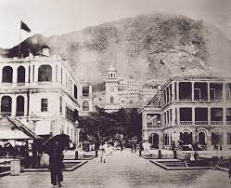
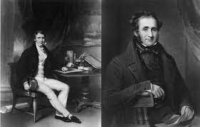
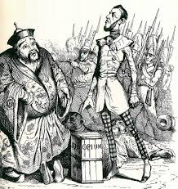

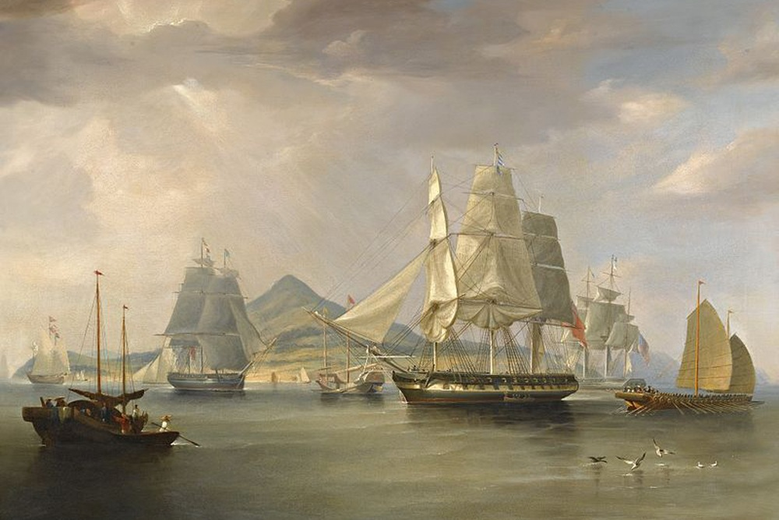
Jardine Matheson (1832)
William Jardine
James Matheson
Headquarters:
- Legal- 1832 - Canton/China
- Strategic 1832 - Canton/China; 1844 - HK
- Financial - UK
Professor Teresa da Silva Lopes

Slide 5


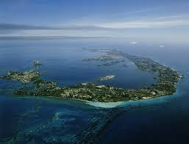
Jardine Matheson (1984)
Headquarters (2024):
- Legal - Bermuda
- Strategic - Hong Kong
- Financial - London, Singapore stock exchange
Jardine House HK
Bermuda – Legal HQ
Professor Teresa da Silva Lopes

Slide 6

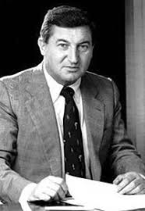
Adidas
Headquarters (1970s/80s):
- Legal - Germany
- Financial - Germany
- Strategic - France
Adolf Dassler
(Adidas, 1949)
Rudolf Dassler
(Puma, 1949)
Horst Dassler
(Adidas, son of Adolf)
Professor Teresa da Silva Lopes

Slide 7
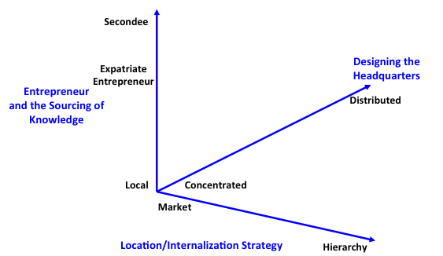
Extended Internalization Theory (Lopes, Jones, & Casson 2019)
Markets vs Hierarchies in international business (Buckley & Casson 1976)
+ design of headquarters (eg. ‘cloaking’ – hiding of assets)
+ role of entrepreneur (eg. expat entrepreneur)
Source: Lopes, Casson, Jones (2019)
Professor Teresa da Silva Lopes

Slide 8
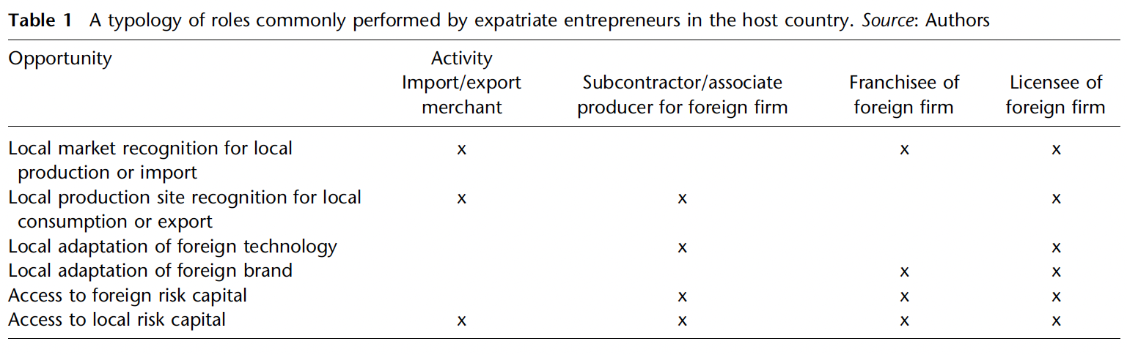
Entrepreneur and Sourcing of Knowledge
Professor Teresa da Silva Lopes

Slide 9
Multiple motivations for organizational Innovation
Some patterns and interdependencies :
Firms investing in distant and less developed markets – tend to create HQ with financial detachment to access more efficient capital markets.
Firms investing/operating in high-risk environments, or aiming to obtain tax efficiencies – tend to choose legal detachment to max possibilities of growth/survival
Firms aiming to achieve efficiencies – eg. communications and the transfer of knowledge and goods, and investments in locations with need to adapt to local markets – tend to choose strategic detachment.
Applicability of expanded theory to Emerging Markets:
high-risk environments; less efficient capital markets; cultural differences; marketing-driven decisions
Professor Teresa da Silva Lopes

Slide 10
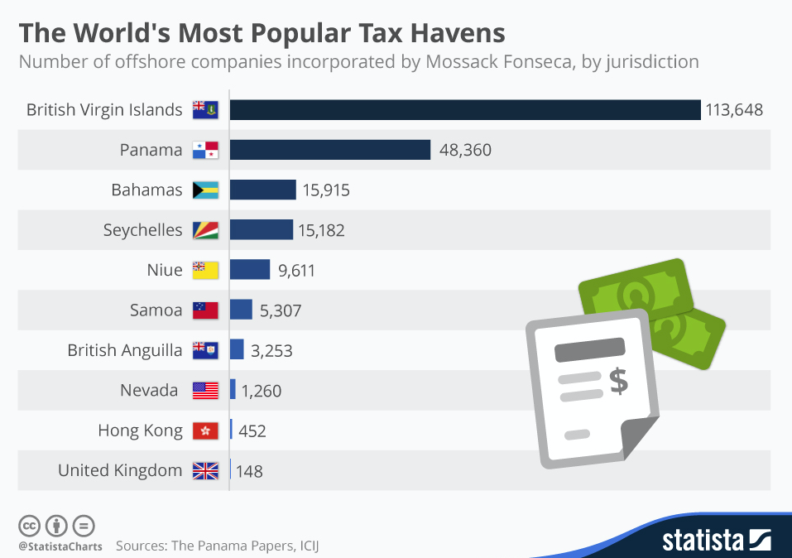
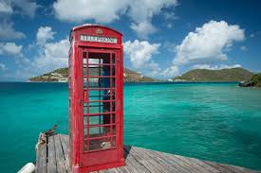
The historical significance of tax havens as a form of organizational innovation
Professor Teresa da Silva Lopes

Slide 11
Tax Havens – Concept and Significance
Concept
They are jurisdictions with zero or very low tax rates for corporations and/or individuals as well as certain secrecy provisions that guarantee the anonymity of those wanting to conceal assets from the eyes of taxmen.(Ogle, 2020)
Why they make the news?
=> Artificial accounting and booking techniques deployed by many MNEs in order to accumulate profits:
- deprive governments of revenue and undermine the integrity of the tax system
- public pressure for individuals and corporations to pay their fair share of taxes
- contribute to growing inequality
Professor Teresa da Silva Lopes

Slide 12
History of Tax Havens
1. WWI – the emergence of first tax havens in Europe
- after the introduction of mass-based income taxes during the war.
- first tax havens to emerge:
Switzerland; Liechtenstein; Luxembourg The British Channel Islands; Bahamas; Bermuda
2. 1950-60s – Proliferation and growth of established and newly emerging havens
- after WWII
. introduction of progressive income tax
. Decolonization – created a money panic leading to withdrawal of funds
(individuals, private companies, public-private enterprises)
- new tax havens emerge
Cayman Islands, The British Virgin islands, Hing Kong, Singapore, Malta, Panama, Beirut
3. 1970s/1980s
- end of the Bretton Woods System and removal of capital controls
Professor Teresa da Silva Lopes

Slide 13
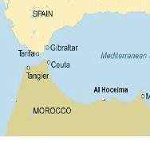
Eg. Tax Haven - ’Tangier’ (Morocco):
Before 1956
Tangier is the centre of money movements in North Africa’
- ‘Haven of four freedoms’: taxes; exchange world’s currencies,
. customs duties on goods in transit,
. for incorporation and operation in secrecy
- Greatly facilitated the registration of companies
- Tax haven - for both licit and illicit business (spies, smugglers, gold traders etc.)
1956
Independence of Morocco => end to Tangier regime
Suez Canal crisis 1956-1957 => deteriorating conditions for foreigners in Egypt
After 1956
One of the biggest waves of money movements out of the colonial/ post-colonial world
- Former colonizers: white settlers, colonial officials and businessmen
- Ethnic and religious minorities (eg. Syro-Lebanese community in West Africa)
- Former investors in the colonial empire based in the metropole
- Newly independent countries – heads of state and wealthy locals
- MNEs investing in the newly independent countries – re-route profits via tax havens
- Hedge funds and mutual funds – for doing portfolio investments
Professor Teresa da Silva Lopes

Slide 14
Session 17 – Main Takeaways
Organizational Innovation: An Historical Perspective
MNEs pursue innovative organizational strategies for multiple reasons. These range from tax efficiencies; to minimization of risks associated with investments in host countries with turbulent environments or less developed institutional environments; access to capital in more developed financial markets; and obtaining efficiencies associated with communications and the transfer of knowledge, goods, and investments in locations with need to adapt to local markets.
The emergence of the first tax havens in Europe during WWI, following the introduction of mass-based income taxes, saw Switzerland, Liechtenstein, Luxembourg, the British Channel Islands, Bahamas, and Bermuda as pioneers. The 1950s-60s marked the proliferation of established and new havens post-WWII, with the introduction of progressive income tax and decolonization prompting the emergence of havens like the Cayman Islands, British Virgin Islands, Hong Kong, Singapore, Malta, Panama, and Beirut. The 1970s and 1980s witnessed the end of the Bretton Woods System and removal of capital controls, further shaping the landscape of global tax havens.
Professor Teresa da Silva Lopes

