Slide 1

Global Business Strategy and Responsibility: Historical Perspecitves
Session 20 - Global Business Stratetegy and Responsibility:
Historical Perspectives – A recap
Professor Teresa da Silva Lopes

Slide 2
Learning Objectives
Session 19 - The Great Divergence and the Great Convergence
- When was the Great Divergence?
- Why did the Rest not catch up?
- Why has the Great Convergence happened?
Session 20 – Global Business Strategy and Responsibility: Historical Perspectives – A recap
Session 21 - Final Takeaways from GBSR; Preparation for the Final Exam
Professor Teresa da Silva Lopes

Slide 3
GBSR – Topics
What is ‘Global Business Strategy and Responsibility: Historical Perspectives’ about?
How have MNEs shaped and been shaped by globalization
The evolution of global business
Foreign market entry strategies
Theories, frameworks and concepts in global business
Case study – Globalizing consumer durables: Singer sewing machine before 1914
Entrepreneurship and responsibility in international business
The responsibility of international business in society
Task: Research activity
Strategic risk management in foreign markets
MNEs non-market strategies in high-risk environments
Case Study: Octopus and the Generals – The United Fruit Company in Guatemala
Multinational strategies and the evolution of global value chains
Issues in the governance of global value chains
Task: Research activity
Diversification; Organizing international business activities
Organizational innovation ; The evolution of tax havens
Case Study: Aristotle Onassis and the Greek shipping industry
The Great Divergence and the Great Convergence
20. Global Business Strategy and Responsibility: Historical Perspective – A recap
21. Final takeaways from GBSR; Preparation for the final exam
Professor Teresa da Silva Lopes

Slide 4
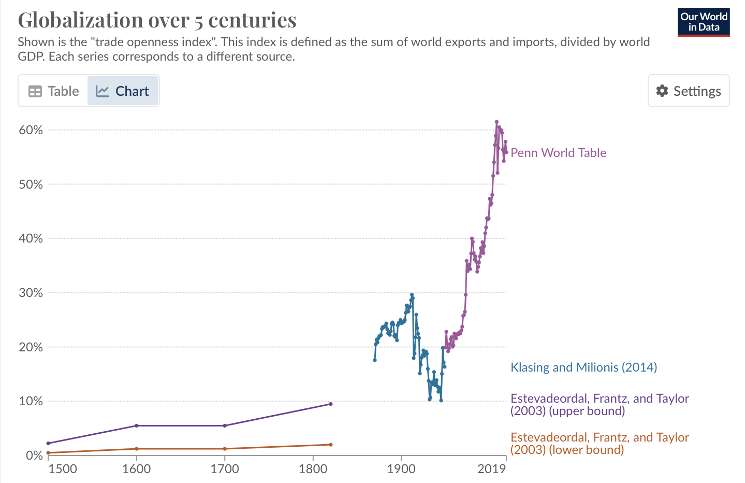
Growth of Global Exports (over 5 centuries)

Slide 5
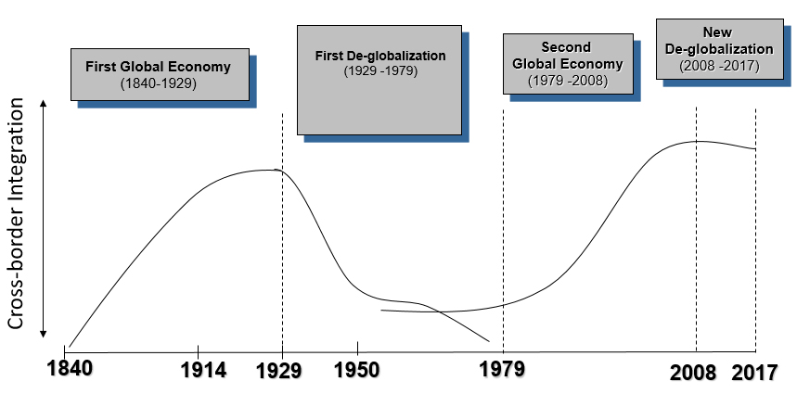
Globalisation Framework
…or slow globalization
World FDI stock as a share of world output (%)
1913
9.0
1960
4.0
1980
4.8
1990
8.5
1997
11.8
Source: Based on Jones (2005)
Professor Teresa da Silva Lopes

Slide 6
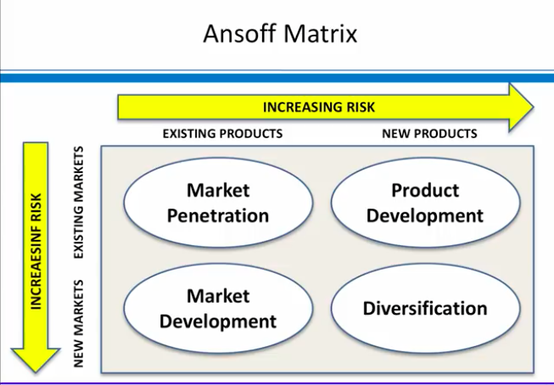
Internationalisation - an alternative growth strategy
Internationalisation
Ansoff (1960)
Internationalisation
Scope of activitiies => multiple regions – multiple customers and competition
Nature of activities => coordination - marketing related activities across different countries; integration sourcing and production with marketing; adaptation vs standadization of marketing strategy to markets etc
Professor Teresa da Silva Lopes

Slide 7
Entry Strategies for International Markets
Time
Branch export/ subsidiary
Perceived Risk
vs.
Level of Control of activities
vs .
Time (experience in the market)
Sole
Venture
Joint Venture
Control
Franchising
Licensing
Agent/Distributor export
Indirect export
Risk
Source: Franklin Root (1987)
Professor Teresa da Silva Lopes

Slide 8
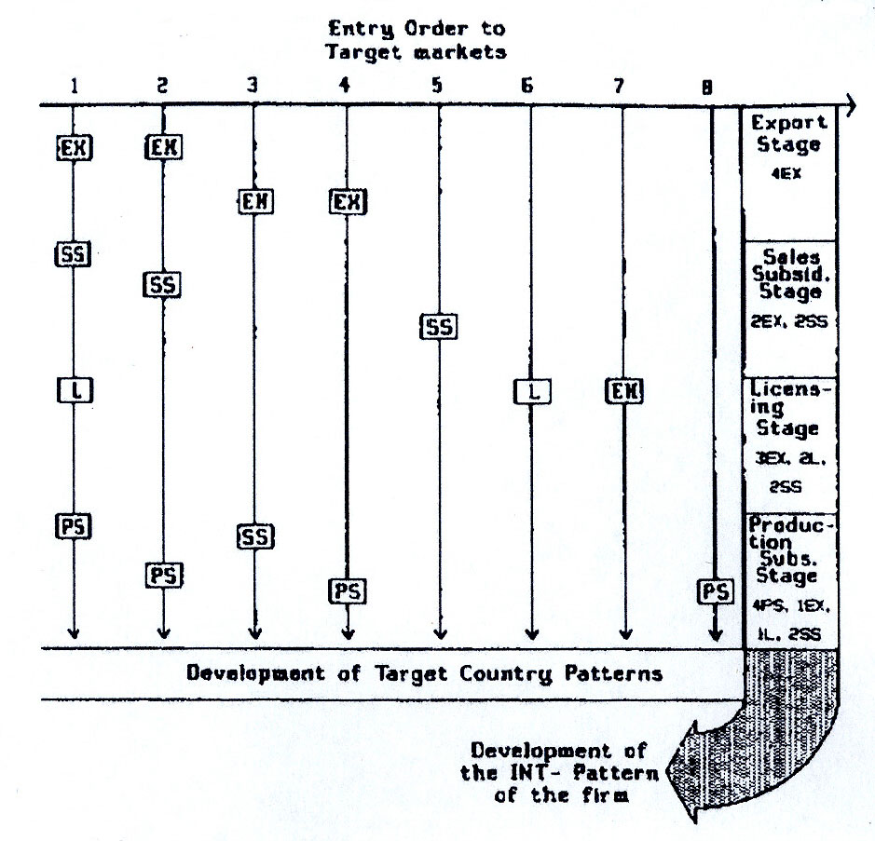

Internationalization process: Is it always Incremental ?
=> The process of involvement in international operations – learning process; evolutionary development (depth of operational mode, diversity of modes used, product offerings and range of markets penetrated)
Most common patterns of internationalisation:
- involve the creation of intermediate steps as a build-up to foreign direct investment
eg. from exports to sales subsidiary
there is often great diversity in the exact structure of the establishment chain
not always sequential, nor smooth (due to threats/opportunities)
Eg. Spotify, Skype, Logitech
What about the ‘Born Global Firms’?
Ex – export; SS – sales subsidiary;
PS – production subsidiary; L - Licensing
Source: Welch and Luostarinen (1988)
Professor Teresa da Silva Lopes

Slide 9
Choosing the Mode of Entry
A Transaction Cost Economics Explanation
  Tradeoff between:
  - the benefits of increased control (eg. indirect exporting vs. wholly-owned subsidiary)
  - the costs of resource commitment and risk.
  - the desirable governance structure will depend on the comparative transaction costs, that is, costs of running the operation via de market, the hierarchy or using a hybrid structure
Hybrid structures (e.g. Strategic aliances)
Hierarchy
Market
(high transaction costs)
(low transaction costs)
Professor Teresa da Silva Lopes

Slide 10
Choosing the Mode of Entry
Decision factors:
. Perceived risk of the market/market knowledge
. Strategic significance of the activities/need for control
Exports
Contractual agreements
FDI
Other
Licensing
Franchising
.
Eg. Contractual Manufacturing
Professor Teresa da Silva Lopes

Slide 11
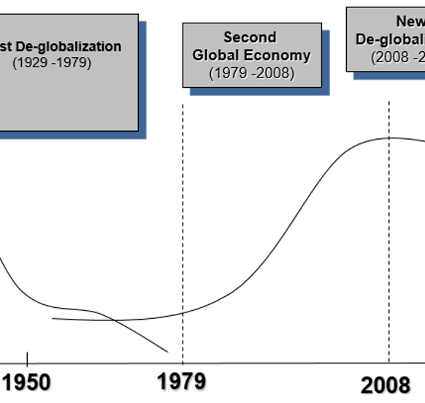
A Recap: World Business Context by 1960s
Second Global Economy
Fast economic growth; capital mobility; high receptivity.
Agents: service MNEs, resource MNEs, manufacturing MNEs
1960s - Theory of the MNE
MNEs profit-maximising ‘black boxes’
‘Representative firm’ - as unit of analysis
=> Need for development of new theories of the firm
Professor Teresa da Silva Lopes

Slide 12
Vernon’s Product Life-Cycle Theory (1966)
Developed out of critique of neoclassical comparative advantage theory
(eg. Failure to deal with the role of innovation in the evolution of trade patterns, lack of attention to the role of economies of scale in determining such patterns)
The first dynamic interpretation of the determinants of, and relationship between, international trade and foreign production
Based on the assumption that for most of the 20th century a very large proportion of the world’s new products had been developed by US firms, and sold first in the US market
This gave US firms incentives to develop new consumer products.
Ethnocentric view? World - US?
A. US
150
A: Early in the life cycle of a typical new product
- demand is starting to grow rapidly in the US,
demand in other advanced countries is limited to high-income groups
no incentive to produce abroad
just exports
100
Production
Imports
Quantity
Exports
50
Consumption
New product
Maturing product
Standardized product
Time
Stages of product development
Professor Teresa da Silva Lopes

Slide 13
Vernon’s Product Life-Cycle Theory (cont.)
B. Other Advanced Countries
150
Exports
100
B: Over time – demand for new products starts to develop in other advanced countries (eg. UK, France, Germany and Japan)
=> Incentives to produce in those markets (by host and foreign firms)
Quantity
Consumption
50
Production
Imports
C. Developing countries
150
C: US + other advanced markets mature
– product becomes more standardized + price becomes the main competitive weapon
other countries can obtain production advantages compared to the US
. first – other advanced countries
. after – developing countries
100
Exports
Quantity
50
Consumption
Imports
Production
CONCLUSION:
Over time the US switches from being an exporter of the product to an importer as producion becomes concentrated in lower – cost foreign locations
New product
Maturing product
Standardized product
Time
Stages pf product development
Professor Teresa da Silva Lopes

Slide 14
Theories of MNE:
The Eclectic Paradigm – OLI Paradigm (John Dunning, 1993)
O + L : Ownership (O) and Location (L) Advantages
- Ownership/Monopolistic advantages (Stephen Hymer, 1960)
- Product Life-Cycle (Raymond Vernon, mid-1960s, HBS)
I : Internalization (I) and the Boudaries of the Firm
- Imperfections in Markets (Hymer, 1960)
- Transaction costs (Coase, 1937, Williamson, 1975)
- Internalization Theory (Buckley and Casson, 1976)
All add to our understanding about the cross-border organisation of economic activities
Professor Teresa da Silva Lopes

Slide 15
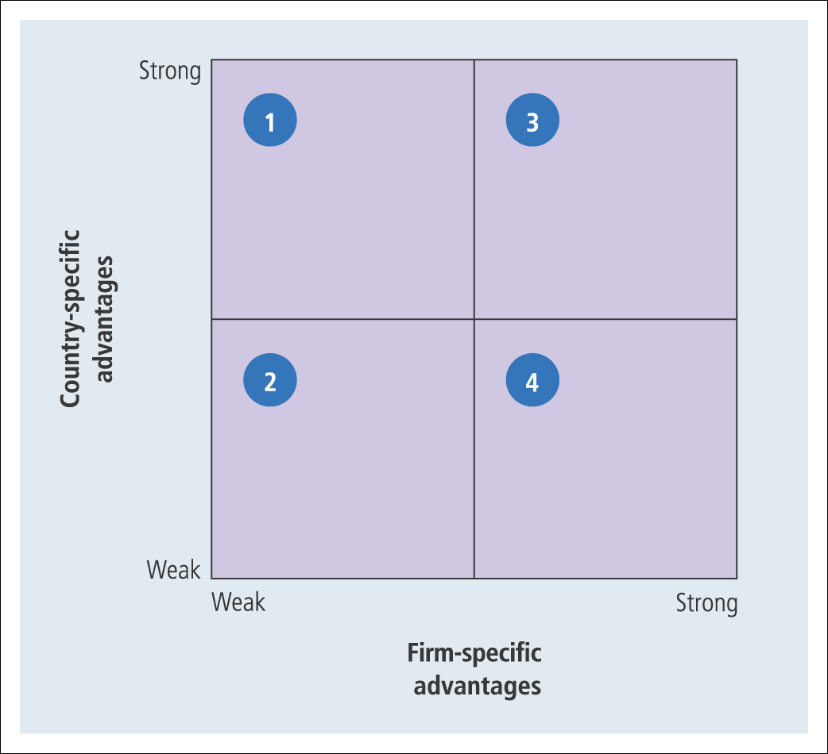
Rugman’s FSA-CSA Matrix
Quadrant 1: resource-based and/or mature, globally-oriented firms producing a commodity-type product ➔ cost leadership (Improving FSA can make them move to quadrant 3.)
Quadrant 2: inefficient, floundering firms with no consistent strategy, nor any intrinsic CSAs or FSAs ➔ no alternative but to exit or to restructure
Quadrant 3: follow any of the generic strategies ➔ both cost leadership or differentiation
Quadrant 4: differentiated firms with strong FSAs in marketing and customization ➔ differentiation (the CSA is not relevant)
Professor Teresa da Silva Lopes

Slide 16
Some related concepts:
‘Lack of fit’, ‘Liability of Newness’ and ‘Liability of Foreignness’,
Liability of Foreignness (Zaheer, 1995)
=> Relates to the social and economic costs arising when firms operate in an unfamiliar environment
. These costs originate in limited local knowledge and competitive disadvantage for a MNE subunit (there are many costs for a firm operating in a market overseas that a local firm would not incur).
. Similar to Hymer’s ‘costs of doing business abroad’.
They lead to performance gaps between foreign and local firms (ceteris paribus)
Examples: Unfamiliarity, relational and discrimination hazards
Source: Sethi and Guisinger (2002)
Professor Teresa da Silva Lopes

Slide 17
Entrepreneur - Productive/Unproductive Framework (Baumol,1990)
Individual entrepreneurs can have multiple economic and societal impacts
Baumol (1990) suggests entrepreneurship takes many forms which have different outcomes on society:
- Productive (eg. innovation)
- Unproductive (eg. rent seeking; organised crime)
“Rules of the game” (set by institutions) explain why entrepreneurial activities are allocated to one form or another in a given time and country
Professor Teresa da Silva Lopes

Slide 18
Can businesses de deeply responsible and still be competitive?
Porter and Kramer (2011)
Shared value
=>relates to corporate policies and operating strategies and practices that enhance the competitiveness of a company while simultaneously advancing the economic and social conditions in the communities in which it operates.
Requires New Skills:
Governments - learn how to regulate in ways that enable shared value rather than work against it
Managers - far deeper appreciation of societal needs; greater understanding of the true basis of company productivity; ability to collaborate across profit/non-profit boundaries
Corporations - redefine their purpose to create shared value, not just profit per se
Professor Teresa da Silva Lopes

Slide 19
Levels of Shared value (Porter and Kramer, 2011)
1. Reconceiving customer needs, products, and markets to address societal needs
=> new opportunities to differentiate, innovate and grow
- design new products and services
Eg. environmental impact, safety, health, education, nutrition, living with disability, housing, financial security
- open new markets by serving unmet needs in underserved communities
(often requires redesigned products or different distribution methods)
2. Redefining productivity in the value chain
eg. improve employment in disadvantaged regions, minimise logistical impacts in distribution, energy and water use in production, limiting emissions and waste
3. Enabling local cluster development
(business cluster - geographical concentration of interconnected businesses; eg. Sillicon Valley)
- strengthen the links within the cluster => strengthens links with the community
Professor Teresa da Silva Lopes

Slide 20
Possible advantages for MNEs adopting a ‘shared value’ approach
- Develop new FSAs (Firm Specific Advantages), often building on existing FSAs, and improve performance
- Improve Location Advantages (L) (easier in emerging economies)
e.g. Nike partnering in local suppliers in emerging markets - help them better integrate in global supply chains, moving from transactional relations to cooperative/alliances.
- Create institutional spillovers and help fill institutional voids in foreign markets which are not host countries to their FDI; where FSAs may take a long time to materialize
e.g. sometimes the best location for value creation does not coincide with the best location for the MNE to enter in the short-run
- Change mode of entry and/or organizational form in host market
e.g. partner with other private sector entities, local governments etc, to create new ecosystems to address grand challenges such as poverty and inequality
- Legitimize the role of business in society again - improve the reputation of the MNE
=> issue of genuine value creation vs greenwashing
- Drives innovation and productivity growth in the global economy
Professor Teresa da Silva Lopes

Slide 21
Legitimacy of Business in Society is being questioned
Business:
- responsible for key transformations in society – technologies, knowledge and skills, globalization etc…
- recent years, growing commitment to corporate social responsibility (CSR) activities
But
. Businesses are increasingly being criticized (social, economic and environmental problems)
All this is threatening the legitimacy of business
and impacting on business growth and innovation
Professor Teresa da Silva Lopes

Slide 22
‘Whitewashing’
"Whitewashing"
(whitewashing - involves applying a white coating or paint to something to make it look cleaner or more attractive)
- In business, whitewashing refers to the practice of concealing or downplaying negative aspects of a company's operations, products, or practices in order to create a more favourable or misleading impression.
Can occur in several areas within the business context:
- CSR (exaggeration of social and environmental initiatives) ,
- ethical practices (cover up labour violations, corruption, environment harm through public campaigns);
- financial reporting (manipulation of financial statements or accounting practices),
- marketing (deceptive advertising, ‘healthwashing’ - exaggeration of health benefits etc)
- corporate governance (opaque decision making, inadequate disclosure)
Professor Teresa da Silva Lopes

Slide 23

Businesses Going “green”
“green”: supporting environmentalism,
~1971 (cp Greenpeace)
"greenwashing”: falsely representing a person, company, or product as being environmentally responsible, ~1986
Some characteristics of greenwashing:
- misleading marketing of products as environmentally friendly, exagerated benefits, selective disclosure of environmental practices, lack of transparency on accountability of environmental claims
“Greenwashing”
–Jay Westerveld 1986
Professor Teresa da Silva Lopes

Slide 24
Demand for non-financial disclosure is rapidly rising
=> to inform what is often referred as responsible, impact of ESG investing
ESG (Environmental, Social, Governance)
- refers to a set of criteria that investors and stakeholders use to evaluate a company's performance and impact in these three key areas
- emerged in 2004, coined by UN Report “Who care wins: connecting financial markets to a changing world”, and 2005 ‘Freshfield Report” of the UNEP-FI
- useful to address information asymmetry
- has become a new body of information used to assess companies in capital markets
BUT:
- while there are accounting standards for companies’ financial performance,
- there are no universally accepted standards for disclosure of non-financial data, often referred to as ESG measures
Professor Teresa da Silva Lopes

Slide 25
Types of Risks Faced by MNEs
. Tend to diminish once the MNE has entered and learned how to operate in the foreign environment
Normal Risks
Competition
Distance
. Prevail however much experience the firm acquires in the host market.
. Result from factors that are impossible to control:
- Institutional risks
- Natural Hazards
Extraordinary Risks
Single external shocks
Sequences of smaller risks
VUCA
Environments
Professor Teresa da Silva Lopes

Slide 26
Classification of Risks
Class of risk | Type of agent causing disruption | Examples
Political | Governments: Host government (national or local) International organizations | War damage and dislocation Expropriation, punitive taxation, freezing of assets and other discrimination High taxes and tariffs by populist nationalist government
Social | Social groups in the host country: Trades unions Trade associations, Political pressure groups Bandits, terrorists | Strikes Sabotage, violence by protest groups Customer boycotts
Business | Other firms in the host economy: Rivals Imitators Suppliers and customers | Weak intellectual property rights leading to patent and trademark infringement Incompetent local suppliers Conflict with independent upstream or downstream monopolies Cheating by joint-venture partners, licensees, subcontractors and franchisees
Financial | Banks, speculators | Fraud Bankruptcy of debtors Unanticipated inflation and currency devaluation
Natural | Extreme weather: Floods, Fires Famines, Diseases Earthquakes | Damage to plant, equipment, and transport infrastructure, and energy supplies. Poor health of workers
All are also Financial Risks!
Professor Teresa da Silva Lopes

Slide 27
Types of Risk Management Strategies
Avoidance/Withdrawal
- staying away or divesting from the hostile environment
Prevention
- taking action to reduce the probability that hostile conditions will occur
Mitigation
- taking action to reduce the negative impact of hostile conditions once they have occurred
Professor Teresa da Silva Lopes

Slide 28
Relation between MNEs FSAs in extraordinary risk management and strategies and tactics for operating in VUCA environments
Source: da Silva Lopes (2022)
Professor Teresa da Silva Lopes

Slide 29
What are Non-Market Strategies (NMS)?
Refer to the actions undertaken by firms to improve their organizational performance by managing the political, institutional and societal context in which they operate (Boddewyn, 2003)
Include a wide variety of activities:
A – corporate political activity (CPA) (eg. building coalitions, lobbying legislators or regulators, making campaigns)
B – political and corporate, social and responsible (CSR) (eg. mobilizing social actors to support/oppose particular initiatives)
Main aims of NMS by MNEs:
- to secure the provision of critical resources
- to gain the support of salient stakeholders
- to obtain organizational legitimacy (actions that are in accordance with local norms, values, beliefs and definitions)
- ultimately, the aim is to shape the MNE market environment and neutralize hostility (or potential hostility) in the host country s by engaging in operations that benefit host government or influential stakeholders
NMS are not always successful, or moral/ethical and responsible (eg. corruption-bribing)
Professor Teresa da Silva Lopes

Slide 30
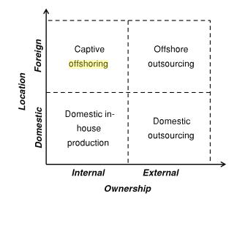
A simple framework of Offshoring and Outsourcing
On-shore
Source: Bals et al (2013), ‘Exploring Layers of Complexity in Offshoring Research and Practice’, in Pedersen et al (eds.) The Offshoring Challenge. Springer
Professor Teresa da Silva Lopes

Slide 31
The ‘Smile’ Curve of Global Value Creation
Professor Teresa da Silva Lopes

Slide 32
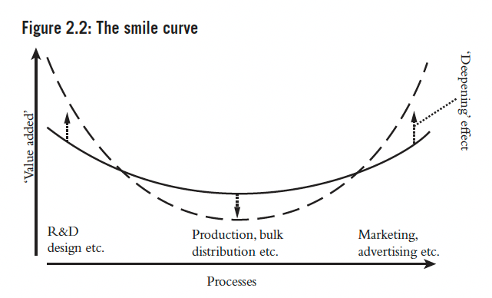
GVC and Aggravation of Inequality
Source: Palpacuer and Smith (2021)
Professor Teresa da Silva Lopes

Slide 33
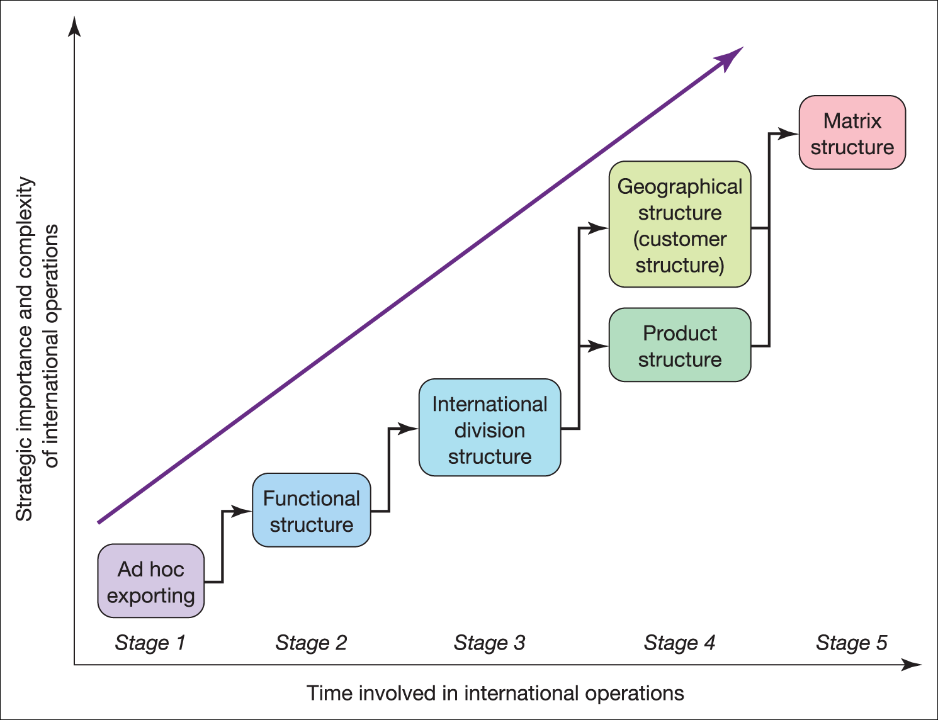
Figure 19.1 Structural evolution of international operations
Professor Teresa da Silva Lopes

Slide 34
Types of organisational structures for the internalisationalised firm
Rugman’s Competitive Advantage Matrix – Related Organisational Structures
Quadrant 1 – cost leadership
a centralised and hierarchical structure usually followed by firms in cell 1 pursuing economic integration
Quadrant 2 - exit
Quadrant 4 – differentiation (building brands, investing in marketing)
the strategy of national responsiveness may require a decentralized organizational structure
Quadrant 3 – cost Leadership or differentiation
it may be necessary to combine the advantages of both a centralized and decentralized organizational structure – matrix structure (complementary assets need to be combined)
Professor Teresa da Silva Lopes

Slide 35
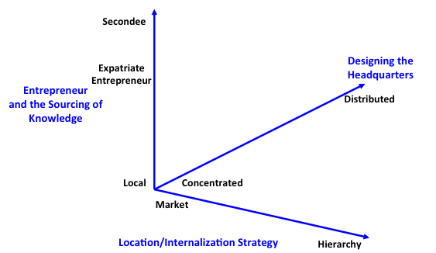
Extended Internalization Theory (Lopes, Jones, & Casson 2019)
Markets vs Hierarchies in international business (Buckley & Casson 1976)
+ design of headquarters (eg. ‘cloaking’ – hiding of assets)
+ role of entrepreneur (eg. expat entrepreneur)
Source: Lopes, Casson, Jones (2019)
Professor Teresa da Silva Lopes

Slide 36
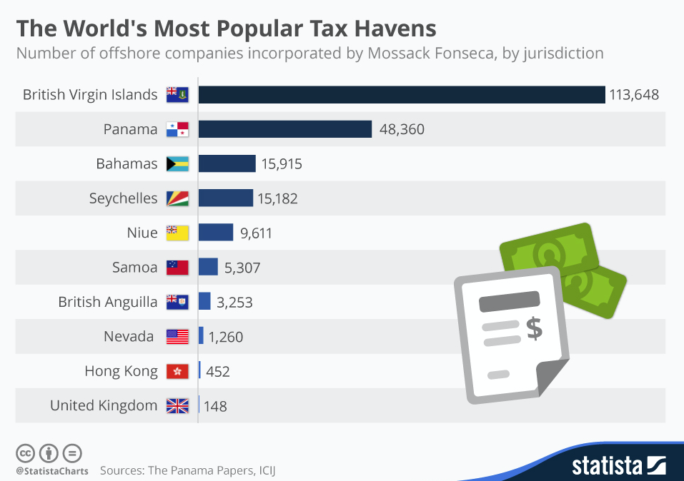
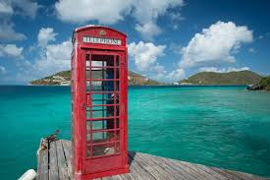
The historical significance of tax havens as a form of organizational innovation
Professor Teresa da Silva Lopes

Slide 37


