Slide 1

Global Business Strategy and Responsibility: Historical Perspecitves
Session 19
The Great Divergence and the Great Convergence
Professor Teresa da Silva Lopes

Slide 2
Learning Objectives
Session 19 - The Great Divergence and the Great Convergence
- When was the Great Divergence?
- Why did the Rest not catch up?
- Why has the Great Convergence happened?
Session 20 – Global Business Stratetegy and Responsibility: Historical Perspectives – A recap
Session 21 - Final Takeaways; Preparation for the Final Exam
Professor Teresa da Silva Lopes

Slide 3
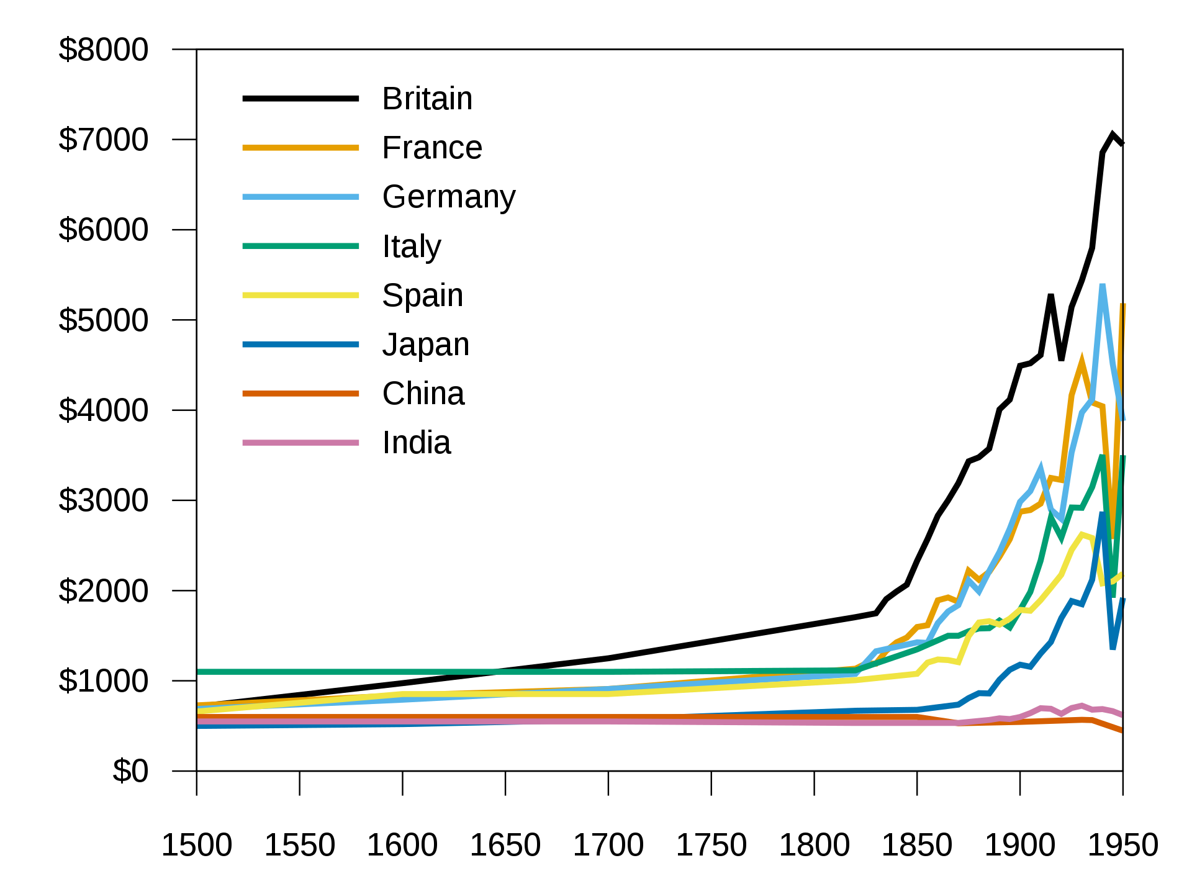
The ‘Great Divergence’
Source: Maddison’s Estimates od GDP per capita at purchasing power parity in 1990 international dollars for selected European and Asian nations 1500 - 1950

Slide 4
Origins of the Great Divergence
XVIII century - ‘Little Divergences’
- income levels already diverged: England and Low countries vs Italy and Spain; Japan vs China and India
- reflected trends which had begun at least 300 years earlier due to a variety of factors (agricultural system, fertility rates, flexibility of labour supplies, differences in state capacity)
XIX century – ’The Great Divergence: West and the Rest’
- early XIX century: divergence between Northern Europe (Britain, Netherlands, Belgium) and China, India, and Central and Southern Europe
- throughout the XIX century: much of the Western countries caught up with advanced North sea countries, the ‘Rest’ did not
- Latin American countries began converging from the 1870s
- Asia countries began converging from the 1890s
- Sub-Saharan Africa and Middle East began converging during the interwar years
Professor Teresa da Silva Lopes

Slide 5
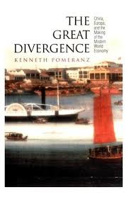
When the ‘Great Divergence’?
- Term ‘Great Divergence’ coined by Samuel Huntington (1996)
- used by Kenneth Pomeranz in his book ‘The Great Divergence’ (2000)
=> Pomeranz explanation:
. Great Divergence took place around 1800 (other consider it was earlier, c1750s)
. Capitalism takes shape more prominently then
(private ownership, market competition, profit maximization)
. Industrial Revolution take place:
- Europe - suffered from lack of energy and raw materials
=> developed industrial technology; colonization and
development of trade
- China and the East - rich in natural resources
Professor Teresa da Silva Lopes

Slide 6
Europe: A beacon of progress or a ruthless thief ?
Cultural Factors – Religion (Max Weber, 1905)
. European Calvinism (a branch of Protestantism) – encouraged thrifty and rational behaviour; concerned with material gain.
. ‘The Rest’ – material wealth not revered; entrepreneurship seen as subversive
Environmental factors (Jared Diamond, 1997)
. Highlights the role of geography, agriculture, and disease in shaping society
. Europe uniquely endowed with domesticable plants and animals
. Population immune to disease
. Access to cheap coal in England
. High wages relative to the price of capital
=> these led to higher productivity and higher population density
Professor Teresa da Silva Lopes

Slide 7
Europe: A beacon of progress or a ruthless thief? (cont.)
A ‘macabre’ twist (Gregory Clark, 2007)
. Diseases (smallpox, tuberculosis, malaria) picked off Britain’s poor residents
. Increasing genetic quality of population steadily contributed to technological innovation, entrepreneurship, leading to the industrial revolution
Critical Views - Economic, political, and historical factors (James Blaut, 1993)
. Europeans caused the ‘Great Divergence’ by plundering off and pillage of foreign lands – exploitation, colonialism, imperialism.
. Christopher Columbus (1492) landed in America and set off hundreds of years of colonialism
. Europe created unequal power relations: pulled in raw materials, currency and labour, and deliberately held back the rest of the world
Professor Teresa da Silva Lopes

Slide 8
Europe: A beacon of progress or a ruthless thief? (cont.)
Institutions and Legal factors – Invention of Freedom (Thomas Sowell, 2015)
. British institutions (rule of law, property rights, free markets) created an environment conducive to innovation, entrepreneurship and economic growth which led to the Industrial Revolution
Combination of multiple factors (Joel Mokyr, 1990)
. Development of ‘open science’ in the XVI century – helped spread economically useful ideas.
. Development of a business-friendly economy, with the reduction of the power of monarchs in Britain from the 1680s (less concern about profits being seized by the Crown).
. Separation of Europe into smaller independent states promoted a culture of innovation and resulted in faster development than unitary states like China.
. Development of institutions such as cities, bureaucracies and literate classes fostered economic growth and contributed to the ‘Great Divergence’.
Professor Teresa da Silva Lopes

Slide 9
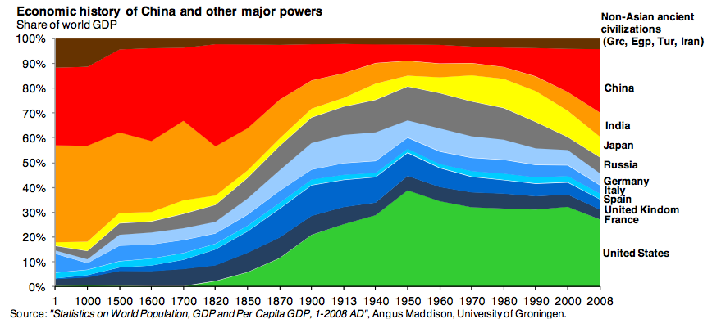
Notes:
.

Slide 10
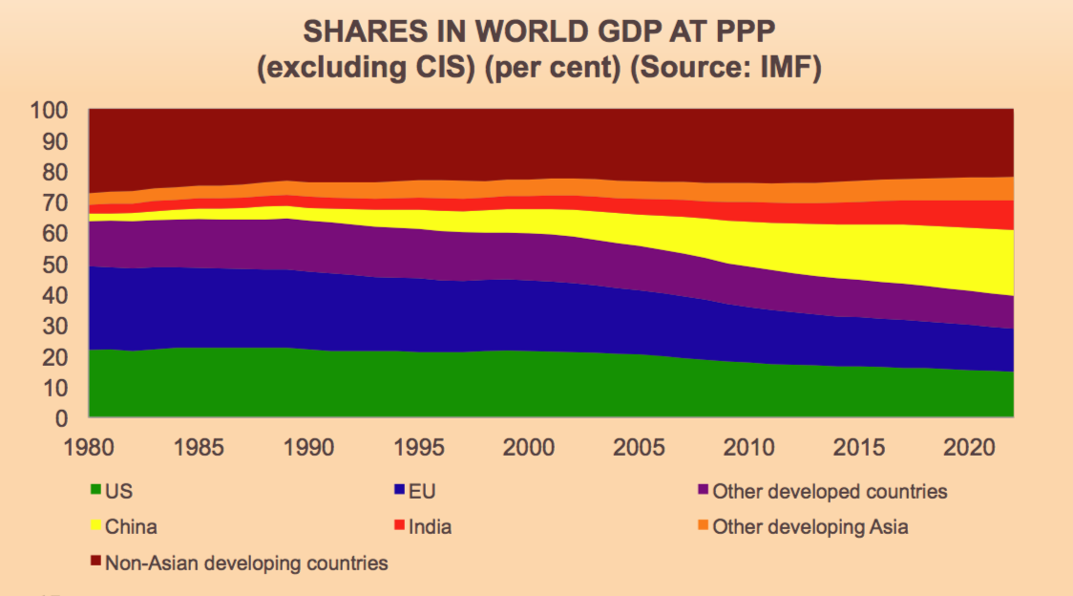
The Asian Convergence
Source: Financial Times

Slide 11
First Globalization Wave and the ‘Great Divergence’
. First Global Economy – international trade and FDI soars 1870-1914
. But most Western FDI in ‘Rest’ is in resources and services:
- highly ‘enclavist’ – limited transfer of knowledge and skills
- lock-in dependence on primary commodities,
- growth-retarding domestic institutions
- reinforced institutional constraints on domestic entrepreneurship
Limited diffusion of entrepreneurship and organizing capabilities from Western firms in the ‘Rest’.
Professor Teresa da Silva Lopes

Slide 12
‘Catching up’ after the Great Divergence
=> Why it took so long or the “Rest” of the world to catch up?
Context Matters
- Culture – West has the right culture for capitalist enterprise (Weber, 2011, Landes, 1998, Mokyr, 1990)
- Institutions – West has the right institutions to promote capitalist economic growth (North, 1990, 2005)
- Education (lack of literacy can create high costs for skilled labour; however, high levels of education in China never translated into entrepreneurship) (Easterlin, 1981)
- There is a lot of literature on the topic at macro economic level
- But what about the role of business?
Professor Teresa da Silva Lopes

Slide 13
The role of business in ‘The Great Convergence’
- Geography (market size, ) - creation of highly competitive ‘Modern’ enterprises has driven convergence
- Early import substitution/planning era 1945-1980 had a role
=> let’s local firms scale domestically; after 1980 let’s them globalize
(eg. Japan after 1945 - Nissan , Toyota; South Korea 1960 – Samsung)
- Liberalization policies toward foreign firms (eg. China)
- Disintegration of vertically integrated firms (M-Form) and development of Global Value Chains (outsourcing and alliances) provided emerging markets’ firms new opportunities
=> emerging markets were able to piggy-back (eg. Foxcoon(Taiwan) and Apple)
- Returning Diasporas as transferors of entrepreneurship, knowledge, capital and connections back into the home country firms (eg. India 1990s and China)
- Role of business schools and management consultants in advanced knowledge acquisition
- Role of governments in promoting catch up (eg. Chinese firms)
Professor Teresa da Silva Lopes

Slide 14
Ethnic Minorities and the ‘Great Convergence’
. Where were they from, and where were they going to?
Chinese in South-East Asia; Indians in east Africa; Lebanese in West Africa; Italians in Argentina; Italians and Chinese in Peru; and French in Mexico
=> they were intermediaries between locals and Western firms
. Reasons for Success
- Culture – they had particular ethical and working practices, very useful in societies where trust levels were poor, information flows inadequate, institutions weak, and capital scarce.
- Intermediary role – meant access to knowledge and information from and about Western countries.
- Some had unique cost accounting methods
Professor Teresa da Silva Lopes

Slide 15
Second Globalization Wave and the ‘Great Convergence’
Opportunities to catch up from the ‘Rest’
- firms from the ‘Rest’ had the chance to access global networks – and access knowledge and capital
- governments provided effective support for corporate catch-up.
The growth of powerful MNEs from the ‘Rest’ was an important driver for the ‘Great Convergence’:
Egs. Huawei (China), Foxcoon (Taiwan), Bimbo (Mexico), Concha yToro (Chile), Natura (Brazil), Tata Group (India), MTM (South Africa)
Professor Teresa da Silva Lopes

Slide 16
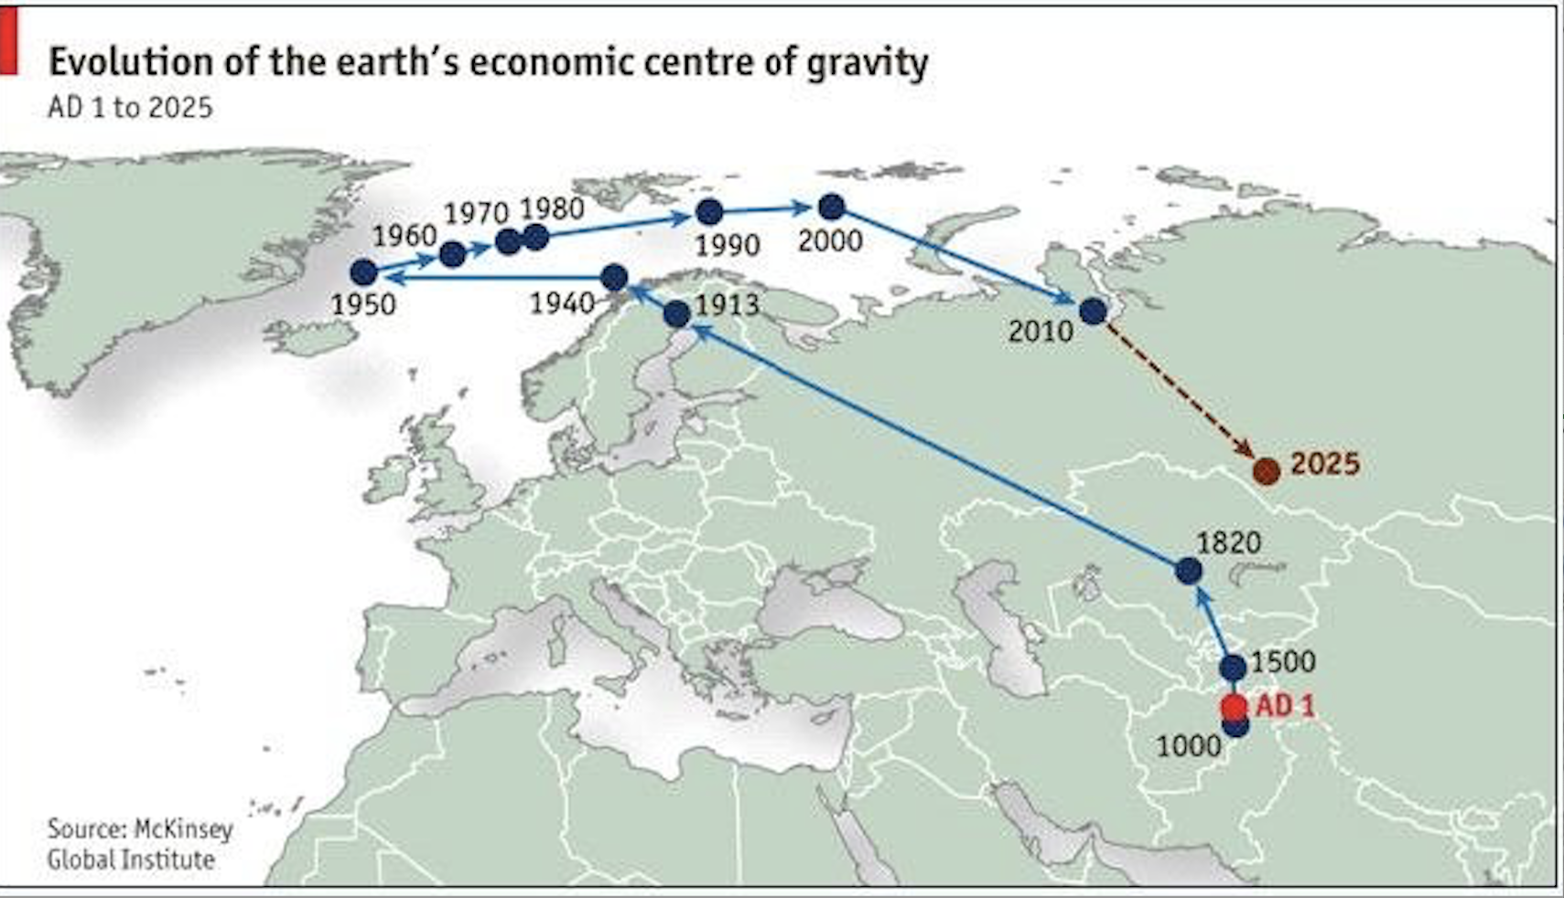
Evolution of the Earth Economic Centre of Gravity, AD1-2025
Professor Teresa da Silva Lopes

Slide 17
Session 19 – Main Takeaways
The Great Divergence and the Great Convergence
The ‘Great Divergence’ took place around 1800; only in the late XX century did the ‘Rest’ of the world start to catch up
There are different explanations for the ‘Great Divergence’ which involve different factors such cultural, institutional, economical, educational, or a combination of these.
While there are many studies about the ‘Great Divergence’ and the ‘Great Convergence’ which rely on macro factors, business has been less analysed and provides neu angles to explain why the ‘Rest’ of the world struggled to catch up, and why from the 1980s modern business enterprises based in emerging markets have grown very successfully.
The growth of outsourcing, diaspora links, the role of business schools and consultancies are important components of the story.
Professor Teresa da Silva Lopes

