Slide 1
Accounting
Basis for accounting, double entries

Slide 2
Agenda
Fundamentals of account
Double entry
From transaction to financial statements

Slide 3
The accounting is the process of recording financial transactions, meaning the exchange of money for goods and services. The most used method is called double entry bookkeeping.

Slide 4
Accounting is the recording of monetary transactions. These transactions might be recorded on a 1) cash basis or 2) accrual basis.
On a cash basis transactions are recorded in general ledger, the master book where transaction are booked, once cash receipts and cash payments are actually operated.
On an accrual basis of accounting, also known as mercantile basis, income and expenses are recorded once the firm has given or received benefit from a transaction, even if has not paid or received cash yet.
In December I paid for a service to be provided in the first days of next year
Cash basis: transaction is recorded in December when paid
Accrual basis: transaction is recorded in January NY when service is provided

Slide 5
In all business transactions there are two separate and distinct aspects to be recorded within the same accounting period. Two separate accounts are involved in each transactions: one records the debit (receiving), the other the credit (giving).
 | Debit | Receiver / Comes in
Transaction
 | Credit | Giver / Goes Out

Slide 6
Double Entry
Double entry is an accounting system already used by Arab merchants during VII century as far as it is known. This method has spread within merchants for centuries and several evidences of the application of this method came to us. The first treaty on double entry method has been attributed to an Italian Franciscan monk named Luca Bartolomeo de Pacioli born in Sansepolcro (Arezzo) during the XV century.
The method has been first created as a test to verify the correctness of the accounting, since, during XV century, accountants were easily wrong and had no instruments to check the adequacy of their records. During the same period has been introduced the use of the “journal” as evidence for the certainty of recording in case of controversy.
The monk, assistant of Leonardo da Vinci, wrote several principles that are still at the basis of the modern accounting methods. i.e. the words credit and debit come from the latin words debitum and creditum.

Slide 7
Double Entry
All transactions need to be recorded into the «journal». The journal, known as well as the book of original entries, is a daily record of business transactions where every posting is recorded first.
Progressive # | Entry date | Description | Account | Debit (Dr) | Credit (Cr)
1 | YYYY/MM/DD | Brief description of transaction to be recorded | Name of the account debited | XXX
 |  |  | Name of the account credited |  | XXX

Slide 8
Fundamentals of Accounts
The three rules of accounting are:
Debit the receiver and Credit the giver
Debit what comes in and Credit what goes out
Debit all expenses and Credit all gains and profits
The double-entry bookkeeping system is based on the principle that for every business transaction that takes place two entries must be made in the accounts:
a debit entry, showing goods or value coming into the business
a corresponding credit entry, showing goods or value going out of the business.

Slide 9
Rules of debit and credit
Increase in assets are debits and decrease are credits
Increase in liabilities are credits and decrease are debits
Increase in capital are credits and decrease are debits
Increase in expenses are debits and decrease are credits
Increase in revenues are credits and decrease are debits
Debit | Credit
Asset (+) | Asset (-)
Liabilities (-) | Liabilities (+)
Capital (-) | Capital (+)
Revenue (-) | Revenue (+)
Expenses (+) | Expenses (-)

Slide 10
Every entry in an account requires a corresponding and opposite entry in a different account. Every account, at the end of a period, could have more than one transaction that has been recorded in. All transactions are kept on the folios of the books, also named the ledger.
A ledger account is a summary of all transactions, showing the net effect of, related to a person, asset, income or expense that have taken place during a specific period.
In practice, separate ledgers are kept for different accounts.
The process of transferring the entries from journal to ledger is known as posting

Slide 11
15/01/2020 | Bank Account ### | 100
 | Trade Receivables |  | 100
18/01/2020 | Payables to employees | 200
 | Bank Account ### |  | 200
22/01/2020 | Bank Account ### | 300
 | Bank Account xxx |  | 300
Bank Account ###
Debit |  |  | Credit
Date | Desc. Of trans | Amount | Date | Desc. Of trans | Amount
15/01/2020 | Cash receipt | 100
 |  |  | // | // | //
// | // | //
Total Debit |  | 100 | Total Credit |  | -
Net Balance |  | 100
Bank Account ###
Debit |  |  | Credit
Date | Desc. Of trans | Amount | Date | Desc. Of trans | Amount
15/01/2020 | Cash receipt | 100 | 18/01/2020 | Payment of salary | 200
 |  |  | // | // | //
// | // | //
Total Debit |  | 100 | Total Credit |  | 200
Net Balance |  |  |  |  | -100
Bank Account ###
Debit |  |  | Credit
Date | Desc. Of trans | Amount | Date | Desc. Of trans | Amount
15/01/2020 | Cash receipt | 100 | 18/01/2020 | Payment of salary | 200
22/01/2020 | Transfer from xxx | 300 | // | // | //
// | // | //
Total Debit |  | 400 | Total Credit |  | 200
Net Balance |  | 200

Slide 12
Accounting recognition
ECONOMIC
(consumption of productive means and goods value)
NUMERIC
(increase/reduction cash/receivables/payables)
1
Each relevant transaction is measured through two perspectives
2
Chronologic criteria through
JOURNAL ENTRIES
Nature criteria through
LEDGER
1
Each relevant transaction is recorded according to
2

Slide 13
The ledger is then balanced in the view of preparing the financial statements for the company by:
Taking the total of the two sides
Calculating the sum of each side
Entering the difference in the lower column. The two sides are balanced. This process is known as carrying down the balances
The balance is then brought forward in the next period by posting it on the opposite side in the opening ledger.
31/12/2020 | Balance Sheet | 200
 | Bank Account ### |  | 200
01/01/2021 | Bank Account ### | 200
 | Balance Sheet |  | 200

Slide 14
Trial balance
After the completion of the posting the next step is the extraction of all balances on a statement named trial balance. Trial balance is a list of balances obtained from the ledger of accounts at a certain date, i.e. at the end of an accounting period.
Since the trial balance is the result of the sum of ledger of accounts, and these are obtained as a result of double entries posting, the total debit balance is to be equal to the total credit balance. At this stage all double entries have been completed thus debit and credit are only exposed and, if trial balance has no omissions, the debit is equal to credit.
If a mistake has taken place in posting, totaling and balancing the entries the two sides of trial balance will not tally. This means trial balance is an instrument of testing the adequacy of double entry posting before preparing the final accounts together with a easier way of summarizing accounts.
An example of mistakes could be omissions, typing error, error of principles, duplication, etc.

Slide 15
The financial statements
As part of the year-end closing, companies prepare the financial statements based on the country-specific regulation that applies.
Financial statements is the main source of information on the company business for the main stakeholders.
Starting from the trial balance, accounts are classified into the financial statements where they are aggregated according to their nature

Slide 16
Recording and representation of economic transactions
Economic Result
Cost /Revenues/
Results
Financial Statements
FLOWS
Investments and source of financing
Net Capital
STOCK
The financial statements reflect the income and capital of a company dividing the productive life into periods

Slide 17
The accrual principle of preparing the FS
The accrual criteria:
Difference with time events
Every element that has a direct economic correlation should be represented in the FS
SCELTA EFFETICATA
Economic Elements
Costs
Consumption of productive factors
Revenues
Value of products sold
Consumed productive factors
Correlation between costs and revenues
To realize (inventory) or sell products (sales)
8

Slide 18
Financial Statements
Financial
Statements
Balance Sheet
Profit & Loss
Numeric impact
Economic impact
BS
P&L
Assets
Investment in productive factors
Liabilities /Equity
Way of financing
Expenses
Consumption of productive factors
Revenues
Value of products sold or realized
Stock
Working capital
Flow
Result of the period
9

Slide 19
Purchase of goods | 100
Account payables |  | 100
The company X buys goods against credit
The company Y sells goods against credit
The Company Y receives cash for the transaction above
Account receivables | 200
Sales of goods |  | 200
Cash | 200
Account receivables |  | 200
Purchase of goods
100
Account payables
 | 100
Account receivables
200
Sales of goods
 | 200
Cash
200
Account receivables
 | 200

Slide 20
Purchase of goods
100
Account payables
 | 100
Account receivables
200 | 200
Sales of goods
 | 200
Cash
200

Slide 21
Purchase of goods
100
Account payables
 | 100
Cash
200
Sales of goods
 | 200
Balance Sheet
Assets | 200 | Liabilities | 100
Current assets | 200 | Current liabilities | 100
Cash | 200 | Account payables | 100

Slide 22
Purchase of goods
100
Account payables
 | 100
Cash
200
Sales of goods
 | 200
Income statement
Revenues | 200
Sales of goods | 200
Expenses | 100
Purchase of goods | 100
Result of the year | 100

Slide 23
The FS closing process
Events that have external relevance
Recorded through double entry bookkeeping system (every event is analyzed from two sides) and using ledgers
Set of events during a period
Accounting report prepared based on time
Passage from a time based reporting method to an economic one
Income result and working capital
FS prepared based on the accrual accounting principle

Slide 24
On 01/12/2020 X bought three months maintenance services from Y paying 300
Purchase of maintenance | 300
Account payables |  | 300
The service will be rendered from 01/12/2020 to 28/02/2021. What about the situation at 31/12/2020? Are all the services to be accrued in 2020?
Deferred expenses | 200
Purchase of maintenance |  | 200

Slide 25
From a time basis to an accrual basis
Expenses
Transaction from a «picture» of productive factors purchased (immediate consumption of multiannual) to consumed productive factors
Revenues
Transaction from the «picture» of value of goods sold to the value of products sold and realized
SCOPE
Correlation (MATCHING PRINCIPLE)
Recording (time principle) of events until a defined period (accounting report)
Integration to the accounting report of relevant events that had not an external occurence
Method

Slide 26
Determine the income of the period
Expenses and revenues realized but with a financial occurence in a different period numeraria esercizio diverso
Adjustments in addition
Invoice to be received/issued
Prepayments/advances
Wages to be paid or employees benefits
Gain or loss on currencies
TAX
Expenses and revenues with a financial occurence but not an economic occurence
Adjustments in reduction
Expenses capitalized
Inventories
Valuation of assets
Values considerations
Modification of value of assets
Depreciation
Devaluation
PPE/Intangibles/Financial assets
AR
Provision for future expenses or risks
Provision for future
expenses to be
sustained
Provision for risks
Uncertain amount &/or time of occurence
9

Slide 27
On 01/12/2020 X bought three months maintenance services from Y the payment is done on 28/02/2021 for 300
The service will be rendered from 01/12/2020 to 28/02/2021. What about the situation at 31/12/2020? Are all the services to be accrued in 2020?
Dec 20
Purchase of maintenance IS | 100
accrued expenses BS |  | 100
Jan 21
accrued expenses BS | 100
Purchase of maintenance IS |  | 100
Feb 28, 21
Purchase of maintenance IS | 300
Account payables BS |  | 300

Slide 28
Financial statements, known also as final accounts, according to IFRS is the document composed by the following statements:
Statement of financial position, also known as balance sheet
Statement of comprehensive income, also known as income statement
Statement of cash flow
Statement of change in equity
Explanatory notes
Please note that structure of financial statements could be different according to different GAAP

Slide 29
Statement of financial position
The statement of financial position, or balance sheet, is the statement that shows the value of the company’s assets and liabilities at a particular point in time.
It represents the capital owned by the company and owed to company’s creditors. What you own is called Assets. What you owe is called Liabilities
The net worth, called also equity, is the difference between asset and liabilities and approximate the net value of the firm.
In the balance sheet are represented stock values at a specific point in time.

Slide 30
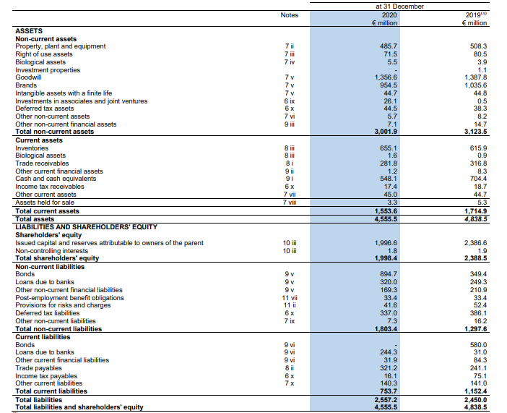

Slide 31
Statement of comprehensive income
The statement of comprehensive income, known also as income statement, shows the revenue, expenses and net income of a firm over a period of time.
It represents the result of the business during a specific interval represented trough different subtotals in order to represent different faces had incidence on business.

Slide 32
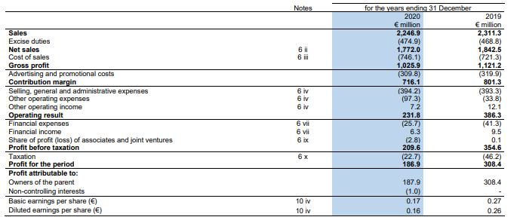

Slide 33
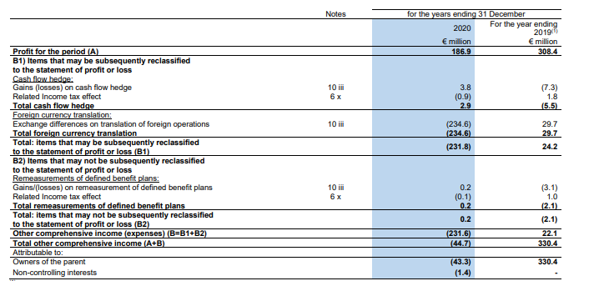

Slide 34
Statement of cash flow
The statement of cash flow represents the company’s cash receipts and cash payments made over a period of time.
It is represented in order to analyze the different influences of business on cash.

Slide 35
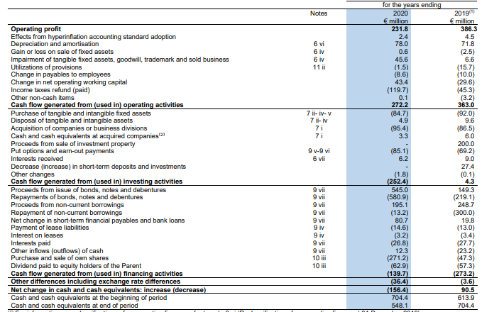

Slide 36
Statement of change in equity
The statement of change in equity gives a representation of the main events gave rise to a change in the net worth of the company.
In the change in equity is represented the result of the period that allows balancing the balance sheet.

Slide 37
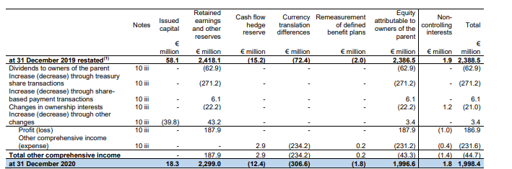

Slide 38
Explanatory notes
The financial statements are to be accompanied by the explanatory notes that clarify the applied material accounting principles, the main estimates made by management in preparing the financial statements, the main accounting policy, and give a deeper understanding of the main events of the year that impacted the business as well as the expectations for the future results that influenced the preparation of the financial statements.
Information to be reported in the explanatory notes are defined according to different regulations and GAAP.

Slide 39
Let’s think at your business as a fruit bearing tree. The results of your business are represented by the harvest of the year. Each year this result is reset and the yield is stored into a warehouse. The tree to be productive needs a robust trunk and after storing the results of the year this trunk become larger and larger. To be productive the tree needs also water.
In the same way the results of your business are represented in the income statement. Every year this is reset and start from zero. The results of the year are reopened into the equity as retained earnings. The more results are retained into the equity the more the balance sheet will be robust to substain the business in the long haul. To run the business you need cash. The statement of cash flow measures how many cash you “consumed” in your business.

