Slide 1
Accounting
Balance Sheet: Intangibles and Investments

Slide 2
Agenda
Intangible assets
Determination and classification of assets
Financial assets

Slide 3
Intangible Assets
An intangible asset is:
an identifiable non-monetary asset without physical substance. Such an asset is identifiable when it is separable, or when it arises from contractual or other legal rights.
The use within the business of intangible assets is similar to that of property, plant and equipment
Example of intangibles are:
Software
Trademarks
Customer lists
Licenses
Patent rights
Etc.

Slide 4
Intangible Assets
IAS 38 is applied to every intangible asset except to:
goodwill (IFRS 3)
financial assets (IFRS 9)
deferred tax assets (IAS 12)
assets held for sale (IFRS 5)
Assets arose from the operation in specific industries that requires the application of special principles.

Slide 5
It is sometimes hard to recognize an intangible assets because of its dependency to a material asset (let’s think to a software of a computer). In these cases is important to understand the relevance of the intangible assets compared to the tangible part. If linked to tangible assets which value and relevance is more important than intangible assets these should not be recognized as a separate one.
Separability is not a necessary condition for the intangible assets to be recognized in the balance sheet. It’s enough the asset to be separately identifiable. I.e. I could buy for a server and a separate firmware necessary to allow server to be connected. Firmware could not be separate by server (it wouldn’t work) but as this has an economic value and specific features this is separately identifiable.
IAS 38 par 13 specify that an entity should record for an intangible asset when it has the control, meaning when the company has the power to obtain future economic benefits from the use.
Future economic benefits are (par.17) revenues from the sales of products or services (I bought a patent for a new product), saving of costs (I bought a software for the efficiency of production lines) or other benefits deriving from the use of the asset within the business (I bought a certification for recycling, improving the social perception from market).

Slide 6
IAS 38 requires an item could be recognized as intangible assets only if cost might be reliably determined and is likely that future economic benefits linked to the asset will be hold by the company.
Is not allowed to recognize within the intangible assets costs related to research. These costs are to be recorded in the profit and loss.
An intangible asset arising from the development phase of an internal project must be recognised if, and only if, an entity can demonstrate all of the following:
the technical feasibility of completing the intangible asset so that it will be available for use or sale.
its intention to complete the intangible asset and use or sell it.
its ability to use or sell the intangible asset.
how the intangible asset will generate probable future economic benefits. Among other things, the entity can demonstrate the existence of a market for the output of the intangible asset or the intangible asset itself or, if it is to be used internally, the usefulness of the intangible asset.
the availability of adequate technical, financial and other resources to complete the development and to use or sell the intangible asset.
its ability to measure reliably the expenditure attributable to the intangible asset during its development.

Slide 7
On february 15 2020 a Company buys a software at a price of Euro 10.000.
IN | Software | 10.000
IN | VAT on purchases (22%) | 2.200
OUT | Payables to B |  | 12.200
 | Balance Sheet
Asset |  | Equity | -
Fixed Assets | 10.000 | Liabilities | 12.200
Intangibles | 10.000
Working Capital | 2.200
Other AR | 2.200
TOTAL ASSETS | 12.200 | Total Liabilities & Equity | 12.200
Software
10.000
10.000
Payables to B
 | 12.200
 | 12.200
VAT on purchases
2.200
2.200

Slide 8
On January 4 2020 a Company buys a tablet at a price of Euro 800. Tablet incorporates a firmware that is not separable and has not economic value as this could not be bought separately. Even more the value of firmware is insignificant if compared to tablet. For these consideration firmware, even if identifiable (you know it exists), is not accounted separately.
IN | Tablet | 800
IN | VAT on purchases (22%) | 176
OUT | Payables to B |  | 976
Tablet
800
800
VAT on purchases
176
176
 | Balance Sheet
Asset |  | Equity | -
Fixed Assets | 800 | Liabilities | 976
Tangibles | 800
Working Capital | 176
Other AR | 176
TOTAL ASSETS | 976 | Total Liabilities & Equity | 976
Payables to B
 | 976
 | 976

Slide 9
Recognition
The cost of intangible assets shall be recognized as an asset if, and only if:
it is probable that future economic benefits associated with the item will flow to the entity; and
the cost of the item can be measured reliably.
An entity shall assess the probability of expected future economic benefits using reasonable and supportable assumptions that represent management's best estimate of the set of economic conditions that will exist over the useful life of the asset.
An entity uses judgement to assess the degree of certainty attached to the flow of future economic benefits that are attributable to the use of the asset on the basis of the evidence available at the time of initial recognition, giving greater weight to external evidence.
An intangible asset shall be measured initially at cost.

Slide 10
Measurement after initial recognition
IAS 38 provides two accounting models to evaluate the intangible assets:
Cost model: after recognition as an asset shall be carried at its cost less any accumulated depreciation and any accumulated impairment losses;
Revaluation model: which consists in evaluating the asset at its fair value less any accumulated depreciation and any accumulated impairment losses. Fundamental assumption is an active market exists. For this reason this model is not largely used.
  Revaluation model does not allow to:
    Evaluate intangible assets not previously accounted as assets;
    To recognize the asset at a value greater than its cost
  If an intangible asset is revaluated, cumulated depreciation at the date of revaluation are:
    Proportionally recalculated to adapt to the revalued lord value of the asset;
    Eliminated against the lord value of the asset.

Slide 11
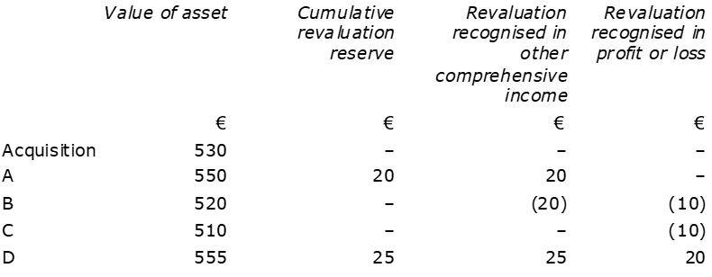
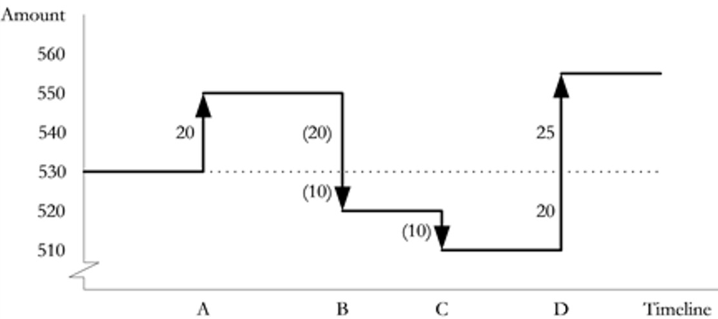
The revaluation of an intangible assets should be written within the other comprehensive income. The loss of fair value should be booked in the profit and loss unless this loss is subsequent to a previous revaluation accounted to the equity. In this last case loss should be booked in reduction of this equity reserve.
The FV reserve is transferred to profit and loss when realized (sold or used)

Slide 12
A) | IN | Asset | 20
 | OUT | Cumulative Revaluation Reserve (OIC) |  | 20
B) | IN | Devaluation (PL) | 10
 | IN | Cumulative Revaluation Reserve (OCI) | 20
 | OUT | Asset |  | 30
C) | IN | Devaluation (PL) | 10
 | OUT | Asset |  | 10
D) | IN | Asset | 45
 | OUT | Revaluation (PL) |  | 20
 | OUT | Cumulative Revaluation Reserve (OCI) |  | 25

Slide 13
Depreciation of intangible assets
IAS 38 distinguishes between asset with defined useful life, regularly depreciated, and undefined useful life, subject to annual impairment test.
IAS 38 specifies an intangible asset with undefined useful life has not to be depreciated.
According to IAS 36, a company has to verify if an intangible with indefinite useful life has maintained its value comparing its carrying amount with its recoverable amount. To determine if an asset has recognized a loss in its value you must apply IAS 36.
A software is reliably giving its benefits for a defined period after that is considered obsolete and no more useful for the company.
In the other hand is not easy to determine the useful life of goodwill or trademarks (with some exceptions)

Slide 14
Depreciation of intangible assets
The depreciation charge for each period shall be recognised in profit or loss.
The depreciable amount of an asset shall be allocated on a systematic basis over its useful life.
The residual value and the useful life of an asset shall be reviewed at least at each financial year-end and, if expectations differ from previous estimates, the change(s) shall be accounted for as a change in an accounting estimate in accordance with IAS 8
Depreciation of an asset begins when it is available for use, ie when it is in the location and condition necessary for it to be capable of operating in the manner intended by management. Depreciation of an asset ceases at the earlier of the date that the asset is classified as held for sale and the date that the asset is derecognised.
The useful life of an asset is defined in terms of the asset's expected utility to the entity.

Slide 15
Depreciation
Company XXX purchased a software for Euro 10.000 with an estimated useful life of 5 years. Depreciation is then calculated in Euro 2.000 (10.000 / 5 Years)
After 1 year
Software (BS)
10.000
10.000
IN | Depreciation of software | 2.000
OUT | Depreciation fund - software |  | 2.000
Depreciation fund (BS)
 | 2.000
 | 2.000
 | 4.000
IN | Depreciation of software | 2.000
OUT | Depreciation fund - software |  | 2.000
Depreciation of soft (P&L) 1st Y
2.000
2.000
Depreciation of sft (P&L) 2nd Y
2.000
2.000

Slide 16
Depreciation
At the end of the year, when the company is to prepare its financial statements, it needs to classify those accounts into class of accounts. We said that after recognition as an asset shall be carried at its cost less any accumulated depreciation and any accumulated impairment losses Thus in the balance sheet software are to be reported net of the accumulated depreciation:
 | Balance Sheet
Asset | 6.000 | Equity | 6.000
Fixed Assets | 6.000 | Liabilities | -
Intangibles | 6.000
Software | 6.000
TOTAL ASSETS | 6.000 | Total Liabilities & Equity | 6.000

Slide 17
Depreciation methods
These are the same provided by IAS 16. Remind these are:
Straight line
Diminishing balance
Units of production
Historical cost | Y1 | Y2 | Y3 | Y4 | Y5
100 | 20 | 20 | 20 | 20 | 20
 | Y1 | Y2 | Y3 | Y4 | Y5 | …
Book Value | 100 | 80 | 64 | 51 | 41 | …
Depreciation (20%) | 20 | 16 | 13 | 10 | 8 | …
 | Y1 | Y2 | Y3 | Y4 | Y5
Produced Units | 50 | 100 | 200 | 200 | 150
Depreciation | 8 | 14 | 28 | 28 | 22

Slide 18
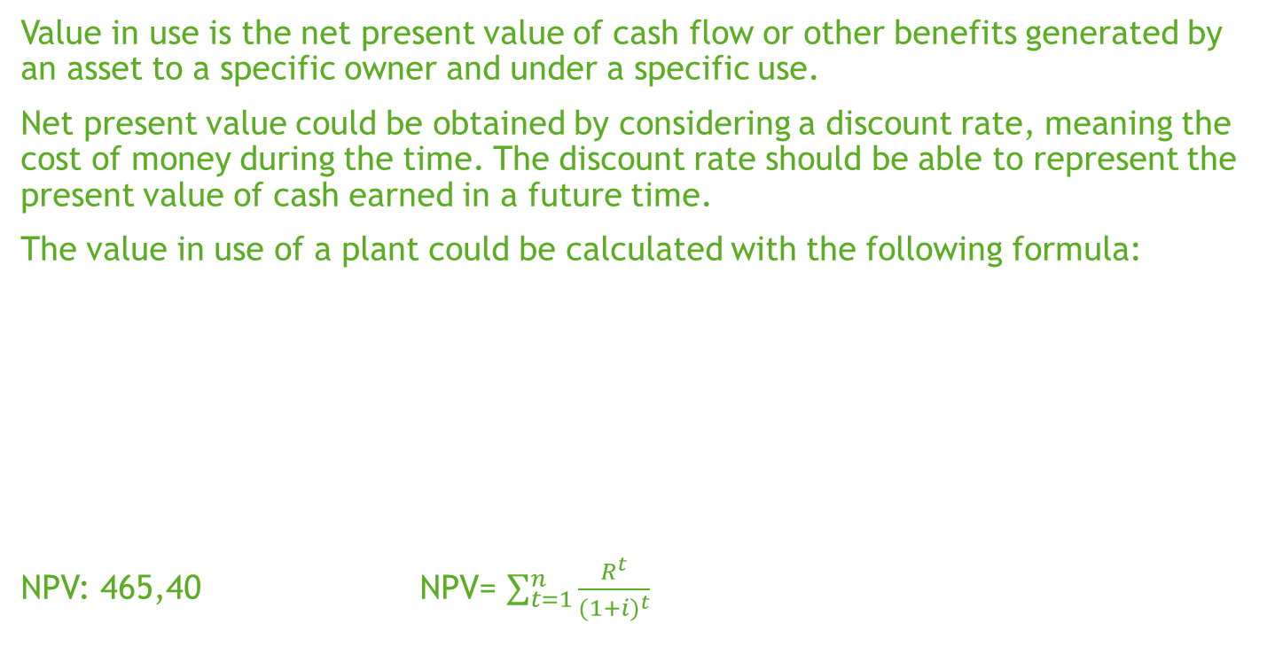
Value in use
Value in use is the net present value of cash flow or other benefits generated by an asset to a specific owner and under a specific use.
Net present value could be obtained by considering a discount rate, meaning the cost of money during the time. The discount rate should be able to represent the present value of cash earned in a future time.
The value in use of a plant could be calculated with the following formula:
NPV: 465,40 NPV= $\sum_{t=1}^{n}{\frac{R^{t}}{{(1+i)}^{t}}}$
Historical cost | Y1 | Y2 | Y3 | Y4 | Y5
Cash Flows | 100 | 120 | 140 | 140 | 120
Discount rate | 10% | 10%^2 | 10%^3 | 10%^4 | 10%^5
Discounted Flows | 90,9 | 99,2 | 105,2 | 95,6 | 74,5

Slide 19

Impairment of intangible assets
Example:
Carrying amount of intangibles: 105
Net selling price
Sales price: 110 - Cost of Disposal: 15 = Net sale price: 95
Value in use
Estimated future cash flows per year: 55, 60
Discount rate: 10%
Fair value less cost to sell:110-15= 95
Value in use: 100 (55/1,10+60/1,10^2)
Acc. Depreciation 15
Historical Cost 120
Recoverable amount: 100
Impairment: 5

Slide 20
Impairment of assets
IN | Impairment of assets (PL) | 5
OUT | Intangible asset (BS) |  | 5
Impairment of assets (P&L) 1st Y
5
Intangible Asset
120 | 5
115
Acc. Depreciation
 | 15
 | 15
 | Balance Sheet
Asset | 100 | Equity | 100
Fixed Assets |  | Liabilities | -
Intangibles | 100
Software | 100
TOTAL ASSETS | 100 | Total Liabilities & Equity | 100

Slide 21
Derecognition
The carrying amount of an intangible asset shall be derecognised:
on disposal; or
when no future economic benefits are expected from its use or disposal.
The gain or loss arising from the derecognition of an intangible shall be included in profit or loss when the item is derecognised.
The date of disposal of the intangible is the date the recipient obtains control of that item in accordance with the requirements for determining when a performance obligation is satisfied in IFRS 15.

Slide 22
Derecognition
Sale at a price of 5.000 + VAT (22%) 0
Software
10.000
10.000
Acc. Depreciation
 | 4.000
 | 4.000
IN | Receivables | 6.100
IN | Acc. Depreciation | 4.000
IN | Loss on Sale (PL) | 1.000
OUT | VAT on sales (22%) |  | 1.100
OUT | Software |  | 10.000
Software
10.000 | 10.000
// | //
Acc. Depreciation
4.000 | 4.000
// | //

Slide 23
Derecognition
No future benef. Future value :0
Software
10.000
10.000
Acc. Depreciation
 | 4.000
 | 4.000
IN | Acc. Depreciation | 4.000
IN | Loss on Sale (PL) | 6.000
OUT | Software |  | 10.000
Software
10.000 | 10.000
// | //
Acc. Depreciation
4.000 | 4.000
// | //

Slide 24
IAS vs OIC
In Italy intangibles are accounted according to OIC 24. OIC 24 is related to the accounting of:
  Pluriannual costs;
  Intangibles goods;
  Both internal and external costs related to intangible assets;
  Goodwill
1) Thus the class of intangible assets as defined by OIC 24 is wider than IAS 38 as it includes pluriannual costs (i.e. cost related to the establishment of the company as i.e. registration to chambers registers) not allowed by IFRS, as no direct future economic benefits are related to these costs.
2) Italian principles does not allow the revaluation model. Revaluation is possible only in connection with special laws.
3) Italian GAAP don’t recognize undefined useful life assets. All intangible assets are to be depreciated.

Slide 25
Goodwill
Goodwill refers to the difference between the total value of a business and the value of its net assets. It represents the ability of the business to generate future cash flows that are not represented in the balance sheet of the acquired. The value of goodwill is often only determined when a business is bought or sold.
Goodwill is initially measured at cost. After initial recognition, goodwill is measured at cost less any accumulated impairment losses. For the purpose of impairment testing, goodwill acquired in a business combination is, from the acquisition date, allocated to a Group’s cash-generating units (CGU).
A CGU is the smallest identifiable group of assets that generates cash inflows that are largely independent of the cash inflows from other assets or groups of assets. I.e. within a Company it could be identifiable more than one CGU depending on geographies (CGU America vs Europe), lines of products (CGU Jewels vs Accessories), type of business (CGU Distribution vs Commercial).

Slide 26
Goodwill
The Company X, that is a longlasting company in the business of bags, is buying a set of assets from a Company Y, an emerging company in the productions of innovative leathers. The carrying amount of purchased assets is Euro 50.000. The price paid by X is 80.000.
After tried allocating this paid extra value on purchased assets X concluded this is not identifiable as a higher value of any of those assets, but should be seen as the capability of the entire set of assets to produce future benefits. The purchase of assets gave origin to a goodwill of Euro 30.000.
In other words, those assets separately, are not able to produce the same future cash flows than when considered together.

Slide 27
Goodwill
 | Company Y
 | Balance Sheet
Asset | 100 | Equity | 50.000
Fixed Assets | 80.000 | Liabilities | 50.000
Inventories | 20.000
TOTAL ASSETS | 100.000 | Total Liabilities & Equity | 100.000
IN | Fixed Assets | 80.000
IN | Inventories | 20.000
IN | Goodwill | 30.000
OUT | Liabilities |  | 50.000
OUT | Payables to Y |  | 80.000

Slide 28
Goodwill
 | Company X
 | Balance Sheet
Asset |  | Equity | -
Fixed Assets | 80.000 | Liabilities | 130.000
Intangible Assets | 30.000
Inventories | 20.000
TOTAL ASSETS | 130.000 | Total Liabilities & Equity | 130.000
Here is the representation of the purchased assets in the BS of the Company X. Only for simplification are not being represented the other components of the BS for the Company X.
Goodwill is accounted within the intangible assets and its recoverability is verified at each subsequent closing date through impairment test.

Slide 29
Investments
Investments are representative titles of rights over cash flows of an owned company. When a company owns another entity or part of it, in its balance sheet is to be represented the value of title.
This should be represented through fixes assets, if investment is oriented to retain in the company for long time, or through working capital, if the investment is not durable.
Based on the percentage of possession and on the influence the investor has over the investee, the investments might be classified as:
Subsidiaries;
Joint control/joint operations
Associate
Others
These are accounted according to different accounting principles

Slide 30
Investments
Entities can acquire shares in another entity (e.g. investment) for many purposes (trading, held to maturity).
Where no particular relationship exists with the investee, the investor has acquired financial instruments that fall in the scope of IFRS9;
Where the investment gives the investor a significance influence over the investee, the investee is called associate and the investment is normally accounted using the equity method.
The equity method is a method of accounting whereby the investment is initially recognized at cost and adjusted thereafter for the post-acquisition change in the investor’s share of the net assets of the investee.

Slide 31
Investments
Where the influence increases to give the investor the control over the investee (definition of control is in IFRS10) the accounting will depend on whether:
Control is obtained due to a joint arrangement (Joint operation or Joint Venture) and IFRS 11 is applied
Where the investor exercises control on its own over the investee, the investor apply IFRS10 and prepare consolidated financial statements.
The definition of controls over a company is contained in the IFRS 10. According to IFRS you have control over a company when you’re able to influence its business through votes, agreements or other facts and circumstances.

Slide 32
Investments
Subsidiary
A subsidiary is an investee on which the investor has the control.
These could be evaluated at costs, equity method or at FV according to IFRS 9.
This last accounting is only referred to the case the holding company is an investing company (the investment is held to trade on its value).
When an investment is evaluated at cost means that its value corresponds to the purchase cost. This value is then subsequently verified to measure the recoverable amount through impairment test.
The equity method provides that the cost of the investment is integrated or diminished according to the share of equity own by the investor.

Slide 33
Investments
Investments in associates
An associate is an entity over which a Company has significant influence. Significant influence is the power to participate in the financial and operating policy decisions of the investee, but is not control or joint control over those policies. Is an investment in associates a participation to the 20% of shares of capital of a company that allows the shareholder nominating one member of the BoD without having the majority of votes.
Significant influence is usually evidenced by one of the following non exhaustive ways
Representation on the board of directors
Participation in policy making processes (including decisions about dividends)
Material transactions between the investor and the investee
Interchange of management personnel
Provision of essential technical information
Where the investment gives the investor a significance influence over the investee, the investee is called associate and the investment is normally accounted using the equity method.
The equity method is a method of accounting whereby the investment is initially recognized at cost and adjusted thereafter for the post-acquisition change in the investor’s share of the net assets of the investee.

Slide 34
Investments
Joint ventures
A joint venture is a type of joint arrangement whereby the parties that have joint control of the arrangement have rights to the net assets of the joint venture. Joint control is the contractually agreed sharing of control of an arrangement, which exists only when decisions about the relevant activities require the unanimous consent of the parties sharing control. Is a joint venture an agreement between two entities that regulates the participation in a company of equal parts (50%) which rights and obligations are defined by clauses.
Investments, other than non significant influence investments, are to be recognized at cost or at the Fair Value according to IFRS 9.
Every year the value of the investments is to be verified comparing its carrying amount to the recoverable amount.
The recoverable amount of the investments might be represented by the market value, if company is public, or the value in use of the company based on expected future cash flows.

Slide 35
Investments
Entities can acquire shares in another entity for many purposes (trading, held to maturity).
Where no particular relationship exists with the investee, the investor has acquired financial instruments that fall in the scope of IFRS9.
Within the scope of IFRS9 you distinguish between:
Those which changes in value are classified within the OCI: the aim of the company is to sell the investments together with the conditions provided by the IFRS9 for the financial instruments (these are mostly related to financial and contractual terms);
Those which changes in value are classified within the P&L: this is a residual category which applies only when the conditions provided by IFRS9 are not met. Then, even if conditions are not met the company might decide to account changes in the OCI as well (as conditions were met). In this case this choice, made up at the inception, could no more be changed.

Slide 36
Investments
Here below are summarized the different accounting methods provided by IAS in a separate FS
Classification
Substantive criterion
% voting rights
Accounting Treatment
Standard
Subsidiary
Control
>50%
Consolidation
IFRS 10
Joint venture
Joint operation
Joint control
N/A
Equity method
Proportionate
IFRS 11
IAS 28R
Associate
Significant
influence
20%-50%
Equity method
IAS 28R
Other equity
investments
No significant
influence
<20%
Fair value in
P/L or equity
IFRS 9

Slide 37
Investments
We represent the different accounting treatment for an investment in the company A which presents the following BS
 | Company A
 | Balance Sheet
Asset |  | Equity | 50.000
Fixed Assets | 80.000 | Liabilities | 50.000
Inventories | 20.000
TOTAL ASSETS | 100.000 | Total Liabilities & Equity | 100.000

Slide 38
Investments
Cost Method
The Company X helds the 100% of shares in the investment A purchased at a price of Euro 80.000
To be verified annually for recoverability (impairment test)
IN | Investment in A | 80.000
OUT | Cash |  | 80.000
At the purchase date

Slide 39
Investments
Equity Method
The Company X purchased the 20% of shares in the investment A. The initial investment in A was 20.000
IN | Investment in A | 20.000
OUT | Cash |  | 20.000
At the purchase date
IN | Equity reserve | 10.000
OUT | Investment in A |  | 10.000
At the first reporting date

Slide 40
Investments
Fair Value
The Company X purchased the 2% of shares in the investment A. The initial investment in A was 2.000
IN | Investment in A | 2.000
OUT | Cash |  | 2.000
At the purchase date
IN | Investment in A | 100
OUT | Equity reserve |  | 100
At the first reporting date
The investment is evaluated at FV. At the reporting date the FV of investment in company A, which is public traded, is Euro 105.000. As a consequence the Company X recognized an increase the value of the investment of Euro 100 (5.000 * 2%).

Slide 41
Investments
The calculation of VIU is based on the following cash flows:
Terminal value (TV) expresses the value of the company beyond the explicit period of the plan. Actually companies have difficulties in estimating the free cash flows of an asset beyond an explicit period of 3-5 year. Thus approximate the free cash flow of the last explicit year to be infinitely projected based on a defined growth rate and then discounted by WACC.
Year | 1 | 2 | 3 | TV
Cash Flows | 10.000 | 12.000 | 6.000 | 6.000
Discount Rate | 8% |  |  | WACC 8% G-rate 1%
Discounted Flows | 9.259 | 10.288 | 4.763 | 63.633
NPV | 87.950

Slide 42
Investments
The impairment test over the investment reports a loss or Euro 12.050 to be written by Company
IN | Impairment loss | 12.050
IN | Investment in YYY |  | 12.050
Investment in YYY
100.000 | 12.050
87.950

Slide 43
Investments
There are no significant difference between IFRS and OIC with reference to investments. The only important difference is related to impairment, not systematically provided by OIC. OIC 9 provides you need to verify if a durable loss in value of assets is present. Only when loss is considered to be durable you need to recognize the minor value.

