Slide 1
Accounting
Balance Sheet: Trade receivable

Slide 2
Agenda
Trade receivable
Determination and classification of assets
Impairment of AR
Factoring

Slide 3
Receivables
Receivables represent the right to receive a certain amount of cash or cash equivalent. It is the title giving the right to perceive future cash flow.
Receivables are ruled by IFRS 15 and IFRS 9.
Receivables includes all money claims against other people, companies and other organizations.
Receivables that result from the sales of goods or service might be called trade receivables or account receivables.
Trade receivables are classified in the balance sheet within the current assets and form part of the working capital. The classification of account receivables within current assets is because of these are normally collected within a short period (less than 12 months).
If collection of trade receivables is expected to be beyond 12 months these are classified within non-current assets.

Slide 4
Receivables
Receivables might be recorded also against a transaction different from a sale of goods and service. Example of receivables are:
Advances to officers and employees.
Advances to subsidiaries.
Deposits to cover potential damages or losses.
Deposits as a guarantee of performance or payment.
Dividends and interest receivable.
Claims against:
  Insurance companies for casualties sustained.
  Defendants under suit.
  Governmental bodies for tax refunds.
  Common carriers for damaged or lost goods.
  Creditors for returned, damaged, or lost goods.
  Customers for returnable items (crates, containers, etc.).

Slide 5
Initial recognition
A receivable is written in the moment the right to receive cash is born. This moment is normally related to the selling of goods (transfer of control over goods) and the execution of a service. The initial recognition might be decided in the agreement providing some milestone during the transaction.
At the moment of recognition of an account receivable the company records for:
BS
AR 122 | EQUITY 100
 | VAT AP 22
IN | Receivables from XXX | 122
OUT | VAT on sales (22%) |  | 22
OUT | Sales (PL) |  | 100
Receivables
122
122
VAT on sales
 | 22
 | 22
Sales
 | 100
 | 100

Slide 6
Initial recognition
In the common commercial practice happens that goods are sold reduced by a trade discount. Trade discounts are reduction from the normal price list. These are often applied directly in the moment of sales. The accounting for discounts and rebates is the following:
IN | Receivables from XXX | 122
IN | Discount on sales | 10
IN | VAT on sales (22%) | 2
OUT | VAT on sales (22%) |  | 24
OUT | Sales |  | 110
BS
AR 122 | EQUITY 100
 | VAT AP 22
Receivables
122
122
VAT on sales
2 | 24
 | 22
Discounts on sales
10
10
Sales
 | 110
 | 110

Slide 7
Initial recognition
It is also common that some discounts or rebates are applied subsequently to the account receivables in the moment of payment:
IN | Cash | 110
IN | Discount on sales | 10
IN | VAT on sales | 2
OUT | Receivables from XXX |  | 122
Receivables
122 | 122
//
VAT on sales
2 | 24
2
 | 20
Discounts on sales
10
10
20
Sales
 | 110
 | 110
Cash
110
110

Slide 8
Receivables
Account receivables
Receivables are claims held against customers and others for money, goods, or services
Promises of the purchaser to pay for goods and services sold
Written promise to pay a sum of money on a specified future date
Account Receivables
Notes Receivables

Slide 9
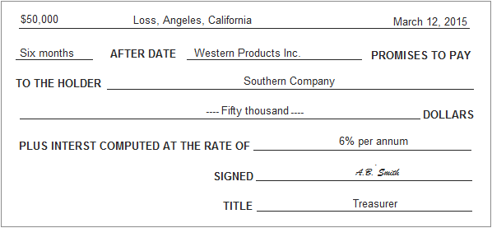
Notes Receivables
Sometime receivables might be collected through the emission of a note receivable. Notes receivables are amount customers owe for which a formal, written instruments of credit has been issued.
Notes receivables are:
negotiables instruments;
The issuer signs in favor of the payee;
Interest bearing (as stated) or
Zero interest bearing.

Slide 10
Notes Receivables
Terms used in the notes receivables:
Principal: the amount borrowed/ the nominal value/ the stated amount of the note
Maturity date: the date the note is to be repaid/due
Term: the time period/life of the note (in days or months)
Interest: the amount charged on the borrower for the use of the money borrowed
Maturity value: the amount of cash to be repaid including principal and interest on the maturity date

Slide 11
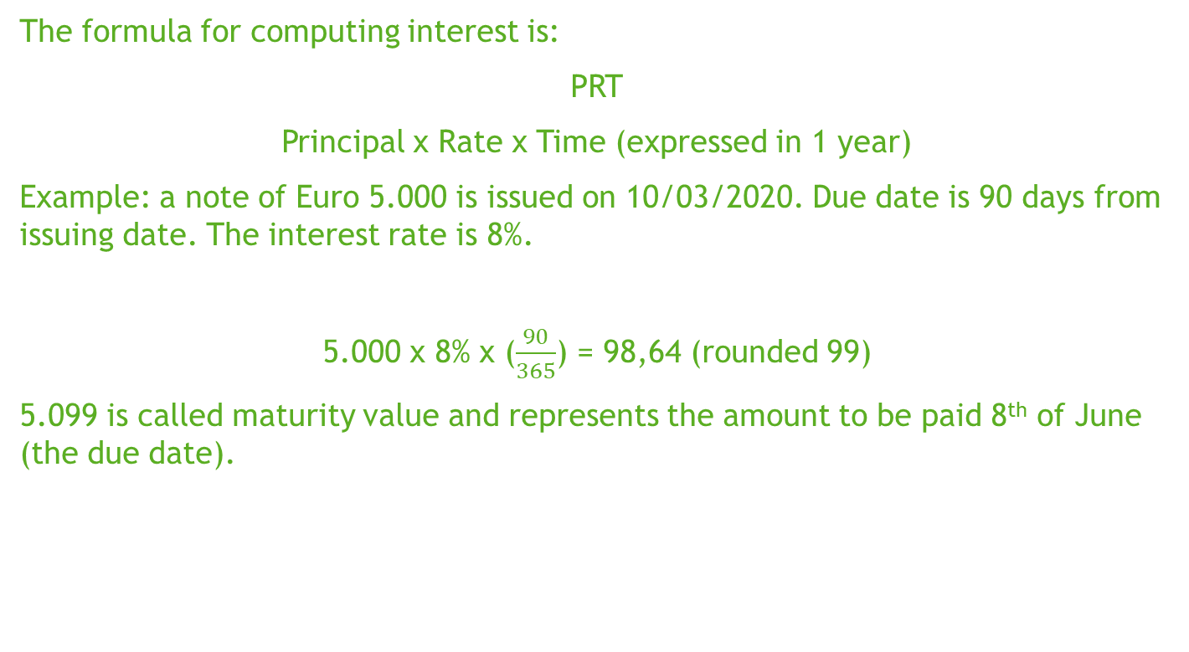
Notes Receivables
The formula for computing interest is:
PRT
Principal x Rate x Time (expressed in 1 year)
Example: a note of Euro 5.000 is issued on 10/03/2020. Due date is 90 days from issuing date. The interest rate is 8%.
5.000 x 8% x ($\frac{90}{365}$) = 98,64 (rounded 99)
5.099 is called maturity value and represents the amount to be paid 8th of June (the due date).

Slide 12
Notes Receivables
Notes receivables are reported at the net realizable value, meaning the amount of cash will be collected when the notes will be honored.
A note is honored when it is paid in full at the maturity
Interests represents revenue to be recorded when matured. In interim period interests are to be accrued in order to represent in the profit and loss the amount of interests matured at that date.
In the example of previous slide:
At the maturity date
IN | Cash | 5.099
OUT | Notes receivables |  | 5.000
OUT | Interests |  | 99

Slide 13
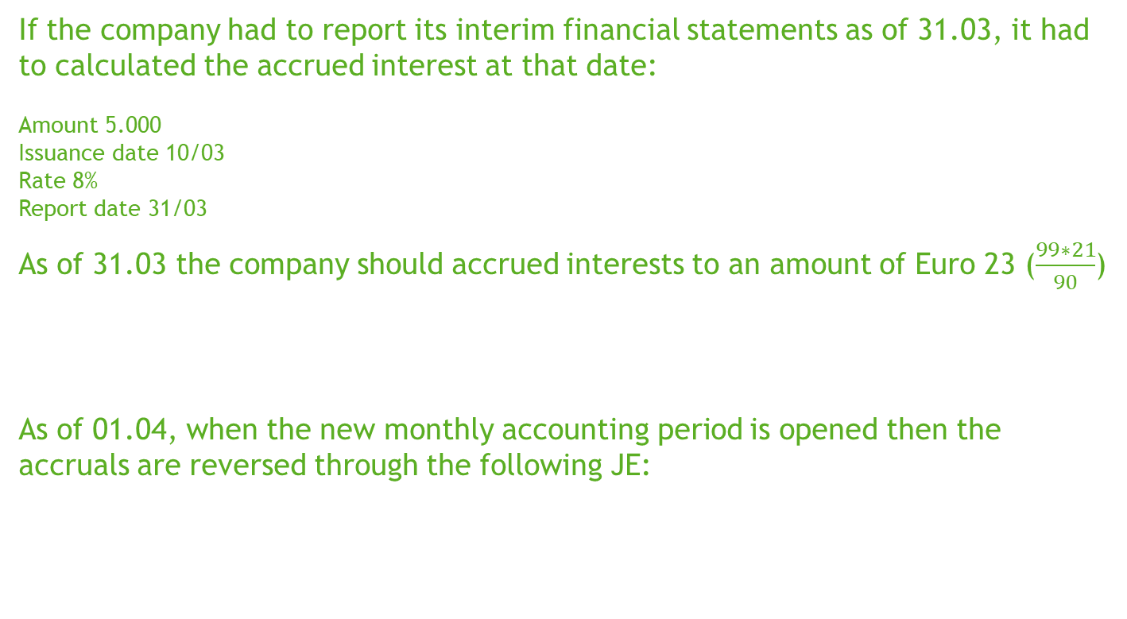
Notes Receivables
If the company had to report its interim financial statements as of 31.03, it had to calculated the accrued interest at that date:
Amount 5.000
Issuance date 10/03
Rate 8%
Report date 31/03
As of 31.03 the company should accrued interests to an amount of Euro 23 ($\frac{99∗21}{90}$)
As of 01.04, when the new monthly accounting period is opened then the accruals are reversed through the following JE:
IN | Accrued revenues | 23
OUT | Interests |  | 23
IN | Interests | 23
OUT | Accrued revenues |  | 23

Slide 14
Notes Receivables
Notes receivables are often used to regulate an account receivable:
IN | Note receivables | 122
OUT | Receivables from XXX |  | 122
IN | Cash | 122
OUT | Note receivables |  | 122
Receivables
122 | 122
// | //
Note receivables
122 | 122
// | //
Cash
122
122

Slide 15
Credit note
It happens that invoices are to be corrected because 1) are erroneously issued or 2) goods and service are returned or 3) any subsequent agreement between parties and are to be fully or partially corrected.
A credit note, or credit memo, is a commercial formal document issued by the seller to the buyer. This document cancel full or part of a previously issued invoice. When a credit note is issued the accounting is the following:
IN | Sales | 5.000
IN | VAT on sales | 1.100
OUT | Credit Note |  | 6.100

Slide 16
Valuation after initial recognition
At the initial recognition account receivables are recorded at their nominal amount, named also face amount, meaning the nominal value of the title giving the right to collect future cash flows.
After initial recognition a company is called in estimating which is the recoverable amount in terms of net realizable value.
Sales may raise the possibility some amounts become uncollectible and when this happens the company has to:
Record for a decrease in the asset
Record for a decrease in the income statement.

Slide 17
Allowance for bad debts
Accounting for uncollectible accounts
The amount of account receivables are directly written off against the loss.
Losses are estimated and allocated to a correction fund in the balance sheet.
Direct write-off
Allowance method

Slide 18
Allowance for bad debts
You can get to the estimation for bad debts through different methods. Among these:
Percentage on sales, which consists in estimating a percentage on sales amount over a period. The percentage should be defined based on past experience and applicable credit policy;
Percentage on account receivables, this could be get through:
  A unique percentage applied to account receivables balance as at a specific date
  Different rates to be applied to an aging schedule of account receivables at a specific date.

Slide 19
Allowance for bad debts
Percentage on sales
The Company A estimates from past experience that about 1% of credit sales become uncollectible. If net sales are Euro 800.000 in 2019, it records bad debt expense as follows:
Allowance for bad debts is a correction account recorded within the assets
IN | Bad Debt | 8.000
OUT | Allowance for bad debts |  | 8.000
Bad Debt
8.000
8.000
Allowance for bad debts
 | 8.000
 | 8.000

Slide 20
Allowance for bad debts
Percentage on AR
The Company A estimates its bad debt provision based on the following aging schedule:
Client | Balance at 31.12.2019 | Days from due date
 |  | Not yet due | 0-90 | 91-180 | 181-365 | > 1 year
XXX | 2.000 | 1.000 | 600 | 400 | - | -
YYY | 4.000 | - | - | 500 | 1.500 | 2.000
ZZZ | 1.000 | - | - | - | - | 1.000
Total | 7.000 | 1.000 | 600 | 900 | 1.500 | 3.000
Percentage to be uncollectible | - | - | 5% | 10% | 20% | 100%
Year end allowance for bad debt | 3.420 | - | 30 | 90 | 300 | 3.000

Slide 21
Allowance for bad debts
If the opening balance of allowance for doubtful accounts was 1.420 the accounting for the Company A is the following:
2.000 represents the amount to be recorded in the profit and loss based on loss sustained by the Company in current year. The amount of Euro 3.420 represents the risk on total account receivables outstanding at the date of estimation.
IN | Bad Debt (PL) | 2.000
OUT | Allowance for bad debts |  | 2.000
Bad Debt
2.000
2.000
Allowance for bad debts
 | 1.420
 | 2.000
 | 3.420

Slide 22
Allowance for bad debts
Now assume that the Board of Directors of Company A authorizes the write-off of account receivables owed by ZZZ. Client, indeed, is out of business due to a long market outbreak and court has recently declared it on bankruptcy. Court judgement declared then no assets of ZZZ are attackable.
Company A had already allowed the total amount of AR in previous period, thus no more costs are to be recorded in the profit and loss. The accounting will be the following:
IN | Allowance for bad debts | 1.000
OUT | Account receivable |  | 1.000
Account receivables
7.000 | 1.000
6.000
Allowance for bad debts
1.000 | 1.420
 | 2.000
 | 2.420

Slide 23
Allowance for bad debts
IFRS 9, a new IFRS Standard introduced starting January 1st 2018, has replaced IAS 39. It contains three areas of accounting for financial instruments:
Classification and measurement
Impairment
Hedge accounting.
Under the point of impairment of AR, IFRS 9 replaced IAS 39 introducing a new model of credit loss. Substantially IFRS passed from a incurred loss model to an expected loss model.
As we represented in the previous slide a loss model might be based on observation, on historical data (see percentage on AR). This kind of models are called incurred loss model, meaning the loss or conditions had already occurred before the allowance was booked.

Slide 24
Allowance for bad debts
The expected credit loss (ECL) model was originated by a need from bank financial statements after the financial crisis of 2008. A criticism from the crisis was that banks recognized loss on their credits too late. A long process for restating the impairment of financial instruments has been concluded with the issuance of IFRS 9 effective from January 1st 2018.
The expected credit loss is a looking forward model trying to anticipate the expected credit loss in the FS.
A looking forward model means recognizing a credit loss before this happened.

Slide 25
Allowance for bad debts
= X
PD: probability of default expresses the weighted average of probability to incur in a credit loss. This is normally expressed by the market specific on client or, if data are not available, based on industry.
EL: expected loss express the present value of losses when a default is incurred. This is the expression of what will be the loss if the event of default is incurred. This information is an estimate based on information on client liquidity.
These elements require a reasonable and supportable information from the past, present and future.
ECL
PD
EL

Slide 26
Allowance for bad debts
ECL
Through the appliance of ECL model a Company should be able to evaluate which is the expected loss related to each Euro of sales at the moment this is invoiced.
Client | Balance at 31.12.2019 | PD | EL | ECL
XXX | 2.000 | 0,1% | 10% | 0,2
YYY | 4.000 | 10% | 8% | 32
ZZZ | 1.000 | 40% | 60% | 240
Total | 7.000 |  |  | 272,2

Slide 27
Derecognition of receivables
A company may decide to wait for collecting the amounts recorded within the account receivables or to transfer its right to another company against cash.
This last operation is known as factoring. Derecognition of account receivables (also due to factoring) is discussed in the IFRS 9.
A company may have different reasons for transferring its account receivables; among these:
because of liquidity issues;
Because the process of collecting it time and cost-consuming.
Factoring might be distinguished in:
With recourse (with guarantee)
Without recourse (with no guarantee)
Next to factoring we may report the secured borrowing

Slide 28
Factoring
Secured borrowing, known also as assignment, is a financial transaction through which the company obtain an amount of cash (loan) pledging its account receivable. In this operation the company retains the ownership of AR.
In this operation trade receivables are used as a collateral to obtain a certain amount of cash from the bank. Risks of bad debts are not transferred to the bank as the Company is retaining the ownership of its receivables.
Transferor records for cash when collect its trade receivables. Periodically transfers to the bank the cash collected. The company pays for interests and charges based on agreement.

Slide 29
Factoring
The company A provides (assigns) Euro 700.000 of its accounts receivable to Bank as collateral for a Euro 500.000 note. Company A continues to collect the accounts receivable and the account debtors are not notified of the arrangement.
Bank assesses a finance charge of 1% of the accounts receivable (Euro 7.000) and interest on the note of 12%. Company A makes monthly payments to the bank for all cash it collects on the receivables.
When transfer is realized
IN | Cash | 493.000
IN | Finance Charge | 7.000
OUT | Financial Payable |  | 500.000

Slide 30
Factoring
Then the Company A collects Euro 440.000 from one its customers
On collection Company A remits to Bank the amount collected plus accrued interests:
IN | Cash | 440.000
OUT | Account receivables |  | 440.000
IN | Interest expenses | 5.000
IN | Financial payables | 440.000
OUT | Cash |  | 445.000

Slide 31
Factoring
Then the Company A collects Euro 260.000 from one its customers less 10.000 uncollectible not previously allowed:
On collection Company A remits to Bank the remaining due amount plus accrued interests:
IN | Cash | 250.000
IN | Loss on AR | 10.000
OUT | Account receivables |  | 260.000
IN | Interest expenses | 600
IN | Financial payables | 60.000
OUT | Cash |  | 60.600

Slide 32
Factoring
Factoring accounts receivables means selling them and transferring all rights and obligations to the Factor.
A factor is a finance company or banks that buys receivables from business for a fee.

Slide 33
Factoring
Sale without Guarantee (Recourse)
The legal title (the form) together with the risks and rewards (the substance) of the trade debts pass to the factoring company.
The difference between the net proceeds and the carrying amount of the trade debts (if any) is recognized as a loss on sale of trade debts in the income statement.
Ownership, risks and gain will be transferred to the factoring company. As a consequence control of receivables would be in the hand of factoring company. For these services the factoring company will charge the commission based on the risks associated to trade receivables. Factoring company normally pays 80% -90% of the face value after considering the potential sales return/allowance

Slide 34
Factoring
Sale without Guarantee (Recourse)
Company ZZZ factors Euro 500.000 of accounts receivable with Bank on a without recourse basis. The receivable records are transferred to Bank, which will receive the collections. The Bank assesses a finance charge of 3% of the amount of accounts receivable and retains an amount equal to 5% of the accounts receivable.
IN | Cash | 460.000
IN | Bank Charge | 25.000
IN | Finance Charge | 15.000
OUT | Account receivables |  | 500.000

Slide 35
Factoring
Debt factoring with recourse
Immediate cash advances for certain % of the debt factored provided by the factoring company. The factor company acts as a collection agent.
The seller has retained all the risk associated with the trade receivable thus “full recourse”.
The trade receivables would be retained on the BS as assets and the proceeds received would be recognized as a liability. As when the trade debtors settled and the cash was passed over to the factor, the trade receivables and liability would be reduced.

Slide 36
Factoring
Debt factoring with recourse
Company YYY has Euro 4.000.000 accounts receivable and decides to sold to a bank on a recourse factoring arrangement. The amount of cash advance obtained was Euro 3.600.000 less a factoring fee of Euro 60.000. Also finance interest is
calculated at 15% per year.
As you can note account receivables had not been derecognized as the Company still owns the AR and still supports the risk related.
IN | Cash | 3.540.000
IN | Factoring fee | 60.000
OUT | Financial liability |  | 3.600.000

Slide 37
Factoring
Debt factoring with recourse
The account receivables will be only derecognized when the debtor actually pays. We have two options:
1) Debtor pays to the original creditor and cash will then be transferred to the factor if the debtor keep on paying to the original creditor:
Then cash is transferred to factor:
2) More commonly debtor pays directly to the factor who communicates to the company the receipt:
IN | Cash | 3.600.000
OUT | Account receivables |  | 3.600.000
IN | Financial liability | 3.600.000
OUT | Cash |  | 3.600.000
IN | Financial Liability | 3.600.000
OUT | Account receivables |  | 3.600.000

Slide 38
Other Receivables: VAT (Value added Tax)
Value added tax (VAT) is an indirect tax on goods. The VAT is imposed only on the amount of value addition. It is a multi-point tax levied as a proportion of value addition, where the tax burden can be shifted from one person to another person till the ultimate consumer can consume the goods.
• VAT is charged by state government,
• VAT is a intra state sales tax (sales within the state)

Slide 39
VAT
The VAT is imposed only on the amount of value addition. I.e. in the hypothetical “Tor Vergata” State VAT is 20%
B is buying from A raw materials at 100 + VAT
C is buying from B final product at a price of 200 + VAT
C is finally selling to final customers in its stores at a price of 400 + VAT
At the end the VAT is actually charged only on final customer. Companies act as intermediary and VAT has just a financial impact in their accountancy.
Buyer/seller | A | B | C | Consumer | To be paid to Tax Authority
A |  | 20 |  |  | 20
B | -20 |  | 40 |  | 20
C |  | -40 |  | 80 | 40
Consumer |  |  | -80 |  | -

Slide 40
VAT
VAT is only generated when invoices are issued.
An invoice is the formal mandatory document whit tax relevance where is contained a statement of goods/services sold by a company which reports the name of the selling company as well as the name of the buying company and a detail of
quantity of items sold
price per item sold
total price for line of item
the % of tax to be applied on every item
a final sum due for these.

Slide 41
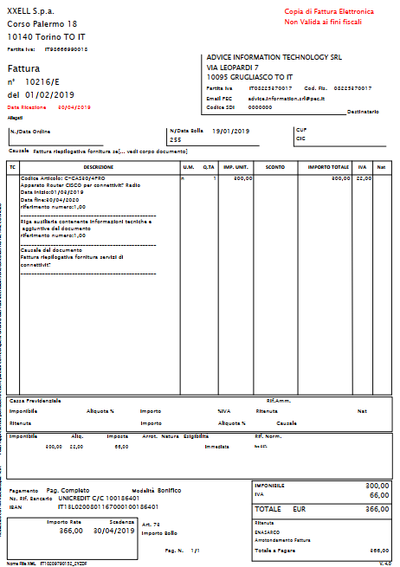
VAT

Slide 42
VAT
When you buy VAT is a receivable: you paid VAT to the supplier thus you have a receivable against the Government.
When you sell VAT is a payable: you received VAT by the customer to be reversed to the Government.
VAT is then reversed to Government on a periodicity that depends on laws and dimension of the entity. Actually often VAT is reversed on a monthly basis.
VAT on purchase
5.000
5.000
VAT on sales
 | 10.000
 | 10.000

Slide 43
VAT
VAT is paid to Government for the net difference of VAT on purchases and VAT on sales.
At the end of the month:
IN | VAT Liquidation | 5.000
OUT | VAT on purchases |  | 5.000
IN | VAT on sales | 10.000
OUT | VAT Liquidation |  | 10.000
VAT on purchase
5.000 | 5.000
// | //
VAT on sales
10.000 | 10.000
// | //
VAT Liquidation
5.000 | 10.000
 | 5.000

Slide 44
VAT
The situation represented in the previous slide exposes a payable to Government.
Then VAT is paid to Government:
IN | VAT Liquidation | 5.000
OUT | Cash |  | 5.000
VAT Liquidation
5.000 | 10.000
5.000
// | //
Cash
 | 5.000
 | 5.000

