Slide 1
Accounting
Balance Sheet: Inventories

Slide 2
Agenda
Inventories
Determination and classification of assets
Valuation of inventories

Slide 3
Inventories
Inventories are assets:
held for sale in the ordinary course of business
in the process of production or
raw materials or supplies to be consumed in the production process or in the rendering of services
Net realizable value is the estimated selling price in the course of business less the estimated completion costs and the estimated costs to realize the sale.
Fair value is the value which the asset can be exchanged or a liability can be paid between parties.

Slide 4
The business cycle
Purchasing
Inventories for raw materials
Financing
Processing/Producing
Selling
Inventories for finished products

Slide 5


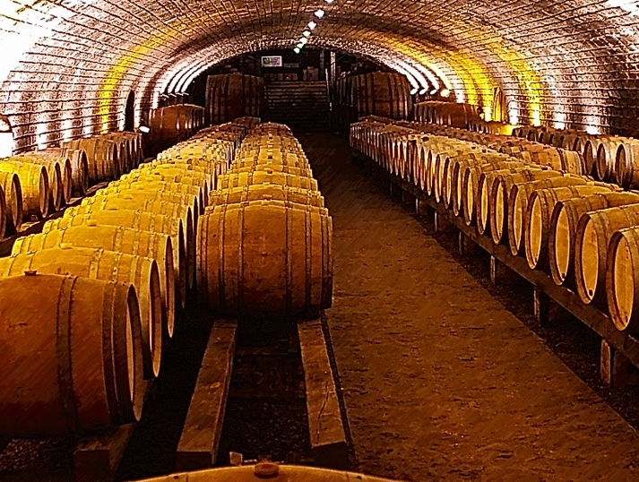
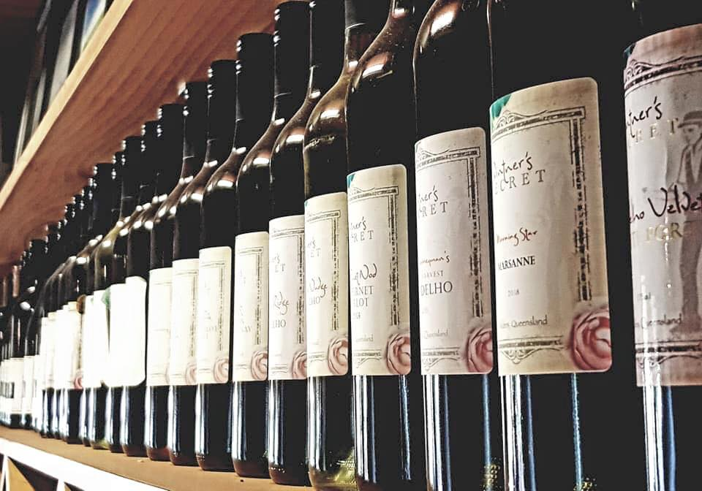
Inventories
A wine company processes grapes harvested from its vineyards into wine in a one-year process cycle.
Up to the point of the harvest, grapes are not inventory and are ruled by IAS 41 “Biological Assets”
From the harvest until wine’s bottles are sold, these are inventories.
Raw materials are resources purchased by the company waiting to be introduced in its production/processing cycle to be converted into finished products. Finished products are resources resulting from the production/processing cycle waiting to be sold to market.
Biological Assets
IAS 41
Raw Materials
IAS 2
Semi-processed
IAS 2
Finished products
IAS 2
This Photo by Unknown Author is licensed under CC BY

Slide 6
Inventories
IAS 2 applies to all inventories other than
work in progress arising under construction contracts (IFRS 15)
financial instruments (IFRS 9)
livestock, agricultural products, mineral ores (IAS 41)
These are recognized when:
risks and rewards of ownership have transferred
effective control over goods
cost can be measured reliably
economic benefits flow to company

Slide 7
Inventories
According to IAS 2 inventories are to be evaluated at the lowest between cost and net realizable value.
Cost to be recognized in the standard is represented by:
costs of purchase, costs of conversion
other costs incurred in bringing the inventories to their present location and condition (i.e. cost for transportation)
Net realizable value is:
Cost of substitution, meaning the cost of purchasing of raw materials from market
Expected selling price for partially finished and finished products

Slide 8
Inventories
With reference to the cost of conversion (transformation or production), IAS 2 specifies these have to include those directly related to the produced item, as i.e. the direct labor, and must then include also a portion of general production costs fixed and variables, i.e. depreciation, maintenance, etc.
This estimation is to be operated considering a normal productive condition. In a period with unusually low production inventories are to be evaluated considering the normal level of costs/production. IAS 2 does not allow inefficiencies to be suspended in the inventories.

Slide 9
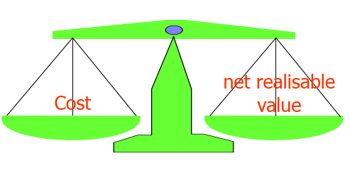
Inventories
Net realizable value =
Estimated selling price –
Estimated costs of completion -
Estimated costs of selling

Slide 10
Inventories
IAS 2 specifies also other costs could be suspended in the value of inventories if these have been sustained to bring inventories in the location and conditions where they are.
According to IAS 2 the cost of inventories that are not interchangeable as for the goods and products distinguished for specific projects, is to be evaluated considering precise evaluations of their specific costs. In other words a company should evaluate for each item category what is the specific cost of purchasing, cost of production (such as direct labor), allocation of variable costs. This criteria is complicated and onerous.
With reference to interchangeable goods, IAS 2, apart of the specific cost criteria even applicable, provides the reference evaluation method is FIFO or weighted average cost.
Interchangeable goods are items similar for nature or use (i.e. a box of oranges, a certain quantity of screws, etc.).

Slide 11
Inventories
FIFO stands for First In First Out, according to this method first purchased or produced quantities are the first to be sold or used in the production; as a consequence only most recent purchased and productions remain in the warehouse.
According to weighted average cost of goods purchased or produced items are no more individually identifiable and become part of set in which goods are equally available.
LIFO, Last in First Out, is not applicable. Is not allowed applying a different method for goods of equal nature while is possible applying a different method for inventories with different nature or use (consistency principle). i.e. the same raw material used in different industrial sectors can be evaluated by a different method.

Slide 12
Inventories
FIFO
Risk with this method, in a inflated economy, is overestimation of assets
Date | Event | Transferred in | Sold | Unit Price | Value of goods
01/01 | Beginning inventory | 1.000 |  | Euro 3,00 | 1.000x3,00
04/01 | Transfer | 800 |  | Euro 3,10 | 1.000x3,00 800x3,10
06/01 | Sale |  | 500 |  | 500x3,00 800x3,10
08/01 | Sale |  | 800 |  | 500x3,10
14/01 | Transfer | 500 |  | Euro 3,30 | 500x3,10 500x3,30
16/01 | Sale |  | 700 |  | 300x3,30
Total |  |  |  |  | 990

Slide 13
Inventories
Weighted average cost
Date | Event | Transferred in | Sold | Unit Price | Value of goods
01/01 | Beginning inventory | 1.000 |  | Euro 3,00 | 1.000x3,00
04/01 | Transfer | 800 |  | Euro 3,10 | 1.800x3,044
06/01 | Sale |  | 500 |  | 1.300x3,044
08/01 | Sale |  | 800 |  | 500x3,044
14/01 | Transfer | 500 |  | Euro 3,30 | 1.000x3,17
16/01 | Sale |  | 700 |  | 300x3,17
Total |  |  |  |  | 951,67

Slide 14
Inventories
When a material or a finished product is purchased this might be suspended in the inventories through the following JE:
When purchased
Then costs are suspended in the inventories while processed/sold
IN | Costs | 2.000
OUT | Payables |  | 2.000
IN | Inventories | 2.000
OUT | Costs |  | 2.000

Slide 15
Net realizable value
According to IAS 2 cost of inventories will not be realizable if these are damaged, if became wholly or partially obsolete, or if selling prices decreased.
If value is not realizable, even if partially, an impairment is to be written. The estimation of net realizable value is operated in consideration of the more reliable available information. i.e. a sales agreement, even if consider less quantities of those available, might be considered a source of information for realizable value.
Considerations over value of inventories need to be repeated on every subsequent period after recording the impairment. If conditions or information are no more actual the impairment has to be canceled.
Impairment is recorded in the profit and loss when loss incurred.

Slide 16
Net realizable value
The company has in its inventories a value of Euro 1M for 100K bottles of wine. This value has been obtained by considering the purchasing cost of grapes, casks not reusable and bottles, the costs incurred in processing the grapes, for storage, labelling and marketing. The cost per bottle have hugely increased in current year considering an abnormal low availability of grapes in the market. The market price for the wines produces by the company has never been higher than 8 Euro per bottle in the local market and 9,5 abroad which represents the 30% of sales. A market research demonstrated Italy price might be raised to 8,5. The NRV for the inventories is:
Q | Cost | Expected Selling Price | NRV
70.000 | 10 | 8,5 | 595.000
30.000 | 10 | 9,5 | 285.000
Total |  |  | 880.000

Slide 17
Net realizable value
Consequently the company records for an impairment of Euro 120.000
IN | Impairment in inventories | 120.000
OUT | Inventories |  | 120.000

Slide 18
Profit and loss
When items are sold their value is recorded as a cost in the profit and loss in the same period relative revenue is recorded (matching principle).
Within the same class of items (same valuation method) the amount to be written in the profit and loss corresponds to the difference between beginning inventories and final inventories. Difference is recorded within costs or revenues based on its balance and nature. Changes in raw materials are recorded within costs, changes in finished products are recorded within revenues.

Slide 19
Profit and loss
At the end of the year inventories in final products decreased of Euro 2.010. JEs are the following
Date | Decription | Value
01/01 | Beginning inventory | 3.000
31/12 | Final inventory | 990
When at the end of period the company realize a certain amount of finished products have not been sold yet:
IN | Inventories in FP | 3.000
OUT | Ending inventories in FP |  | 3.000
IN | Beginning inventories in FP (P&L) | 3.000
OUT | Inventories in FP (BS) |  | 3.000
IN | Inventories in FP (BS) | 990
OUT | Ending inventories in FP (P&L) |  | 990

Slide 20
Profit and loss
 | Inventories in FP
31/12/XX-1 | 3.000
 |  | 01/01/XX | 3.000
31/12/XX | 990
 | 990
Balance Sheet
 | Beginning inventories in FP
01/01/XX | 3.000
 | 3.000
Ending inventories in FP
 | 31/12/XX | 990
 |  | 990
Profit and loss

Slide 21
Profit and loss
Change in inventories of finished products is then recorded in the profit and loss in reduction of revenues.
IN | Change in inventories | 2.010
IN | Ending inventories in FP | 990
OUT | Beginning inventories in FP |  | 3.000
Beginning inventories in FP
3.000 | 3.000
// | //
Ending inventories in FP
990 | 990
// | //
Change in inventories
2.010
2.010

Slide 22
IAS vs OIC
The main difference between IAS 2 and OIC 13 is related to the allowed evaluation methods. The Italian law provides four different methods for the evaluation of inventories:
Specific costs
Weighted average cost
FIFO
LIFO
LIFO is not allowed by IAS.

Slide 23
IAS vs OIC
LIFO
Risk with this method, in a inflated economy, is underestimation of assets
Date | Event | Transferred in | Sold | Unit Price | Value of goods
01/01 | Beginning inventory | 1.000 |  | Euro 3,00 | 1.000x3,00
04/01 | Transfer | 800 |  | Euro 3,10 | 1.000x3,00 800x3,10
06/01 | Sale |  | 500 |  | 1.000x3,00 300x3,10
08/01 | Sale |  | 800 |  | 500x3,00
14/01 | Transfer | 500 |  | Euro 3,30 | 500x3,00 500x3,30
16/01 | Sale |  | 700 |  | 300x3,00
Total |  |  |  |  | 900

