Slide 1
Practice on Practice on Accounting
Exercise 3 – Fixed Assets

Slide 2
Initial Recognition
PP&E are initially measured at cost:
The amount of cash or cash equivalents paid and the fair value of the other considerations given to acquire an asset at the time of its acquisition or construction

Slide 3
Initial Recognition
At 15.03 an entity buys a machinery to be introduced in its production chain. Nominal cost of the machinery is Euro 100.000. The company is buying the machinery against a loan. The purchase of machinery needed some preparing consultancies and legal expenses for a total amount of Euro 10.000 for which received invoices at 01.03. Furthermore the costs of transportation is Euro 2.000.
IN | Consultancy (engin.) | 6.000
IN | VAT on Purchases | 1.320
OUT | Payables to A |  | 7.320
IN | Consultancy (legal) | 4.000
IN | VAT on Purchases | 880
OUT | Payables to B |  | 4.880

Slide 4
 | Consultancy
01/03/20XX | 6.000
01/03/20XX | 4.000
 | 10.000
 | VAT on purchases
01/03/20XX | 1.320
01/03/20XX | 880
 | 2.200
 | Payables to A
01/03/20XX |  | 7.320
 |  | 7.320
 | Payables to B
01/03/20XX |  | 4.880
 |  | 4.880

Slide 5
Initial Recognition
IN | Machinery | 100.000
IN | VAT on Purchases | 22.000
OUT | Payables to C |  | 122.000
IN | Transportation | 2.000
IN | VAT on Purchases | 440
OUT | Payables to D |  | 2.440

Slide 6
 | Machinery
15/03/20XX | 100.000
 | 100.000
 | VAT on purchases
01/03/20XX | 1.320
01/03/20XX | 880
15/03/20XX | 22.000
15/03/20XX | 440
 | 24.640
 | Payables to C
15/03/20XX |  | 122.000
 |  | 122.000
 | Payables to D
15/03/20XX |  | 2.440
 |  | 2.440
 | Transportation
15/03/20XX | 2.000
 | 2.000

Slide 7
As you can see, transportation and consultancies are initially recorded within the expenses in the profit & loss. The Company has then evaluated these expenses are related to the purchasing of the machinery and, more important, 1) these costs wouldn’t have been sustained if the machinery wasn’t purchased and 2) without these costs the machinery couldn’t be operating.
When the Company evaluates these costs are increasing the value of the machinery or are necessary to the machinery to produce value then has to remove them from the profit and loss and capitalize them.

Slide 8
IN | Machinery | 12.000
OUT | Transportation |  | 2.000
OUT | Consultancy |  | 10.000
 | Consultancy
01/03/20XX | 6.000
01/03/20XX | 4.000
15/03/20XX |  | 10.000
 | // | //
 | Transportation
15/03/20XX | 2.000
15/03/20XX |  | 2.000
 | // | //
 | Machinery
15/03/20XX | 100.000
15/03/20XX | 12.000
 | 112.000
After capitalization of these expenses profit and loss of the Company is net of any costs and the value of these has increased the value of asset

Slide 9
When the Company obtains the loan from the bank and pays C for the machinery
IN | Bank | 122.000
OUT | Loan |  | 122.000
IN | Payables to C | 122.000
OUT | Bank |  | 122.000
 | Payables to C
15/03/20XX |  | 122.000
30/03/20XX | 122.000
 | // | //
 | Bank
30/03/20XX | 122.000
30/03/20XX |  | 122.000
 | // | //
 | Loan
30/03/20XX |  | 122.000
 |  | 122.000

Slide 10
At year end the company needs to prepare its FS and to depreciate its assets
Machinery is written at an amount of 112.000 (Carrying amount) and the Company estimates the useful life is 8 years. The depreciation method is straight line. As the machinery has enter in operation in the second half of the period after a period of setup lasted 3 months, the Company decided to depreciate it half for the first year.
 | Machinery
15/03/20XX | 100.000
15/03/20XX | 12.000
 | 112.000
IN | Depreciation Machinery | 7.000
OUT | Depreciation fund - Machinery |  | 7.000
 | Depreciation fund – Machinery
31/12/20XX |  | 7.000
 |  | 7.000
 | Depreciation of Machinery
31/12/20XX | 7.000
 | 7.000

Slide 11
At the end of second year
IN | Depreciation Machinery | 14.000
OUT | Depreciation fund - Machinery |  | 14.000
 | Depreciation fund – Machinery
31/12/20XX |  | 7.000
31/12/20XX+1 |  | 14.000
 |  | 21.000
 | Depreciation of Machinery
31/12/20XX+1 | 14.000
 | 14.000

Slide 12
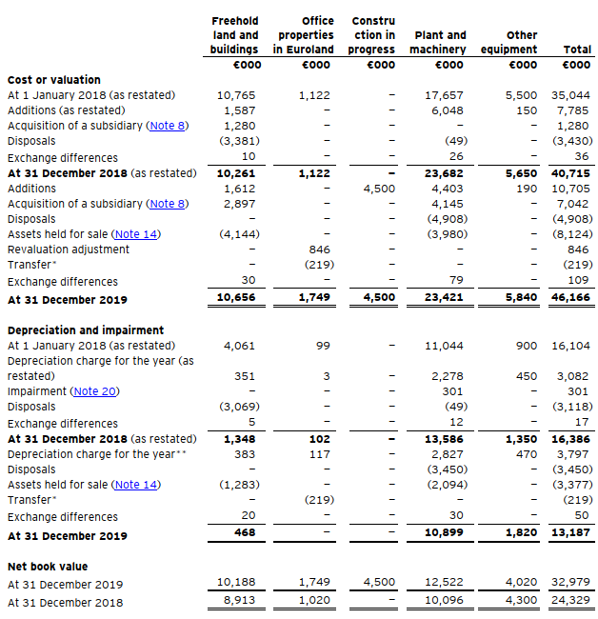
Example of classification of PPE in the notes to the FS
PPE are to be reported in the FS net of any cumulated depreciation (depreciation funds) and any impairment. Then in the balance sheet the value of PPE is going to decrease as the depreciation increase year per year (considering no new investments are realized). However, in the explanatory notes, the amount of historical cost and depreciation fund is to be represented separately in a specific commentary statement of the PPE where, category by category, is reported the evolution of the asset during the year:
Historical cost (opening and closing)
Any increase and disposals of the year
Depreciation for the year
Depreciation fund (opening and closing)
Net book value (opening and closing).
Actually this information are represented both for CY and PY (in the table you can see both 2019 and 2018).
Through this statement a reader is able to intercept any event or circumstance that affected the PPE during the year.

Slide 13
During the third year the company has complied with the periodic maintenance of the machinery. The cost is 4.000 Euro
IN | Maintenance of Machinery | 4.000
IN | VAT on purchases | 880
OUT | Payables |  | 4.880
During the same year the company has launched a new line of products for which it has been required to modify its machinery with an extra-ordinary intervention for Euro 14.000
IN | Extraordinary maintenance | 14.000
IN | VAT on Purchases | 3.080
OUT | Payables |  | 17.080
IN | Machinery | 14.000
OUT | Extraordinary maintenance |  | 14.000

Slide 14
Goodwill
As at 31 December X decides to buy the 100% of shares of the Company Y. The purchasing price is Euro 1.000.000 and the net worth of the company Y is Euro 400.000.
The external auditor of the company X asks the management to test the recoverability of this investment through the compilation of an impairment test. The company Y is not a public company thus a public market does not exist.
 | Investment in Y
31/12/20XX | 1.000.000
 | Equity of Y
31/12/20XX |  | 400.000
 |  | 400.000

Slide 15
Goodwill
The impairment was performed by management calculating the NPV of future provisional cash flow for the company Y
Assuming the NFP of the investee is zero, the discounted cash flows show the recoverable amount for the company is less than the nominal amount. The company X should record for an impairment
Year | 1 | 2 | 3 | TV
Cash Flows | 100.000 | 120.000 | 60.000 | 60.000
Discount Rate | 8% |  |  | WACC 8% G-rate 1%
Discounted Flows | 92.590 | 102.880 | 47.630 | 687.230
NPV | 930.330

Slide 16
Goodwill
Let’s assume the company X already had the possession of the investment in the Company Y as at 31.12 and, with effect from 31.12 decide to merge incorporating the net assets of Y in its own financial statements. Starting from this date Y does no more exist. The two companies have been merged and from this moment is to be considered as one.
The merging accounting is similar to a consolidation. X incorporates the amounts of Y in its BS, summing the assets and liabilities of the two companies and eliminating intercompany operations. This operation led to a difference between the amount recorded in X (1.000.000) and the net worth in Y (400.000).
This amount is to be recorded as goodwill, if and only if, the recoverability of this amount is verified.
Then the auditor ask the company to prepare a specific impairment test on the goodwill.
The results of the test are to be the same of the example above. Then an impairment is to be recorded.

Slide 17
During the fourth year, a market breakout in the product which the Company is specialized is pushing the company in evaluating for future strategies. The firm needs to evaluate the recoverable amount of its machinery.
A consultancy firm prepared a specific business plan which reports the following cash flows for the machinery over a period of 5 years:
The firm suggests to discount the cash flows using WACC (Weighted Average Cost of Capital). WACC for the Company is 8% based on market and composition of capital.
In the other side the Company received an offer to sell its machinery to a price of Euro 70.000. The offer requests the company to pay for dismantling and transportation for an estimated amount of Euro 6.000
Y1 | Y2 | Y3 | Y4 | Y5
30.000 | 25.000 | 10.000 | 10.000 | 5.000

Slide 18
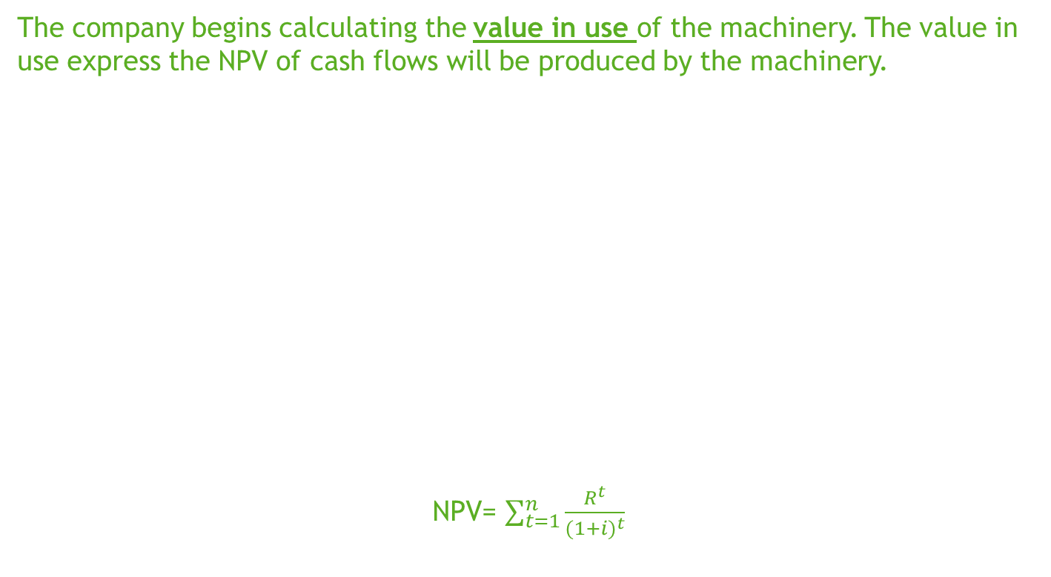
The company begins calculating the value in use of the machinery. The value in use express the NPV of cash flows will be produced by the machinery.
NPV= $\sum_{t=1}^{n}{\frac{R^{t}}{{(1+i)}^{t}}}$
Year | 1 | 2 | 3 | 4 | 5
Cash Flows | 30.000 | 25.000 | 10.000 | 10.000 | 5.000
Discount Rate | 8%
Discounted Flows | 27.778 | 21.433 | 7.938 | 7.350 | 3.403
NPV | 67.903

Slide 19
The selling price in the other hand is Euro 70.000 but the Company has to consider for the cost of disposals for Euro 6.000. Then the net selling price is Euro 64.000.
Whatever is the decision of the company (sell or retain the machinery), worried by decreasing volumes the management decide to evaluate the recoverable amount of the asset and to verify if the value of machinery recorded in the FS is still fair.
Let’s say the company is making this valuation at 30/06/20XX+3

Slide 20
Net selling price: Euro 64.000
Value in use: Euro 67.900
Carrying amount:
 | Depreciation fund – Machinery
31/12/20XX |  | 7.000
31/12/20XX+1 |  | 14.000
31/12/20XX+2 |  | 16.000
30/06/20XX+3 |  | 8.000
 |  | 45.000
 | Machinery
15/03/20XX | 100.000
15/03/20XX | 12.000
31/05/20XX+2 | 14.000
 | 126.000
81.000

Slide 21
As the carrying amount (the amount which the asset is recorded in the accounting system) is higher than the recoverable amount (both the value in use and the selling price) the Company has to record an impairment. The amount of impairment is the difference between the carrying amount and the highest between the value in use and the selling price.
IN | Impairment of Machinery | 13.100
OUT | Machinery |  | 13.100
 | Machinery
15/03/20XX | 100.000
15/03/20XX | 12.000
31/05/20XX+2 | 14.000
30/06/20XX+3 |  | 13.100
 | 112.900
 | Impairment of Machinery
30/06/20XX+3 | 13.100
 | 13.100
The new carrying amount of the machinery is 67.900 (112.900 – 45.000). As a consequence the depreciation amount per year is adjusted (67.900 / the remaining useful life)

Slide 22
At the end of the year the Company decides to sell its machinery responding to the original offer. When decision is taken the carrying amount for the machinery is the following.
 | Depreciation fund – Machinery
31/12/20XX |  | 7.000
31/12/20XX+1 |  | 14.000
31/12/20XX+2 |  | 16.000
31/12/20XX+3 |  | 15.000
 |  | 52.000
 | Machinery
15/03/20XX | 100.000
15/03/20XX | 12.000
31/05/20XX+2 | 14.000
30/06/20XX+3 |  | 13.100
 | 112.900
60.900

Slide 23
The record is the following:
IN | Depreciation Fund – Machinery | 52.000
IN | Receivables | 85.400
OUT | VAT on sales |  | 15.400
OUT | Machinery |  | 112.900
OUT | Gain on sale |  | 9.100
 | Depreciation fund – Machinery
31/12/20XX |  | 7.000
31/12/20XX+1 |  | 14.000
31/12/20XX+2 |  | 16.000
31/12/20XX+3 |  | 15.000
31/12/20XX+3 | 52.000
 | // | //
 | Machinery
15/03/20XX | 100.000
15/03/20XX | 12.000
31/05/20XX+2 | 14.000
30/06/20XX+3 |  | 13.100
31/12/20XX+3 |  | 112.900
 | // | //

Slide 24
The record is the following:
In consideration of the sale, the machinery is no more in the balance sheet of the Company. The difference between the price of sale and the carrying amount of the sold asset is a gain.
As the price of sale (Euro 70.000) was lord of additional costs (Euro 6.000) gain should not be represented in the FS lord of these. Furthermore, the expenses are related to the realized sale. The following JE should be used to represent the actual value of gain:
IN | Dismantling expenses | 4.000
IN | Transportation costs | 2.000
OUT | Payables |  | 6.000
IN | Gain on sale | 6.000
OUT | Transportation costs |  | 2.000
OUT | Dismantling expenses |  | 4.000

Slide 25
The asset was paid by a loan for Euro 122.000. The loan was obtained at the following conditions:
Capital: 122.000
Interest Rate: 3%
Length: 8 years
When the machinery has been sold the status of loan repayment plan was the following:
Year | Capital | Capital repaid | Interest | Remaining amount
1 | 122.000 | 15.250 | 3.660 | 110.410
2 | 106.750 | 15.250 | 3.203 | 94.703
3 | 91.500 | 15.250 | 2.745 | 78.995
4 | 76.250 | 15.250 | 2.288 | 63.288
5 | 61.000 | 15.250 | 1.830 | 47.580
6 | 45.750 | 15.250 | 1.373 | 31.873
7 | 30.500 | 15.250 | 915 | 16.165
8 | 15.250 | 15.250 | 458 | 458

Slide 26
The Company is willing to replace the machinery with a new one, which price is Euro 200.000. To find the financial resources necessary to buy the new machinery the company decide to renegotiate the loan with the bank. The new conditions of the agreement are the following:
Capital: 200.000
Interest Rate: 4,5%
Length: 10 years
Bank will pay for the difference between new capital (200.000) and remaining capital of old loan.
As the renegotiation has changed both the length and the rate, substance of contract has changed. Based on IFRS 9 this represents a wholly new agreement. The old loan is to be derecognized and a new loan is to be recorded.

Slide 27
 | Loan A
30/03/20XX |  | 122.000
31/12/20XX | 18.910 | 3.660
31/12/20XX+1 | 18.453 | 3.203
31/12/20XX+2 | 17.995 | 2.745
31/12/20XX+3 | 17.538 | 2.288
31/12/20XX+3 | 61.000
 | // | //
 | Loan B
31/12/20XX+3 |  | 61.000
31/12/20XX+3 |  | 139.000
 |  | 200.000
IN | Loan A | 61.000
OUT | Loan B |  | 61.000
IN | Cash | 139.000
OUT | Loan B |  | 139.000

Slide 28
Then the company buys the new machinery
IN | Machinery | 200.000
OUT | Bank |  | 200.000
 | Machinery
02/01/20XX+4 | 200.000
 | 200.000

Slide 29
During the year a theft impacted the company and a significant part (a roller) of the machinery has been stolen. The value of roller has been estimated in Euro 40.000.
IN | Loss for theft | 40.000
OUT | Machinery |  | 40.000
 | Machinery
02/01/20XX+4 | 200.000
15/06/20XX+4 |  | 40.000
 | 160.000

Slide 30
Then the maintenance for replacement of the roller has been accounted as following
IN | Maintenance of Machinery | 50.000
IN | VAT on purchases | 11.000
OUT | Payables |  | 61.000
IN | Machinery | 50.000
OUT | Maintenance of Machinery |  | 50.000
 | Machinery
02/01/20XX+4 | 200.000
15/06/20XX+4 |  | 40.000
30/06/20XX+4 | 50.000
 | 210.000
 | Maintenance for Machinery
30/06/20XX+4 | 50.000
30/06/20XX+4 |  | 50.000
 | // | //

Slide 31

Appendix – What is an assertion
Let’s think at the exercise:
We considered PPE from the point of view of the existence:
  The machinery has been purchased and transported to…
We considered PPE from the point of view of the completeness
  The machinery has been depreciated yearly…
We considered PPE from the point of view of valuation
  Is the value of machinery still recoverable?
When you think to an account you need to consider each relevant assertion to be represented in the FS. An assertion is the smallest characteristic of the account, a point of view. Try to consider the account as a cube. The assertion is a face of the cube. Every time you turn the cube you can see a different characteristic of the cube.

Slide 32
Completeness: all of the information has been included within the financial statements.
Existence: the information recorded in the financial statements actually occurred during the year.
Valuation: the transactions that are summarized in the financial statements were properly valued.
Rights and obligations: the entity is entitled to the assets it is reporting, and is reporting all of its obligations as liabilities.
Presentation and Disclosure: all information have been disclosed within the FS.

Slide 33
Knowing each characteristics of the account could be useful in preparing the FS taking care of every element of the accounting should be reflected in the FS, giving a fair and true representation of the events of the period.

