Slide 1
Accounting
Balance Sheet: Equity

Slide 2
Agenda
Equity
Statement of changes in equity

Slide 3
Equity
Equity represents the difference between assets and liabilities.
Definition is not contained in any dedicated principle even if important information are contained in IAS 1, mostly related to presentation and disclosure.
IAS 1 provides that, an entity shall disclose the following, either in the statement of financial position or the statement of changes in equity, or in the notes:
for each class of share capital:
  the number of shares authorised;
  the number of shares issued and fully paid, and issued but not fully paid;
  par value per share, or that the shares have no par value;
  a reconciliation of the number of shares outstanding at the beginning and at the end of the period;
  the rights, preferences and restrictions attaching to that class including restrictions on the distribution of dividends and the repayment of capital;
  shares in the entity held by the entity or by its subsidiaries or associates; and
  shares reserved for issue under options and contracts for the sale of shares, including terms and amounts; and
a description of the nature and purpose of each reserve within equity.

Slide 4
Equity
An important information to be included in the financial statements according to IAS 1 is related to the statement of changes in equity.
The statement of changes in equity includes the following information:
total comprehensive income for the period, showing separately the total amounts attributable to owners of the parent and to non-controlling interests;
for each component of equity, the effects of retrospective application or retrospective restatement recognised in accordance with IAS 8; and
for each component of equity, a reconciliation between the carrying amount at the beginning and the end of the period, separately (as a minimum) disclosing changes resulting from:
  profit or loss;
  other comprehensive income; and
  transactions with owners in their capacity as owners, showing separately contributions by and distributions to owners and changes in ownership interests in subsidiaries that do not result in a loss of control.

Slide 5
Equity
An entity shall present, either in the statement of changes in equity or in the notes, the amount of dividends recognised as distributions to owners during the period, and the related amount of dividends per share.
Changes in an entity's equity between the beginning and the end of the reporting period reflect the increase or decrease in its net assets during the period.
Except for changes resulting from transactions with owners (such as equity contributions, reacquisitions of the entity's own equity instruments and dividends), the overall change in equity during a period represents the total amount of income and expense generated by the entity's activities during that period.
Adjustments required by IAS 8, changes in principles or correction of errors, require adjustments to the opening balance of retained earnings, except when an IFRS requires retrospective adjustment of another component of equity.

Slide 6
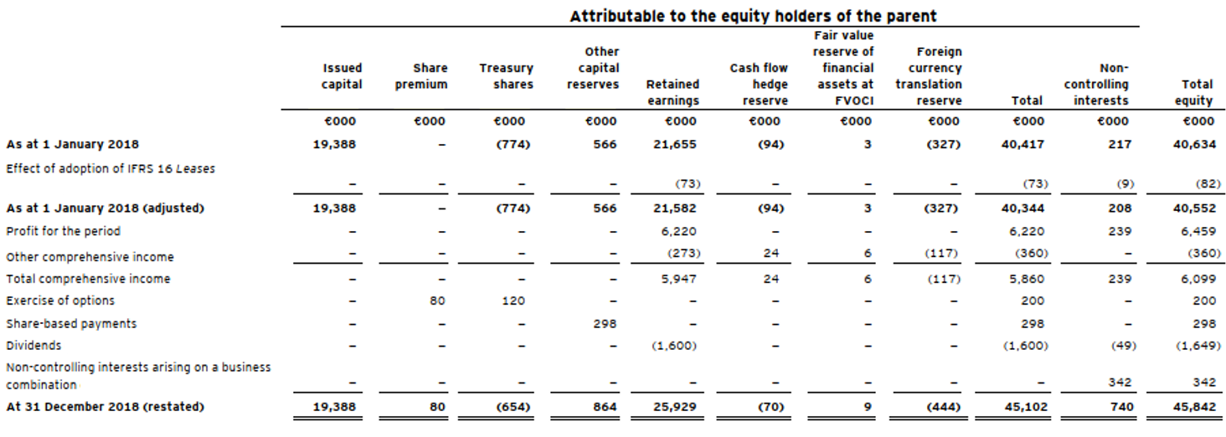
Equity

Slide 7
Equity
Profit in the profit and loss for the year is then reopened as an increasing element of the opening equity next year. In the example reported the company realized 6.220 profit. When the shareholders meeting approves the FS they decide how to allocate this created value. If this is maintained in the retaining earnings its means these resources are retained within the company
IN | Profit for the period | 6.220
OUT | Retaining earnings (Equity) |  | 6.220

Slide 8
Equity
It is possible that shareholders would like to claim for the value or part of the value produced by the company. This value, namely profit, is claimed through dividends. The payment of dividends is normally decided by a shareholders meeting. The decision produce a reduction of equity against payables to shareholders
At the decision:
At the payment:
IN | Equity | 6.000
OUT | Payables to shareholders |  | 6.000
IN | Payables to shareholders | 6.000
OUT | Cash |  | 6.000

Slide 9
Equity
The equity is also the statement in which are cumulated the changes represented in OCI. IAS 19 i.e. requires companies to reassess the value of the post employment benefit in order to represent the fair value based on a actuarial model. When changes are identified these are represented in the OCI
This change is represented in a specific reserve in the equity. You might call it IAS 19 reserve. This reserve will never be reversed in the P&L as at the moment of payment of post employment benefit actually you will pay the nominal value. Then this reserve is going to be reduced as you go next to the payment moment.
IN | Changes in Post Emp Fund | 10.000
OUT | Post Employment Fund |  | 10.000

Slide 10
Equity
Other changes to be represented in the OCI are changes in exchange rate. When you buy something on credit in a different currency it is common (and expected) that at the payment date the exchange rate will be different from the exchange rate at the purchase date. i.e. On November I purchased a phone from a US supplier at a price of $800. The exchange rate was 0,9 then the exchange was Euro 720. For simplification purposes let’s assume no VAT
On December I’m going to pay this phone. Now the exchange rate is 0,95, then the countervalue in Euro is 760. I realized a loss on exchange rate of 40
IN | Phone | 720
OUT | Payables |  | 720
IN | Payables | 720
IN | Loss on exchange rate | 40
OUT | Cash |  | 760

Slide 11
Equity
Let’s assume at the end of the period when I’m preparing the FS the company didn’t pay the payables yet. It means this loss has not being realized thus it is necessary to recognize it in the OCI
The payables are increased for 40 as this new value better represent the actual value of the obligations at year end. At the moment the loss is not realized as payment is not occurred yet. This value will be represented in a specific reserve in the equity. When payment is made (in next year), then the loss is realized thus it is reversed in the P&L
IN | Loss on exchange rate | 40
OUT | Payables |  | 40

Slide 12
IAS vs OIC
OIC 28 requires more detailed information if compared to IAS. Statement is more rigid and comprises the following information to be included mandatory:
Share capital
Share premium reserve
Revaluation reserve
Legal reserve
Own shares reserve
Statutory reserves
Other reserves
Profit (loss) carryforward
Result of the year
Disclosure is not different to IAS/IFRS

