Slide 1
Accounting
Balance Sheet: Liabilities

Slide 2
Agenda
Payables
Derecognition
Reverse factoring

Slide 3
Payables
Account payables include liabilities for which invoices have been received and liabilities for goods and services received that have not been matched with related invoices.
Accounts payables represent the amount of cash that the companies owe to their suppliers as the result of purchasing goods or rendering the services on credits.
According to IFRS 9 trade payables are to be recognized at fair value and then measured at amortized cost.
The company should record and recognize as payable at the time they record and recognize the expenses or assets of the same transactions.
You can distinguish between trade payables and financial payables.
Fair value represents the intrinsic value of an asset/liabilities. IFRS 13 defines it as the value which an asset will be exchanged, a liabilities paid, between parties aware and available, in a transaction between independents parties.

Slide 4
Payables
Trade payable are classified in the balance sheet within the current liabilities and form part of the working capital. The classification of account payables within current liabilities is because of these are normally paid within a short period (less than 12 months).
When payable is expected to be paid more than one year, then that liabilities should be recording in non-current liabilities categories.

Slide 5
Payables
Payables might be recorded also against a transaction different from a sale of goods and service. Example of payables are:
Payables to employees
Advances from subsidiaries
Received deposits to cover potential damages or losses
Received deposits as a guarantee of performance or payment
Dividends and interest payable
Etc.

Slide 6
Trade Payables
Trade payable are recognized in consideration of a commercial transaction, meaning an exchange of goods or services.
Company has to recognize payables in the moment where transaction has been operated, thus goods or services have been received.
When transaction is received the following journal entries is operated:
Goods/services represent the expenses sustained by the company for purchasing of goods or services while payables are the amount owed to the supplier. The initial recognition of payables is usually based on the agreement thus the initial recognition might be judged on the occurrence or not of some events. In other words sometimes the initial recognition might be complex.
IN | Goods/services | 3.000
OUT | Payables |  | 3.000

Slide 7
Trade Payables
When the service is rendered or goods delivered in and no invoice has been received yet the Company must accrued for the amount owed to supplier based on the fair value of goods or services received.
The above journal entry allows the company recording for the expense sustained and accruing for the relative amount within the liabilities. When invoice is received:
The above journal entry offsets the amount of invoice to be received versus trade payables to be recorded nominally to a specific supplier.
IN | Goods/services | 3.000
OUT | Invoice to be received |  | 3.000
IN | Invoice to be received | 3.000
IN | VAT on purchases | 660
OUT | Trade payables |  | 3.660

Slide 8
Debit note
It happens that invoices are to be corrected because 1) are erroneously received or 2) goods and service are returned or 3) any subsequent agreement between parties and are to be fully or partially corrected.
A debit note, or debit memo, is a commercial formal document issued by the seller to the buyer. This document cancel full or part of a previously received invoice.
i.e. a company has checked a purchasing invoice contained an higher amount for Euro 5.000 and obtained this to be corrected by supplier.
When a debit note is received the accounting is the following:
IN | Debit Note | 6.100
OUT | VAT on purchases |  | 1.100
OUT | Costs |  | 5.000

Slide 9
Trade Payables
Trade payables could be derecognized when are paid or transferred to another party.
When paid payables are cancelled from the balance sheet and are no more reported in the financial statements.
IN | Trade payables | 3.660
OUT | Cash |  | 3.660

Slide 10
Trade Payables
Sometime happens payables are not paid by cash but with the issuance of a note payable. Notes payables are amount companies owe for which a formal, written instruments of debit has been issued.
Note payables are formal promises to pay a certain amount in favor to a payee.
In terms of accounting notes payable represent a liability in which is written the face amount of the promissory note issued.
When payables are paid the following JE is entered:
It is common the issuer / borrower to pay interests. Usually interests are capitalized on the amount of liability through the following JE:
IN | Trade payables | 3.000
OUT | Notes payables |  | 3.000
IN | Interests | 99
OUT | Trade payables |  | 99

Slide 11
Trade Payables
When the note payables is paid actually you pay also the cumulated interests. The JE is the following:
IN | Notes payables | 3.000
IN | Trade payables (for interests) | 99
OUT | Cash |  | 3.099

Slide 12
Derecognition of payables
A company may elect for transferring its payables to another entity against cash.
This operation is known as reverse factoring, or indirect factoring. As well as factoring, derecognition is discussed in the IFRS 9.
The reason for reverse factoring is because of liquidity issues. The debtor turns to bank asking for a certain amount of cash against the payment of its payables to creditor. The payables written because of the regulation of trade payables are financial payables

Slide 13
Derecognition of payables
A company turns to a bank to obtain a delay of 90 days for its trade payables written in the FS for an amount of Euro 3.660. Bank agrees the delay to the company and accepts to pay its trade payables to supplier on behalf of the company. The configuration of this operation is similar to a loan from the bank, even if the bank does not directly give cash to company. The cost of this operation will be Euro 340, paid at reimbursement. When the reverse factoring is obtained the company derecognize the payables from its balance sheet through the following:
After 90 days the company reimburses the amount borrowed by the bank:
IN | Trade payables | 3.660
OUT | Payables to bank |  | 3.660
IN | Payables to bank | 3.660
IN | Interests | 340
OUT | Cash |  | 4.000

Slide 14
Financial payables
A company may raise capital through loans by financial institutions, as i.e. banks.
Usually loan is defined by an agreement between the bank (lender) and the company (borrower), by which this last is engaged in repaying the amount received plus a certain amount of interests.
Interests represent the cost of capital for the borrower and is accounted as an expense. The payable to bank, both principal and interest, is accounted in the financial liabilities.
When loan is received the company write for the following JE:
IN | Cash | 10.000
OUT | Loan |  | 10.000

Slide 15
Financial payables
It happens the borrower has to pay an upfront fee to bank. Usually this amount is direct retained from the amount of cash obtained by the lender. In this last case the record is the following:
The upfront fee represents an additional cost of capital to be paid by the borrower. If this was not retained at the emission the entry would be:
IN | Cash | 9.500
IN | Upfront Fee | 500
OUT | Loan |  | 10.000
IN | Cash | 10.000
IN | Upfront Fee | 500
OUT | Loan |  | 10.500

Slide 16
Financial payables
Often a company may elect for rediscuss the original agreement with the bank. IFRS 9 provides a contract is not wholly new if in the substance has not changed. In this case original agreement has not to be derecognized against the new agreed terms and conditions.
When a contract change the substance of the original contract the entity should derecognize the original contract and record for a new one.
A company must assess if quantitively and qualitatively affected the substance of the contract. The qualitative assessment is made by reading the contract (i.e. change in termination date). Terms of a loan are considered to have been substantially modified when the net present value of the cash flows under the new terms, including any fees paid net of any fees received and discounted using the original effective interest rate differs by at least 10 per cent from the present value of the remaining cash flows under the original terms.

Slide 17
Financial payables
When new terms and conditions don’t affect the substance of the contract usually this is not reflected in any journal entry but is reflected by a difference in interest or termination date.
A company obtains a renewal of its loan which original termination was on 2019 and remaining sum was Euro 6.000 at a rate of 2%. New conditions are:
  New termination on 2021;
  Sum Euro 10.000
  Rate 2%
  Upfront fee 500
After assessing these new conditions affect the substance of contract the company records for the derecognition of the original loan and the recognition of the new one:
IN | Original Loan (remaining sum) | 6.000
IN | Upfront Fee | 500
IN | Cash | 3.500
OUT | Loan |  | 10.000

Slide 18
Financial payables
A loan is to be derecognized when paid or transferred. Loan is usually paid periodically by a systematic repayment plan
IN | Loan | 800
IN | Interests | 200
OUT | Cash |  | 1.000

Slide 19
Amortized cost
The amortized cost of a financial asset or financial liability at each reporting date is the net of the following amounts:
  the amount at which the financial asset or financial liability is measured at initial recognition;
  minus any repayments of the principal;
  plus or minus the cumulative amortization using the effective interest method of any difference between the amount at initial recognition and the maturity amount; and
  minus, in the case of a financial asset, any reduction for impairment or uncollectibility.
Trade payable which are usually paid within one year are measured at an undiscounted amount. When these are regulated beyond one year it could be necessary amortized cost to be calculated.

Slide 20
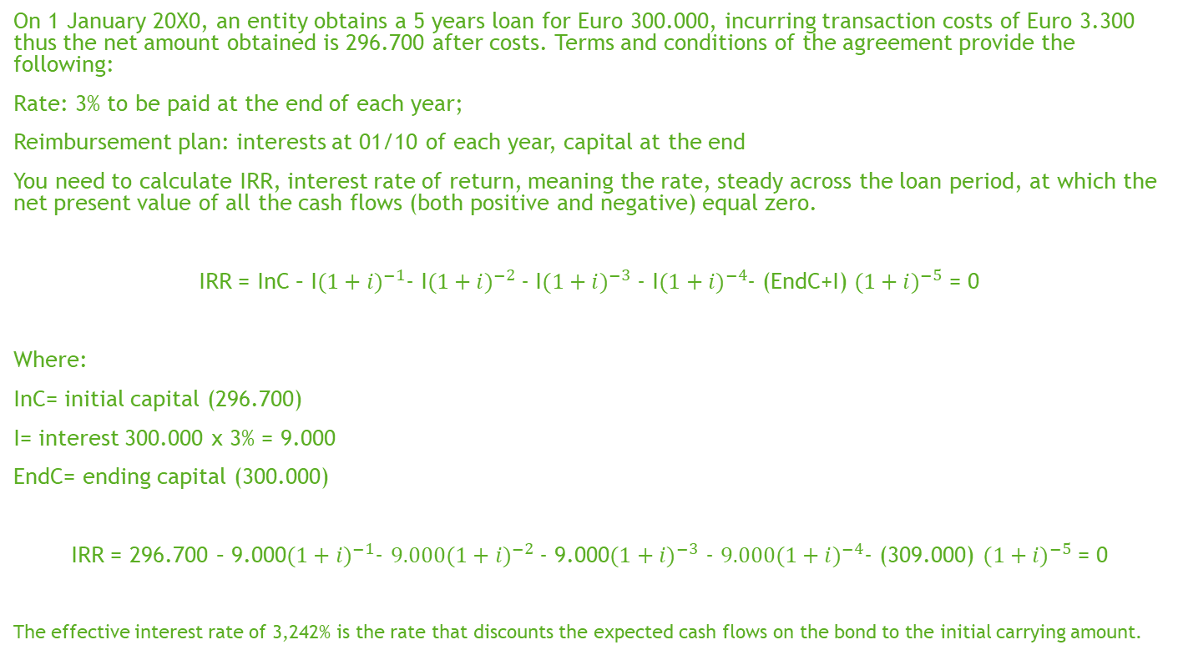
Amortized cost
On 1 January 20X0, an entity obtains a 5 years loan for Euro 300.000, incurring transaction costs of Euro 3.300 thus the net amount obtained is 296.700 after costs. Terms and conditions of the agreement provide the following:
Rate: 3% to be paid at the end of each year;
Reimbursement plan: interests at 01/10 of each year, capital at the end
You need to calculate IRR, interest rate of return, meaning the rate, steady across the loan period, at which the net present value of all the cash flows (both positive and negative) equal zero.
IRR = InC – I${(1+i)}^{−1}$- I${(1+i)}^{−2}$- I${(1+i)}^{−3}$ - I${(1+i)}^{−4}$- (EndC+I) ${(1+i)}^{−5}$ = 0
Where:
InC= initial capital (296.700)
I= interest 300.000 x 3% = 9.000
EndC= ending capital (300.000)
IRR = 296.700 – 9.000${(1+i)}^{−1}$- $9.000{(1+i)}^{−2}$- 9.000${(1+i)}^{−3}$ - $9.000{(1+i)}^{−4}$- (309.000) ${(1+i)}^{−5}$ = 0
The effective interest rate of 3,242% is the rate that discounts the expected cash flows on the bond to the initial carrying amount.

Slide 21
Amortized cost
The effect of calculation is the following development:
Year | Accounting Value at the beginning of period | Positive interests calculated by IRR | Cash flows | Accounting Value at the closing of period
 | a | b = a x 3,242% | c
20X0 | 296.700 | 9.619 | (9.000) | 297.319
20X1 | 297.319 | 9.639 | (9.000) | 297.958
20X2 | 297.958 | 9.659 | (9.000) | 298.617
20X3 | 298.617 | 9.681 | (9.000) | 299.298
20X4 | 299.298 | 9.702 | (9.000) | 300.000

Slide 22
Amortized cost
At inception:
IN | Cash | 296.700
OUT | Loan |  | 296.700
Cash
296.700
296.700
Loan
 | 296.700
 | 296.700

Slide 23
Amortized cost
At the first payment:
IN | Interests | 9.000
OUT | Cash |  | 9.000
Cash
296.700
 | 9.000
287.700
Interests
9.000
9.000
Loan
 | 296.700
 | 296.700

Slide 24
Amortized cost
Then you write for the amortized cost:
The effect you account for in the P&L is the difference between interests paid (9.000) and effective rate interests (9.619).
IN | Interests | 619
OUT | Loan |  | 619
Cash
296.700
 | 9.000
287.700
Interests
9.000
619
9.619
Loan
 | 296.700
 | 619
 | 297.319

Slide 25
IFRS vs OIC
OIC 19 requires trade payables to be recognized at amortized cost. Fair value is not allowed.
There are no other significant differences between GAAPs

