Slide 1
Accounting
Balance Sheet: Provisions and employment benefits

Slide 2
Agenda
Provisions
Onerous contracts
Employee benefits

Slide 3
Provisions
A company throughout the period must be alerted for obligations that may warrant accrual at the end of the period. Obligations that represent legal or contractual liabilities should generally be accrued; the accrual of other amounts is based generally on the notion of matching costs and revenues. Obligations that may be accrued include:
Compensation (wages, salaries, bonuses, commissions, retroactive pay, termination benefits)
Compensated absences (vacation pay, illness, holidays)
Other employment benefits (profit sharing, pension, deferred compensation, post-retirement benefits other than pensions)
Taxes other than taxes on income (payroll, property, franchise, sales)
Product service (warranties, guarantees, return privileges, contract renegotiation)
Unusual charges (legal settlements, product claims)
Other expenses (rents, royalties, interest, insurance and advertising)

Slide 4
Provisions
Among provisions a company is required to record for:
Post-employment benefit obligations and other employee related non-current provisions. These might include:
  Pensions, these might be mandated by law in some countries and may require the work of actuaries to be reported (IAS 19)
  Other post retirement employee benefits, the entity may offer other post-retirement benefits to its employees, such as health care benefits. Measuring the future costs of these benefits is often difficult, and may involve a higher degree of uncertainty than many other accounting estimates.
Environmental liabilities. Environmental issues affect virtually every industry and are not limited to entities in industries such as chemicals, oil and gas, mining, and manufacturing. For example, activities that could create environmental liabilities include:
  Generating, transporting, treating, or disposing of solid or hazardous wastes
  Buying, managing, and selling property (real estate), for example, past or current ownership of property on which hazardous substances are being or were disposed of, or sales of contaminated land under arrangements whereby the seller retains responsibility for clean-up

Slide 5
Provisions
Warranty provision. In many industries, products are sold with a warranty or guarantee, which promises the buyer a replacement product or repair if the purchased product becomes faulty within a fixed period after purchase. The costs of the replacement product or repair are generally borne by the manufacturer of the product.
Other legal risks. This represents a risk related to any lawsuit or claims raised during the course of business
Restructuring costs. These costs are related to a future restructuring of a business
Onerous contracts
Restorations costs

Slide 6
Provisions
According to IAS 37, a provision shall be recognised when:
an entity has a present obligation (legal or constructive) as a result of a past event;
it is probable that an outflow of resources embodying economic benefits will be required to settle the obligation; and
a reliable estimate can be made of the amount of the obligation.
If these conditions are not met, no provision shall be recognised.

Slide 7
Provisions
In rare cases it is not clear whether there is a present obligation. In these cases, a past event is deemed to give rise to a present obligation if, taking account of all available evidence, it is more likely than not that a present obligation exists at the end of the reporting period.
For example in a lawsuit, it may be disputed either whether certain events have occurred or whether those events result in a present obligation. In such a case, an entity determines whether a present obligation exists at the end of the reporting period by taking account of all available evidence, including, for example, the opinion of experts.
A past event that leads to a present obligation is called an obligating event. For an event to be an obligating event, it is necessary that the entity has no realistic alternative to settling the obligation created by the event

Slide 8
Provisions
It is only those obligations arising from past events existing independently of an entity's future actions (ie the future conduct of its business) that are recognised as provisions.
Examples of such obligations are penalties or clean-up costs for unlawful environmental damage, both of which would lead to an outflow of resources embodying economic benefits in settlement regardless of the future actions of the entity.
Similarly, an entity recognises a provision for the decommissioning costs of an oil installation or a nuclear power station to the extent that the entity is obliged to rectify damage already caused.
An obligation always involves another party to whom the obligation is owed. It is not necessary, however, to know the identity of the party to whom the obligation is owed, indeed the obligation may be to the public at large

Slide 9
Provisions
For a liability to qualify for recognition there must be not only a present obligation but also the probability of an outflow of resources embodying economic benefits to settle that obligation.
According to IAS 37, an outflow of resources or other event is regarded as probable if the event is more likely than not to occur, i.e. the probability that the event will occur is greater than the probability that it will not.
Where it is not probable that a present obligation exists, an entity discloses a contingent liability, unless the possibility of an outflow of resources embodying economic benefits is remote

Slide 10
Provisions
The use of estimates is an essential part of the preparation of financial statements and does not undermine their reliability. This is especially true in the case of provisions, which by their nature are more uncertain than most other items in the statement of financial position. Except in extremely rare cases, an entity will be able to determine a range of possible outcomes and can therefore make an estimate of the obligation that is sufficiently reliable to use in recognising a provision.
In the case where no reliable estimate can be made, a liability exists that cannot be recognised. That liability is disclosed as a contingent liability
The amount recognised as a provision shall be the best estimate of the expenditure required to settle the present obligation at the end of the reporting period. The estimates of outcome and financial effect are determined by the judgement of the management of the entity, supplemented by experience of similar transactions and, in some cases, reports from independent experts
The risks and uncertainties that inevitably surround many events and circumstances shall be taken into account in reaching the best estimate of a provision.

Slide 11
Provisions
Future events that may affect the amount required to settle an obligation shall be reflected in the amount of a provision where there is sufficient objective evidence that they will occur.
For example, an entity may believe that the cost of cleaning up a site at the end of its life will be reduced by future changes in technology. The amount recognised reflects a reasonable expectation of technically qualified, objective observers, taking account of all available evidence as to the technology that will be available at the time of the clean-up. Thus it is appropriate to include, for example, expected cost reductions associated with increased experience in applying existing technology or the expected cost of applying existing technology to a larger or more complex clean-up operation than has previously been carried out.

Slide 12
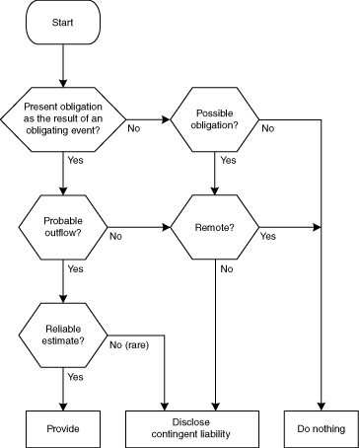
Provisions

Slide 13
Provisions
An entity sells goods with a warranty under which customers are covered for the cost of repairs of any manufacturing defects that become apparent within the first six months after purchase. If minor defects were detected in all products sold, repair costs of 1 million would result. If major defects were detected in all products sold, repair costs of 4 million would result. The entity's past experience and future expectations indicate that, for the coming year, 75 per cent of the goods sold will have no defects, 20 per cent of the goods sold will have minor defects and 5 per cent of the goods sold will have major defects. An entity assesses the probability of an outflow for the warranty obligations as a whole.
The expected value of the cost of repairs is:
(75% of nil) + (20% of 1M) + (5% of 4M) = Euro 400.000
IN | Provisions (P&L) | 400.000
OUT | Provision for warranty (BS) |  | 400.000

Slide 14
Provisions
Then, when the event occurs the provision is used with the following JE (let’s assume a nominal cost for warranty of 10.000):
Let’s then assume the company decides to interrupt the product line and no more potential risks remain (risks were only in the first six months). The accrued provision is no more needed thus has to be released. The company has accrued for 400k and used for 10k, then the JE is:
IN | Provision for warranty (BS) | 10.000
OUT | Payable vs repairer/cash |  | 10.000
IN | Provision for warranty (BS) | 390.000
OUT | Income |  | 390.000

Slide 15
Provisions
An entity in the oil industry causes contamination but cleans up only when required to do so under the laws of the particular country in which it operates. One country in which it operates has had no legislation requiring cleaning up, and the entity has been contaminating land in that country for several years. At 31 December 20X0 it is virtually certain that a draft law requiring a clean-up of land already contaminated will be enacted shortly after the year-end.
  Present obligation as a result of a past obligating event is the contamination of the land because of the virtual certainty of legislation requiring cleaning up.
  An outflow of resources embodying economic benefits in settlement is probable.
A provision is recognised for the best estimate of the costs of the clean-up
IN | Provisions (P&L) | XXX
OUT | Provision for contamination (BS) |  | XXX

Slide 16
Provisions
After a wedding in 20X0, ten people died, possibly as a result of food poisoning from products sold by the entity. Legal proceedings are started seeking damages from the entity but it disputes liability. Up to the date of authorisation of the financial statements for the year to 31 December 20X0 for issue, the entity's lawyers advise that it is probable that the entity will not be found liable. However, when the entity prepares the financial statements for the year to 31 December 20X1, its lawyers advise that, owing to developments in the case, it is probable that the entity will be found liable.
At 31 December 20X0
  Present obligation as a result of a past obligating event — On the basis of the evidence available when the financial statements were approved, there is no obligation as a result of past events.
  Conclusion — No provision is recognised and the matter is disclosed as a contingent liability unless the probability of any outflow is regarded as remote.
At 31 December 20X1
  Present obligation as a result of a past obligating event — On the basis of the evidence available, there is a present obligation.
  An outflow of resources embodying economic benefits in settlement — Probable.
  Conclusion — A provision is recognised for the best estimate of the amount to settle the obligation

Slide 17
Provisions
Provisions shall be reviewed at the end of each reporting period and adjusted to reflect the current best estimate. If it is no longer probable that an outflow of resources embodying economic benefits will be required to settle the obligation, the provision shall be reversed.
A provision shall be used only for expenditures for which the provision was originally recognised. Only expenditures that relate to the original provision are set against it. i.e. provision for warranty on products might be used only to cover actual expenditures for execution of warranties.
IN | Provision for warranty (BS) | 400.000
OUT | Reversing of a provision (P&L) |  | 400.000

Slide 18
Provisions
Provisions shall not be recognised for future operating losses as do not meet the definition of a liability and the general recognition criteria set out in IAS 37
An expectation of future operating losses is an indication that certain assets of the operation may be impaired. An entity tests these assets for impairment under IAS 36

Slide 19
Onerous Contract
An onerous contract is a contract in which the unavoidable costs of meeting the obligations under the contract exceed the economic benefits expected to be received under it. The unavoidable costs under a contract reflect the least net cost of exiting from the contract, which is the lower of the cost of fulfilling it and any compensation or penalties arising from failure to fulfil it.
If an entity has a contract that is onerous, the present obligation under the contract shall be recognised and measured as a provision.
Many contracts establish both rights and obligations for each of the contracting parties (i.e. cancellation requires a party to pay for a compensation to the other party). Where events make such a contract onerous, the contract falls within the scope of IAS 37 and a liability exists which is recognised.
Before a separate provision for an onerous contract is established, an entity recognises any impairment loss that has occurred on assets dedicated to that contract

Slide 20
Onerous Contract
In year n the company entered into a contract with a supplier to provide 100.000 units of the main component used in their manufacturing process. The contract stipulates that the price of each unit is Euro 5. All quantities must be purchased by the end of n+2. The company forecasted the following selling price:
In the first year 20.000 units were sold at the expected price of Euro 10. In second year a competitor entered the market and offered a similar product at Euro 5.
Expected economic benefits: 80.000 finished goods * (CU 5-CU 1) = CU 320.000
Unavoidable costs: 80.000 units * CU 5 = CU 400.000
In this case, the unavoidable costs do exceed the expected benefits under the contract. The contract is thus onerous and a provision shall be recognised
Description | Amount
Selling price | Euro 10
Component cost | Euro 5
Other variable costs | Euro 1
Margin | Euro 4

Slide 21
Onerous Contract
The future operating losses is accounted as following:
IN | Provision | 80.000
OUT | Future operating losses |  | 80.000
Future operating losses
 | 80.000
 | 80.000
Provision
80.000
80.000

Slide 22
IAS vs OIC
Provisions are defined by OIC 31 which defines post-employment benefits too. Compared to IAS 37 there are no relevant differences with reference to the definition of provision. The Italian principle statues more precisely what is meant for:
Probable – the occurrence of an event is bases on reliable and serious reasons even if not certain…it is probable opinion deserving the assent of a prudent person
Possible – the probability of occurrence of an event is less than probable. It can occur, but considering the information available is not probable.
Remote – the event has very poor probability to occur.
When probable a provision must be reported. When possible an even must be disclosed. When remote an event has not to be reported nor disclosed.
The relevant difference between IAS 37 and OIC 31 is related to the actualization of amount when the provision is relevant. OIC 31 does not require it.

Slide 23
Employee benefits
According to IAS 19 employee benefits are all forms of consideration given by an entity in exchange for service rendered by employees or for the termination of employment.
Short-term employee benefits are employee benefits that are expected to be settled wholly before twelve months after the end of the annual reporting period in which the employees render the related service.
Post-employment benefits are employee benefits that are payable after the completion of employment.
Other long-term employee benefits are all employee benefits other than short-term employee benefits, post-employment benefits and termination benefits.
Termination benefits are employee benefits provided in exchange for the termination of an employee's employment as a result of either:
  an entity's decision to terminate an employee's employment before the normal retirement date; or
  an employee's decision to accept an offer of benefits in exchange for the termination of employment.

Slide 24
Employee benefits
Short-term employee benefits include items such as the following, if expected to be settled wholly before twelve months after the end of the annual reporting period in which the employees render the related services:
wages, salaries and social security contributions;
paid annual leave and paid sick leave;
profit-sharing and bonuses; and
non-monetary benefits (such as medical care, housing, cars and free or subsidised goods or services) for current employees.
When an employee has rendered service to an entity during an accounting period, the entity shall recognise the undiscounted amount of short-term employee benefits expected to be paid in exchange for that service:
as a liability (accrued expense), after deducting any amount already paid.
as an expense.

Slide 25
Employee benefits
IN | Wages to employees | 2.000
OUT | Debts for wages |  | 2.000
IN | Debts for wages | 2.000
OUT | Cash |  | 2.000
Cash
 | 2.000
 | 2.000
Debt for Wages
2.000 | 2.000
// | //
Wages to employees
2.000
2.000

Slide 26
Employee benefits
Post-employment benefits include items such as the following:
retirement benefits (eg pensions and lump sum payments on retirement); and
other post-employment benefits, such as post-employment life insurance and post-employment medical care.
Arrangements whereby an entity provides post-employment benefits are post-employment benefit plans. Post-employment benefit plans are classified as either defined contribution plans or defined benefit plans.

Slide 27
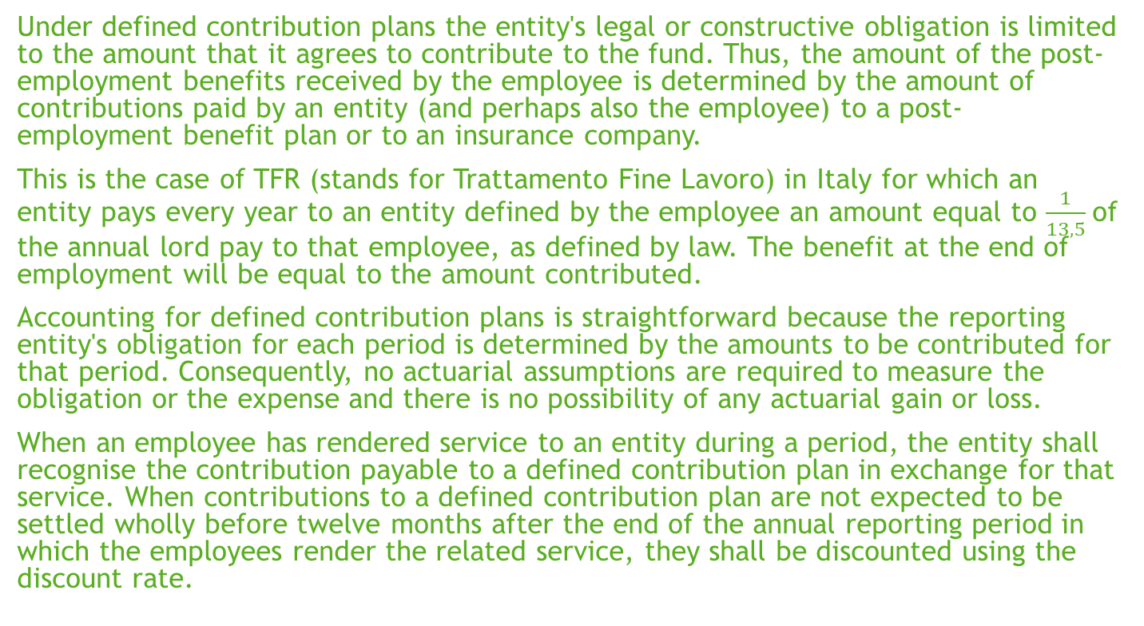
Employee benefits
Under defined contribution plans the entity's legal or constructive obligation is limited to the amount that it agrees to contribute to the fund. Thus, the amount of the post-employment benefits received by the employee is determined by the amount of contributions paid by an entity (and perhaps also the employee) to a post-employment benefit plan or to an insurance company.
This is the case of TFR (stands for Trattamento Fine Lavoro) in Italy for which an entity pays every year to an entity defined by the employee an amount equal to $\frac{1}{13,5}$of the annual lord pay to that employee, as defined by law. The benefit at the end of employment will be equal to the amount contributed.
Accounting for defined contribution plans is straightforward because the reporting entity's obligation for each period is determined by the amounts to be contributed for that period. Consequently, no actuarial assumptions are required to measure the obligation or the expense and there is no possibility of any actuarial gain or loss.
When an employee has rendered service to an entity during a period, the entity shall recognise the contribution payable to a defined contribution plan in exchange for that service. When contributions to a defined contribution plan are not expected to be settled wholly before twelve months after the end of the annual reporting period in which the employees render the related service, they shall be discounted using the discount rate.

Slide 28
Employee benefits
Every year when provision is made:
At the end of work relationship when benefit is paid:
IN | Post Employment Benefit | 1.000
OUT | PEB Fund |  | 1.000
IN | PEB Fund | 1.000
OUT | Cash |  | 1.000
Post Employment Benefit
1.000
1.000
Cash
 | 1.000
 | 1.000
PEB Fund
1.000 | 1.000
// | //

Slide 29
Employee benefits
Under defined benefit plans:
the entity's obligation is to provide the agreed benefits to current and former employees; and
actuarial risk (that benefits will cost more than expected) and investment risk fall, in substance, on the entity. If actuarial or investment experience are worse than expected, the entity's obligation may be increased
Accounting for defined benefit plans is complex because actuarial assumptions are required to measure the obligation and the expense and there is a possibility of actuarial gains and losses. This involves:
determining the deficit or surplus by:
  using an actuarial technique, the projected unit credit method, to make a reliable estimate of the ultimate cost to the entity of the benefit that employees have earned in return for their service in the current and prior periods
  discounting that benefit in order to determine the present value of the defined benefit obligation and the current service cost
  deducting the fair value of any plan assets from the present value of the defined benefit obligation.
determining the amount of the net defined benefit liability (asset) as the amount of the deficit or surplus determined in (a), adjusted for any effect of limiting a net defined benefit asset to the asset ceiling
determining amounts to be recognised in profit or loss
determining the remeasurements of the net defined benefit liability (asset), to be recognised in other comprehensive income

Slide 30
Employee benefits
The following example, taken from the Illustrative Example to the par. 68 of IAS 19, represents some of the considerations that enter into an actuarial calculation:
A lump sum benefit is payable on termination of service and equal to 1 per cent of final salary for each year of service. The salary in year 1 is Euro 10.000 and is assumed to increase at 7 per cent (compound) each year. The discount rate used is 10 per cent per year. The employee is expected to leave at Y5.
Year | 1 | 2 | 3 | 4 | 5
Salary (7% annuum increase) | 10.000 | 10.700 | 11.449 | 12.250 | 13.108
Benefit prior years | 0 | 131 | 262 | 393 | 524
Benefit current year (1% of 13.108) | 131 | 131 | 131 | 131 | 131
Cumulative Benefit | 131 | 262 | 393 | 524 | 655
Opening Obligation (NPV benefit attributed to prior years) | 0 | 89 | 196 | 324 | 476
Interest at 10% | 0 | 9 | 20 | 32 | 48
Current service cost (NPV of CY benefit) | 89 | 98 | 108 | 119 | 131
Closing obligation (NPV of the benefit attributed to CY and PYs) | 89 | 196 | 324 | 476 | 655

Slide 31
Employee benefits
In year 1 the PEB fund was
For a detailed exposition of the accounting related to the example please open the Excel worksheet
IN | PEB Fund | 42
OUT | Actuarial reserve |  | 42
PEB Fund
42 | 131
 | 89
Actuarial reserve
 | 42
 | 42

Slide 32
Employee benefits
Other long-term employee benefits include items such as the following, if not expected to be settled wholly before twelve months after the end of the annual reporting period in which the employees render the related service:
long-term paid absences such as long-service or sabbatical leave;
jubilee or other long-service benefits;
long-term disability benefits;
profit-sharing and bonuses; and
deferred remuneration.

Slide 33
Employee benefits
Termination benefits result from either an entity's decision to terminate the employment or an employee's decision to accept an entity's offer of benefits in exchange for termination of employment.
Termination benefits are typically lump sum payments, but sometimes also include:
enhancement of post-employment benefits, either indirectly through an employee benefit plan or directly.
salary until the end of a specified notice period if the employee renders no further service that provides economic benefits to the entity.
An entity shall recognise a liability and expense for termination benefits at the earlier of the following dates:
when the entity can no longer withdraw the offer of those benefits; and
when the entity recognises costs for a restructuring that is within the scope of IAS 37 and involves the payment of termination benefits.

Slide 34
IAS vs OIC
The employee benefits are defined in the standard OIC 31. The difference between the two accounting standards is related to the total absence of a reference to any actualization operation in the Italian GAAP.
Based on Italian standards the provision is to be accrued when it is probable the outcome and as this provision, when a contractual obligation exists, is certain it has to be accrued year per year. Its value is represented by the value defined by the Italian law. Art. 61 of OIC 31 stands “it should be measured based on art. 2120 of Civil Code”.
This means the actual obligation to the employees exactly will correspond to the accounting value of the provision without taking into consideration any time effect, probability of occurrence (is certain), composition of the employees within the company.
This difference is basically explained by the fact that Italian laws predict a certain amount to be paid at the end of the work period and this is not always provided in other legislations.

