Slide 1
Accounting
Balance Sheet: Provision & Liabilities

Slide 2
Provisions
Let’s think the provision fund as a cauldron where all expenses and risks are represented:
Nature | Provision Fund PY | Provision of the year | Use | Release | Provision Fund
Risk on litigations | 1.000 | 200 | 50 | - | 1.150
Employee litigation | - | 400 |  |  | 400
Decommissioning | 10.000 |  |  | 1.000 | 9.000
Tax litigation | 2.000 |  | 2.000 |  | -
Total | 13.000 | 600 | 2.050 | 1.000 | 10.550

Slide 3
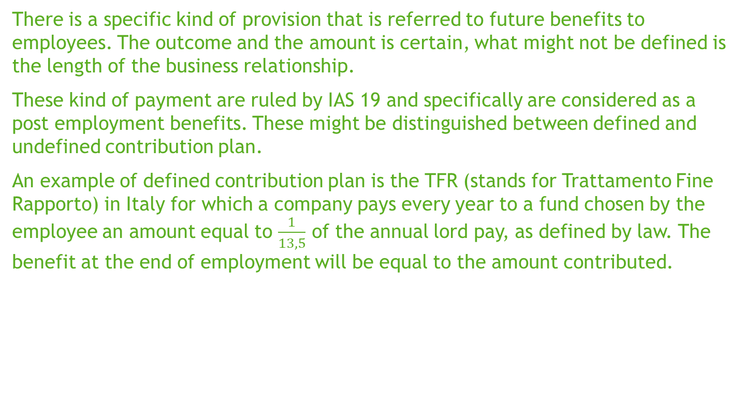
Provisions
There is a specific kind of provision that is referred to future benefits to employees. The outcome and the amount is certain, what might not be defined is the length of the business relationship.
These kind of payment are ruled by IAS 19 and specifically are considered as a post employment benefits. These might be distinguished between defined and undefined contribution plan.
An example of defined contribution plan is the TFR (stands for Trattamento Fine Rapporto) in Italy for which a company pays every year to a fund chosen by the employee an amount equal to $\frac{1}{13,5}$ of the annual lord pay, as defined by law. The benefit at the end of employment will be equal to the amount contributed.

Slide 4
Provisions
The company X, that operates in Italy, has a work contract with an employee which lord wage is Euro 30.000. Each year the company X accrues for the portion of TFR to be corresponded to the employee:
Year 1: 30.000/13,5 = 2.222
In Year 2 at the end of June the employee left the company:
IN | Provision for PEB (P&L) | 2.222
OUT | PEB Fund(BS) |  | 2.222
IN | Provision for PEB (P&L) | 1.111
OUT | PEB Fund (BS) |  | 1.111
IN | PEB Fund(BS) | 3.333
OUT | Cash |  | 3.333

Slide 5
Provisions
Actually the Italian law provides that the accumulated benefit, at each closing period are to be revaluated considering the inflation (meaning the increase in cost of life). This is usually calculated considering a reference index. Italian law provides this index is given by the increase in cost of life published by ISTAT. The formula provides that accumulated benefits are to be revaluated as following:
PEB Fund * [1,5% + (75%*ISTAT Index)]
PEB Fund = 2.222
ISTAT Index = 0,8%
2.222 * [1,5% + (75%*0,8%)]= 2.222 * 2,1% = 47
IN | Revaluation of PEB (P&L) | 47
OUT | PEB Fund(BS) |  | 47

Slide 6
Provisions
Italian standards do not require any actualization of benefits to the employees as defined by OIC 31. On the contrary IAS 19 require those benefits to be actualized based on a complex model which often require the support of an expert. Actuarial techniques are hard to be implemented without any specific competency. The actuarial models consider many variables as the average age of employees, the kind of business, the turnover of employees, the increase in salary, inflation, the mortality etc.
All these considerations are evaluated in the actuarial model in order to get to the final result. All differences between the actual fund and the actualized one are to be accounted in the OCI.
Assume the actuarial model shows a PEB fund in the Y1 for Euro 2.200 then the accounting is:
IN | PEB Fund(BS) | 22
OUT | Actuarial Gain&Loss Reserve (OCI/BS) |  | 22

Slide 7
Amortized cost
The amortized cost of a financial asset or financial liability at each reporting date is the net of the following amounts:
  the amount at which the financial asset or financial liability is measured at initial recognition;
  minus any repayments of the principal;
  plus or minus the cumulative amortization using the effective interest method of any difference between the amount at initial recognition and the maturity amount; and
  minus, in the case of a financial asset, any reduction for impairment or uncollectibility.
Trade payable which are usually paid within one year are measured at an undiscounted amount. When these are regulated beyond one year it could be necessary amortized cost to be calculated.

Slide 8
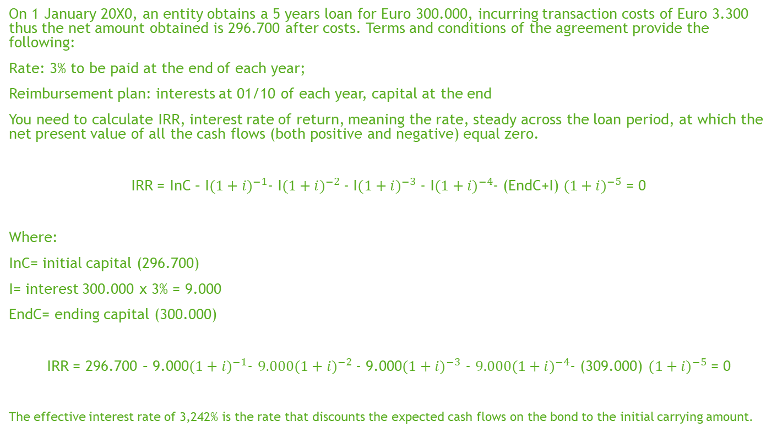
Amortized cost
On 1 January 20X0, an entity obtains a 5 years loan for Euro 300.000, incurring transaction costs of Euro 3.300 thus the net amount obtained is 296.700 after costs. Terms and conditions of the agreement provide the following:
Rate: 3% to be paid at the end of each year;
Reimbursement plan: interests at 01/10 of each year, capital at the end
You need to calculate IRR, interest rate of return, meaning the rate, steady across the loan period, at which the net present value of all the cash flows (both positive and negative) equal zero.
IRR = InC – I${(1+i)}^{−1}$- I${(1+i)}^{−2}$- I${(1+i)}^{−3}$ - I${(1+i)}^{−4}$- (EndC+I) ${(1+i)}^{−5}$ = 0
Where:
InC= initial capital (296.700)
I= interest 300.000 x 3% = 9.000
EndC= ending capital (300.000)
IRR = 296.700 – 9.000${(1+i)}^{−1}$- $9.000{(1+i)}^{−2}$- 9.000${(1+i)}^{−3}$ - $9.000{(1+i)}^{−4}$- (309.000) ${(1+i)}^{−5}$ = 0
The effective interest rate of 3,242% is the rate that discounts the expected cash flows on the bond to the initial carrying amount.

Slide 9
Amortized cost
The effect of calculation is the following development:
Year | Accounting Value at the beginning of period | Positive interests calculated by IRR | Cash flows | Accounting Value at the closing of period
 | a | b = a x 3,242% | c
20X0 | 296.700 | 9.619 | (9.000) | 297.319
20X1 | 297.319 | 9.639 | (9.000) | 297.958
20X2 | 297.958 | 9.659 | (9.000) | 298.617
20X3 | 298.617 | 9.681 | (9.000) | 299.298
20X4 | 299.298 | 9.702 | (9.000) | 300.000

Slide 10
Amortized cost
At inception:
IN | Cash | 296.700
OUT | Loan |  | 296.700
Cash
296.700
296.700
Loan
 | 296.700
 | 296.700

Slide 11
Amortized cost
At the first payment:
IN | Interests | 9.000
OUT | Cash |  | 9.000
Cash
296.700
 | 9.000
287.700
Interests
9.000
9.000
Loan
 | 296.700
 | 296.700

Slide 12
Amortized cost
Then you write for the amortized cost:
The effect you account for in the P&L is the difference between interests paid (9.000) and effective rate interests (9.619).
IN | Interests | 619
OUT | Loan |  | 619
Cash
296.700
 | 9.000
287.700
Interests
9.000
619
9.619
Loan
 | 296.700
 | 619
 | 297.319

Slide 13
IFRS vs OIC
OIC 19 requires trade payables to be recognized at amortized cost. Fair value is not allowed.
There are no other significant differences between GAAPs

