Slide 1
Accounting
The role of valuation, assumption and estimates

Slide 2
Agenda
Valuation
Estimates

Slide 3
The Financial Statements
Balance Sheet
As of right now:
What do you have?
How much do you owe?
POINT IN TIME
Income Statement
How much did you make:
This week?
This month?
OVER TIME
vs

Slide 4
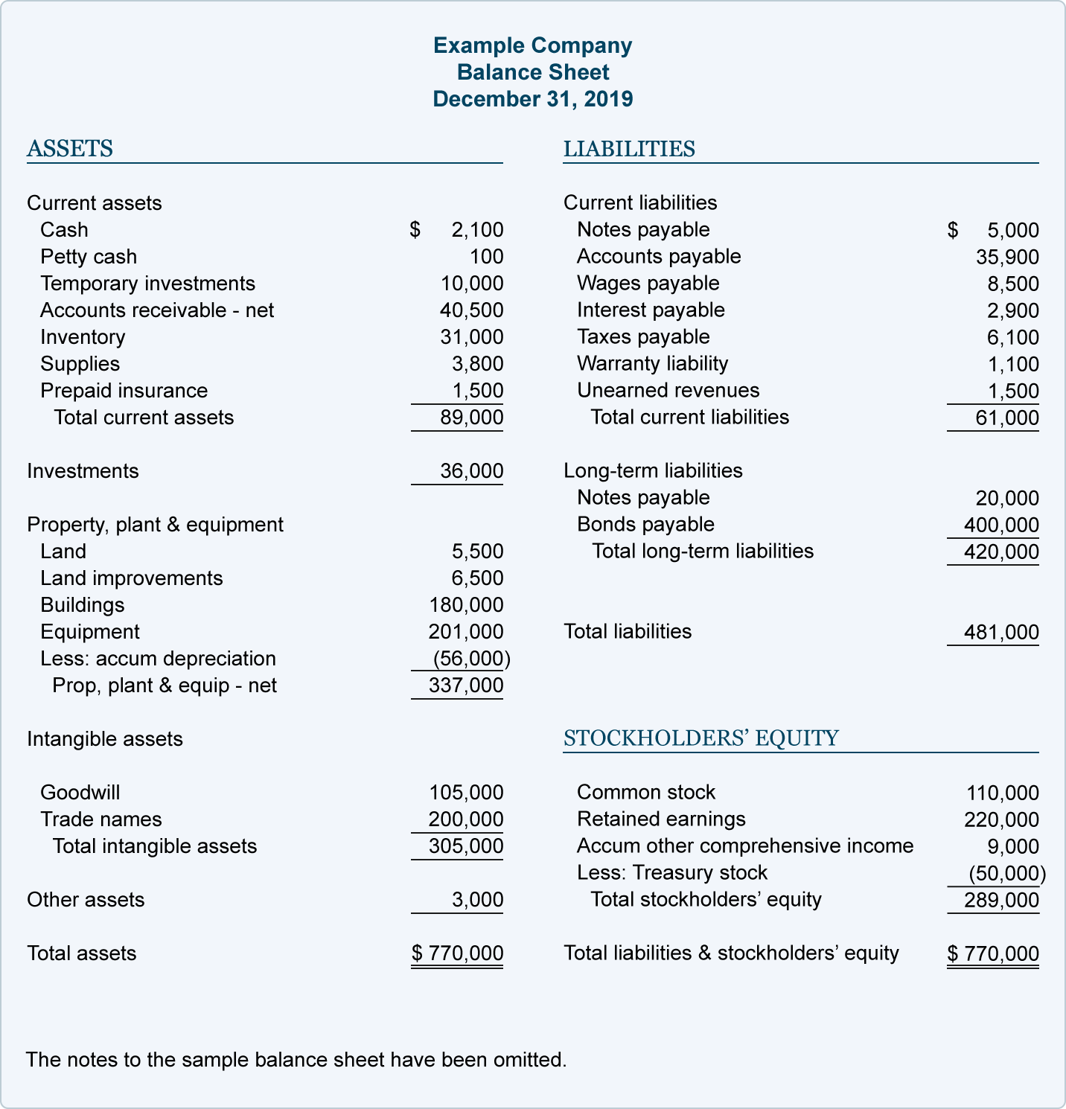
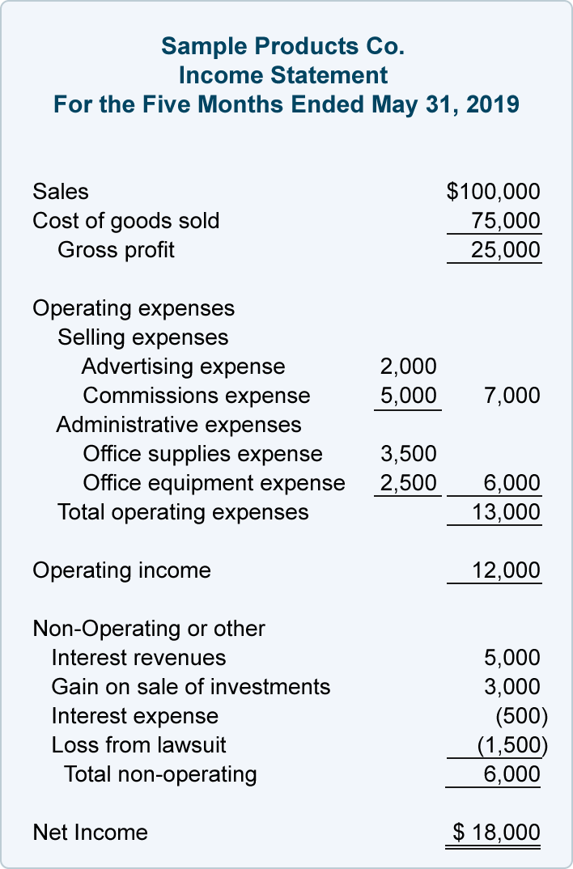
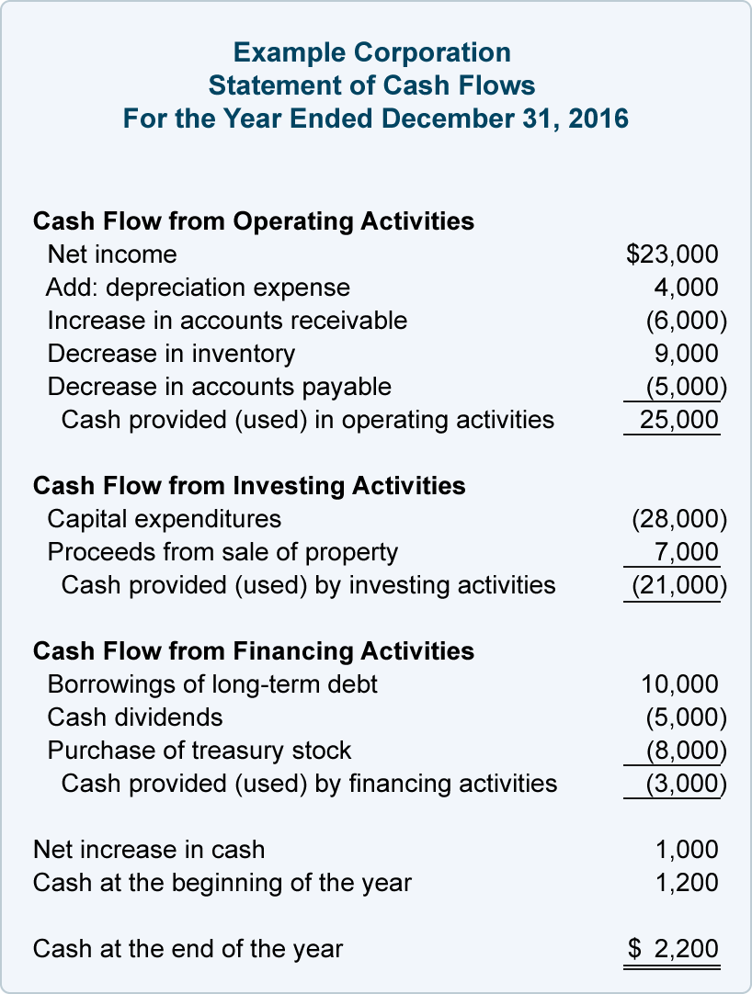
The Financial Statements
The Financial Statements are useful because they:
Provide a great deal of information to the users
Show a picture of the company’s past financial data
But..
They do not contain all the information
needed for business analysis
Taken alone, Financial data can hide
many other relevant information.
Value and Valuation are core subjects and
major concerns in Accounting

Slide 5
The Financial Statements
The financial statements is a judgmental process which aims to measure
economic values (sales, expenses)
  What is the actual value of transactions reported in the financial statements?
financial values (level of investments and of debt and the composition of sources of financing)
  What is the value of assets as of at date? What are the financing as of a date?
the association between economic values and financial values
  What is the future economic return of my investments?
the best possible estimates and predictions about the future conditions
  What are the future evolution of litigations I’m involved in? What is the % of collectability of account receivables recorded at a date?

Slide 6
The Financial Statements
Valuation is a subjective mental process aiming to:
Setting a value (or a monetary level) on a certain element (asset, liability, equity, company, business)
The act of appraisal
The estimation or acknowledgement of the worth of something
In other words valuation is the process of estimating the market value of a financial asset or liability. Valuations can be done on assets (for example, investments in marketable securities such as stocks, options, business enterprises, or intangible assets such as patents, trademarks, know-how, software, databases, and goodwill) or on liabilities (e.g., bonds issued by a company). Valuations are required in many contexts including investment analysis, capital budgeting, merger and acquisition transactions, financial reporting, taxable events to determine the proper tax liability, and in litigation.

Slide 7
The Financial Statements
Value is a complex notion, including:
Intrinsic Value:
  reflects the objective, hard, visible, tangible, concrete, verifiable part of an asset, a liability, a business or a company
  inspires and generates patrimonial valuation methods, based on costs of incorporated factors (labour, energy, materials and information) in the element to be valued
Utility Value
  represents the extension of user’s want/need fulfillment and satisfaction, it is highly subjective
  reflects the subjective, soft, invisible, hardly verifiable or provable part of an asset, a liability, a business or a company.
  generates non-patrimonial valuation methods, such as Discounted Cash Flow.

Slide 8
The Financial Statements
What is “Valuable”?
Having considerable monetary worth
Of considerable use or importance
Having qualities worthy of esteem
We valuate everything a company owns or owes, and the company as a whole.
According to IAS/IFRS Framework, a financial statement element (assets, liabilities, equity, income, expenses) should be recognized in the financial statements only if:
It is probable that any future economic benefit associated with the item will flow to or from the entity; and
The item has a cost or value that can be measured with reliability

Slide 9
The types of value
Historical cost or book value: purchase or production cost plus other expenses (freight, installation, provision, non-deductible taxes)
  The Company purchased a machinery to a total cost of Euro 10.000
Current (present, actual) cost: updated, nowadays historical cost less depreciation or amortization
  After 2 years the Company depreciated the machinery for Euro 4.000 thus the current cost is Euro 6.000
Net realizable (settlement) value: sale price less sale expenses
  The Company sold the machinery to a price of Euro 5.800 agreeing to pay for dismantling cost for Euro 200, then the NRV is Euro 5.600.
Present (market) value, a variety of Fair Value
  The present value for that sort of machinery observable to the market at that specific time is Euro 6.500

Slide 10
The types of value
Whenever possible, financial statement elements should be valuated at a Fair Value. IFRS 13 provides a defined hierarchy of fair value based on three levels input:
Level 1 inputs are quoted prices in active markets for identical assets or liabilities that the entity can access at the measurement date (IFRS 13 par. 76)
  Market Value is the most desirable variety of Fair Value. A quoted market price in an active market provides the most reliable evidence of fair value and is used without adjustment to measure fair value whenever available, with limited exceptions
Level 2 inputs are inputs other than quoted market prices included within Level 1 that are observable for the asset or liability, either directly or indirectly. It includes:
  quoted prices for similar assets or liabilities in active markets
  quoted prices for identical or similar assets or liabilities in markets that are not active
  inputs other than quoted prices that are observable for the asset or liability, for example:
    interest rates and yield curves observable at commonly quoted intervals
    implied volatilities
    credit spreads
  inputs that are derived principally from or corroborated by observable market data by correlation or other means
Level 3 inputs inputs are unobservable inputs for the asset or liability. Unobservable inputs are used to measure fair value to the extent that relevant observable inputs are not available, thereby allowing for situations in which there is little, if any, market activity for the asset or liability at the measurement date

Slide 11
The types of value
Market Value is accepted only if all Active Market conditions exist:
The items traded in the market are homogeneous;
Willing buyers and sellers can normally be found at any time; and
Prices are available to the public.
Market value is the estimated amount for which a property should exchange on the date of valuation between a willing buyer and a willing seller in an arm’s-length transaction after proper marketing wherein the parties had each acted knowledgeably, prudently, and without compulsion.

Slide 12
The types of value
Accounting estimates vary widely in nature and are required to be made by management when the monetary amounts cannot be directly observed. The measurement of these monetary amounts is subject to estimation uncertainty, which reflects inherent limitations in knowledge or data. These limitations give rise to inherent subjectivity and variation in the measurement outcomes. The process of making accounting estimates involves selecting and applying a method using assumptions and data, which requires judgment by management and can give rise to complexity in measurement.
The following elements in example are subject to estimation:
Bad debts;
Inventory obsolescence;
The fair value of financial assets or financial liabilities;
The useful lives of, or expected pattern of consumption of the future economic benefits embodied in depreciable assets;
Warranty obligations.
IAS 1.10 provides a complete set of financial statements includes, other than mandatory statements, notes, comprising a summary of significant accounting policies and other explanatory notes including those over significant estimates in preparation of financial statements. Furthermore IAS 1.125 specifies an entity must also disclose, in the notes, information about the key assumptions concerning the future, and other key sources of estimation uncertainty at the end of the reporting period, that have a significant risk of causing a material adjustment to the carrying amounts of assets and liabilities within the next financial year.

Slide 13
The types of value
The use of reasonable estimates is an essential part of the preparation of financial statements and does not undermine their reliability.
An estimate may need revision if changes occur in the circumstances on which the estimate was based or as result of new information or more experience (IAS 8)
vs
Truthful
True

Slide 14
The types of value
Example:
You are involved in a litigation with one of your customer related to damages one of your employee produced to its machinery during an ordinary maintenance. A legal confirmation received at year end says the risk related is possible.
Due to this statement you decide not to include any provision in your financial statements. After the court hearing of April your legal send you an update based on the new evidences and information presented. The new legal confirmation says the risk now is probable and the related risk for the company is valuable in Euro 100.000. Based on the new statement the company decides to record for a provision for Euro 100.000.
In this case, what is owed by the company, is based on the estimates for future implications of the litigation the company is involved in.

Slide 15
The types of value
Example:
The company is performing its annual test of impairment over the investments recorded in its assets. Test of impairment is based on the NPV of the future cash flows of the vehicle company it owns. The future cash flows are estimated by management in a business plan for the next 5 years. Business plan is built on the following assumptions:
A growth of local market of 5%
A growth of foreign markets of 20%
A cost reduction of 2%
Investments in fixed assets steady during the period
A WACC of 8%
1/2

Slide 16
The types of value
Example:
The recoverable amount of the investments recorded in the financial statements by the company is based on the feasibility of the assumptions the company used for the estimation of the future cash flows.
This procedure is highly subjective even if this not affect the reliability of the information included in the financial statements.
To be acceptable an estimation and the related assumptions are to be related to events both realizable and verifiable based on the available information in a specific moment
2/2

