Slide 1
Accounting
General recap

Slide 2
A company purchased a building to start its business. The cost of building is 1.000 + VAT 20% and its expected useful life is 20 years. The purchase has been financed through a 10 years loan with the bank. What is the accounting at inception?
IN | Building | 1.000
IN | VAT 20% | 200
OUT | Payables |  | 1.200
IN | Payables | 1.200
OUT | Loan |  | 1.200
Building
1.000
1.000
VAT
200
200
Loan
 | 1.200
 | 1.200

Slide 3
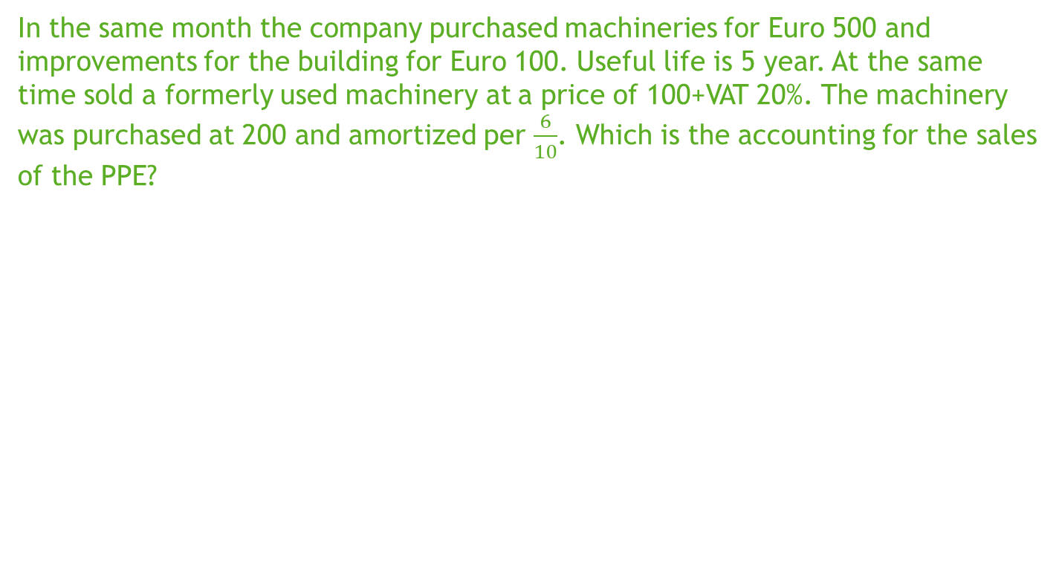
In the same month the company purchased machineries for Euro 500 and improvements for the building for Euro 100. Useful life is 5 year. At the same time sold a formerly used machinery at a price of 100+VAT 20%. The machinery was purchased at 200 and amortized per $\frac{6}{10}$. Which is the accounting for the sales of the PPE?
IN | Account receivables | 120
IN | Depreciation fund | 120
OUT | Surplus on sales |  | 20
OUT | VAT |  | 20
OUT | Machinery |  | 200
Account receivables
120
120
VAT
 | 20
 | 20
Surplus on sales
 | 20
 | 20
Machinery
200 | 200
Depreciation fund
120 | 120

Slide 4
A new shareholder entered in the business contributing by cash Euro 1.000 for the 50% or shares. Considering this new source of financing the BoD decided to anticipately repay the loan to the bank. Interests until the repayment date are Euro 10.
IN | Cash | 1.000
OUT | Capital |  | 1.000
IN | Loan | 1.200
IN | Interests | 10
OUT | Cash |  | 1.210

Slide 5
On the 1 June the company entered in a contract with a customer for an exclusive selling of its products. The contract worth Euro 2.400 + VAT per year on a fixed amount for a fixed quantity of goods. Payment is made in advance each semester. Which is the accounting at the issuance of the invoices and at the payments?
IN | Account receivables | 1.440
OUT | Selling of products |  | 1.200
OUT | VAT |  | 240
IN | Cash | 1.440
OUT | Account receivables |  | 1.440

Slide 6

Based on the realized transactions which are the operations to be performed for the preparation of the closing of the financial statements?
Calculating depreciation |  | Calculating accruals
Considerations on inventories |  | Evaluating the recoverable amount of investments
Evaluating the recoverable amount of AR |  | Determining the amount of invoice to be issued
Considering the amount of invoice to be received |  | Determine the economic result from the operations from the period
Determine the destination of the result |  | Determine cost to be paid to personnel
Determine the value of any benefit fund to personnel |  | Determine Taxes
Determine any tax temporary difference |  | Determine the budget for future

Slide 7
The company has to calculate the amount of depreciation for the PPE purchased during the year.
IN | Depreciation Building | 50
OUT | Depreciation fund Building |  | 50
IN | Depreciation Machinery | 100
OUT | Depreciation fund machinery |  | 100
IN | Depreciation improvements | 20
OUT | Depreciation fund improvements |  | 20

Slide 8
At year end the company has to determine which is the amount of revenues for the year
IN | Revenue | 1.000
OUT | Deferred revenues |  | 1.000

Slide 9
During the year paid its employees a total amount of Euro 400 for wages and salaries. At the end of the year records an accrual for Euro 20
IN | Salaries | 400
OUT | Cash |  | 400
IN | Salaries | 20
OUT | Accrued expenses |  | 20

Slide 10
On last eligible day paid VAT
IN | VAT on debit | 500
OUT | VAT on credit |  | 320
OUT | VAT to be paid |  | 180
IN | VAT to be paid | 180
OUT | Cash |  | 180

Slide 11
Let’s fill the financial statements for the company. The opening financial statements for the company was:
 | Balance sheet
PPE | 80 | Capital | 1.080
Cash | 1.000

Slide 12
Let’s fill the financial statements for the company
Building
1.000
1.000
VAT
200
200
Loan
 | 1.200
 | 1.200
Cash
1.000 | 1.000
Capital
 | 1.000
Account receivables
120
120
VAT
 | 20
 | 20
Surplus on sales
 | 20
 | 20
Machinery
200 | 200
Depreciation fund
120 | 120
XXX

Slide 13
Let’s fill the financial statements for the company.
The balance sheet does not balance. What is the cause and what the solution?
 | Balance sheet
PPE | 1.430 | Capital | 2.080
Cash | 2.370 | Deferred Revenues | 1.000
Account receivables | 120 | Accrued expenses | 20
Total assets | 3.920 | Total Liabilities | 3.100
Profit & Loss
Revenues | 1.400
Salaries | 420
Depreciation | 170
Surplus on sales | 20
Interests | 10
P&L Result | 820

Slide 14
Let’s fill the financial statements for the company.
Statement of Cash Flow
P&L Result | 820
Depreciation | 170
Deferred income | 1.000
Accrued expenses | 20
Operating Cash Flow before change in WC | 2.010
Change in AR | -120
Operating Cash Flow | 1.890
Investing in PPE | -1.520
Investing Cash flow | -1.520
Capital contribution | 1.000
Financing Cash Flow | 1.000
Cash Flow | 1.370

