Slide 1

Course on Comparative politics
Daniela Irrera

Slide 2



Slide 3
Key-words
Power
Legitimisation
Representation
Democracy
Authoritarianism
Government
Anarchy
History

Slide 4
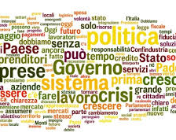
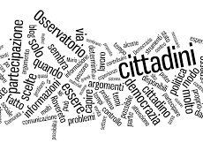

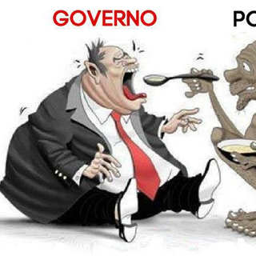
Politics, POLICY, POLITY

Slide 5
Declination of politics:
Domestic policy: action of a state to realise its objectives within national borders.
Foreign policy: action of a state to realise its objectives in the international arena.
International policy: set of interactions of the external actions of states and other international actors (international organisations, NGOs, multinationals).
Local politics: set of institutions and decisions governing small sub-national areas (regions; provinces; municipalities).
Comparative politics: study of political phenomena using the comparative method.

Slide 6
-Power
-ability of one actor to influence the decisions of another actor.
-Power can be:
-persuasive if the action of compliance with the command is free;
-constructive if the action of compliance with the command is imposed;
-actual if it expresses the actual determination by one actor of the conduct of another actor;
-potential if it expresses the possible capacity of an actor to influence the conduct of another actor.

Slide 7
The state by its very nature tends to place itself in the sphere of properly political power and is characterised:
by exclusive control over the material and organisational instruments of violence (monopoly of force);
by the use of definitive violence when all other sanctions have proved ineffective in protecting the integrity of a political system (legitimate monopoly of force).
Competition for power

Slide 8
The domestic political system is:
hierarchical and equipped with institutions that perform government functions;
founded on a peaceful conflict resolution mechanism accepted and recognised by all political forces;
characterised by the presence of a single actor with the legitimacy to resort to violence in the interest of the entire national community.

Slide 9
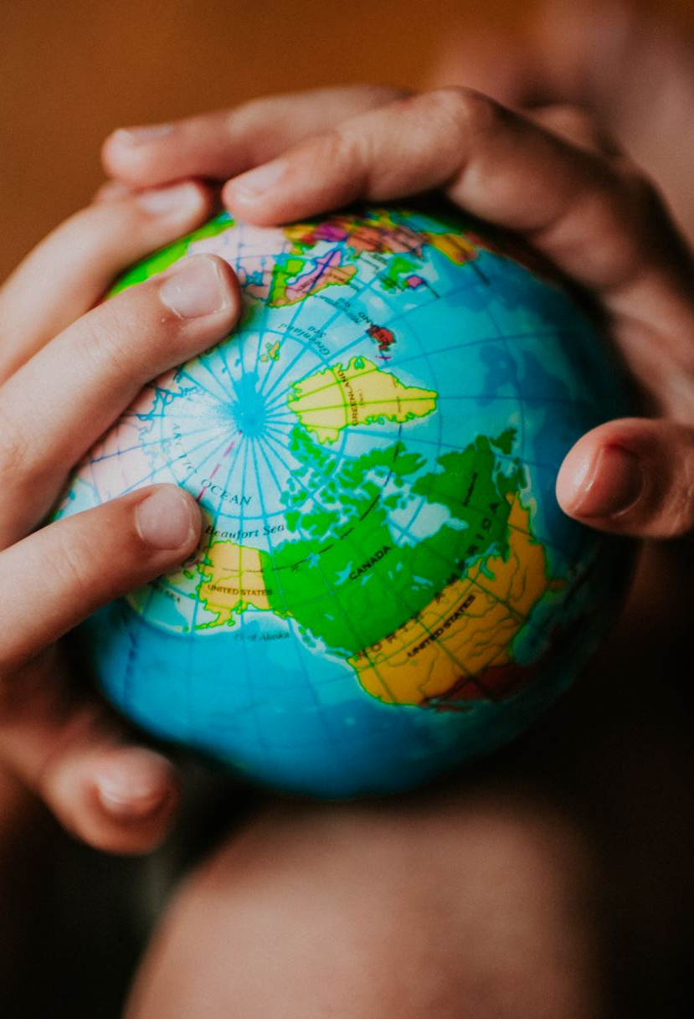
The international political system is:
anarchic and decentralised;
founded, ultimately, on the principle of self-defence;
characterised by the absence of a single authority capable of legitimately resorting to violence in the interest of the entire international community.

Slide 10
Influence of international politics on domestic politics
Structural factors
International anarchy
Configuration of the international system
Power position
Economic Interdependence
Role of supranational organisations
Economic factors
-Degree of international tension
-War
-International regimes

Slide 11
Influence of domestic politics on international politics
Institutional factors
Political Regimes
Coalition dominance
Regime transition
State consolidation
Cultural factors
Clash of civilization

Slide 12
Comparative politics exercise
You want to analyse a policy area.
1. What is your research question? What do you want to know?
Select the field you are most interested in.
Select one or two more countries.

Slide 13
Where does politics come from?
Plato and Aristotle
Comparison of different political regimes:
Aristocracy;
Oligarchy;
Tyranny
Democracy

Slide 14
What is being compared?
A small number of states (two or more)
Or a very large sample
Analysis of states, regions, sub-regions or supranational entities

Slide 15
What is being compared?
Political systems;
Regimes;
Istitutions;
Actors;
Processes;
Policies.

Slide 16
Our course
-Why are some countries more stable than others?
-Why are some states more democratic than others?
-Why are some states characterised by violence?

