Slide 1

Totalitarian Regimes

Slide 2
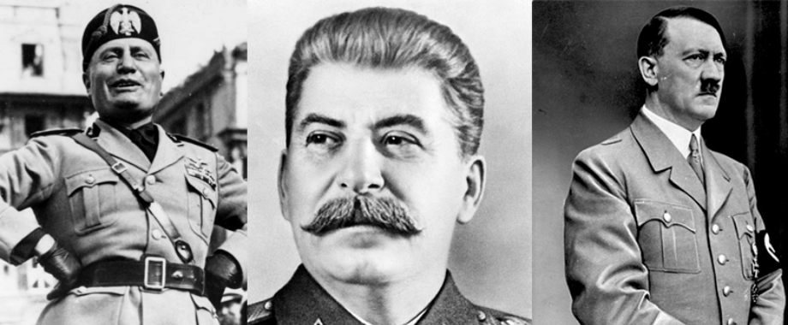

Slide 3
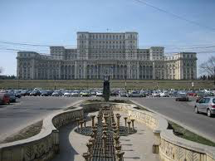
Totalitarian Regimes
Soviet Union(USSR);
Nazism in Germany;
Fascism in Italy;
Romania (Nicolae Ceauşescu)

Slide 4
Definition
A political system with limited and unaccountable political pluralism, without an elaborate guiding ideology, but with characteristic mentalities, without extensive or intense political mobilisation, except at certain moments in its development, and with a leader and sometimes a small group exercising power within formally ill-defined, but in reality quite predictable limits (J. Linz))

Slide 5
Dimensions
-Political pluralism: absent or limited?
-Participation or mobilisation?
-Ideology or mentality?
-Institutional structuring:
-single party, hegemonic, no party?
-militaries?
-corporatism?
-parliamentary assemblies and elections?

Slide 6
Totalitarian and Authoritarian regimes
-Authoritarian
-A political regime in which power is exercised by a small group of individuals without representative relationships
-Restrictions on freedoms
-Mentality domination
-Totalitarian
-A highly centralised political regime, dominated by the idelogy that transforms all sectors of society, including the economy
-Total transformation and control of society and the organisation;
-Extirpation of individual freedoms.

Slide 7
Political control
Coercion
-Surveillance
-Cooptation
-Cult of personality

Slide 8
Totalitarian regimes
Absence of political pluralism
Articulate ideology comprising an official body of doctrines concerning every aspect of human existence, with the aim of achieving a perfect final society and building the new man;
A single mass party controlled by an oligarchy, often confused with the state bureaucracy;
The state as the transmission belt of party power
8
Notes:
8

Slide 9
Totalitarian Regimes
Leader or small group at the top of the single party
Unforeseeable limits to the leader's power
A system of internal terror used both against the regime's enemies and against entire sectors of society, the elimination of which is a condition for the realisation of the ideological goals;
Monopolistic control of the coercive system, the mass media and the entire economic sector
9
Notes:
9

Slide 10
post-totalitarism
Post-Stalinist communist regimes
-Preservation of structures
-Attenuation of mobilisation and terror
-Weakening of leadership and ideology
-Weak institutional pluralism
-Weak economic centralisation

Slide 11
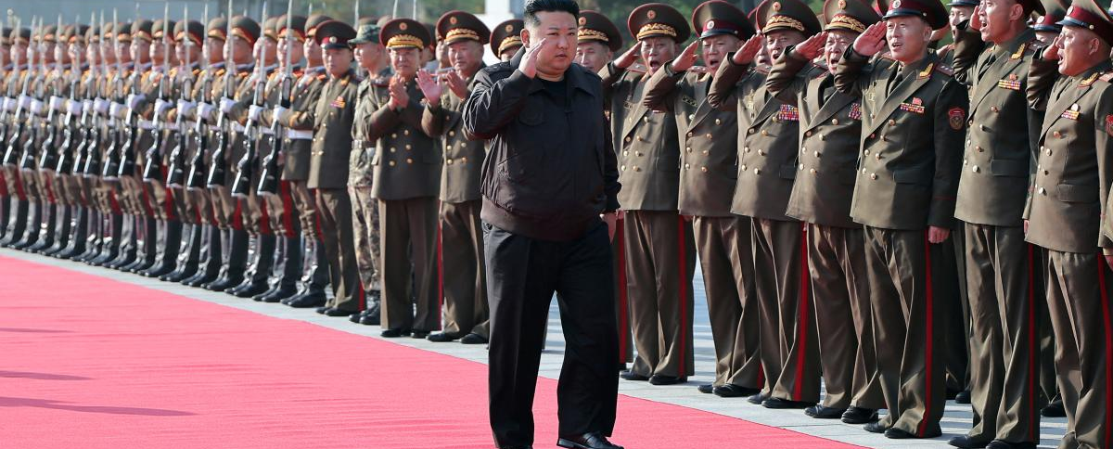
North Korea as a totalitarian regime?

