Slide 1

Authoritarian Regimes

Slide 2
Definition
A political system with limited and unaccountable political pluralism, without an elaborate guiding ideology, but with characteristic mentalities, without extensive or intense political mobilisation, except at certain moments in its development, and with a leader and sometimes a small group exercising power within formally ill-defined, but in reality quite predictable limits (J. Linz))

Slide 3
Totalitarian and Authoritarian regimes
-Authoritarian
-A political regime in which power is exercised by a small group of individuals without representative relationships
-Restrictions on freedoms
-Mentality domination
-Totalitarian
-A highly centralised political regime, dominated by the idelogy that transforms all sectors of society, including the economy
-Total transformation and control of society and the organisation;
-Extirpation of individual freedoms.

Slide 4
Authoritarian Regimes
-Military: military-moderators, military-guardians, military-governors.
-Civil-military: bureaucratic-military, corporatist, populist.
-Civil: nationalist, fascist, communist, religiously based.

Slide 5
Authoritarian Regimes
-Elites using repressive means to maintain power;
-Regimes ignore the initiatives of individual groups until they are perceived as threats to power;

Slide 6
Authoritarian Regimes
Theocracies
-God's Law
-Instruments of control
-Religious leadership/political authority
-Iran 1979 - today
-Afghanistan 1996 - 2001
-Saudi Arabia

Slide 7
SULTANIST REGIMES
the fundamental reality in a sultanist regime is that all individuals, groups and institutions are permanently subject to the unpredictable and despotic intervention of the sultan, and consequently pluralism is precarious (Linz and Stepan, 1996);
Legitimisation: patrimonialism, kinship ties and the monarchical institution
Based on the personal power of the ruler and his family

Slide 8
Why the military intervenes
-Political and state institutions are weak and crumbling
-Serious crisis situation, at risk of collapse, extensive social mobilisation, internal unrest (Chile 1973)
-Corporate interests (reduction of defence expenditure, creation of alternative militias, etc.)
-Defence of the state from external threats

Slide 9
Participation in an authoritarian regime
-Political parties;
-Petitions;
-Civil movements;
-Elections;
-Protests;
-Civil disobedience;
-State coups, revolutions, uprisings.

Slide 10

Bureaucracy in an authoritarian regime
-Recruitment based on affiliation;
-Non-relevance of merit
-Expansion ofcompetences and tasks;
-Lack ofinterest in transparency;
-Bureaucracy organises the material benefits the regime distributes in exchange for loyalty.

Slide 11
«HYBRID» Regimes
Façade democracies o quasi-democracies (Finer 1970)
Dictablandas e democraduras (O’Donnell; Schmitter 1986)
Illiberal democracies (Zakaria 1997)
Pseudodemocracies (Diamond 2002)
Competitive authoritarianisms (Levitsky e Way 2002)
Limited democracies (Morlino 2003)

Slide 12
HYBRID Regimes
Quasi-democracies: with elections that meet democratic requirements, but still with major shortcomings in terms of civil liberties;
-Pseudo-democracies: elections are the result of a liberalisation process of the regime and are beyond its control; strong limits to political pluralism, competition, fairness and transparency of elections, and parliaments with little influence on the government.

Slide 13

Illiberal democracies
-Irregular' elections
-Non-independent judiciary
-Weak rule of law, poor accountability
-Weak civil society
-Interest groups
-Media
-Social fragmentation
-Elections held regularly
-Restrictions on the nomination of candidates
-Permanence of political institutions
-Non-independence

Slide 14
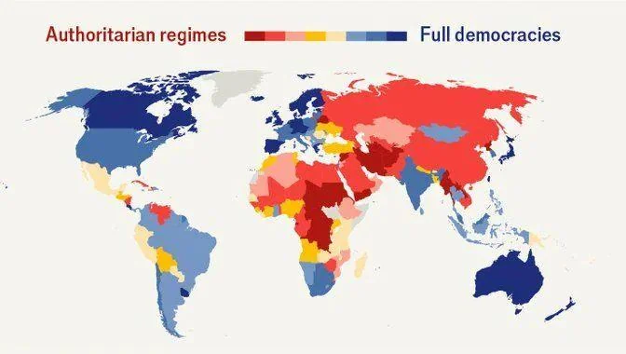

Slide 15
Playing with political regimes
Select a case (among the authoritarian ones);
Analyse the political regime;
Define the label and the level of illiberalism
Analyse the impact on the region

