Slide 1
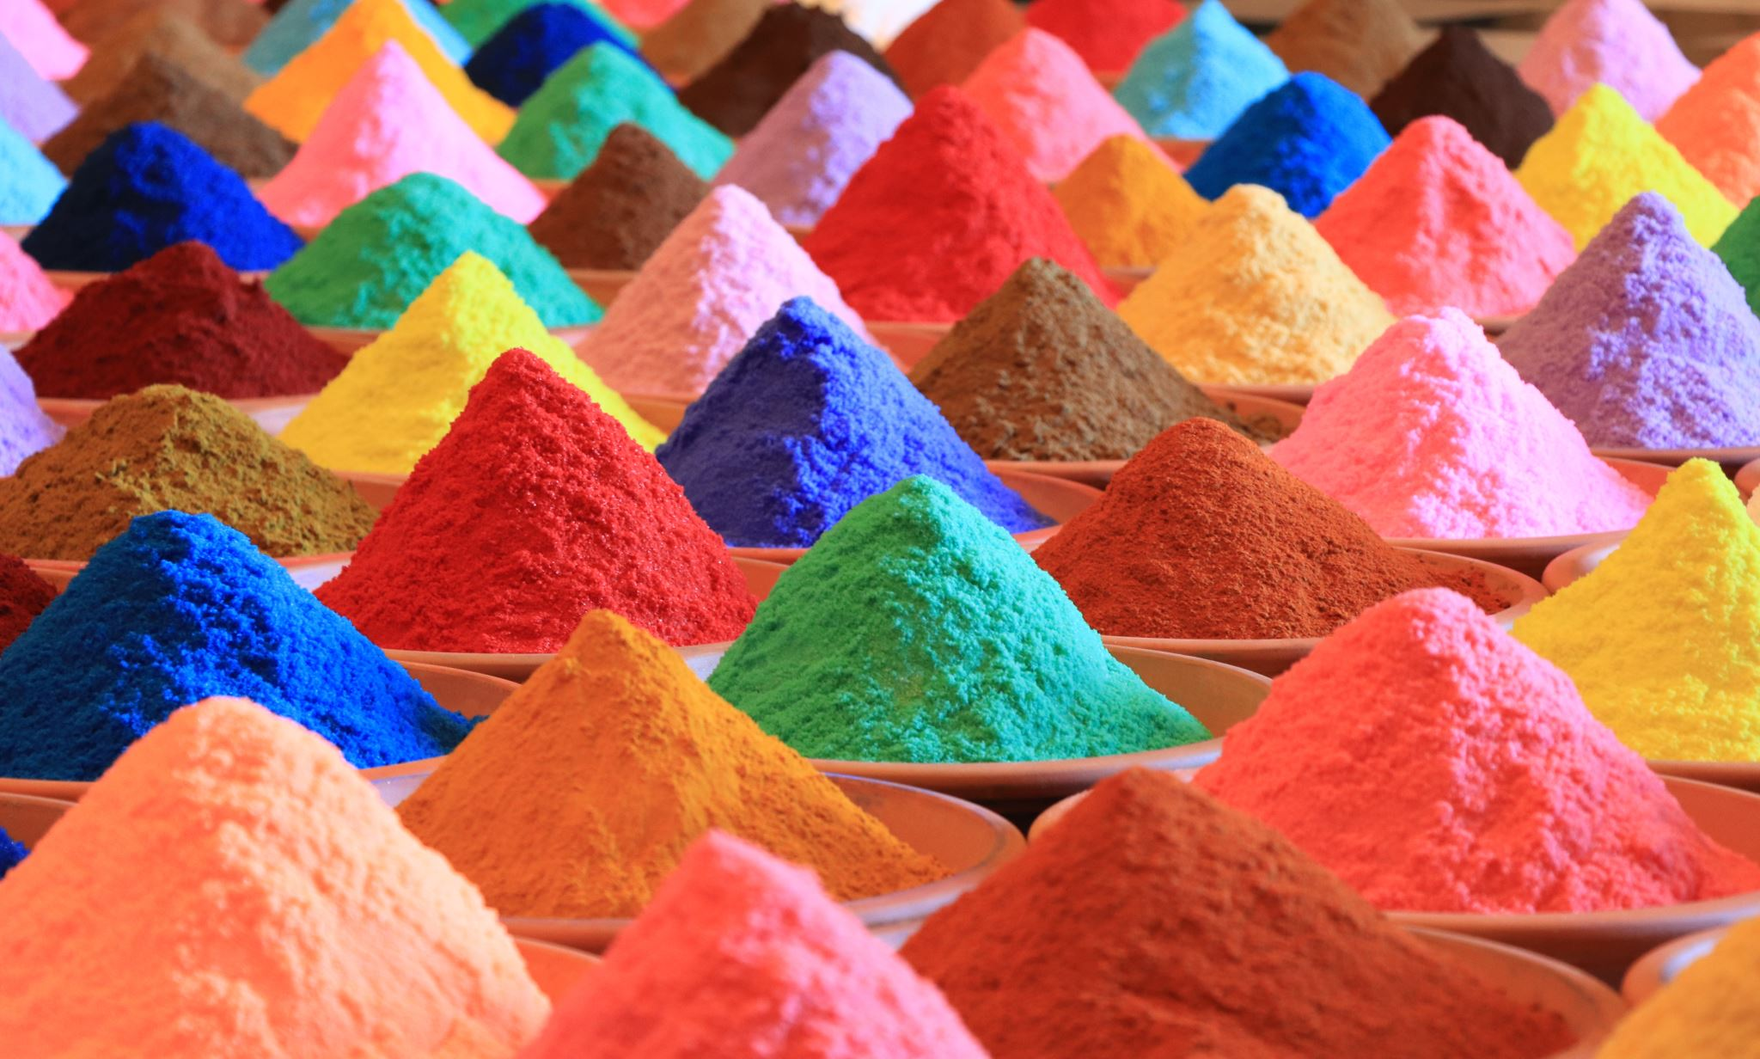
Democratization processes

Slide 2
Waves (S.P. Huntington)
First wave (1828-1926)
First roll-back (1922-1942)
Second wave (1943-1962)
Second roll-back (1958-1975)
Third wave (1974-2004)

Slide 4
Regime change
-The crisis/collapse of the previous regime
-The transition
-The Establishment
--Consolidation
4
Notes:
4

Slide 5
Democratic transitions
Ambiguous and intermediate period in which the regime has lost the crucial features of the previous institutional set-up and has not yet acquired those of the new regime (Morlino).
Phase of uncertainty following the end of a regime (Linz e Stepan).

Slide 6
Establishment of a democracy
Process of building and initiating the functioning of the main democratic institutions of the state.

Slide 7
Democratic consolidation: institutions
-Process of defining and adapting the various structures and norms of the democratic regime;
-Progressive broadening of the acceptance of structures and norms for the peaceful resolution of conflicts and progressive expansion of the legitimacy of the regime;
-Construction of stable relations between the new institutions, the new intermediate structures and civil society;

Slide 8
Democratic consolidation: community
Democracy is the only potential alternative
(the only game in town),
social, insitutional and even psycological perceptions.

Slide 9
How democracy spreads?
-Emulation: the democratic model is imitated and adopted because it is more attractive and because alternative models lose their appeal
-Promotion: pressure from outside (previous slide)
-Imposition: democracy is imposed manu militari (outcome of a war, intervention for humanitarian purposes, pacification, restoration of legality, etc.).

Slide 10
Roll-back
-Weak democratic values
-Economic crisis
-Polarisation
-Presence of political violence (terrorism; paramilitaries)
-External interventions

Slide 11
Formal and informal actors
Veto-players
Change agents
Political élites and economic actors
Civil society and media

Slide 12
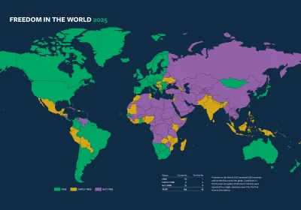

Slide 13
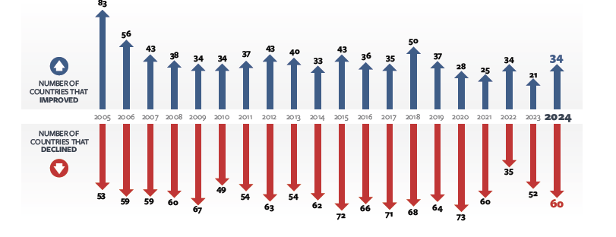

Slide 14
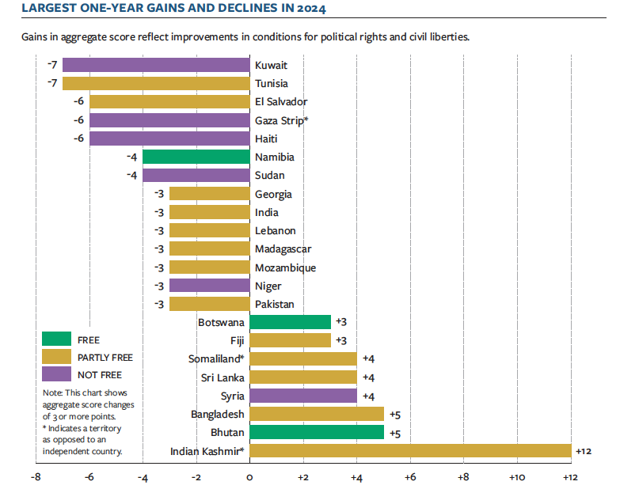

Slide 15
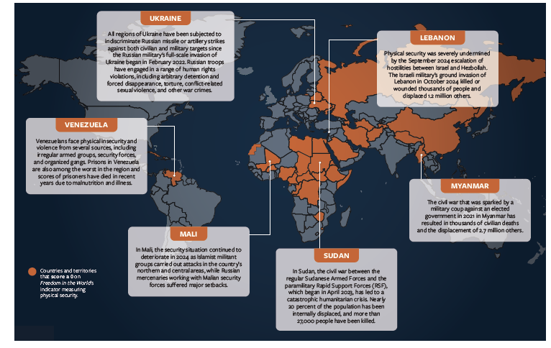

Slide 16


