Slide 1


Public Policies
Definitions
Actors and tools
Policy-making models
Policy-making steps
Policy-making implementation
Evaluation criteria
Types of public policies
Do Policies Determine Politics?

Slide 2
Topics
Public order ;
social services;
international relations
Recipients
Very few
people or
all citizens,
with very different
social impacts
Competences
They can allocate goods,
deploy or check out resources, or
regulate existing relationships,
with different temporal effects

Slide 3
Definitions
(Meny Thoenig 1989): Set of practices and directives emanating from one or more public actors
(Dente): A set of actions, carried out by a set of actors, acting in relation to a collective problem"
(Dunn): A public policy is the answer to a problem perceived as public
(Lindblom): process of successive approximations to some desired goal, where what is desired is continually subjected to reconsideration

Slide 4
Definitions
Anderson (1990), policies are public when they are produced by government authorities in a broad sense.
Lowi (1999), a public policy is the product of the intervention of public authorities.
It is neither politicians nor rulers who produce public policies alone, which are, rather, the product of composite aggregations of actors (individuals, institutions, groups, associations, etc.).

Slide 5
A public action programme…
consists of a plurality of measures,
emanates from public authorities endowed with a specific legitimacy;
has normative value;
refers to a certain social sphere ...
of which the decision-making and implementation processes are an integral part

Slide 6
Public policy and issues of collective relevance
Not always there is a "problem" to be addressedwhen there is a public policy : there may be an interest of the authorities to advertise, obtain funds, favor certain groups.
Not always when there is a problem there is a public policy to solve it:
It may be a marginal problem, concerninf a few groups with little influence.
It's an intractable problem.
It is a problem whose existence the political authorities can exploit for multiple ends.

Slide 7
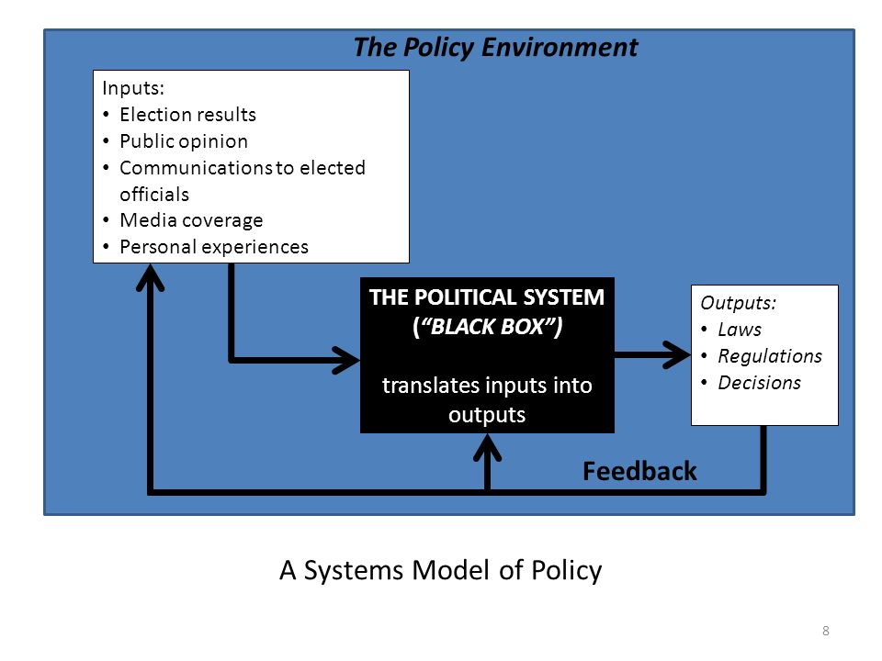
Public policies and political system
Public policy studies can be approached using systemic analysis of policy, as presented by David Easton (imperative assignment of values for a society).

Slide 8
Public policies and policy tools
Public policy must be understood as an instrument of the exercise of public authority to solve problems collectively understood as public (Capano, Lippi)
Policy
Strategies
Rationality
Pluralization

Slide 9
    Factors that may influence implementation
Political and Normative context
Economy
Policy Implementation
Media
Global system
Notes:
9

Slide 10
Global Agenda
Problems of collective responsibility (human rights, security)
Problems of collective management (environment, health)
Problems with a global political solution (economic gap; terrorism)
Getting a problem on the agenda: political, social and material factors
Identification of problems on the agenda
Solutions to problems on the agenda and international political change
Notes:
fattori politici sono il sostegno o l’opposizione dei governi degli stati che hanno ruoli organizzativi preminenti, il sostegno o l’opposizione dei governi che controllano risorse direttamente importanti per il problema in questione, il sostegno o l’opposizione di gruppi di stati abbastanza forti e coesi.
Fattori sociali sono processi economici, come le fasi di crescita o di contrazione dei cicli economici, e processi culturali, come le fasi espansive o riflessive di una civilità o di una cultura.
Fattori di tipo materiale sono le innovazioni e il progresso tecnologico.

Slide 11
Global Policy-making
problems that a large number or all of the actors in the system consider to be of great importance for the political-institutional organisation and development of the system, and
for whose solution they have different preferences. The importance of a problem and the diversity of preferences lead to
conflicting oppositions that prevent the formulation of policies to solve the problem, and
keep a problem alive for a long time, whether or not it is placed high on the system's agenda.

