Slide 1
Project Management

Slide 2
Project Management
4 key areas of management
Planning – (what is to be done, aims and objectives, short-term and long-term)
Organising – (who and how, course of action)
Leading – (how others are to get it done, sharing vision)
Controlling – (monitoring if it is or is not getting done and what to do if it is not – looking at the results of action – correcting)

Slide 3
What is a Project?
Key Features
Has a defined start and end
  Not repeated
Has an organised plan
  To be delivered on time
  To be delivered on budget

Slide 4
What is a Project?
Key Features
Separate Resources
  Time
  People
  Money
Teamwork
  Responsibility
  Set own objectives
  Offer new challenges and experiences

Slide 5
What is a Project?
Key Features
Established Goals
  Set objectives for all
  Create something new
No Rehearsal

Slide 6
Project Management
Examples
Constructing a building or bridge
Painting a room
Throwing a party
Taking a holiday
Selling a car/buying a car
Writing an essay/paper/thesis
Delivering a presentation
Delivering an event/conference/symposium

Slide 7
Project Management
Keys for Success
Gain Commitment
  Collaboration from stakeholders
  Clarify the motivation for key players
  Recognise skills of team
  Recognise developmental needs of team

Slide 8
Project Management
Keys for Success
Be Flexible
  Managing change
  Monitoring Development
  Re-evaluating
  Acting early

Slide 9
Project Management
Keys for Success
Have clear aims, objectives and goals
  Clearly defined
  Agreed
  SMART (Specific, Measurable, Achievable, Realistic, Time-related)

Slide 10
Project Management
Keys for Success
Planning and Communication
  ‘Front-end’ planning for,,,
    People
    Facilities
    Equipment
    Materials

Slide 11
Project Management
Tools
Project Pyramid
Time/Cost/Quality Triangle
Quality/Results
Time
Cost/Resources

Slide 12
Project Management
Tools
Project Pyramid
Time/Cost/Quality Triangle
Customer Satisfaction
Quality
Time
Cost/Resources

Slide 13
Project Management
Tools
SWOT Analysis
Strengths
Weaknesses
Opportunities
Threats

Slide 14
Project Management
Tools
Swot Analysis
Strengths
Weaknesses
Opportunities
Threats
Strengths
Weaknesses
Opportunities
Threats

Slide 15
Project Management
Tools
PESTLE Analysis
  Political
  Economic
  Social
  Technological
  Legal
  Environmental

Slide 16
Project Management
Tools
Force Field Analysis
Positive Negative
Driving Forces Resisting Forces
Develop Staff Lack of budget
New niche Current workload
Need revenue

Slide 17
Project Management
Tools
Implementation
Phase
Definition &
Design
Phase
Acceptance
Phase
Planning
Phase
Conceptual
Phase
Resources
Time

Slide 18
Project Management
Tools
Gantt Charts
Developed by Henry Gantt in 1917
Graphically show a complete list of all the tasks required
Show the time needed for each task
Helps to plan, coordinate and track tasks
Can be done on a spreadsheet

Slide 19
Project Management Tools
Gantt Charts
  Overlapping activities
  Looking at minimal time

Slide 20
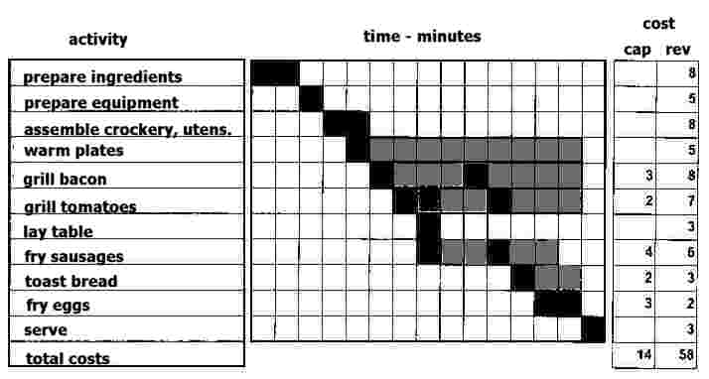
Tools – Simple Gantt Chart

Slide 21
Tools – PERT Charts
Used to schedule, organise and coordinate tasks
‘Programme Evaluation Review Technique’
Also known as ‘Critical Path Method’ or a ‘Flow Chart’

Slide 22
Tools – PERT Charts
  Longest route is defined
  Graphic view to measure progress
  Programmes such Microsoft Project and Artifax Event use this approach

Slide 23
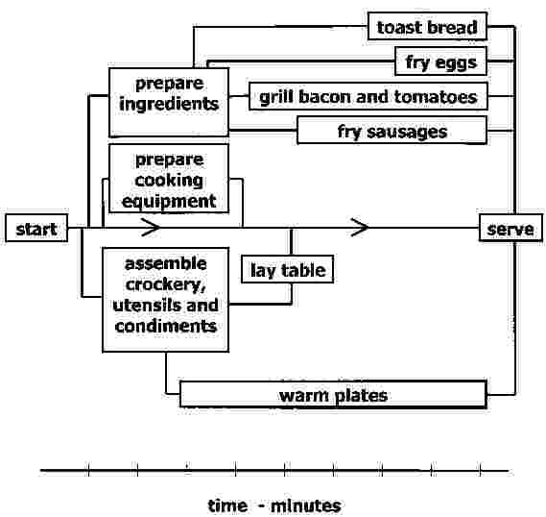
Tools – Simple PERT Chart

Slide 24
Project Management
Tools Summary
Time/Cost/Quality Triangle
SWOT analysis
PESTLE analysis
Force Field Analysis
Project Life Cycle
SMART objectives
Planning Tools (Pert Charts & Gantt Charts)
Budgets

Slide 25
Project Management
Key Players
Sponsor
  Gives resources
  Defines objectives
Project Manager
  Makes plan of action
  Motivates and develops the team
  Communicates
  Monitors

Slide 26
Project Management
Key Players
Stakeholders
  Contribute to objectives
  Affected by outcomes
  Involved at various times
Team Members
  Do activities
  Maybe specialist advisors
  Occasional involvement

Slide 27
Project Management
Key Players
Customers
  Provide direction
  Affect objectives
Suppliers
  Supportive
  Supply on time
  Agree cost at outset

Slide 28
Project Management
7 traits of good managers
Enthusiasm for project
Ability to manage change effectively
A tolerant attitude to ambiguity
Team building and negotiating skills
A customer orientation
Adherence to business priorities
Industry knowledge

Slide 29
Project Management
Development
Agree a vision
  Need for change
  Meet with key members and sponsor
  Define the ideal
  Consider likelihood of reaching ideal
  Produce a statement
  Agree the statement
  Publish the statement

Slide 30
Project Management
Development
Check Feasibility
  Define intangibles
  Timing
  Consider driving and resisting forces
Outline Purpose and Objectives
  Involve all key people
  SMART objectives

Slide 31
Project Management
Development
Activities & Resources Agreed and Prioritised
  Plan all activities
    Brainstorm full list
    Group in logical order
    Check nothing is missing
    Give each a number and title

Slide 32
Project Management
Development
Activities & Resources Agreed and Prioritised
  Value and assign resources
  Prioritise and schedule
  Create master schedule

Slide 33
Project Management
Development
Project Plan Approved/Agreed by All
Project manager executes plan
  Guides team to achieve individual and collective goals
Plan is continually monitored
  Plan is revised as necessary

Slide 34
Project Management
Summary of keys to Success
Gain commitment
Have clear goals
Careful planning
Clear communication
Being flexible

Slide 35
Why Projects Fail
Poor Communication
Ill Defined Objectives
Unrealistic Estimates
Poor Management Support
Lack of Stakeholder Buy-in
Ill Defined Roles/Responsibilities

Slide 36
Why Projects Fail
75% - Time Resource Estimates Unrealistic
71% - Objectives Not Clearly Defined or Measurable
64% - Project Manager : Poor Communication Skills
61% - Objectives changed during project

Slide 37
Why Projects Fail
59% - Project Manager : Poor Leadership Skills
56% - Senior Management : Not showing strong support
56% - Stakeholders : not taking ownership of project

Slide 38
Why Projects Fail
54% - Roles and responsibilities of the project team not defined
54% - Resources not identified or made available from the start
53% - Project Team : did not work as a team

Slide 39
Key Skills of a Project Manager
Leadership
Change Management
Communication
Negotiation
Delegation
Problem Solving

Slide 40
Project Management
Easy
as
that!

