Slide 1
Paolo Vineis
From the microbiological revolution to NCD
Causality

Slide 2
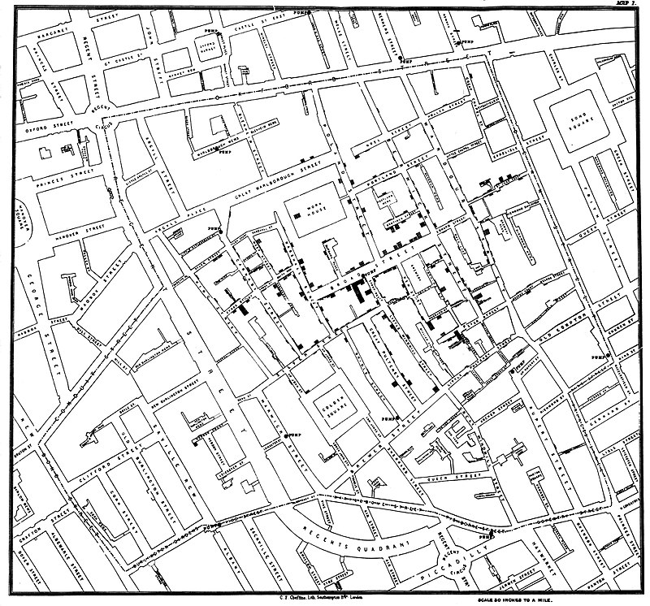
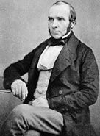
Original map by John Snow showing the clusters of cholera cases (indicated by
stacked rectangles) in the London epidemic of 1854.

Slide 3
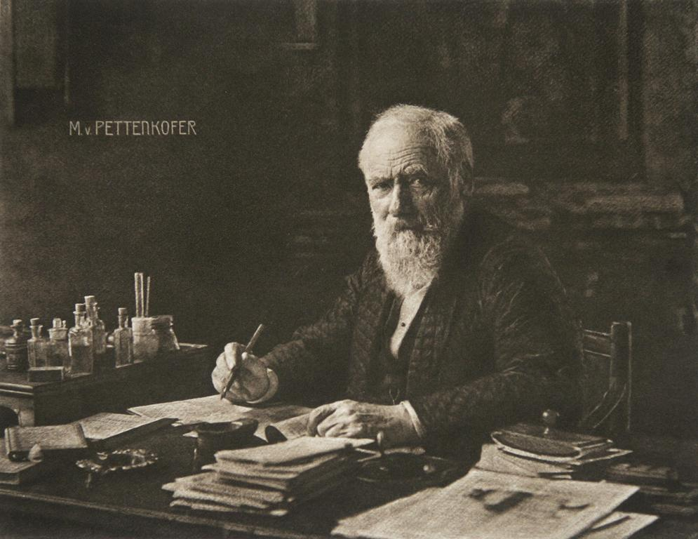
Pettenkofer - He is known for his work in practical hygiene, as an apostle of good water, fresh air and proper sewage disposal. He was an anti-contagionist

Slide 4
Closing the Broad Street pump was successful because there is a single cause of cholera, only transmitted by water, and the latency period is very short
What about the multiple causes of cancer, the multiple effects of air pollution or chemical water contaminants?
Can we simply abolish air pollution? Can we simply eliminate disinfection by-products in swimming pools?

Slide 5
In other words, can we do the “Snow manoeuvre” with the causes of NCDs?
What are non-communicable diseases (NCD)?
Allen and Feigl (Lancet GH, 29017) have proposed a renaming/reframing as “socially transmitted diseases”
“The current list of NCDs describes a ragtag group of leftovers that do not satisfy Koch’s postulates”

Slide 6
Their attributes:
- chronicity
- global burden
- preventable nature
- common proximal risk factors
(cholesterol, blood pressure, glucose, obesity)
- common behavioural risk factors (smoking, alcohol, diet, inactivity, air pollution)
- common distal risk factors (economic, social, environmental)
- common issues of inequality and injustice
In addition, risk factors for NCD often have a linear do-response with risk, which leads to Rose’s paradox

Slide 7
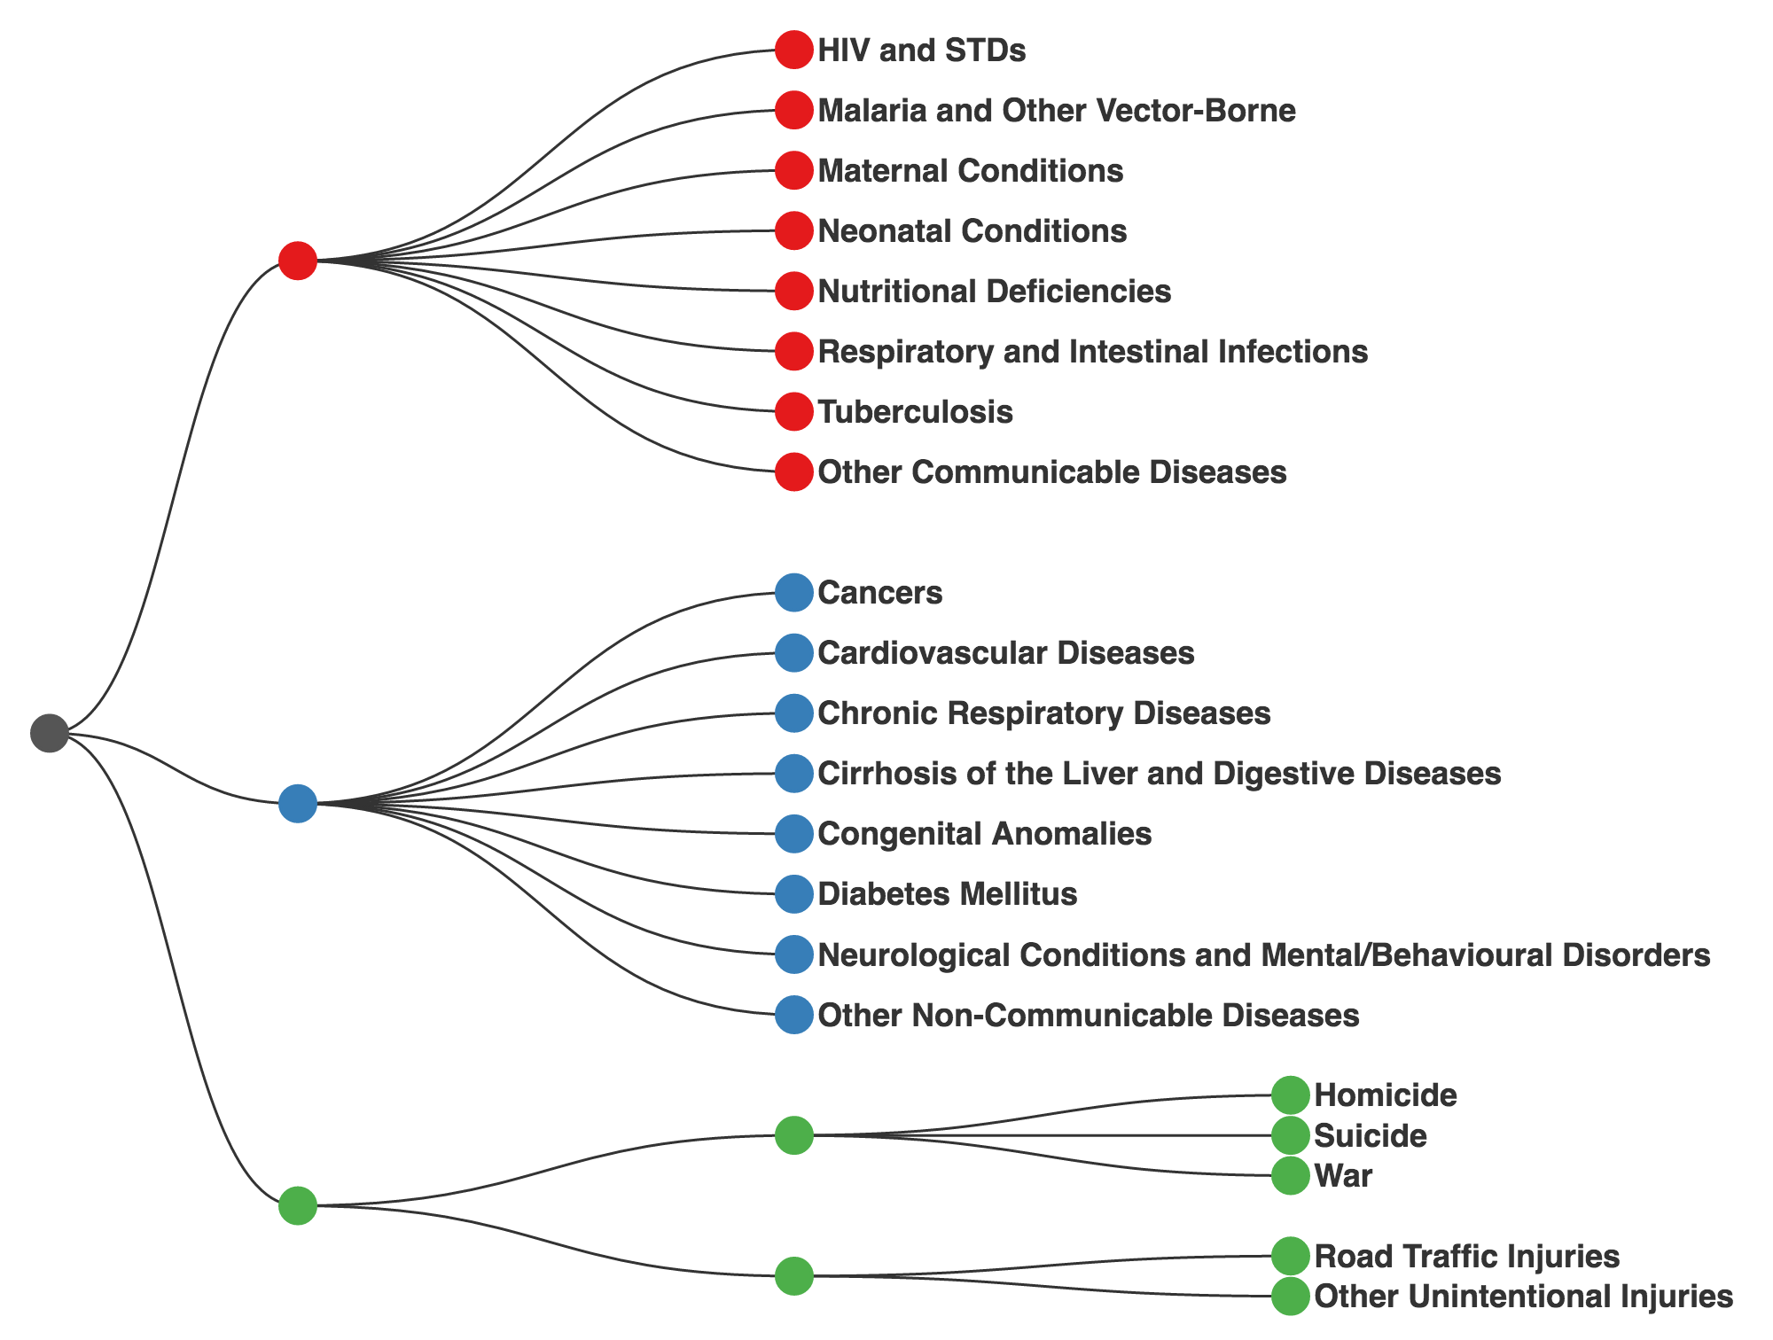
Classification of diseases and injuries
Communicable, maternal, perinatal and nutritional
Non-communicable
Injuries
Intentional
Un-intentional

Slide 8
Challenges in NCD epidemiology

Slide 9
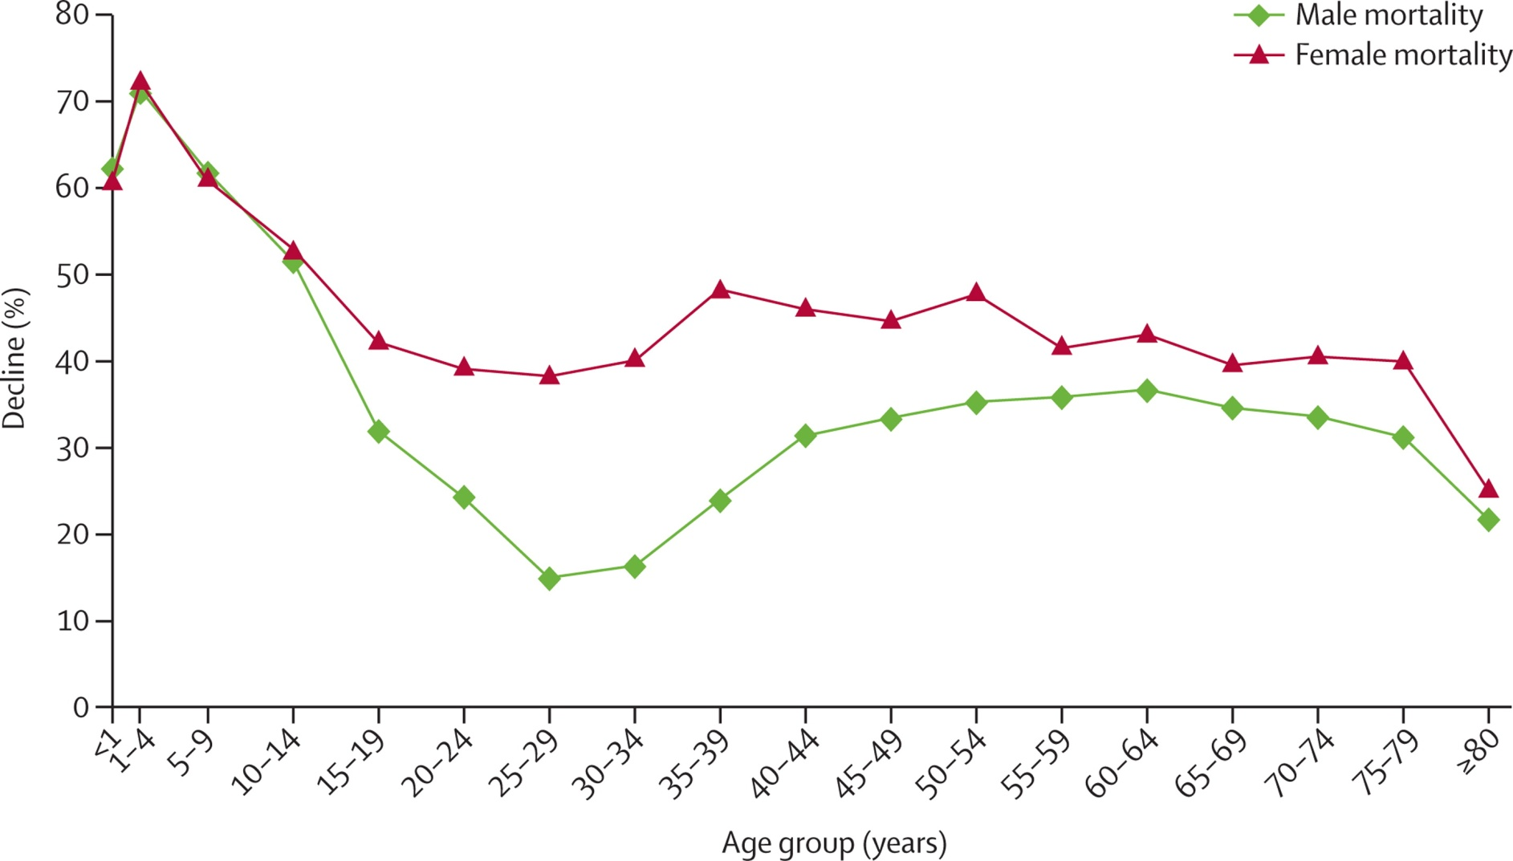
Percent decline in age-specific mortality between 1970 and 2010 in the world
Wang et al Lancet 2012

Slide 10
Leading cause of death in 2010 by country

Slide 11
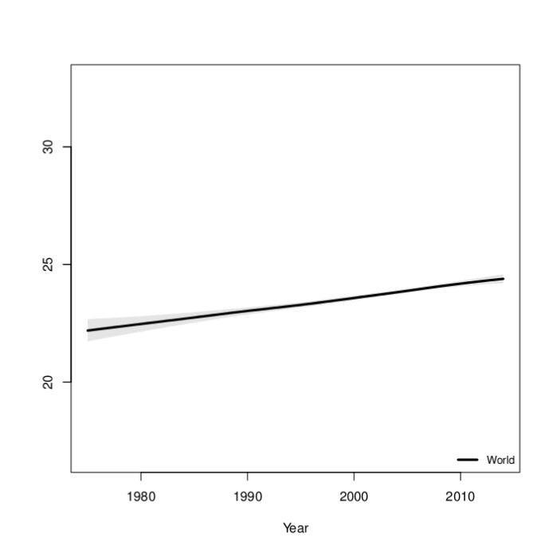
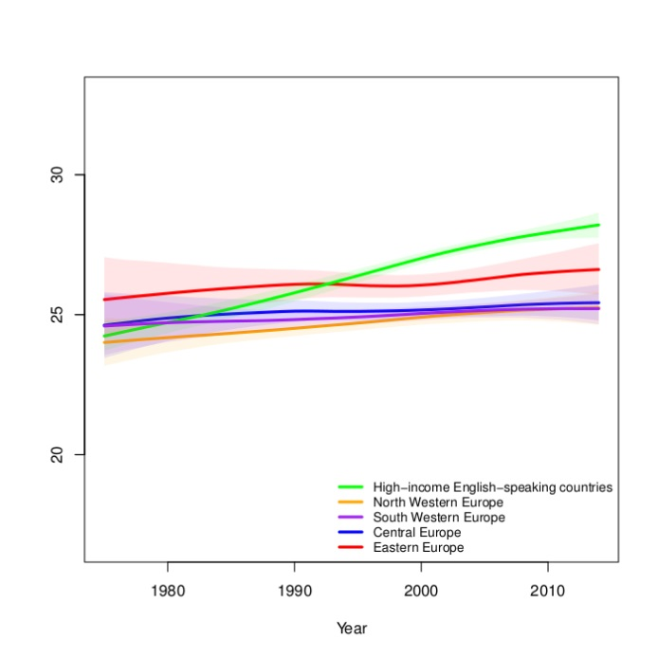
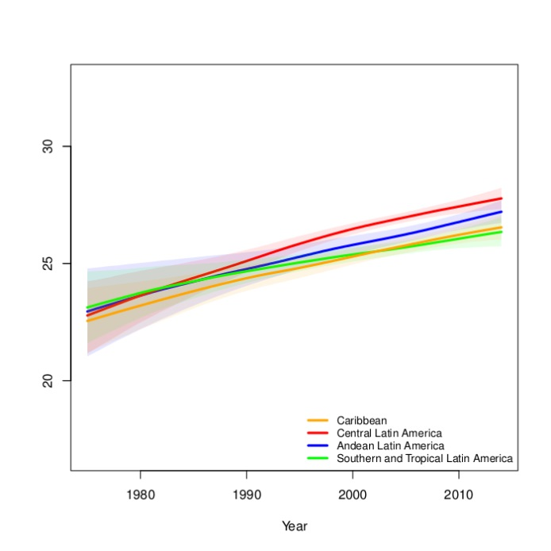
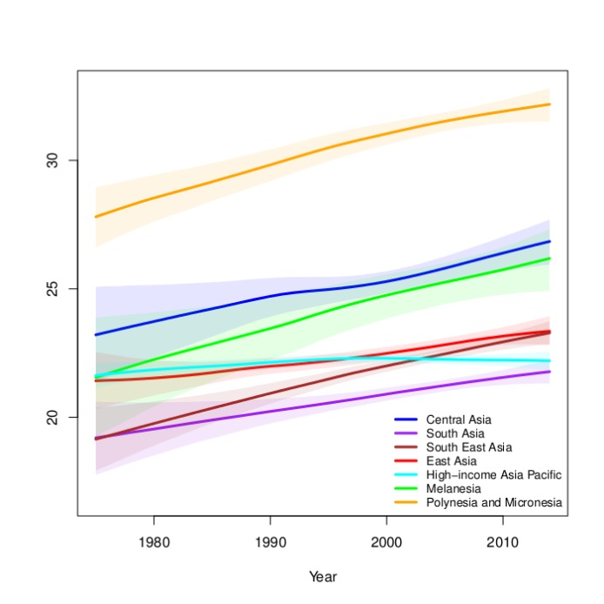
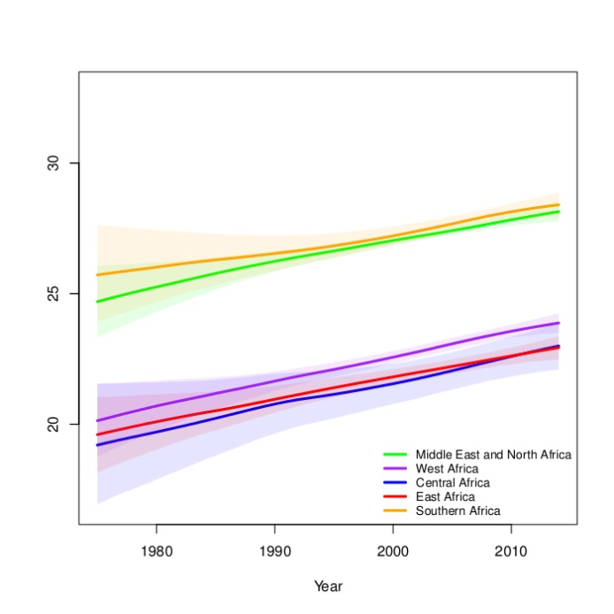
Regional trends in mean BMI (women)
NCD Risk Factor Collaboration Lancet 2016

Slide 12
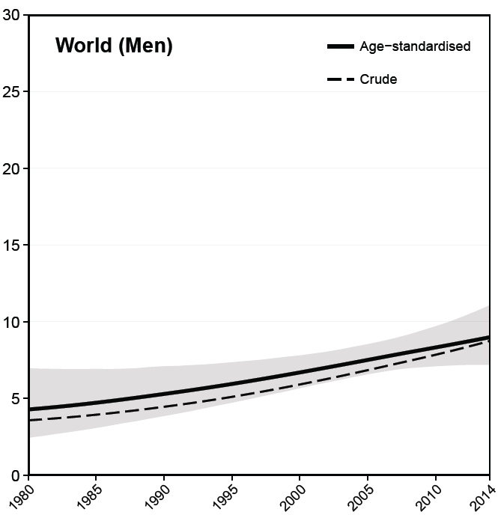
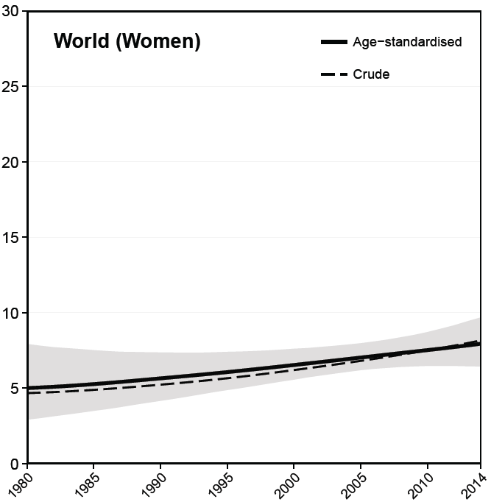
Trends in diabetes prevalence in the world
Men
Women
NCD Risk Factor Collaboration Lancet 2016

Slide 13
SBP trends by region (men)
NCD Risk Factor Collaboration Lancet 2016

Slide 14
SBP trends by region (women)
NCD Risk Factor Collaboration Lancet 2016

Slide 15
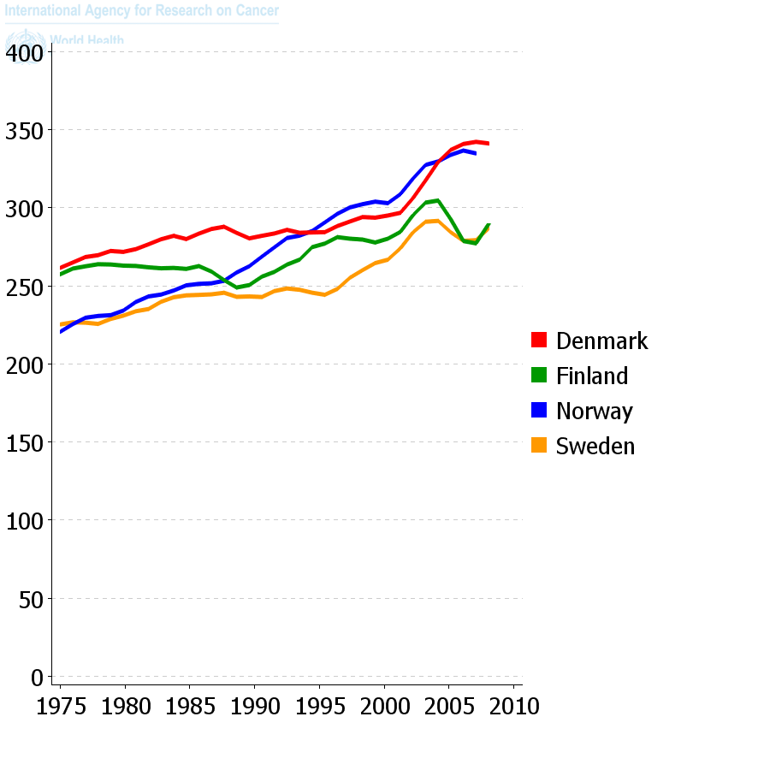
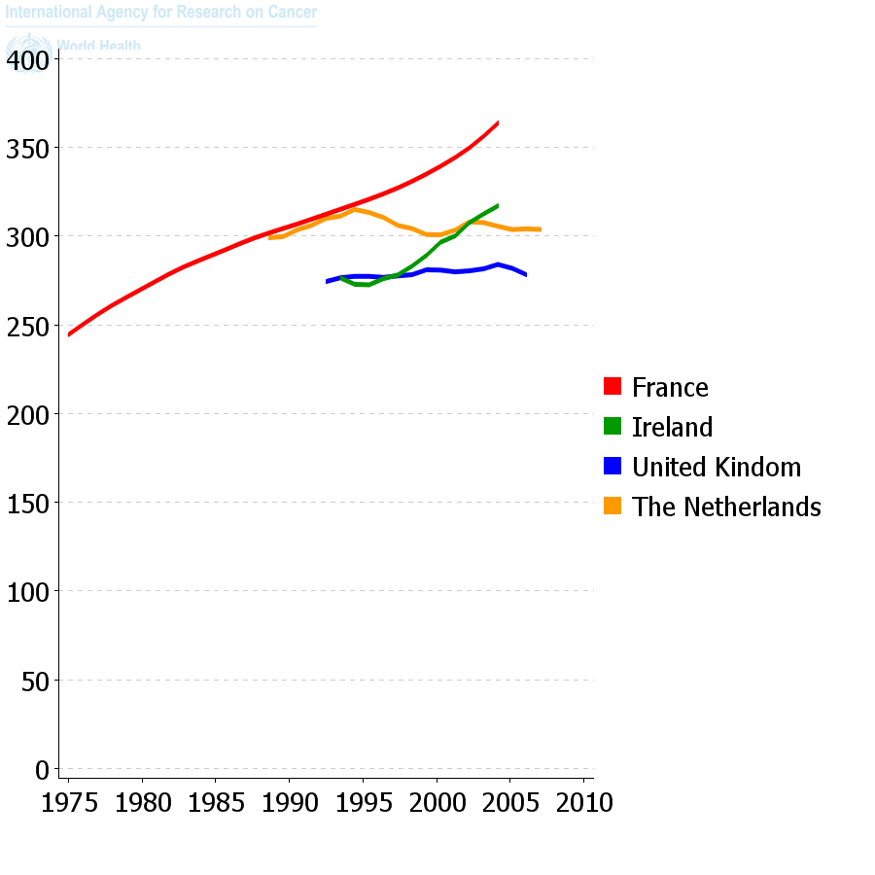
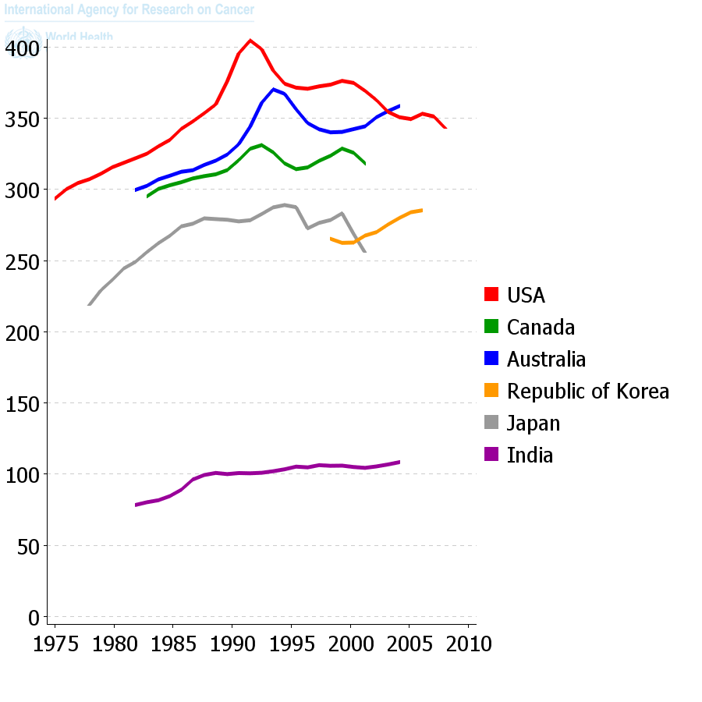

Trends in incidence of cancer in selected countries: age-standardised rate per 100,000, men
Cancer in 5 Continents, IARC
Trends in cancer incidence, men 1975-2010 – all cancers, from Globocan IARC

Slide 16
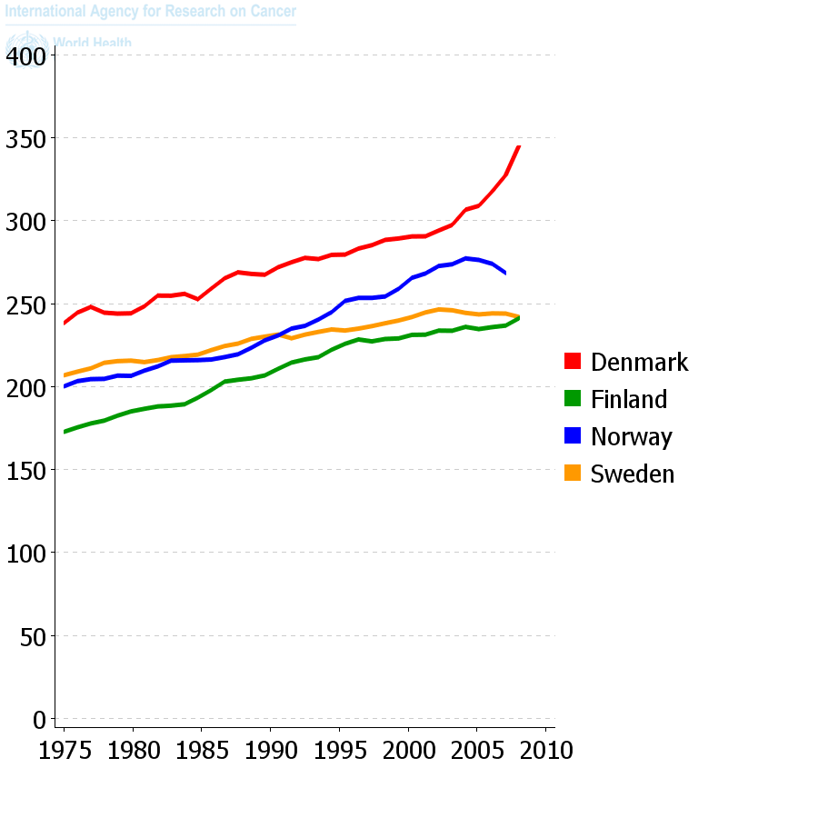
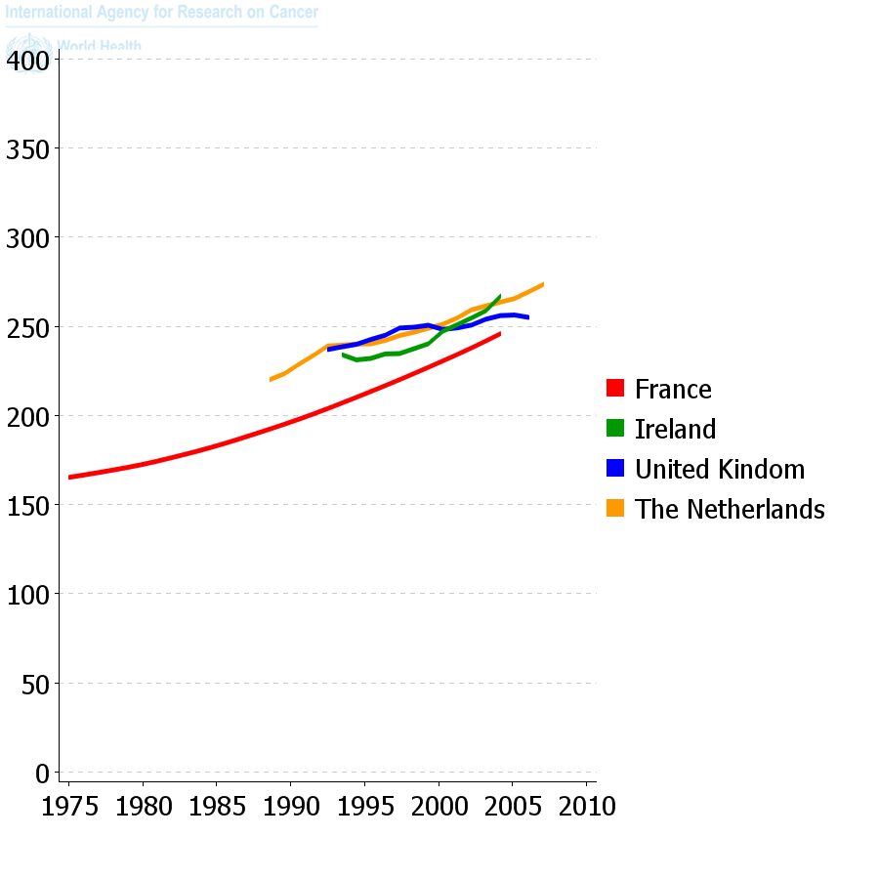
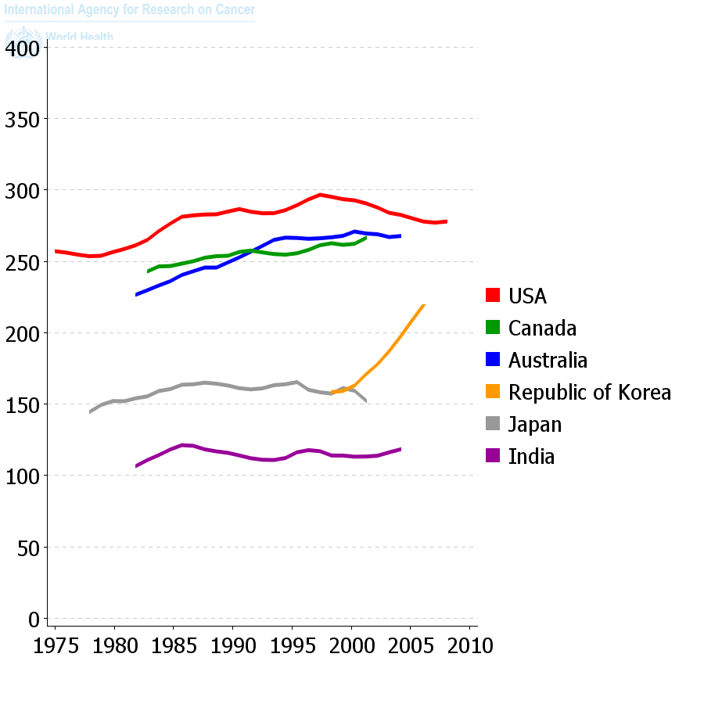
Trends in incidence of cancer in selected countries: age-standardised rate per 100,000, women
Cancer in 5 Continents, IARC

Slide 17
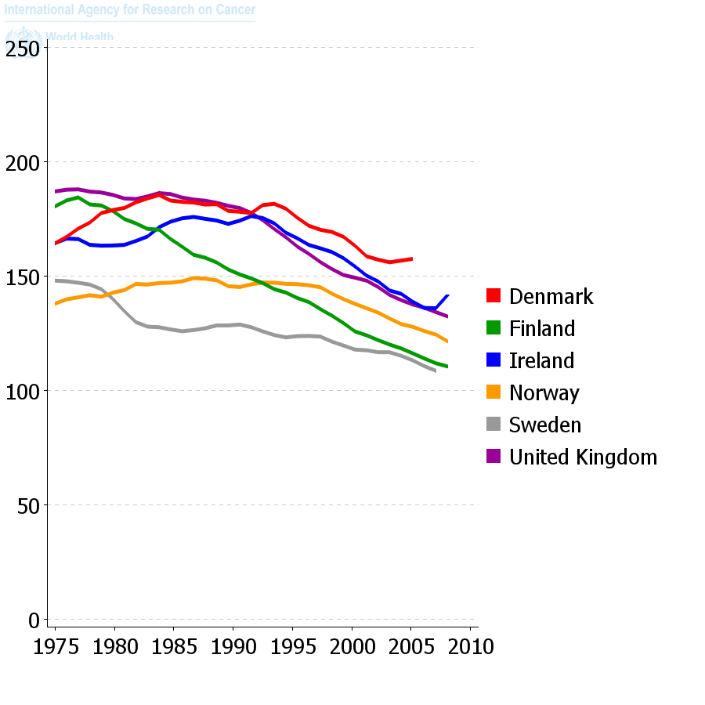
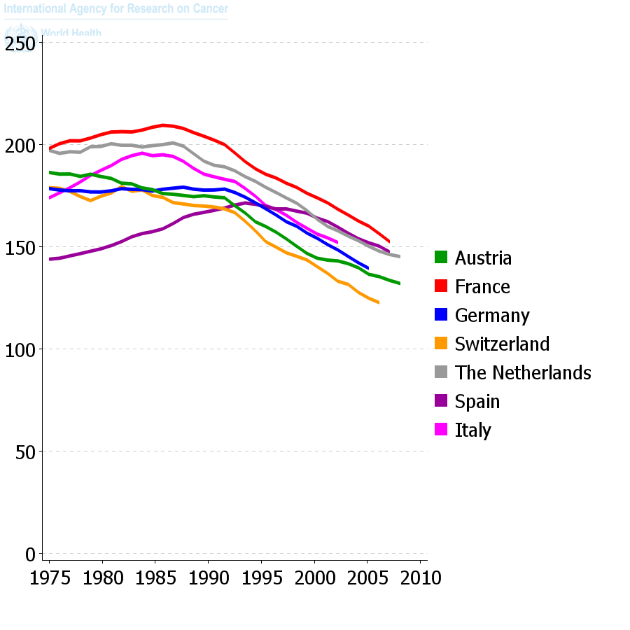
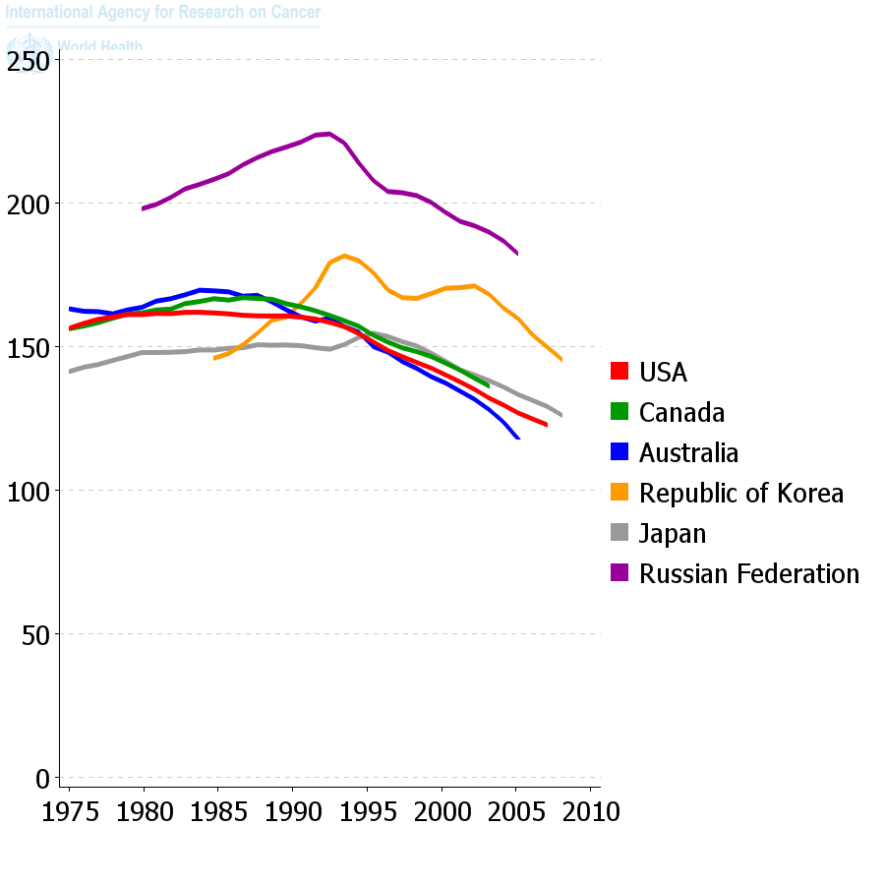
Trends in mortality from cancer in selected countries: age-standardised rate per 100,000, men
WHO (www.who.int/whosis) | WHO (www.who.int/whosis) | WHO (www.who.int/whosis)
Cancer in 5 Continents, IARC

Slide 18
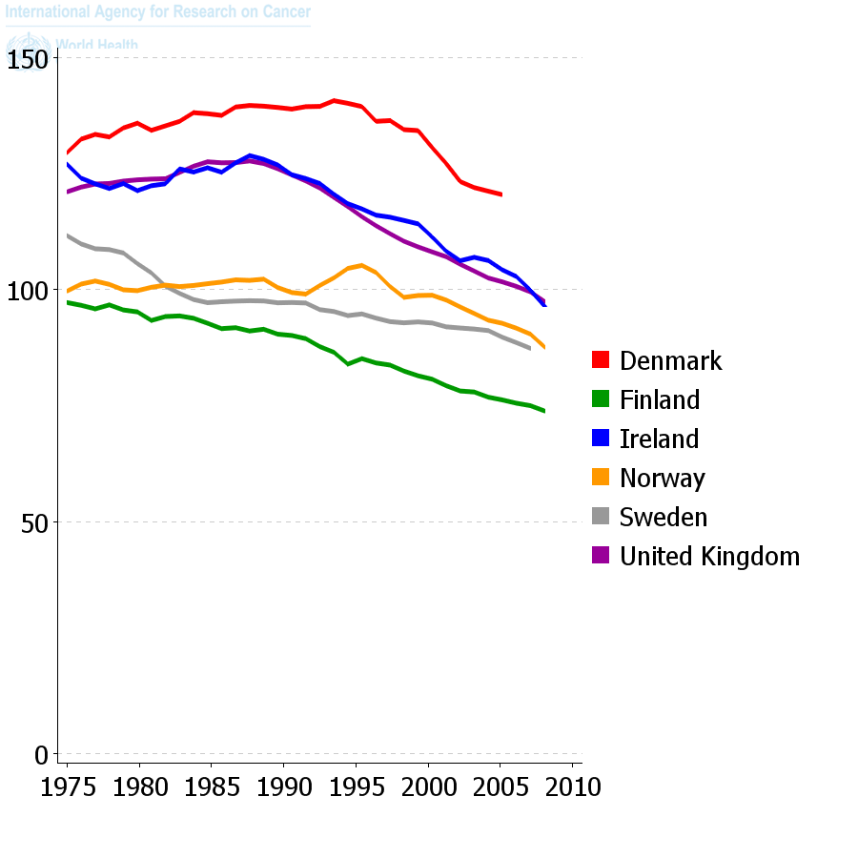
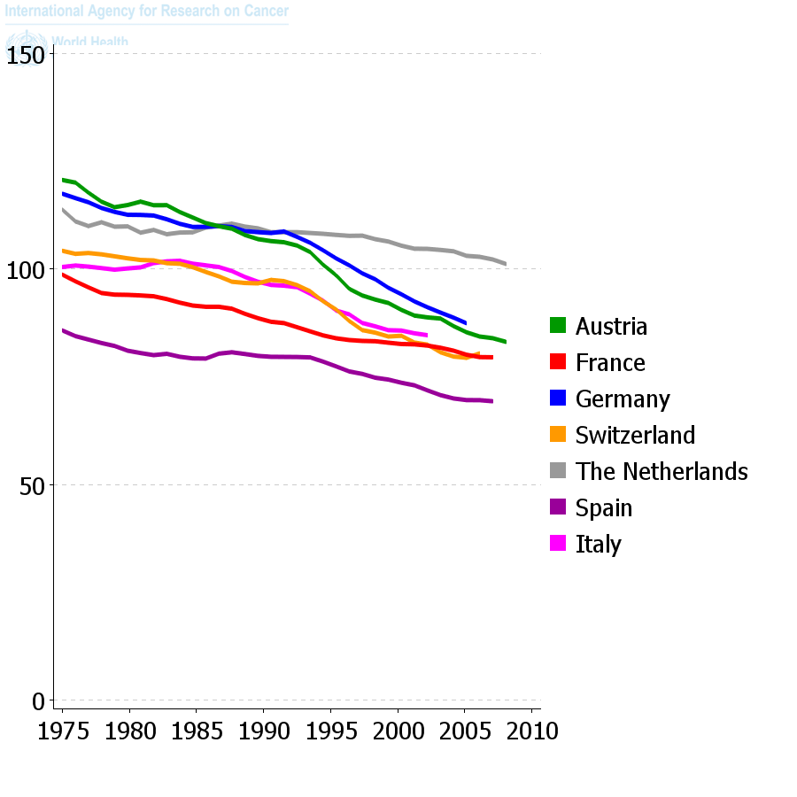
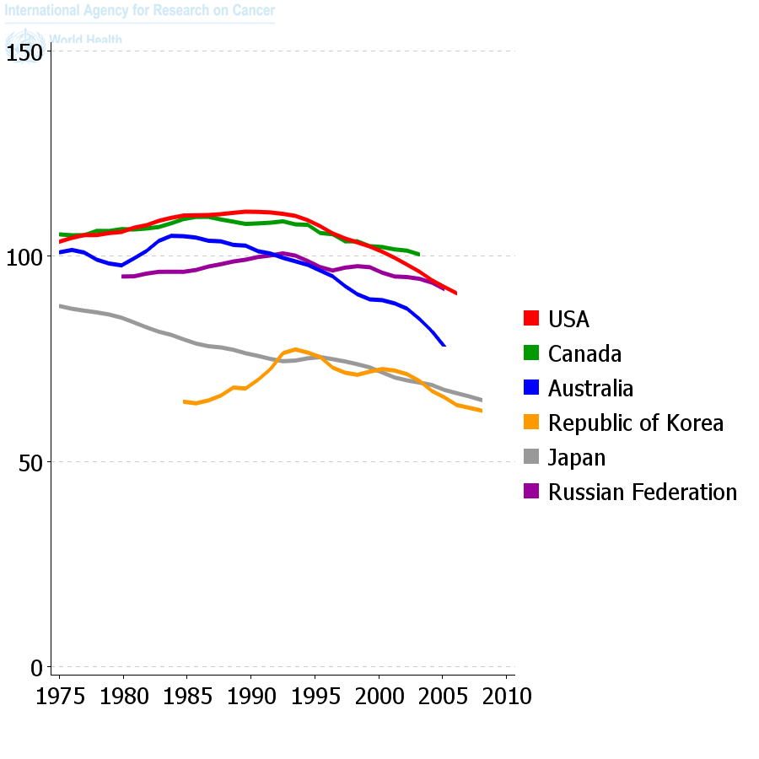
Trends in mortality from cancer in selected countries: age-standardised rate per 100,000, women
Cancer in 5 Continents, IARC

Slide 19
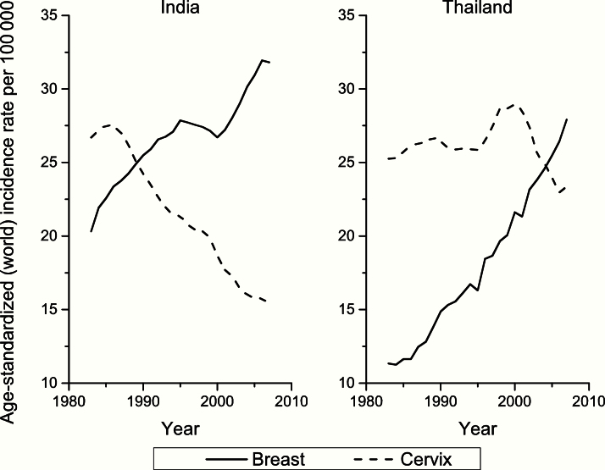
The crossing of the curves for breast and cervical cancers is a typical indicator of transition of low-income countries to a pattern typical of high-income countries (from Cancer Atlas, American Cancer Society, Atlanta, 2014).

Slide 20
Cancers where a significant proportion remain of unknown aetiology
Organ sites | Estimated annual no. new cases worldwide | Percent global cancer burden
Prostate | 1,100,000 | 7.9
Lymphoma and Leukaemia | 850,000 | 6.0
Kidney | 340,000 | 2.4
Pancreas | 340,000 | 2.4
Thyroid | 300,000 | 2.1
Brain | 260,000 | 1.8
Colorectal | 1,400,000 | 9.7

Slide 21
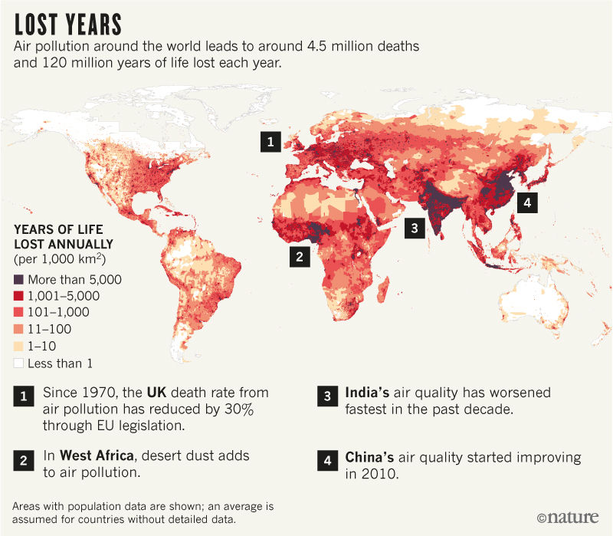

Slide 22
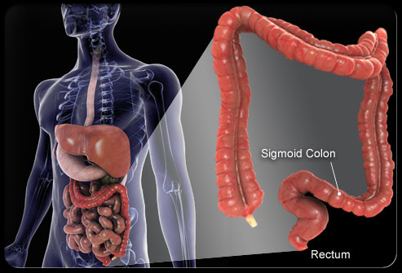
Systems Biology Approach to
Colorectal Cancer
Gut
Microbiome
Metabolomic/Hormonal Profiling
Tumour Profiling
Genomics
(GWAS, Sequencing)
Diet/Lifestyle Data
Epigenetics

Slide 23
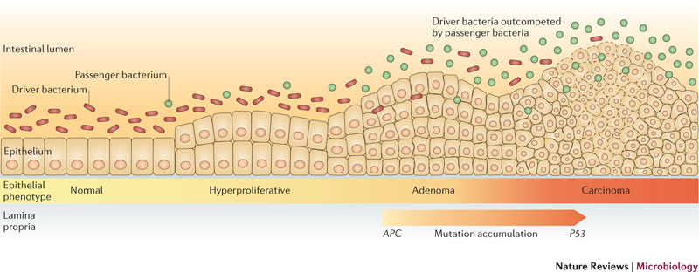
Bacterial driver-passenger model
of colorectal cancer neoplasia
Tjalsma H, et al. Nature Rev Microbiol 2012;25:575-82.

Slide 24
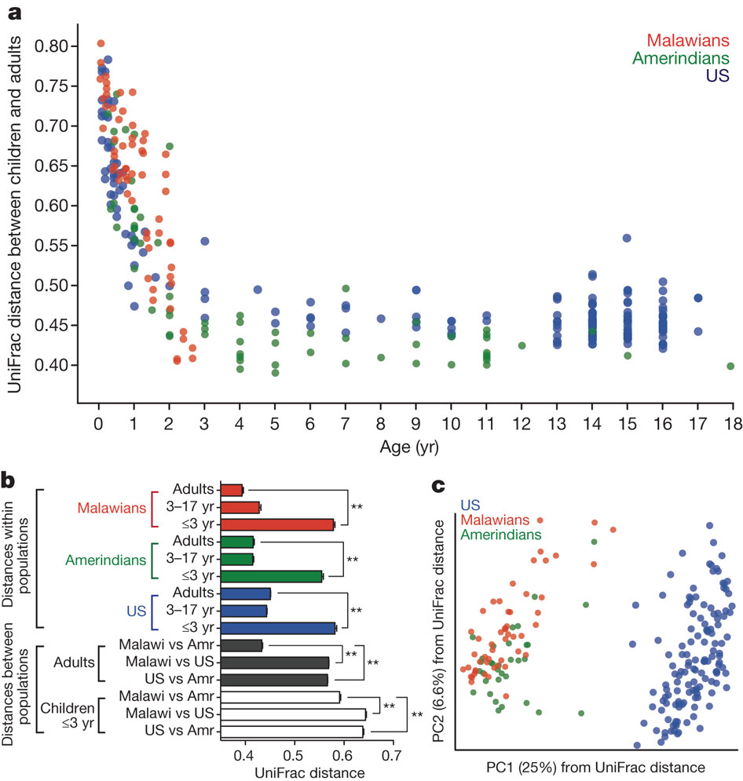
Differences in the fecal bacterial communities of Malawians,
Amerindians and US children and adults.
Yatsunenko, T et al. Nature 2012; 486:222-27. doi:10.1038/nature11053

Slide 25
The worldwide epidemiological transition
Overall improvement in mortality across the world, with near stagnation in Eastern Europe and parts of sub-Saharan Africa
Large declines in child infectious diseases and in the burden of its key risk factors, leading to more people dying at older ages and larger share of disease burden from NCDs
  More to be done in sub-Saharan Africa and South Asia

Slide 26
The worldwide epidemiological transition
Shifting burden of smoking from high-income to low-and-middle-income countries
Worldwide rise in body weight and glycaemia, with rare regions where it has been stable
Decline in blood pressure in high-income and some middle-income countries; BP stable in East Asia and rising in sub-Saharan Africa and South Asia
Massive harms from alcohol use in Eastern Europe, Southern Africa and parts of Latin America

Slide 27
Causality
From single causes to the perturbation of pathways
The 1940s and 1950s saw a burgeoning of the randomized clinical trial as a paradigm for causality, with emphasis on single causal factors (treatments or otherwise “actionable” agents).
Guidelines for causality assessment in an observational context were inspired by Henle-Koch’s rules – originally developed for microbiology -; Bradford Hill and others weakened such rules to adapt them to chronic multifactorial diseases.
Still, most historical examples of causes of chronic diseases involved single, powerful agents such as tobacco and asbestos. No necessary cause except perhaps HPV is known for NCDs.

Slide 28
In the last two decades we have learnt that “weak” causal agents (e.g., some carcinogens) actually contribute to causing chronic diseases. One prominent example is air pollution, now recognized as a human carcinogen.
Etiology is currently better understood as a process involving the complex interplay of numerous agents that act along several mechanistic pathways.
This is not extraneous to clinical practice: patients’ response to therapies is also more complex than we thought 50 years ago, and it depends on complex networks that include co-morbidities, co-exposures, and individual susceptibility.

Slide 29
An evolutionary perspective
Adaptive biological strategies to maximise survival and fitness occur from conception onwards. The literature on developmental origins of adult health and disease is rife with instances of biological adaptive responses to external conditions.
Programming is the effect of an early stimulus operating at a critical or sensitive period, that results in permanent or long-term change in the structure or function of the organism. A set of adaptations, such as small body size and a modified metabolism occurring in early life that would improve an individual’s survival in a harsh environment have been termed the ‘thrifty phenotype’.

Slide 30
By being ‘programmed’ an organism responds to stimulus from its environment by optimally adapting itself to the prevailing conditions, thus potentially prolonging its survival in that environment.
However, such an adaptation is only beneficial to the individual in the short-term because, by fixing its adaptation so early, the organism is accommodating to one set of circumstances, but is not necessarily adapted if those circumstances should change.
In terms of the foetal origins of adult disease hypothesis, taking the example of nutrition as an exposure this implies: (i) programming due to nutritional impairment in early life, and (ii) an abundant and affluent environment subsequent to the initial adaptation.

Slide 31
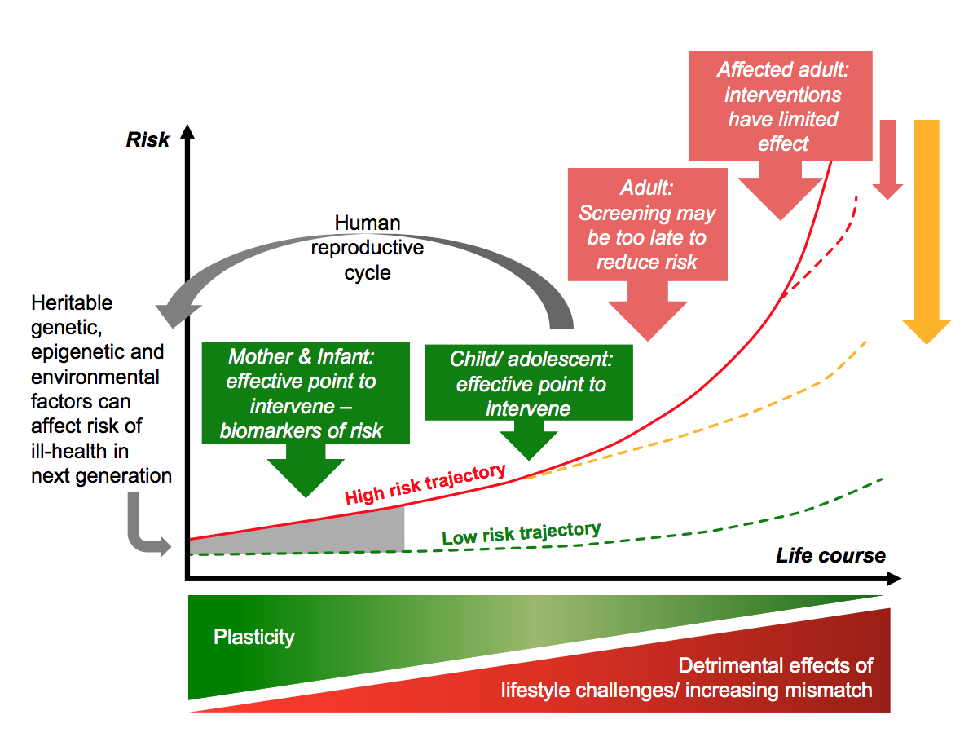
Developmental origin of disease model in light of the life course. The prenatal period establishes risk through interaction between genetic, epigenetic, and environmental factors. Reproduced from (Hanson and Gluckman 2014).

