Slide 1
Paolo Vineis
Study design: an elementary introduction

Slide 2

Measures of Occurrences
Prevalence- measure of existing disease occurrence/ changes in health states at a particular stage in time
Incidence- measure of new disease occurrence /changes in health states
# of people with the outcome
# of new people with the outcome
# of people in the total population
# of people in the total population

Slide 3
What information can we obtain from the presentation of results?
Study design
  Prospective, retrospective
  Type of study
    case/control, cohort
Number of participants
  By cases/controls
  By exposure
Exposure (s) of interest
  Continuous
  Categories
  Dose response
Prevalence or incidence of outcome
Potential confounders chosen by the researchers
Estimates for measures of association and what is indicative of significant associations
  Odds Ratios
  Risk
  Rate

Slide 4
What influences the interpretation of results?
Study design
Confounders
Measurement of exposures and outcomes
We want to reduce systematic errors as this can lead to a distortion of study results.
Choice of the measure of the effect
  Incidence
  Prevalence

Slide 5
Confounders
Confounders can influence results by:
  the choice of confounders measured
  method for controlling for confounders
  unmeasured confounders
Criteria for a potential confounder:
  1. Associated with the exposure
  2. Associated with the disease
  3. Not on the causal path of the exposure to disease

Slide 6
How to discuss confounding
What was adjusted for, how and why?
  Age, sex, education
    Those exposed to pesticides are likely older and there is an increase in risk for breast cancer in older women.
  Matching, stratification, included in the model
Is there any indication of confounding bias?

Slide 7
How to improve the study design?
Reduce potential bias
  Selection Bias
  Information/Measurement Bias
  Confounding Bias
Selection Bias
  Is the population chosen representative of the general population ?
    Choice of controls can create a bias
  Who participated in the study?
    Only healthy individuals (healthy worker effect)
Information Bias
  How were the exposure/outcome data collected?
        Measuring
        Interviewing
        Recalling
        Reporting
        Abstracting data
  Can result in misclassification of the exposure and/or disease

Slide 8
Systematic Review
“...differ from traditional narrative reviews by adopting a replicable, scientific and transparent process, in other words a detailed technology, that aims to minimize bias through exhaustive literature searches of published and unpublished studies and by providing an audit trail of the reviewers’ decisions, procedures and conclusions.”
(Tranfield, D., Denyer, D., & Smart, P. (2003). Toward a methodology for developing evidence-informed management knowledge by means of systematic review. British Journal of Management, 14, 207–222)

Slide 9
Formulating the Question
In patients [significant demographics] with [Target Problem ] does [Intervention-exposure] or [Comparison, if any] affect [Outcome]?
PICO(S)
P = Patient, population
I = Intervention
C= Comparison
O= Outcome
S=Study design

Slide 10
Literature search
• Comprehensive
• Searching determined by research question and resources
• Variety of methods (electronic and manual) and by searching multiple, possibly overlapping resources
• At the beginning with an update search towards the end
• Bibliographic software to manage references: documenting the process, production of reference lists for reports and journal papers
• Document the search process in full or provide details of where the strategy can be obtained

Slide 11
Assessment of studies
• Studies should be assessed for inclusion using selection criteria (inclusion and exclusion)
• Study selection : citations located by the search-> title, abstract
->retrieving full reports of potentially relevant citations
• Parallel independent assessments to minimize risk of errors. Disagreements should be resolved by consensus and arbitration according to a predefined strategy
• Document study selection, reasons for exclusion of studies

Slide 12
Bias in systematic reviews
o publication bias
o choice of databases
o biased inclusion criteria
o differentially delayed publication
o publication language
o selective reporting

Slide 13
Bias in systematic reviews: Publication bias
•Publication bias only a subset of the relevant data is available.
•Null or non significant findings (esp. in small studies) are less likely to be reported/published than statistically significant findings.
•Empirical examination of patterns of results (e.g., funnel plots) may suggest publication bias but should be interpreted with caution.
•Systematic reviews performed early, when only few initial studies are available, will overestimate effects when “negative” studies face delayed publication. Early positive studies, particularly if small in size, are suspect.
Guyatt et al. J Clin Epidemiol. 2011;64(12):1277-82.

Slide 14
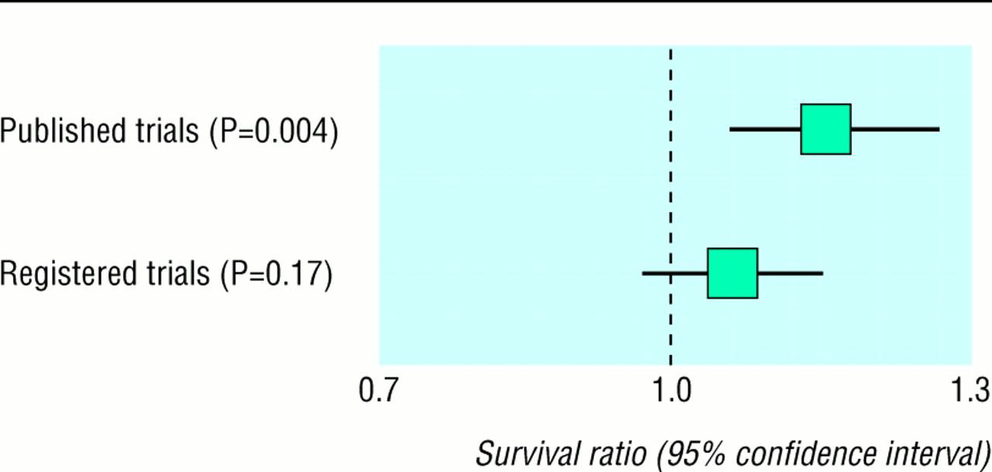
Survival of patients with advanced ovarian cancer treated with combination chemotherapy compared with monotherapy with alkylating agent.
Egger M , and Smith G D BMJ 1998;316:61-66

Slide 15
Meta-analysis
Statistical analysis of a collection of studies, especially an analysis in which studies are the primary units of analysis, i.e., methods in which the study is the individual unit of statistical analysis for the purpose of integrating findings

Slide 16
What does a meta-analysis involve?
•Effect estimates are abstracted (or calculated) from the selected studies
•These individual study effect estimates are pooled to produce a weighted average effect across all studies.
•Studies are weighted according to a measure of its importance.
–Most weight to informative studies (often large studies with precise effect estimates)
–Least weight to less informative studies (often smaller studies with imprecise effect estimates).

Slide 17
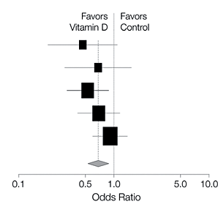
FOREST PLOT
Size of box proportional to the
weight of each study
Width of whiskers =
95% confidence interval

Slide 18
Meta-analysis. Goal 1.
Synthetic goal: estimation of an overall summary of average effect across studies:
- to synthesize the data from multiple studies
- to increase precision
- in the event that the studies yield comparable effects, to report this effect

Slide 19
Meta-analysis. Goal 2
Analytic goal: identification and estimation of differences among study-specific effects
- In the event that the effect varies among studies, to track down the source of the variation (e.g. quality of the study, population source, exposure measurement)

Slide 20
Sources of heterogeneity in meta-analysis of data from epidemiologic studies
Variation of exposure definition, exposure measurement and exposure levels across studies
Heterogeneity of a disease or its classification
Differences in covariates
Differences in design and implementation of studies to be combined
Differences in statistical analyses
Differences in populations
Bias

Slide 21
•If too much heterogeneity exists, it might not be appropriate to pool the studies.
•If specific sub-groups of studies display heterogeneity, these can be pooled separately in sub-analyses.
Examples…
•Studies on younger patients, females, pre/post menopausal…
•Studies with longer interventions, high dose trials…
•Studies with specific diagnostic criteria/methods…
•Specific study design e.g. blind trials, prospective versus retrospective exposure assessment…
Dealing with heterogeneity

Slide 22
Publication bias in meta-analysis: statistical methods
•Begg’s rank correlation methods
•Egger method
•Funnel plot regression

Slide 23
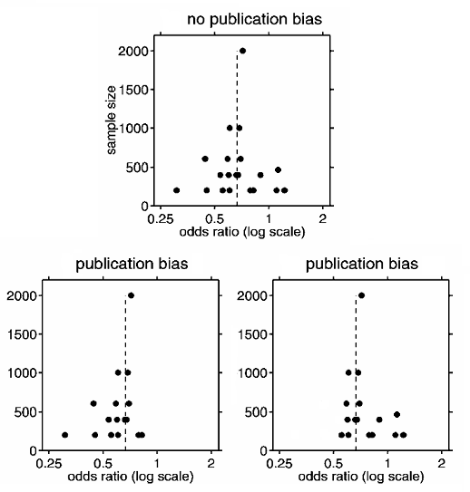

Slide 24
References
The Cochrane Collaboration: http://www.cochrane.org
Egger, M, Davey Smith, G, Altman, eds. DG. Systematic Reviews in Health Care, BMJ Publishing Group, 2001.

