Slide 1
Macroeconomics
Lecture 2
23.04.24
Paolo Paesani
University of Rome Tor Vergata
Department of Economics and Finance

Slide 2
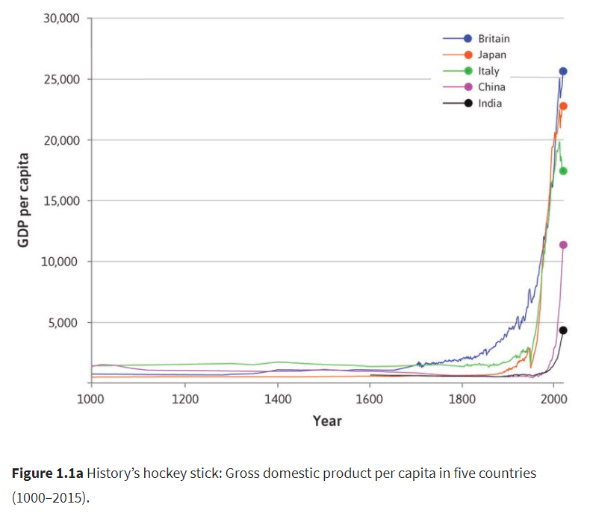
GDP per capita as an indicator of economic welfare

Slide 3
Income and well-being
Is GDP per capita a good measure of well-being?
Up to a point yes, but GDP per capita and GDP in the first place leave out many relevant factors that affect human well-being (economic and non economic)
  Income inequality
  Quality of the «environment» (physical, social, political)
  Goods and services that we do not buy (e.g. produced within the household)
  Other aspects that influence well-being (rule of law, protection of human rights, Freedom of : association, belief (religious, political), speech, to express oneself, of the press, to choose one’s life state, from slavery and bondage)

Slide 4

Income inequality
Countries differ in terms of GDP and GDP (income) per capita
  Between-countries inequality (see L1 and Fig. 1.1 above)
  Within-countries inequality (GDP per capita is an average)
Income distribution and income inequality depend on many causes
  Available resources and their distribution
  Technology and technological progress
  Historical / Political / Geopolitical considerations
  Quality of institutions (private and public)

Slide 5
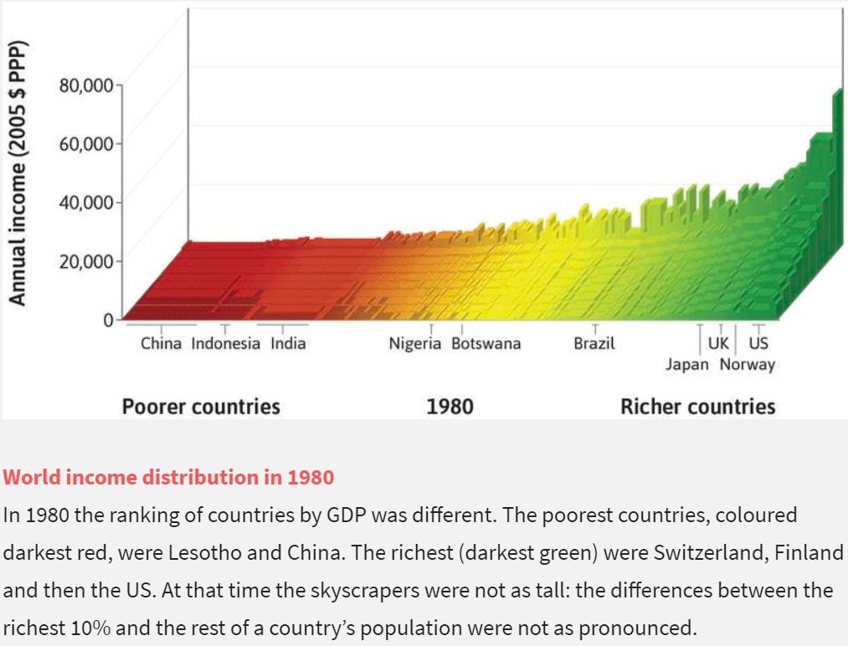
Source: https://www.core-econ.org/the-economy/book/text/01.html#figure-1-2c

Slide 6
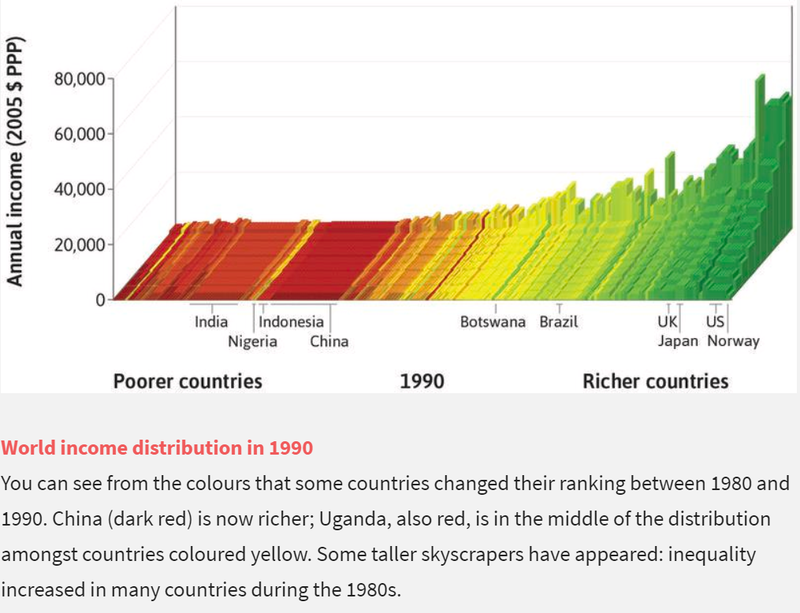
Source: https://www.core-econ.org/the-economy/book/text/01.html#figure-1-2c

Slide 7
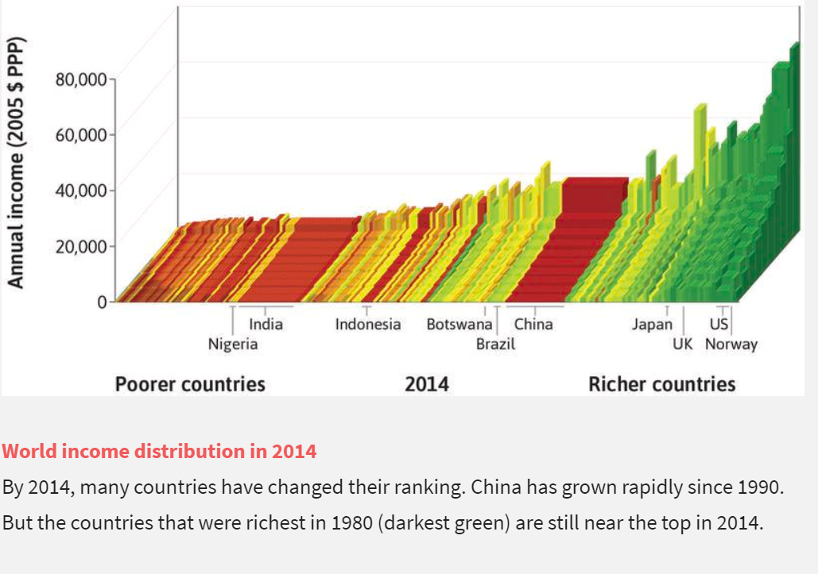
Source: https://www.core-econ.org/the-economy/book/text/01.html#figure-1-2c

Slide 8

https://twitter.com/TheEconomist/status/629263734486265856/photo/1

Slide 9
Is within-country income inequality bad?
High income inequality within a country
  Weakens social bonds between «rich» and «poor»
  Increases tensions between «rich» and «poor» and crime
  Increases risks of poverty, social exclusion, illness and early death for the «poor».
  Gives the «rich» the means to preserve and strengthen their economic and social position, including through lobbying, bribery and the conditioning of political processes.
  Hinders social mobility and worsens the quality of democratic processes
  Increases economic instability, financial crisis, debt and inflation with negative cross-country effects related for example to migration with its economic / social / human effects.

Slide 10
Is within-country income inequality good?
Inequality gives individuals incentives to work (study) harder, become more productive, put extra effort in what they do as long as that effort is adequately compensated in terms of higher wages, prizes, bonuses etc.
Inequality is necessary to encourage entrepreneurs to innovate, take risks and set up a new business with the aim of increasing their profits (.
The «rich» can transfer some extra income to the «poor», who end up better than without those transfers (Trickle down effect)
We are born unequal and diverse and in this sense inequality is a fact of life.
Too much economic equality is bad for economic growth.

Slide 11
Flash questions
Average disposable income and well-being ?
  Country A
    Aggregate Disposable Income 5.000.000€
    Population 1000
    Average disposable income per capita 5.000€
    Perfectly equal distribution
  Coutry B
    Aggregate Disposable Income 5.250.000€
    Population 1000
    Average disposable income per capita 5.250€
    500 people earn 10.000 each and 500 people earn 500€
  Is it better to live in country A or B? Discuss
  Would you rather live in country A or B? Discuss

Slide 12
Flash questions
Complete the following sentence: «If country A’s GDP per capita is twice as high as country B’s GDP per capita, this implies that ….»
Complete the following sentence, providing a short explanation: «If a country’s GDP increases by 3% year on year and the country’s population increases by 4% year on year, the country’s GDP per capita …»
Complete the following sentence, providing a short explanation: «If a country’s GDP falls, the citizens of that country may still end up being better off on average if …»

Slide 13
Take-off in living standards, 1

Slide 14
Take-off in living standards, 2
«For a very long time, living standards did not grow in any sustained way. When sustained growth occurred it began at different times in different countries, leading to vast differences in living standards around the world» (TB, p. 12)
Stagnation (and in some cases decline) followed by take-off
  Some countries take off before others (timing)
  Some countries, while enjoying relatively high living standards, take off later than less well-off countries (relationship between GDP per capita level and growth)
  Some countries stagnate for a long time and then take off very rapidly (pace)
  Some countries (not on the graph) never take off or do so at a very slow pace.

Slide 15
Take-off in living standards, 3
Questions
  Why do people living in some countries enjoy much higher average living standards than people living in other countries?
  What can be done to improve a country’s living standards?
  What makes certain countries «richer» (and therefore more powerful) than others?
Starting in the XVII century, as take-offs began in several European countries (notable Great Britain), many people were asking these questions and looking for answers…
This is how modern economic thought began…

Slide 16
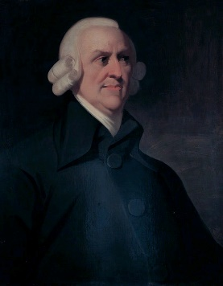
Adam Smith
Among those who were investigating living standards, take-offs and their causes in the XVII century, a Scottish man named Adam Smith (1723 – 1790), came up with a set of answers, partly drawn from original observations partly from other sources, which he published in 1776 under the title Inquiry into the Nature and Causes of the Wealth of Nations.
Adam Smith witnessed the transition from the commercial revolution to the beginning of the industrial revolution (which took place after his death). As an economist, Smith studied how:
  Economic systems, based on decentralized activities conducted by different actors (agents), pursuing self-interest, work and expand
  How coordination among different actors takes place
  How the private and the public sector interact
  Why certain countries are richer than others

Slide 17
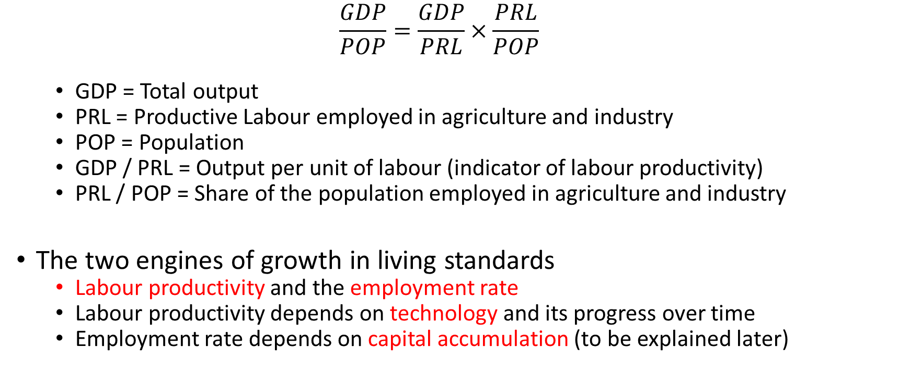
Adam Smith’s formula
  $$\frac{GDP}{POP}=\frac{GDP}{PRL}×\frac{PRL}{POP}$$
  GDP = Total output
  PRL = Productive Labour employed in agriculture and industry
  POP = Population
  GDP / PRL = Output per unit of labour (indicator of labour productivity)
  PRL / POP = Share of the population employed in agriculture and industry
The two engines of growth in living standards
  Labour productivity and the employment rate
  Labour productivity depends on technology and its progress over time
  Employment rate depends on capital accumulation (to be explained later)

Slide 18
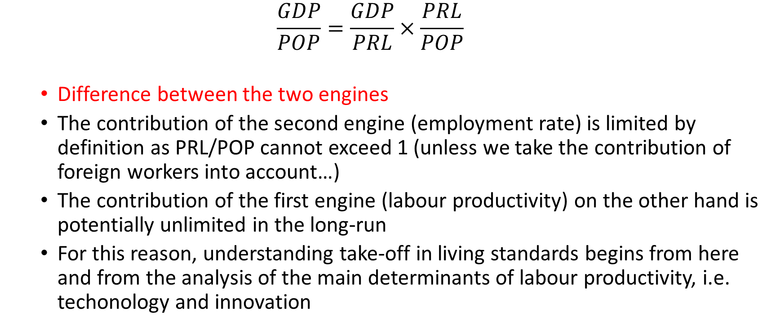
Adam Smith’s formula, 2
  $$\frac{GDP}{POP}=\frac{GDP}{PRL}×\frac{PRL}{POP}$$
  Difference between the two engines
  The contribution of the second engine (employment rate) is limited by definition as PRL/POP cannot exceed 1 (unless we take the contribution of foreign workers into account…)
  The contribution of the first engine (labour productivity) on the other hand is potentially unlimited in the long-run
  For this reason, understanding take-off in living standards begins from here and from the analysis of the main determinants of labour productivity, i.e. techonology and innovation

Slide 19
Technology as an engine of growth
Technology: application of scientific knowledge to the production of goods and services (transformation of inputs into outputs).
Average productivity of labour = ALP = GDP / PRL
As ALP increases for a given rate of employment, income per capita and living standards increase (provided firms sell what they produce).
Innovation and technological progress lead APL to increase
  Improved equipment
  New methods of production, new products (see example of lighting)
  New inputs, new markets, new ways of organising production
  New ways of conveying information

Slide 20
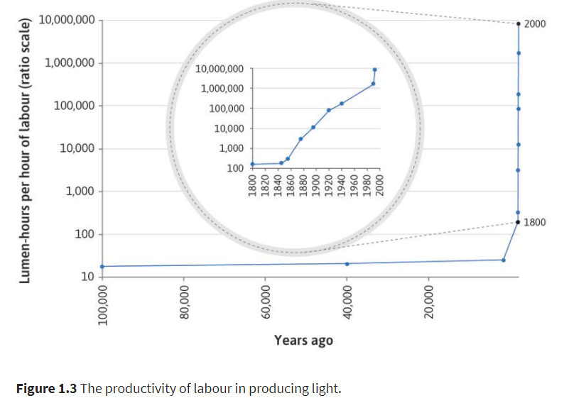
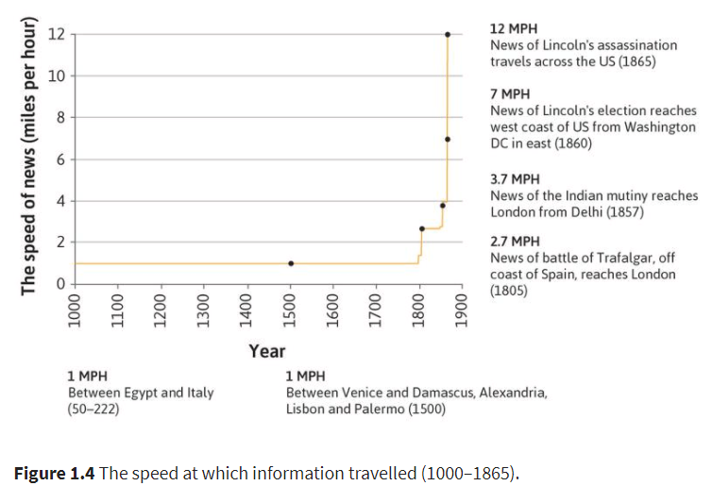
Technology as an engine of growth (2)
https://lucept.files.wordpress.com/2014/11/william-nordhaus-the-cost-of-light.pdf

Slide 21
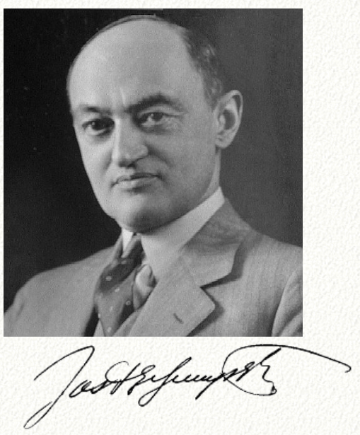
HET Intermezzo: J.A. Schumpeter
Joseph A. Schumpeter, 1883-1950.
We give him the honor of founding evolutionary economics, given his concern with economic change brought about by the interaction between individuals and the economy as a whole, a concern with socio-economic history and institutions, but not enough to overshadow his search for an inherently theoretical explanation for the development of capitalism.
Schumpeter brought to economics the idea of the entrepreneur as the central actor in the capitalist economic system. The entrepreneur is the agent of change who introduces new products, new methods of production, and opens up new markets. Imitators follow, and the innovation is diffused through the economy. A new entrepreneur and innovation launch the next upswing.
Innovation: new products, new methods of production, new inputs, new markets, new organizations
Innovations disrupt pre-existing equilibriums. Firms da do not innovate succumb to competition (creative destruction)
Source: http://www.hetwebsite.net/het/profiles/schumpeter.htm

Slide 22
Homework
Complete the following sentence, providing a short explanation: «Based on Adam Smith’s formula, if the rate of productive employment is 50% and average labour productivity is 100.000, GDP per capita is …»
Complete the following sentence: «Based on the previous question, if labour productivity increases by 5% year on year and the employment rate falls from 50% to 48%, living standards …»
Complete the following sentence, providing a short explanation «Based on Adam Smith’s formula, if the rate of productive employment falls everything else constant, living standards … unless …»
Exercises 1.1, 1.2, 1.3 in the textbook
Listen to Robert Kennedy’s speech about GDP and briefly comment it.

