Slide 1
Macroeconomics
Lecture 3
24.04.24
Paolo Paesani
University of Rome Tor Vergata
Department of Economics and Finance

Slide 2
Key points, 1
Macroeconomics is the study of the structure and performance of the economic system as a whole (households, firms, government, markets).
GDP is an indicator of the size of a country’s economy / level of economic activity: related concepts (nominal vs. real GDP, final vs. intermediate goods, sectors of the economy) and methods of calculation (total value added, total income, total expenditure).
GDP per capita = Income per capita = Spending per capita (indicator of economic welfare often used for cross-country comparison)

Slide 3
Key points, 2
Countries differ in terms of GDP per capita: Between-country inequality (High, Middle, Low income countries)
In each country, individual incomes differ from GDP per capita: Within-country inequality (Rich vs. poor) and the other limits to the possibility of using GDP per capita as a welfare indicator.
Inequality as a problem (Is inequality bad?) and as an opportunity (Is inequality good?)

Slide 4
Key points, 3
Inequality patterns change over time and space.
Within-country inequality has been rising in recent years but for the time being we will not discuss it.
Our main focus is on between-country inequality, looked at from a very long run time perspective (hockey stick).

Slide 5
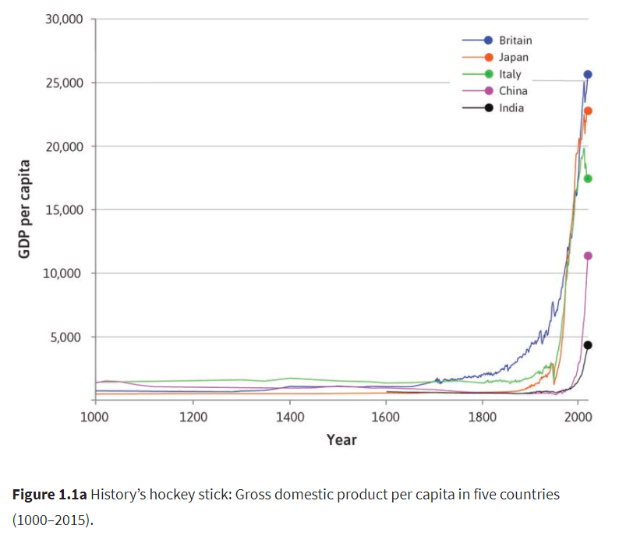
GDP per capita as an indicator of economic welfare

Slide 6
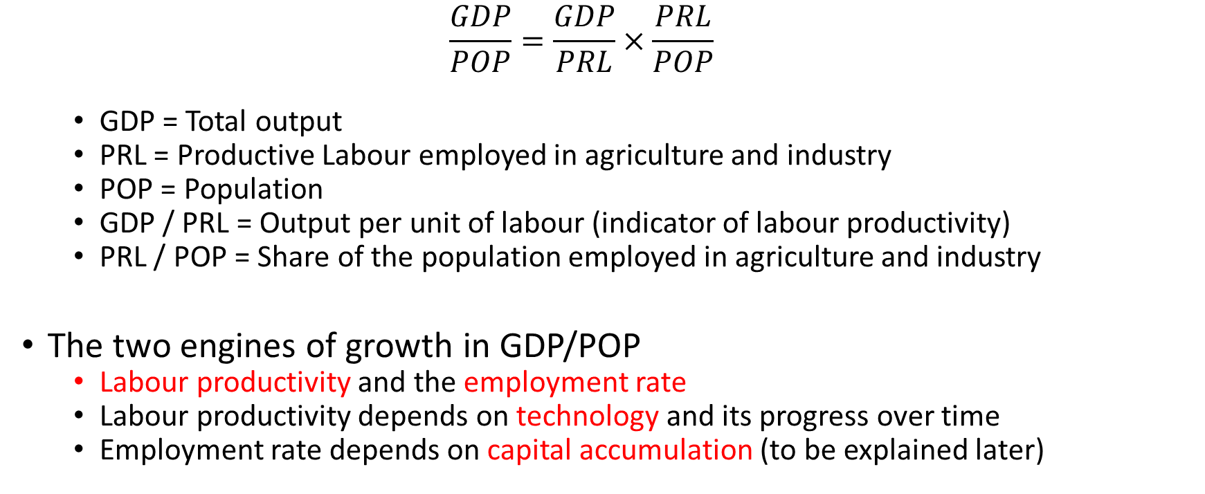
Adam Smith’s formula and the Labour-GDP nexus, 1
  $$\frac{GDP}{POP}=\frac{GDP}{PRL}×\frac{PRL}{POP}$$
  GDP = Total output
  PRL = Productive Labour employed in agriculture and industry
  POP = Population
  GDP / PRL = Output per unit of labour (indicator of labour productivity)
  PRL / POP = Share of the population employed in agriculture and industry
The two engines of growth in GDP/POP
  Labour productivity and the employment rate
  Labour productivity depends on technology and its progress over time
  Employment rate depends on capital accumulation (to be explained later)

Slide 7
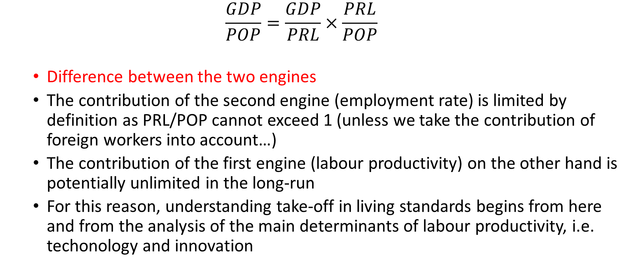
Adam Smith’s formula and the Labour-GDP nexus, 2
  $$\frac{GDP}{POP}=\frac{GDP}{PRL}×\frac{PRL}{POP}$$
  Difference between the two engines
  The contribution of the second engine (employment rate) is limited by definition as PRL/POP cannot exceed 1 (unless we take the contribution of foreign workers into account…)
  The contribution of the first engine (labour productivity) on the other hand is potentially unlimited in the long-run
  For this reason, understanding take-off in living standards begins from here and from the analysis of the main determinants of labour productivity, i.e. techonology and innovation

Slide 8
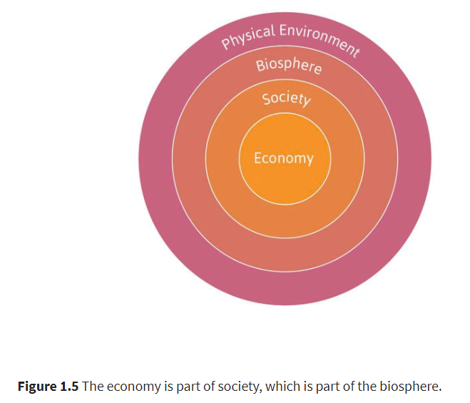
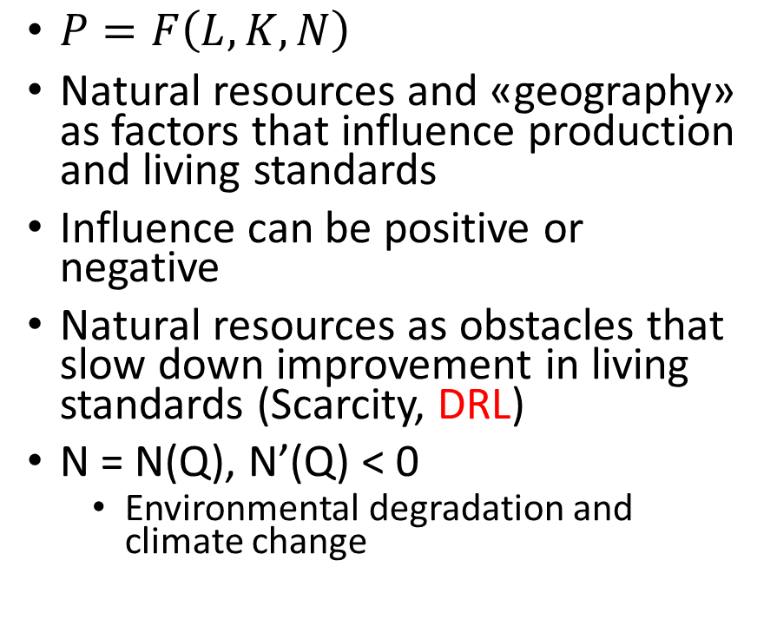
The economy, society and the environment
$P=F\left(L,K,N\right)$
Natural resources and «geography» as factors that influence production and living standards
Influence can be positive or negative
Natural resources as obstacles that slow down improvement in living standards (Scarcity, DRL)
N = N(Q), N’(Q) < 0
  Environmental degradation and climate change

Slide 9
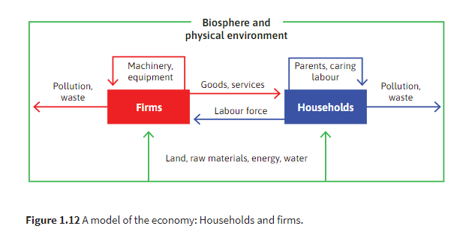

Slide 10
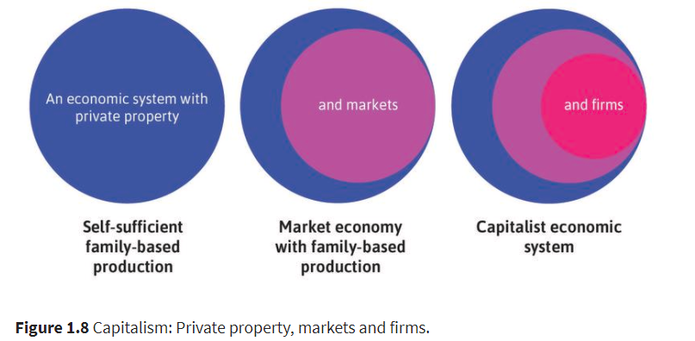
Take-off in GDP/POP and capitalism, 1
TB identifies the emergence of capitalism as the main determinant (although not the only one) of take-offs in living standards
Different types of economic systems exist (e.g. self-sufficient family based production systems, planned economies) including Capitalism
Capitalism organizes the production and distribution of goods and services based on specific features.
Capitalism is dynamic and adaptable to different societies and political systems.

Slide 11
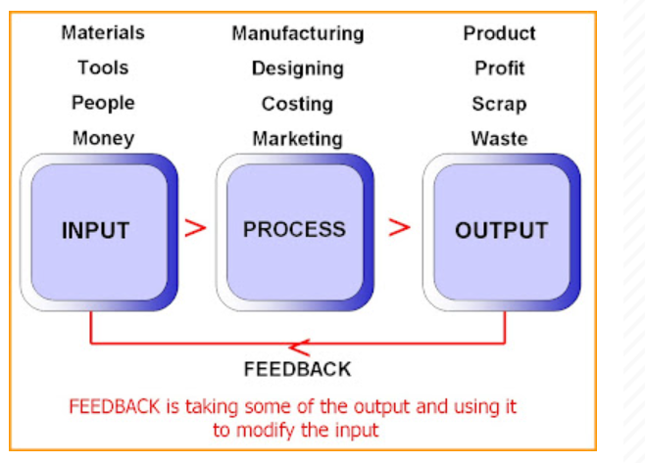
Firms
The firm acn be conceived in two ways
an economic agent in the capitalist economy based on innovation and competition (Schumpeter)
a stage on which complex interactions among the firm’s employees, managers, and owners are played out at local, national and international level (offshoring, outsourcing global supply chains)
COSTS
REVENUES

Slide 12
Firms and the division of labour
From self-sufficient households producing their food, clothes, tools etc. to firms organizing production around the division of labour.
‘One man draws out the wire, another straights it, a third cuts it, a fourth points it, a fifth grinds it at the top for receiving the head; to make the head requires two or three distinct operations; to put it on, is a peculiar business, to whiten the pins is another; it is even a trade by itself to put them into the paper; and the important business of making a pin is, in this manner, divided into about eighteen distinct operations, which, in some manufactories, are all performed by distinct hands’.
Division of labour makes it possible to obtain ↑ L →↑APL → ↑GDP/POP
The three dimensions of the division of labour: micro, macro, global

Slide 13
Firms and markets, 1
Division of labour requires co-ordination (and organization)
Coordination through (and within) firms
  Centralized, vertical, based on plans instructions contracts that transfer authority, generally orderly, often based on long-term relationships within the firm that give rise to skills, networks, and friendships relationship-specific or firm-specific assets (less and less so)
Coordination through markets
  Decentralized, horizontal, based on prices voluntary transactions contracts that transfer ownership from seller to buyer, often disorderly, limited room for long-term relationships prevalence of anonimity (think of purchases on Amazon or E-bay)
Firms and markets «need» each other.
  Firms without markets = centrally planned economy (no competition)
  Markets without firms = subsistance economy (no economies of scale)
  Firms as buyers (input markets) and sellers (output markets)
  Firms as “islands of conscious power in this oceans of unconscious cooperation” (D.H. Robertson quoted on p. 240)

Slide 14
Firms and markets, 2
Firms represent a concentration of economic power
  This is placed in the hands of the owners and managers, who regularly issue directives with the expectation that their employees will carry them out. An ‘order’ in the firm is a command. (Do not forget about the link between Firm size and power. “Inside power” and “Outside power”)
(Competitive) markets are characterized by a decentralization of power
  Purchases and sales result from the buyers’ and sellers’ autonomous decision. An ‘order’ in a market is a request for a purchase that can be rejected if the seller pleases. (Do not forget about the notion of “Market power” and the existence of different firms)

Slide 15
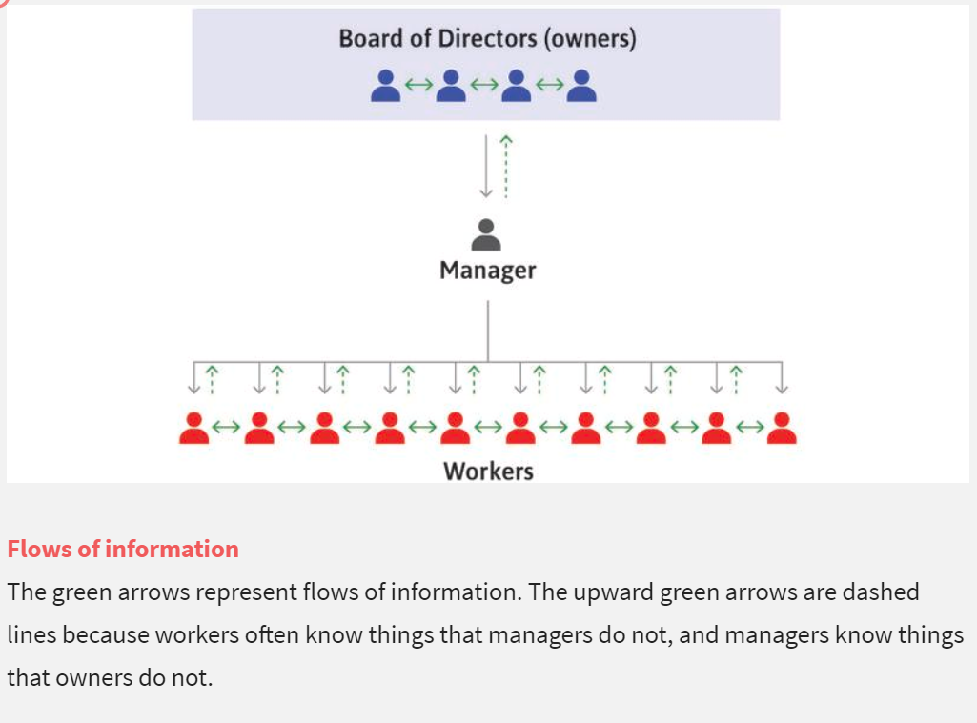
Firms and the division of labour
Managers organise production and decide the amount of profits that go to the owners (separation of ownership and control).
This can put profit maximization in question (principal-agent problem).
Monitoring and stock-options as mechanisms to incentivize managers
Owners own the company’s assets and receive profits (residual claimants) that depend on the actions of managers and employees. Shares represent ownership.
Different ownership models: public company (many small shareholders), concentrated ownership (few large shareholders)

Slide 16
The employer – employee relationship and the PA model, 1
Hiring labour is different from buying other goods and services, and the contract between the employer and the employee is incomplete. It does not cover what the employer really cares about, which is how hard and well the employee works.
Incomplete contracts arise when important information, such as the employee’s effort, is asymmetric or non-verifiable.
In economics, employment is modelled as a principal (the employer) interacting with an agent (the employee).

Slide 17
The employer – employee relationship and the PA model, 2
The principal assigns tasks to the agent and expects the agent to complete them on time and in the best interests of the principal.
The agent, upon receiving instructions from the principal, has to decide whether and how to complete the task taking into account his/her personal goals.
If the agent's and the principal's objectives match, the agent will complete the assigned task in the manner and within the timeframe envisaged by the principal. (Scenario 1)
If the agent's goals do not coincide with those of the principal, the agent - being rational and prioritising her personal goals over those of the principal - will not complete the task in the manner and timeframe envisaged by the principal and will try to remain undetected by exploiting the informational advantage she derives from being directly involved in the assigned task unlike the principal who delegates. (Scenario 2)
The second case poses a problem for the principal who must therefore try to avoid it.
How? Through Labour contract design (and in other ways)

Slide 18
The employer – employee relationship and the PA model, 3
The principal–agent model can be used to study other relationships with incomplete contracts, such as the interaction between an employer and en employee, a lender and a borrower ot he interaction between owner (shareholder, principal) and manager (agent).
In a principal – agent world firms do not always pay the lowest wages possible.
Often, firms set wages so that employees earn economic rents, to motivate them to work effectively, and stay with the firm. (Efficency wages)
Working together in firms brings mutual gains: profit for owners, and economic rents for managers and employees. But rents also lead to involuntary unemployment in the economy.

Slide 19
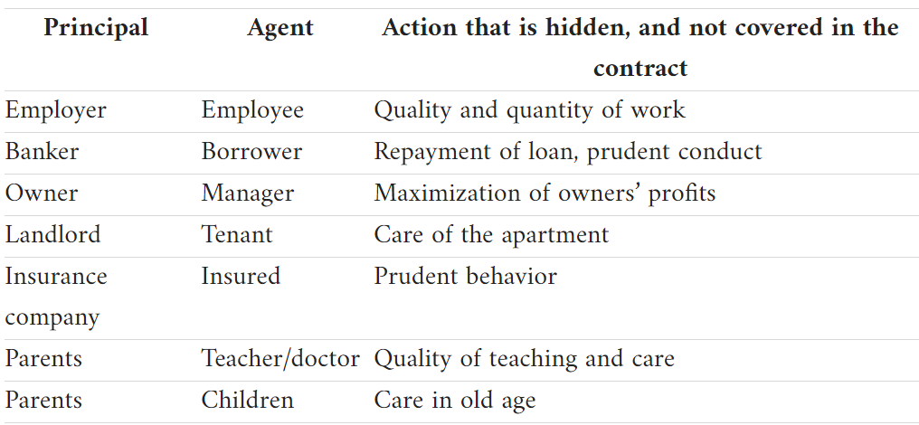

Slide 20
The agent’s perspective (TB 6.4)
There are many reasons why people put in a good day’s work. For many people, doing a good job is its own reward, and doing anything else would contradict their work ethic. Even for those not intrinsically motivated to work hard, feelings of responsibility for other employees or for one’s employer may provide strong work motivation.
For some employees, hard work is a way to reciprocate a feeling of gratitude to the employer for providing a job with good working conditions. In other cases, firms identify teams of workers whose output is readily measured—for example, the percentage of on-time departures for airline staff—and pay a benefit to the whole group that is divided among team members.
But in the background, there is another reason to do a good job: the fear of being fired, or of missing the opportunity to be promoted into a position that has higher pay and greater job security.
Laws and practices concerning the termination of employment for cause (that is, because of inadequate or low quality work, not due to insufficient demand for the firm’s product) differ among countries. In some countries, the owners of the firm have the right to fire a worker whenever they choose, while in others, dismissal is difficult and costly. But even in these cases, an employee has to fear the consequences of not working up to the employer’s desired standards. Such a worker, for example, would be unlikely to achieve a position in the firm where she could count on remaining employed when lower demand for the firm’s products results in other workers being dismissed.
Do workers care whether they lose their jobs?

